Slide 1

Status of the LHC
Mike Lamont for the LHC team

Slide 2
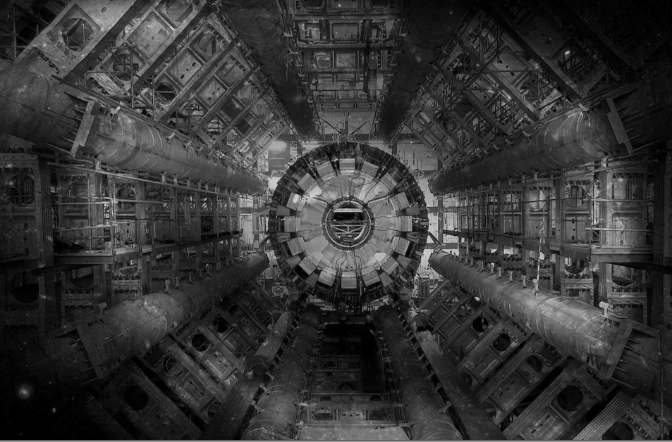
The LHC
Very big
Very cold
Very high energy

Slide 3
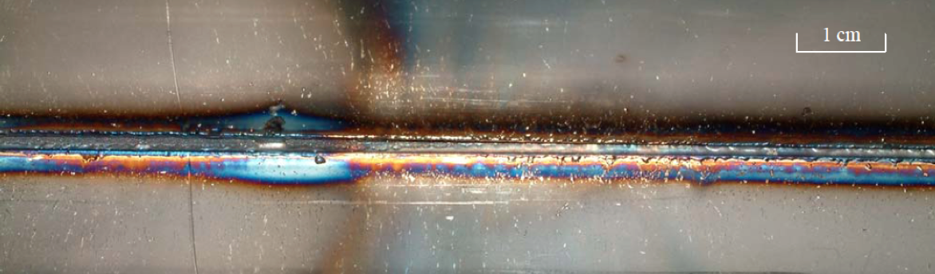
Energy
3.5 TeV with 1380 bunches – September 2011
~3 GJ of energy stored in the magnets
100 MJ stored in each beam ~21 kg of TNT.
Underpins our thoughts
During an SPS extraction test in 2004…
The beam was a 450 GeV full LHC injection batch of 3.4 10¹³ p+ in 288 bunches [2.5 MJ]

Slide 4
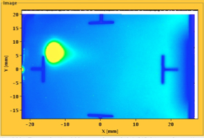
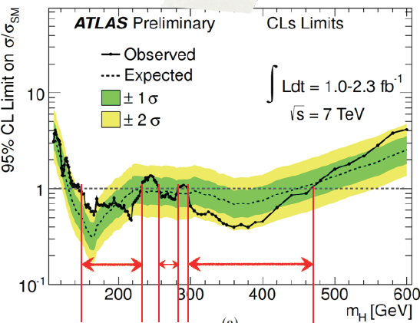
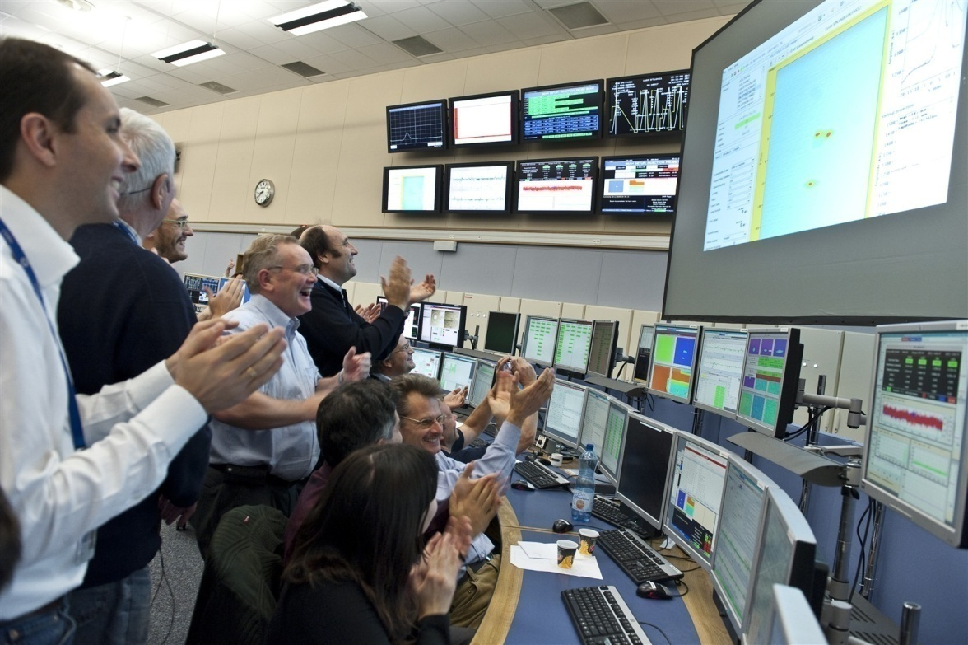

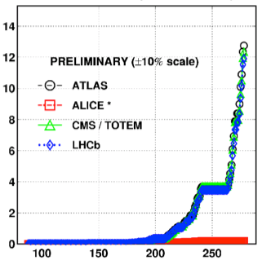

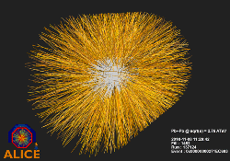
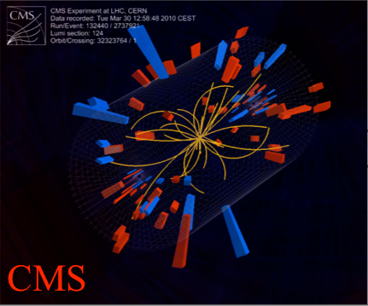
August 2008
First injection test
November 29, 2009
Beam back
August, 2011
2.3e33, 2.6 fb⁻¹
1380 bunches
September 10, 2008
First beams around
June 28 2011
1380 bunches
October 14 2010
1e32
248 bunches
1380
2008
2009
2010
2011
November 2010
Ions
March 30, 2010
First collisions at 3.5 TeV
September 19, 2008
Disaster
Accidental release of 600 MJ stored in one sector of LHC dipole magnets
LHC Timeline

Slide 5
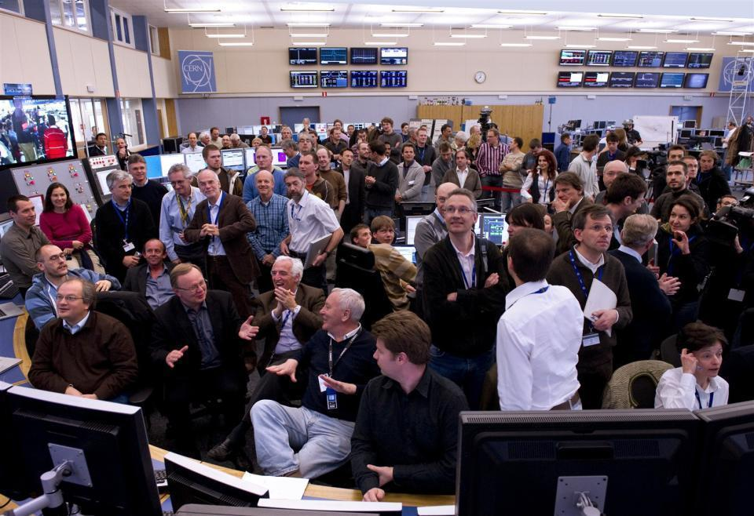
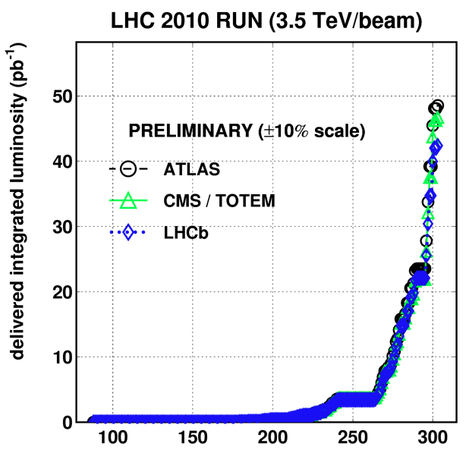
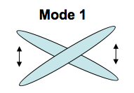
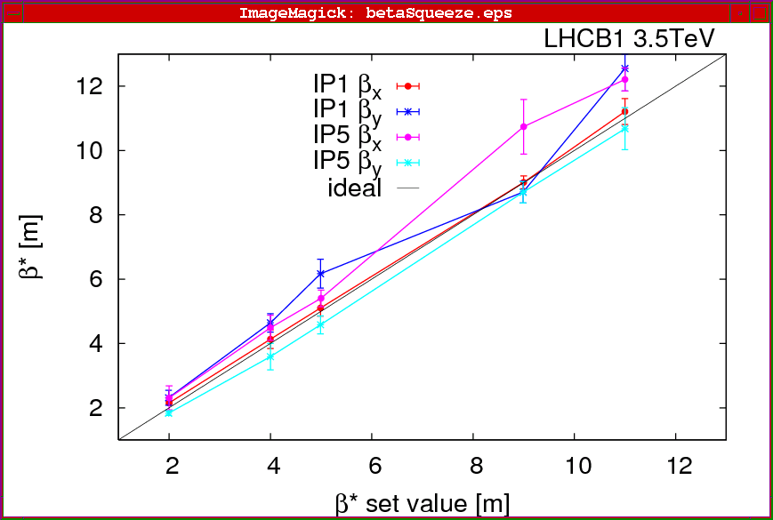
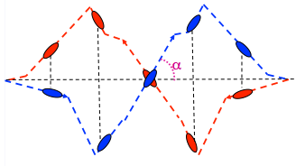
June
Commission nominal bunch intensity
March 30
First collisions 3.5 TeV
October
Luminosity
production
Feb 27
Beam back
QUALIFICATION
February
March
April
May
June
July
August
September
October
November
April
Commission squeeze
September
Crossing angles on
A closer look at 2010

Slide 6
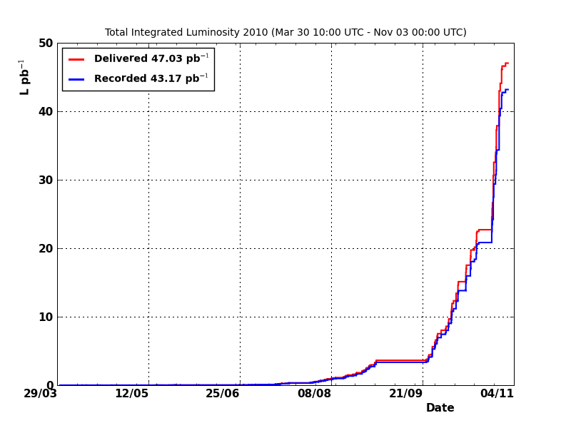
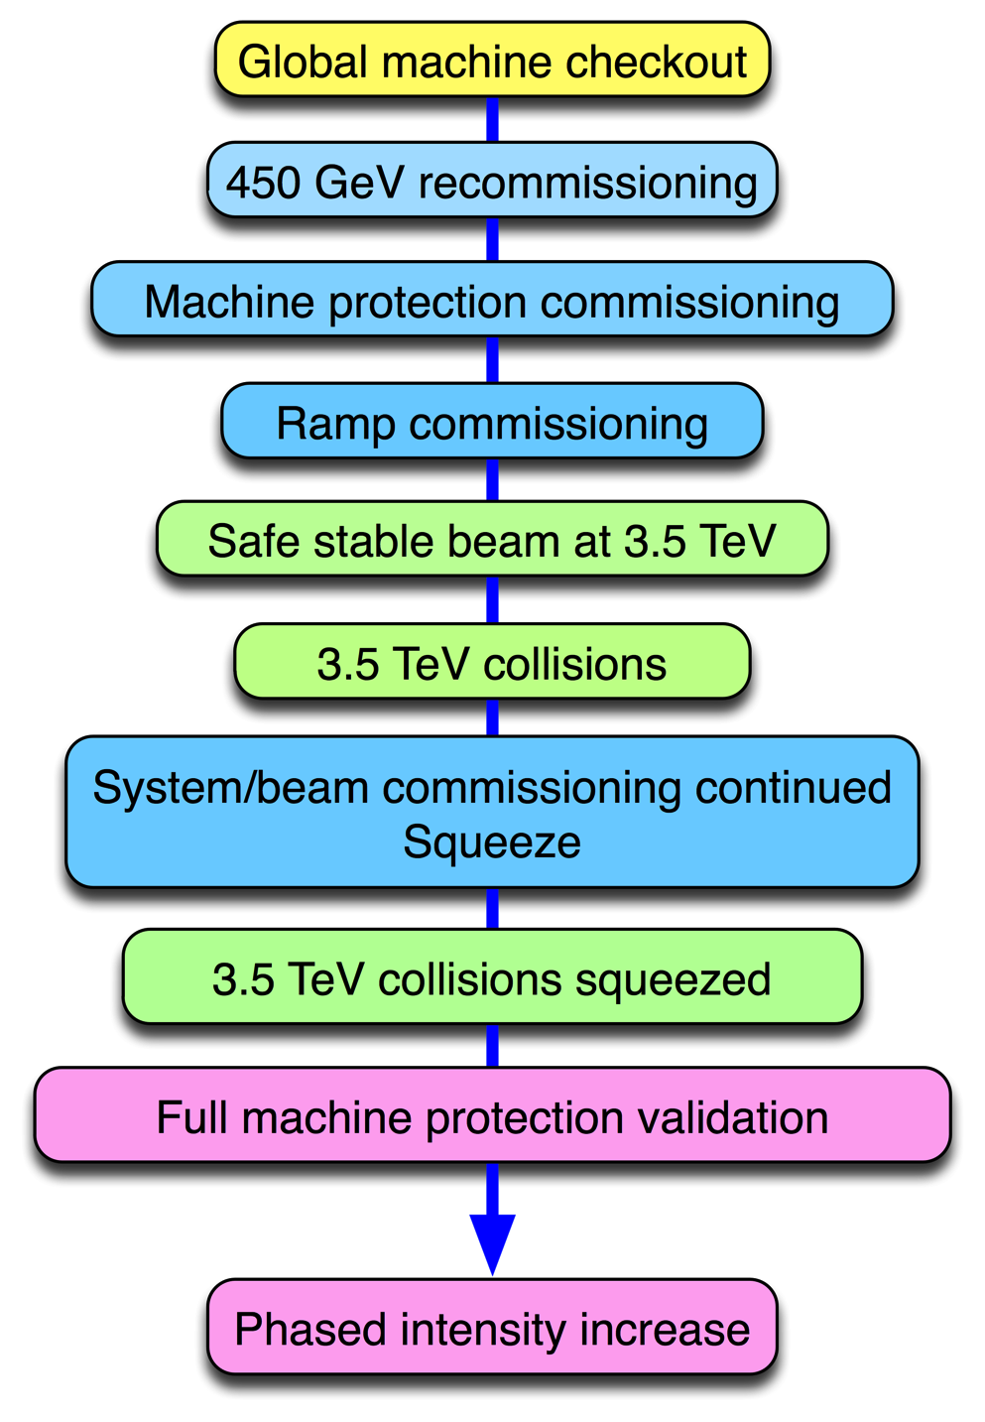
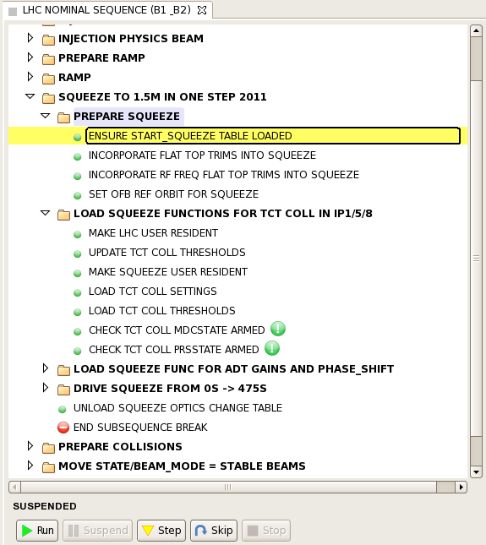
2010 – integrated luminosity
CONSOLIDATION
COMMISSIONING
and frantic debugging
EXPLOITATION

Slide 7
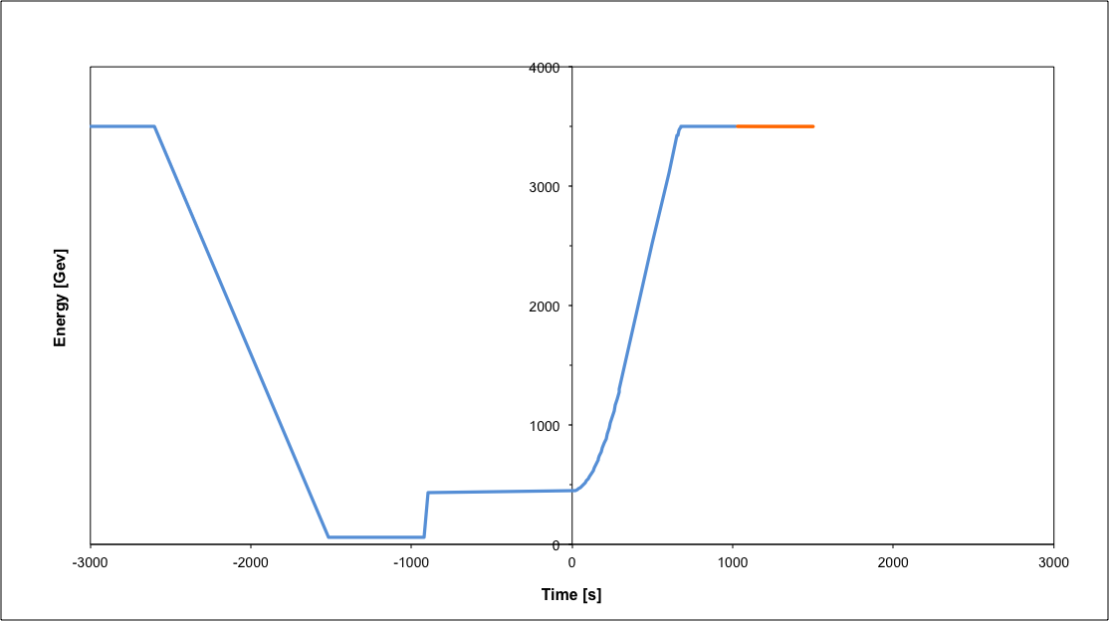
Nominal cycle
Beam dump
Squeeze
Stable beams
Collide
Ramp
Ramp down/precycle
Ramp down | 35 mins
Injection | ~30 mins
Ramp | 17 mins
Squeeze | 8 mins
Collide | 1 mins
Stable beams | 0 – 30 hours
Injection
Fastest turn around down from 3h40m in 2010 to 2h7m in 2011 after optimization

Slide 8
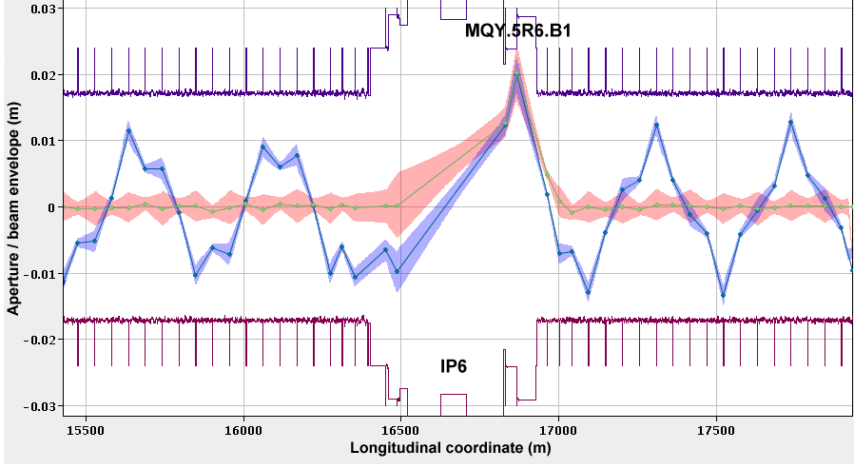
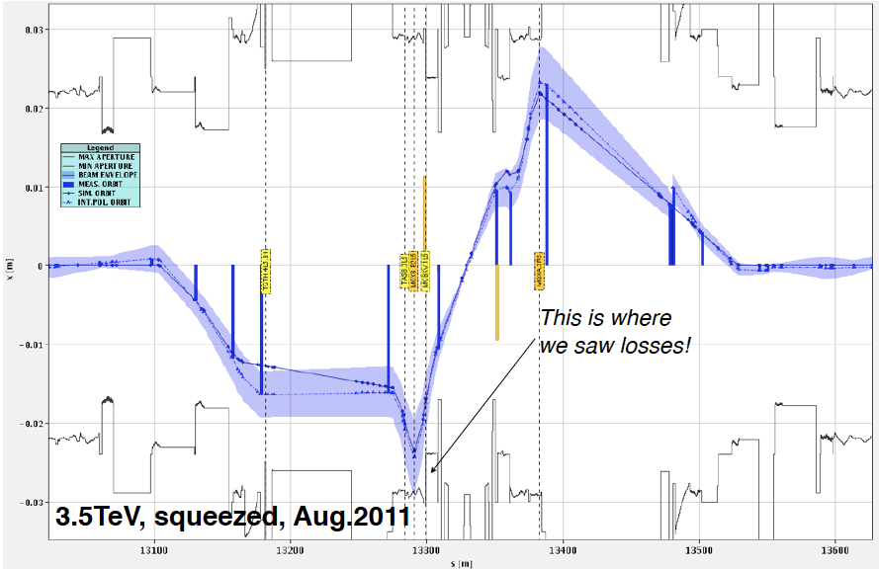
Aperture
Aperture systematically measured (locally and globally)
Better than anticipated w.r.t. tolerances on orbit & alignment
Aperture compatible with a well-aligned machine, a well centred orbit and close to design mechanical aperture

Slide 9
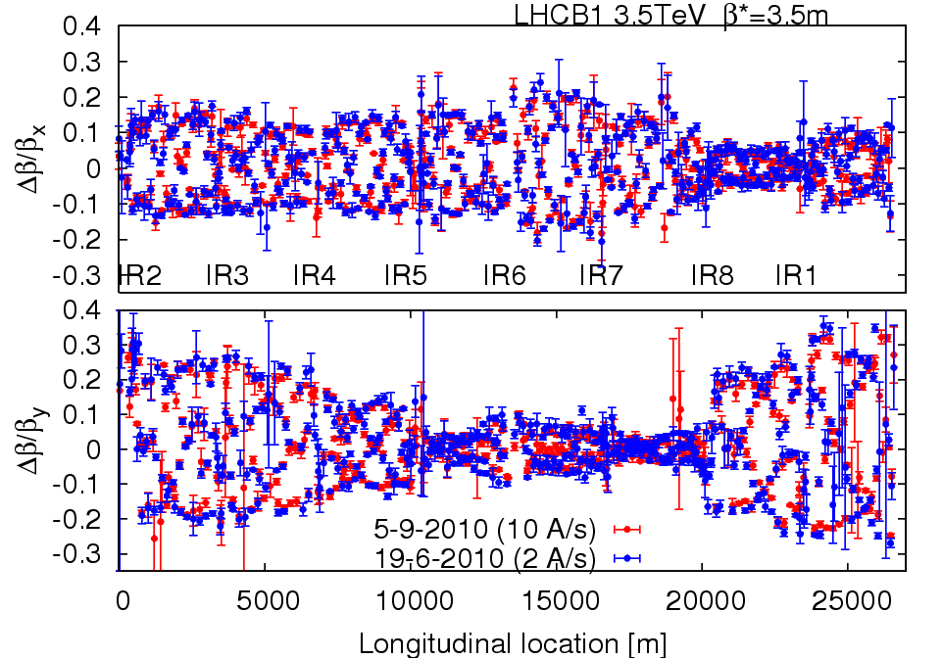
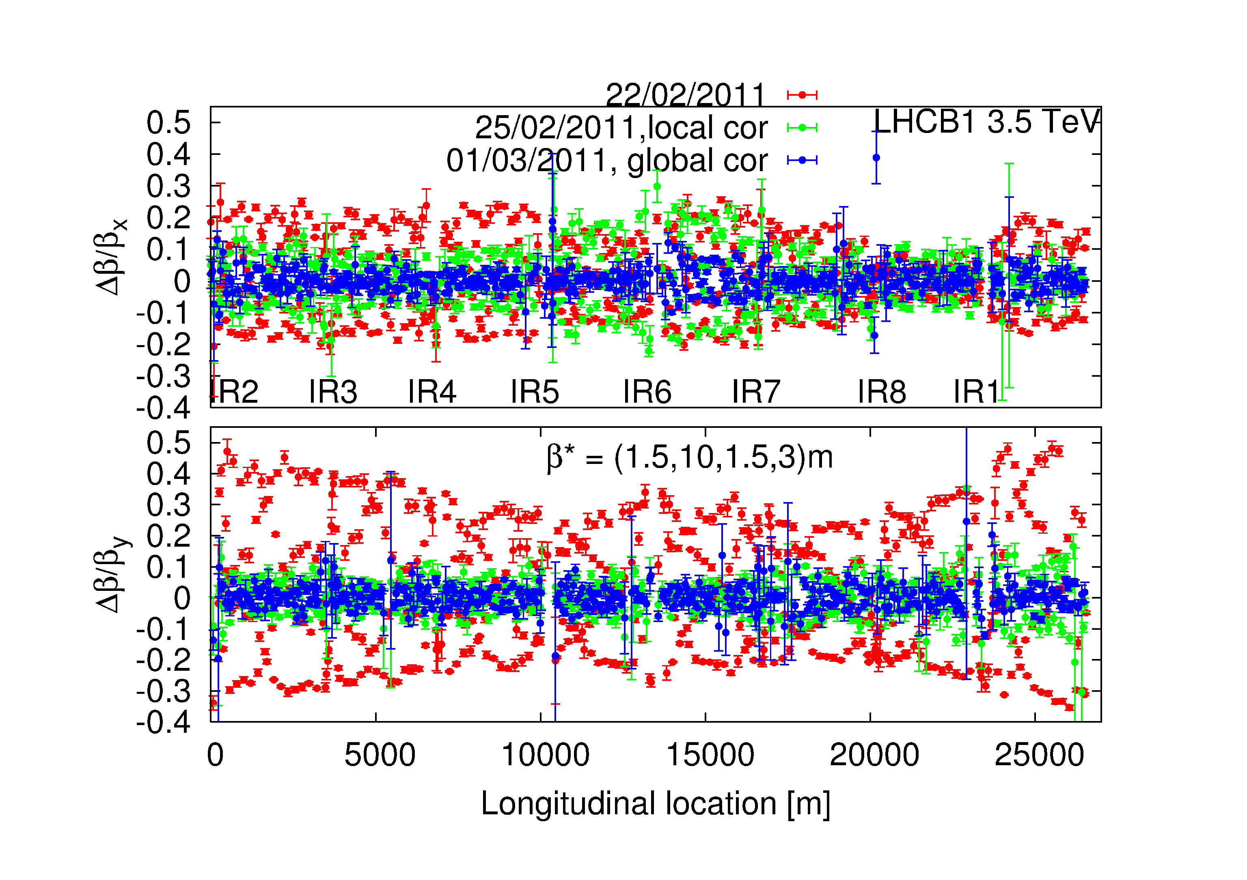
Optics
Optics stunningly stable
and well corrected
Two measurements of beating at 3.5 m
3 months apart
Local and global correction at 1.5 m

Slide 10
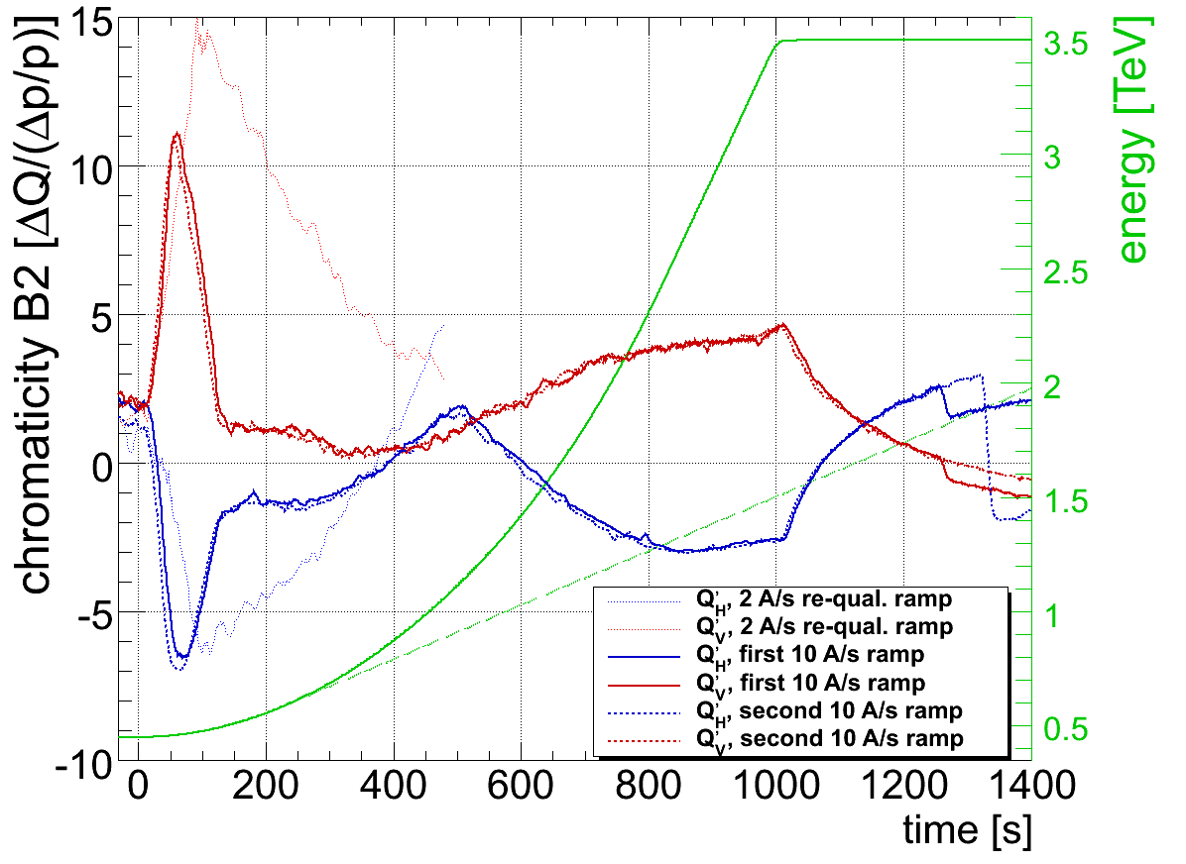
Magnet model
Knowledge of the magnetic machine is remarkable
All magnet ‘transfer functions’, all harmonics including decay and snapback of persistent currents
Tunes, momentum, optics remarkably close to the model
Model based feed-forward reduces chromaticity swing from 80 to less than 10 units

Slide 11
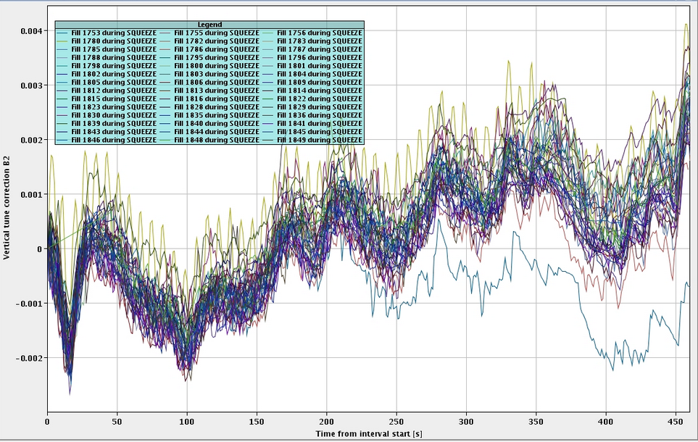
Reproducibility
LHC magnetically reproducible with rigorous pre-cycling - set-up remains valid from month to month
7 e-3
Tune corrections made by feedback during squeeze

Slide 12
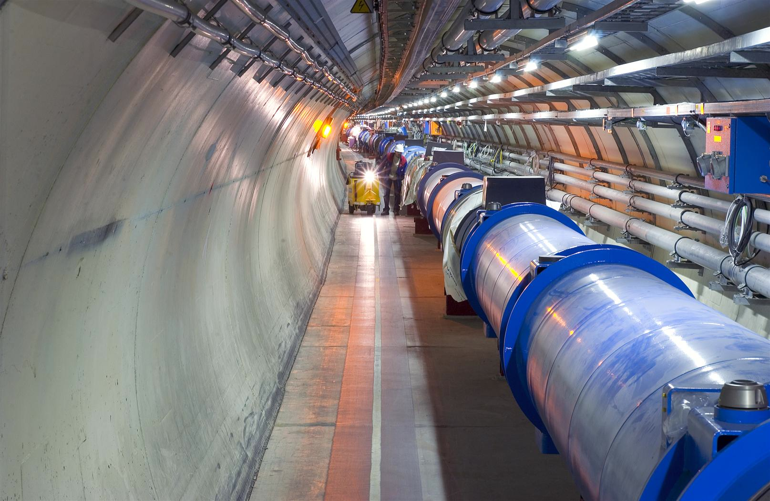
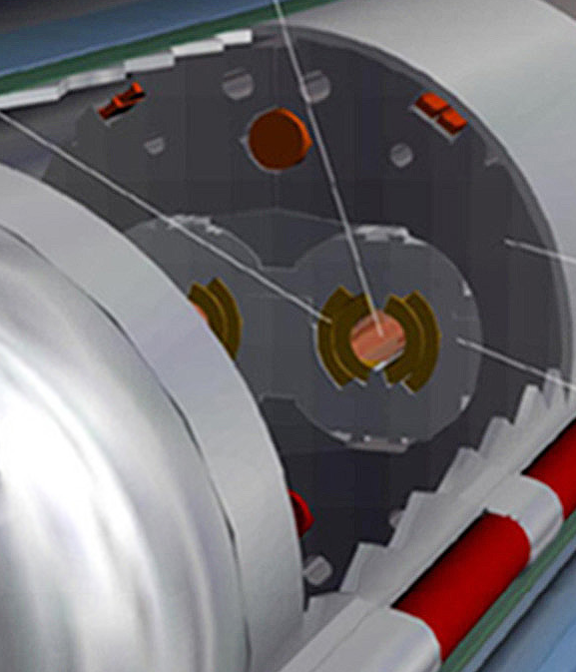
Machine protection – the challenge
Situation at 3.5 TeV (in August 2011)
Beam
100 MJ
Not a single beam-induced quench at 3.5 TeV
… YET
11 magnet quench at 450 GeV – injection kicker flash-over
56 mm
SC Coil:
quench limit
15-100 mJ/cm³

Slide 13
Beam Interlock System
Safe Beam Parameter Distribution
Jaw Position
Temperature
Special
BLMs
Safe
LHC
Parameter
Software
Interlock
System
Operator Buttons
CCC
Vacuum
System
Screens and Mirrors
beam observation
RF
System
(f_RF + P)
Access
System
Collimation
System
Beam Interlock System
Beam
Dumping System
Safe
Beam
Flag
Injection Interlock
Powering
Interlocks
superconducting magnets
Powering
Interlocks
normal conducting magnets
Fast Magnet Current
change Monitor
BPMs
LHC
Experiments
Beam loss monitors
BLM
Timing System
(Post Mortem Trigger)
Magnets
Power Converters
Beam Loss
Monitors
BCM
Monitors
aperture limits
(some 100)
Monitors in arcs
(several 1000)
Magnet protection system
(20000 channels)
Power
Converters
~1600
AUG
UPS
Cryogenics
some 10000 channels

Slide 14
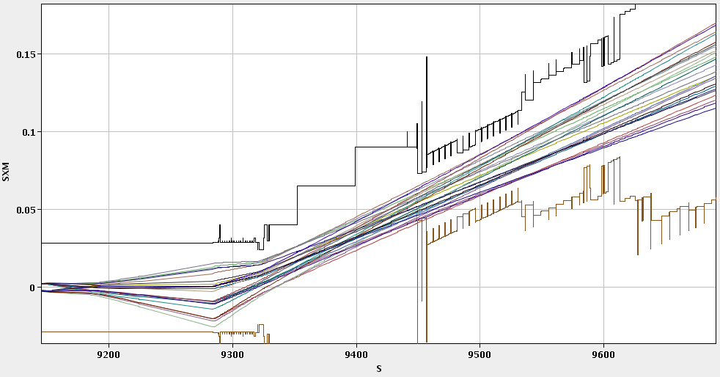
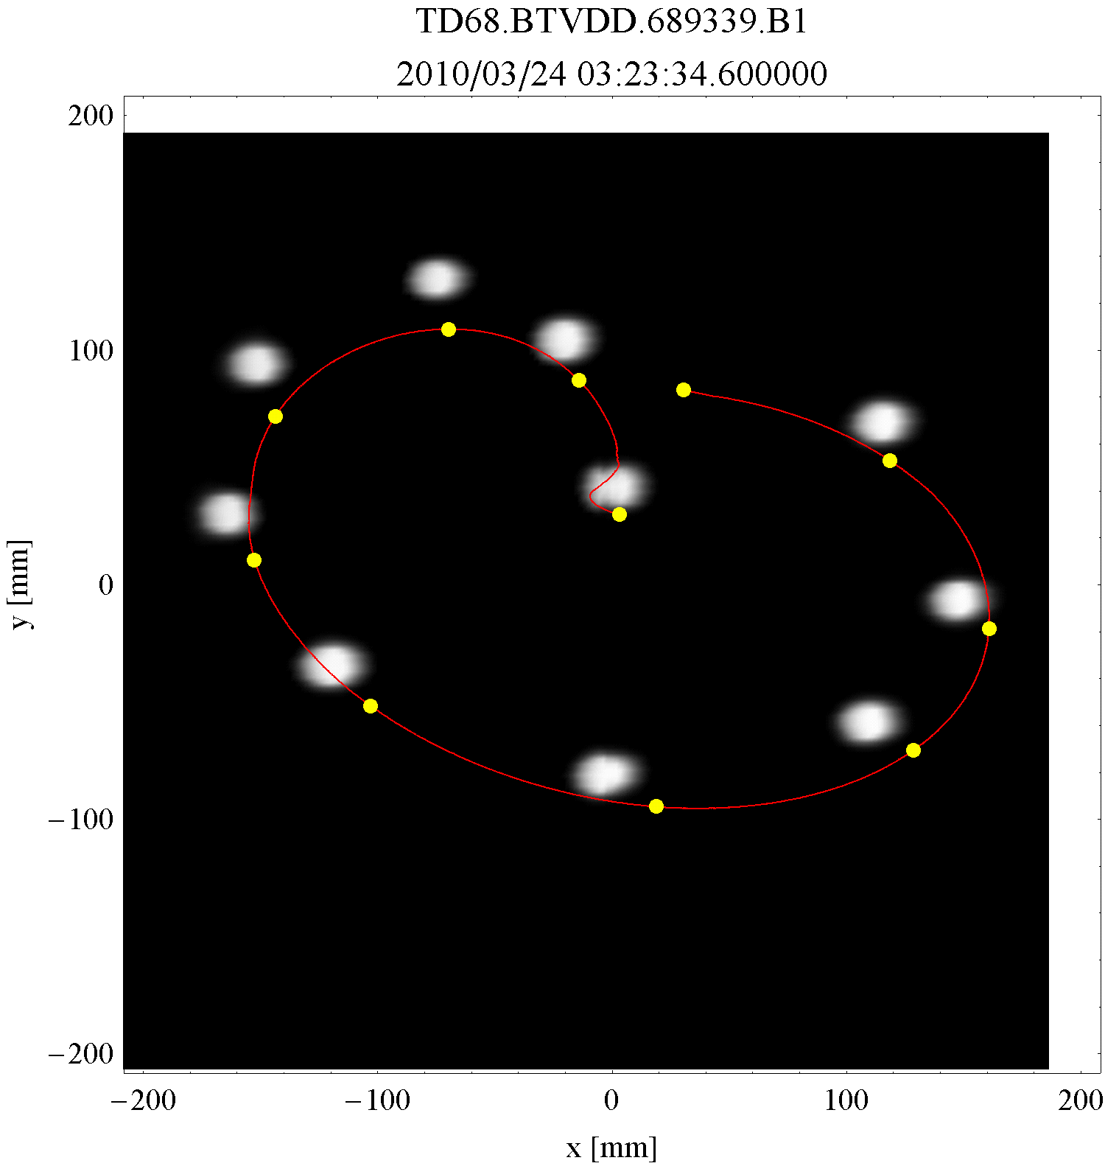
Beam Dump System (LBDS)
Absolutely critical. Rigorous and extensive program of commissioning and tests with beam.
Expected about two asynchronous dumps per year – one to date with beam
IR6 H Beam2, extracted

Slide 15
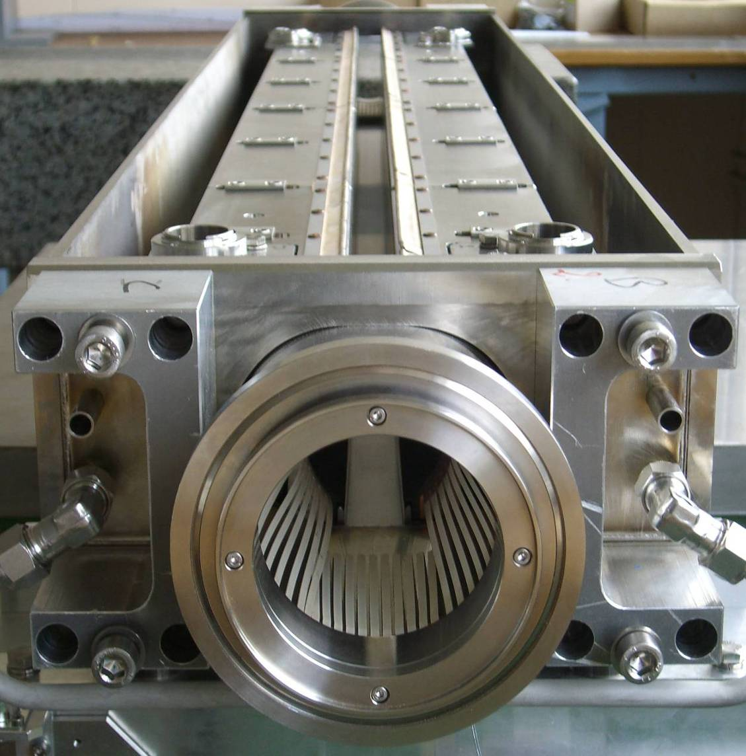
Collimation
Two warm cleaning insertions
IR3: Momentum cleaning
1 primary (H)
4 secondary (H,S)
4 shower abs. (H,V)
IR7: Betatron cleaning
3 primary (H,V,S)
11 secondary (H,V,S)
5 shower abs. (H,V)
Local IP cleaning: 8 tertiary coll.
1.2 m
Total = 108 collimators
About 500 degrees of freedom.
beam

Slide 16
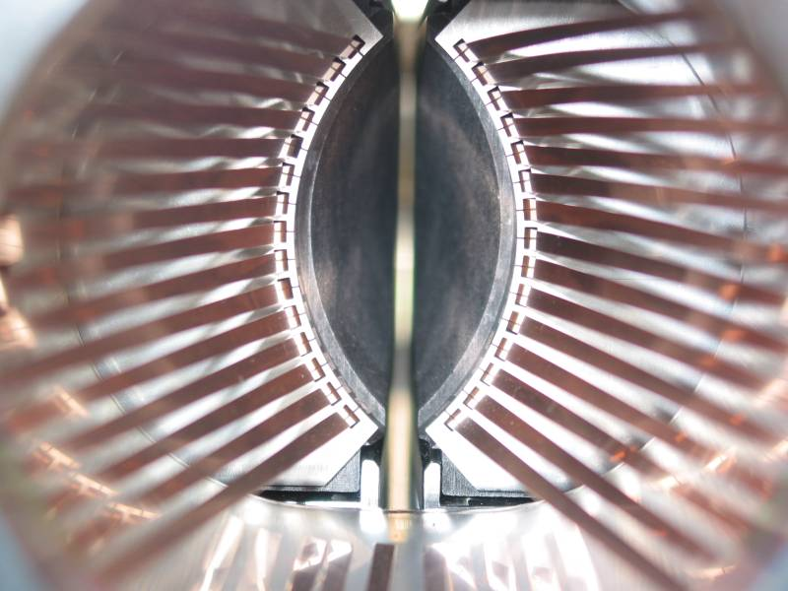
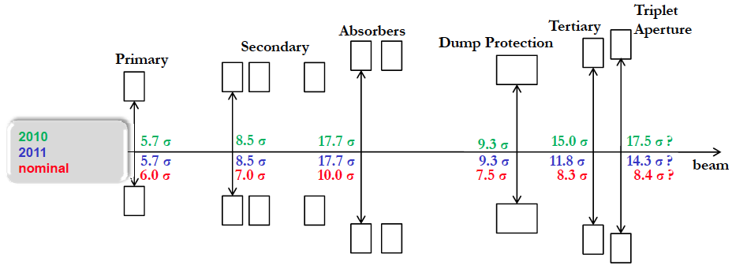
Collimation
Triplet aperture must be protected by tertiary collimators (TCTs)
TCTs must be shadowed by dump protection (not robust)
Dump protection must be outside primary and secondary collimators
Hierarchy must be satisfied even if orbit and optics drift after setup
  margins needed between collimators

Slide 17
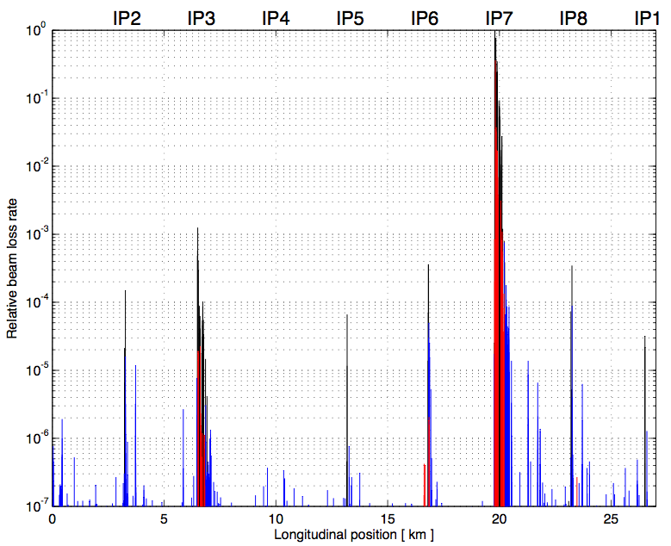
Collimation cleaning at 3.5 TeV
Generate higher loss rates: beam across the 3rd order resonance.
Beam 1
Betatron
Off-momentum
0.00001
Dump
TCTs
TCTs
TCTs
TCTs
Legend:
Collimators
Cold losses
Warm losses
0.000001
Outstanding performance:
No beam-induced quenches in 2010/2011

Slide 18
Exit 2010: beam parameters
 | 2010 | Nominal
Energy [TeV] | 3.5 | 7
beta* [m] | 3.5, 3.5, 3.5, 3.5 m | 0.55, 10, 0.55, 10
Emittance [microns] | 2.0 – 3.5 start of fill | 3.75
Bunch intensity | 1.2e11 | 1.15e11
Number of bunches | 368 348 collisions/IP | 2808
Stored energy [MJ] | 28 | 360
Peak luminosity [cm⁻²s⁻¹] | 2e32 | 1e34

Slide 19
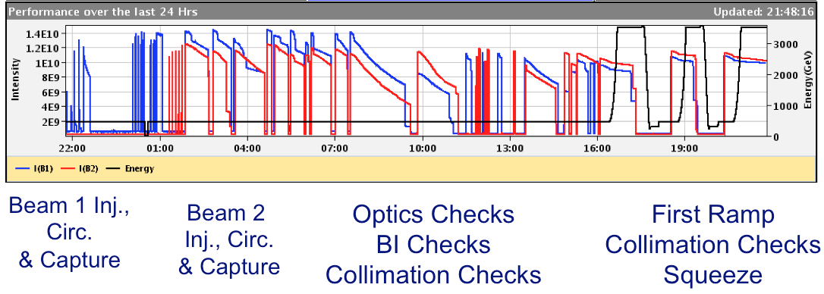
Lead ion run 2010
Collisions within 54 hours of first injection
Experience and Lorentz’s law.

Slide 20
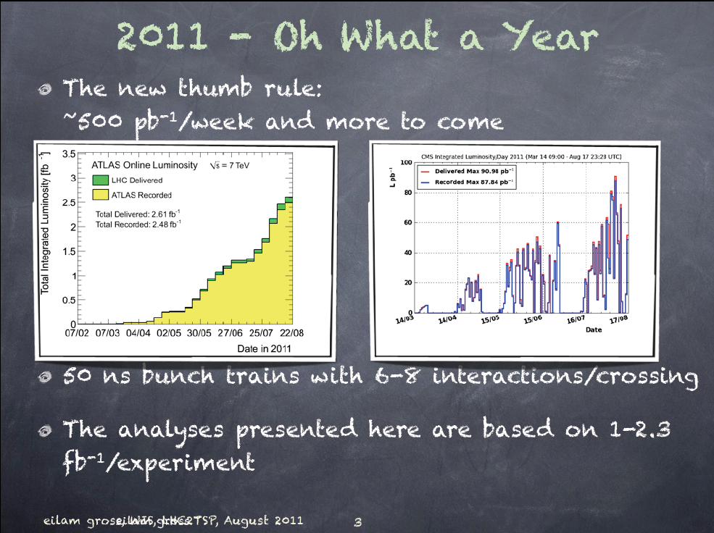
90 pb⁻¹/day
2.6 fb⁻¹

Slide 21
Emittance
x’
As we move around the machine the shape of the phase space ellipse will change as β(s) changes with the varying quadrupole (de-)focusing
However the area of the ellipse (πε) does not change
Emittance shrinks naturally as we go up in energy (p_{S} increases, p_{T} doesn’t)
Define energy independent normalized emittance:
Units are mm.mrad but normally use microns (and drop ‘normalized’)
Useful – constant across complex (give or take some blow-up)
x
σ
x

Slide 22



Aim: maximize peak luminosity
N | Number of particles per bunch
K_{b} | Number of bunches
f | Revolution frequency
 | Beam size at interaction point
F | Reduction factor due to crossing angle
 | Emittance
 | Normalized emittance
 | Beta function at IP

Slide 23
Beam from injectors
Excellent performance
Higher than nominal bunch intensity
Smaller than nominal emittance
Bunch spacing | From Booster | Np/bunch | Emittance H&V [mm.mrad]
150 | Single batch | 1.1 x 10¹¹ | 1.6
75 | Single batch | 1.2 x 10¹¹ | 2.0
50 | Single batch | 1.45 x 10¹¹ | 3.5
50 | Double batch | 1.6 x 10¹¹ | 2.0
25 | Double batch | 1.2 x 10¹¹ | 2.7
At present: ~1.3 x 10¹¹ppb, 2.0 microns into collision

Slide 24
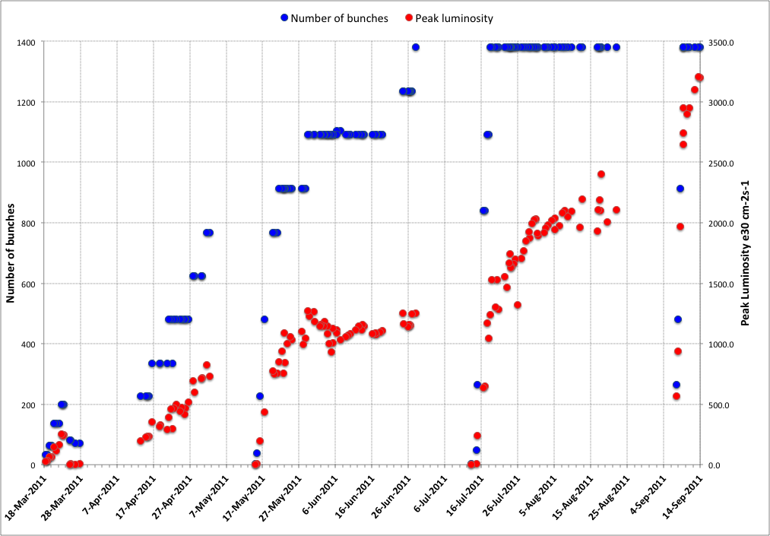
2011
75 ns
50 ns
Intermediate energy run, technical stop, scrubbing
MD, technical stop
MD, technical stop
MD, technical stop, SQUEEZE
Smaller emittance
from injectors

Slide 25
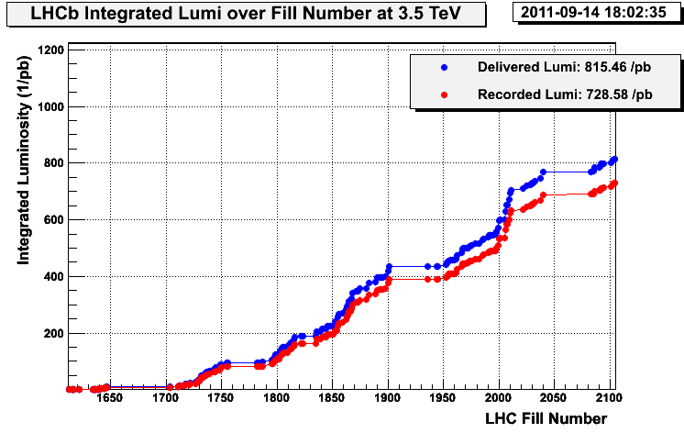
2011: (c/o Atlas & LHCb)
Peak stable luminosity | 3.29 x 10³³ cm⁻²s⁻¹
Max. luminosity in one fill | 114 pb⁻¹
Max. luminosity delivered in 7 days | 499.45 pb⁻¹
Longest time in stable beams | 26.0 hours
Longest time in stable beams for 7 days | 107.1 hours (63.7%)
Fastest turnaround | 2 hours 7 minutes
33% of design luminosity:
- half design energy
- nominal bunch intensity+
- ~half nominal emittance
- beta* = 1.0 m (design 0.55 m)
- half nominal number of bunches

Slide 26
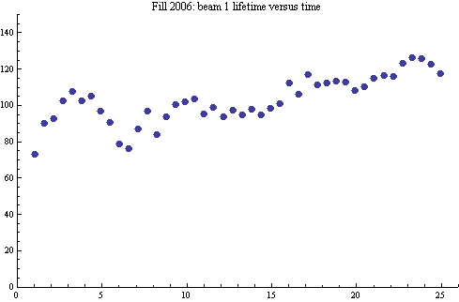
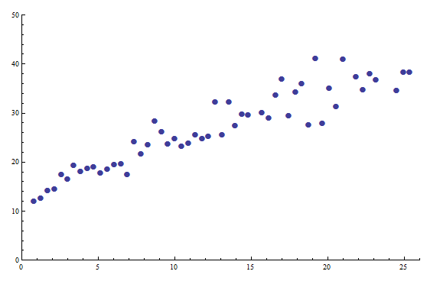
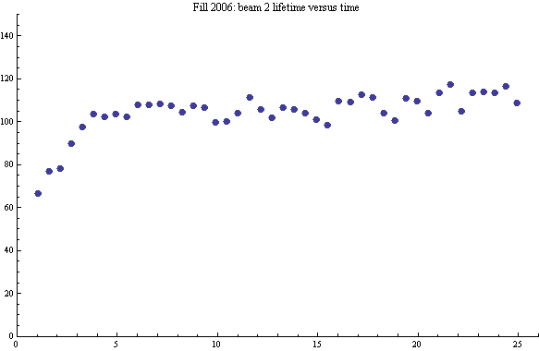
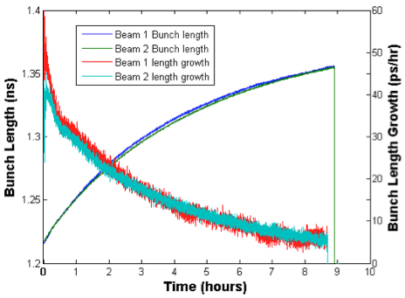
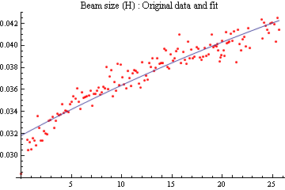
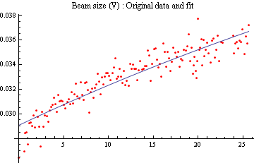
Fill 2006: Luminosity lifetime
A “typical” fill that lasted 26 hours and delivered 100 pb⁻¹
100 hours
Lifetime beam 1
30 hours
Luminosity lifetime
Lifetime beam 2
H growth rate ~64 hours
V growth rate ~84 hours

Slide 27
2011 parameters – now
Energy [TeV] | 3.5
Beta* [m] | 1.0, 10, 1.0, 3.0 m
Normalized emittance [microns] | ~2.0+ start of fill
Bunch intensity | 1.3e11
Number of bunches | 1380 1318 collisions/IP1&5
Bunch spacing [ns] | 50
Stored energy [MJ] | 90 to 100
Peak luminosity [cm⁻²s⁻¹] | 3.3e33
Beam-beam tune shift (start fill) | ~0.023

Slide 28
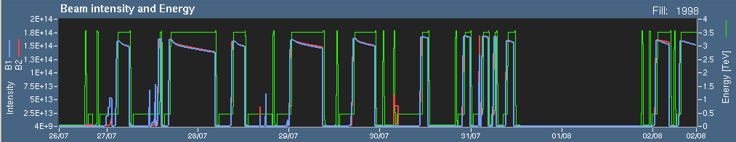
Availability - efficiency
Premature end to fills

Slide 29
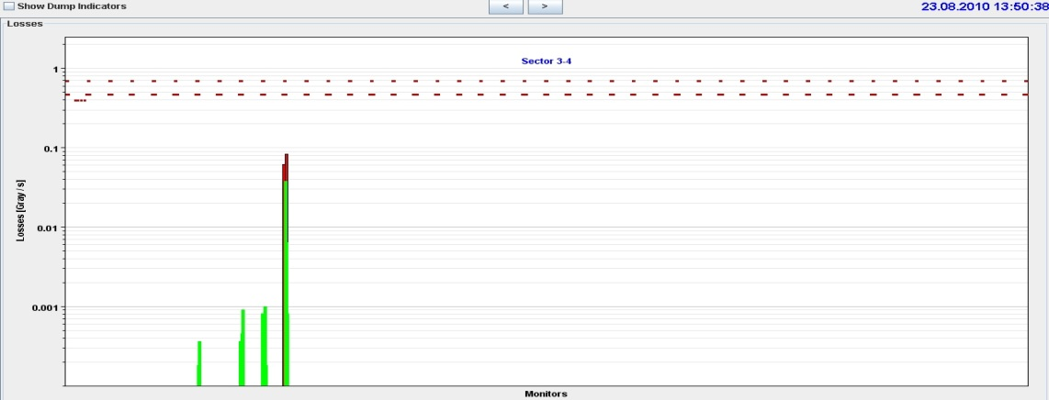
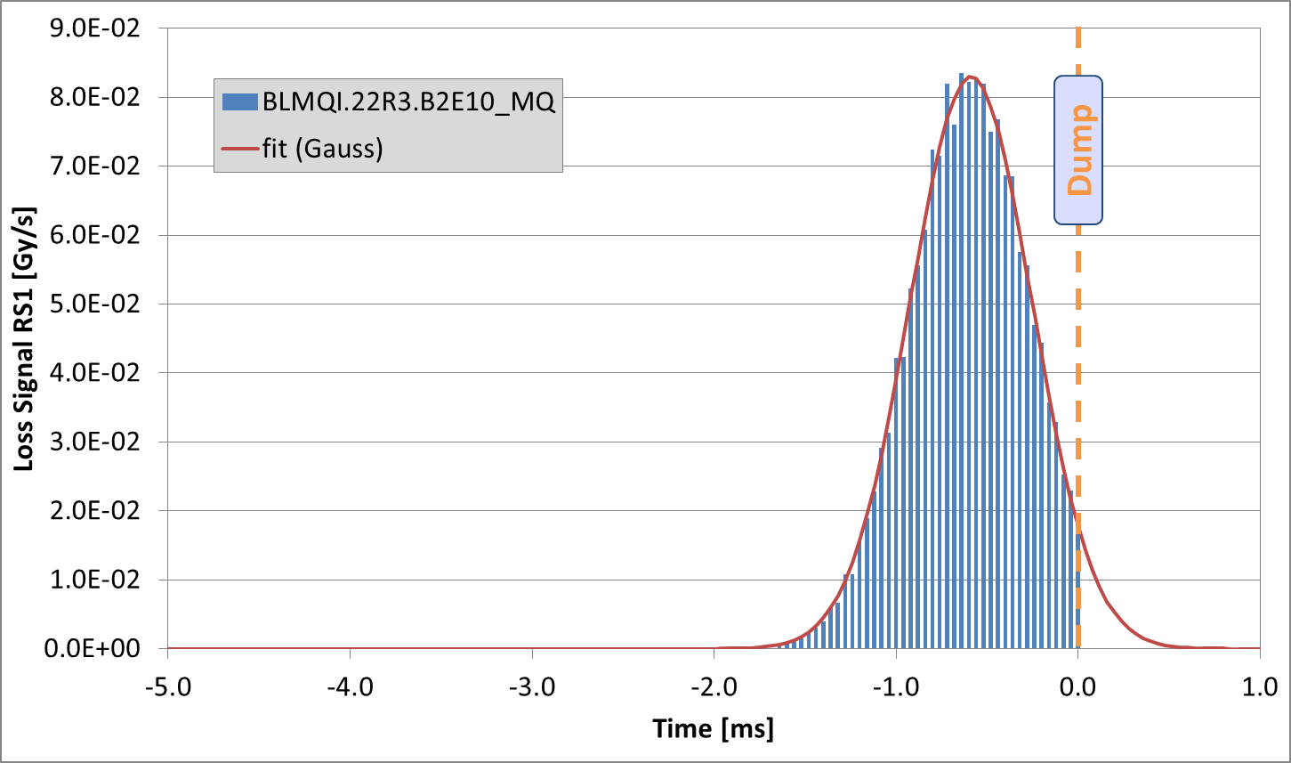
UFOs in the LHC
Since July 2010, 35 fast loss events led to a beam dump.
18 in 2010, 17 in 2011.
13 around MKIs.
6 dumps by experiments.
1 at 450 GeV.
Typical characteristics:
  Loss duration: about 10 turns
  Often unconventional loss locations (e.g. in the arc)
The events are believed to be due to (Unidentified) Falling Objects (UFOs).
Spatial and temporal loss profile of UFO on 23.08.2010

Slide 30
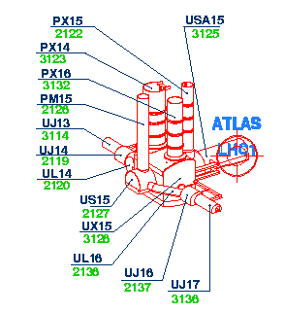
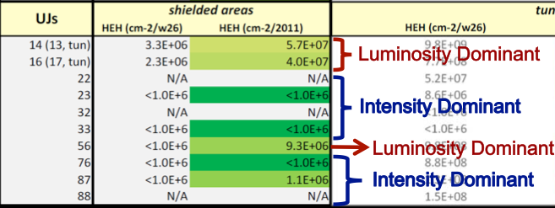
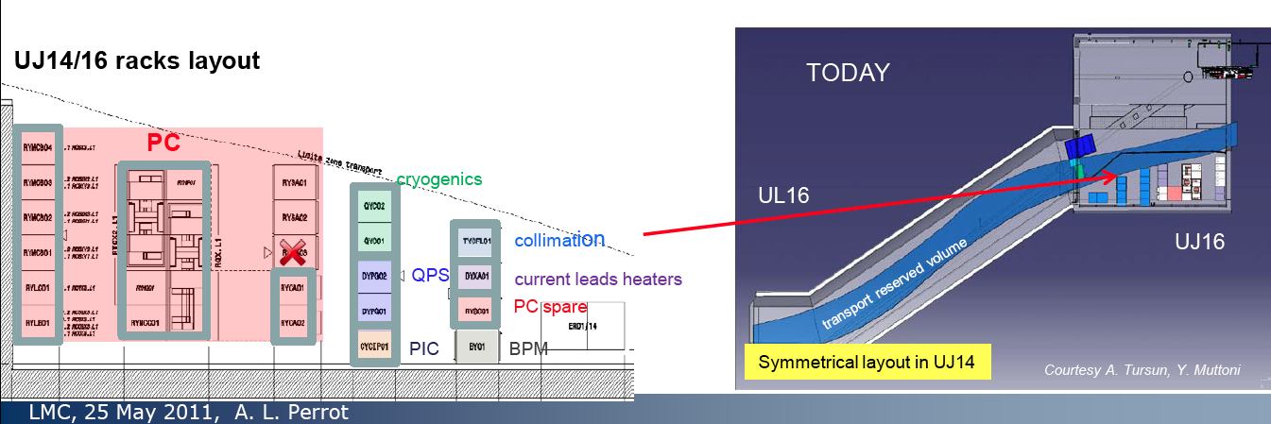
Single Event Effects
Major campaign ongoing: shield and relocate

Slide 31
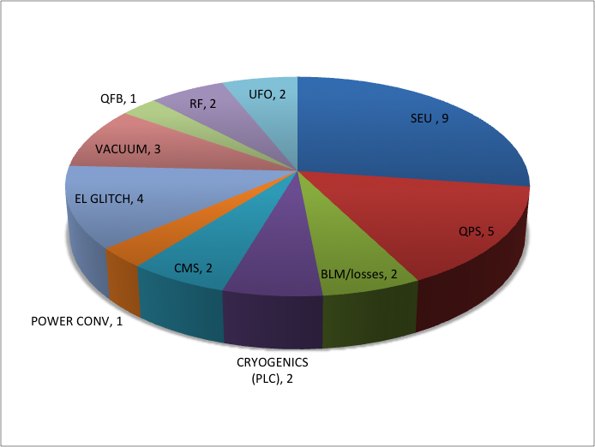
Dumps > 450 GeV July-August
Room for improvement

Slide 32
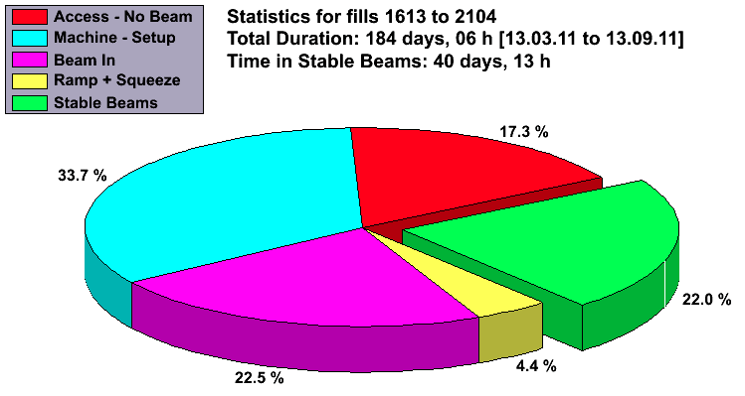
Availability 2011
Beam in ~49% of the time

Slide 33
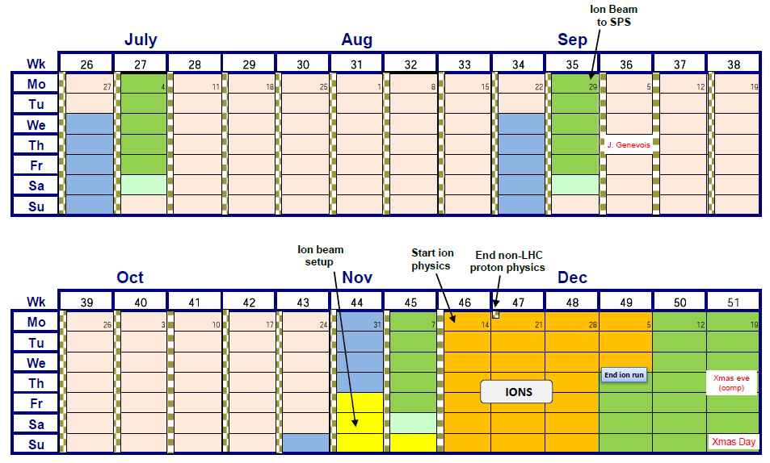
Rest of this year

Slide 34


Rest of this year
3.3 e33 cm⁻²s⁻¹
3 fb⁻¹ plus…
…another ~40 days and reasonable efficiency: might just manage another 2 fb⁻¹

Slide 35

2012
 | Days
Commissioning | 23
MD | 22
Technical stops | 20
Recovery & ramp-up | 16
Initial ramp-up | 16
Proton running | ~130
Special runs | ~8
Ion setup | 4
Ion run | 24
DRAFT!
Possible energy increase?
50 ns versus 25 ns?

Slide 36
Pile-up
Luminosity per crossing
Inelastic cross section (~72 mb at 3.5 TeV)
average number of visible interactions per bunch crossing

Slide 37
Pileup
Bunch spacing | No. of bunches | Energy [TeV] | Beta* [m] | Normalized emittance [micron] | Protons per bunch [e11] | Peak lumi [cm-2s-1] | Peak mean mu
50 ns | 1380 | 3.5 | 1.0 | 2.0 | 1.3 | 3.37 | 16.4
50 ns | 1380 | 3.5 | 1.0 | 2.3 | 1.6 | 4.49 | 21.8
50 ns | 1380 | 4.0 | 0.8 | 2.0 | 1.3 | 4.1 | 19.9
50 ns | 1380 | 4.0 | 0.8 | 2.3 | 1.6 | 6.2 | 30.2
25 ns | 2760 | 3.5 | 1.0 | 2.8 | 1.2 | 4.1 | 10.0
25 ns | 2760 | 4.0 | 1.0 | 2.8 | 1.2 | 4.6 | 11.2
130 days at reasonable efficiency – might hope to push towards 10 fb⁻¹

Slide 38


Further ahead
NB: not yet approved

Slide 39
Conclusion
Successful commissioning and good transition from commissioning to operations
  Cycle is solid
  Performance is quite staggering (and will now flatten out)
  Machine protection working well
  Availability with high intensity acceptable with issues being addressed
The LHC is a beautiful machine and a real testament to those who conceived, built and installed it.

