Slide 1
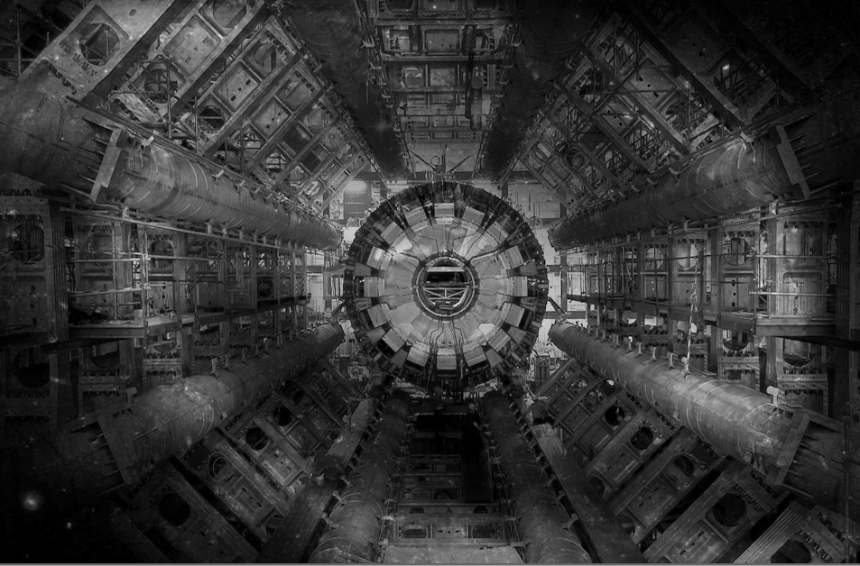
The LHC
Very big
Very cold
Very high energy

Slide 2

LHC tunnel
Circumference = 26.7 km
Depth = 70-140 m
Slope = 1.4 %

Slide 3
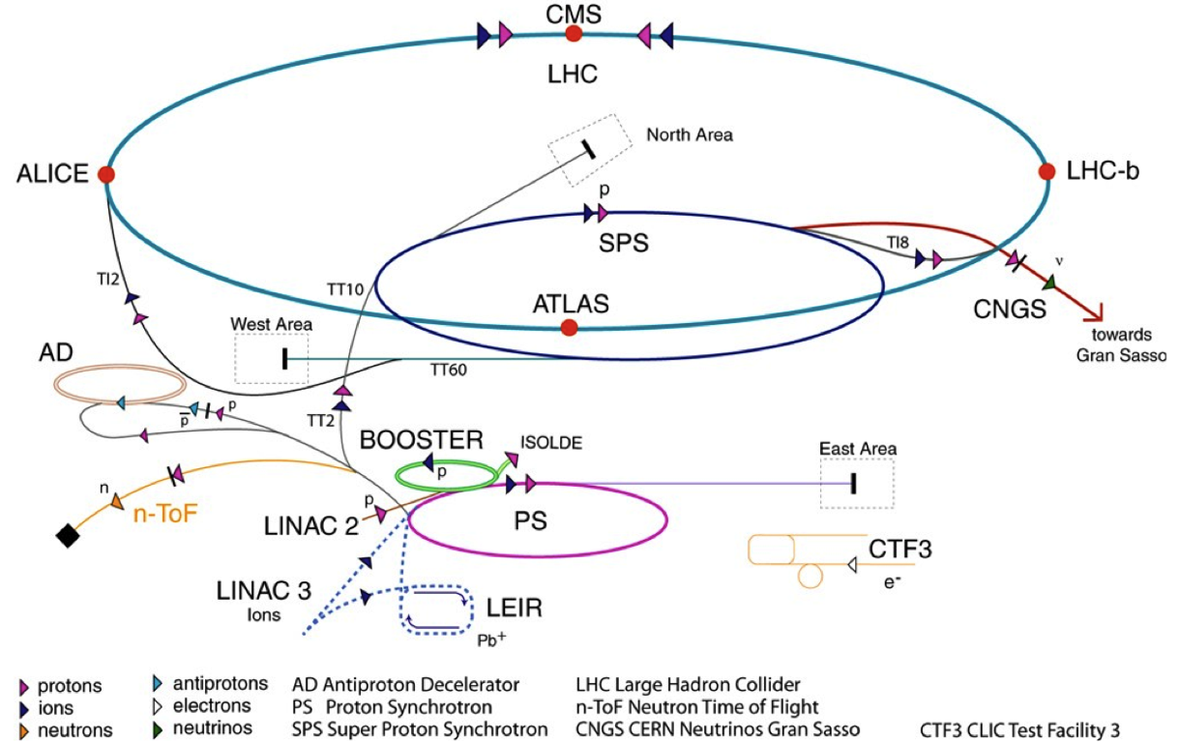
LHC injector complex
Beam 1
Beam 2
TI8
TI2
Year Top energy Length
[GeV] [ m ]
Linac 1979 0.05 30
PSB 1972 1.4 157
PS 1959 26.0 628
SPS 1976 450.0 6’911
LHC 2008 7000.0 26’657
LHC proton path

Slide 4
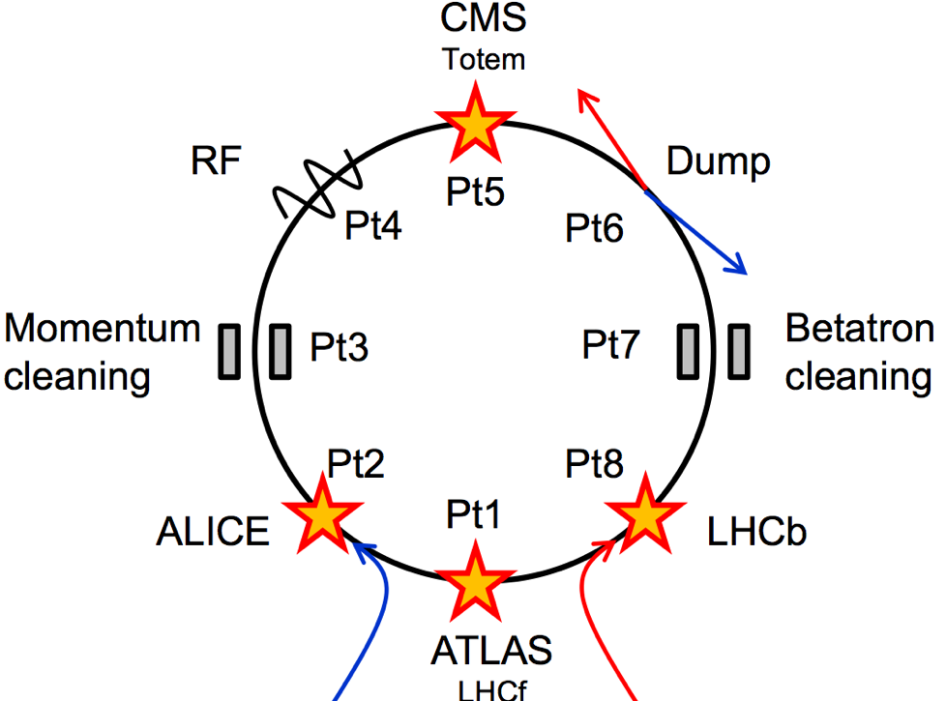
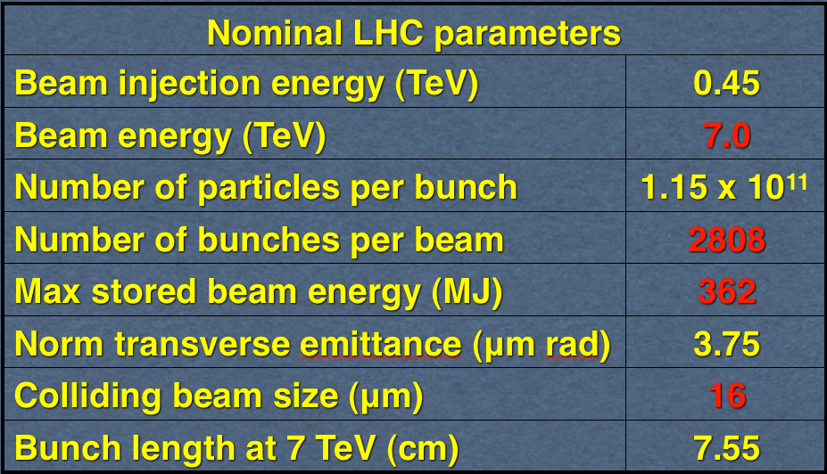






Layout and accelerator systems
LHC Layout
8 arcs (~3 km)
8 straight sections (~700 m).
Two-in-one magnet design
4 interaction points (IPs):
IP1, IP2, IP5, IP8
IP2/IP8: beam injection
IP6: beam dump region
IP4: RF (acceleration)
IP3/IP7: beam cleaning

Slide 5
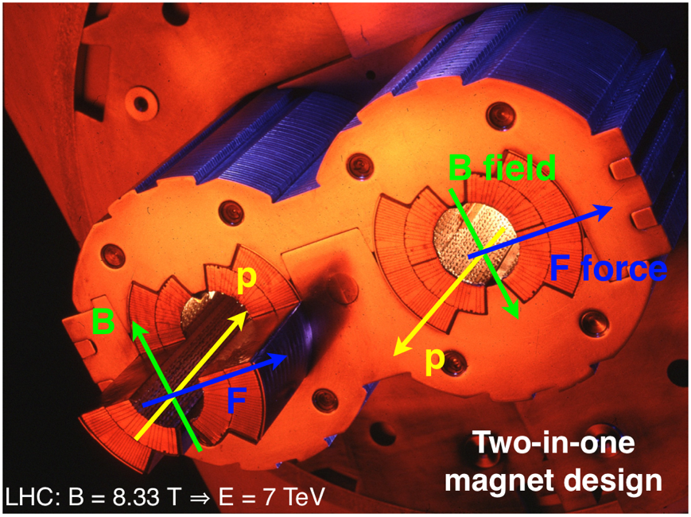
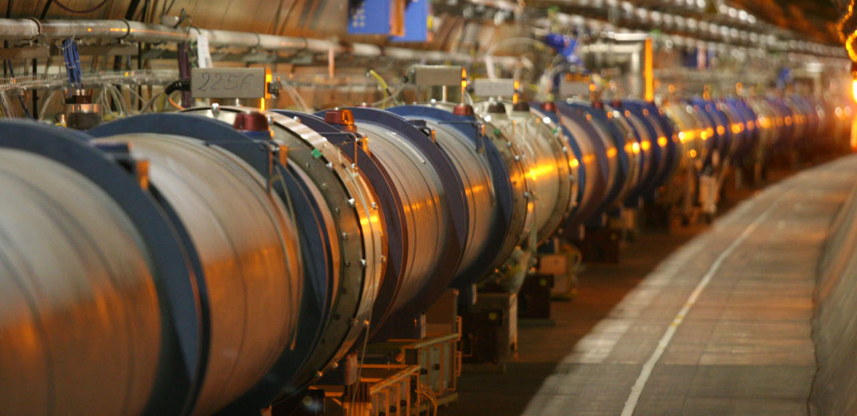
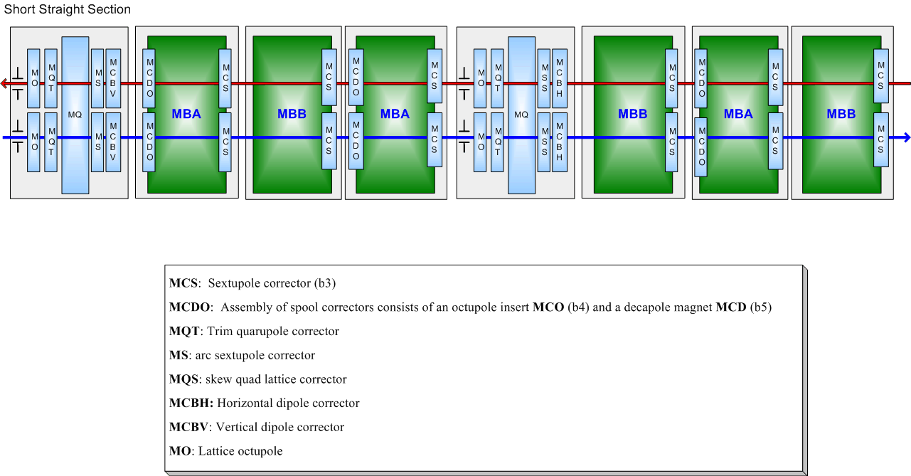
LHC arcs
1232 main dipoles + 3700 multipole corrector magnets
392 main quadrupoles + 2500 corrector magnets

Slide 6
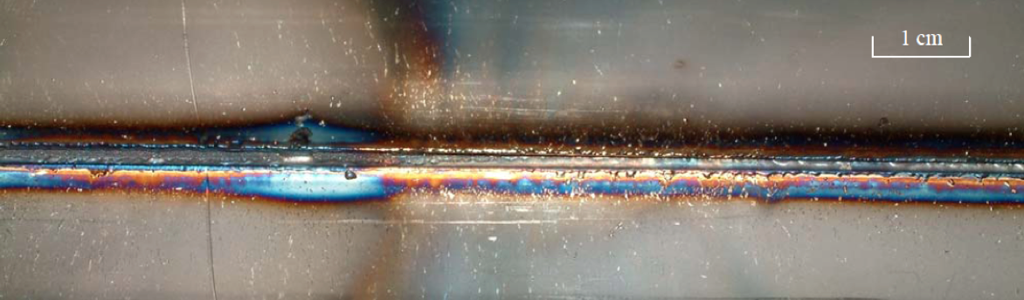
Energy
3.5 TeV with 1380 bunches – September 2011
~3 GJ of energy stored in the magnets
100 MJ stored in each beam ~21 kg of TNT.
Underpins our thoughts
During an SPS extraction test in 2004…
The beam was a 450 GeV full LHC injection batch of 3.4 10¹³ p+ in 288 bunches [2.5 MJ]

Slide 7
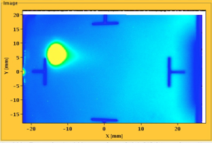
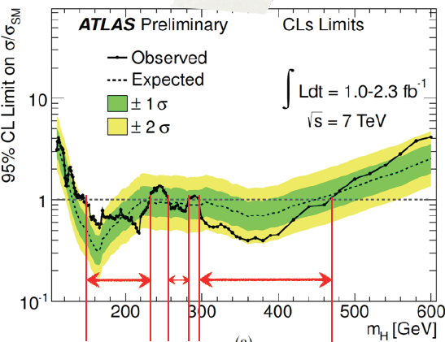
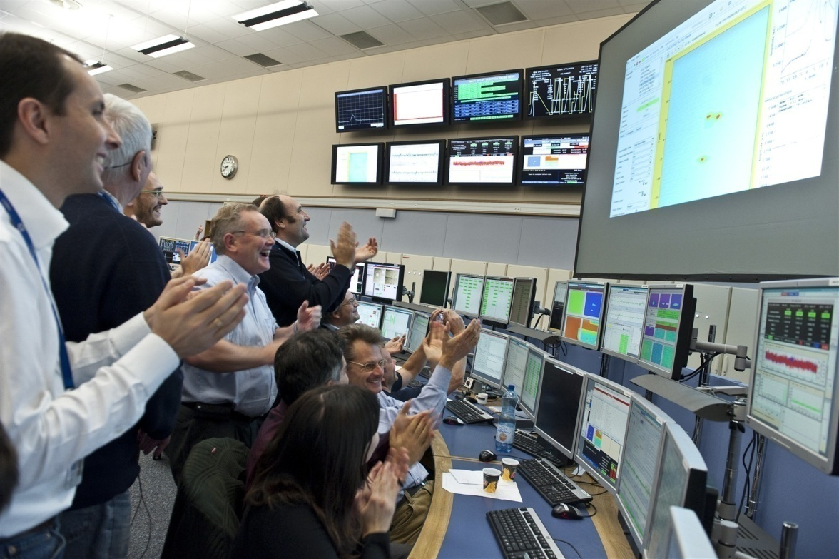

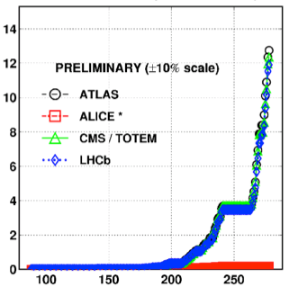

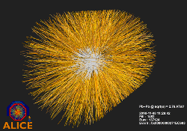
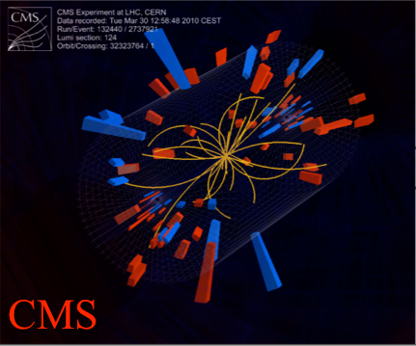
August 2008
First injection test
November 29, 2009
Beam back
August, 2011
2.3e33, 2.6 fb⁻¹
1380 bunches
September 10, 2008
First beams around
June 28 2011
1380 bunches
October 14 2010
1e32
248 bunches
1380
2008
2009
2010
2011
November 2010
Ions
March 30, 2010
First collisions at 3.5 TeV
September 19, 2008
Disaster
Accidental release of 600 MJ stored in one sector of LHC dipole magnets
LHC Timeline

Slide 8
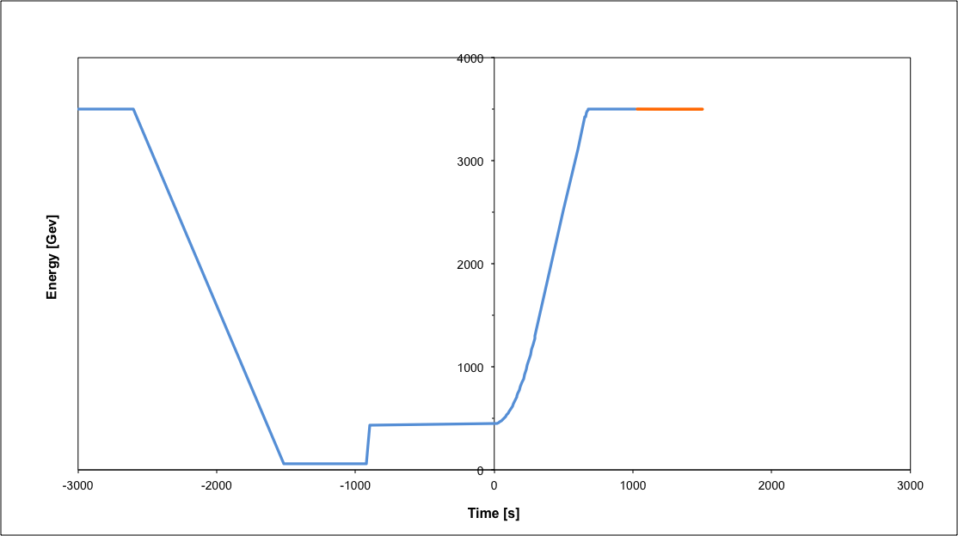
Nominal cycle
Beam dump
Squeeze
Stable beams
Collide
Ramp
Ramp down/precycle
Ramp down | 35 mins
Injection | ~30 mins
Ramp | 17 mins
Squeeze | 8 mins
Collide | 1 mins
Stable beams | 0 – 30 hours
Injection
Fastest turn around down from 3h40m in 2010 to 2h7m in 2011 after optimization

Slide 9
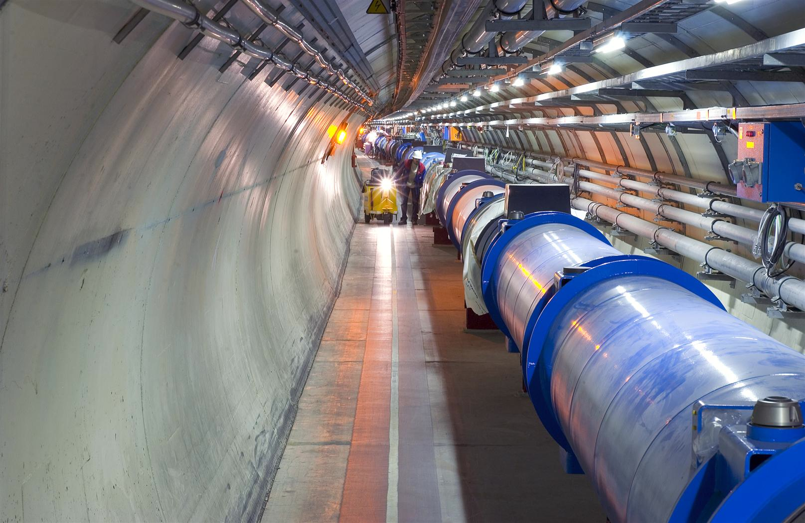
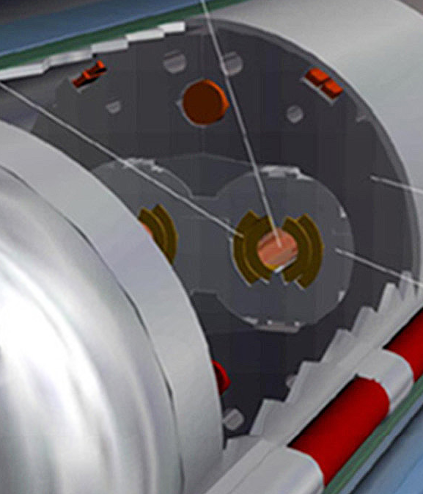
Machine protection – the challenge
Situation at 3.5 TeV (in August 2011)
Beam
100 MJ
Not a single beam-induced quench at 3.5 TeV
… YET
11 magnet quench at 450 GeV – injection kicker flash-over
56 mm
SC Coil:
quench limit
15-100 mJ/cm³

Slide 10
Beam Interlock System
Safe Beam Parameter Distribution
Jaw Position
Temperature
Special
BLMs
Safe
LHC
Parameter
Software
Interlock
System
Operator Buttons
CCC
Vacuum
System
Screens and Mirrors
beam observation
RF
System
(f_RF + P)
Access
System
Collimation
System
Beam Interlock System
Beam
Dumping System
Safe
Beam
Flag
Injection Interlock
Powering
Interlocks
superconducting magnets
Powering
Interlocks
normal conducting magnets
Fast Magnet Current
change Monitor
BPMs
LHC
Experiments
Beam loss monitors
BLM
Timing System
(Post Mortem Trigger)
Magnets
Power Converters
Beam Loss
Monitors
BCM
Monitors
aperture limits
(some 100)
Monitors in arcs
(several 1000)
Magnet protection system
(20000 channels)
Power
Converters
~1600
AUG
UPS
Cryogenics
some 10000 channels

Slide 11
Layout of LHC beam dumping system
Beam 1
Septum magnet deflecting the extracted beam
H-V dilution kickers
Quad
Beam Dump Block
Quad
about 700 m
Fast kicker magnets
Movable protection device (TCDQ)
about 500 m
Energy tracking critical
Beam 2

Slide 12
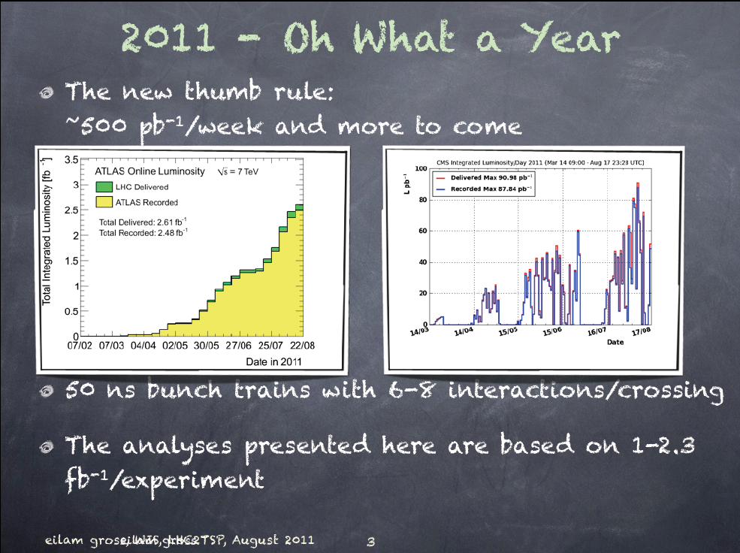
90 pb⁻¹/day
2.6 fb⁻¹

Slide 13
Emittance
x’
As we move around the machine the shape of the phase space ellipse will change as β(s) changes with the varying quadrupole (de-)focusing
However the area of the ellipse (πε) does not change
Emittance shrinks naturally as we go up in energy (p_{S} increases, p_{T} doesn’t)
Define energy independent normalized emittance:
Units are mm.mrad but normally use microns (and drop ‘normalized’)
Useful – constant across complex (give or take some blow-up)
x
σ
x

Slide 14



Aim: maximize peak luminosity
N | Number of particles per bunch
K_{b} | Number of bunches
f | Revolution frequency
 | Beam size at interaction point
F | Reduction factor due to crossing angle
 | Emittance
 | Normalized emittance
 | Beta function at IP

Slide 15
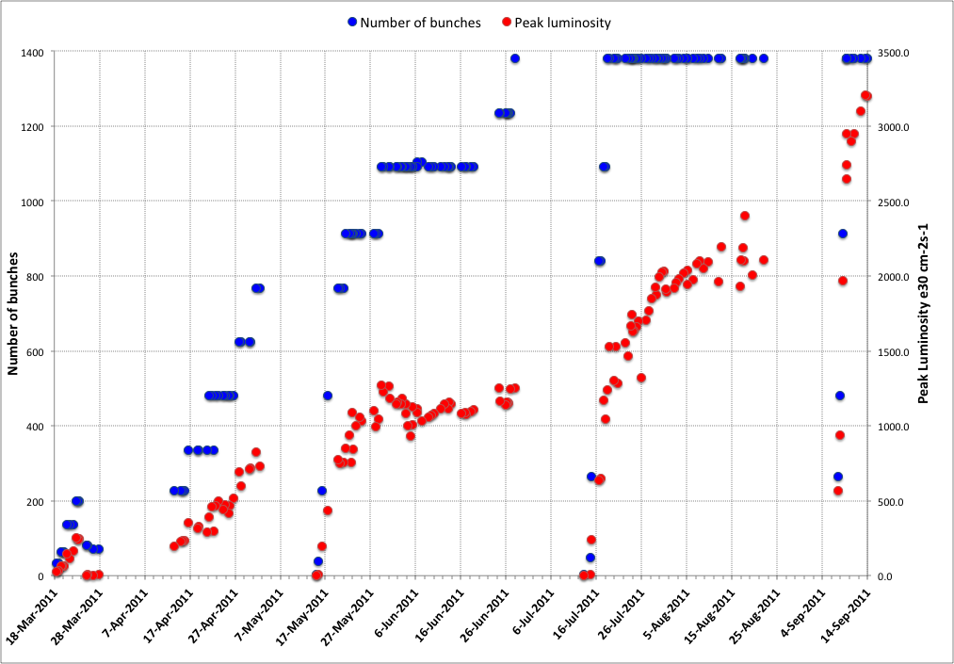
2011
75 ns
50 ns
Intermediate energy run, technical stop, scrubbing
MD, technical stop
MD, technical stop
MD, technical stop, SQUEEZE
Smaller emittance
from injectors

Slide 16
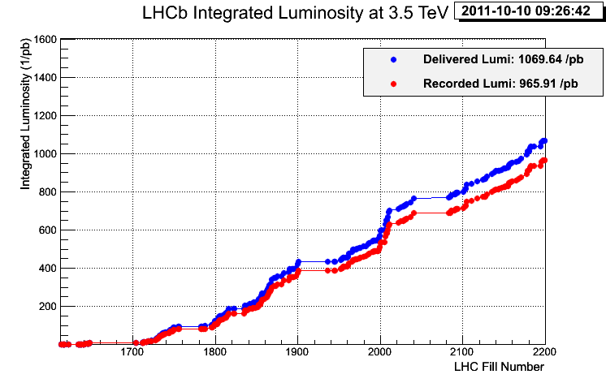
2011: (c/o Atlas & LHCb)
Peak stable luminosity | 3.42 x 10³³ cm⁻²s⁻¹
Max. luminosity in one fill | 120 pb⁻¹
Max. luminosity delivered in 7 days | ~500 pb⁻¹
33% of design luminosity:
- half design energy
- nominal bunch intensity+
- ~half nominal emittance
- beta* = 1.0 m (design 0.55 m)
- half nominal number of bunches

Slide 17
2011 parameters – now
Energy [TeV] | 3.5
Beta* [m] | 1.0, 10, 1.0, 3.0 m
Normalized emittance [microns] | ~2.1+ start of fill
Bunch intensity | 1.3e11
Number of bunches | 1380 1318 collisions/IP1&5
Bunch spacing [ns] | 50
Stored energy [MJ] | 90 to 100
Peak luminosity [cm⁻²s⁻¹] | 3.3e33
Beam-beam tune shift (start fill) | ~0.023

Slide 18
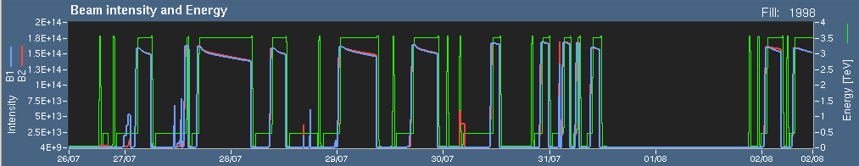
Availability - efficiency
Premature end to fills

Slide 19
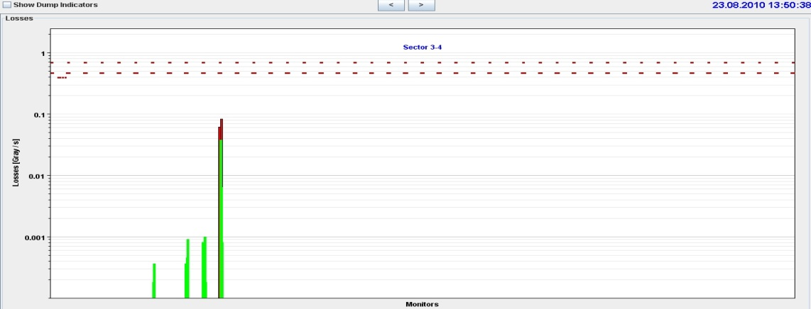
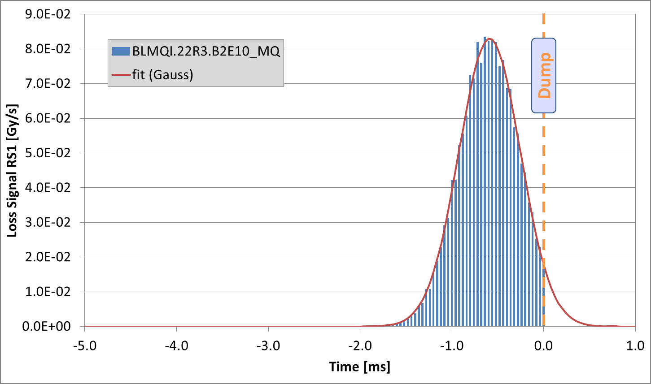
UFOs in the LHC
Since July 2010, 35 fast loss events led to a beam dump.
18 in 2010, 17 in 2011.
13 around MKIs.
6 dumps by experiments.
1 at 450 GeV.
Typical characteristics:
  Loss duration: about 10 turns
  Often unconventional loss locations (e.g. in the arc)
The events are believed to be due to (Unidentified) Falling Objects (UFOs).
Spatial and temporal loss profile of UFO on 23.08.2010

Slide 20
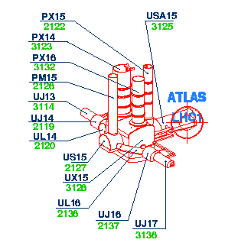
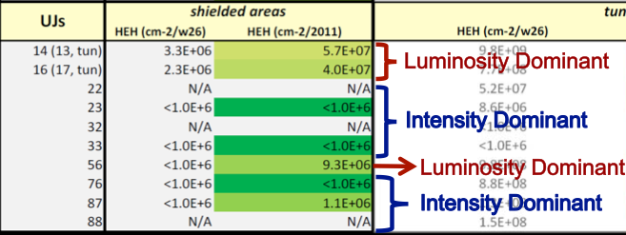
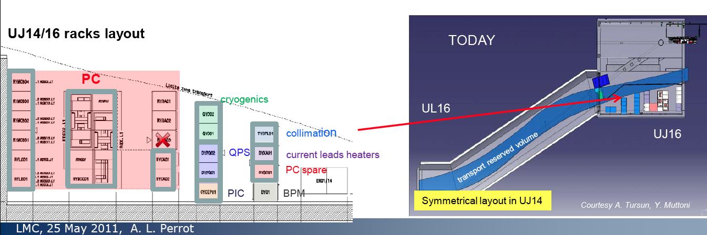
Single Event Effects
Major campaign ongoing: shield and relocate

Slide 21
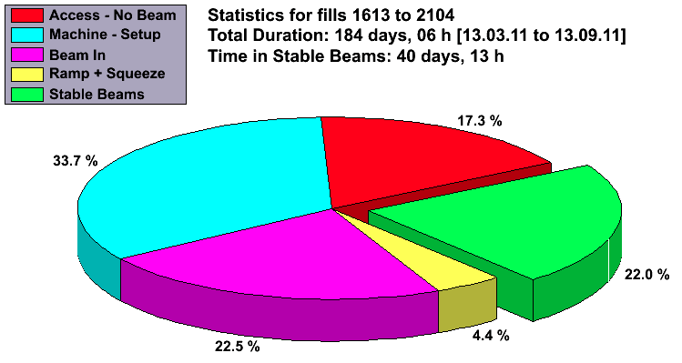
Availability 2011
Beam in ~49% of the time

Slide 22
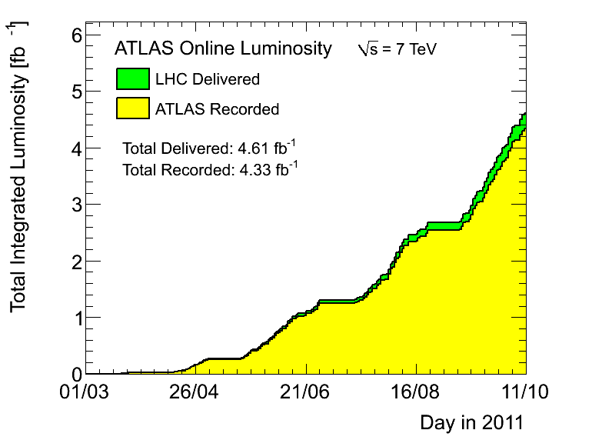
This morning

Slide 23
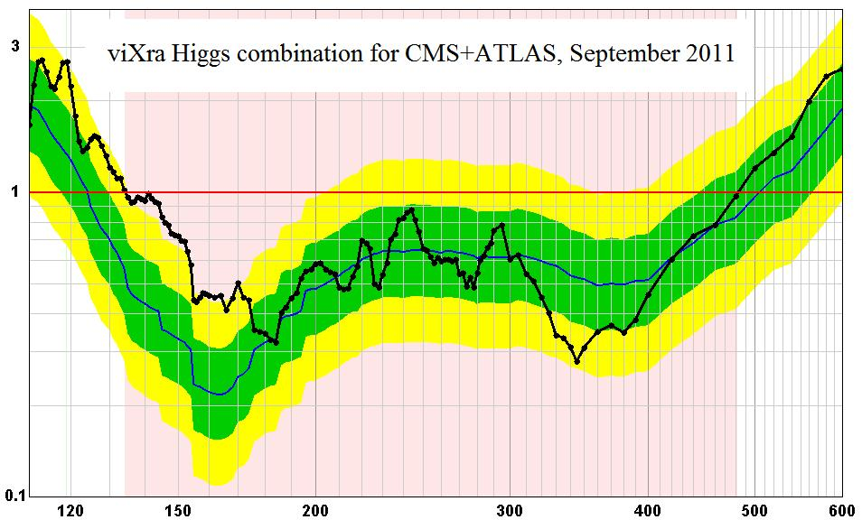
Higg’s hunting season

