Slide 1
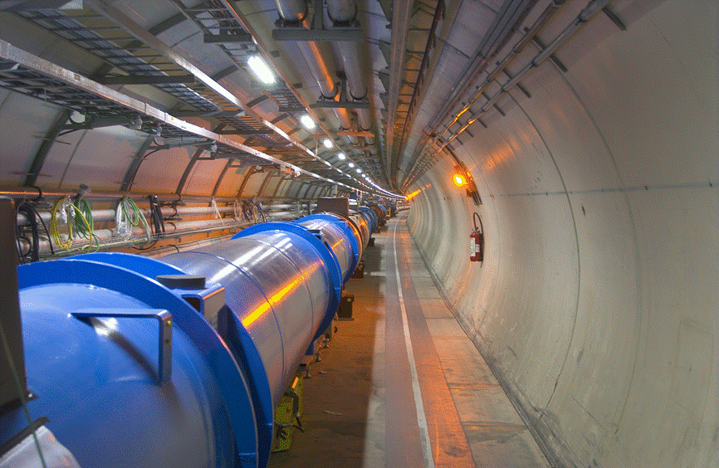
LHC machine commissioning and the near future
Mike Lamont
for the LHC team

Slide 2

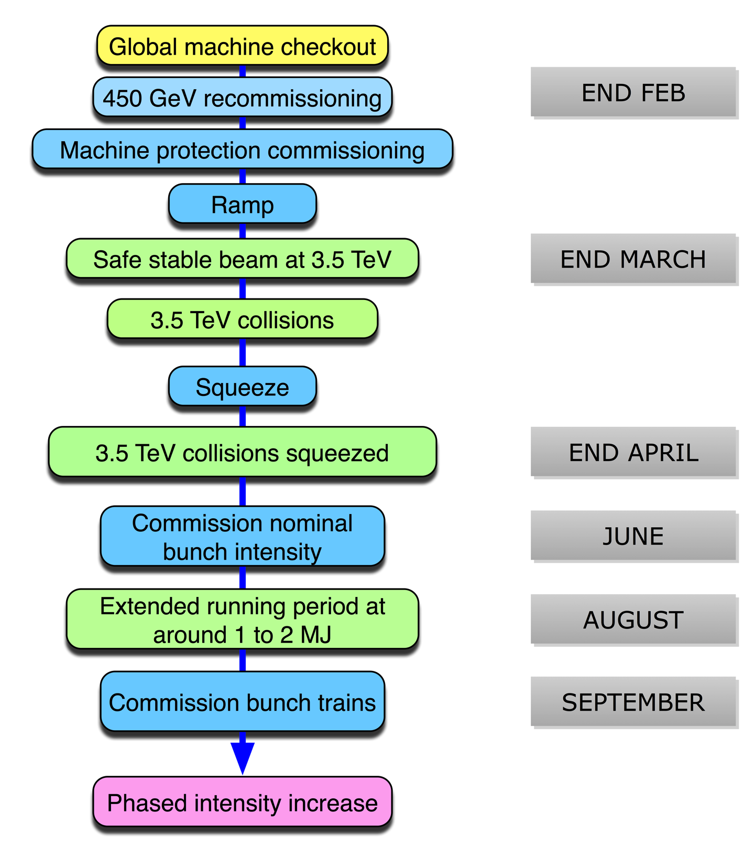



It’s been a long year…

Slide 3
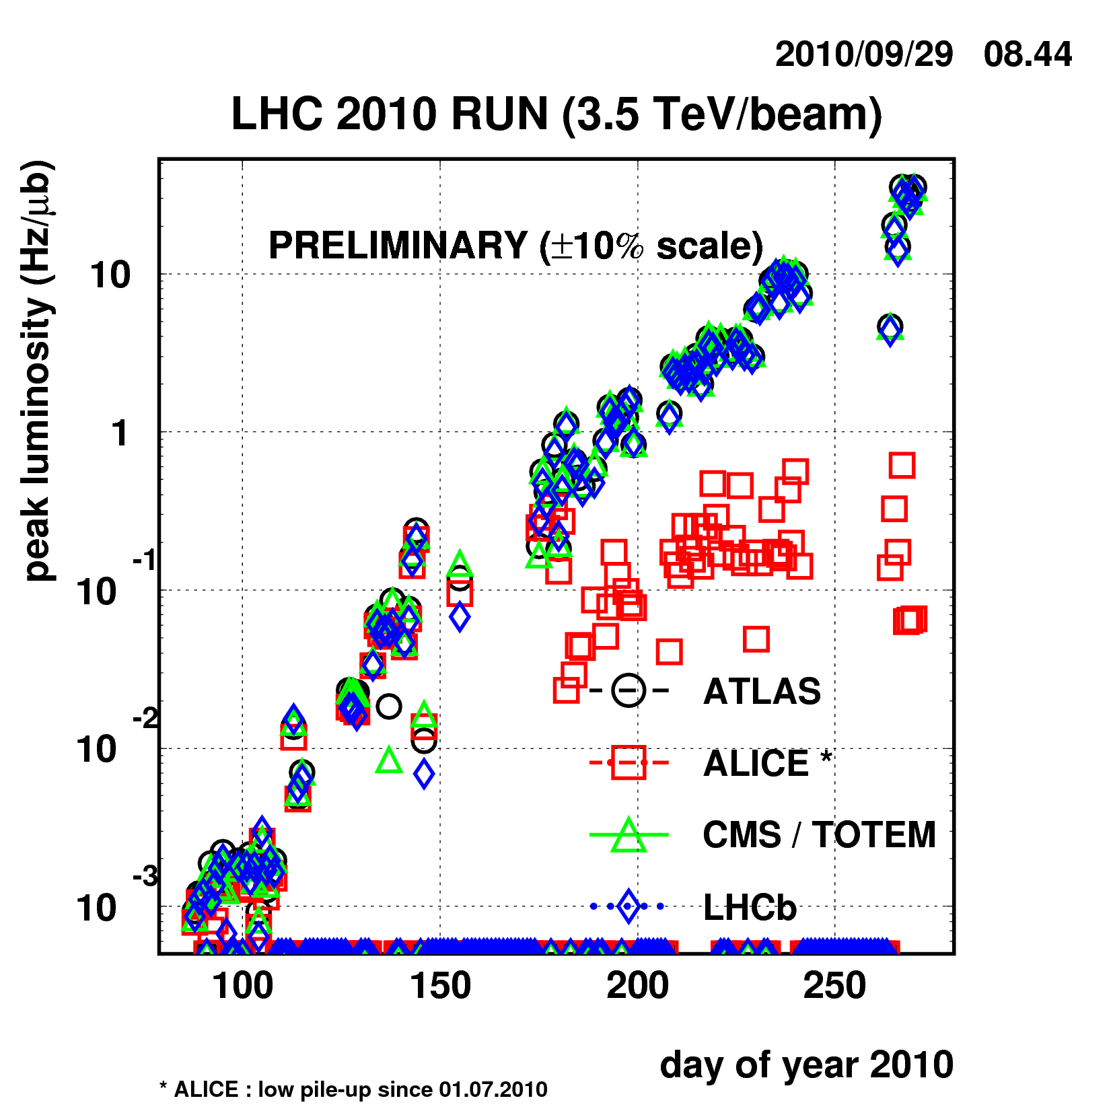
From diddly-squat…
5e31
Bunch trains
Nominal bunch intensity
2e27
> 4 orders of magnitude in 6 months

Slide 4
Associated parameters
 | Present | Design
Energy [TeV] | 3.5 | 7
beta* [m] | 3.5,3.5,3.5,3.5 m | 0.55,10,0.55,10
Emittance [microns] | 2.5 – 3.5 start of fill | 3.75
Transverse beam size at IP [microns] | around 60 | 16.7
Bunch current | 1.1e11 | 1.15e11
Number of bunches | 152 140 collisions/IP | 2808
Stored energy [MJ] | 10 | 360
Peak luminosity [cm⁻²s⁻¹] | 5e31 | 1e34

Slide 5
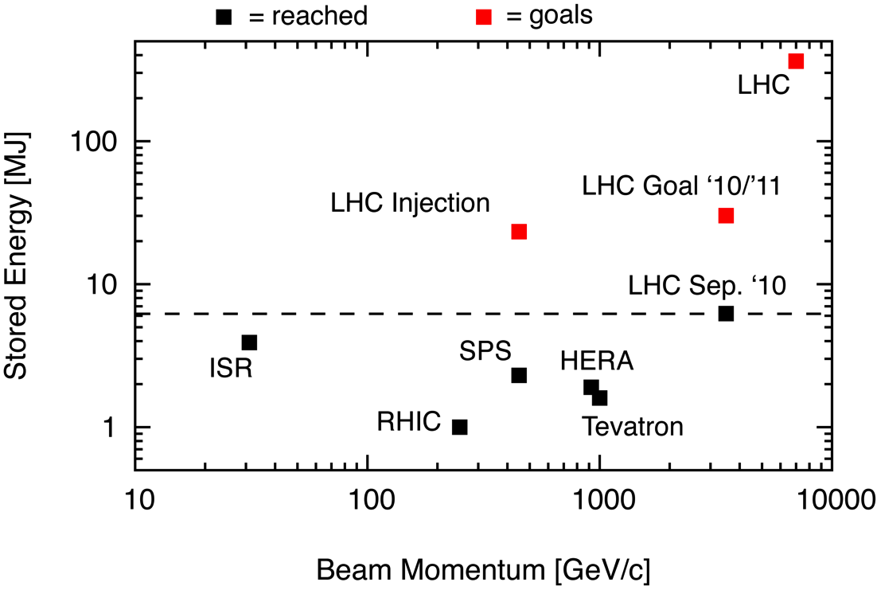
Stored energy
Ralph Assmann

Slide 6
Commissioning – Where do we stand?

Slide 7
Operational Cycle
Squeeze
Collisions
Ramp-down
Ramp
Injection
Injection | Ramp | Squeeze | Collisions | Ramp-down
Multi-bunch, unsafe beam | Dynamic effects Feedbacks | Optics Collimators | Beam steering Beam-beam | Ramp rates Reproducibility
← All through the cycle →
Beam dump Collimations system Protection devices

Slide 8
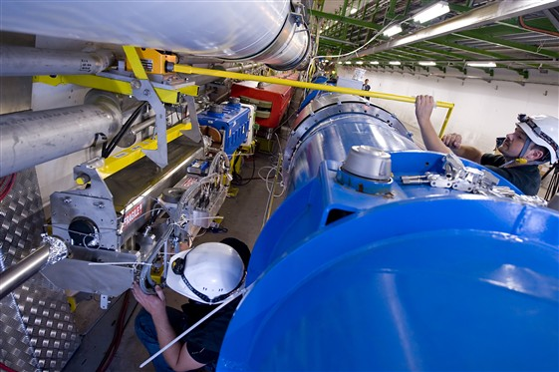
Injection
Now inject 16 nominal bunches per extraction from the SPS
  1.6e12 protons is above the safe beam limit at 450 GeV
  Careful adjustment of:
    transfer lines and collimators
    energy matching between SPS and LHC
    injection protection devices (transfer line collimators etc.)
  Transverse damper fully operational to damp injection oscillations
Transfer line collimator
Ring magnets with beam loss monitors

Slide 9
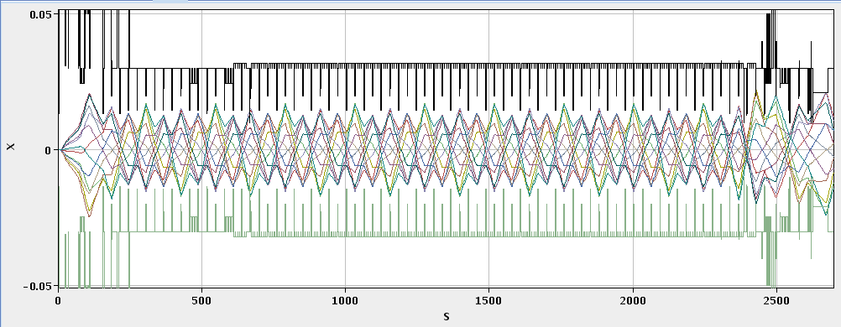
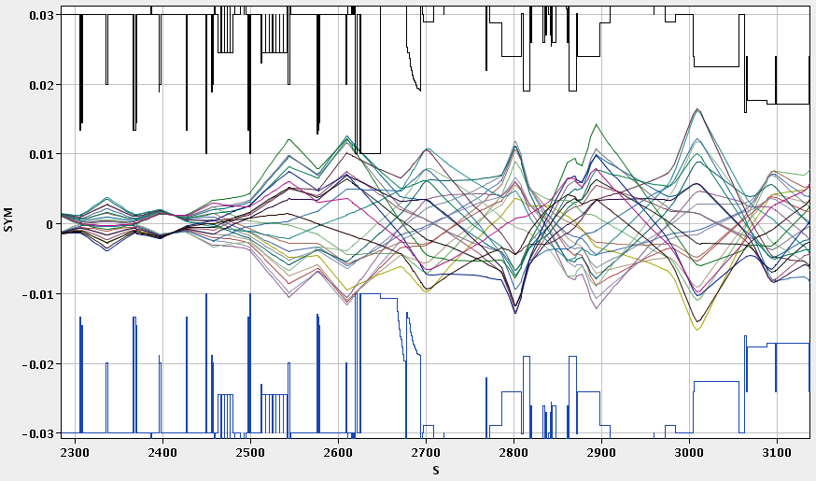
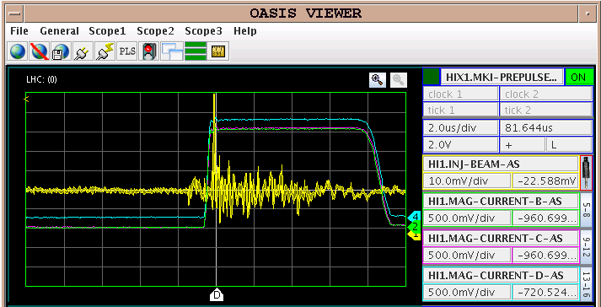
Beam transfer and Injection

Slide 10
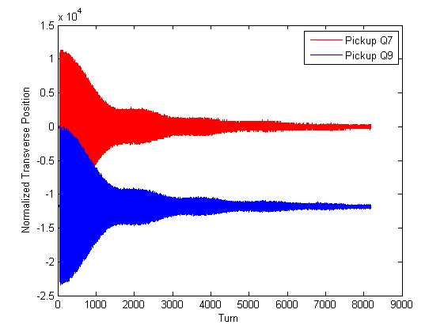
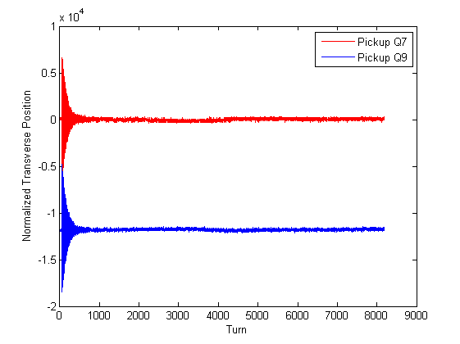
Transverse dampers
Injection
Crucial to keep emittance growth under control
Transverse position
OFF
ON
Turn number
Operational through the cycle – including stable beams

Slide 11
Ramp
450 GeV – 3500 GeV
  17 minutes
  Parabolic – exponential – linear – parabolic to minimize effects of snapback and duration
  Snapback correction pre-programmed for b2,b3,b4,b5,a2,a3 based on FIDEL predictions for full decay
Preloaded functions to power converters, collimators, RF
  ramp initiated with timing event
Fill-to-fill feed-forward performed intermittently
Tune and orbit feedback considered mandatory
  The performance of the FBs is good and the LHC only operates reliably with both orbit and tune FBs (ramp and squeeze).
Ramp and squeeze essentially without losses….

Slide 12
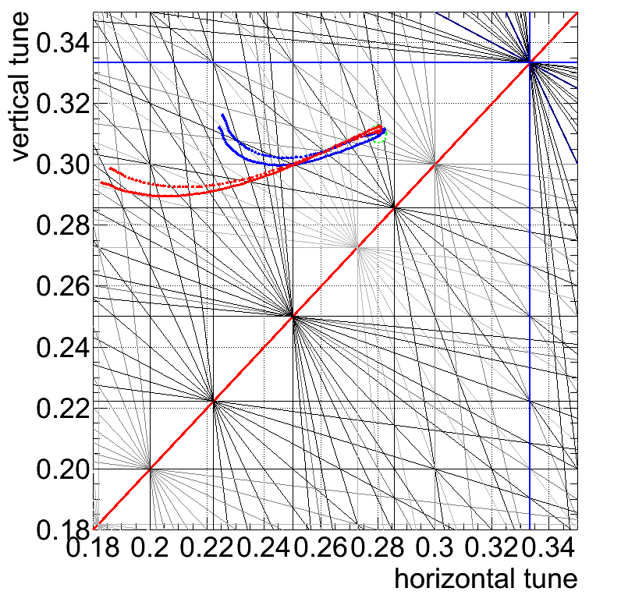
Ramp – Tune feedback
Feedback employed early. Reconstructed tune excursions

Slide 13
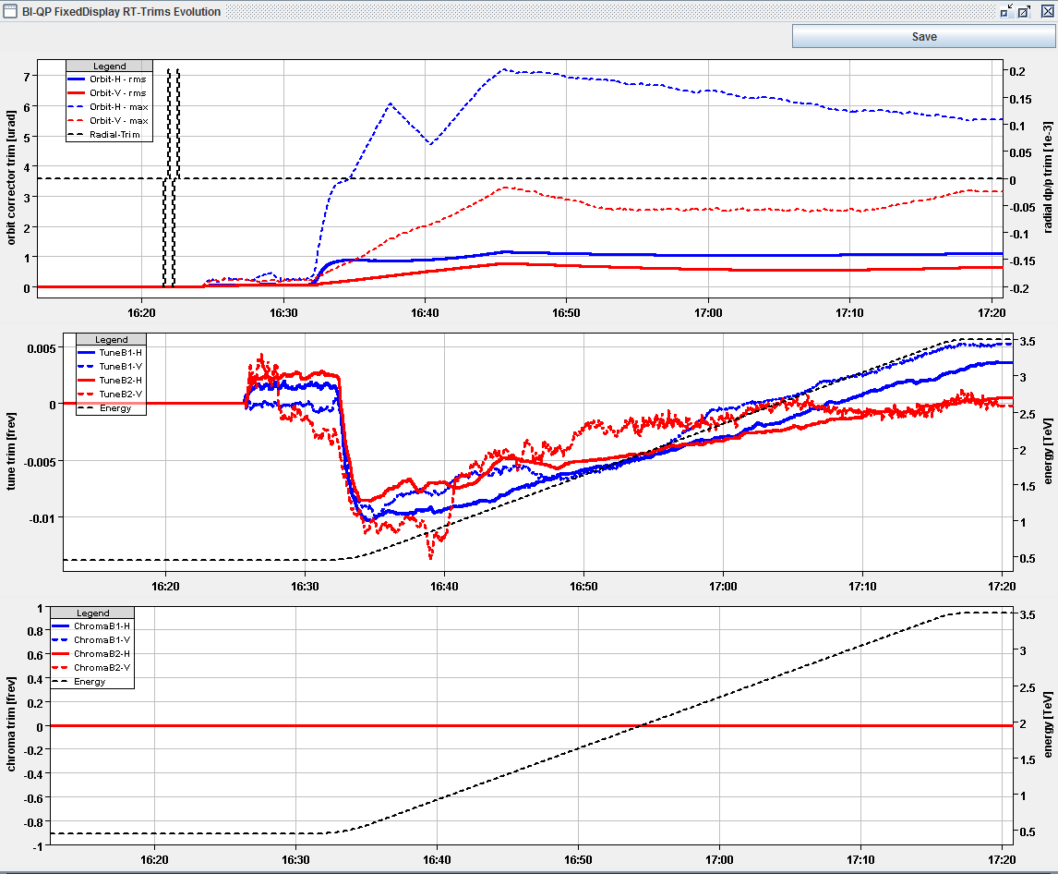
Feedbacks in action: ramp
Fill 1309
29.08.2010
OFB trims (μrad)
QFB trims
Energy (TeV)

Slide 14
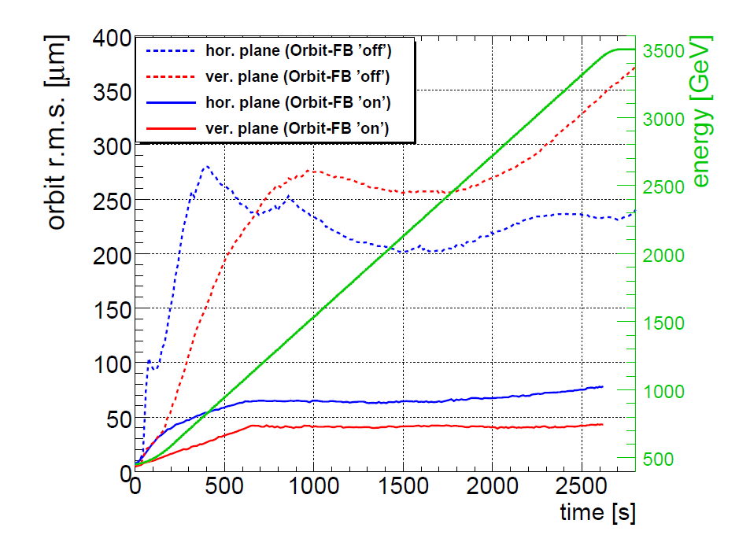
Orbit feedback performance: ramp
Orbit stability in the ramp: ≤ 80 μm rms
R. Steinhagen

Slide 15
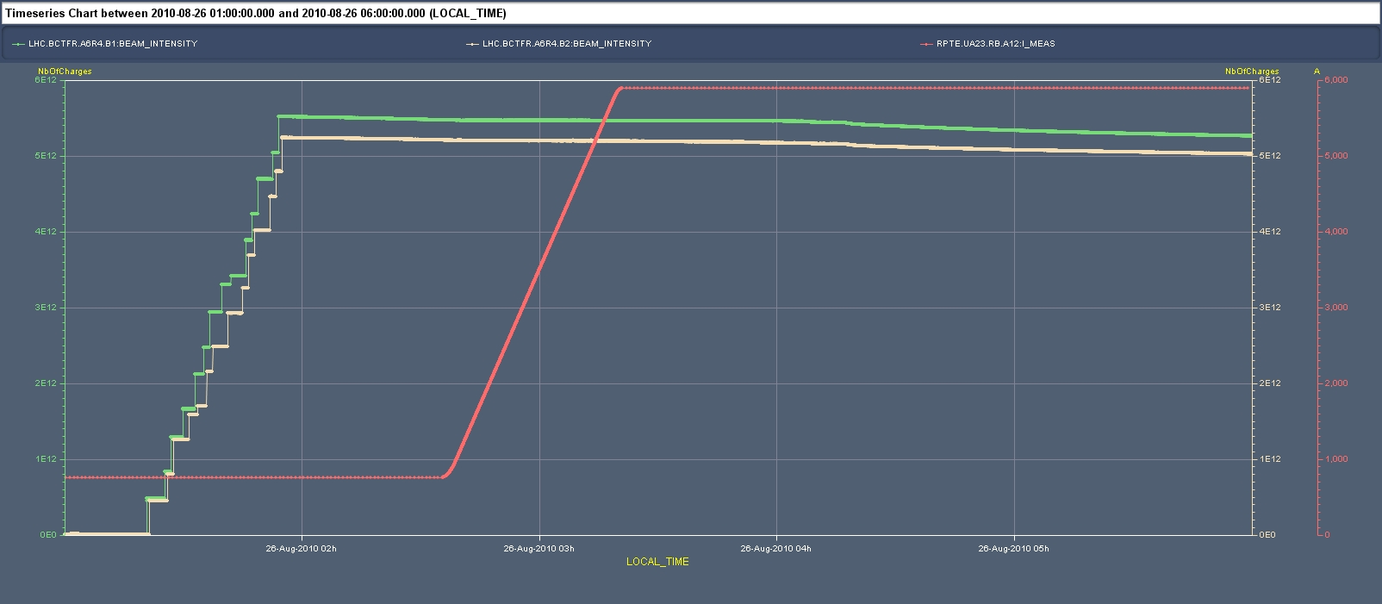
Beam current during fill 25/08/2010
Quite frankly: we’re dreaming…
“The price of freedom is eternal vigilance.”

Slide 16
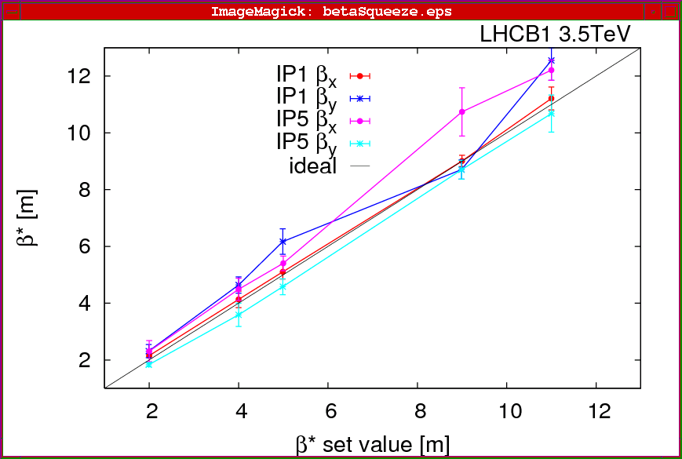
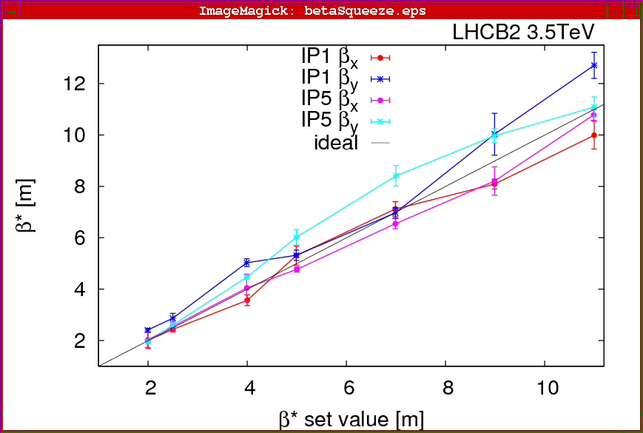
Squeeze: a delicate process
From 11-10-11-10 to 3.5-3.5-3.5-3.5 m
Move to collisions tunes at start
Tune and orbit feedback on
Worry about
  Tune, Q’, coupling, orbit, optics corrections
  Positions of tertiary collimators
Squeeze in three stages at the moment

Slide 17
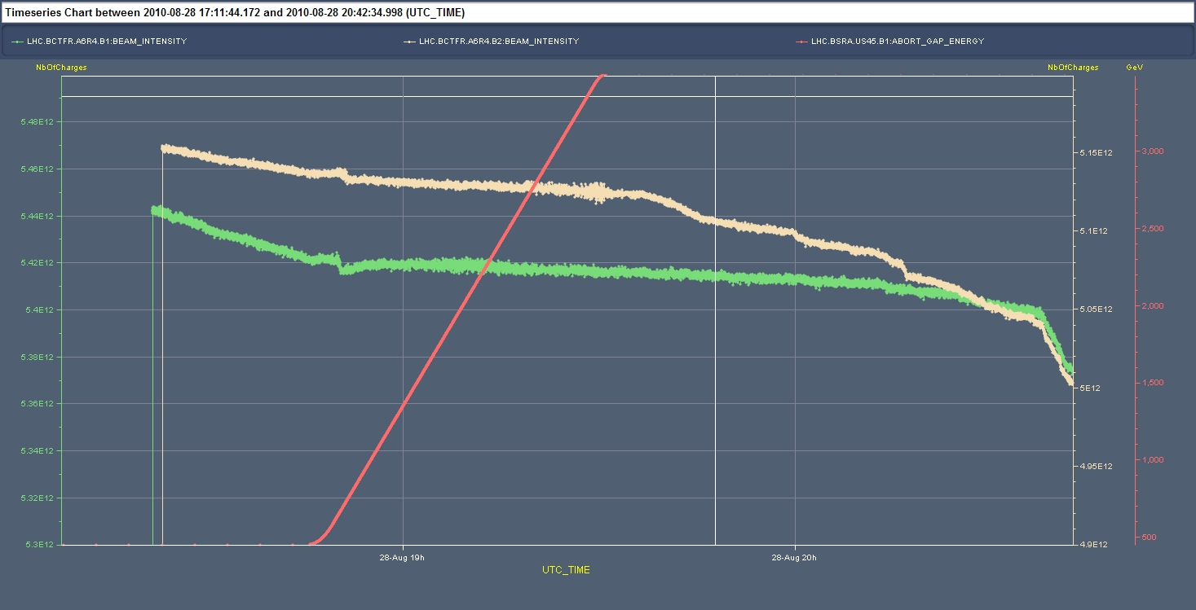
Beam intensities up the ramp…
…and through the squeeze
Fill 1308
28.08.2010
Ramp
Squeeze
B2
B1
1%
Bunch length
artifact
Collide
again essentially without loss

Slide 18
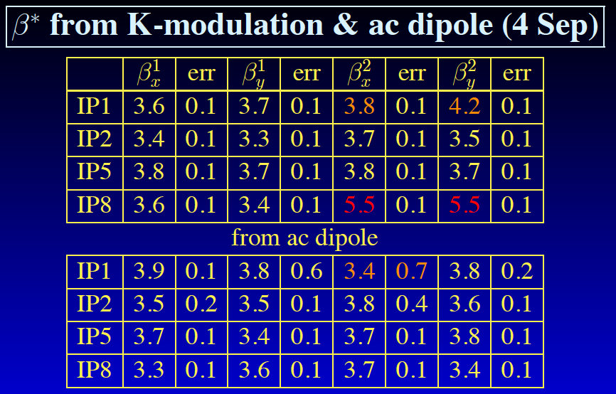
Measured betas at interaction points

Slide 19
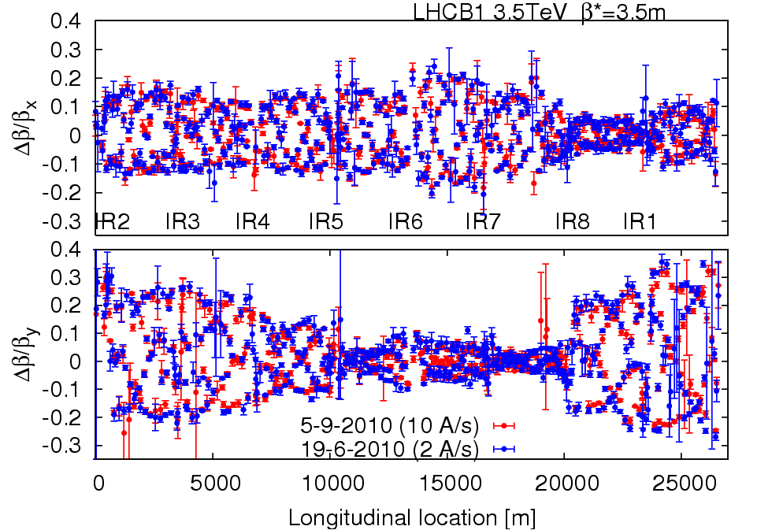
Optics & magnetic machine
Optics stunningly stable
Machine magnetically and optically well understood
  Excellent agreement with model and machine
Magnetically reproducible
  Important because set-up remains valid from fill to fill

Slide 20
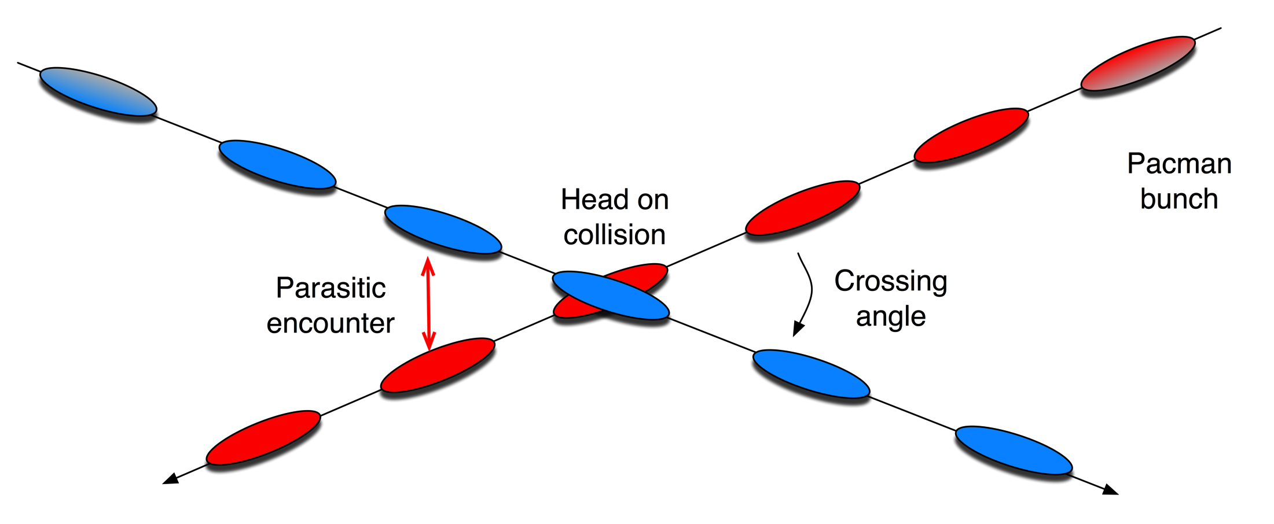
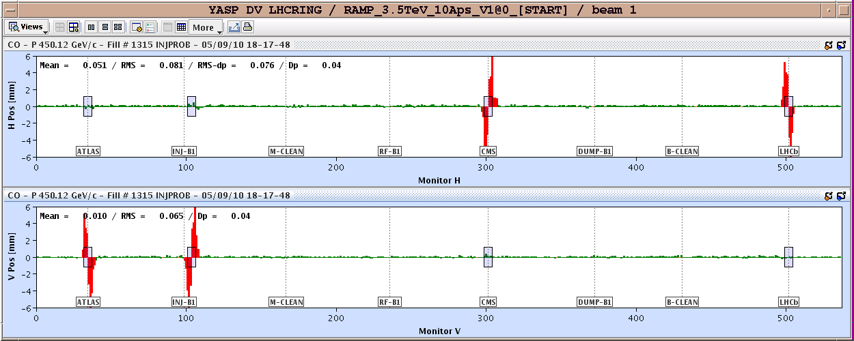
Crossing angles

Slide 21
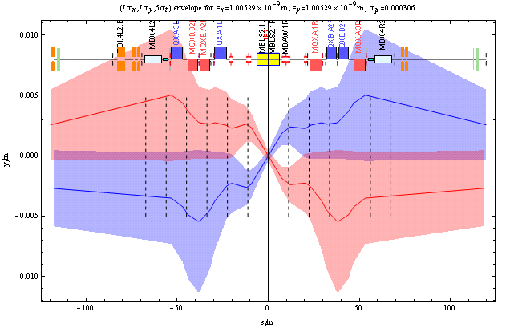
Crossing angle – IP2
John Jowett

Slide 22
MACHINE PROTECTION
Briefly, why we can’t deliver 1e32 cm⁻²s⁻¹ immediately

Slide 23
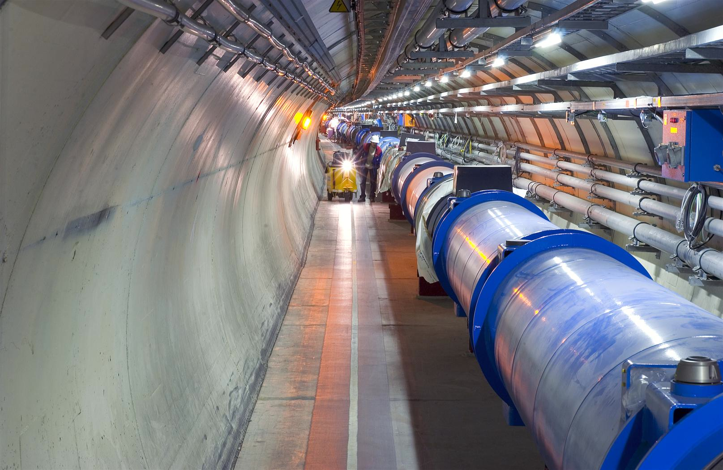
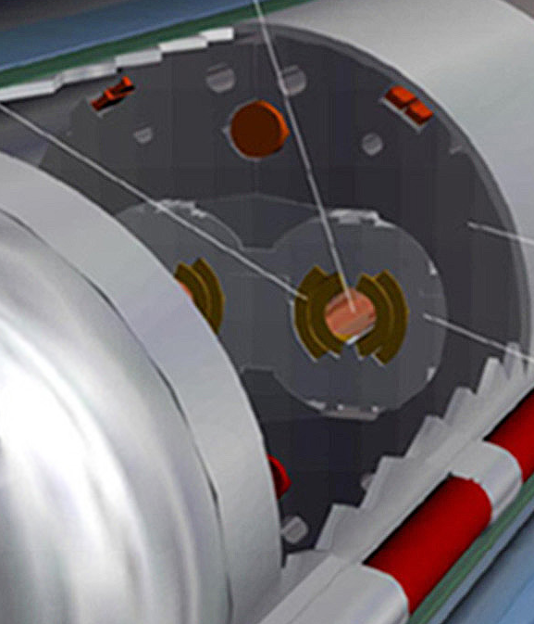
Quench Limit of LHC Super-Conducting Magnets
Situation at 3.5 TeV (in October 2010)
Beam
10 MJ
Not a single beam-induced quench at 3.5 TeV
… YET
56 mm
SC Coil:
quench limit
15-100 mJ/cm³

Slide 24
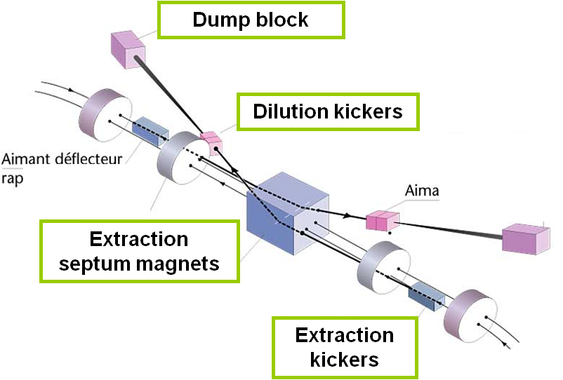
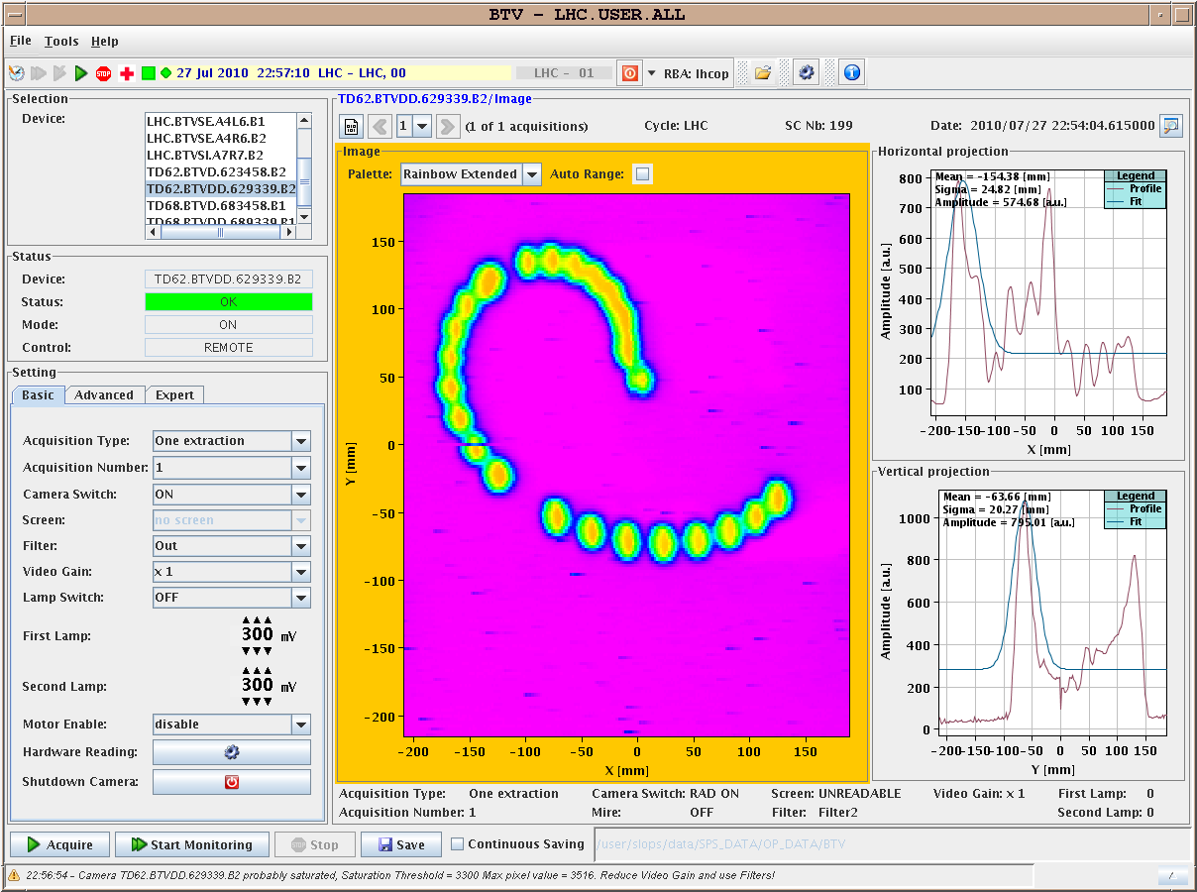
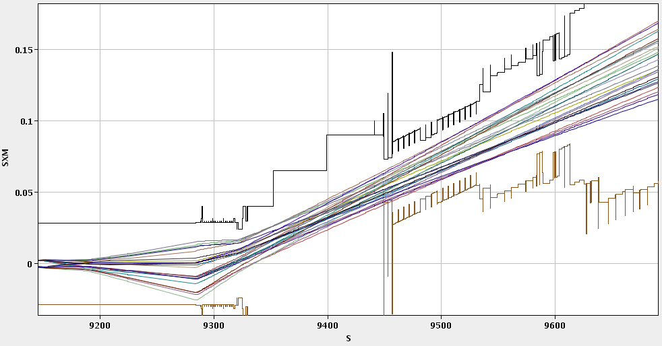
Beam Interlock System & Beam dump
Beam interlock system
  Tells beam dump to fire with 3 turns
  Around 20,000 inputs
  Caught everything so far
Beam dump system (LBDS)
  Well set-up and closely monitored
  No major issues yet
IR6 H Beam2, extracted

Slide 25
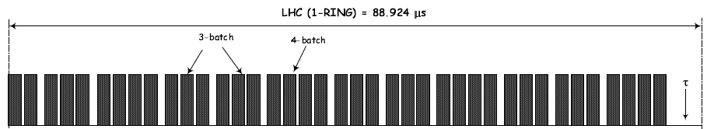
Abort Gap
dump trigger
Extraction kicker MKD deflection
LHC
Beam
3.0 μs
particle-free
abort gap

Slide 26
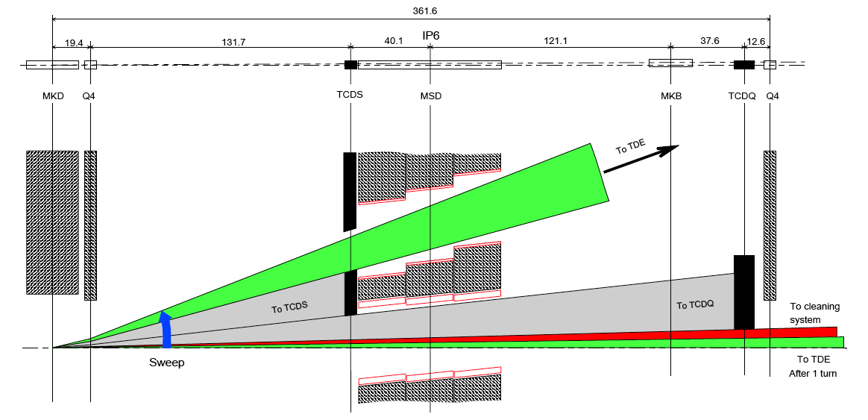
Asynchronous Beam Dump
Estimated occurrence : at least once per year,
0 events up to now!
TCDQ + TCSG to protect downstream superconducting magnets (Q4)
TCSG
TCDQ = 6 m long CFC* one-sided collimator
TCSG = 1 m long CFC* two-sided collimator
*CFC = carbon fibre compound

Slide 27
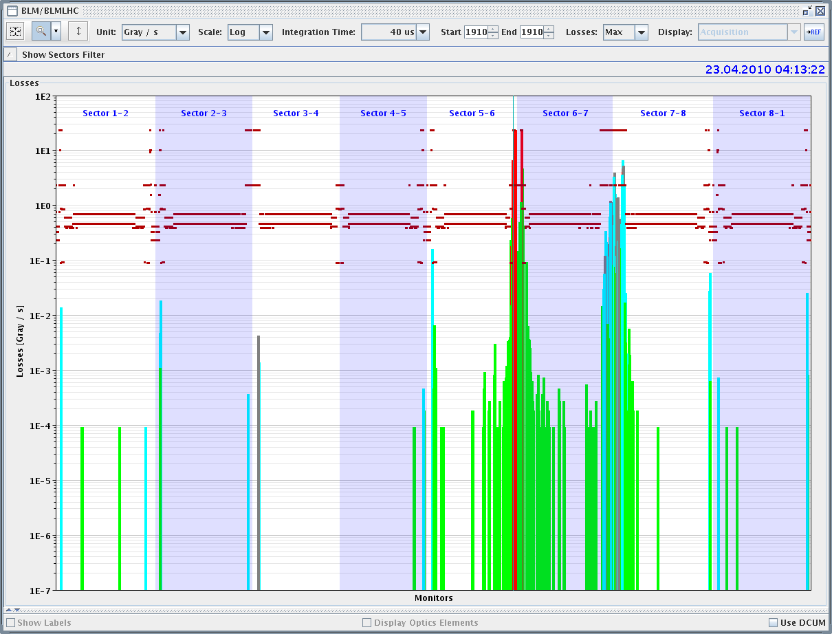
Beam dump protection systems efficiency
Provoked asynchronous beam dump
1e-3 leakage to tertiary collimators in IR’s
➔ OK for stable beams from beam dump

Slide 28
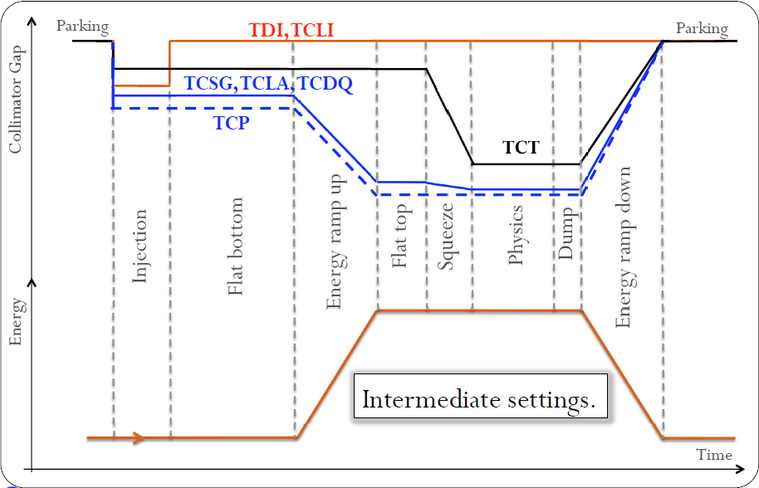
Collimation system

Slide 29
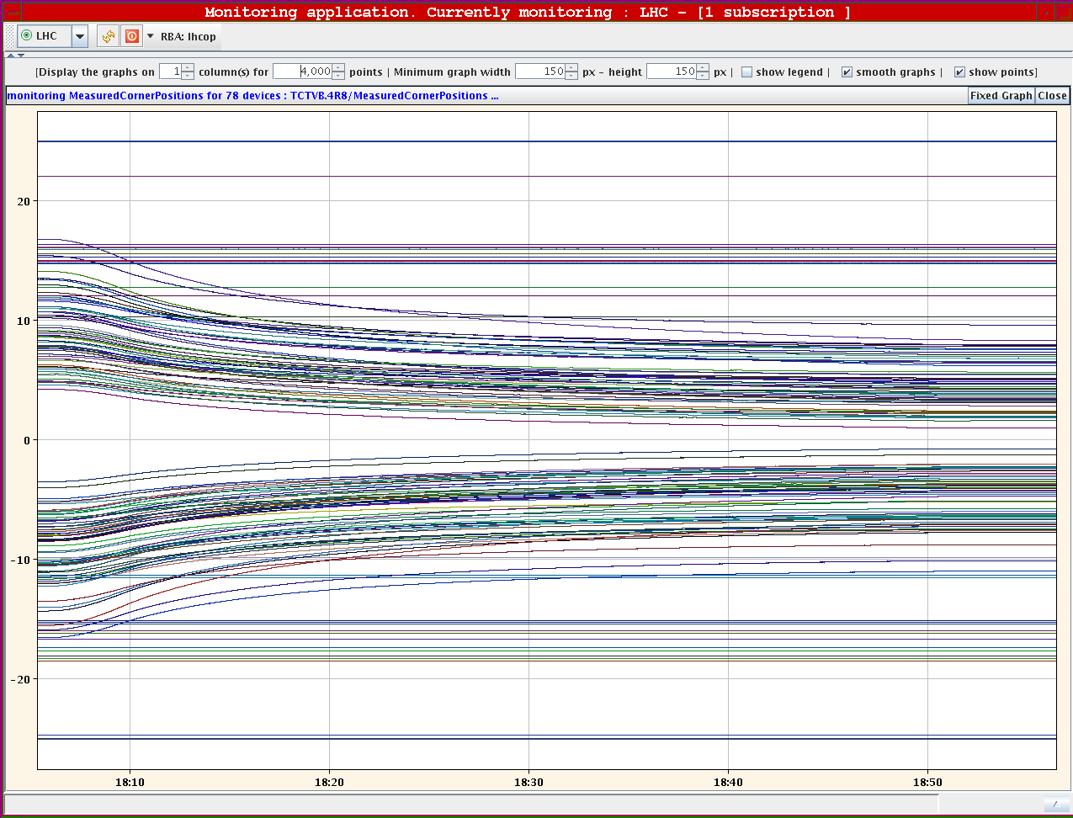
Ramp - collimators

Slide 30
Collimation set-up
Collimation is set up with multi-stage logic for cleaning and protection
In normalized phase space, talking in nominal sigmas:
“THE HIERARCHY”
Tertiary
+Triplet
Tertiary
+Triplet
Secondary
Dump Protection
Primary
Not robust
ROBUST
MARGIN
Beam dump envelope
Not robust
Dump Kicker
… but efficient …

Slide 31
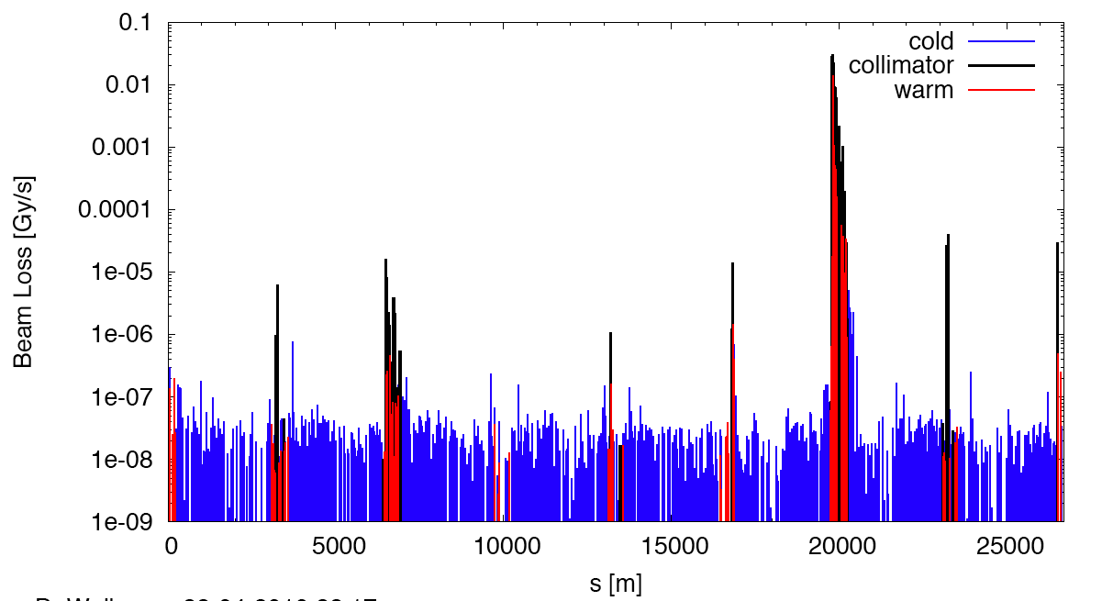
Measured Cleaning at 3.5 TeV
Making sure the hierarchy is respected
(beam1, vertical beam loss, intermediate settings)
Dump Protection Col.
Momentum Cleaning
IR1
IR8
IR2
IR5

Slide 32
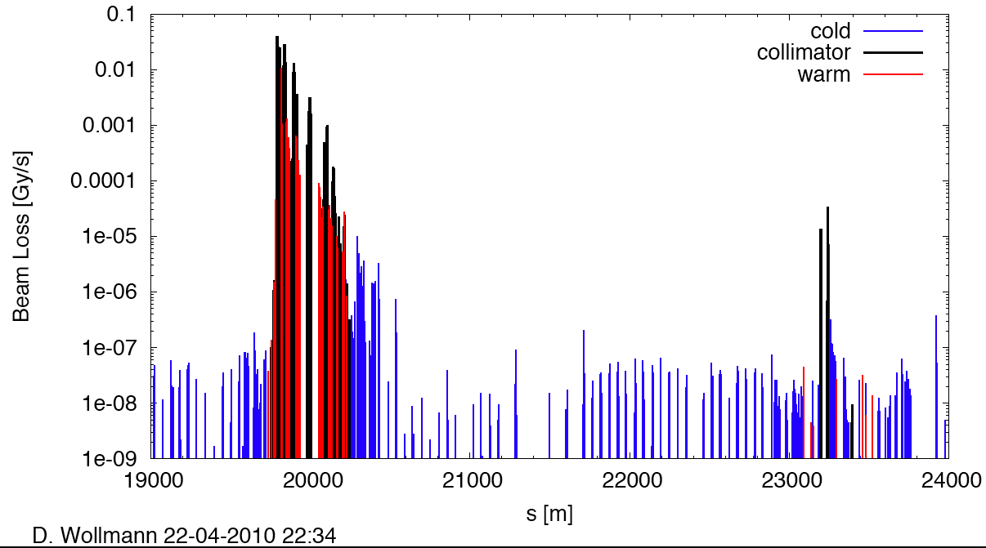
Zoom around betatron cleaning
factor 4,000
factor 1,000
factor 600,000
IR8
➔ OK for stable beams from collimation

Slide 33
Why we spend so long messing around…
The collimators and protection devices must be in position at all times
The hierarchy must be respected
The collimators and protection devices are positioned with respect to the closed orbit
Therefore the closed orbit must be in tolerance at all times. This includes the ramp and squeeze.
  Orbit feedback becomes mandatory
  Interlocks on orbit position become mandatory
If these rules are not respected something will get broken.
Frequent validation to make sure that the rules are respected…
Full validation with new set-ups – takes time

Slide 34
Measured 450 GeV Aperture
On-momentum, as relevant for collimation and protection.
Predicted aperture bottlenecks in triplets (n1=7) are less than expected (orbit, alignment, mechanical tolerances)
“Measured” n1 = 10 – 12 (on-momentum) instead of the design value of n1 = 7. Excellent news…
Beam / plane | Limiting element | Aperture [σ]
Beam 1 H | Q6.R2 | 12.5
Beam 1 V | Q4.L6 | 13.5
Beam 2 H | Q5.R6 | 14.0
Beam 2 V | Q4.R6 | 13.0

Slide 35
LUMINOSITY PRODUCTION

Slide 36
Luminosity
Very good single beam lifetime
  Inject nominal bunch intensities, ramp, squeeze…
  Vacuum, non-linearities, IBS, noise
Beam-beam (head-on)
  Nominal bunch intensity
  Less than nominal emittances
  A lot easier than expected – nominal figures exceeded
  Resolved expected problems with predicted cures.
    Octupoles, transverse dampers cope with instabilities
Transverse emittance (read beam size)
  Too small emittance from injectors! Blow-up required.
  Ditto longitudinal plane
Luminosity lifetime
  Of the order 20-25 hours
  Single beam, luminosity, emittance growth
STILL SURPRISING

Slide 37
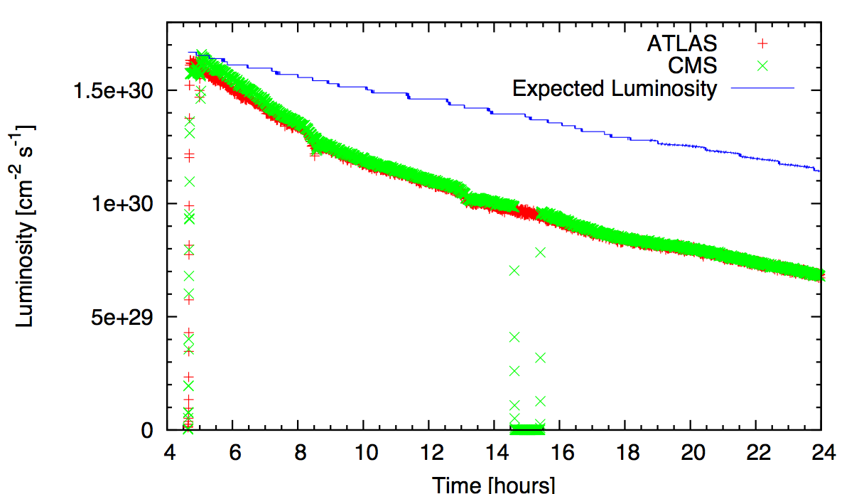
Collisions – emittance blow up
Machine parameters very well controlled!
calculated with measured bunch intensity, nominal γε = 3.75 μm and β*=3.5m
CALCULATED
ATLAS
Emittance growth
CMS

Slide 38
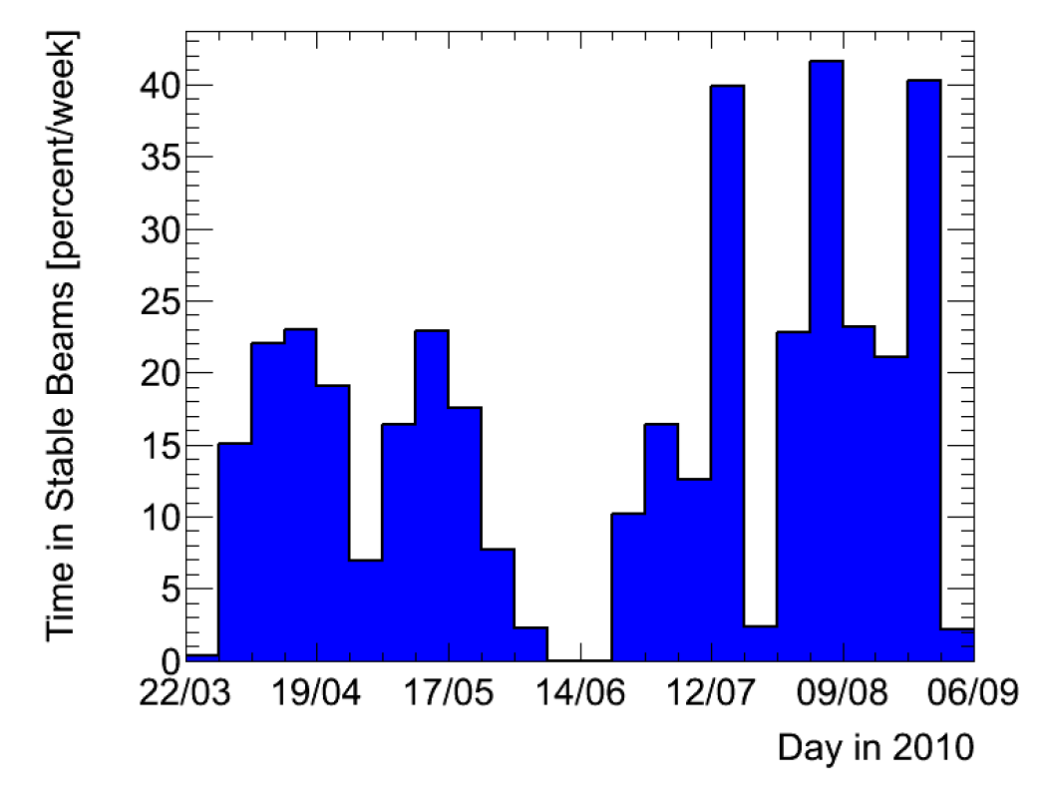
Coupled with remarkable machine availability
= integrated luminosity
Impressive performance
of:
  cryogenics,
  QPS
  power converters
  RF
  instrumentation,
  collimators,
  vacuum,
  beam dump and kickers,
  services,
  Injectors, …
Hard work of the many teams to constantly improve weaknesses and to keep it all working.
Courtesy ATLAS
Time in Stable
Beams

Slide 39
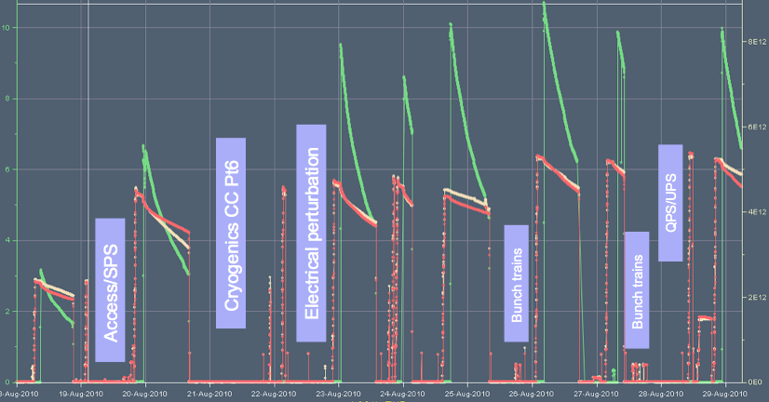
Two weeks in August
25b
48b
50b

Slide 40
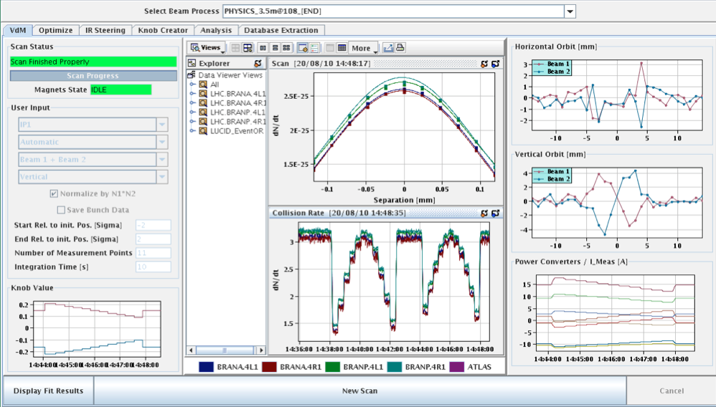
Luminosity scans
Simon White
Luminosity calibrated with van der Meer scans
Luminosity known today to around 11% - error dominated by current measurement
Dedicated campaign underway

Slide 41
PROBLEMS, PROBLEMS

Slide 42
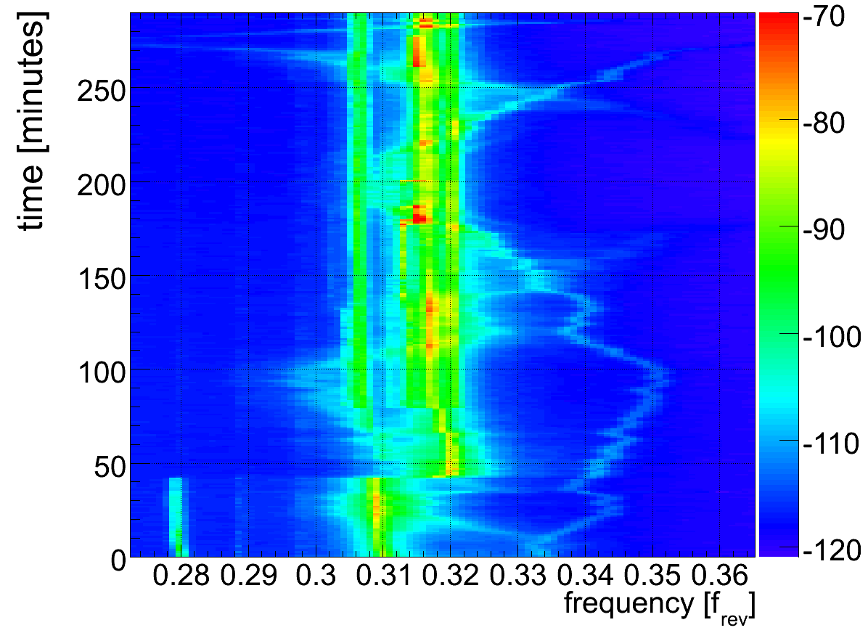
The hump - source still unknown
Tunes
External
excitation

Slide 43
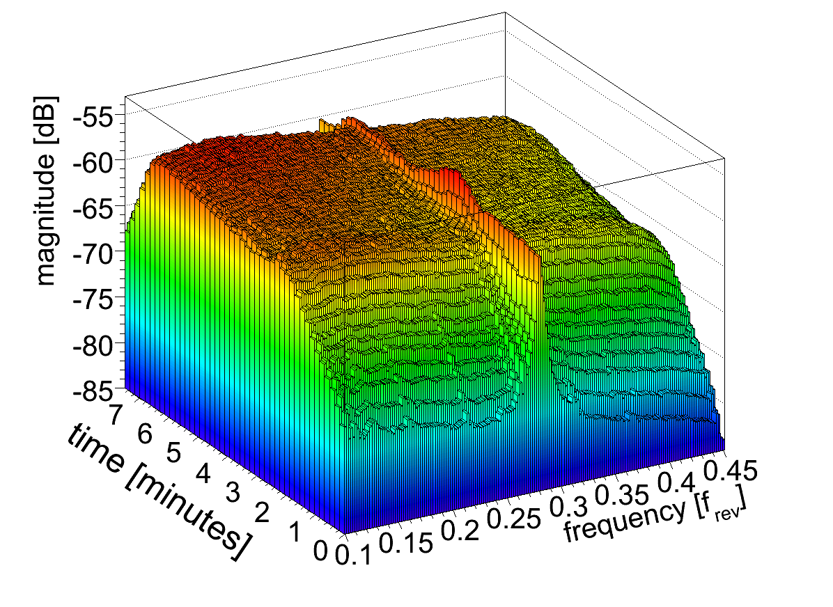
Tune signal swamped in the ramp
With increasing intensity/number of bunches
NOT good for tune feedback

Slide 44
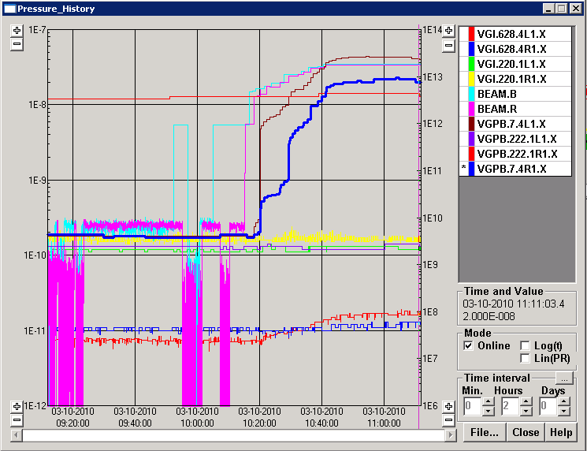
Vacuum – from yesterday
Possibly HOM induced cleaning…
Inner Triplet left 1 (VGPB.7.4L1.X):
  Start pressure before filling: 1.8x10⁻¹⁰mbar
  End pressure after filling: 4.3x10⁻⁸mbar

Slide 45
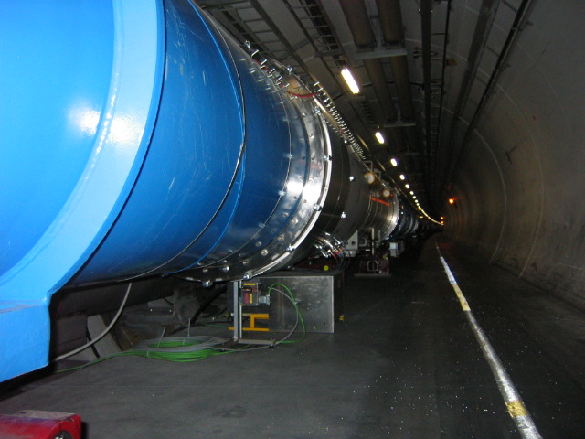
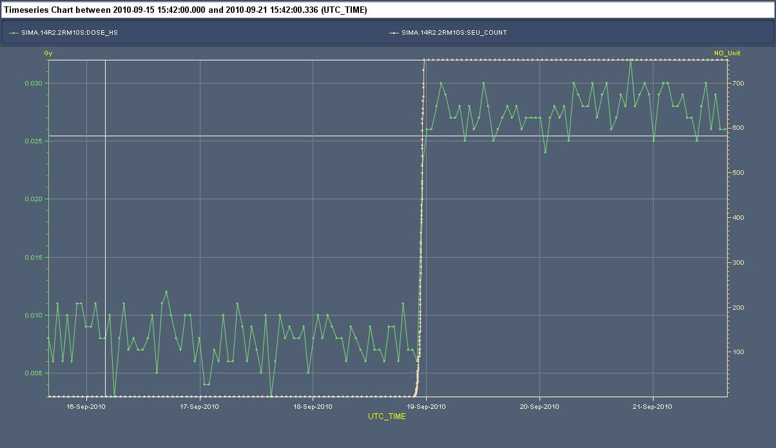
SEUs
QPS crate
SEU count (RADMON) during off momentum loss map
Thijs Wijnands
Not a problem at the moment but being monitored carefully

Slide 46
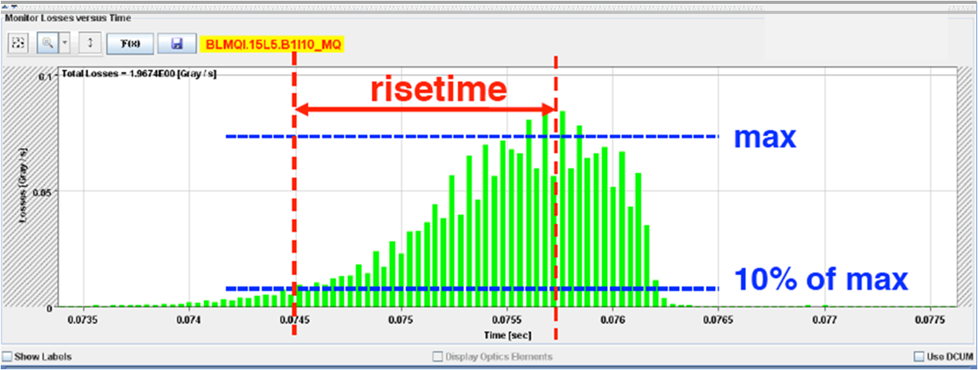
UFOs – sudden local losses
12 events of sudden local losses (some in the middle of the arc) have been recorded. No quench, but preventive dumps
Rise time partly < 1 ms.
Potential explanation: dust particles falling into beam creating scatter losses and showers propagating downstream

Slide 47
2010 incoming

Slide 48
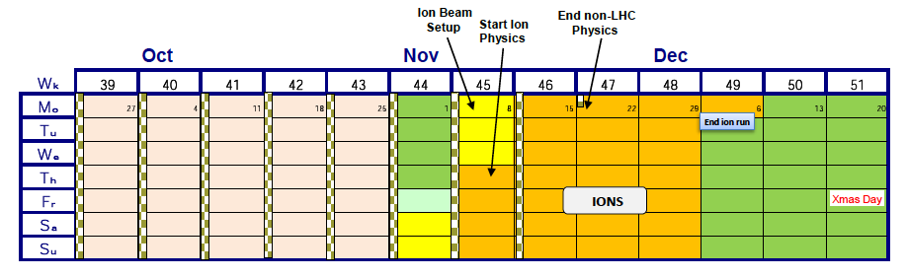
Schedule – rest of 2010
Next up: 150ns_200b_186_8_186_8+8bpi17inj
104
200
288
Reserve!
152
240
336
Number of bunches | Peak Luminosity [cm⁻²s⁻¹] | 5day@0.2HF [pb⁻¹] | MJ
336 | 1.0 x 10³² | 8.9 | 20.7

Slide 49
Early Heavy Ion Run
 |  | Early (2010/11) | Nominal
√s per nucleon | TeV | 2.76 | 5.5
Initial Luminosity (L₀) | cm⁻²s⁻¹ | 1.25 x 10²⁵ | 10²⁷
Number of bunches |  | 62 | 592
Bunch spacing | ns | 1350 | 99.8
β* | m | 2 | 0.5
Pb ions/bunch |  | 7x10⁷ | 7x10⁷
Transverse norm. emittance | μm | 1.5 | 1.5
Luminosity half life (1,2,3 expts.) | h | τ_{IBS}=7-30 | 8, 4.5, 3
Initial interaction rate: 100 Hz (10 Hz central collisions b = 0 – 5 fm)
~10⁸ interaction/10⁶s (~1 month)
In two years: 2 x10⁷ central collisions, integrated luminosity 25 μb⁻¹

Slide 50
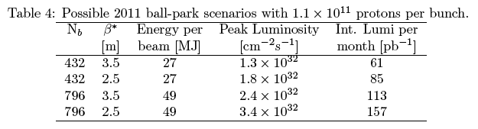
2011 – 3.5 TeV
Restart 4th February (?)
9 months protons, 4 weeks ions
Integrated luminosity target driven: 1 fb⁻¹
Need to run flat out above 1e32 cm⁻²s⁻¹
Beta* etc. under close examination – tests incoming

Slide 51
Conclusions 1/2
Injection, ramp and squeeze operational
LHC magnetic model, optics astoundingly good.
Beam instrumentation in good shape.
Feedbacks on orbit and tune(?) operational
Beam cleaning and collimation works reliably with predicted efficiency.
Machine protection reliably catches failures etc.
Machine aperture looks very good
Remarkably few problems colliding nominal bunch intensities

Slide 52
Conclusions 2/2
All key systems performing remarkably well & there are some hugely complex systems out there.
  Some commissioning still required, issues still to address
  And NB there are still problems
Handling dangerous beams already - have to remain vigilant at all times (and not get carried away)
Performance with beam (losses, lifetimes, luminosity, emittance growth etc.) is very encouraging
Machine availability is excellent – the hard work of numerous teams
On route towards 10³² cm⁻² s⁻¹ for end of the year - a factor 2 to go

