Slide 1
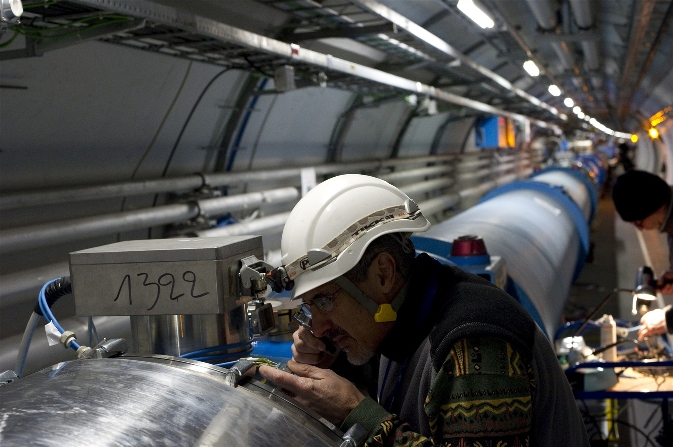
(n)QPS
LHC Status and Plans
Mike Lamont
for the LHC team

Slide 2
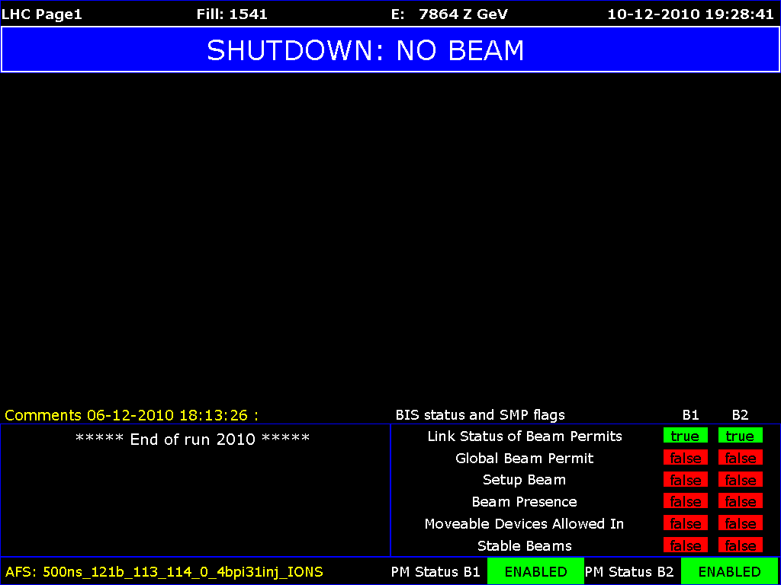

Slide 3
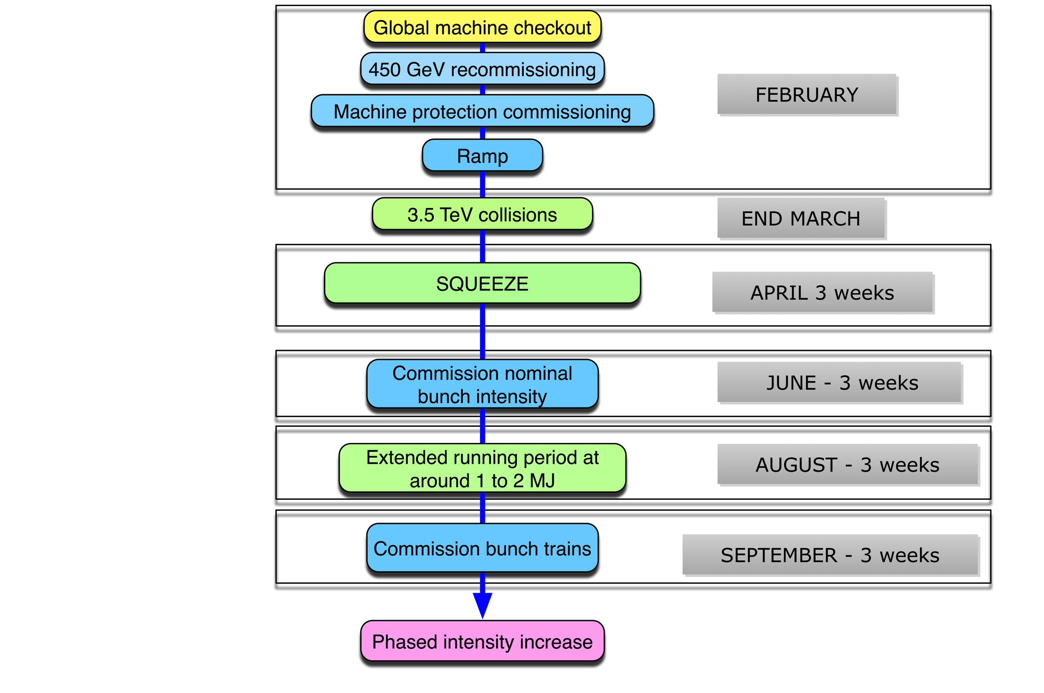




It’s been a long year…

Slide 4
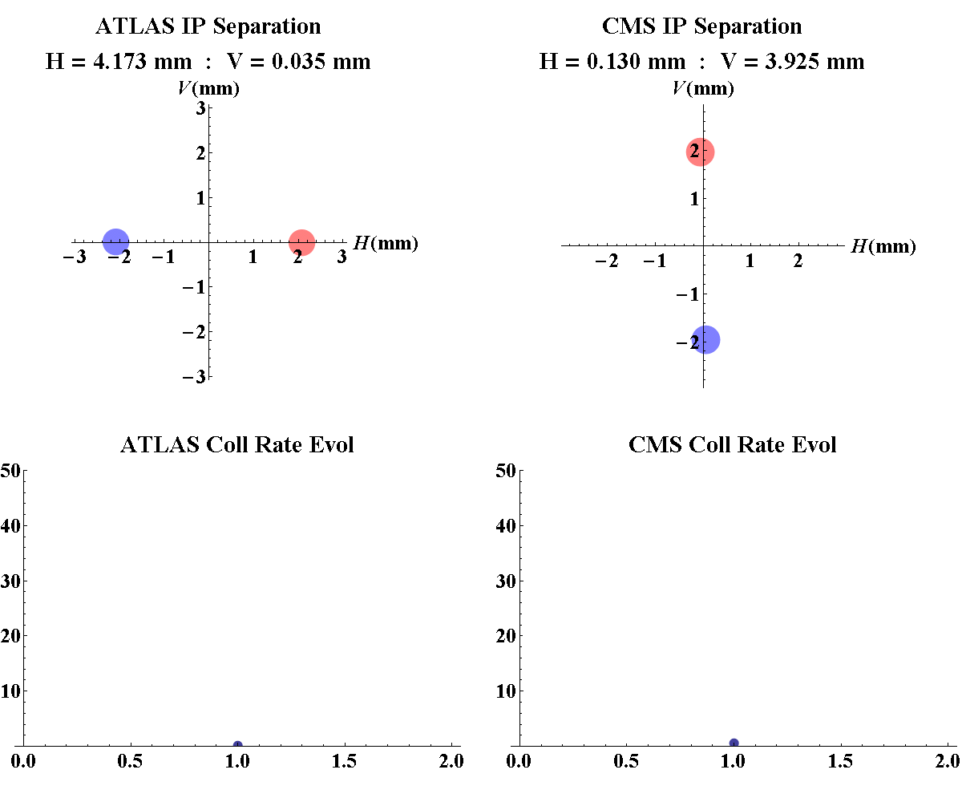
March 30 2010
No one is sure how we got away with it

Slide 5
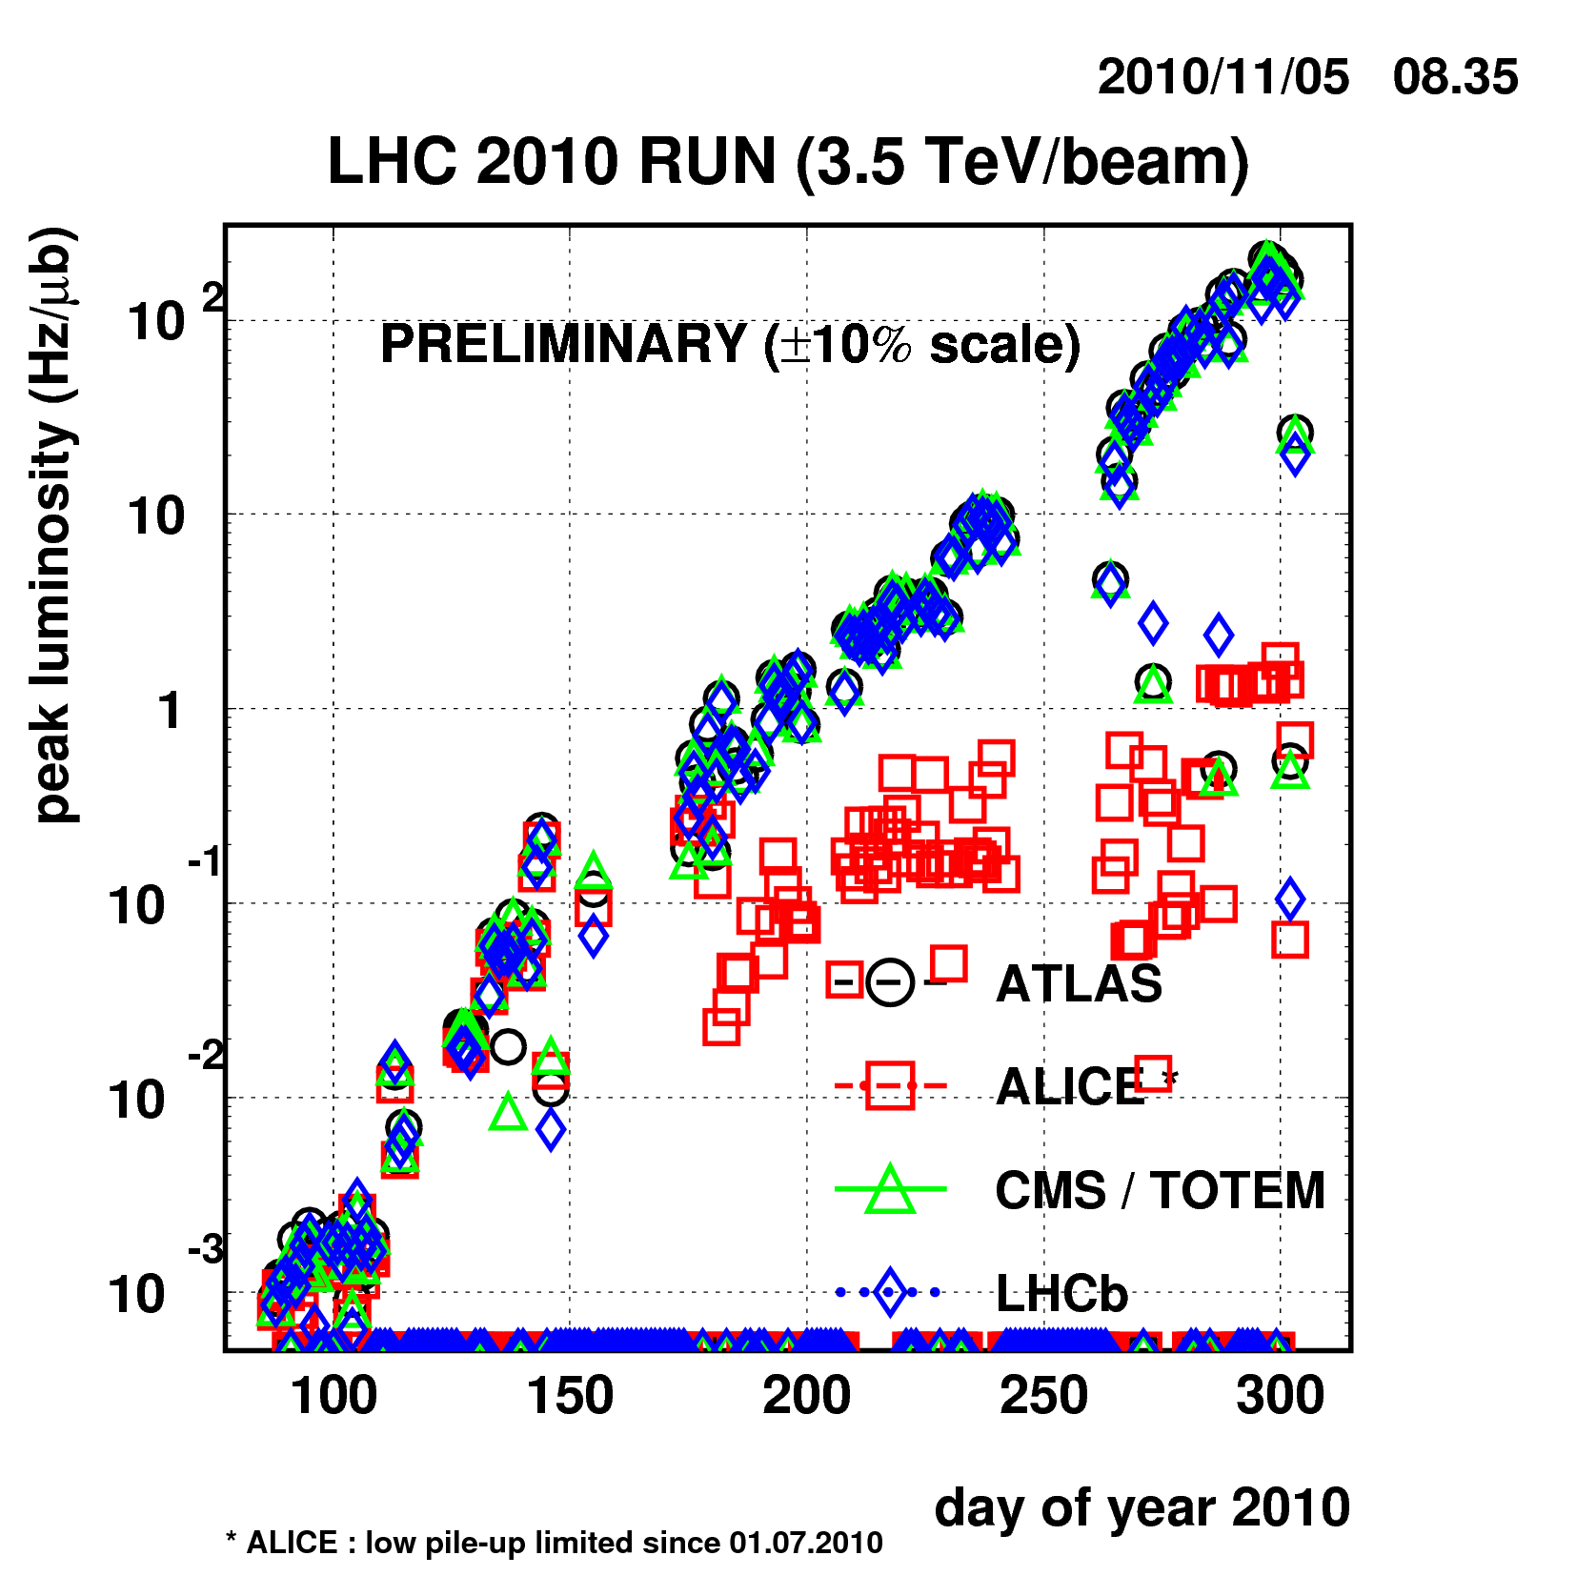
Nominal Bunch intensity
Bunch trains

Slide 6
Bunch intensity - bunch spacing
Started low before moving to nominal bunch intensity
  1.15 x 10¹¹
  Limit given by the predicted beam-beam limit
  Surprisingly easy
Nominal number of bunches: 2808
Nominal bunch spacing: 25 ns (with various gaps)
Worked this year with a few (~50) widely spaced bunches to start with…
before moving to 150 ns bunch trains
  Crossing angles on
  Pushed to 368 bunches

Slide 7
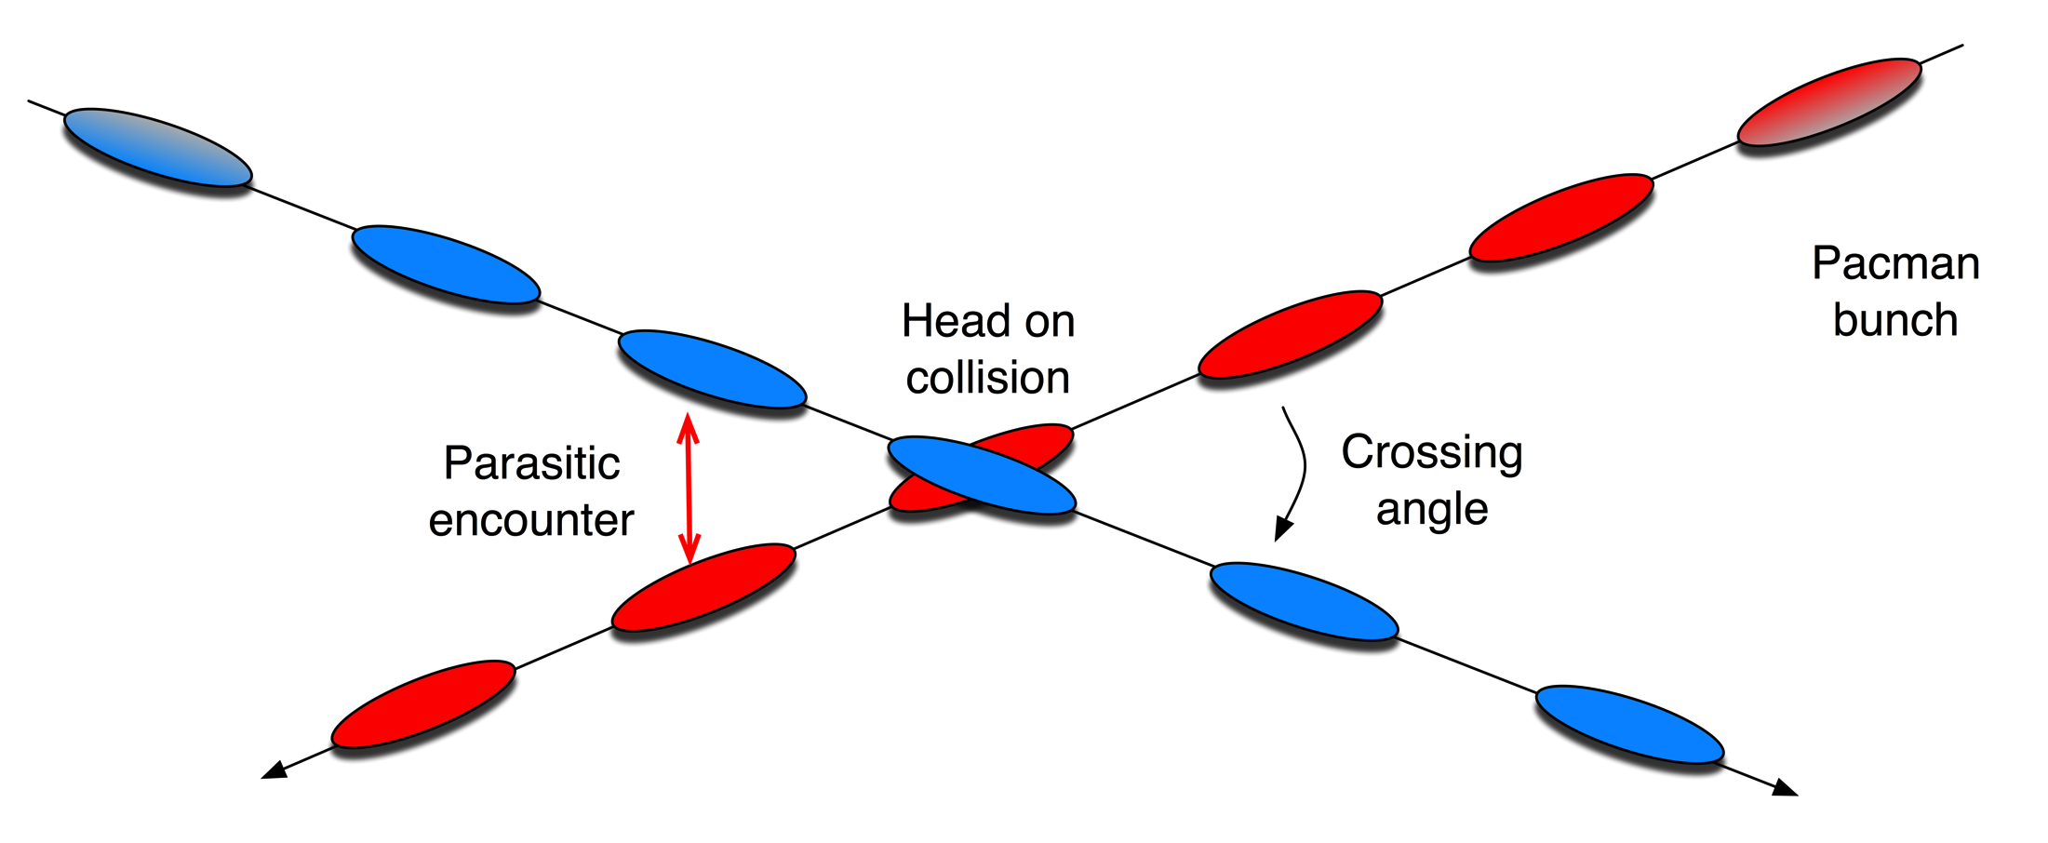
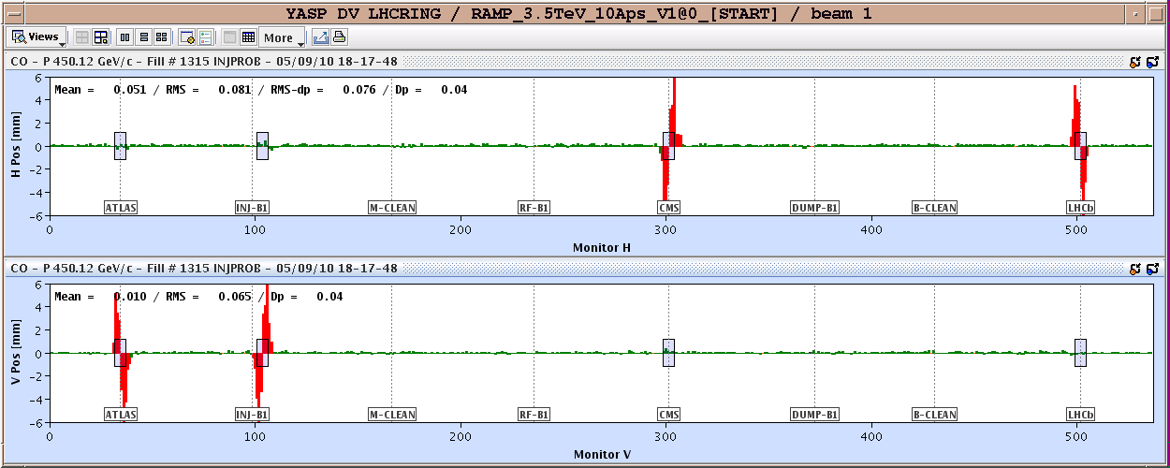
Crossing angles

Slide 8
2010 parameters
 | 2010 | Nominal
Energy [TeV] | 3.5 | 7
beta* [m] | 3.5, 3.5, 3.5, 3.5 m | 0.55, 10, 0.55, 10
Emittance [microns] | 2.0 – 3.5 start of fill | 3.75
Transverse beam size at IP [microns] | around 60 | 16.7
Bunch current | 1.2e11 | 1.15e11
Number of bunches | 368 348 collisions/IP | 2808
Stored energy [MJ] | 28 | 360
Peak luminosity [cm⁻²s⁻¹] | 2e32 | 1e34

Slide 9
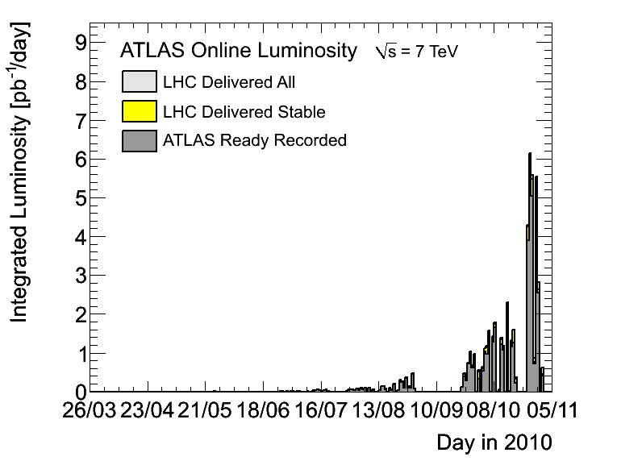

Slide 10
2010 - records
Peak stable luminosity delivered | 2.07 x 10³² cm⁻²s⁻¹
Maximum luminosity delivered in one fill | 6.3 pb⁻¹
Maximum luminosity delivered in one day | 5.98 pb⁻¹
Maximum luminosity delivered in 7 days | 24.6 pb⁻¹
Maximum colliding bunches | 348
Maximum average events per bunch crossing | 3.78
Longest time in Stable Beams for one fill | 30.3 hours
Longest time in Stable Beams for one day | 22.8 hours (94.9%)
Longest time in Stable Beams for 7 days | 69.9 hours (41.6%)
Fastest turnaround to Stable Beams | 3.66 hours (protons)
Courtesy Atlas

Slide 11
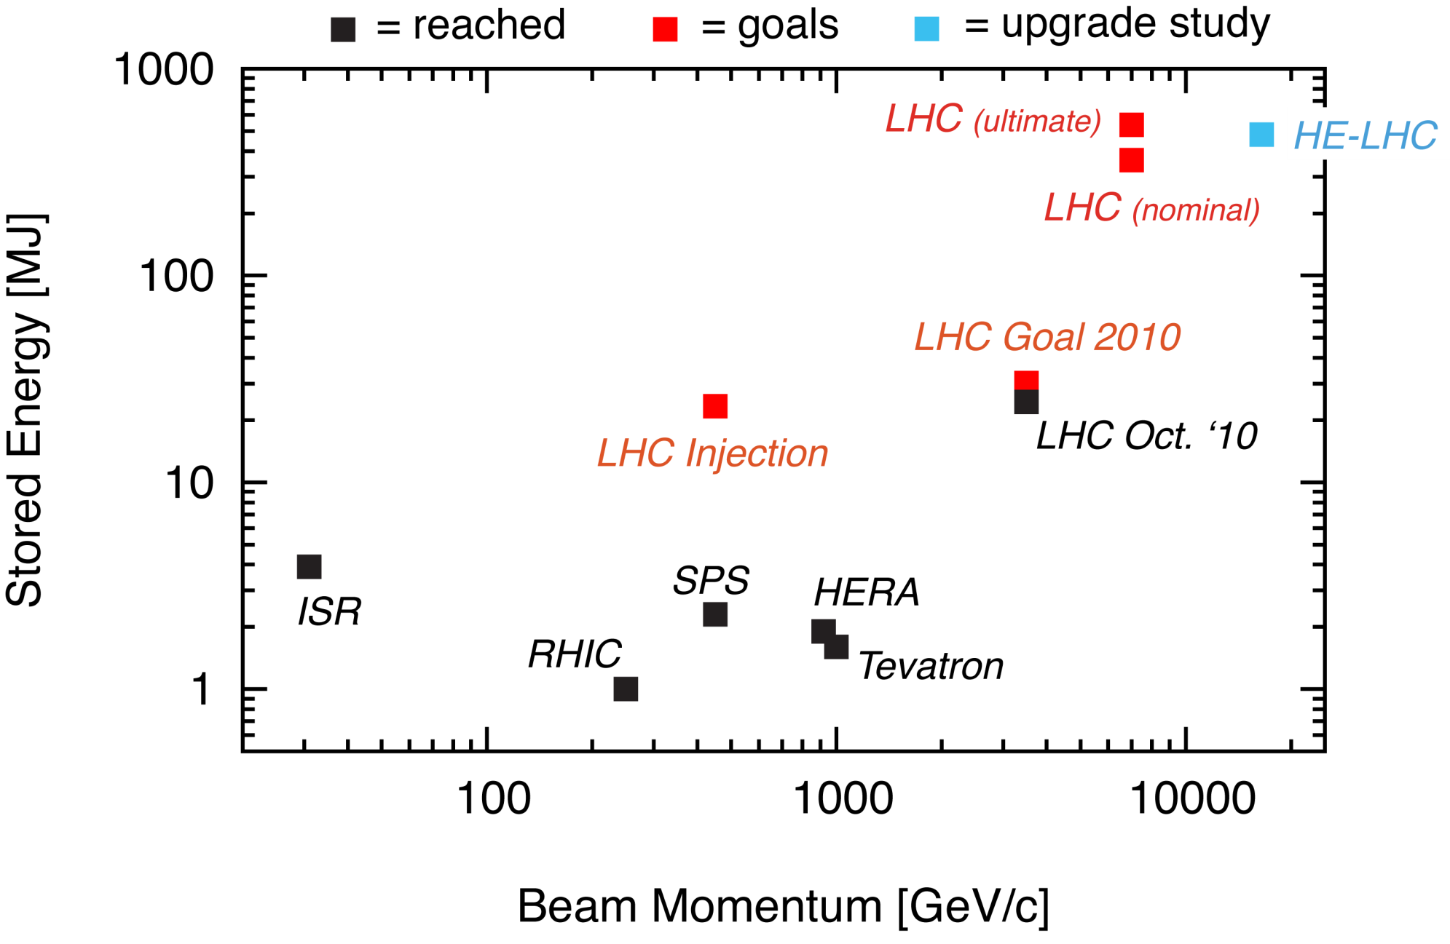
Status LHC Stored Energy
80 kg TNT
Stored energy reached at 3.5 TeV: 28.0 MJ

Slide 12
Ions - cunning wheeze – remembered Lorentz
Used the identical magnetic machine as used for protons until the very last moment in the cycle:
  Same ramp, squeeze to 3.5 m.
  Kept separation and crossing angles the same
Happily the BPMs gave similar readings for low intensity ions as those of high intensity protons
  Same reference orbit more-or-less
  Same collimator settings through ramp and squeeze
Brought crossing angles to desired positions when going into collision
  Set-up tertiary collimators in collision, validated with loss maps
  Collided and declared stable beams
Four days from first injection to first stable beams

Slide 13
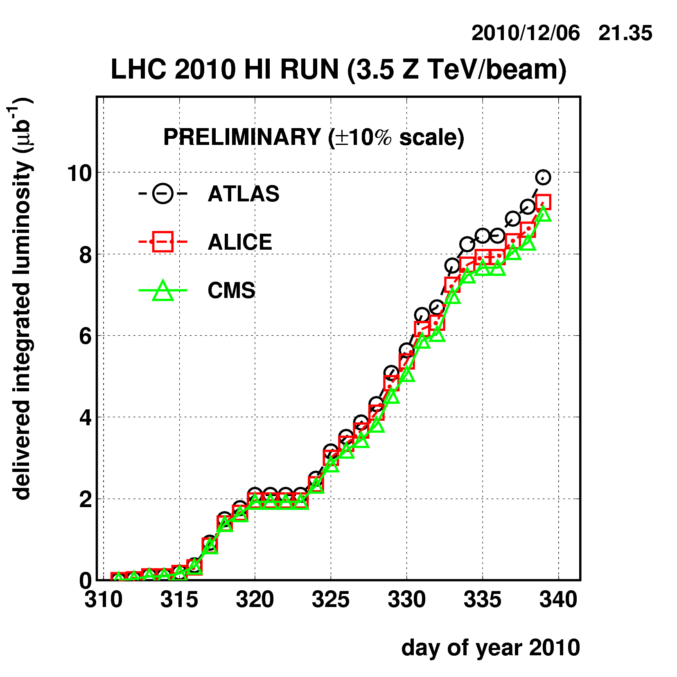
Ions
Protons
again

Slide 14
2010 – main aims
Clear priority to lay the foundations for 2011 and the delivery of 1 fb⁻¹. Peak luminosity target 1x10³² cm⁻²s⁻¹
Gain solid operational experience of injecting, ramping, squeezing and establishing stable beams
Steady running at or around 1 MJ for an extended period
Perform a safe, phased increase in intensity with validation and a running period at each step
✔
✔-
✔
✔

Slide 15
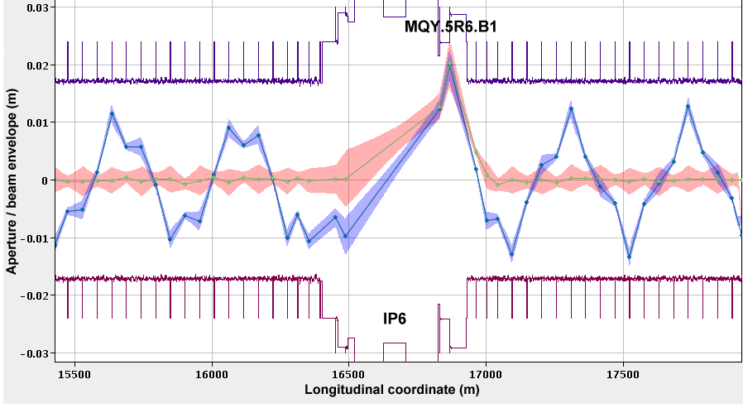
Aperture

Slide 16
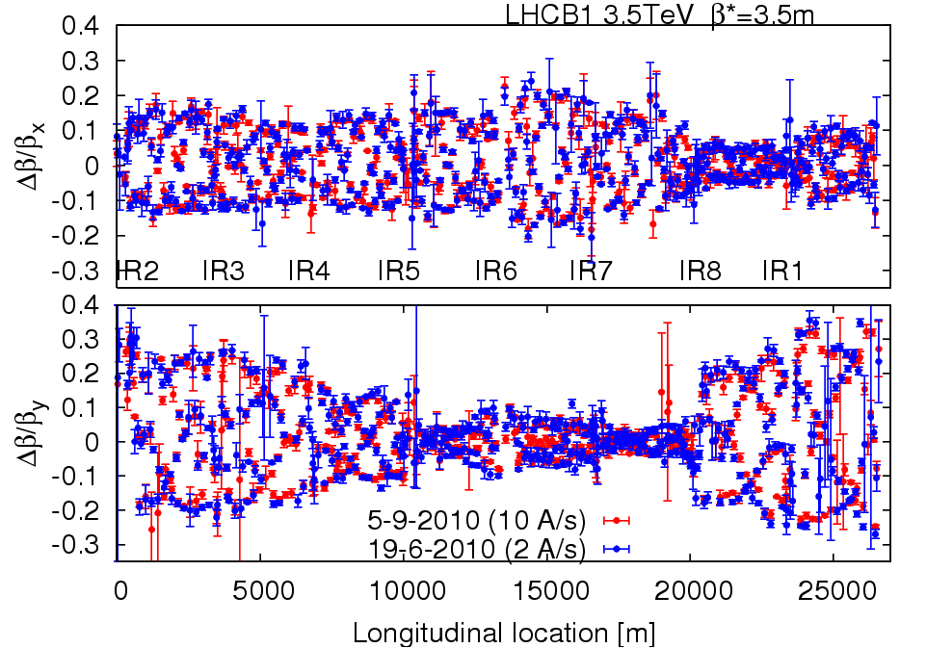
Optics & magnetic machine
Optics stunningly stable
Machine magnetically and optically well understood
  Excellent agreement with model and machine
Magnetically reproducible
  Important because set-up remains valid from fill to fill

Slide 17
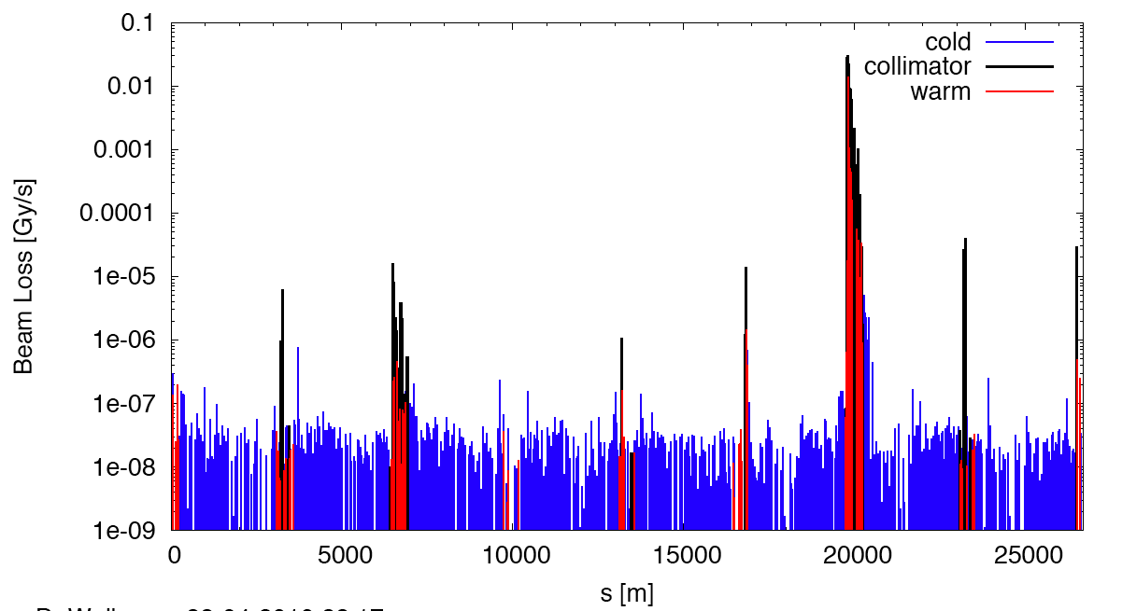
Measured Cleaning at 3.5 TeV
Making sure the hierarchy is respected
(beam1, vertical beam loss, intermediate settings)
Dump Protection Col.
Momentum Cleaning
IR1
IR8
IR2
IR5

Slide 18
Of note
Excellent single beam lifetime
Ramp & squeeze essentially without loss
Optics close to model (and correctable)
Excellent reproducibility
Aperture as expected
Better than nominal from injectors
  Emittances, bunch intensity
Beam-beam: can collide nominal bunch currents
  With smaller that nominal emittances
And surprisingly good availability…

Slide 19
Cryogenics -Global performance monitoring
1 Refrigerator for 2 sectors at P6 & P8 (-8MW w.r.t HWC scenario, ≈ -3MCHF)
Upgraded turbine test at P6
90% +/-8% availability all included (since 1st April)
98.5% +/-1% outside TechStop (since 1st July)
Serge Claudet
From design, implementation to operation: it works, the dream comes true !!!

Slide 20
PROBLEMS – TWO OF them

Slide 21
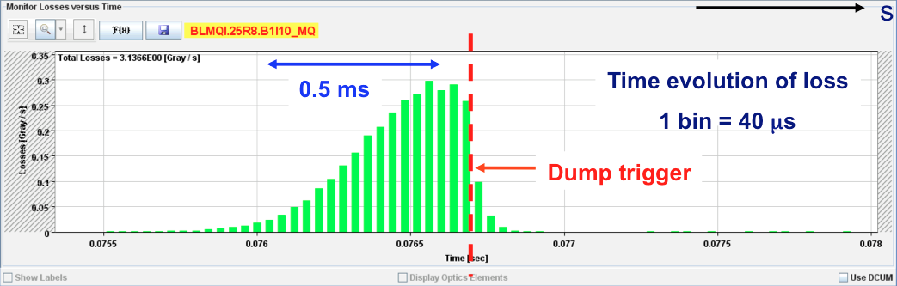
UFOs – unidentified falling objects
Many sudden local losses have been recorded.
No quench, but preventive dumps
Rise time around of the order 1 ms.
Potential explanation: dust particles falling into beam creating scatter losses and showers propagating downstream
Distributed around the ring – arcs, inner triplets, IRs

Slide 22
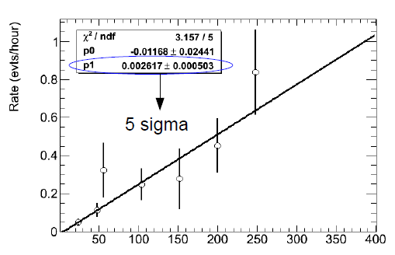


UFO: intensity dependence
Beam loss monitor thresholds have been raised at the appropriate timescales
Logging data mined for events not above threshold

Slide 23
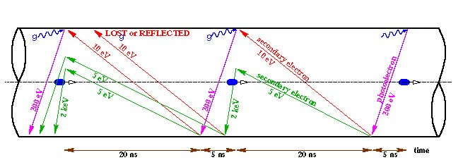
Electron cloud
Reflection
Secondary emission yield [SEY]
Schematic of electron cloud build up in LHC arc beam pipe due to photoemission and secondary emission [F. Ruggiero]

Slide 24
Electron cloud effects
Electron cloud effects occur both in the warm and cold regions.
Vacuum pressure rise (background in experiments)
Single-bunch instability
Multi-bunch instability
Interplay with impedance & beam-beam
Incoherent emittance growth
Heat load in cold arcs (quenches in the limit)
Perturbation of beam diagnostics

Slide 25
Experience in 2010
Vacuum activity started off in regions with common beam pipe at 450 GeV as we pushed up the number of bunches with 150 ns spacing
  Test solenoids cured problem – electron cloud
Tried 50 ns bunch spacing
  Things really kicked off
  High vacuum activity in warm regions (single beam pipe)
  Significant heat load in cold regions
  Instabilities and beam size growth observed
  Surface conditioning (‘scrubbing’) observed
    Gas desorption rates and SEY drop
    Time constant < 1 day
Situation a lot cleaner with 75 ns
  incoherent effects seen – emittance blow-up
  800+ bunches injected into both beams

Slide 26
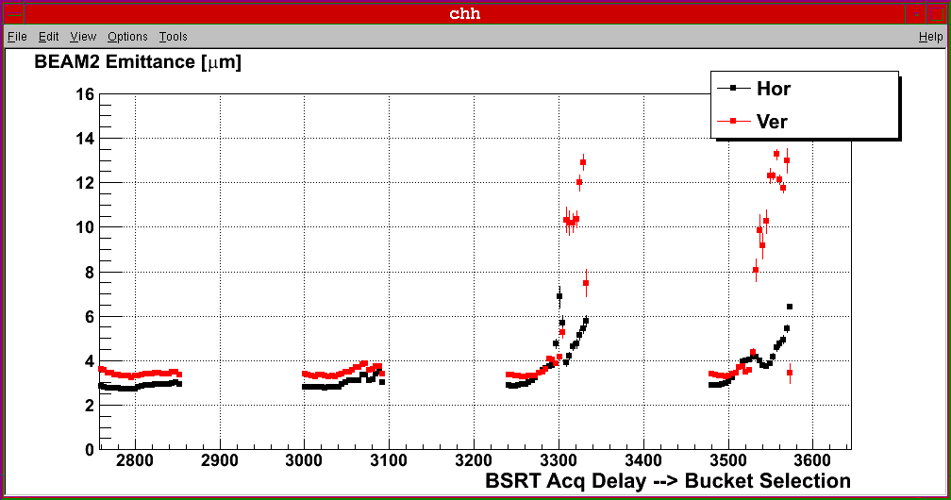
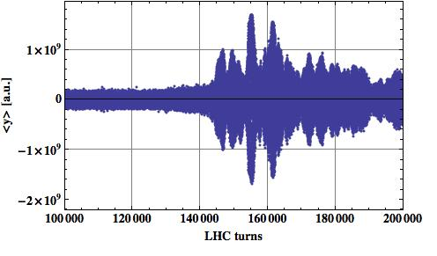
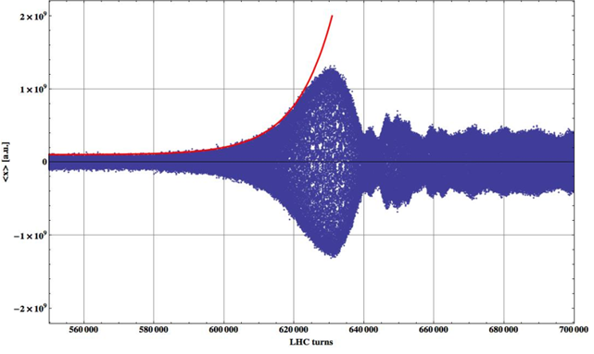
Beam stability at 450 GeV/c (50 ns)
Build-up of the electron cloud over more than one train leading to instabilities and emittance blow-up along the trains.
Compatible with electron cloud instability
F. Roncarolo
12+4x24 – 1.85 μs spacing
V: ~0.2 s rise time
H: ~1 s rise time
E. Métral

Slide 27
Strategy
One week’s scrubbing with 50 ns beam is being discussed
  Good for 75 ns with 1.3e11 bunch intensity
Lots of wire is being wrapped around warm bits during the technical stop (solenoids)
Push 75 ns to a maximum of 930 bunches
Pushing 150 ns to a maximum of 450 bunches is a backup option
Keep 50 ns for machine development

Slide 28
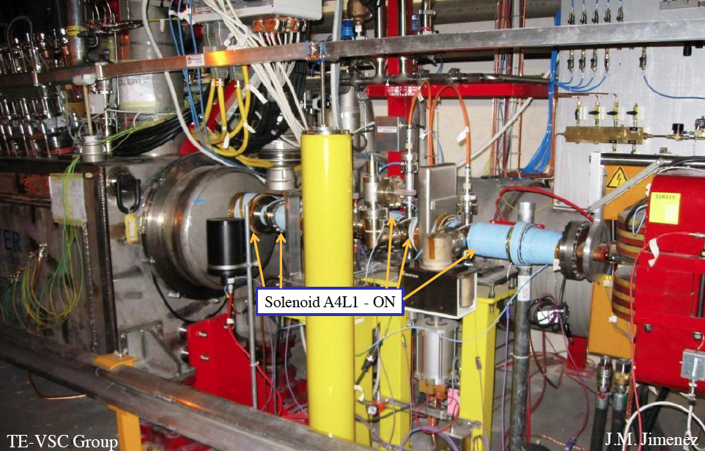
Solenoids between DFBX and D1 in IR1R

Slide 29
PLANNING

Slide 30
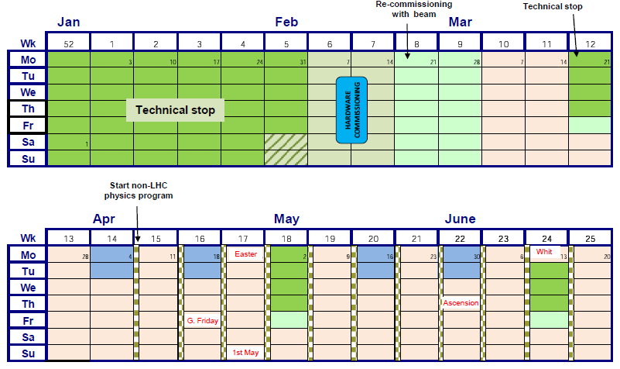
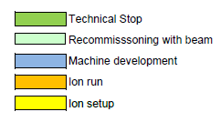
Draft LHC schedule 2011 Q1 & Q2
Re-commissioning

Slide 31
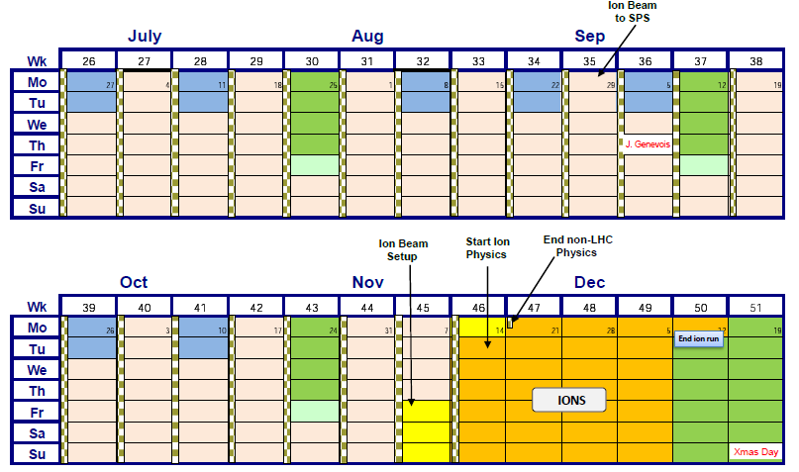
2011 Q3 & Q4

Slide 32
2011 schedule
First beam: 21st February
End proton run: 10th November
 | Days
Re-commissioning | 21
Machine development | 22
Technical stops | 30
(Scrubbing run) | (7)
Special physics runs | 10
Ramp-up to peak luminosity | 40
Peak luminosity | 133
Total | 263

Slide 33
Options for 2011
Energy to 4 TeV under consideration
  Not yet given
Reduction of beta* to a minimum of 1.5 m
  Collimation, aperture, orbit look OK
  Alice and LHCb (max. lumi 1e32) to be decided
  Between 2.5 to 1.5 m certainly possible
Bunch intensity at least nominal
  1.5 to 1.6 e11 could be available from injectors depending on bunch scheme
Emittance – again bunch spacing dependent
  2.5 to 3 microns seems reasonable

Slide 34
2011: conservative numbers
3.5 or 4 TeV
930 bunches (75 ns)
3 micron emittance
1.2 x 10¹¹ protons/bunch
beta* = 2.5 m, nominal crossing angle
Hubner factor 0.2
Peak luminosity | ~6 x 10³²
Integrated per day | 11 pb⁻¹
~170 days | ~2 fb⁻¹
Stored energy | 72 MJ
Lot of variations possible: 1 to 3 fb⁻¹ looks reasonable
1 x 10³³ cm⁻²s⁻¹ not out of reach – usual caveats

Slide 35
Conclusions 1/2
Injection, ramp and squeeze fully operational
LHC magnetic model, optics excellent
Beam instrumentation in good shape.
Beam cleaning and collimation works reliably with predicted efficiency.
Machine protection reliably catches failures etc.
Machine aperture looks good
Performance with beam (losses, lifetimes, luminosity, emittance growth etc.) is encouraging
Handling dangerous beams already

Slide 36
Conclusions 2/2
Machine availability is excellent – the hard work of numerous teams
There are problems
  UFOs somewhat worrying
  Electron cloud well understood – measures prepared
2011 – another long year ahead…
  Will probably move to 75 ns. bunch spacing – up to 930 bunches
  With nominal intensities, beta* between 1.5 and 2.5 m.
  should be good for 5 to 10 x 10³² cm⁻²s⁻¹
  and 1 to 3 fb⁻¹
Decision on 2012 incoming soon

Slide 37
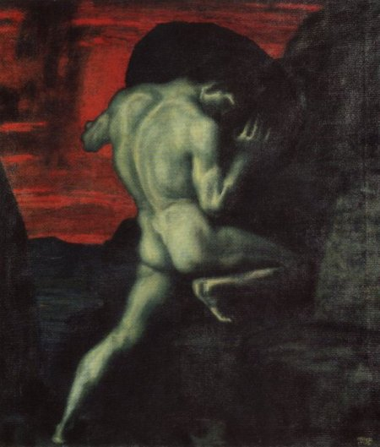
The gods had condemned Sisyphus to ceaselessly rolling a rock to the top of a mountain, whence the stone would fall back of its own weight. They had thought with some reason that there is no more dreadful punishment than futile and hopeless labor.

Slide 38
I leave Sisyphus at the foot of the mountain! One always finds one's burden again. But Sisyphus teaches the higher fidelity that negates the gods and raises rocks. He too concludes that all is well…
…The struggle itself toward the heights is enough to fill a man's heart. One must imagine Sisyphus happy.
Albert Camus
HAPPY CHRISTMAS!!!

