Slide 1
LHC status & 2009/2010 operations
Mike Lamont
for the extended LHC team

Slide 2
Contents
Consolidation – brief recall
Splices
Operational energies
Potential performance
Present status
Plans for 2009-2010

Slide 3
Consolidation 1/2
Besides the major effort required to repair sector 34…
Major upgrade of the quench protection system
Protection of all main quadrupole and dipole joints (0.3 mV threshold).
High statistics measurement accuracy to < 1 nΩ.
Installation of > 200 km of cables, production of thousands of electronic boards. >> protection against similar issues in the future.
Massive measurement campaign to identify bad splices
Calorimetric methods (~ 40 nΩ) to identify possible bad cells
High precision voltage meas. (~ 1 nΩ) to identify problematic splices
Improved active protection
Diagnostics

Slide 4
Consolidation 2/2
Mitigation of collateral effects in case of problems:
Additional release valves (“DN200”)
Improvement of the pressure relief system to eventually cope with maximum He flow of 40 kg/s in the arcs (maximum conceivable flow)
Installation completed in 4 sectors (1-2, 3-4, 5-6, 6-7)
Also done for inner triplets, standalone magnets and DFBs:
Reinforcement of the quadrupole supports
Arc quadrupoles (total 104 with vacuum barrier)
Semi-stand alone magnets
Inner triplet and DFBAs
Energy extraction times lowered
Faster discharge of the energy from circuits
Possible because of lower energy running
Mitigation of damage

Slide 5
Additional splice problem
The enhanced quality assurance introduced during sector 3-4 repair has revealed new facts concerning the copper bus bar in which the superconductor is embedded.
The process of soldering the superconductor in the interconnecting high-current splices can cause discontinuity of the copper part of the bus-bars and voids which prevent contact between the super-conducting cable and the copper.
Danger only in case of a quench

Slide 6
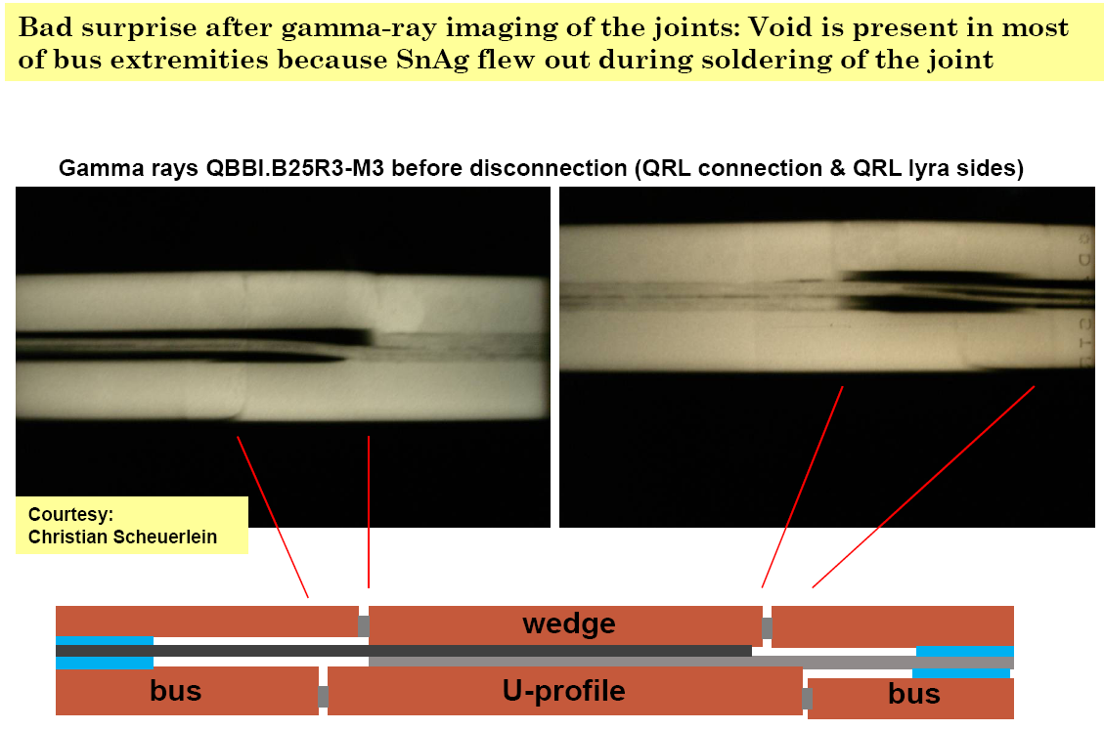
Stablizer problem
Bad electrical contact between wedge and U-profile with the bus on at least 1 side of the joint
Bad contact at joint with the U-profile and the wedge

Slide 7
Splices - summary
Bad splices
Resolution (measurements at 1.9K):
Calorimetry → 40 nΩ;
Electric → 1 nΩ
Two bad cases found in 6 sectors:
50 nΩ (1-2) and 100 nΩ (6-7); repaired.
Two sectors still to be measured cold (4-5, 3-4)
Copper stabilizer problem
Measurements at room temperature done in 6 sectors,
10 dipole (> 35 µΩ) and 10 quadrupole (> 80 µΩ) joints repaired
Two sectors still to be measured warm (7-8, 8-1)
Lot of effort has gone into modeling the problem…

Slide 10
Initial operating energy of the LHC
Operating at 3.5 TeV with a dipole energy extraction time of 50 s.
Simulations show that resistances of 120 micro-ohm are safe from thermal runaway under conservative assumed conditions of worst case conditions for the copper quality (RRR) and no cooling to the copper stabilizer from the gaseous helium
Decision:
Operation initially at 3.5 TeV (energy extraction time of 50 s) with a safety factor or more than 2 for the worst stabilizers.
Then operate at 4 to 5 TeV

Slide 11
Higher than 3.5 TeV?
Operating at 5 TeV com with a dipole energy extraction time of 68s
Simulations show that resistances of 67 µΩ are safe from thermal runaway under conservative assumed conditions of worst case conditions for the copper quality (RRR), and with estimated cooling to the stabilizer from the gaseous helium
Warm local measurements of the joint resistances in sector 45 revealed record surplus joint resistance of about 60 µΩ, caused by double joint fault on both sides of the SC splice
Conservative estimates based on statistical analysis and the worse joints seen estimate a conservative maximum of ~ 90 µΩ
We have 2 sectors which have not been measured warm.
The essential question is “what is the maximum resistance we can “reasonably” expect in the unmeasured sectors?”

Slide 12
Higher than 3.5 TeV?
FRESCA
Validation of splice model in the lab
Testing fully instrumented bad splice in 1.9 K Helium
Full re-analysis of previous measurements
Analysis of warm non-invasive dipole measurements
Statistical analysis of invasive warm “R16” measurements
Analysis of failure modes and of worse joints found in the six sectors measured
Monitor carefully all quenches to gain additional information.
Behaviour (nQPS) – propagation times, current levels…
Likelihood with beam, confirmation of simulations
Experiments’ interest in increasing the energy is noted.
The jury is definitely out on this one - but we have some time.

Slide 13
FRESCA – hot off the press
Conceptual design - courtesy of A. Verweij, TE-MPE
to the current leads
SC joint
interconnect
return leg
gap
G-11 spacer
SC cables
heaters
insulated cavity
solder

Slide 14
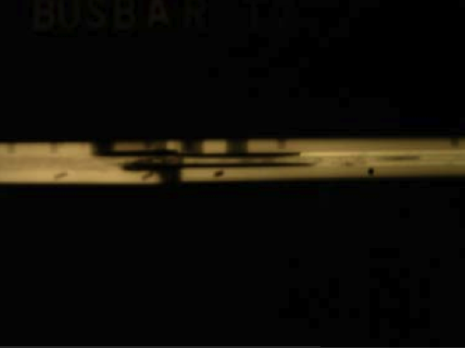
A controlled defect
≈ 45 mm
Clean gap in the stabilizer
Preparation and realization by C. Urpin and H. Prin, TE-MSC

Slide 15
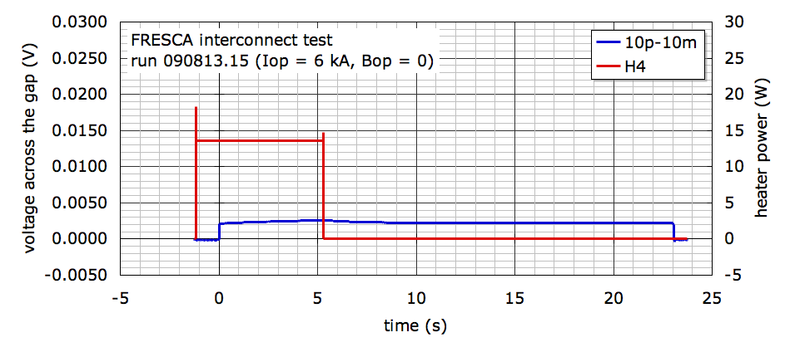
Run 090813.15
Stable quench: a normal zone is established and reaches steady-state conditions at a temperature such that the Joule heat generation is removed by conduction/convection cooling
stable

Slide 16
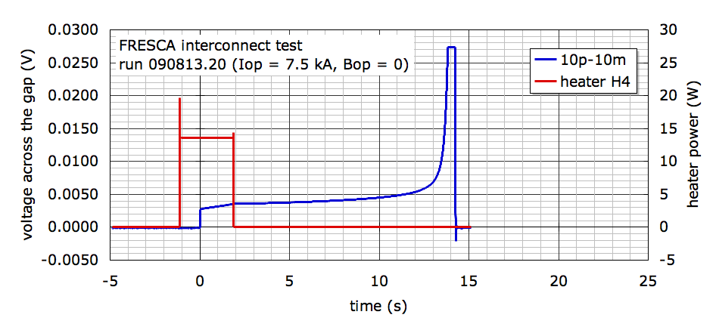
Run 090813.20
Runaway quench: the normal zone reaches a temperature at which the Joule heat generation in the normal zone exceeds the maximum cooling capability leading to a thermal runaway
runaway

Slide 17
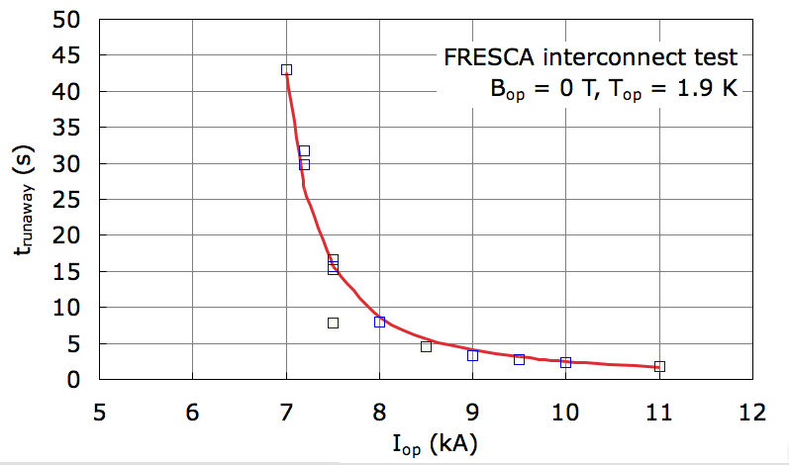
t_{runaway} vs. I_{op}
For any given test condition of temperature and background field it is possible to summarise the above results in a plot of runaway time t_{runaway} vs. operating current I_{op}
Luca Bottura

Slide 18
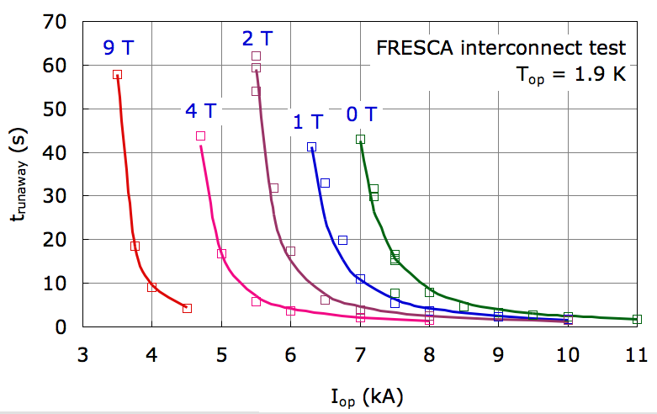
Effect of B_{op}
A background field has been used to Increase the electrical resistivity & decrease the thermal conductivity thus simulating the effect of a lower RRR
Applied magnetic field induces magnetoresistance and reduces thermal conduction ⇒ the effect is an increased tendency to thermal runaway
Luca Bottura

Slide 19
FRESCA - caveats
NB: early results
Sample thermal conditions at the interconnect are not the same as for a magnet interconnect
The defect tested is clean and located on one side of the joint, which may not be the most common situation in the machine
Tests and analysis still very much in progress

Slide 20
Assume a step up in energy – how long?
Task | Comment | Time
Hardware commissioning of main circuits | Modification and testing of dump resistors Installation of snubbing circuits Calorimetry and QPS measurements | ~ 2 weeks
Qualification of machine protection without beam | FMCMs, PIC, Collimators, TCDQ, BLMs, BPM interlocks, SMPs, RF, LBDS | In parallel with HWC
Operation dry runs of re-qualified sectors |  | After hand over from HWC
Re-commissioning of ramp and associated machine protection | Safe beam: LBDS, BLMs, RF | ~ 1 week
Re-commissioning of squeeze | Could possibly ramp-squeeze-ramp (avoiding the need to re-com the 3.5 TeV squeeze)
Optics and operations’ checks at high energy |  | ~ 2 days
Collimator re-optimization |  | ~4 days
Estimate: 4 weeks to re-establish physics

Slide 21
Possible evolution
Physics at 3.5 TeV beta* = ~3 m no crossing angle, 72 bunches
Step up in energy
Ramp, squeeze, ramp to 4-5 TeV beta* = 4 m no crossing angle, 72 bunches
Ramp, squeeze at 4-5 TeV beta* = 4 m crossing angle, 50 ns

Slide 22
3.5 TeV running - recall
Emittance goes down with increasing :
And so beam size:
And thus luminosity increases with increasing  IF we can hold other parameters constant:
However, because beam size goes as:
Lower energy:
→ increased beam size – less aperture  higher *
→ separation of beams in interaction regions drops – long range beam-beam

Slide 23
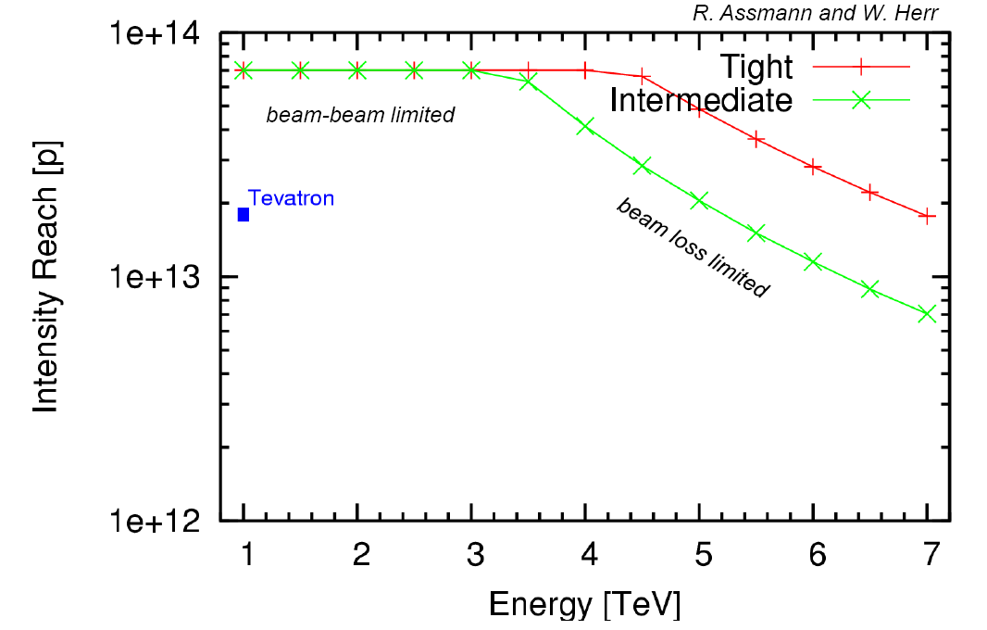
3.5 TeV limits
Ralph Assmann
Werner Herr
Parameter | Limit | Reason(s)
Beam Intensity | ~6 e13 | collimation cleaning efficiency
* - crossing angle off | ~3 m | aperture
* - with crossing angle | ~4 m | aperture, long range beam-beam
Crossing angle [50 ns] | ~300 µrad | *, aperture, long range beam-beam
Peak luminosity | ~1 e32
6 e13

Slide 24
Operation - assumptions
Given these constraints what can we do?
Fill length: 8 hours
Turnaround time: 5 hours
20 hours luminosity lifetime
27 day months.
40% machine availability
Nominal crossing angle assumed for 50 ns.
Nominal transverse emittance
Total intensity limited to around 12% of nominal
beta* = 3 m. with 156 bunches, crossing angle off

Slide 25
Plugging in the numbers with a step in energy
Month | OP scenario | Max number bunch | Protons per bunch | Min beta* | Peak Lumi |  | Integrated |  | % nominal
1 | Beam commissioning
2 | Pilot physics | 19 | 3 x 10¹⁰ | 4 | 2.5 x 10²⁹ |  | ~100 nb⁻¹
3 |  | 19 | 5 x 10¹⁰ | 4 | 1.4 x 10³⁰ |  | ~0.7 pb⁻¹
4 |  | 72 | 5 x 10¹⁰ | 3 | 5.3 x 10³⁰ |  | ~2.5 pb⁻¹ |  | 2.5
5a | No crossing angle | 72 | 7 x 10¹⁰ | 3 | 1 x 10³¹ |  | ~5 pb⁻¹ |  | 3.4
5b | No crossing angle – pushing bunch intensity | 72 | 1 x 10¹¹ | 3 | 2.1 x 10³¹ |  | ~10 pb⁻¹ |  | 4.8
6 | Shift to higher energy: approx 4 weeks | Would aim for physics without crossing angle in the first instance with a gentle ramp back up in intensity
7 | 4 – 5 TeV (5 TeV luminosity numbers quoted) | 72 | 7 x 10¹⁰ | 4 |  | 1.1 x 10³¹ |  | ~6 pb⁻¹ | 3.4
8 | 50 ns – nominal Xing angle | 138 | 7 x 10¹⁰ | 4 |  | 2.2 x 10³¹ |  | ~10 pb⁻¹ | 3.1
9 | 50 ns | 276 | 7 x 10¹⁰ | 4 |  | 4.2 x 10³¹ |  | ~20 pb⁻¹ | 6.2
10 | 50 ns | 414 | 7 x 10¹⁰ | 4 |  | 6.5 x 10³¹ |  | ~31 pb⁻¹ | 9.4
11 | 50 ns | 414 | 9 x 10¹⁰ | 4 |  | 1 x 10³² |  | ~50 pb⁻¹ | 12

Slide 26
Caveats
Big error bars on these numbers
Bunch intensity/ Beam intensity
quench limit, beam lifetimes, parameter tolerances & control, emittance conservation through the cycle…
Cleaning efficiency of collimation versus quench limits
Note: we have already proved that we can quench a dipole with only ~2-3 e9 at 450 GeV
Operability:
reproducibility, ramp, squeeze, beam lifetime, background, critical feedback systems
Machine availability:
just about everything… include the injectors
Machine Protection
has to work perfectly

Slide 27
LHCb aside – collisions in IP8
Complication is internal crossing angle, produced by compensation of spectrometers
Without external angle (i.e. 43 or 156 bunches) no constraint on spectrometer polarity and on strength (even at 450 GeV), i.e. no ramping required
But: large internal angle may substantially reduce luminosity (in particular for lower energies)
When an external angle is required: follow procedures described in reports!
Werner Herr

Slide 28
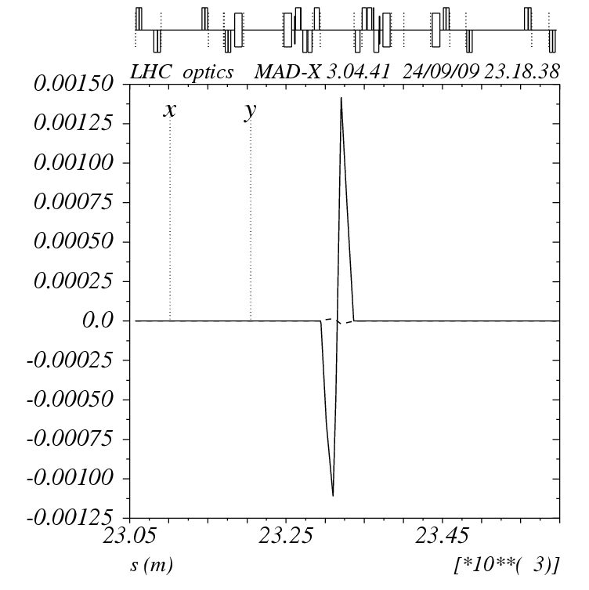
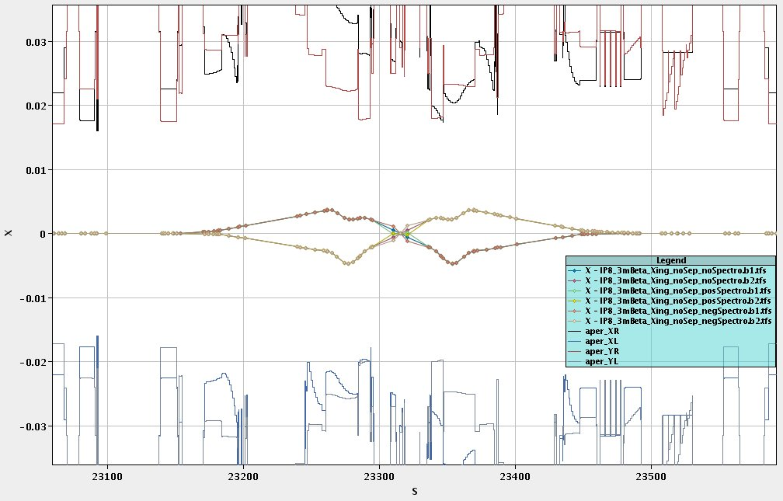
LHCb aside - external angle
With external crossing angle ramping of spectrometer is required for (at least) one of the polarities
At 3.5 TeV running with +polarity and with a crossing angle is ruled out

Slide 29
LHC status - today
Sector | Status | Temp
12 | PO PHASE 1 | 1.9 K | ~90% phase 1 completed Phase 2 started
23 | COLD | 1.9 K | Installation of nQPS 50% complete
34 | COOLDOWN | ~80 K
45 | COLD | 1.9 K
56 | PO PHASE 1 | ~1.9 K | ~75% phase 1
67 | COOLDOWN | ~80 K | Cool-down started few days earlier than foreseen
78 | PO phase 1 | 1.9 K | ~90% phase 1 finished
81 | COLD | 1.9 K
A lot still going on out there: ELQA, QPS…

Slide 30
Hardware commissioning - NB
HWC phase 1
Limited current – no powering of main circuits – restricted access
HWC phase 2
Individual system tests of new QPS
Power main circuits to 6000 A (just over 3.5 TeV)
No access during powering in sector concerned and adjacent access zones
New Quench Protection System still to be installed and tested just about everywhere
Installed in S12, S56, S78 and 50% S23
Some teething problems in S12 but in general looking encouraging

Slide 31
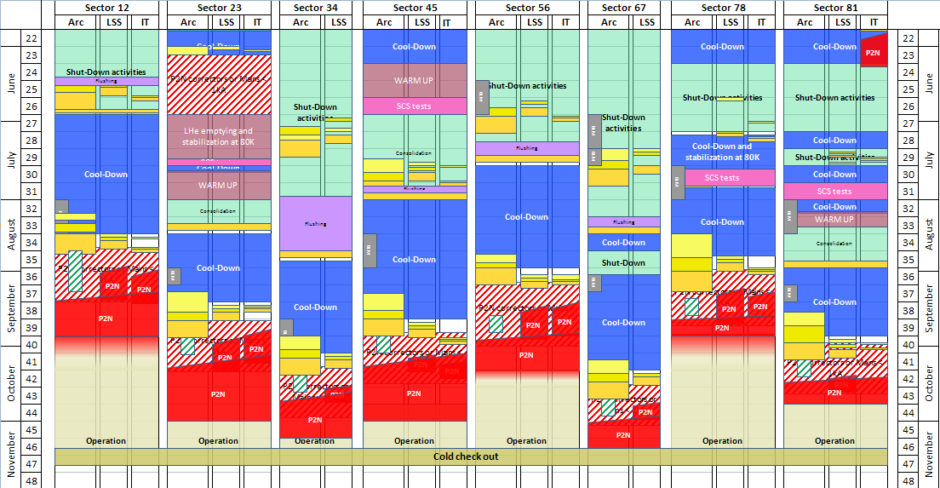
Today
General Schedule 9th, September 09

Slide 32
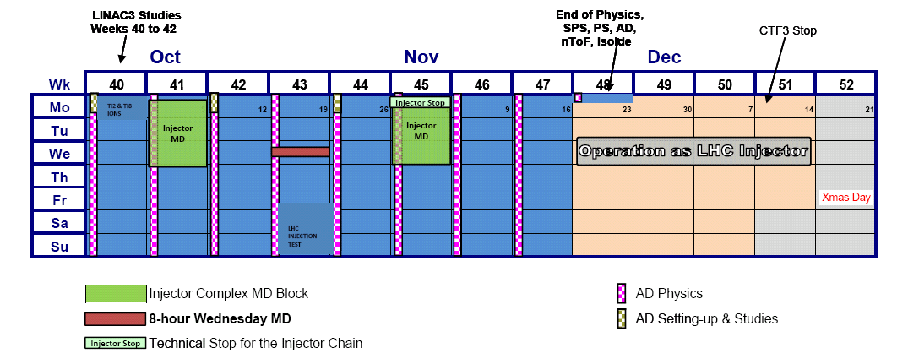
2009 - injectors
Ions in the lines
± first LHC beam
Injection test Sector 23 as first priority Sector 78 if part of 81 required is ready

Slide 33
Beam commissioning
Energy | Safe | Very Safe
450 | 1 e12 | 1 e11
1 TeV | 2.5 e11 | 2.5 e10
3.5 TeV | 2.4 e10 | probe
Global machine checkout
Essential 450 GeV commissioning
Machine protection commissioning 1
Experiments’ magnets at 450 GeV
450 GeV collisions
Ramp commissioning to 1 TeV
System/beam commissioning
Machine protection commissioning 2
3.5 TeV beam & first collisions
Full machine protection qualification
System/beam commissioning
Pilot physics
One month to first collisions

Slide 34
450 GeV collisions
Time limited: 3-4 shifts
No squeeze
Low intensity – machine protection commissioning unlikely to be very advanced.
~1 week after first beam
Number of bunches | 1 | 4 | 12
Particles per bunch | 4 | 4 | 4
Beam intensity | 4 x 10¹⁰ | 1.6 x 10¹¹ | 4.8 x 10¹¹
beta* [m] | 11 | 11 | 11
Luminosity [cm⁻²s⁻¹] | 1.7 x 10²⁷ | 6.6 x 10²⁷ | 2 x 10²⁸
Integrated lumi/24 hours [nb⁻¹] | 0.06 | 0.24 | 0.7

Slide 35
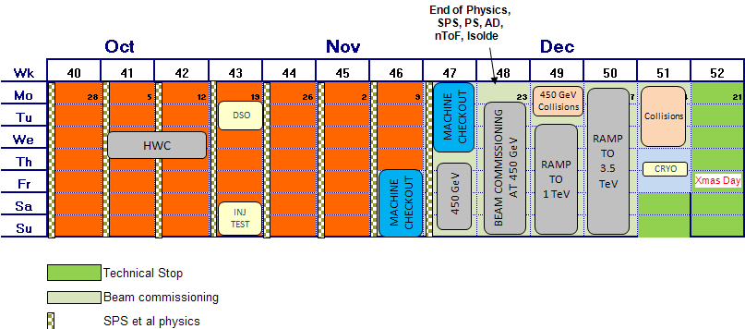
LHC 2009
All dates approximate…
Reasonable machine availability assumed
Stop LHC with beam ~17th December 2009, restart ~ 7th January 2010

Slide 36
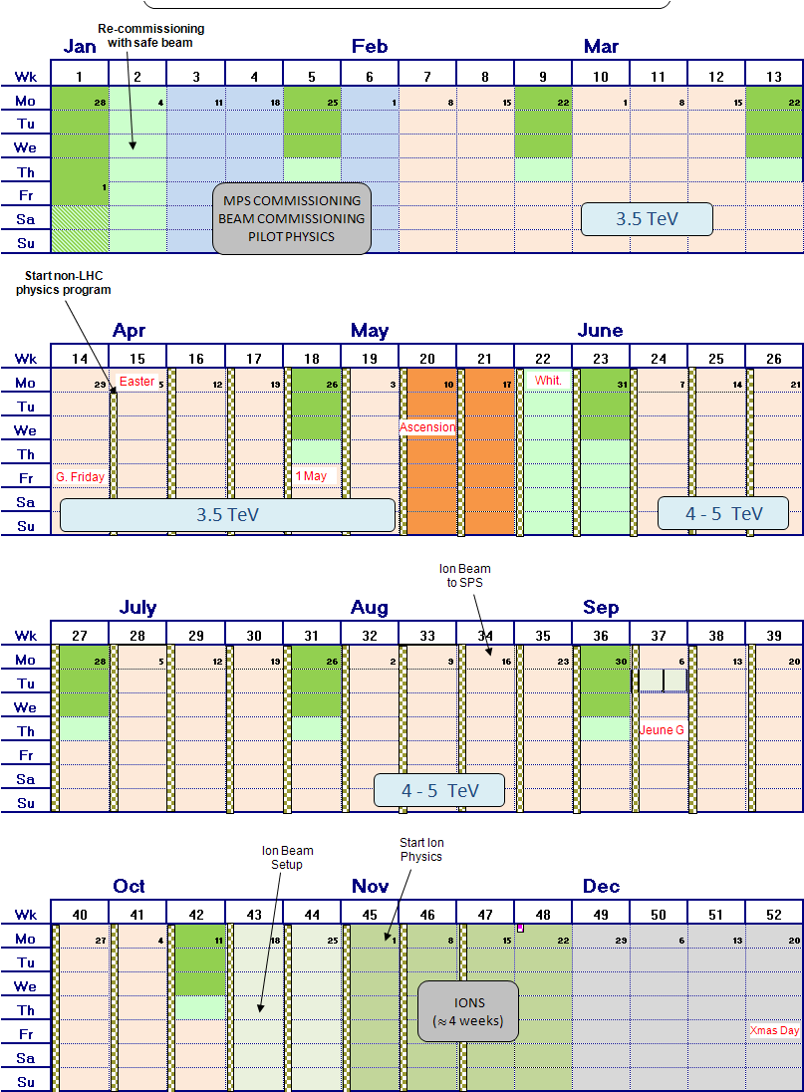
LHC 2010 – very draft
2009:
1 month commissioning
2010:
1 month pilot & commissioning
3 month 3.5 TeV
1 month step-up
5 month 4 - 5 TeV
1 month ions

Slide 37
Conclusions
Splices remain an issue
work continues: on the machine and in the lab
Constraints of 3.5 TeV enumerated
Potential performance shown
100 – 200 pb⁻¹ seem reasonable
Step up in energy would take ~4 weeks – increase to be decided
Would start with a flat machine at the higher energy… before bringing on crossing angle and exploiting 50 ns.
LHC on its way to being fully cold, HWC advancing well and on schedule for mid-November start with beam
With a bit of luck, first high energy collisions before Christmas

Slide 38
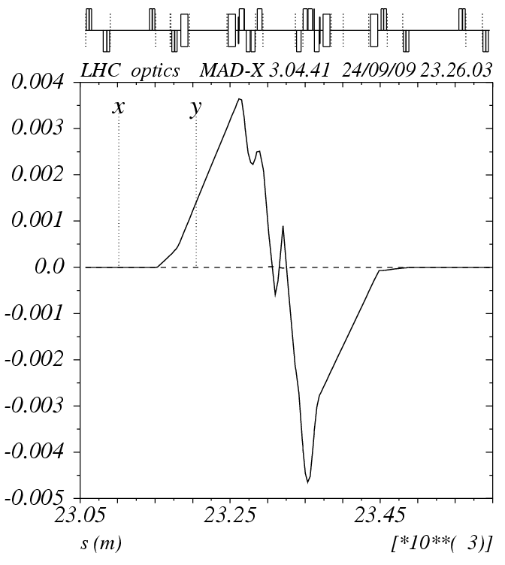
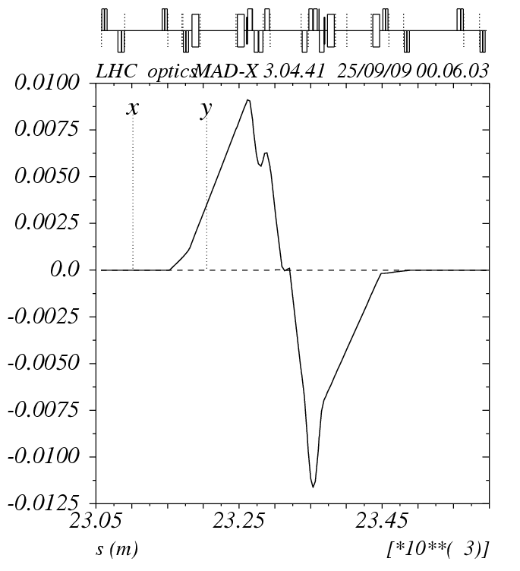
Crossing & spectrometer at 3.5 TeV

