Slide 1
Status of LHC
Mike Lamont
4th HERA and the LHC workshop
26th May 2008

Slide 2
Contents
Cool-down
Hardware commissioning
MB quench tests
Integration tests
Schedule
Baseline beam commissioning
Conclusions

Slide 3
1
Sectors cooling
2
3
4
5
6
‘’7,8’’
Short in connection cryostats and repairs
Open Days
Christmas and water maintenance shut-down
Powering activities + Cooling sectors + Preparation for cool-down
Serge Claudet

Slide 4
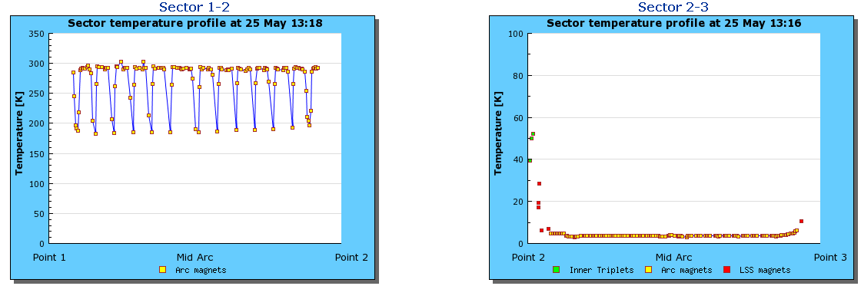
12 & 23
Started cool-down last week
Final stages of cool-down

Slide 5
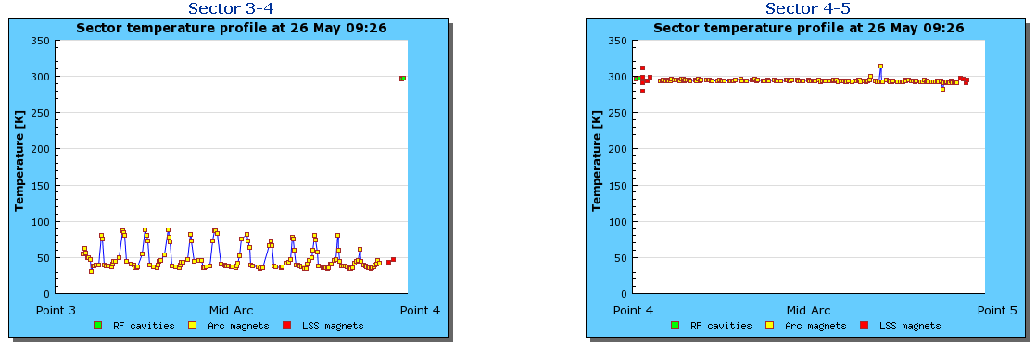
34 & 45
Cool-down in progress
Arc < 80 K
Re-cool-down starts this week

Slide 6
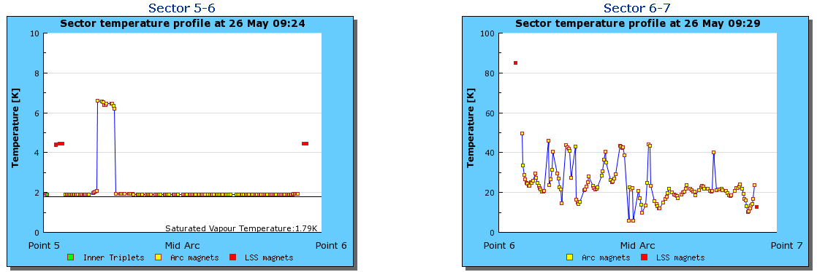
56 & 67
Quench
ARC < 2 K
Quench tests in progress
Cool-down in progress
T_{avg} ≈ 25 K
Progress a little slow – one week’s delay for turbine upgrade

Slide 7
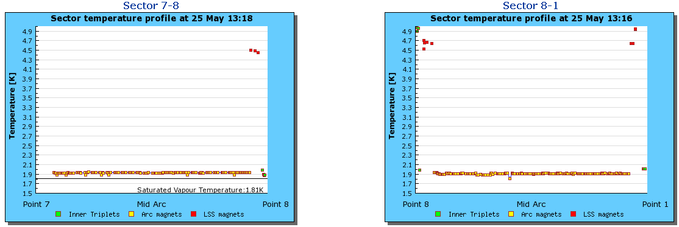
78 & 81
Arc < 2 K
Power tests nearly finished
Arc < 2 K
Quench Protection tests this week.
Powering tests next week.

Slide 8
LHC Cool-down Status
1-2 |  | Started cool-down 22nd May
2-3 |  | 4 to 1.9 K this week
3-4 |  | Cool-down started 23 April 08 Sector at 80 K
4-5 |  | Re-cool down to start this week (week 22)
5-6 |  | ARC < 2K - powering tests finished, quench tests in progress
6-7 |  | Cool-down started 31 Mar 08 T_{avg} ≈ 25 K
7-8 |  | ARC < 2K Powering tests
8-1 |  | ARC < 2K QPS tests

Slide 9
Hardware Commissioning (HWC)
Commissioning of continuous arc cryostat & LSS cryostats (insertion quadrupoles…, inner triplet, etc.)
  Cryogenics, Vacuum, QPS, PIC, Powering:
    Electrical Quality Assurance,
    Tests prior to powering,
    Powering (QPS, PC, MPS) of all circuits one by one,
      Magnets, busbars, DFBs, services, UPS, AUG, controls…
    Powering of all the circuits of a sector together
    Power converters: protection, calibration, ramp tests performed
    Interlocks, compatibility tests, protection tests
Stored magnetic energy up to 1.29 GJ per sector.
[154 dipoles per sector powered in series: ~11700 A at 7 TeV]

Slide 10
Powering Groups of Circuits (PGC)
Antonio Vergara

Slide 11
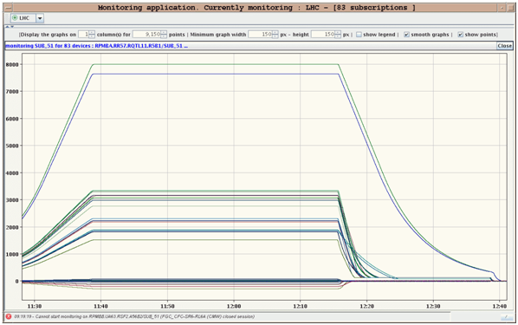
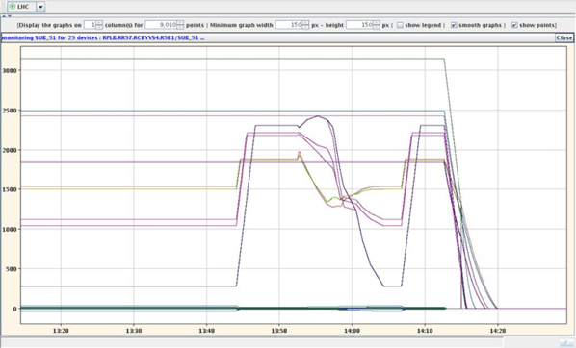
HWC
In general things are going very well
Rattling through tests very efficiently
5 TeV Squeeze IR5
5 TeV Ramp 56

Slide 12
Non-conformities, issues…
Numerous small problems requiring resolution
No show stoppers for the moment
Examples: sector 78
Individual system tests of the QPS system show a damaged quench heater in one MB magnet:
  Studies are carried out by MPP to confirm usage of the LF heaters instead of the damaged HF ones
Some valves of the cooling water circuits in UA83 need to be replaced. A three day intervention has been needed from Monday till Wednesday.
Quench detected in RQ5 at very low current in the first powering maybe due to high resistance in the bus-bars. Needs to be warmed up for fix.

Slide 13
Sector 56 – dipole quench training
Arjan Verweij

Slide 14
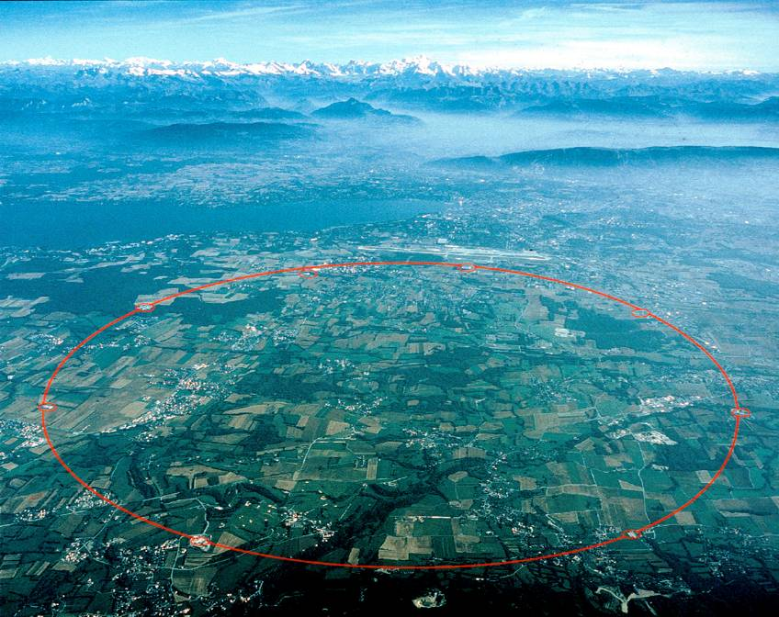
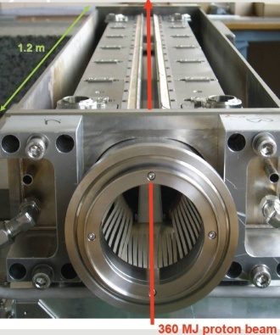
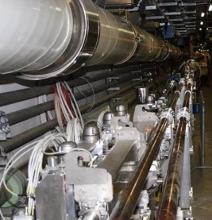
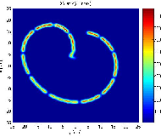
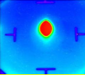
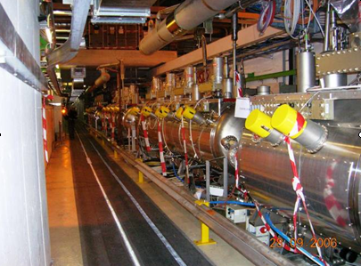
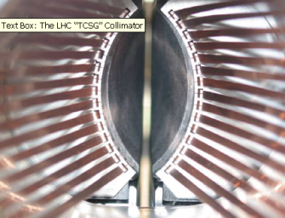
8 essentially independent sectors
  3.3 km of dipoles/quadrupoles++ mostly at 1.9 K
  plus…
and more instrumentation than you can wave a stick at

Slide 15
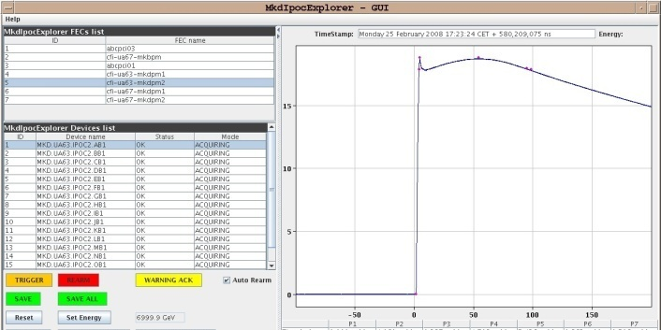
Integration tests – beam dump
Both beam dump firing – controls and software tested
Reliability runs in progress

Slide 16
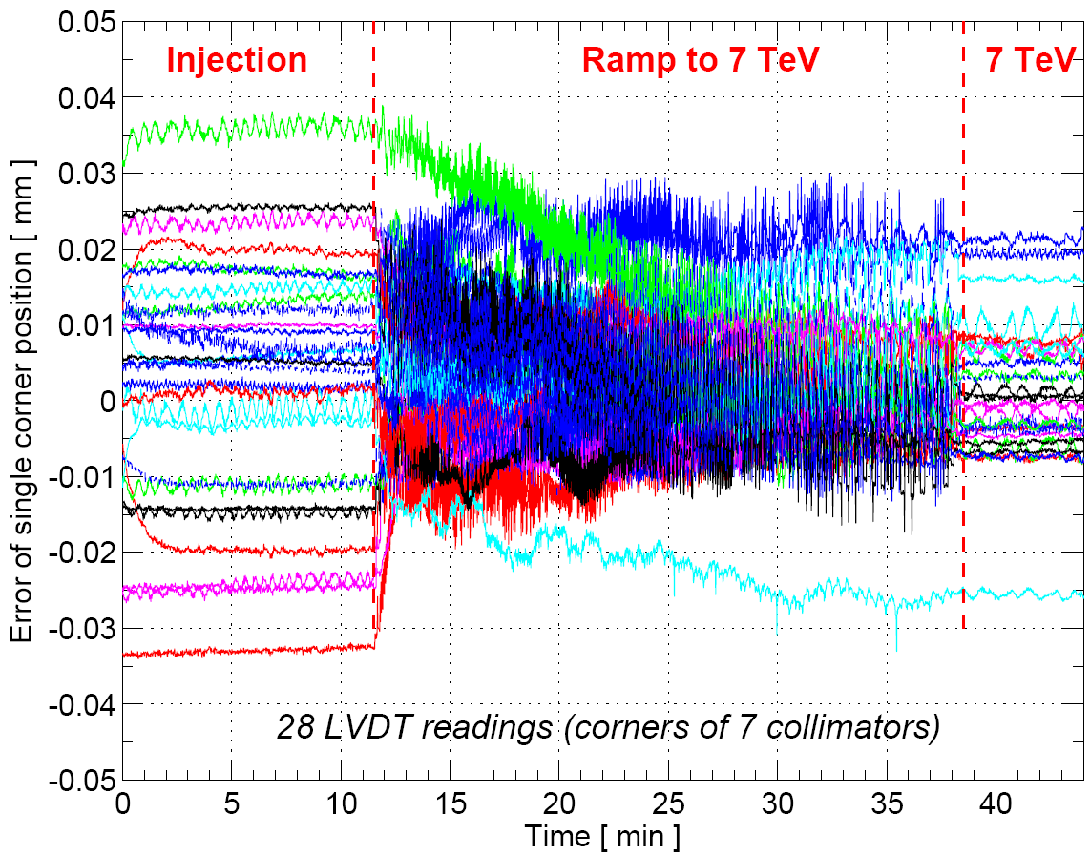
Integration tests - collimators

Slide 17
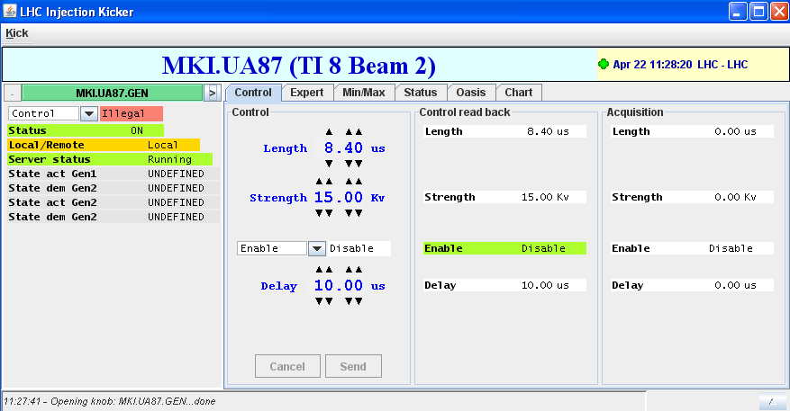
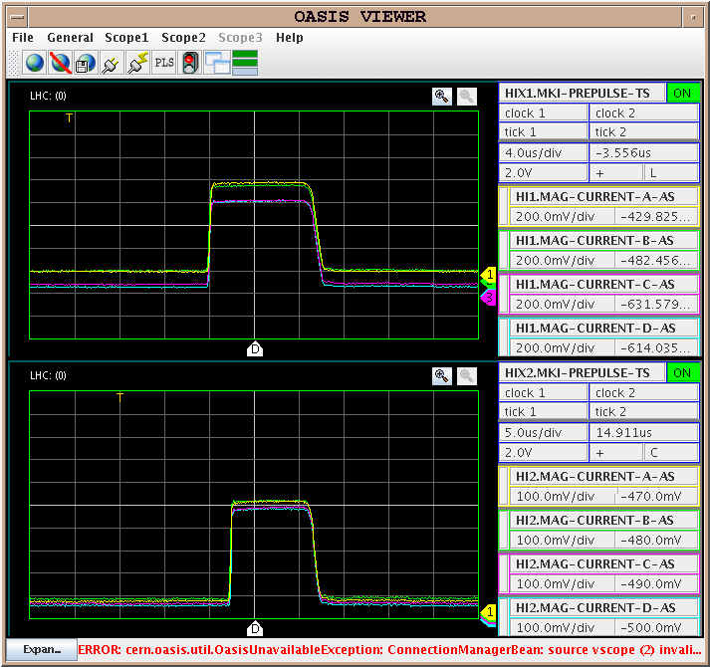
Integration tests – Injection
Pulsing nominal voltage
Control, monitoring, logging, settings, FD, OASIS
Basic injection sequence ring1/ring2
Timing events etc.
Pre-pulses
Abort Gap Keeper
Advanced injection sequence

Slide 18
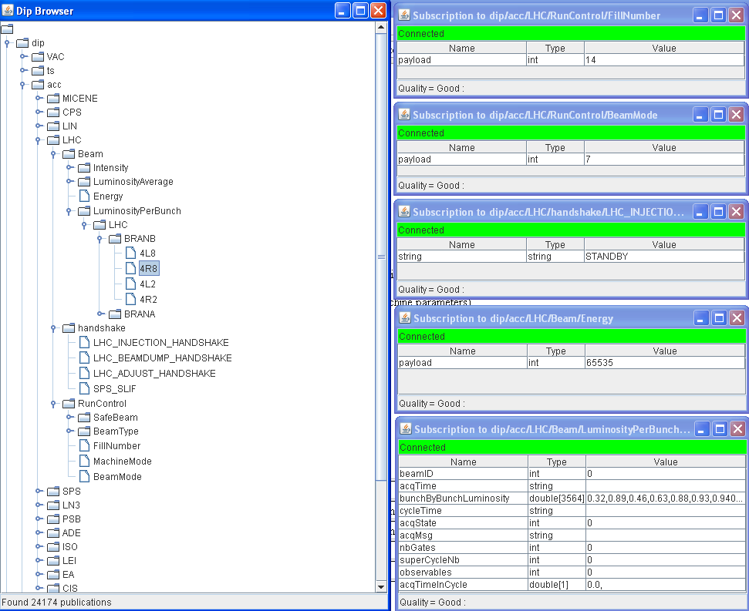
Integration tests – experiment communication

Slide 19
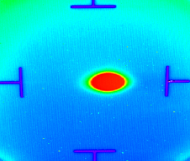
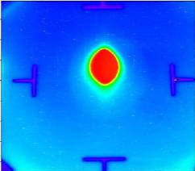
LHC transfer lines
Last Saturday
IR8
TI 8
SPS
LHC
IR2
TI 2
TI 2 beam test 28./29.10.07
PMI2
+ Nominal LHC beam in SPS
Courtesy of V. Mertens

Slide 20
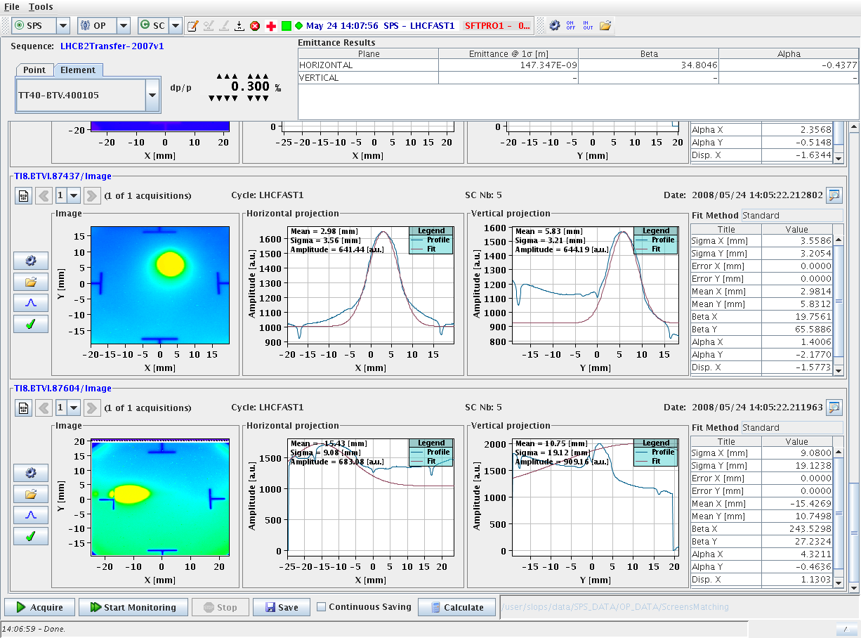
Down TI8 first time - again
Last screen in TI8

Slide 21
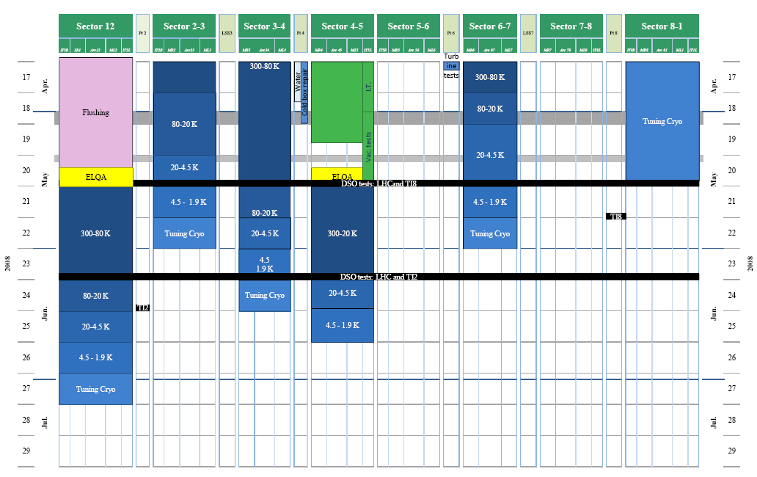
General Coordination Schedule ‐ wk.10 (update wk. 19)
✓+
✓
✓
✓
✓-
✓
✓

Slide 22
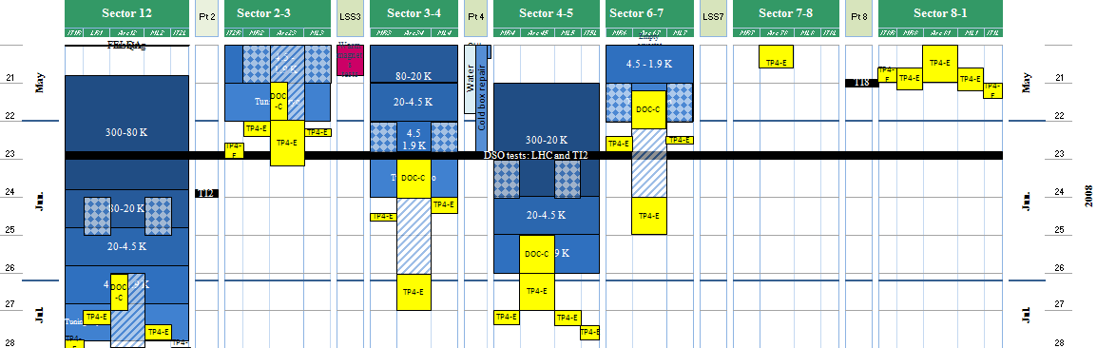
Short term planning
Week 22
Cryo intrum.
LSS level gauges
Katy Foraz

Slide 23
Planning - overview
24/25 May | TI8 – close 78/81 and LHCb
14/15 June | TI2 - close 12/23 and Alice
Early July | The LHC is expected to be cooled down.
Middle July | The experimental caverns will be closed after the caverns and tunnel have been patrolled. From then on the controlled access system will be fully activated.
Last two weeks July | - Powering tests - Machine checkout: vacuum, access, machine protection, system tests etc
End July | First particles injected, commissioning with beams will start…

Slide 24
Beam Commissioning to 7 TeV Collisions
 |  | Rings | Total [days]
1 | Injection and first turn | 2 | 4
2 | Circulating beam | 2 | 3
3 | 450 GeV - initial | 2 | 4
4 | 450 GeV - detailed | 2 | 5
5 | 450 GeV - two beams plus collisions | 1 | 2
6 | Ramp | 2 | 10
7 | 7 TeV measurements plus exp. magnets | 2 | 2
8 | 7 TeV - setup for physics | 1 | 1
9 | Physics un-squeezed | 1 | -
 | TOTAL TO FIRST COLLISIONS |  | 31
 | Commission squeeze | 2 | 6
 | Increase Intensity | 2 | 6
 | Set-up physics - partially squeezed. | 1 | 2
 | Pilot physics run

Slide 25
Initial conditions
Energy: 5 TeV
Initial optics:
  β*= 11 m in IR 1 & 5
  β*= 10 m in IR 2 & 8
Crossing angles off
  Low bunch intensity
  1, 12, 43, 156 bunches per beam
  No parasitic encounters - no long range beam-beam
  Larger aperture in IRs

Slide 26
Stage A: First Collisions
Approx 30 days of beam time to establish first collisions
  Un-squeezed
  Low intensity
Approx 2 months elapsed time
  Given reasonably optimistic machine availability
Continued commissioning thereafter
  Increased intensity
  Squeeze
RHIC 2000:
- First beam April 3rd
- First successful ramp: June 1st
- First collisions June 12th

Slide 27
Stage A - Luminosities
1 to N to 43 to 156 bunches per beam
N bunches displaced in one beam for LHCb
Pushing gradually one or all of:
  Bunches per beam
  Squeeze
  Bunch intensity
IP 1 & 5
Bunches | β* | I_{b} | Luminosity | Event rate
1 x 1 | 11 | 10¹⁰ | ~10²⁷ | Low
43 x 43 | 11 | 3 x 10¹⁰ | 6 x 10²⁹ | 0.05
43 x 43 | 4 | 3 x 10¹⁰ | 1.7 x 10³⁰ | 0.21
43 x 43 | 2 | 4 x 10¹⁰ | 6.1 x 10³⁰ | 0.76
156 x 156 | 4 | 4 x 10¹⁰ | 1.1 x 10³¹ | 0.38
156 x 156 | 4 | 9 x 10¹⁰ | 5.6 x10³¹ | 1.9
156 x 156 | 2 | 9 x 10¹⁰ | 1.1 x10³² | 3.9

Slide 28
Pilot physics – the first month
Interleaved physics and commissioning
Push number of bunches, intensity, squeeze…
  156 x 156
  3 x 10¹⁰ protons per bunch
  β* = 2 m.
Peak luminosity: ~1.2 x 10³¹
Integrated: few pb⁻¹
Pushing the bunch intensities with 156x156
with reasonable operational efficiency
another month would see 30 - 40 pb⁻¹

Slide 29
Conclusions 1/2
Cool-down going very well
  7/8 sectors either cold or cooling
  Last one starts this week
  Aiming for whole machine cold – first half July
Hardware commissioning
  Well oiled machine – very good progress
  Lots of things to follow-up, but mostly in shadow of on-going cool-down. No show stoppers at the moment.
Integration tests
  Ongoing for systems other than cold magnets

Slide 30
Conclusions 2/2
Schedule
  Close machine middle of July
  Followed by ~2-3 weeks
    powering tests of last sector
    in parallel with machine checkout
  Beam end July, early August
  1 -2 months for first collisions
DON’T PANIC!

