Slide 1
Daily Report LHC
5.12.2009

Slide 2
07:30-12:00: Aperture studies continued.
Stopped by beam-induced quench in cell 15R2 (injecting into orbit bump).
Beam intensity was around 4e9 p.

Slide 3
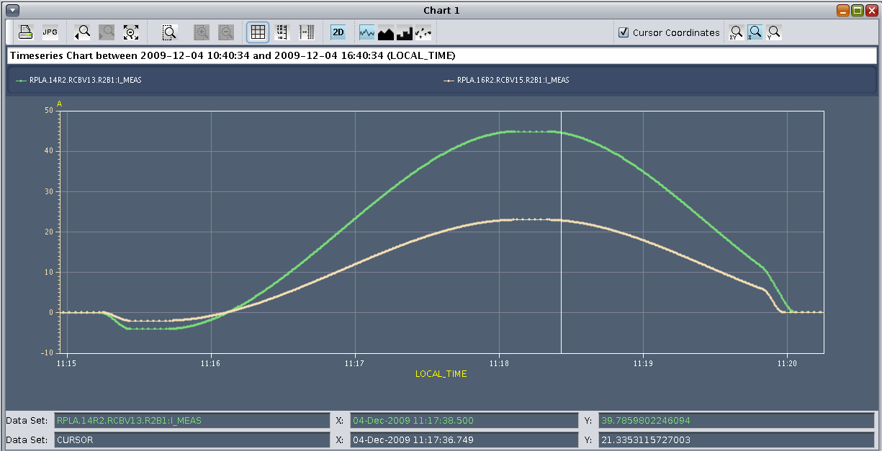

Slide 4
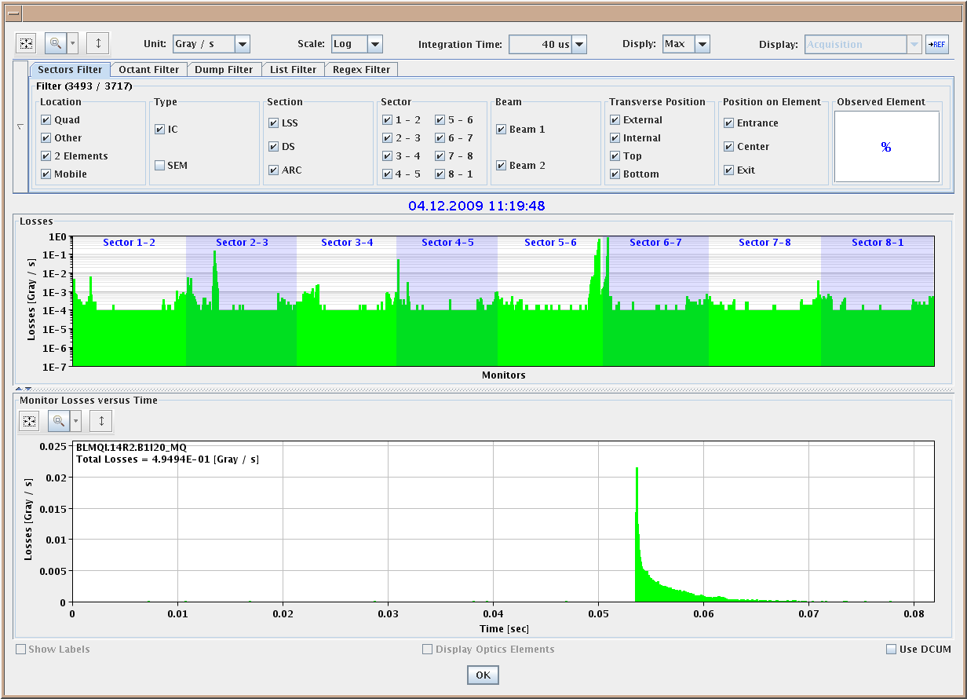

Slide 5
12:00-13:00: Prepare access (advanced this compared to schedule).
13:00-17:00: Access
Work on undulator, TOTEM, wire scanners, LBDS, RF damper and QPS. Intervention on PS magnets.
RF changed configuration: work with half the number of cavities and about the same total voltage (7 MV instead of 8 MV) to reduce power dissipation on the klystron collectors. Also, switch off cavities during no beam periods.
Further analysis of tune ripple observation.
17:00-19:00: Pre-cycle. No problems, except trips RSF2.A78.B1 and RSD2.A78.B2.

Slide 6
19:00-20:00: Injection set-up.
Unable to turn RF power on for module M1B1 for beam 1.
20:00-21:00: Beam 2.
Inject and correct beam 2.
20:30 -> For the first time two bunches in a single LHC beam (total intensity 7e9 p in beam 2).
Systematic checks for instrumentation and beam dump. All OK.

Slide 7
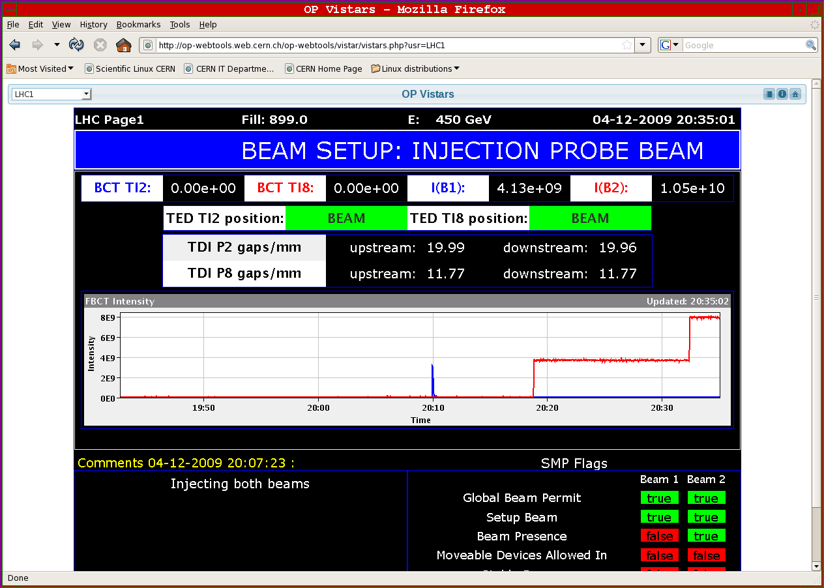

Slide 8
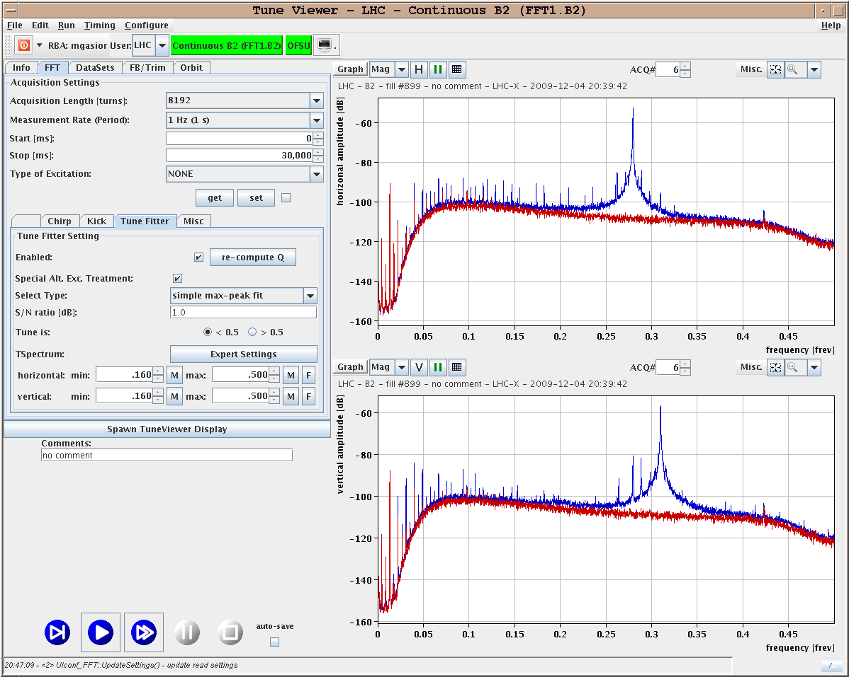

Slide 9
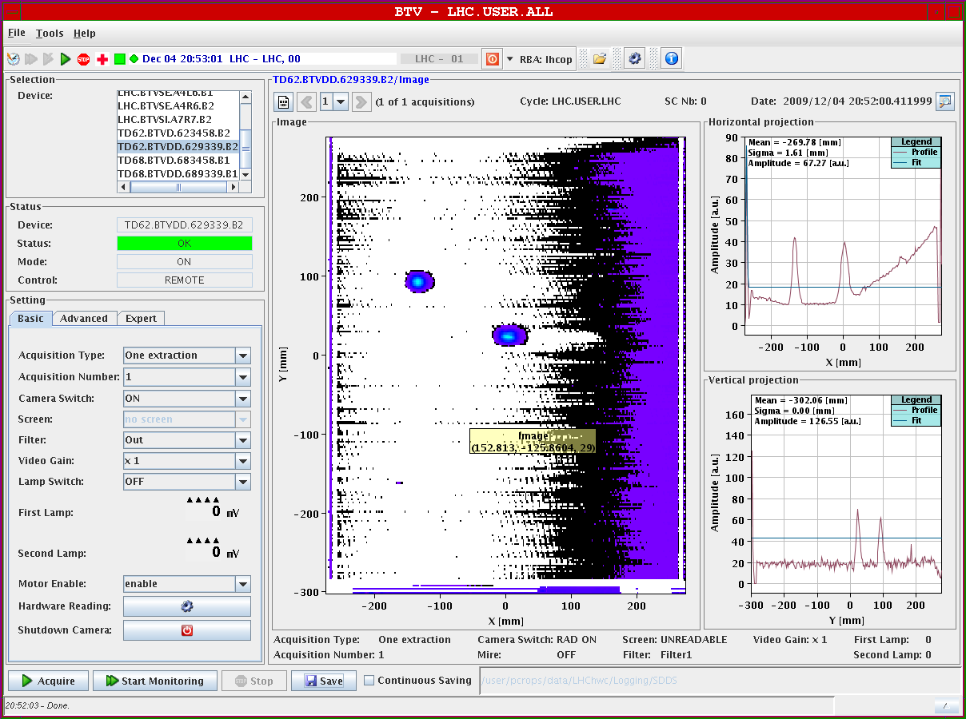

Slide 10
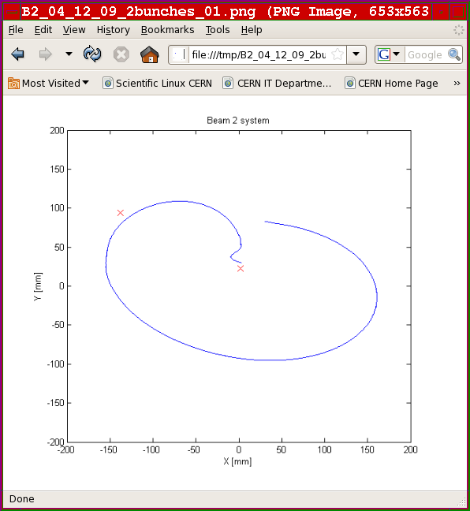

Slide 11
21:00-22:00: Beam 2 continued.
Undulator at 200A, no light seen.
Switching on LHCb spectrometer with beam 2.
Spectrometer at nominal 2106.371 micro-rad = 5850A (non-closure corrected later due to RF problem).
RF triggered beam dump. RF problem related to 18 kV distribution problem.
22:00-01:00: Work on RF. Injection set-up.

Slide 12
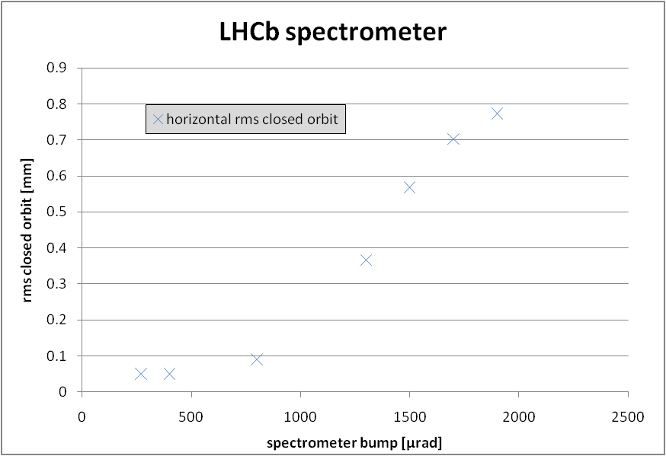

Slide 13
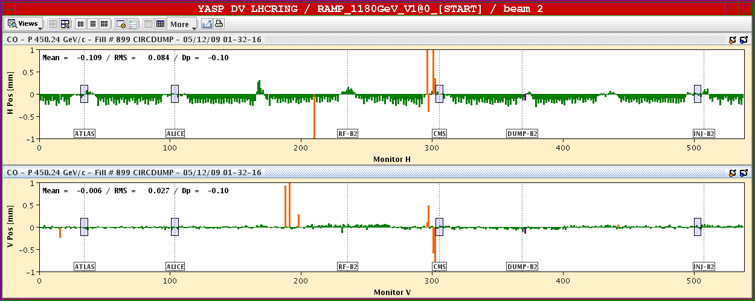

Slide 14
01:00-02:00: Beam2 continued.
LHCb spectrometer non-closure corrected on beam 2. Then beam 2 RF problems.
01:00-06:00: Beam1.
Beta beat studies. Beta-beating correction:
Dipole b2.
IR8 (computed on-line)
IR2 (as computed on the 29 Nov)
Improvement for most arcs in horizontal beta-beating for beam1. Clear big error in IP7 remains.Beam1 no longer available for a planned global correction due to an unmaskable interlock on MKD.
Beam2 has been unavailable throughout the shift. Initial plan was to test the 1000 turn capture mode with beam2, so this is not done.
100 beam dumps to verify change in dump kicker software.
Sequential Beam1 beta-beating correction of:
07:00-10:00: Prepare and perform pre-cycle.

Slide 15
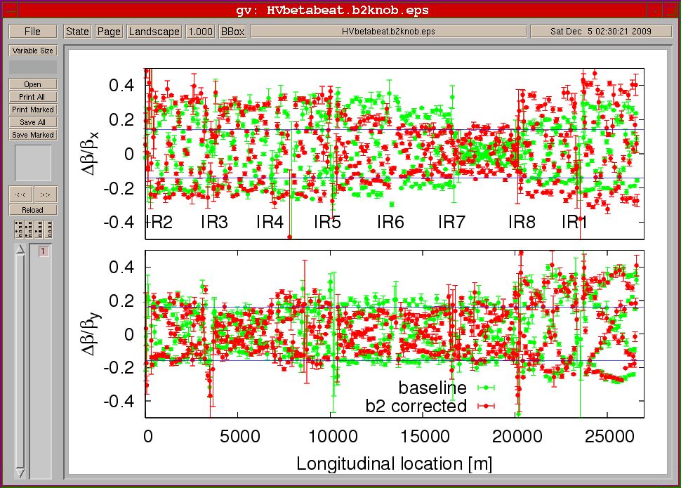

Slide 16
Program: Next Steps

