Slide 1
Report Friday 4.12.2009
Very efficient last 24h!

Slide 2
08:00-13:30: TDI and LBDS studies:
Ring injection protection set up for beam2 (+-6.8sigma for TDI, TCLIA, TCLIB plus TDI angle). Protection verified with injection failure tests with beam. Over-injection mode tested: requires some BLM interlocks disabled for this mode.
b) Dumpline trajectories verified for beam 1 and beam 2. Dump failure tests with beam.
c) IR6 aperture scans with bumps for both beams. No sign of abnormal aperture limits.

Slide 3
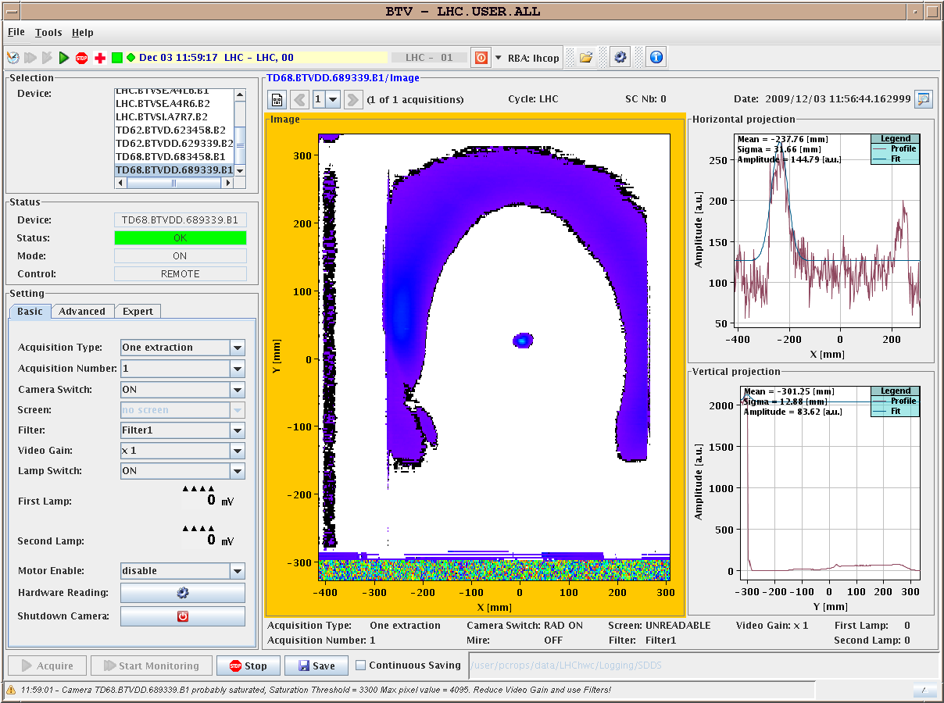

Slide 4
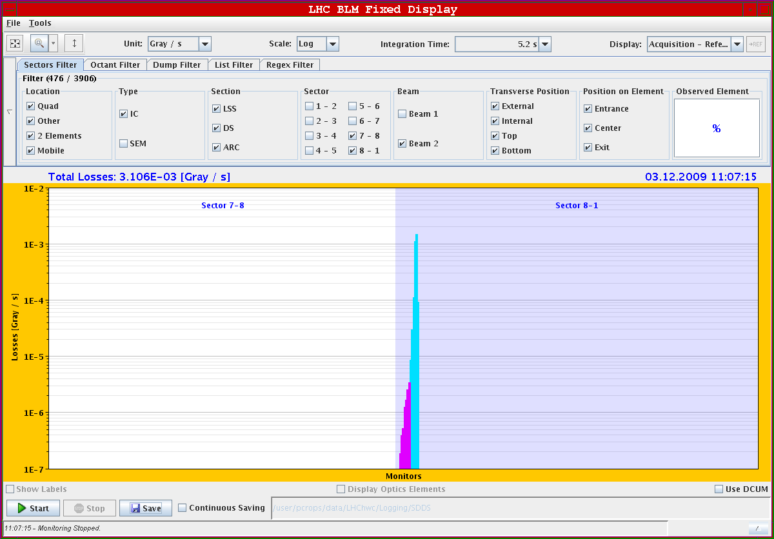

Slide 5
13:30-15:00: Beam instrumentation checks.
Q/Q' and coupling measurements.
Tune stability issue H plane: tune walks around at 0.001 level.

Slide 6
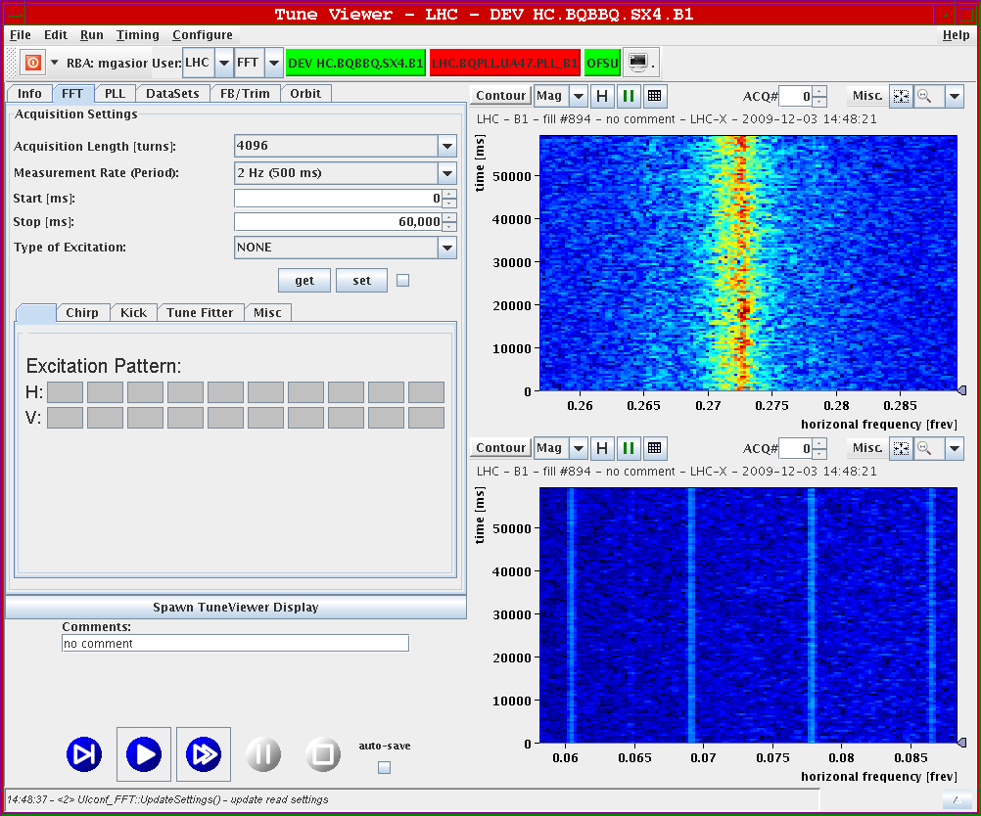

Slide 7
15:00-23:00: IR aperture checks.
CMS aperture scan is OK.
ALICE aperture scan is OK.
In ATLAS the V plane is OK (respectively similar to the other experiments). The H plane is 'different' from all other IRs. ATLAS dumped with the BCM on both beams, while the machine BLMs never gave any significant signal (in the V plane the BLMs gave the usual signals): both beam1 and beam2. Went to relatively large amplitudes, even though less than in other IRs. Be careful not to draw hasty conclusions.

Slide 8
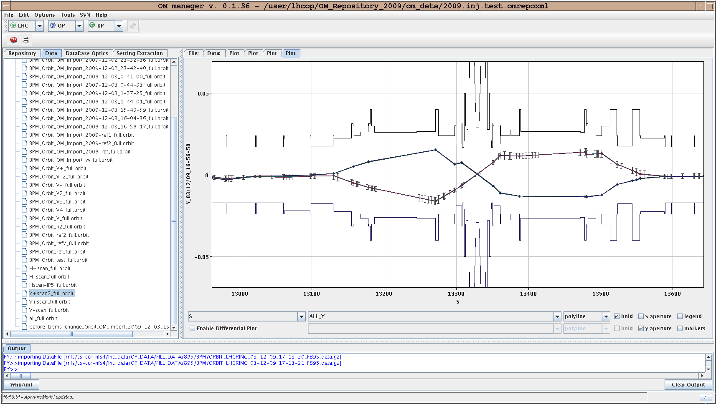
CMS (vertical)

Slide 9
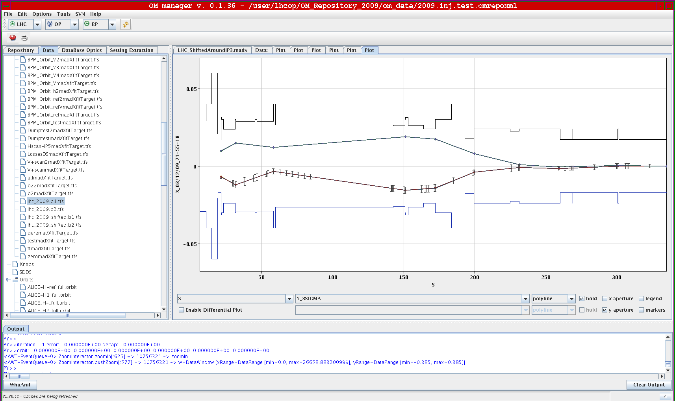
ATLAS (vertical)

Slide 10
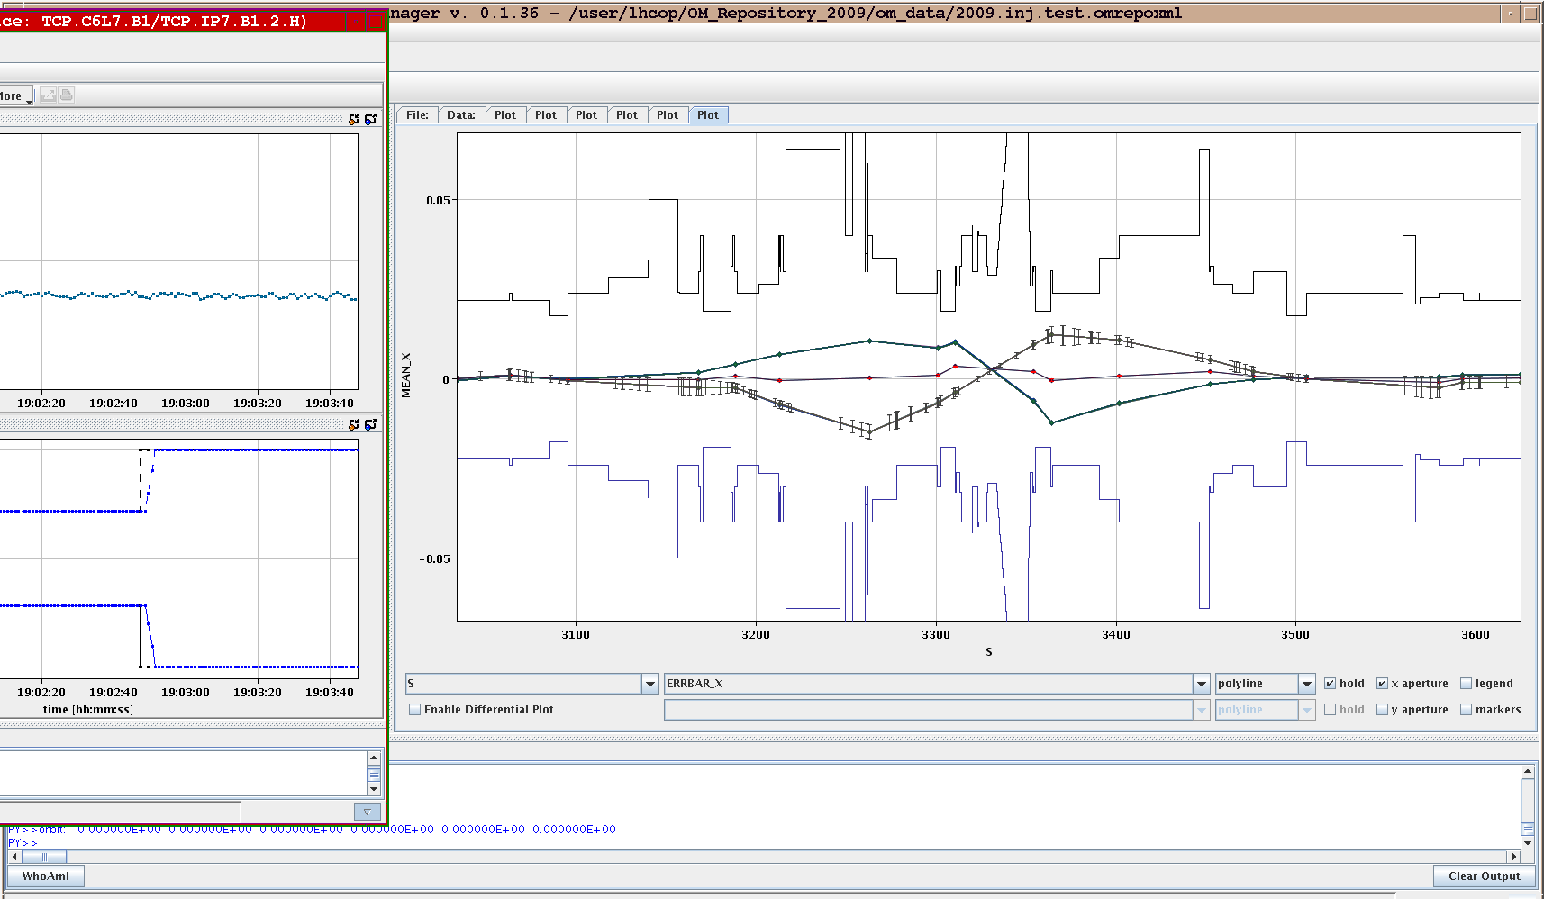
ALICE (horizontal)

Slide 11
00:00-07:30: Separation bumps and crossing angle.
All bumps switched on individually. No problems (polarity etc). Non-closure and dispersion verified.
Luminosity scan knobs tested successfully.
Finally at 06:25 all separation bumps and crossing angles (nominal injection values) switched on and both beams injected with NO major losses. IP8 losses not related to IR setup (stayed unchanged). No sign of problems with cross-talk from MCBX’s (nested IP correctors).
Orbit saved and bumps removed.

Slide 12
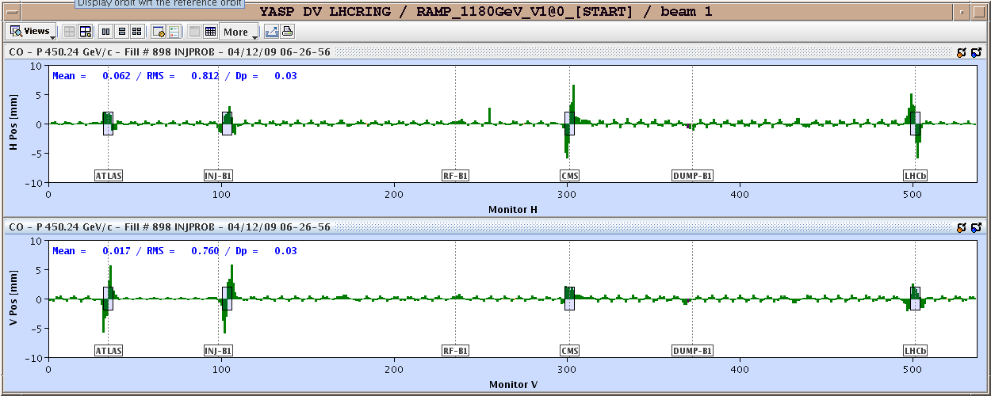

Slide 13
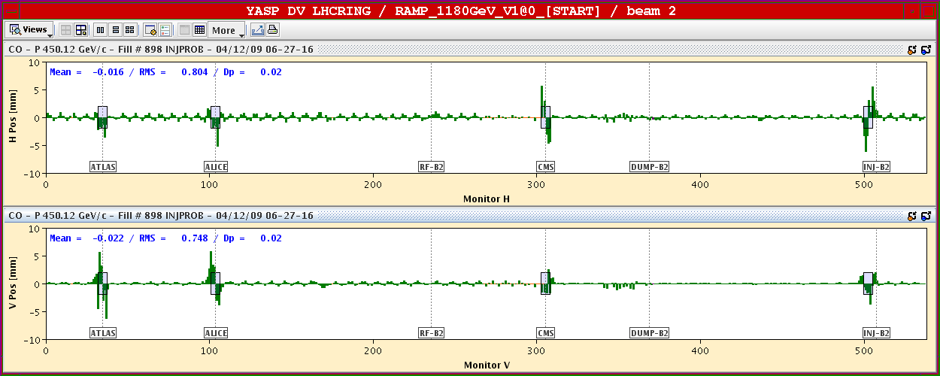

Slide 14
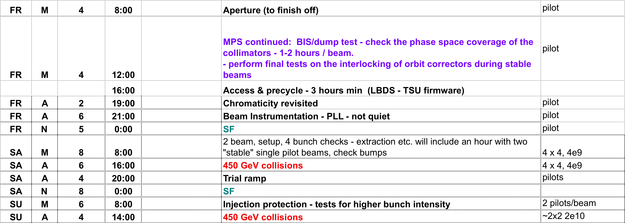
Access: IR6 LBDS
IR4 Wire Scanner
IR4 undulator
Cryo intervention ROD.A45.B2 (replace card)

