Slide 1
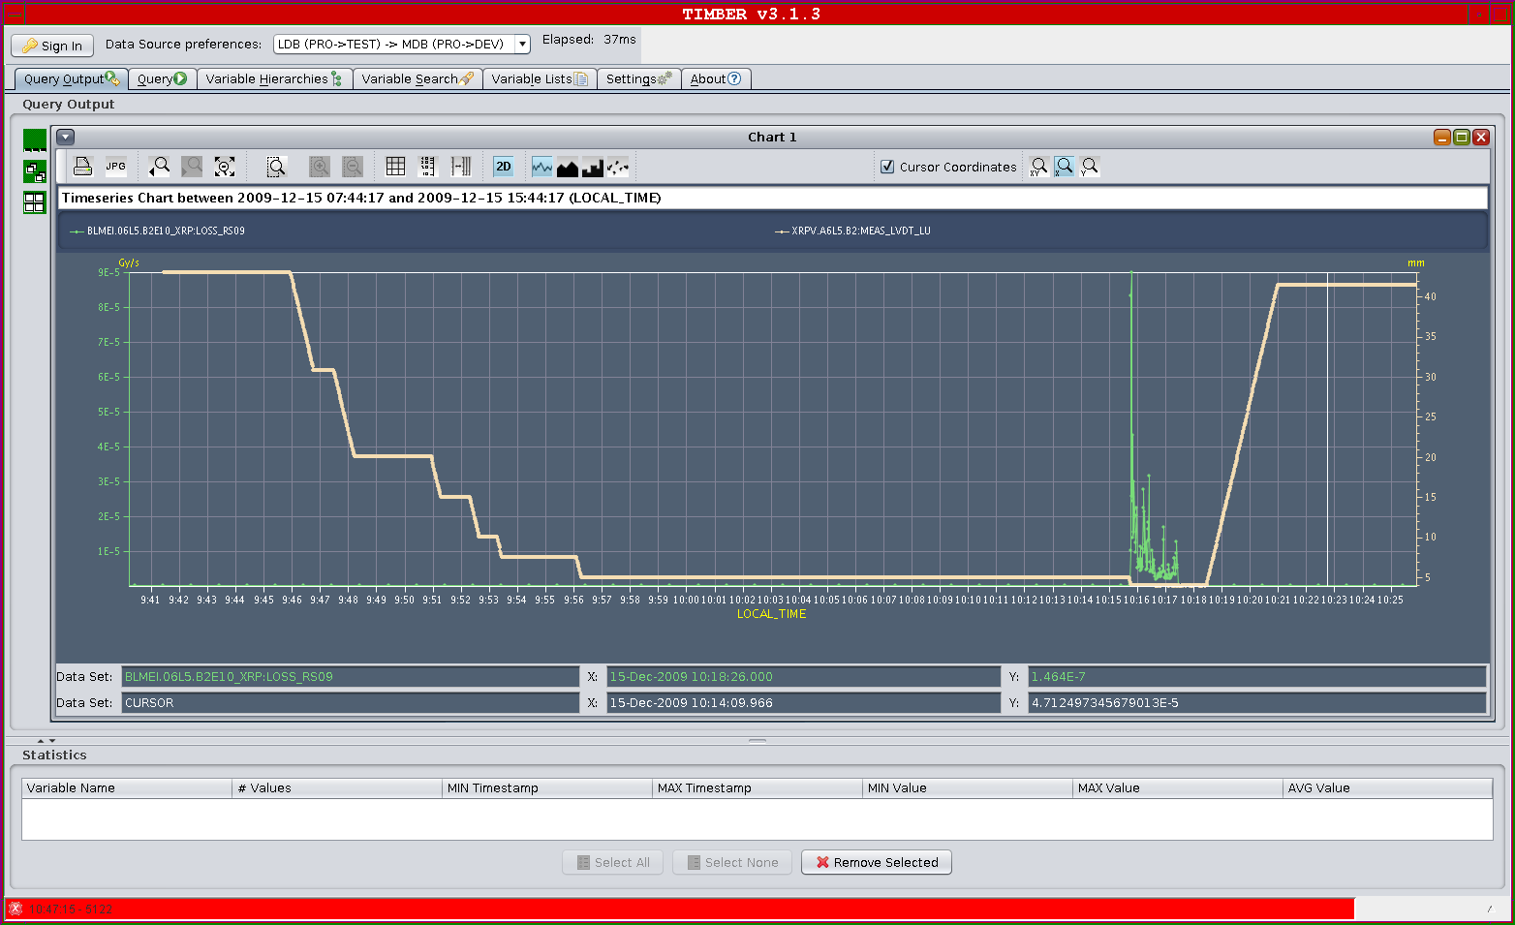
15/12/2009
Vacuum interlock in sector 78 understood ➔ out-gassing of a Penning gauge ignited as a result of ionization or dust arcing
In conclusion: NO LEAK, just a problem of vacuum instrumentation, VSC following up the issue
Re-injected beam at ~08:30
TOTEM test from 08:30 to 10:30

Slide 2
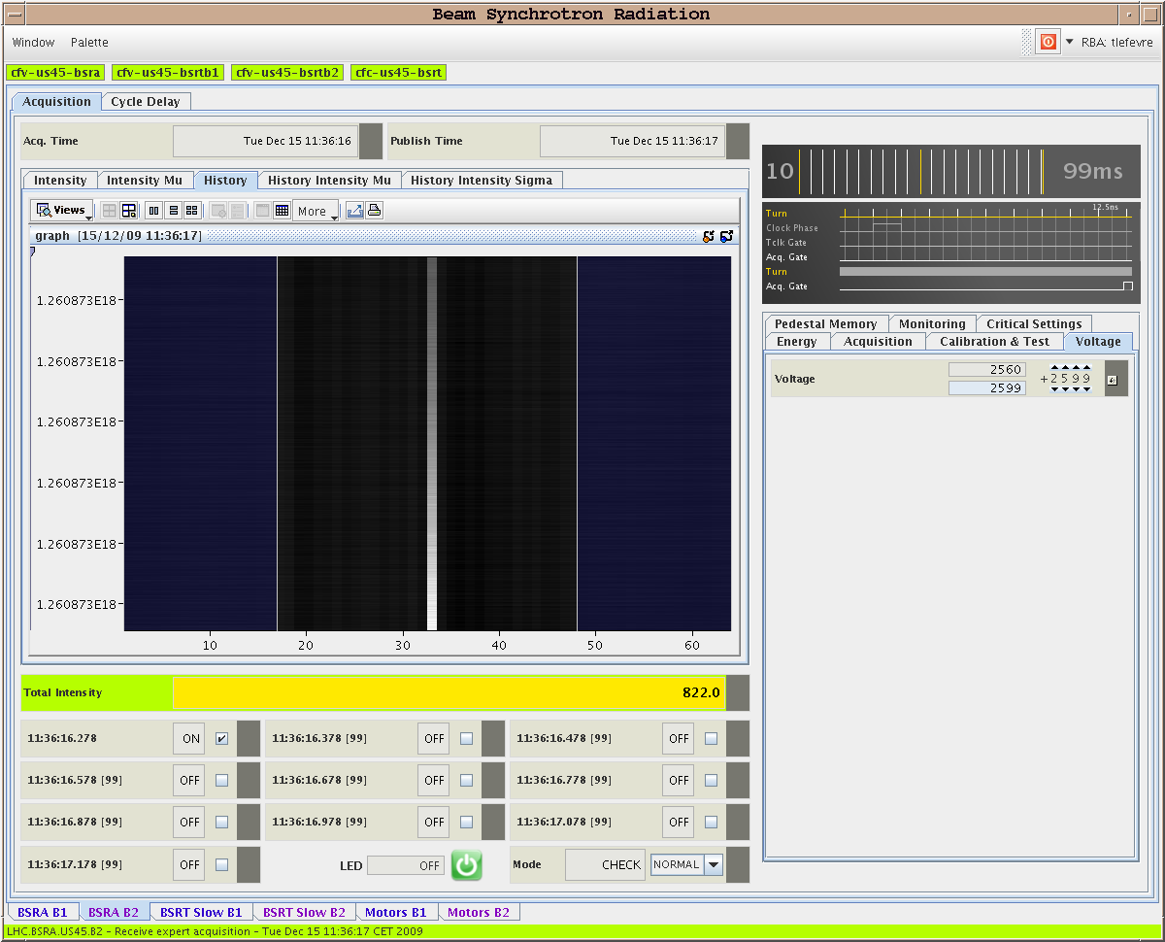
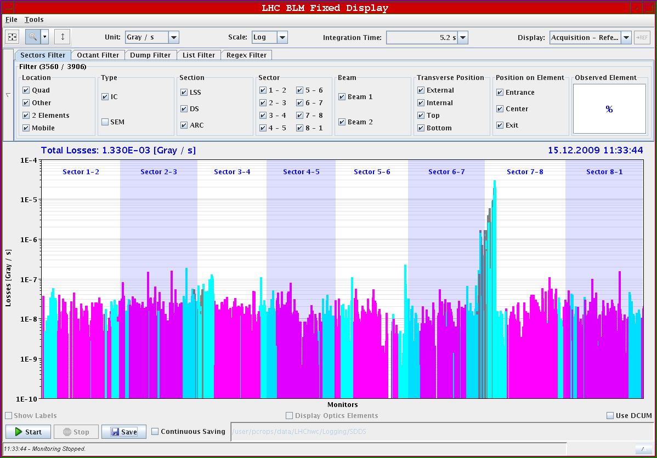
15/12/2009
10:30 -15:00 Abort gap cleaning tests
Cleaning of a selected bunch observed
Attempted gap cleaning on un-bunched beam
Some controls issues on abort gap monitors

Slide 3
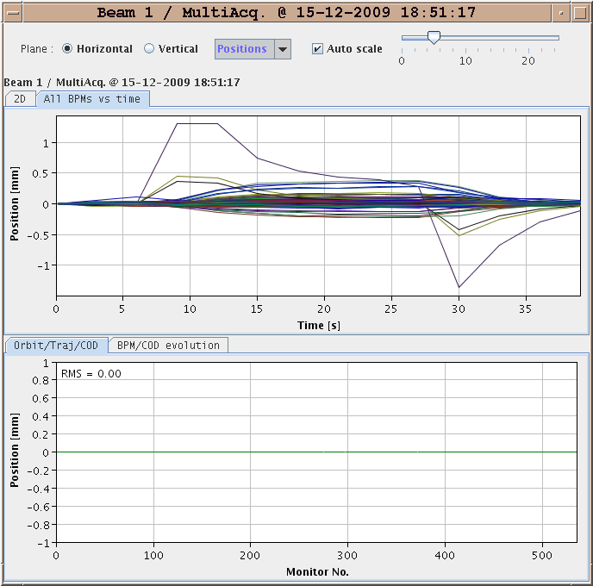
15/12/2009
15:00-19:00 Orbit feedback
Checked by using small orbit bumps trimmed via LSA and that were removed by the feedback
Still some work to be done before putting in operation

Slide 4
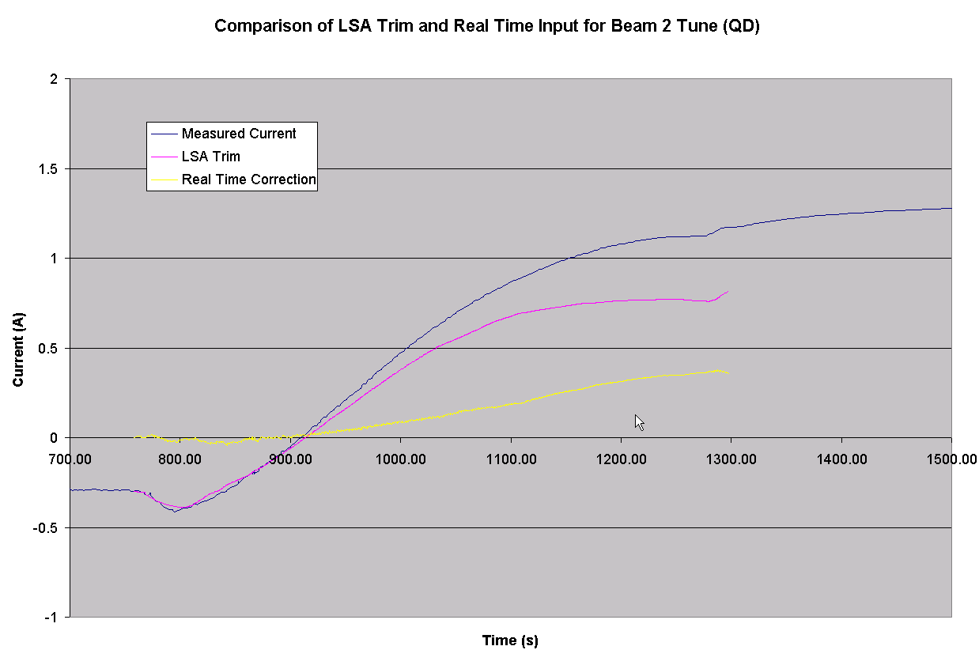
15/12/2009
Ramp with tune feedback very smooth: feedback takes care of the decay at the end of the ramp

Slide 5
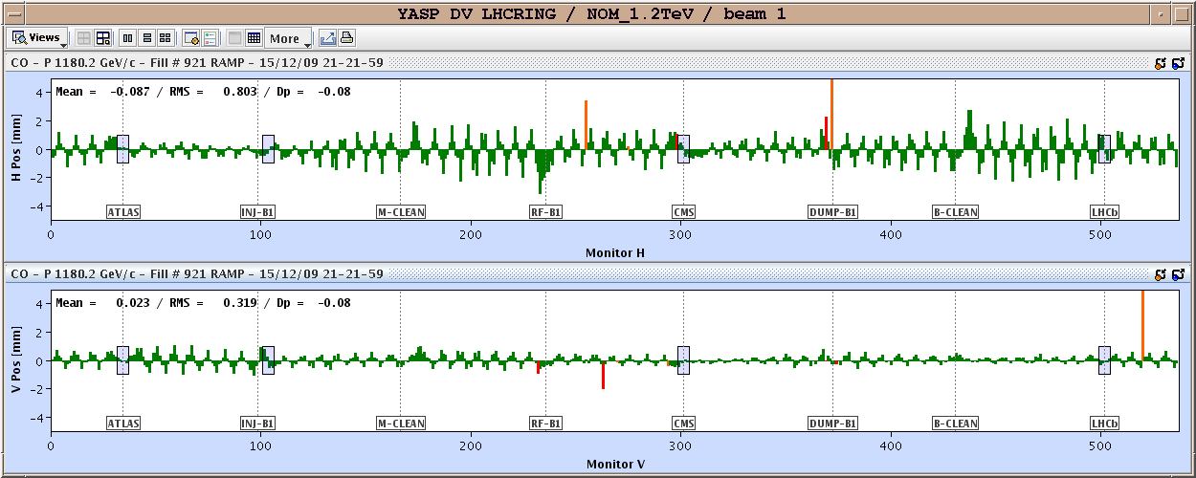
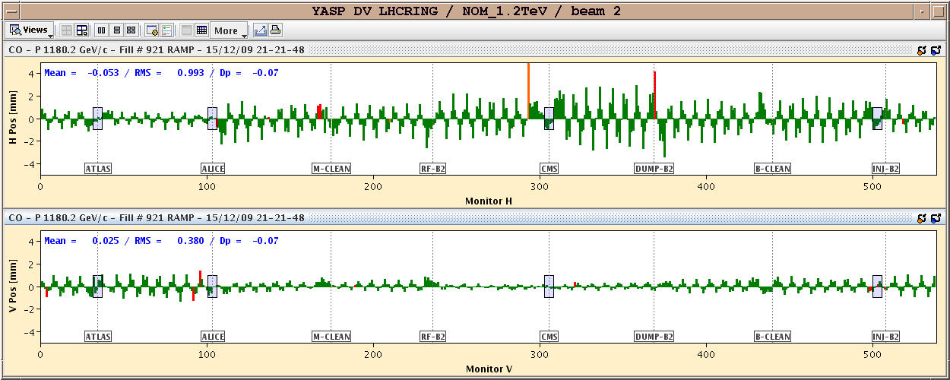
15/12/2009
Orbit at high energy requiring corrections

Slide 6
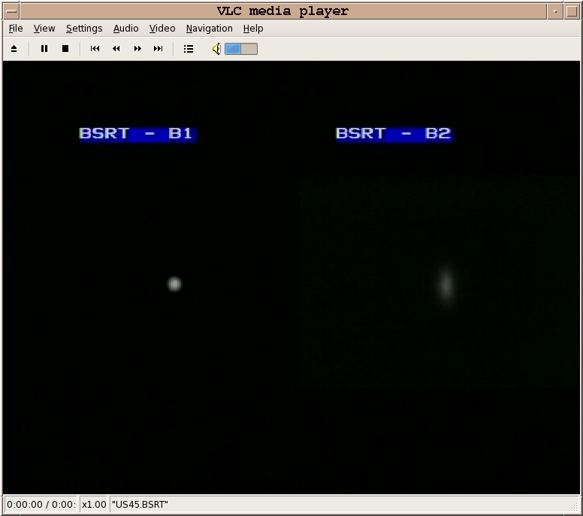
15-16/12/2009
21:40 Beam dump due to triplet orbit corrector induced by a “wild” trim of the orbit feedback (thought to be disabled)
00:00 Ready for injection
01:00 1.18 TeV
Vertical blow-up in beam 2 visible

Slide 7
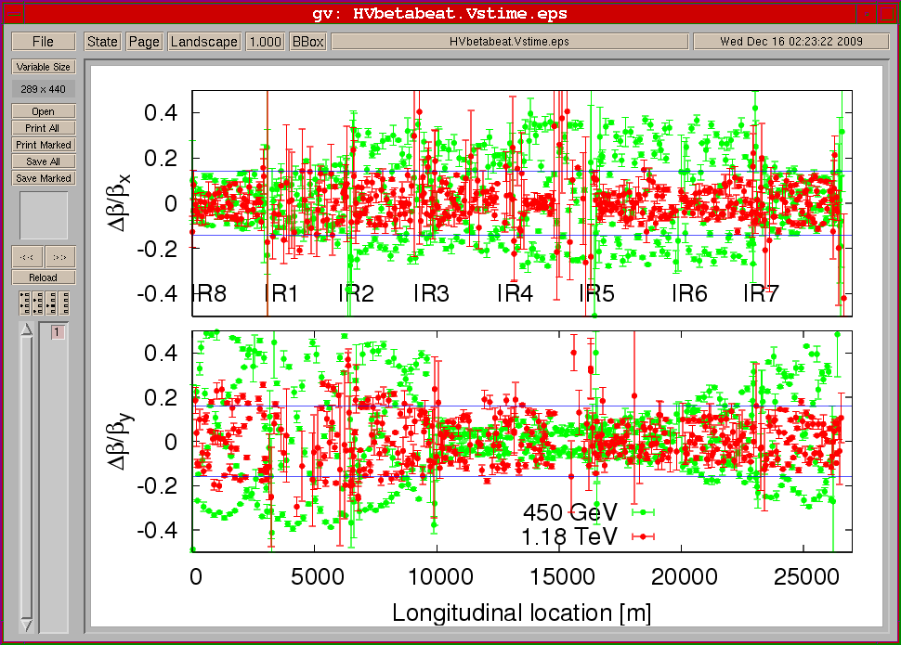
16/12/2009
Beta beating measurements for un-squeezed optics at 1.18 TeV for Beam 2: similar to what observed for beam 1. Optics within specs.

Slide 8
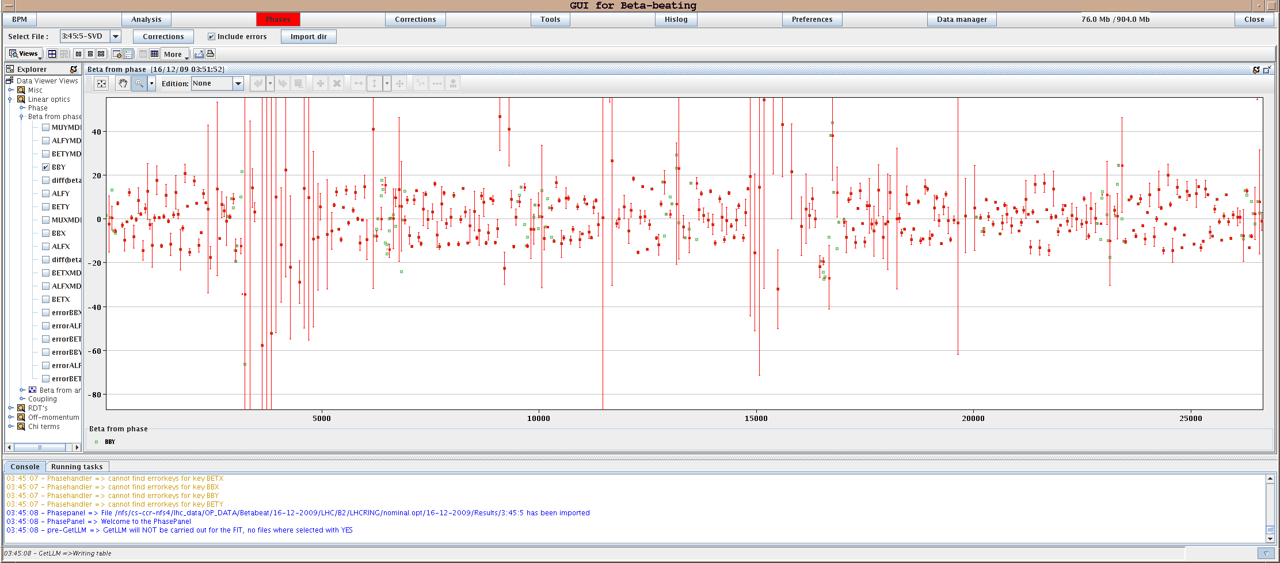
16/12/2009
02:30 Squeeze in IR5 to β*=9m.
After squeeze step 1: IP5 beta's H:8.48+- 0.2m (9.00) V:9.7+-0.4 (9.0)

Slide 9
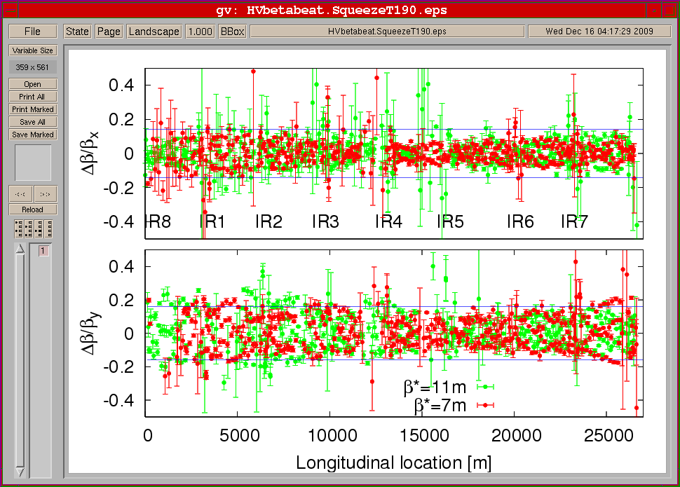
16/12/2009
02:50 Squeeze in IR5 to β*=7m. After squeeze step 2: IP5 beta's H:6.8+- 0.3m (7.00) V:7.5+-0.5 (7.0)
Hands-off from ~03:30 to 04:30 after rough separation tuning in IP1

Slide 10
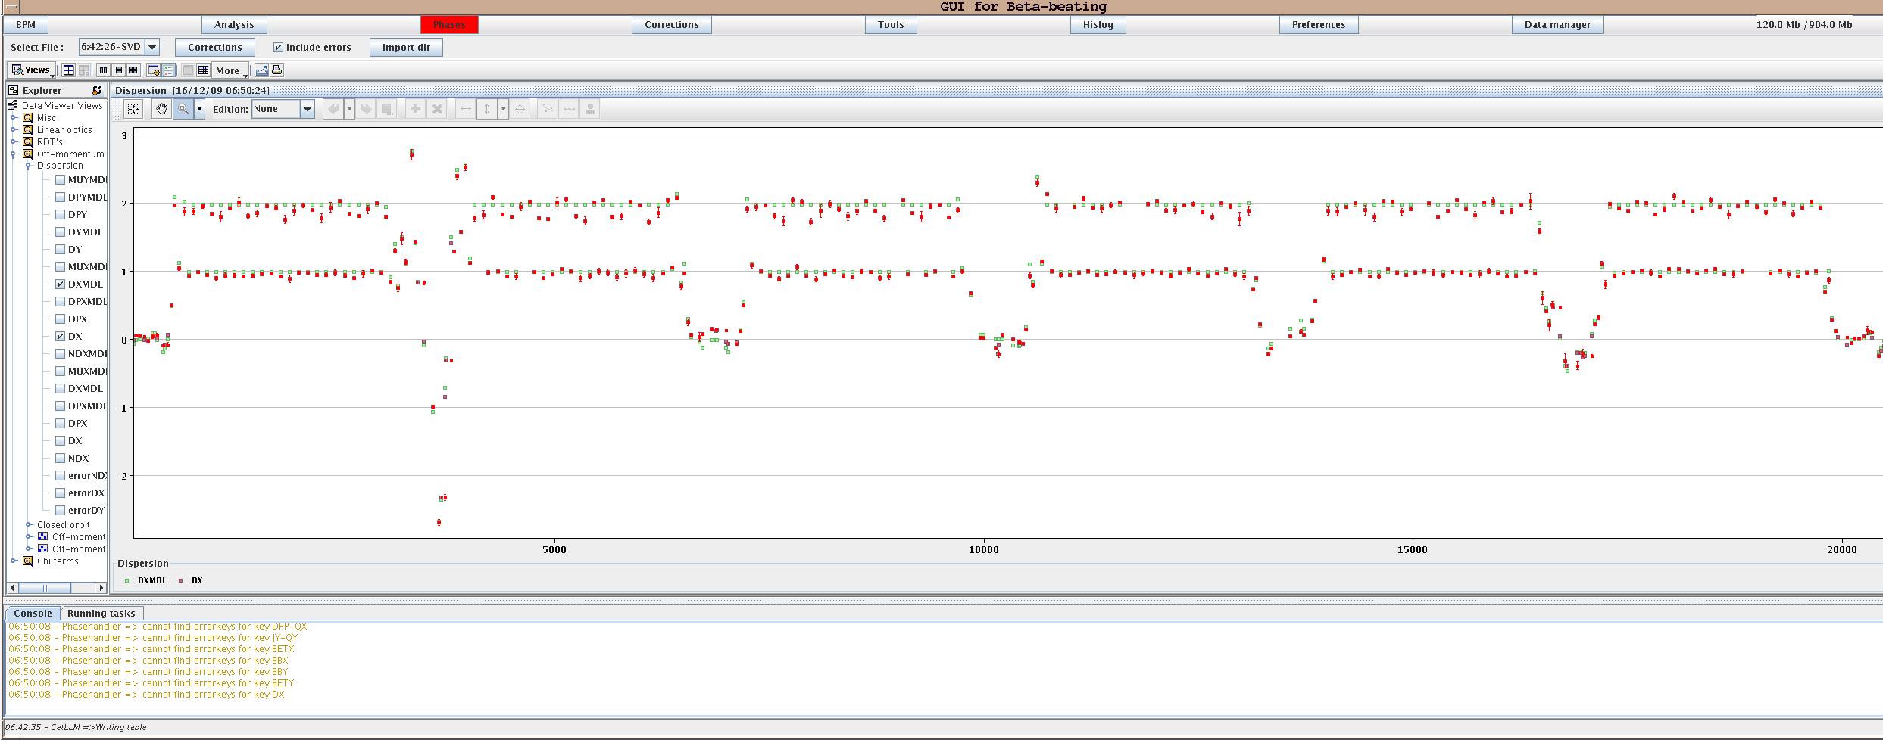
16/12/2009
Additional optics measurements until 05:30 (e.g. Dispersion for beam 1 with β*=7m)
Then energy extraction test in Sector 12 bends for measurements on the energy extraction switches (QPS team)
06:00-08:00 Machine pre-cycled

Slide 11
16/12/2009
08:00-10:00 Injection studies
10:00-12:00 ATLAS aperture
12:00-16:00 Lifetime studies
16:00-17:00 BLM-nQPS test
17:00-18:00 Intrusion test
18:00 End of Run

