Slide 1
Saturday 9.2.2013
02:42 stable beams fill 3541
7:45 beam dump by BPMS IP6 after 5 h in stable beams
8:35 re-injecting for LHCb VdM scan 338/338 bunches/beam
10:40 stable beams fill 3542
11:13 ALICE leveling reached head-on: start Van der Meer scan and length scale calibration in LHCb
13:30 VdM scan completed, re-optimize all collisions
15:00-15:19 Adjust:
Test for 50Hz noise / instability studies by separating the beams and reducing / switching off the ADT gain
15:19 operator beam dump
16:09 re-injecting
18:31 stable beams fill 3543

Slide 2
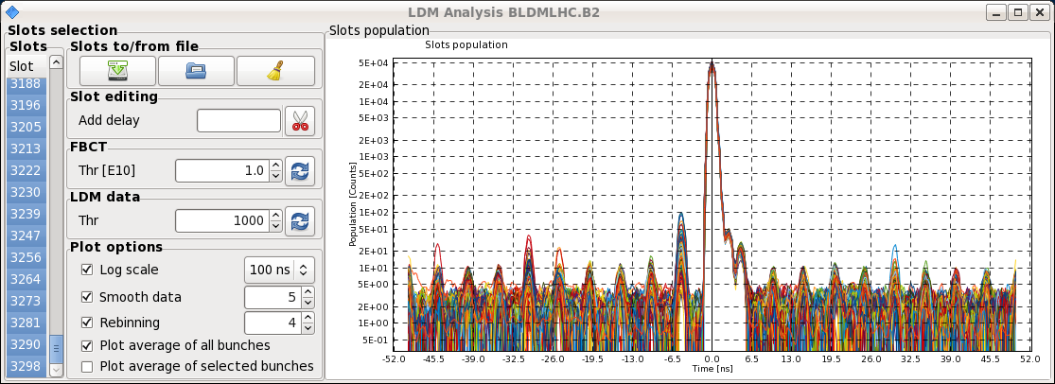
Satellite population comparable to last VdM scan

Slide 3
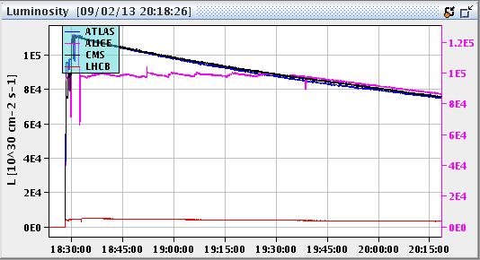
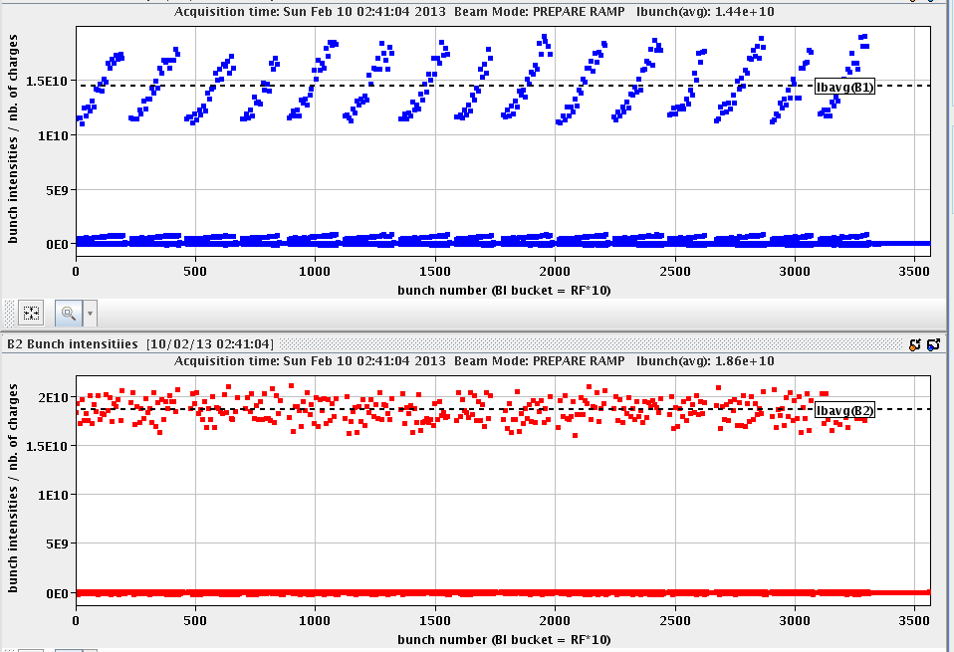
Night
19:39 ALICE leveling in head-on
1:06 beam dump by BPMS IP6 after 6.5 h in stable beams
1:54 re-injecting – very good beam from injectors
3:28 stable beams fill 3544
B1H
B1V

Slide 4
Morning
6:04 OP dump of the last Pb-p fill after 2.5 h in stable beams
ATLAS records
ALICE: 31.14 nb⁻¹
ATLAS: 30.25 nb⁻¹
CMS: 30.79 nb⁻¹
LHCb: 2.08 nb⁻¹

Slide 5
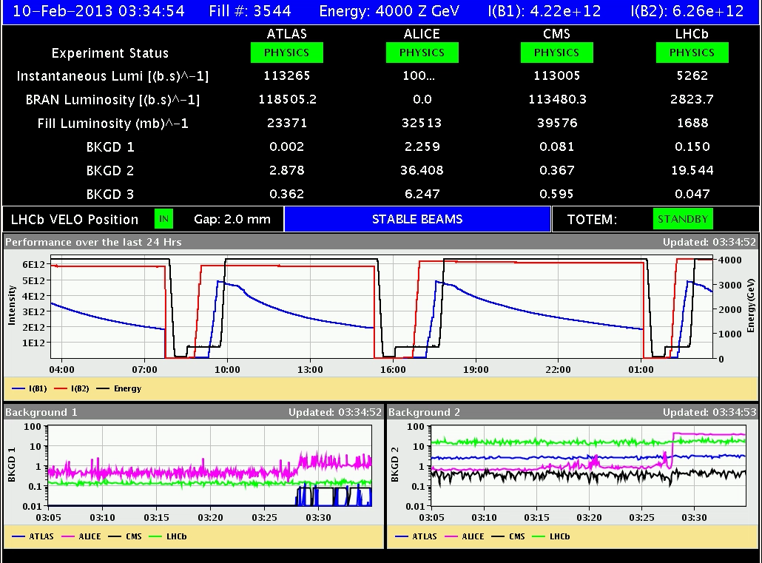
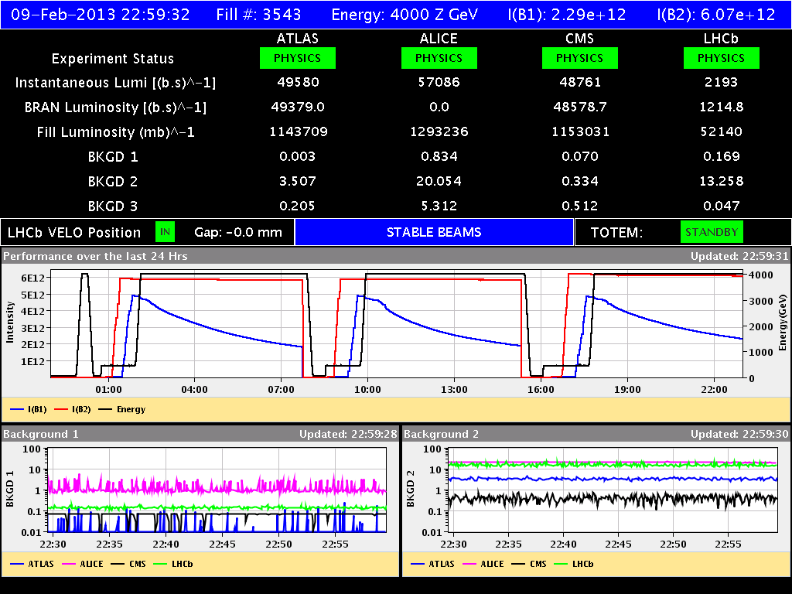
Day of Records

Slide 6
Stable Beams Statistics
Fill | Day | Peak L [10²⁸ cm-2s-1] | Stable beam [h] | Int L [nb-1] | Dump | # bunches [Pb/p]
3523 | Mon 4/2 | 7.2 | 4:22 | 0.74 | BPMS IP6 | 192 / 216
3524 | Mon 4/2 | 7.4 | 3:14 (+0:33) | 0.43 | BPMS IP6 | 192 / 216
3525 | Mon 4/2 | 10 | 2:09 | 0.64 | Trip of RQTL9.R3B2 | 338 / 338
3527 | Tue 5/2 | 10 | 4:22 | 1.04 | BPMS IP6 | 338 / 338
3529 | Tue 5/2 | 10 | 2:08 | 0.64 | S12 trip, likely SEU | 338 / 338
3533 | Wed 6/2 | 10.7 | 3:57 | 1.09 | BPMS IP6 | 338 / 338
3534 | Wed 6/2 | 11.5 | 5:03 | 1.28 | BPMS IP6 | 338 / 338
3535 | Thu 7/2 | 10.2 | 5:07 | 1.33 | SIS orbit correctors (EoF test) | 338/338
3537 | Thu 7/2 | 10 | 5:16 | 0.8 (VdM) | BPMS IP6 | 314/272
3538 | Fri 8/2 | 9.6 | 10:00 | 1.98 (ALICE only) | BPMS IP6 | 338/338
3540 | Fri 8/2 | 8.5 | 1:57 | 0.5 (VdM) | QPS RQX.L8 | 314/272
3541 | Sat 9/2 | 11.6 | 5:03 | 1.28 | BPMS IP6 | 338/338
3542 | Sat 9/2 | 11.7 | 3:57 | 1.17 | OP dump | 338/338
3543 | Sat 9/2 | 12.4 | 6:34 | 1.67 | OP dump | 338/338

Slide 7
Preparations for pp run
Access starts at 7:00
Already done: - hypercycle change - RF ramp rate back to 40Hz/s - ADT injection gain to 0.08 (to be checked/confirmed) - launched ALICE solenoid/dipole sequences for polarity change - launched RU.L4 reset sequence

Slide 8
1.38 TeV p-p run
Access to set-up for the higher intensity → start at 7:00 AM
BPMS IP6 (high intensity protons), BBQ, Head-Tail, etc
ADT settings for high intensity (HW SR4) and possibly attenuator change (piquet)
Re-activate RF hardware interlock on total voltage (can be done before during ramp down)
Reverting ALICE polarity (LHCb polarity already good)
Revert BLM MFs
Revert BTVDD delay settings
Revert BPMS interlock windows to 70/100
ATLAS, CMS
Pre-cycle ~ 1 hour
1 cycle with probes for checkout, correcting chroma and tune, verify instrumentation and damper set-up → 10:00 – 14:00
Testing of interlock BPMS (~2 hours)
Loss maps at injection and asynchronous dump (4 hours)

Slide 9
1.38 TeV p-p run
1 cycle with 5 bunches 8-9x10^10 p/bunch for collimator setup (TCTs), collision setup, first loss maps & asynch. dump test in collision. (4-5 hours+ RP set-up and 1 hour data taking - if approved)
BSRT (B2) and beam dump checks with high intensity and LBDS check (B1) in parallel (5 hours)
1 cycle to complete off-momentum/betatron loss maps → (4 hours).
The hypercycle for 1.38 TeV is : 1.38TeV_2013.
Set total RF voltage to 10 MV at flat top for both beams. B1 is at 12 MV now.

Slide 10
1.38 TeV p-p run
Intensity ramp-up
1 fill with ~80 bunches
1 fill with ~500 bunches (including some individual bunches for VdM scans)
1374 bunches
Need to define filling scheme for 500 bunches

Slide 11
Validation
 | Injection (Inj. Prot. IN) | Injection (Inj. Prot. OUT) | Flat-top separated | Un-Squeezed Collision
Betatronic-H | tbd | tbd | tbd | tbd
Betatronic-V | tbd | tbd | tbd | tbd
Neg. off-mom | tbd | -- | -- | tbd (+500 Hz)
Pos. off-mom | tbd | -- | -- | --
Asynch dump | tbd | -- | -- | tbd
tbd=to be done

Slide 12
Pending
Accesses for quench test:
Scope installation in IP6 (12L6). 2 hours. It has priority over Q6L8 scope installation because we will need it on Monday morning (the first quench test). To be confirmed whether it can be done before high intensity tests/pp physics at intermediate energy
Fast measurement system on RQ6.L8 (30 min in the UA83 by Jaromir Ludwig). Ramp to 300 A afterwards.
LBDS check (E. Carlier – working hours) if in the shadow of another access

Slide 14
Fills that did not make it into stable beams
Fill | Day | Dump
3526 | Tue 5/2 | Switching on OFB after cogging | Losses IP7: Noisy BPM IP8 leads to orbit drift
3528 | Tue 5/2 | Switching on OFB after cogging | Problem diagnosed and BPM disabled
3531 | Tue 5/2 | Losses at start of ramp, IP3 collimation | Reduce blow-up at injection (from 1.4 to 1.1ns)
3532 | Tue 5/2 |  | Same problem with BPM as above – BPM was mysteriously re-enabled
3536 | Thu 7/2 | After cogging: SIS position interlock | Joerg has increased the limit for the orbit position SW_interlock by 0.2mm and Delphine added +4Hz to the cogging frequency trims to move the p+ beam closer to the center.
3539?

