Slide 1
Monday 4.2.2013
8:15 fill 3523 dumped by BPMs IP6
9:50 OFB gain settings increased by a factor 5, which corresponds to a reduction of orbit perturbations by a factor of 2.
→ Losses at max of 21% of BLM dump threshold
11:14 stable beams 3524
11:27 TOTEM and ALFA roman pots moved to physics setting
13:22 start testing B1 horizontal orbit bump in IP7, around RQ11.R7B1
Check if losses in this area can be spread more longitudinally
13:55 back to stable beams again
15:01 fill dumped by BPMs IP6

Slide 2
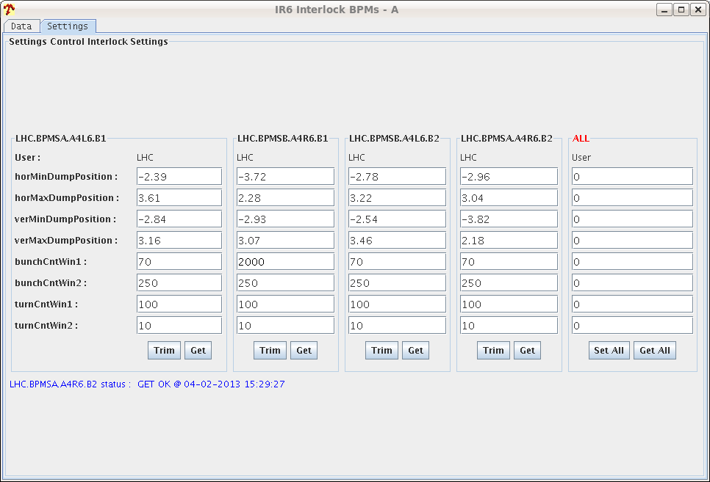
15:27 Interlock threshold relaxed on BPMSB.A4R6.B1 (the one which dumped the last couple of fills)

Slide 3
Evening
Filling 338 Pb 338 p with 5% less Pb intensity and marginally reduced transverse emittance from the injectors
Losses up to 54% on MQ 11R7
18:52 stable beams fill 3525
19:30 RF TOT VOLT increased to 14 MV (plan further increase to 16 MV after a couple of hours)
21:02 beam dump: Trip of RQTL9.R3B2, no fully understood, EPC piquet suspects an overvoltage in the line that made the power converter trip
During ramp down: reboot bpm crates (as recommended by Ralph Steinhagen)

Slide 4
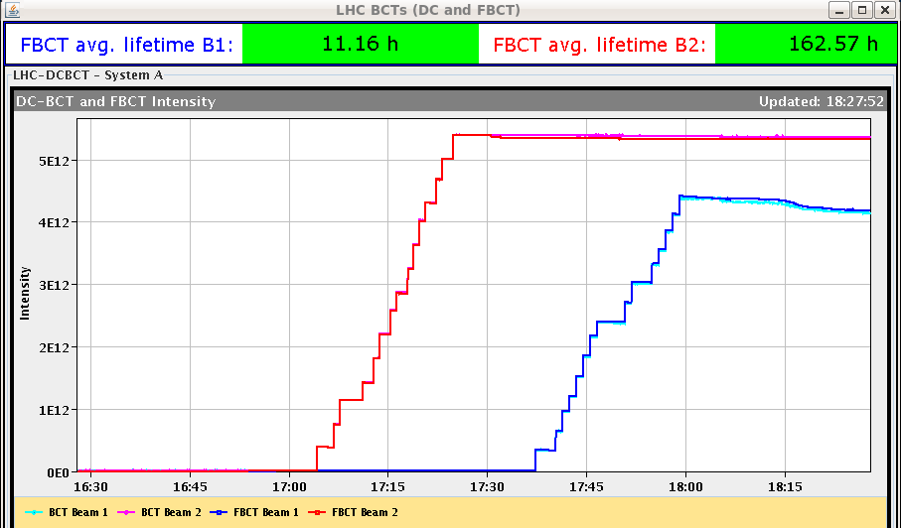
Fast BCT B1
JJ. Gras: The problem with the fast BCT on beam 1 as been investigated. It looks like beam 1 high gain acquisition chain saturates for bunches around 1.6e10p. I forced BCTFR beam 1 to low gain chain and it behaved correctly during following fill. Fine tuning of the phase and scaling factors still need to be done...

Slide 5
Night
0:04 dump of fill 3526 after cogging by BLM 11R7:
Orbit drift when switching on the OFB by 60-90um (BPMs flickering pink during the fill already)
Problem with TOTEM: they will stay OUT till fixed during daytime
Ralph Steinhagen was called:
reboot cfv-ccr-ctlbst1 and cfv-ccr-ctlbst2
restarts OFSU and the feedback controller
reboot the BPMLHCCONC_M under cfc-ccr-bqbpmlhc
→publication of position data still slow, otherwise all ok
3:12 stable beams fill 3527
3:23 RF voltage from 12 to 14 MV
7:35 beam dump of fill 3527 by BPMS in IP6

Slide 6
Stable Beams Statistics
Fill | Day | Peak L [cm-2s-1] | Stable beam [h] | Int L [nb-1] | Dump
3523 | Mon 4/2 | 7.2E+28 | 4:22 | 0.74 | BPMs IP6 | Pb: 192; p: 216
3524 | Mon 4/2 | 7.4E+28 | 3:14 (+0:33) | 0.43 | BPMs IP6 | Pb: 192; p: 216
3525 | Mon 4/2 | 10E+28 | 2:09 | 0.64 | Trip of RQTL9.R3B2 | Pb: 338; p: 338
3527 | Tue 5/2 | 10E+28 | 4:22 | 1.04 | BPMs IP6 | Pb: 338; p: 338

Slide 7
Planning
To be decided – possible measures to further reduce BLM loss/threshold ratio in cells 9R7 and 11R7:
BLM threshold increase
Local orbit bump
Tuesday: LHCb polarity switch
Wednesday: VdM scan
ALICE polarity reversal TBD pending decision on pp intermediate energy run
High intensity test for BSRT 4 hours (+ 2 hours access if no pp intermediate energy run)

Slide 8
1.38 TeV configuration and setting up
Jorg Wenninger / BE-OP-LHC
W. Herr, S. Redaelli, M. Lamont

Slide 9
2013 1.38 TeV run configuration
J. Wenninger
50 ns beam, full machine, not pushed.
Un-squeezed optics (β* = 10/11 m).
Crossing angles ±170 μrad (also IR8).
Separation ±1.5 mm.
LHCb in good polarity, ALICE in negative polarity (PC).
Beam size ~120 μm.
Provides ≥ 10 times larger L than in 2011.
Pre-cycle maintained at 4 TeV (also ramp down from 4 TeV).
With 10x larger luminosity than 2011 we need ~24 hours of stable beams for 2 pb⁻¹
No change wrt injection
Run | Nb | Ib | Nc | β* | ε (μm) | L (cm-2s-1) | Stored E (kJ) | Pile-up
2011 | 80 | 1.20E+11 | 68 | 11 | 2.7 | 4.34E+30 | 2122 | 0.45
2012 | 1374 | 1.20E+11 | 1000 | 11 | 2.2 | 7.75E+31 | 36451 | 0.54

Slide 10
Setup
J. Wenninger
Offline:
Prepare ramp to 1.38 TeV based on truncated 4 TeV ramp.
Collision BP.
Settings of IR7(3) collimators to be defined.
Online:
Reverting to high-intensity proton OP → 1 shift ?
1 cycle with probes for checkout, optics measurements.
1 cycle with 3 nominal bunches for collimator setup (TCTs), collision setup, first loss maps & asynch. dump test in collision.
→ 1½ - 2 shifts.
2 cycles to complete off-p /betatron loss maps → 1 shift.
Setup time ~ 24+ hours.
Plus 2 hours of access to set-up for the higher intensity

Slide 12
Recap 2011
Thursday 17th March : 1 shift of setup.
‘Run’: Thursday 24th March evening – Monday 28th March 06:00.
Un-squeezed, ~80 bunches, ~10¹¹ ppb,
L_{p}~ 4-5x10³⁰ cm⁻²s⁻¹,
35 hours of SB, L^{int} ~ 0.3 pb⁻¹.
Issues with interlock BPMs IR6 (bunch intensity too low).

Slide 13
2013 scenario 1
50 ns beam, not pushed.
Still to clarify radiation issues (injectors) – should be OK.
Filling scheme? Here assume 1000 bunch crossings.
Un-squeezed optics (β* = 10/11 m).
Crossing angles 170 μrad (to be confirmed).
Beam size ~120 μm.
Provides ≥ 10 times larger L than in 2011.
Run | Nb | Ib | Nc | β* | ε (μm) | L (cm-2s-1) | Stored E (kJ) | Pile-up
2011 | 80 | 1.20E+11 | 68 | 11 | 2.7 | 4.34E+30 | 2122 | 0.45
2012 | 1374 | 1.20E+11 | 1000 | 11 | 2.2 | 7.75E+31 | 36451 | 0.54

Slide 14
2013 scenario 2
No 50 ns beam, single bunch schema.
Squeezed optics.
Beam size in triplet
→ β* limit ~2.5 m (scaling 0.9 m from 4 TeV). Standard coll. settings.
No crossing angle needed.
Provides ~10 times larger L than in 2011.
To confirm: β* limit.
Run | Nb | Ib | Nc | β* | ε (μm) | L (cm-2s-1) | Stored E (kJ) | Pile-up
2011 | 80 | 1.20E+11 | 68 | 11 | 2.7 | 4.34E+30 | 2122 | 0.45
2012 /1 | 1374 | 1.20E+11 | 1000 | 11 | 2.2 | 7.75E+31 | 36451 | 0.54
2012 /2 | 150 | 1.20E+11 | 120 | 2.5 | 2.2 | 4.13E+31 | 3979 | 2.4

Slide 15
Comments
It is obviously possible to mix 1+2.
50 ns squeezed (with Xing angles).
50 ns beam situation to be confirmed.
Radiation in the injectors just before LS1 start.
β* limit to be confirmed.
Depends on details of collimator settings.
With 10x larger luminosity than 2011 we need ~24 hours of stable beams for 2 pb⁻¹.

Slide 16
Setup
Offline :
Prepare ramp to 1.38 TeV based on truncated 4 TeV ramp.
(Squeeze and) collision BP.
Settings of IR7(3) collimators to be defined.
Online:
Cycle(s) with probes for checkout, optics measurements & corrections.
Unsqueezed: 1 cycle / 1 shift.
Squeezed: 1-2 cycles / 1-2 shifts.
1 cycle with 3 nominal bunches for collimator setup (TCTs), collision setup, first loss maps & asynch. dump test in collision.
→ 2-3 shifts.

Slide 17
Validation
Configuration | Betatron H+V | Off-momentum - | Off-momentum + | Asynch dump
Flat top | X | X | ? | X
Squeezed | X | X | ? | X
Collisions | X | X | X | X
Validation time:
Un-squeezed: 4-5 additional cycles.
Squeezed: 6-8 additional cycles.
Summary of setup time:
Un-squeezed: 1.5-2 x 24 hours
Squeezed: 2-3 x 24 hours

Slide 18
Recap VdM setup
Rather similar to un-squeezed, but no new ‘flat top’.
But no optics work.
Setup time:
Started Monday 16th July at 10:00
Finished same day at 24:00.
Validation: Betatron H+V, off-mom +/-, asynch dump test (in collision).
→ 2 shifts – 100% machine availability.

