Slide 1
Status of energy calibration at LHC
J. Wenninger

Slide 2
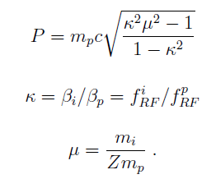
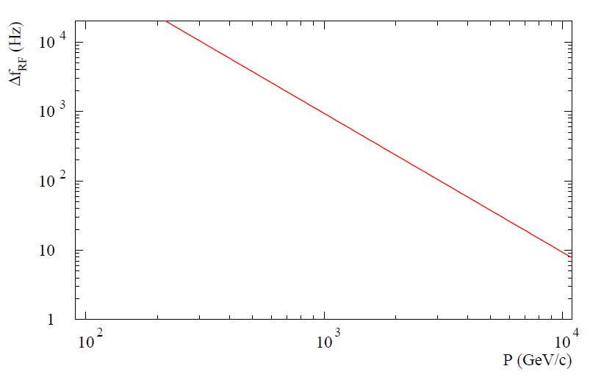
Proton-ion calibration principle
The difference in speed (or corresponding RF frequency) of protons and ions can be used to determine the momentum P of the beam:
~4.5 kHz
LHC
At 4 TeV the effect is small and systematic errors dominate the measurement uncertainty
~59 Hz
~20 Hz

Slide 3
Cogging at 4 TeV
Proton and lead beam at flat top:
Different RF frequencies for p and Pb,
Both beams ~ centered.
x
Proton and lead beams after cogging:
Same RF frequency for p and Pb, ~ average of p and Pb,
Protons move to the outside, Lead ions to the inside.
Δx ∝ Δf
x

Slide 4
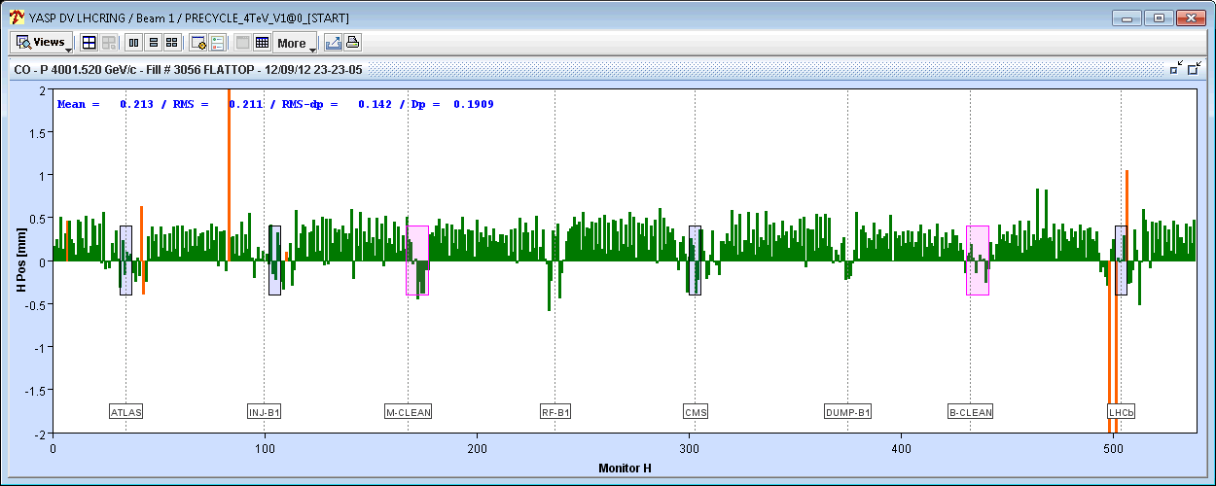
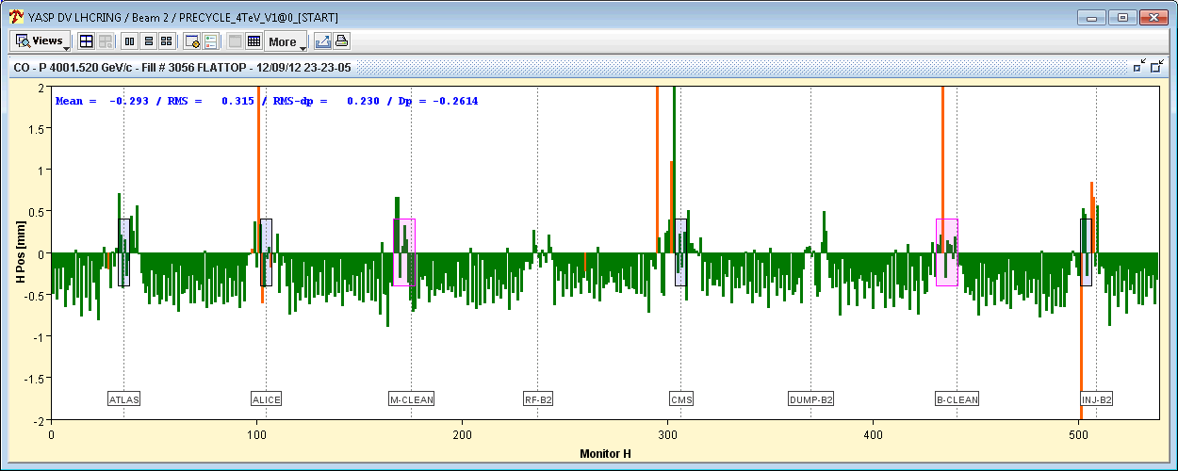
Example : proton & lead orbits
Proton-Pb orbits at 4 Z TeV after cogging (at same RF frequency) revealing the revolution frequency difference → radial position offsets.
We are looking for an accuracy of ~ 10 μm on the radial position
Protons – B1
Lead – B2

Slide 5
Measurement method
The frequency offset is deduced from the orbit offsets of the 2 beams – sensitive to the average BPM offsets wrt center of the LHC quadrupoles !
x
δ₁
δ₂
R1
R2
R1
R2
Δf_{meas,A} = Δf + (δ₁ + δ₂)
Δf_{meas,B} = Δf - (δ₁ + δ₂)
The systematic error from BPM offsets cancels out on the average of the measurements of p-Pb (A) and Pb-p (B) !

Slide 6
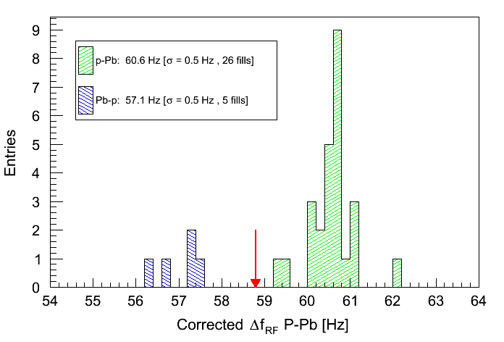
Results - PRELIMINARY !!
p-Pb
Mean value
4 TeV
Pb-p
Mean value p-Pb + Pb-b : 3.99 TeV ± (to be evaluated)

Slide 7
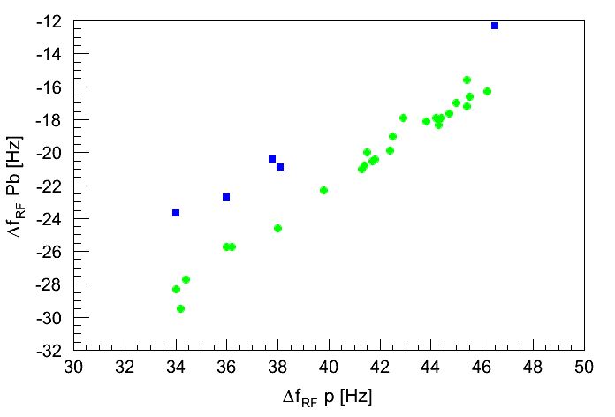
Systematics
Correlation Pb – p frequency – no anomaly.
Changing values: tides etc
Pb-p
p-Pb

Slide 8
To do
Collect more fills..
Systematic analysis of BPM scale and offset.
Scale calibrations are all consistent:
Can be checked in every fill during the cogging,
Dedicated calibration (5 mins each).
Offset dependence on bunch intensity, bunch length and time.
Time: split the sample and look for significant changes etc…
Intensity and bunch length:
Could try to estimate it from the data itself.
~1 hour exercise at injection with scraping and RF voltage.

