Slide 1
Fri 8/2
Fill 3538 ongoing since 02:57 with ALICE head ON and ATLAS/CMS/ LHCb at 1% of their peak luminosity
End of fill at 12:58 (when we were just about to dump…) ➔ BPM in LSS6
ALICE has now reached about the SAME INTEGRATED LUMINOSITY AS ATLAS/CMS

Slide 2
Fri 8/2
During the fill ALICE asked to investigate spikes observed in luminosity ➔ nothing observed on BLM, BBQ, some tune trims done
Finally ALICE realized that the problem is related to the detector

Slide 3
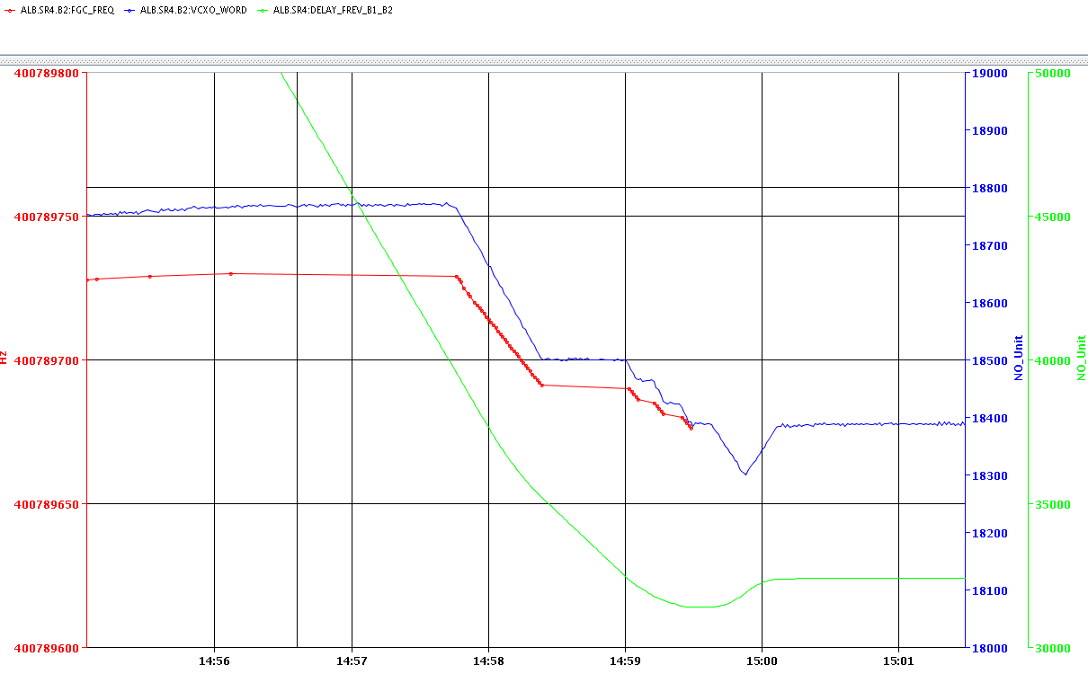
Investigations on beam dump #3536 (P.B.)
On fill 3536 the B2 frequency was 400.789729 MHz before cogging and the locked freq was set at 400.789676 MHz. So the B2 freq (red trace) had to be decreased by 53 Hz at the rate of 1 Hz/s, plus a series of WAIT programmed in the sequencer. By the time the two rings were at the common frequency the Crossing Point had moved PASSED the detector (undershoot in green trace)...The Cogging therefore moved them back by FURTHER DECREASING the p frequency (VCXO in blue trace) resulting in an excessive displacement and dump.

Slide 4
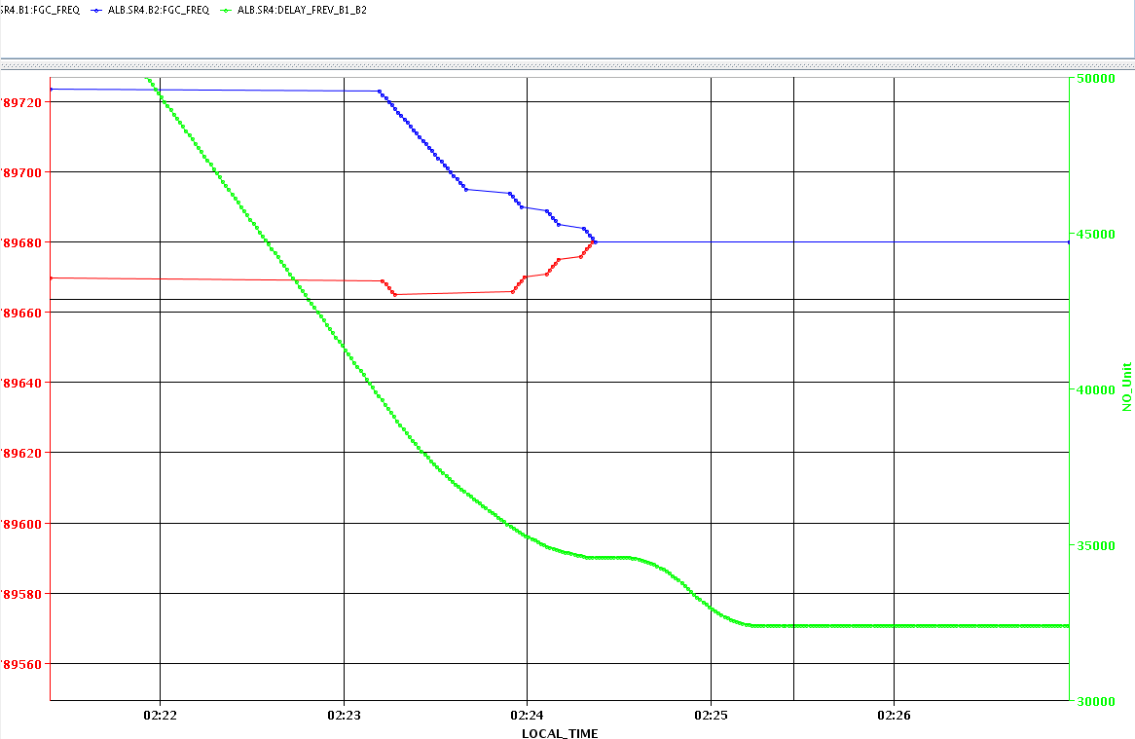
Investigations on beam dump #3536 (P.B.)
We have been more lucky on fills 3537 and 3538 as the common frequency was changed by +4 Hz and we just made it. However the displacement is much larger for B2 than B1. The Pb arrive at flat top, almost on collision orbit (see Fill3538). To give more margin: The common freq is further increased to 400.789682 Hz. That will make the displacement B2 smaller and B1 larger, and the displacement to off-centred orbit starts at a larger offset from the desired intersection point.

Slide 5
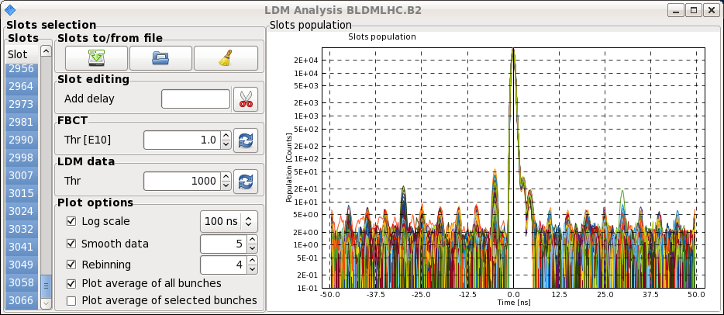
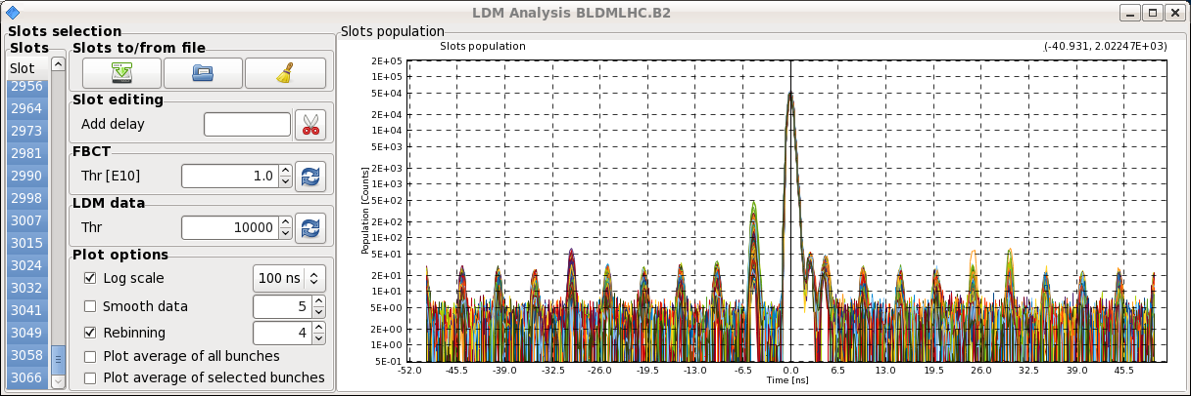
Fri 8/2
14:00 Injecting for VdM scan in ATLAS and LHCb
Satellite population reduced as compared to previous VdM scan (thanks T. Bohl!!)
Fill 3540
Fill 3537

Slide 6
Fri 8/2 – Sat 9/2
16:45 STABLE BEAMS #3540. Start of VdM scan in ATLAS
18:30 VdM Scan in ATLAS completed. Start wit LHCb
18:42 RQX.L8 trip. End of fill #3540
RQX.L8 QPS trigger (heaters fired) due to faulty instrumentation related to voltage tap V1 B of current lead 2. Error not related to protection crate working and reacting correctly. DFBX instrumentation to be checked ➔ Access
In the shadow replacement of CPU (second time) on RF crate used for synchronization
22:27 End of access: QPS piquet left point 8. a pin on the current lead cable was found faulty (weak connection)
23:47 IT.L8 cryogenics OK. Pre-cycle
02:42 STABLE BEAMS #3541
07:45 Beam dump BPM LSS6
Persistent problem with RF synchronization front end

Slide 7
Stable Beams Statistics
Fill | Day | Peak L [10²⁸ cm⁻²s⁻¹] | Stable beam [h] | Int L [nb⁻¹] | Dump reason | # bunches [Pb/p]
3523 | Mon 4/2 | 7.2 | 4:22 | 0.74 | BPMs IP6 | 192/216
3524 | Mon 4/2 | 7.4 | 3:14 (+0:33) | 0.43 | BPMs IP6 | 192/216
3525 | Mon 4/2 | 10 | 2:09 | 0.64 | Trip of RQTL9.R3B2 | 338/338
3527 | Tue 5/2 | 10 | 4:22 | 1.04 | BPMs IP6 | 338/338
3529 | Tue 5/2 | 10 | 2:08 | 0.64 | S12 trip | 338/338
3533 | Wed 6/2 | 10.7 | 3:57 | 1.09 | BPMS IP6 | 338/338
3534 | Wed 6/2 | 11.5 | 5:03 | 1.28 | BPMS IP6 | 338/338
3535 | Thu 7/2 | 10.2 | 5:07 | 1.33 | SIS orbit correctors (EoF test) | 338/338
3537 | Thu 7/2 | 10 | 5:16 | 0.8 (VdM) | BPMS IP6 | 314/272
3538 | Fri 8/2 | 9.6 | 10:00 | 1.98 (ALICE only) | BPMS IP6 | 338/338
3540 | Fri 8/2 | 8.5 | 1:57 | 0.5 (VdM) | RQX.L8 | 314/272
3541 | Sat 9/2 | 11.6 | 5:03 | 1.28 | BPMS IP6 | 338/338

Slide 8
Plan
Next fill VdM scan in LHCb with standard filling scheme.
Physics

Slide 9
1.38 TeV p-p run
End of pPb physics at 06:00 (if fill lost after 03:00 go for dry run/pilot cycle)
Access to set-up for the higher intensity → ~ 2 h (starting between 7 and 9 AM)
BPMS IP6 (high intensity protons), BBQ, Head-Tail, etc
ADT settings for high intensity (HW SR4) and possibly attenuator change (piquet)
Re-activate RF hardware interlock on total voltage (can be done before during ramp down) – possibly today
Reverting ALICE polarity (LHCb polarity already good)
Revert BLM MFs
Revert BTVDD delay settings
ATLAS
Pre-cycle ~ 1 hour
1 cycle with probes for checkout, correcting chroma and tune, verify instrumentation and damper set-up (4 hours)
Testing of interlock BPMS (~2 hours)
Loss maps at injection and asynchronous dump (4 hours)

Slide 10
1.38 TeV p-p run
1 cycle with 3 nominal bunches for collimator setup (TCTs), collision setup, first loss maps & asynch. dump test in collision. (4-5 hours+ RP set-up if approved)
BSRT (B2) and beam dump checks with high intensity and LBDS check (B1) in parallel (5 hours)
2 cycles to complete off-momentum/betatron loss maps → (8 hours).

Slide 11
1.38 TeV p-p run
Intensity ramp-up
1 fill with ~80 bunches
1 fill with ~500 bunches (including some individual bunches for VdM scans)
1374 bunches
Need to define filling scheme for 500 bunches

Slide 12
Validation
 | Injection (Inj. Prot. IN) | Injection (Inj. Prot. OUT) | Flat-top separated | Un-Squeezed Collision
Betatronic-H | tbd | tbd | tbd | tbd
Betatronic-V | tbd | tbd | tbd | tbd
Neg. off-mom | tbd | -- | -- | tbd (+500 Hz)
Pos. off-mom | tbd | -- | -- | --
Asynch dump | tbd | -- | -- | tbd
tbd=to be done

Slide 13
Pending
Accesses for quench test:
Scope installation in IP6 (12L6). 2 hours. It has priority over Q6L8 scope installation because we will need it on Monday morning (the first quench test). To be confirmed whether it can be done before high intensity tests/pp physics at intermediate energy
Fast measurement system on RQ6.L8 (30 min in the UA83 by Jaromir Ludwig). Ramp to 300 A afterwards.
LBDS check (E. Carlier – working hours) if in the shadow of another access

