Slide 1
Thu 06/02
Fill 3535 ongoing since 05:24
10:00-10:30 End of fill test: bump scan at the BSRT position for BSRT calibration. Scan from +1.5 to -1.5 mm. The last trim was just at the edge for the SIS interlock on the COD settings. Beam dump (it was nevertheless very close to its natural length..)
11:30-13:00: Scraping test for determining the systematic errors on energy calibration due to orbit reading dependence on intensity/bunch length.

Slide 2
Thu 6/2
14:00 Injecting for VdM scan in ALICE and CMS
14:59 Beam dump during cogging: too large momentum offset excursion for B2 (p) during the process ➔ > 10 BPMs out of tolerance
From the week-end the common frequency after cogging was trimmed by -10 Hz to keep the Pb beam closer to the central orbit and minimize losses during the squeeze. As a result of that absolute energy offset larger for proton beams circulating radially outwards
On Wednesday we already reduced the common frequency offset from -10 Hz to -6 Hz
Wed
Fill 3534

Slide 3
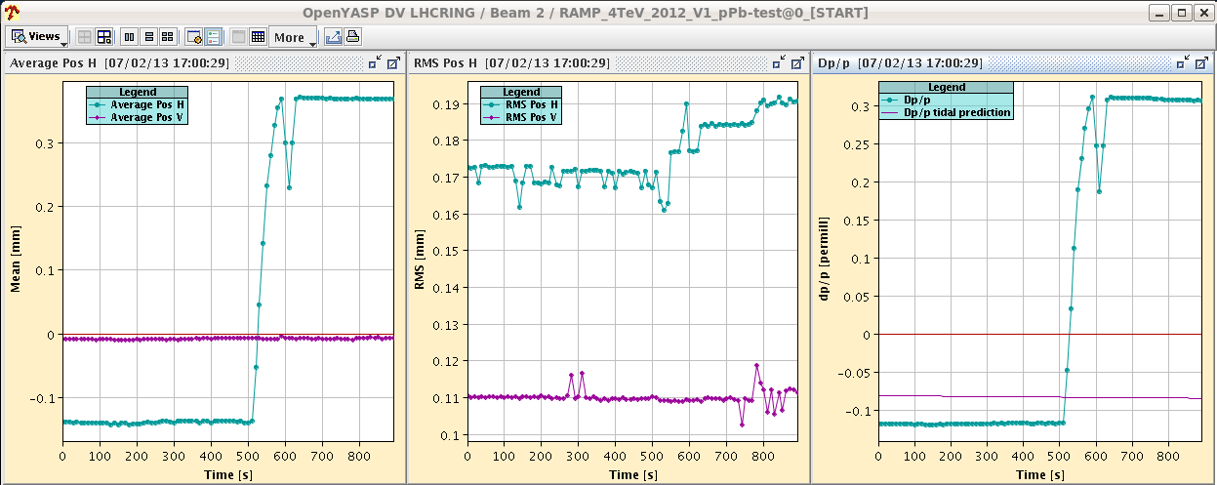
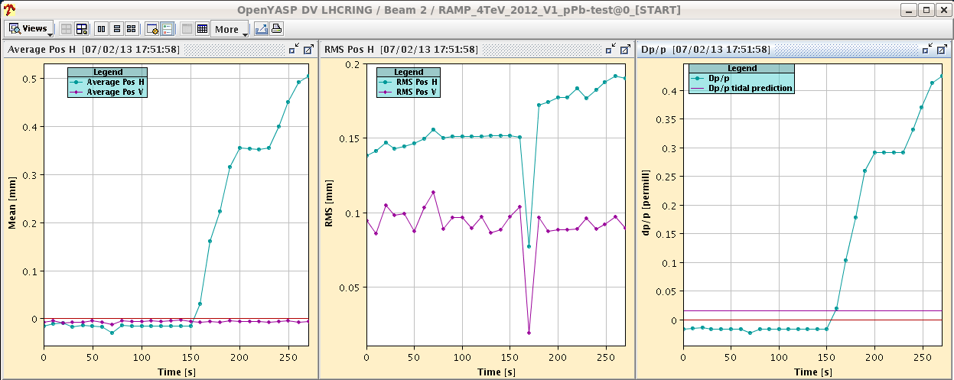
Wed
Fill 3534
Thu
Fill 3536

Slide 4
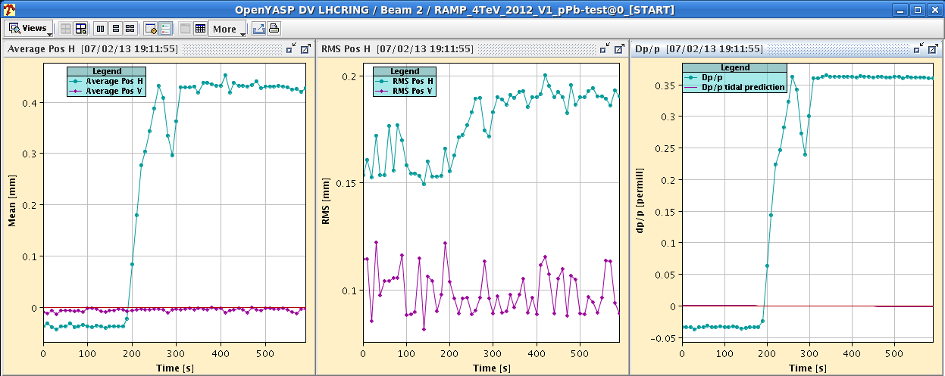
Tue 5/2
Increased the limit for the orbit position SW_interlock by 0.2mm
+4Hz on the common frequency.

Slide 5
Van der Meer scan in ALICE/CMS
18:17 STABLE BEAMS #3537 and VdM scans

Slide 6
Shift crew reluctant to dump the fill…
23:35 BPM interlock
Fill 338 on 338 with ALICE head on and ATLAS/CMS and LHCb at ~1% of peak luminosity – Synchronization problem with SPS delaying fill by ~0.5 h.
02:57 STABLE BEAMS #3538

Slide 7
Plan
Next fill VdM scan in ATLAS and LHCb
200ns_314Pb_272p_14inj_24bpi
Go back to standard physics fills

Slide 8
Stable Beams Statistics
BPMSB.B4R6.B1 interlocking at ~3-3.5x10⁹ charges/bunch since monday afternoon
Fill | Day | Peak L [10²⁸ cm⁻²s⁻¹] | Stable beam [h] | Int L [nb⁻¹] | Dump reason | # bunches [Pb/p]
3523 | Mon 4/2 | 7.2 | 4:22 | 0.74 | BPMs IP6 | 192/216
3524 | Mon 4/2 | 7.4 | 3:14 (+0:33) | 0.43 | BPMs IP6 | 192/216
3525 | Mon 4/2 | 10 | 2:09 | 0.64 | Trip of RQTL9.R3B2 | 338/338
3527 | Tue 5/2 | 10 | 4:22 | 1.04 | BPMs IP6 | 338/338
3529 | Tue 5/2 | 10 | 2:08 | 0.64 | S12 trip | 338/338
3533 | Wed 6/2 | 10.7 | 3:57 | 1.09 | BPMS IP6 | 338/338
3534 | Wed 6/2 | 11.5 | 5:03 | 1.28 | BPMS IP6 | 338/338
3535 | Thu 7/2 | 10.2 | 5:07 | 1.33 | SIS orbit correctors (EoF test) | 338/338
3537 | Thu 7/2 | 10 | 5:16 | 0.8 (VdM) | BPMS IP6 | 314/272
3538 | Fri 8/2 | 9.5 |  |  |  | 338/338

Slide 9
1.38 TeV p-p run
End of pPb physics at 06:00
Access to set-up for the higher intensity → ~ 2 hours
BPMS IP6 (high intensity protons), BBQ, Head-Tail, etc
ADT settings for high intensity (HW SR4) and possibly attenuator change (piquet)
Re-activate RF hardware interlock on total voltage (can be done before during ramp down) – possibly today
Reverting ALICE polarity (LHCb polarity already good)
Revert BLM MFs?
Pre-cycle ~ 1 hour
Testing of interlock BPMS (~2 hours)
1 cycle with probes for checkout, correcting chroma and tune, verify instrumentation and damper set-up (4 hours)
Loss maps at injection and asynchronous dump (4 hours)

Slide 10
1.38 TeV p-p run
BSRT (B2) and beam dump checks with high intensity and LBDS check (B1) in parallel (5 hours)
1 cycle with 3 nominal bunches for collimator setup (TCTs), RP set-up (?), collision setup, first loss maps & asynch. dump test in collision. (6-8 hours)
2 cycles to complete off-p /betatron loss maps → (8 hours).

Slide 11
1.38 TeV p-p run
Intensity ramp-up
1 fill with ~80 bunches
1 fill with ~500 bunches (including some individual bunches for VdM scans)
1374 bunches

Slide 12
Validation
 | Injection (Inj. Prot. IN) | Injection (Inj. Prot. OUT) | Flat-top separated | Un-Squeezed Collision (with RP IN?)
Betatronic-H | tbd | tbd | tbd | tbd
Betatronic-V | tbd | tbd | tbd | tbd
Neg. off-mom | tbd | -- | -- | tbd (+500 Hz)
Pos. off-mom | tbd | -- | -- | --
Asynch dump | tbd | -- | -- | tbd
LBDS B1 train | tbd
tbd=to be done

Slide 13
Pending
Accesses for quench test:
Scope installation in IP6 (12L6). 2 hours. It has priority over Q6L8 scope installation because we will need it on Monday morning (the first quench test). To be confirmed whether it can be done before high intensity tests/pp physics at intermediate energy
Fast measurement system on RQ6.L8 (30 min in the UA83 by Jaromir Ludwig). Ramp to 300 A afterwards.
LBDS check (E. Carlier – working hours) if in the shadow of another access

