Slide 1
Tue 05/02
7:35 dump by BPMS in IP6
Filling rather slow due to frequent latches of the injection quality check due to position at BPMI.87204
Attempts to improve the situation by steering the transfer line not successful
09:36 ready to ramp
Capture losses at ~50% at the beginning of the ramp
B1H
B1V

Slide 2
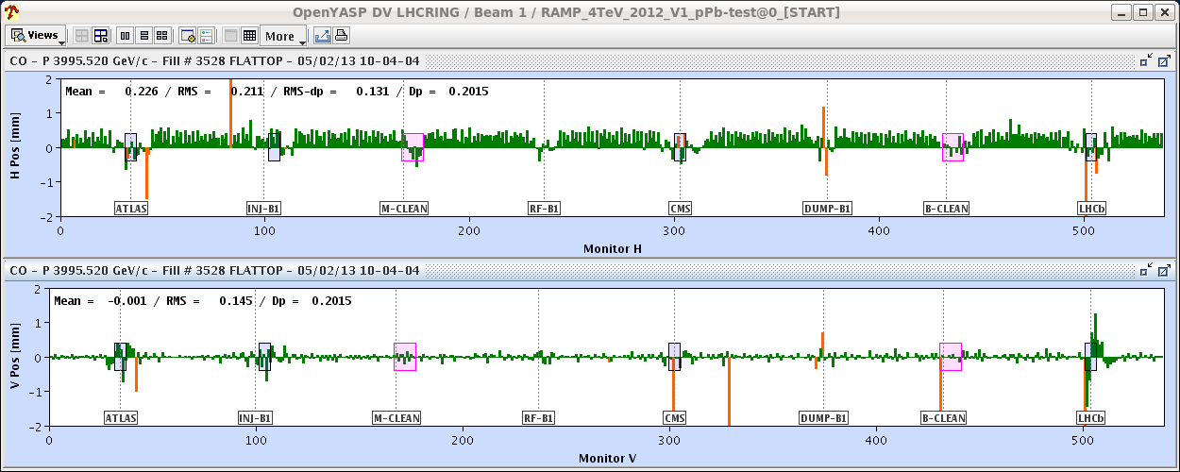
Tue 5/2
10:04 Beam dump when switching ON the OFB after cogging.
Structure appeared in point 8 likely resulting from bad BPM readings (BPMS.2L8.B1 – V- reading between 0 and 2 mm)

Slide 3
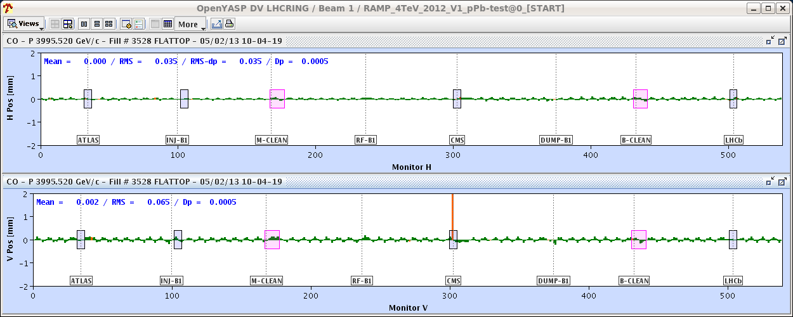
Tue 5/2
Some non closure in the attempt of the OFB to correct it resulting in higher losses at the collimators and beam dump due BLMQI.11R7B1E10_MQ (0.65 ms running sum)
Analysis of the orbit at the end of the cogging process for the previous two fill (including the dump over night) indicated similar behaviour. Decide to run without BPMS.2L8.B1 (V) and unchanged OFB bandwidth

Slide 4
Tue 5/2
BLM Monitor factor (MF) change as agreed by rMPP meeting this morning: - BLMQI.11R7.B1E10_MQ from 0.3 -> 0.45 - BLMQI.09R7.B1E10_MQ from 0.3 -> 0.45 - BLMEI.09R7.B1E21_MBA from 0.1 -> 0.3 - BLMEI.09R7.B1E22_MBA from 0.1 -> 0.3 - BLMEI.09R7.B1E22_MBB from 0.1 -> 0.3 - BLMEI.09R7.B1E23_MBB from 0.1 -> 0.3 - BLMEI.09R7.B1E24_MBB from 0.1 -> 0.3
to give some more margin
IQC BPM tolerances updated. Injection oscillations and losses OK ➔ no more systematic latches
Filling slowed down by QPS communication problems (not understood) and poor ion beam quality (LEIR)

Slide 5
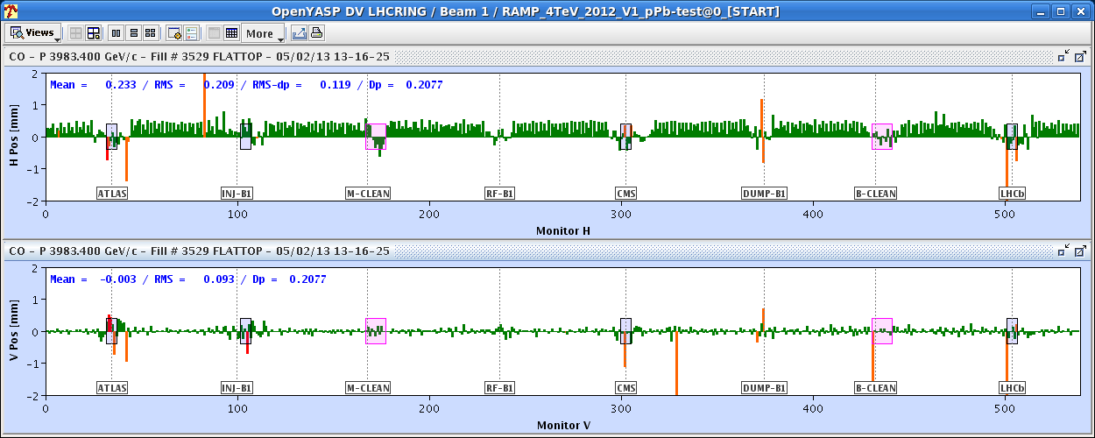
Tue 5/2
Again important losses at the beginning of the ramp likely exacerbated by the long time spent at injection
This time no structure on the orbit in point 8

Slide 6
Tue 5/2
13:48 Stable beams #3529
15:57 Trip of Sector 12 (RB.A12). End of fill #3529. From R. Denz: Stuck bit in interlock driver circuit identified as possible source (=radiation induced fault).
LHCb polarity switch to positive
UA23.RCD.A12B2 - EE system did not open on FPA request during event of 15:57:02. At 18:30 a PIC test was performed and the system reacted normally but origin of the problem not understood leave this circuit off until further analysis of the problem.
19:39 Start filling. Injection frequency for protons and ions to minimize losses in the ramp

Slide 7
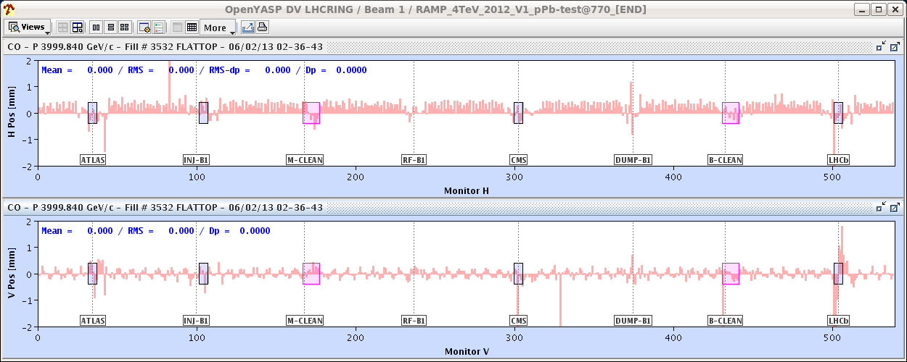
Tue 5/2 – Wed 6/2
21:35 PS RF problem during filling
22:30 Beam back. Dump and refill
23:59 Still important capture losses at the beginning of the ramp inspite of the capture tuning. Beam dump (BLMs in point 3).
Disable the batch by batch longitudinal blow-up at injection. Longer bunches from the SPS?
02:36: Large OFB correction at flat-top BPMS.2L8.B1 (V) was misteriously enabled!!. Beam dump.

Slide 8
Wed 6/2
Again issues with the quality of the ion beam in the injectors. Several injections are inhibited. Lengthy filling. Had to dump and refill.
05:20 Ramp. This time with acceptable losses (35 %)
06:08 STABLE BEAMS #3533.

Slide 9
Stable Beams Statistics
Fill | Day | Peak L [10²⁸ cm⁻²s⁻¹] | Stable beam [h] | Int L [nb⁻¹] | Dump reason | # bunches [Pb/p]
3523 | Mon 4/2 | 7.2 | 4:22 | 0.74 | BPMs IP6 | 192/216
3524 | Mon 4/2 | 7.4 | 3:14 (+0:33) | 0.43 | BPMs IP6 | 192/216
3525 | Mon 4/2 | 10 | 2:09 | 0.64 | Trip of RQTL9.R3B2 | 338/338
3527 | Tue 5/2 | 10 | 4:22 | 1.04 | BPMs IP6 | 338/338
3529 | Tue 5/2 | 10 | 2:08 | 0.64 | S12 trip | 338/338
3533 | Wed 6/2 | 10.7 |  |  |  | 338/338

Slide 10
Plan
VdM scan for ALICE and time permitting CMS:
200ns_338Pb_272p_15inj_24bpi
Second fill for VdM to be confirmed (ATLAS)
Go back to physics 338/338
Wait for confirmation of rest of the programme (ALICE polarity switch and pp intermediate energy run)

Slide 11
Pending
Access to install attenuators for BBQ/HT and other instrumentation (2 hours)
BSRT test with high intensity 50 ns proton beam (up to 1380 bunches with >1.4x10¹¹ p/b) – 4 hours
Accesses for quench test:
Scope installation in IP6 (12L6). 2 hours. It has priority over Q6L8 scope installation because we will need it on Monday morning (the first quench test). To be confirmed whether it can be done before high intensity tests/pp physics at intermediate energy
Fast measurement system on RQ6.L8 (30 min in the UA83 by Jaromir Ludwig). Ramp to 300 A afterwards.

Slide 12
Setup
J. Wenninger
Offline:
Prepare ramp to 1.38 TeV based on truncated 4 TeV ramp.
Collision BP.
Settings of IR7(3) collimators to be defined.
Online:
Reverting to high-intensity proton OP → 1 shift ?
1 cycle with probes for checkout, optics measurements.
1 cycle with 3 nominal bunches for collimator setup (TCTs), collision setup, first loss maps & asynch. dump test in collision.
→ 1½ - 2 shifts.
2 cycles to complete off-p /betatron loss maps → 1 shift.
Setup time ~ 24+ hours.
Plus 2 hours of access to set-up for the higher intensity

