Slide 1
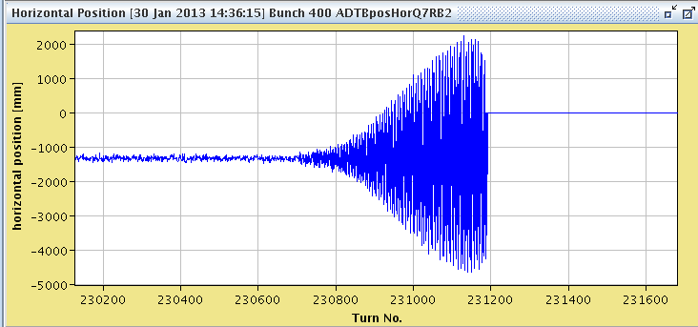
Thursday Morning 31-Jan 2013
Bernhard Holzer, Joerg Wenninger
Wednesday Morning
... LHC in access for temperature alarm
(“RF faraday cage”, ventilation problem)
... after a lengthy discussion ... decide to refill the source
Plan for LHC: ADT set up for the future quench tests
10:00h injection delayed ... POPS
11:30h injection for ADT tests (protons in beam2)

Slide 2
LHC STATUS
Wednesday Late
≈ 16:00h source ready, Pb available
BUT
16:30h Water fault on demineralised water in S23 / S34
loosing 100 m³ / day ... which will run into trouble during the weekend
19:00h Water leak found on pipe connected to RB in S34.
20:10h Expert working on Beam Imminent Warning system ... which is still not
operational in Pt 7/8 ... to be fixed today !!
04:30h ... 21:00h ... in parallel: since early morning intermittent problem at RF:
(problem disappeared at 05:30)
faulty VME modules in the Tuner Controller for cavities 5,6,7 and 8 B1.
22:00h Precycle
22:30h Collimator error
network problem ?

Slide 3
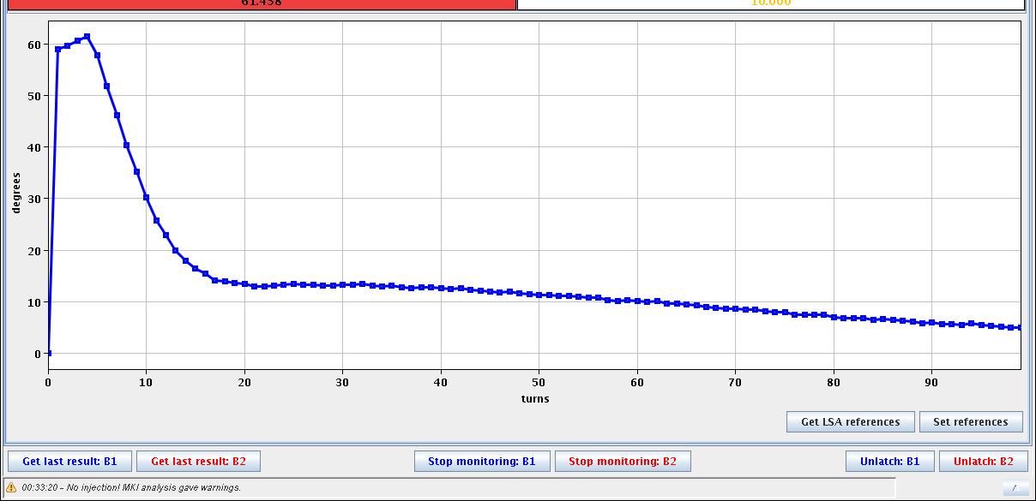
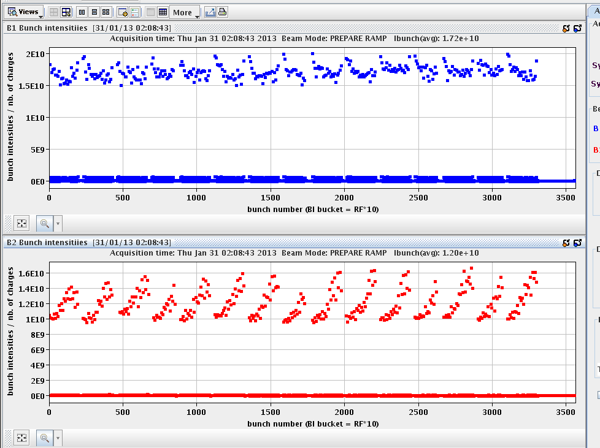
LHC Status
Wednesday Night
00:00h injection probe beam
00:30h injection physics beam
some optimisation needed ...
TL steering, RF phase
00:50h beam dump: false trigger from BLM in point 1 (no losses observed)
->MKD beam 2 in error after the beam dump
“fault on LBDS kicker was "retrigger box1 compensator B" on generator”
01:15h ... 02:00h injection & TL optimisation
02:10h machine full, prepare ramp
60º
inj phase

Slide 4
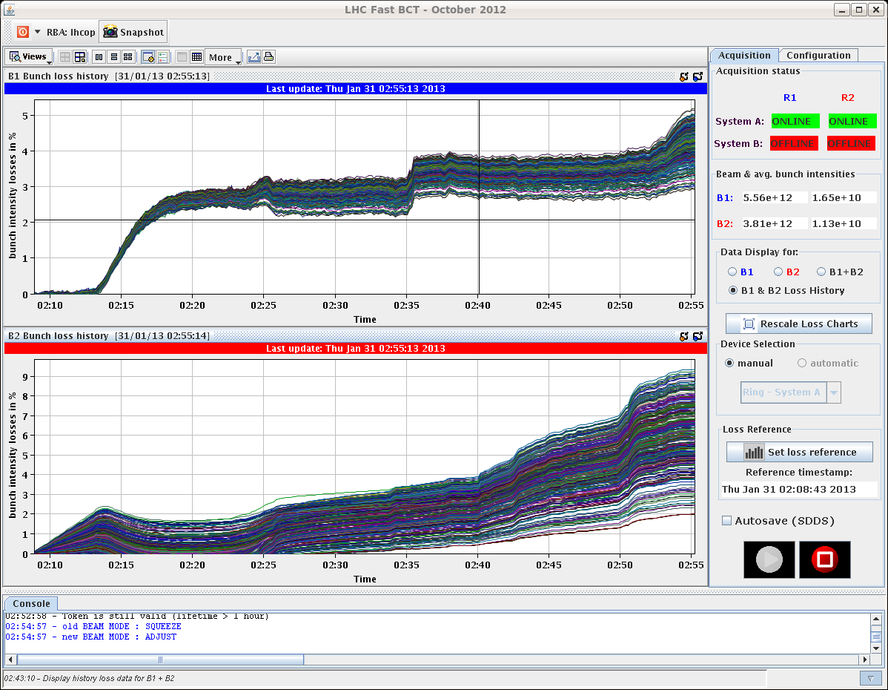
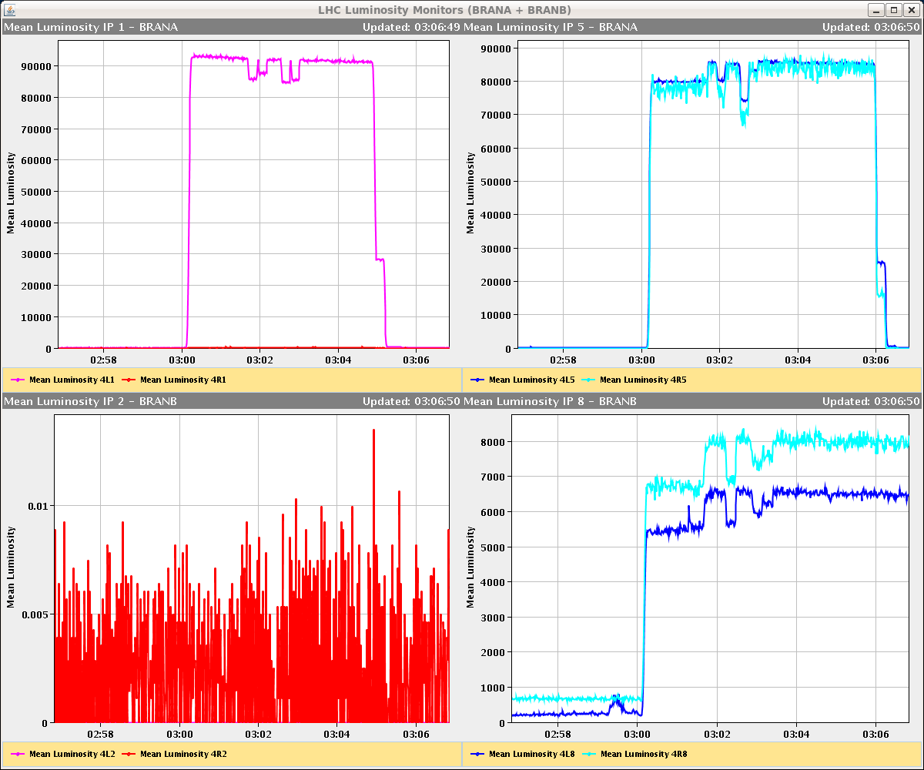
LHC Status
Wednesday Night
02:55h adjust & lumi optimisation
03:00h stable beams
03:04h separating IP1 and 5 by 130 um
in separation plane
5 %
9 %

Slide 5
LHC Status
Wednesday Night
03:10h ... optimisation of lumi & lifetime for beam 2
trim Total voltage to 14MV for B2
orbit correction h & v
tune optimisation
τ ≈ 8.5h

Slide 6
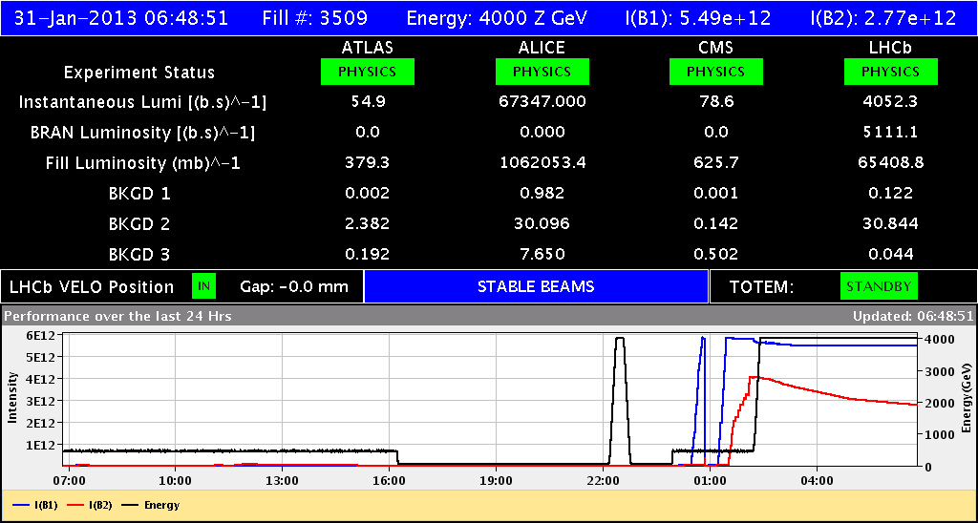
LHC Status
tune optimisation

