Slide 1
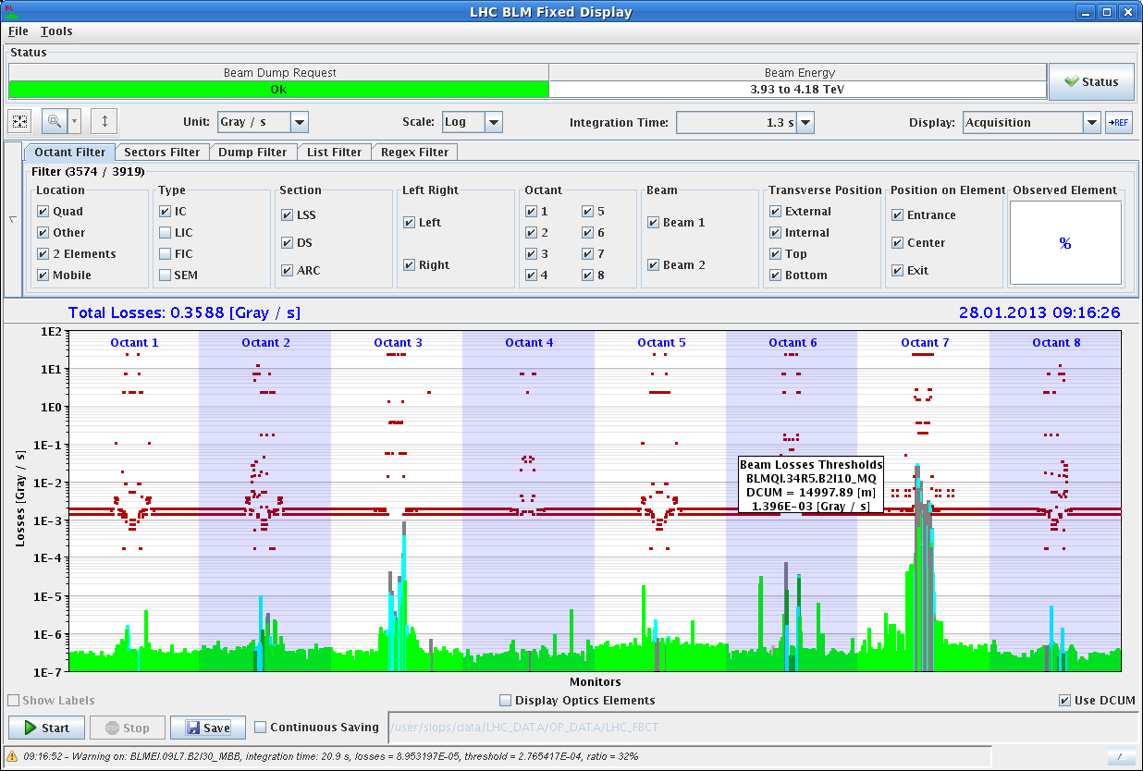
Tuesday Morning 29-Jan 2013
Bernhard Holzer, Joerg Wenninger
Monday Morning
... after ALICE polarity flip
7:20h Injection for validation cycle
8:00h ramp / squeeze / adjust
8:50h collisions optimised
loss map for pos. off-momentum
10:00h set up for VdM scans
Orbit excursion interlock (BPMs in IR6)

Slide 2
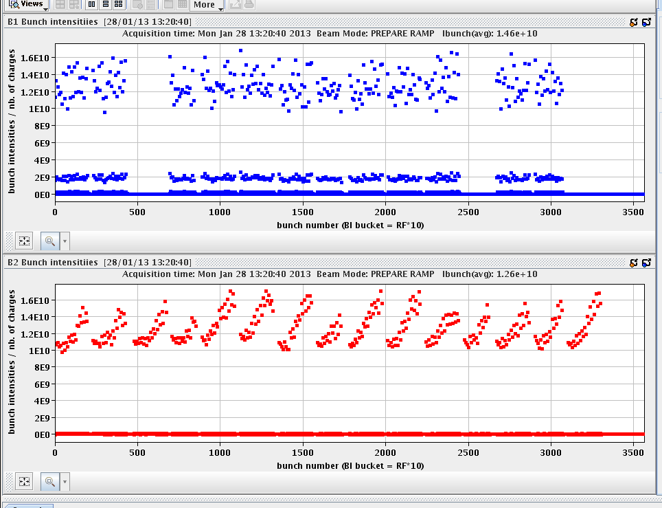
Tuesday Morning 29-Jan 2013
11:40h injection ... but ...
12:30h beam dump: Orbit excursion interlock (BPMs in IR6)
Pilot Pb bunch sat too long at injection and intensity dropped
below threshold of BPM at Pt 6.
12:40h injection finished, prepare ramp
13:20h ramp ... and beam dump at 1.8 TeV
spurious BLM trigger
Beam dump from BLM at pt 4 but no sign of losses

Slide 3
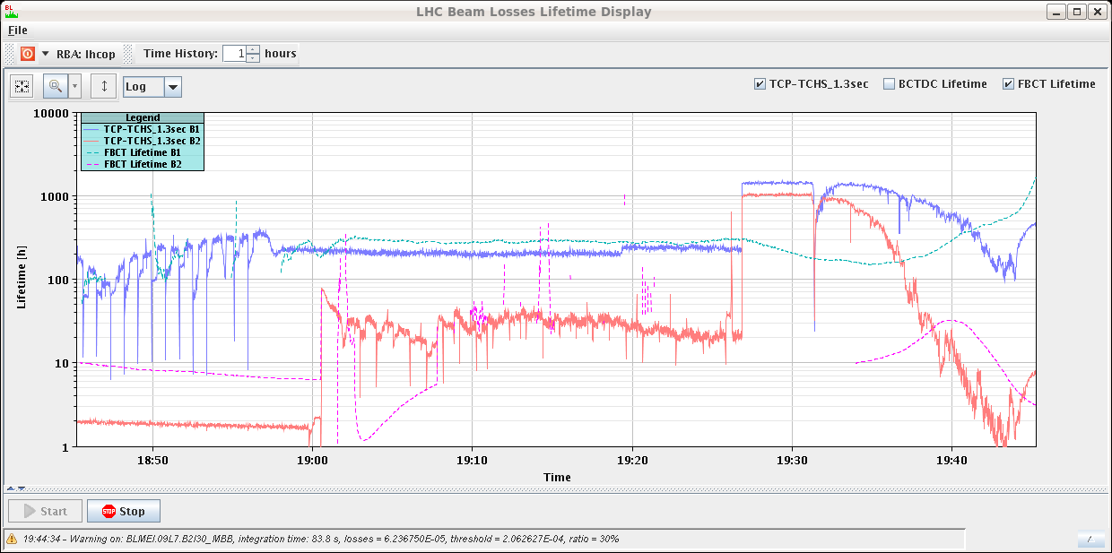
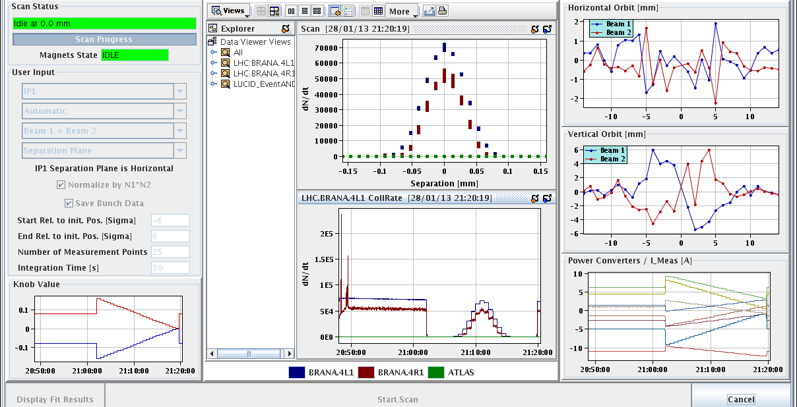
Tuesday Morning 29-Jan 2013
Monday Late
15:50h new injection ... to be optimised (SPS inj kicker delay)
17:30h injection for physics
19:30h ramp etc
... not really easy going
lifetime beam2 ≈ 1h
20:30h optimising IPs & stable beams
21:00h start VdM scan in IP1
- separation plane –

Slide 4
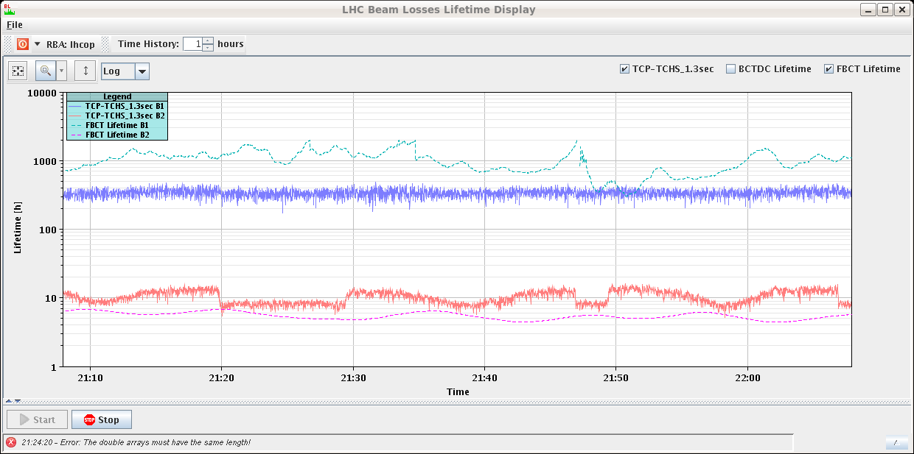
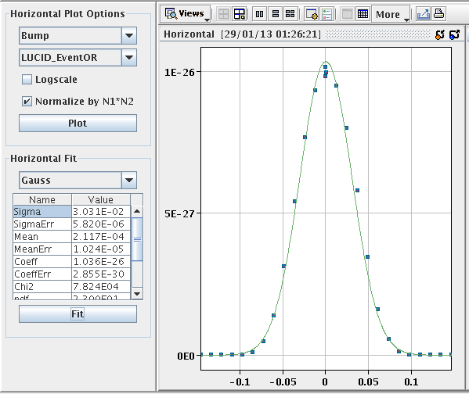
Tuesday Morning 29-Jan 2013
Monday Late / Night
21:30h IP1 VdM crossing plane
btw ... smooth operation
lifetime
23:00h start CMS VdM scan
2:00h Preparing for Distance-Scale Calibration scans
(VdM scans with vertex offset)
3:20h beam dump:
Orbit excursion interlock (BPMs in IR6)
some Pb bunches reached the low intensity threshold
τ

Slide 5
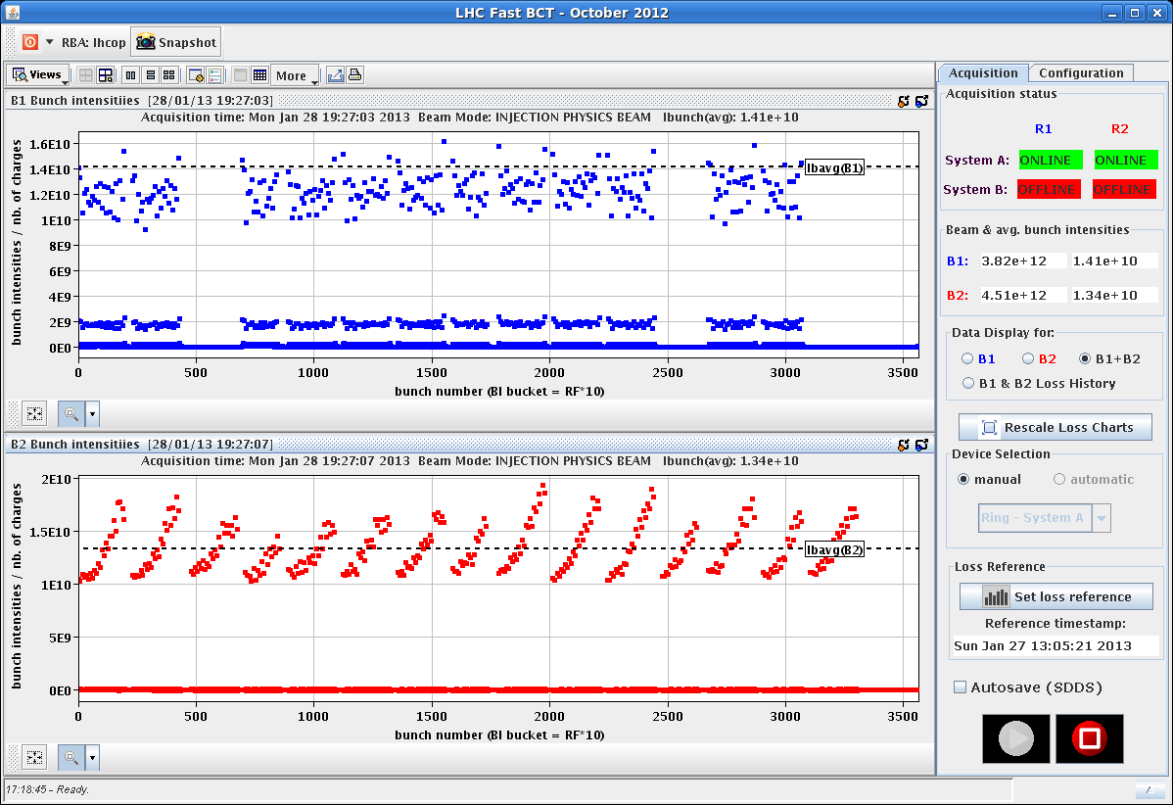
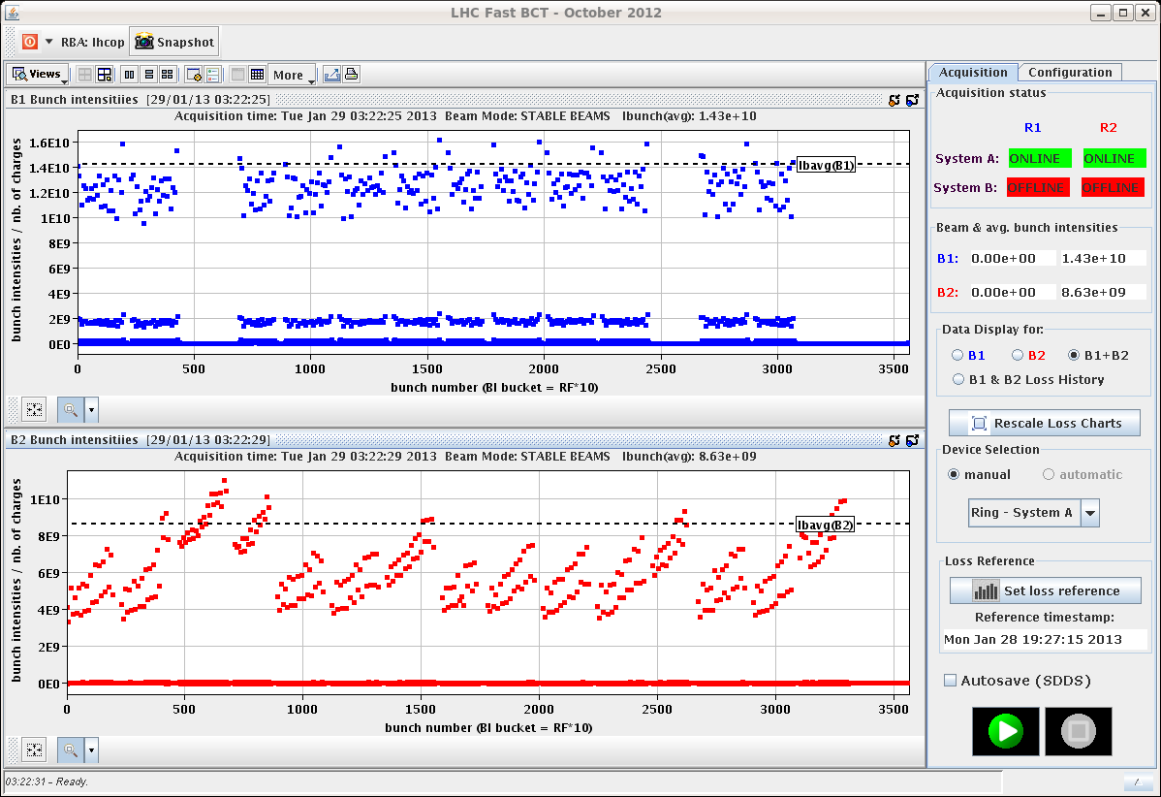
Tuesday Morning 29-Jan 2013
Monday Night
3:20h beam dump:
Orbit excursion interlock (BPMs in IR6)
some Pb bunches reached the low intensity threshold
4:26h machine cycled, new injection ... again SPS optimised
I_{Pb} at ramp
I_{Pb} at ramp
1*10¹⁰
4*10⁹

Slide 6
Tuesday Morning 29-Jan 2013
Monday Night / Tuesday Morning
6:00h injection ... for the remaining VdM scans
fyi ... SPS injection optimisation
Plan: finish the VdM scans
flip LHCb
back to physics

