Slide 1
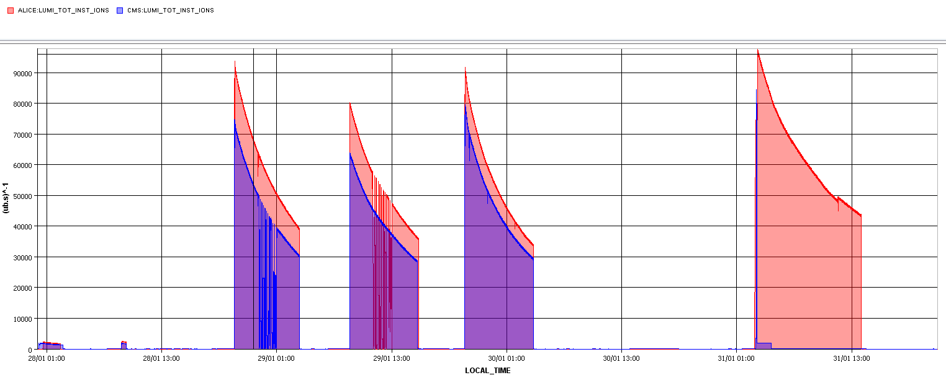
Thursday
Happy stable beams … for ALICE.
14:00 Dumped fill 3509,12 hours, 2.4 nb-1 for ALICE.
Just as we planned to dump cryo problem in S23.
Magnetic bearings of cold compressor.

Slide 2
Thursday
Afternoon – evening : Access for cryo, experiments, wire-scanner, quench test… cryo recovery.
19:00 evacuation alarm system OK in Pts 7 and 8 ... access again allowed in these points.
23:00 Ready – pre-cycle.
No beam from SPS, injection kicker trigger problem (since ~22:00). The problem was identified in a G64 timing crate CPU. A restart of the crate solved the error.
03:00 Injection.
05:00 Stable beams fill 3510

Slide 3
Today and later…
Dump at 09:00.
Beam switch according to plan.
Wire-scanner testing in parallel.
Check faulty injection kicker.

Slide 4
Beam reversal
Preparation: 8 hours
Settings changes, ADT attenuators…
TL steering,
Checkout at injection (RF etc).
Injection loss maps.
Cycle #1: 4 hours
Check-out, cogging Pb-p and optics measurements.
Cycle #2: 8 hours
Collide, TCT alignment, RP alignment, beta-loss map, asynch dump test in collisions.
Cycle #3: 3 hours
Beta-loss map flat top, end of squeeze, off-p map in collision.
Cycle #4: 3 hours
Missing beta-loss map, off-p map in collision.

