Slide 1
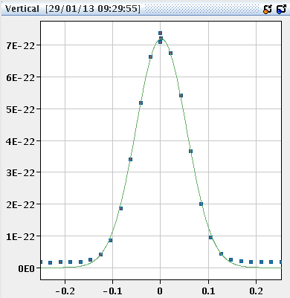
Tuesday
08:40 Stable beams fill 3405.
VdM IR 8, followed by VdM IR2.
Length scale calibration IR1.
End of fill just ‘normal’ stable beams.
15:40 Separated beams in IR1 and IR5 a (rather large) ‘bit’ to observed change of lifetime.
Unfortunately beam dumped a couple minutes later.
Small improvement in B2 lifetime.
15:50 Beam dump – standard BPM interlock.

Slide 2
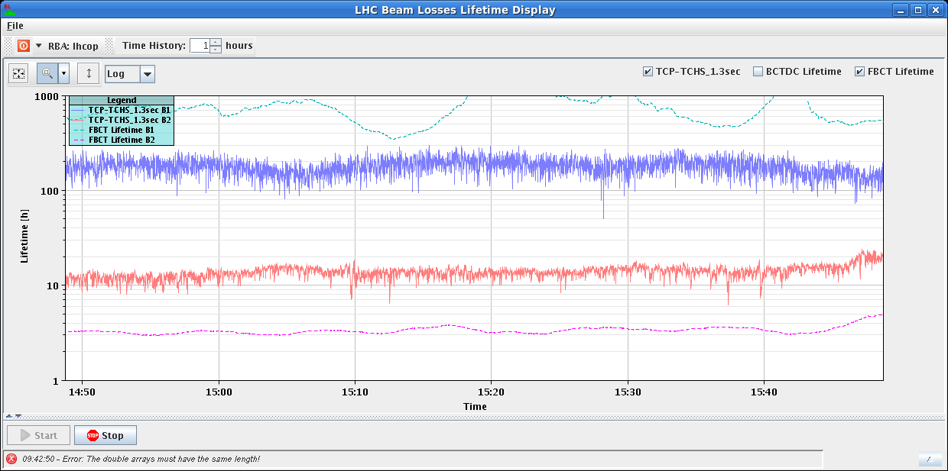
IR1/5 separated

Slide 3
Tuesday
16:00 Access needed for QPS.
LHCb dipole polarity inversion.
A vertical bump of +1 mm was added to B2 for the BGI.
Constant along the cycle.
Target bunch length at injection to 1.5 ns for ions.
17:30 Cycling.
19:00 Injection – back to standard schema.
20:40 Stable beams fill 3506.
03:50 Dump after 7:10 of stable beams by usual interlock BPMs. But rather good timing !!

Slide 4
Wednesday morning
04:00 Problems to load some RF settings – piquet intervention required.
Temperature alarm in UX45 Faraday cage.
06:10 Injection.
07:00 RF re-synch needed.
OFC reboot during a Q’ measurement messed up …
07:30 Access in UX45 for temperature alarm.
Waiting for more informations to decide.

Slide 5
Today and later…
Pb source refill → ‘afternoon’.
In the meantime:
Stable beams, and /or
ADT test on B2 in preparation for quench test, and /or,
Access
Request from PS to try out a new extraction bump with the ions (already done with the p in December) and the protons.
Make it depend on beam inversion timing.
Got 4 nb-1 with this polarity. ALICE wants >= 6 nb-1. We can make it for bam inversion on Friday.

Slide 6
Beam reversal
Preparation: 8 hours
Settings changes, ADT attenuators…
TL steering,
Checkout at injection (RF etc).
Injection loss maps.
Cycle #1: 4 hours
Check-out, cogging Pb-p and optics measurements.
Cycle #2: 8 hours
Collide, TCT alignment, RP alignment, beta-loss map, asynch dump test in collisions.
Cycle #3: 3 hours
Beta-loss map flat top, end of squeeze, off-p map in collision.
Cycle #4: 3 hours
Missing beta-loss map, off-p map in collision.

