Slide 1
Last 24 hours

Slide 2
Saturday 26th January - morning
09:34 ALICE’s solenoid trips
RPTH.SX2.RXSOL.ALICE
11:06 beams dump by BPMS (see over)
Fill 3494: 1.1 nb⁻¹ in 6h21m
Re-injection
phase measurement was not published anymore, so the IQC latched every time. As the fast ICQ was waiting for the data, we could only inject once cycle in 2.
After investigating with Philippe and Themis, we found that the problem was due to CMW that couldn't deal with the bad client, bad client being the console D5LF that was dead with several application accessing the phase. Once the console was rebooted the publication of the phase came back

Slide 3
Saturday to Sunday
15:55 Stable beams 3495
18:40 ALICE’s solenoid off
20:23 Ramping ALICE’s solenoid back-up
21:00 ALICE’s solenoid off
22:06 Beams dumped by BPMS
Fill 3495: 1.2 nb⁻¹ in 6h14m
23:04 Ramping ALICE’s solenoid back-up
23:07 Re-injecting
02:25 Stable beams fill 3496
08:26 Beams dumped by BPMS
Fill 3496: 1.2 nb⁻¹ in 6h2m

Slide 4
Dump of 3494
Dumped by crate 'system B' again.
PM files from BPMINT2 present this time.
Channel that triggered: BPMSB.B4L6.B2
BPMSA.B4R6.B2
118 times on the last 100 turns, 547 in the last 500 turns. (Limits were increased to 2000 in 500 turns.)
BPMSB.B4L6.B2
74 times in the last 100 turns.
BPMSA.B4R6.B2 would have dumped before if the limit would have not been increased.
Eva Calvo

Slide 5
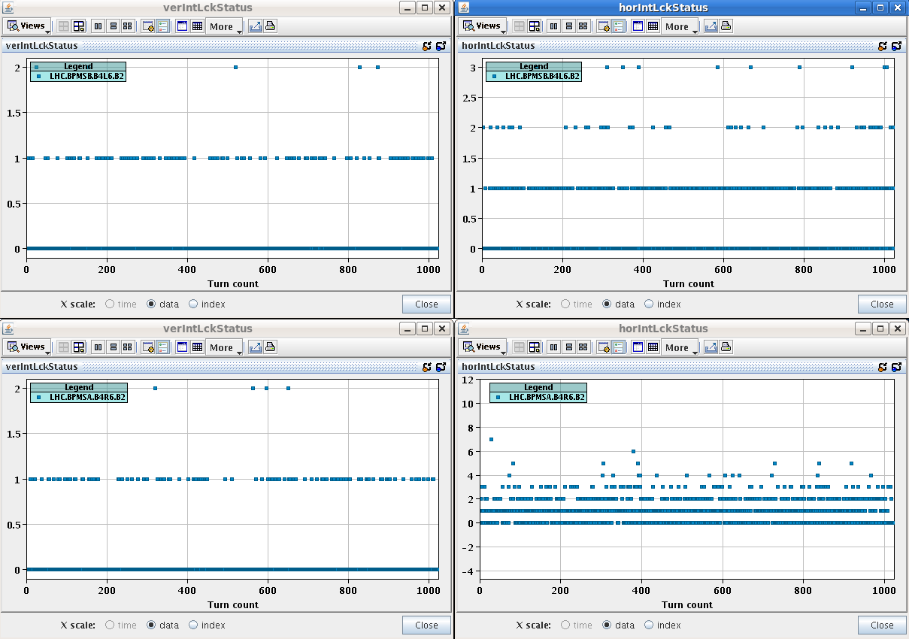
Dump of 3494

Slide 6
pA dump
 |  | Dump | BPMSA.B4R6.B2
3481 | 10h31m | OP
3482 | 11h58m | BPMSA.B4R6.B2 | 70/100
3485 Switch to 338b | 9h25m | BPMSA.B4R6.B2 | 70/100
3486 | 5h28m | BPMSA.B4R6.B2
3489 | 5h51m | BPMSA.B4R6.B2 | 500/100
3490 | 6h31m | BPMSB.B4L6.B2 | 2000/100
3493 | 5h18m | BPMSB.B4L6.B2
3494 | 6h21m | BPMSB.B4L6.B2
3495 | 6h14m | BPMS
3496 | 6h2m | BPMS

Slide 7
Polarity flip
First cycle:
No beam: change polarity, change target external Xing in physics.
Inject. Correct H orbit by hand, incorporate into ramp GRADUAL_OUT (~almost like 1/E).
Run through the cycle with a few bunches up to end of squeeze. Orbit FB will take care of any residual error up to end of squeeze.
3 minute test on FT to calibrate the BPM scale with RF frequency trims (for energy calibration).
Run collision BP, TCTs in IR2 to be handled separately, I recommend opening the TCPs temporarily to 6 sigma to avoid losses from the orbit change. The H orbit in physics will require a correction. Find collisions in IR2 (if needed). Incorporate back orbit trims (! rule).
Align the TCTs around the new orbit in IR2. Perform loss maps etc
Offline:
Prepare new TCT functions for IR2 (collision BP).
Update all orbit and COD interlocks (SIS+Kajetan).
Feed-forward orbit RT trims (if worthwhile).
Second cycle:
Validation of corrections and TCT functions. Test on FT.
Jorg

