Slide 1
Tuesday 22nd January - morning
07:00 Beams dumped by OP
Fill 3481:
Time in stable beams: 10h13m
Peak luminosity: 6.04e28 cm⁻²s⁻¹
Integrated luminosity: 1.2 nb⁻¹
07:55 Injecting probes
SPS proton intensity increased to 1.8e10 ppb
Intervention on ADT – see over
09:40 Injecting for physics

Slide 2
ADT intervention summary
Needed to install attenuators to the B1 Beam Pos modules as a result of sudden decision to increase the proton beam per-bunch intensity.
Sum channels now equipped by 4dB attenuator, Delta by 3dB.
Saturation levels now (measured):
Hor Q7 B1, Sum will saturate at 2.125e+010 charges per bunch
Hor Q9 B1, Sum will saturate at 2.134e+010 charges per bunch
Ver Q7 B1, Sum will saturate at 2.112e+010 charges per bunch
Ver Q9 B1, Sum will saturate at 2.204e+010 charges per bunch
Injection inhibit interlock is set to 3e10 ppb.
This is only a quick fix to allow injection of the proton beam, the foreseen slot (~2 hours) for proper setting up for higher intensity is still required.
Daniel Valuch

Slide 3
Tuesday 22nd January - pm
11:12 Start cogging
No problems – see over
Protons not particularly happy until stable beams (lifetime down to around 3 hours)
11:53 Stable beams fill 3482
12:15 ALFA: Roman Pots on beam 1 at 13 nominal sigma.
12:25 TOTEM pots (2 vertical) in
14:25 beam RF total voltage to 13.5 MV and then 14 MV later
22:01 TOTEM: extracted all Roman Pots manually.
Saw Micro-UFO when XRPV.B6R5.B1 reached garage

Slide 4
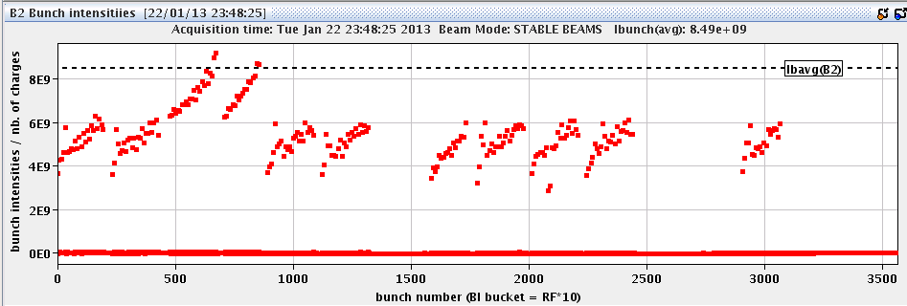
Tuesday 22nd January – last thing
23:48 fill 3482
Dumped by BPMS - low intensity Pb bunches (3e9)
Fill 3482:
Time in stable beams: 11h58m
Peak luminosity: 6.45e28 cm⁻²s⁻¹
Integrated luminosity: 1.5 nb⁻¹

Slide 5
Wednesday 23rd January – early morning
Just past midnight, remaining BLM thresholds around IR7 adjusted
Thanks to Eduardo
Dry run new ALFA RP sequence
00:55 injecting probes
Now switched to full injection scheme 338p_338Pb
Struggle with injection
Beam in SPS (tails, orbit…)
Beam dumped over injecting
Injection sequencer issues…
05:13 Lost RB.81 to QPS trigger
MPE clear to pre-cycle – analysis offline
07:05 Injecting probes

Slide 6
BLM threshold increases
BLMs protecting Q9
BLMQI.09R7.B1E10_MQ
BLMQI.09R7.B1E21_MQ
BLMQI.09R7.B1E22_MQ
BLMQI.09L7.B2I10_MQ
BLMQI.09L7.B2I21_MQ
BLMQI.09L7.B2I22_MQ
BLMs protecting Q11
BLMQI.11L7.B2I10_MQ
BLMQI.11L7.B1E30_MQ
BLMQI.11R7.B2E10_MQ
BLMQI.11R7.B1I30_MQ
BLMs protecting Q17.
BLMQI.17L7.B2I10_MQ
BLMQI.17L7.B2I20_MQ
BLMQI.17R7.B1E10_MQ
BLMQI.17R7.B1E20_MQ
BLMs protecting Q15
BLMQI.15L7.B2I10_MQ
BLMQI.15L7.B2I20_MQ
BLMQI.15R7.B1E10_MQ
BLMQI.15R7.B1E20_MQ
The monitor names in bold red were increased yesterday. The monitors in black bold were increased this morning and the rest of the monitors late last night.
Eduardo Nebot Del Busto

Slide 7
Cogging – symptoms/cures/understanding
3 frequency trims
Beam loss spike and dump on third trim
Last trim split in 2 yesterday
Pragmatic cures:
Raise beam loss thresholds
Slow frequency shifts down (frequency ramp rate, trim size)
Reduced number of bunches
Worked nicely yesterday

Slide 8
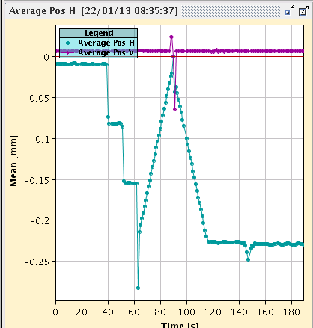
Cogging
Orbit evolution during cogging and re-phasing.

Slide 9
Cogging understanding
Trim to go to the last frequency value (789684 for both beams) is sent by the sequencer, and immediately after the command "lock both frequencies on beam 1" is executed while the frequency trim is still on going.
At this moment that the synthesizer of B2 jumps to the frequency of B1 non-adiabatically - B1 frequency is still moving…

Slide 10
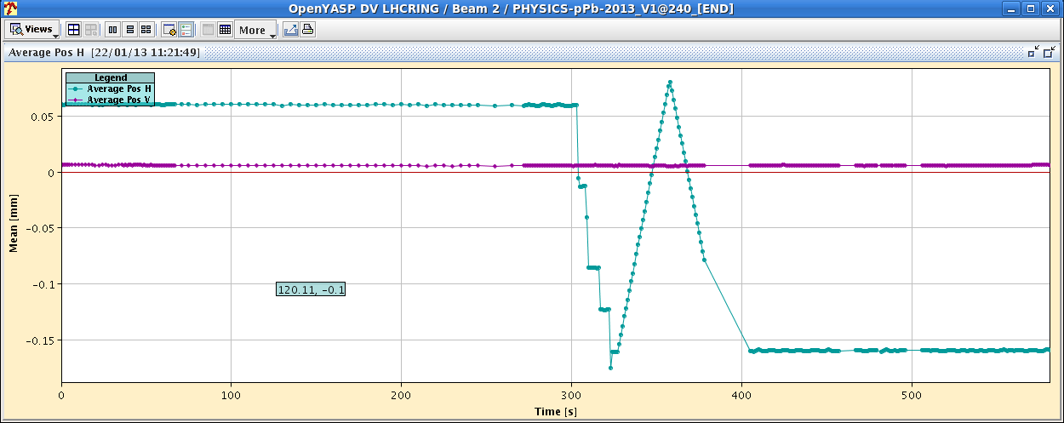
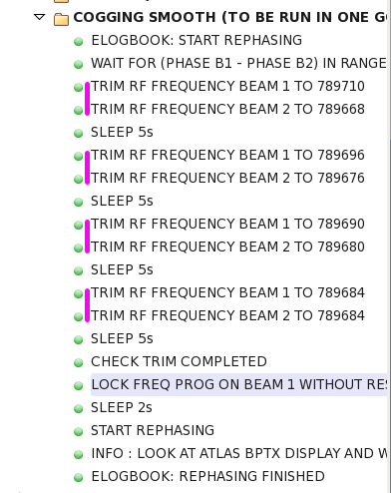
Cogging
Sequence adjusted accordingly

Slide 11
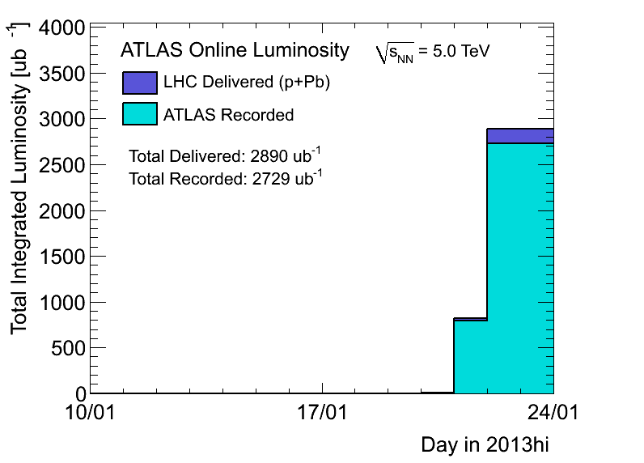
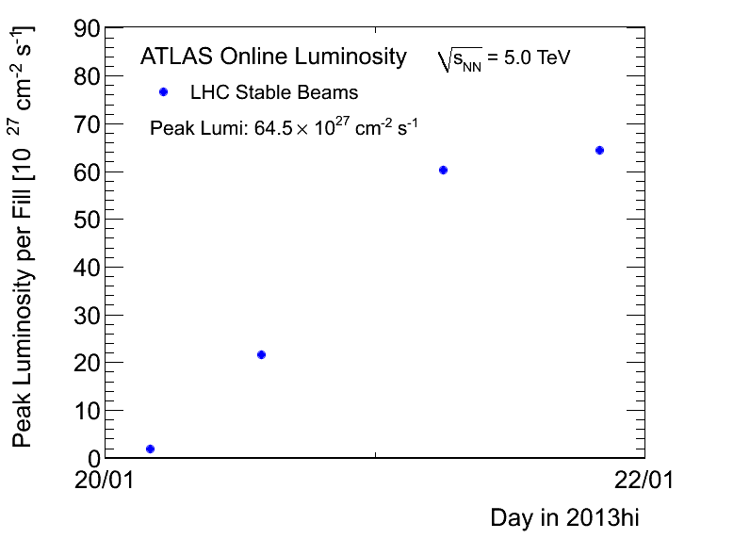
Usual plots

Slide 12
Various
MB for ALICE – +40 hours from yesterday midday
Wire scanners not to be used until checked in tunnel
V/d Meer scans next week Mon/Tue
Access requests:
Wire scanner, J.Emery, point 4, 2 hours.
Collimators UJ33, test position sensors, M. di Castro, A.Masi, 20 minutes.
“Train”, B.Feral, D. Paulic, PM56/UL55, 1 h during working hours
BGI, M.Sapinski, R4, ½ h

