Slide 1
Progress with Commissioning the first LHC p-Pb run
With thanks to far too many people to attempt to list:
OP (p and Pb Injectors, LHC, …), ABP (heavy-ion team, optics correction team, collimation team, …), RF, BI, ABT, CO, …
Also support and interventions from from EN, …
Personal thanks to Michaela Schaumann and Reine Versteegen for help with these slides
Many slides from coordinators, G. Arduini, E.B. Holzer

Slide 2
Goals: Ideal course of the p-Pb run – from LPC
Integrate 30 nb⁻¹ in ALICE as quickly as possible but respecting the constraints:
Means getting to this luminosity in ALICE quickly, most likely if we start with small β* and conservative intensity (reasons later)
Initial minimum bias ~ during luminosity ramp-up
Beam reversal and 2 polarity reversals
Get similar (or more) luminosity in ATLAS and CMS
Get several nb⁻¹ in LHCb
Then switch to 2nd priority intermediate energy p-p operation
Few days required
Then switch to 3rd priority, p-Pb with injection optics for LHCf
About 1 day required to commission and run

Slide 3
Commissioning plan, done by last Monday
ACTION | Species | No. OF BUNCHES/BEAM | TIME (8h shifts) | COMMENT | GROUP | Highly tentative start time
Injection of p, Pb to check timing. | p,Pb | 2,13 or more | 0.125 |  | OP/ABP | Done
Simple ramp | p, Pb | 1 | 0.5 | General check, including dump | OP | Done
Commission beta*=0.8 m in ALICE and beta*=2 m in LHCb, with protons on-momentum, pilot beams, flat machine (with several stops between 3 m and 0.8m). (TCTs, TCPs open, symmetrised) | p | 3 | 1 | Set-up operations with pilot intensity. This is close to the initial value used for physics. Also sort out BPM issues. | OP/ABP | Done
TDI re-alignment | p | 1 | 1 |  | OP/ABT | Done
Apply correction of beta-beating in flat machine (with several stops between 3 m and 0.8m). | p | 3 | 1 | > 24h required following measurements for offline preparation. Local and global corrections inserted. | OP/ABP | Done
IR6 interlock BPMS check at injection ( interlock behaviour check with proton trains), check issues with orbit feedback (with packet latency), injection oscillations with Beam 2, ADT setup for low intensity. | p | >24 | 0.5 | Needs 200 ns proton filling scheme. 1.5 10^10/bunch | OP/BI | Done

Slide 4
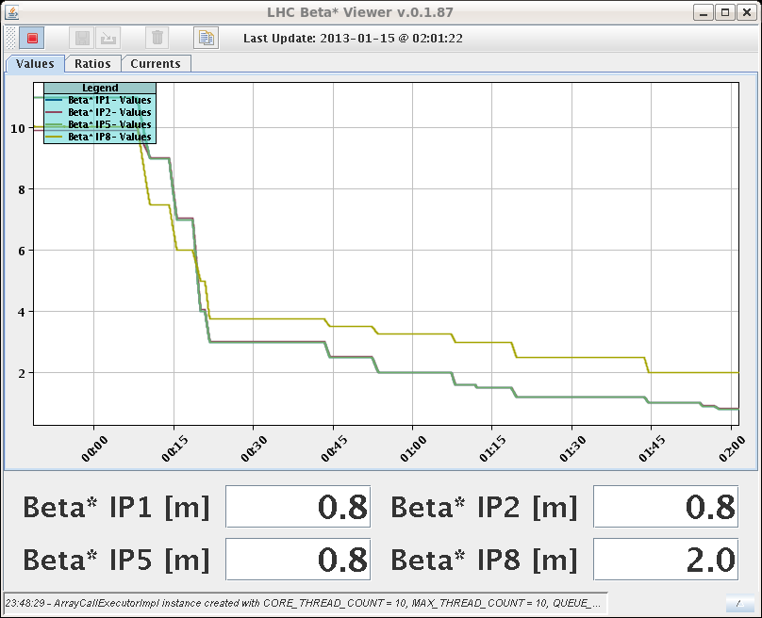
Monday Night
22:20 injecting 3 proton pilots for optics during the squeeze with experimental bumps; on momentum; trying to find collisions
0:00 – 2:00 orbit, tune and coupling corrections for the squeeze
Squeeze summary (Jorg, Ghislain, Rossano): - The orbit bumps went in fine. RT corrections for non-closures very modest. - Corrected the tunes and coupling quite a lot below 2.5 m. The situations looks good. The tune signals with 3 probes were very good! Some work needed on feed-forward of tune between matched points, some excursions in particular between the first points. - We had to open manually the TCTs in IR2 and IR8 as we were touching - we SHOULD NOT REPEAT THIS EXERCISE UNTIL WE HAVE BETTER TCT SETTINGS in IR2 and IR8.
Chromaticity at 0.8m: ~9-10

Slide 5
Tuesday Morning
2:00 – 4:00 collision beam process: orbit, tune and coupling corrections and trying to find collisions in the experiments
Summary (Jorg, Ghislain, Rossano):
Collision beam process is OK – but still have to check the V orbit functions again tomorrow (offline) for consistency.
Did not find collisions in any IP
For comparison of orbit measurement with high and low beam intensity: The BPM high and low sensitivity crossing calibration data has been recorded – will be analyzed today.
4:12 start off momentum optics at beta*=0.8m; Apply and check beta-beating correction knob; Check aperture.

Slide 6
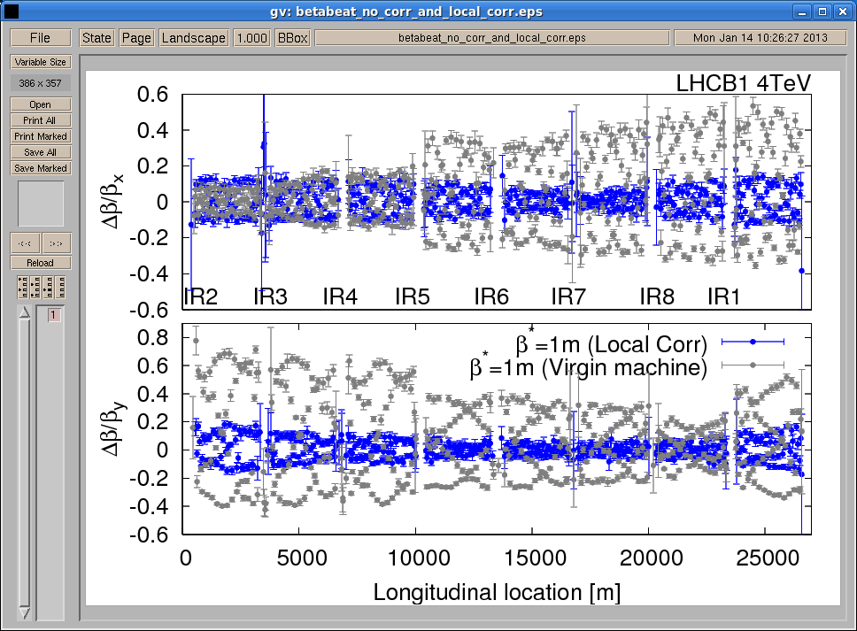
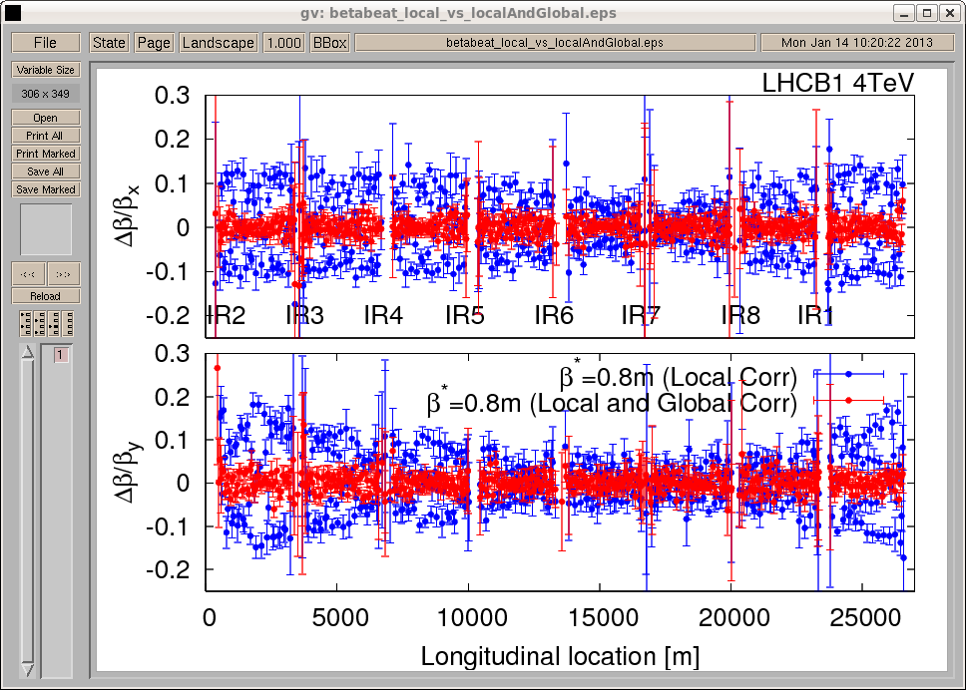
Comparison local corrections and virgin machine
Comparison local corrections and local+global corrections

Slide 7
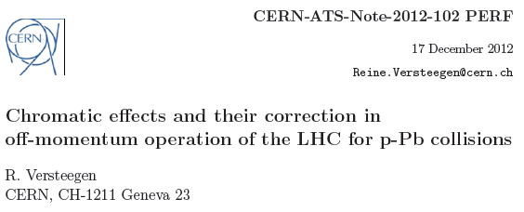
Squeeze commissioning – 1/3
Andy Langer, Yngve Levinsen, Meghan McAteer, Ewen McLean, Tobias Persson, Piotr Skowronski, Rogelio Tomas, Reine Versteegen, Jorg Wenninger, …
New squeeze goes down to β*(IP1, IP2, IP5, IP8) = (0.8, 0.8, 0.8, 2.0) and will be done off-momentum (new for LHC)
Optics measurements and correction were done in three steps with proton beams:
- on momentum squeeze in steps with flat machine, measurements at flat top, 7 m, 3 m, 1 m, and 0.8 m,
- on momentum squeeze in steps applying local IR corrections, same 5 stops to measure beta-beating, additional measurement at 0.8 m with global correction applied,
- on momentum squeeze in steps with experiments bumps ON and beat-beating correction (measurements at 0.8 m), followed by 2 off momentum measurements at 0.8 m with intrinsic beta-beating knob ON, with ± 0.00023 dp/p.

Slide 8
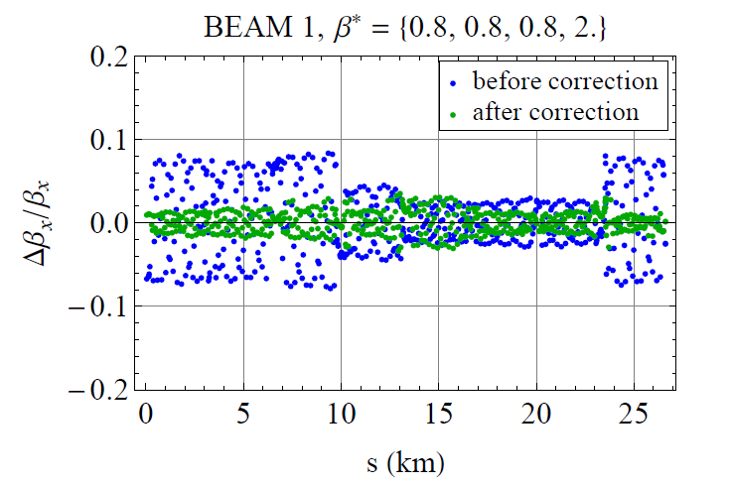
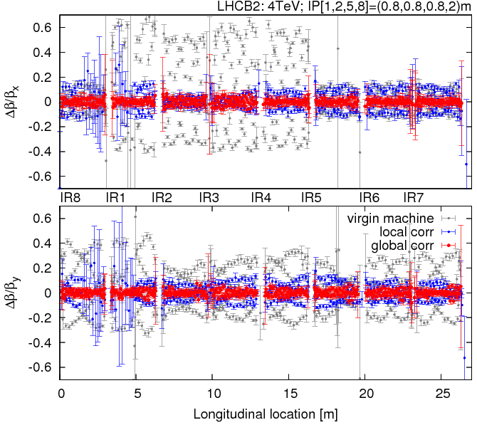
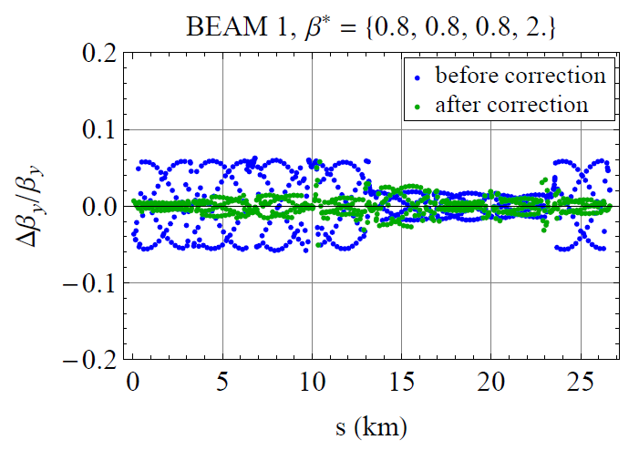
Squeeze commissioning – 2/3
Andy Langer, Yngve Levinsen, Meghan McAteer, Ewen McLean, Tobias Persson, Piotr Skowronski, Mattteo Solfaroli, Rogelio Tomas, Reine Versteegen, Jorg Wenninger, …
On momentum correction:
More than 60% beta-beating without correction (in gray),
Down to 20% with local correction (in blue),
Down to 5% with global correction (in red).
Off momentum intrinsic beta-beating correction knob (as calculated for B1):
IP6
IP6

Slide 9
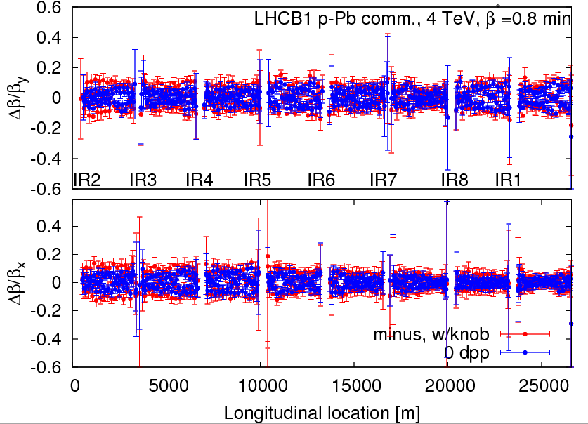
Squeeze commissioning – 3/3
Andy Langer, Yngve Levinsen, Meghan McAteer, Ewen McLean, Tobias Persson, Piotr Skowronski, Mattteo Solfaroli, Rogelio Tomas, Reine Versteegen, Jorg Wenninger, …
Off momentum measurements (with bumps), including intrinsic beta-beating correction knob:
Chromaticity was set two ~2 units,
Off-momentum knob acts on MQTs magnets,
Tune changed suddenly when 20% of the knob was applied for B1, negative dp/p, but did not come back appling -30% -> Hysteresis? Did not happen for pos. dp/p nor for B2.
-> Beta-beating stays below 10% off-momentum (so correction works).
Beam1, dp/p < 0
Start applying the knob on B1
dp/p < 0
Start applying the knob on B2
dp/p < 0

Slide 10
Commissioning plan, done by last Wednesday (LMC)
Cross calibration of orbit measurement in low and high BPM gain setting at injection B1 and B2 | p | 3 | 0.0625 | Must be done before loss maps at flat top. Pilot and INDIV | OP | Done
optics with experiment bumps; on momentum; try to find collisions in all experiments | p | 3 | 0.5 | Pilot bunches, Recommended lumi signals: - ATLAS: LUCID_EventAND_true - CMS: HF_true . | OP/ABP | Done
Go off momentum at beta*=0.8m, in both directions. Apply and check beta-beating correction knob. Check aperture. | p | 3 | 0.25 | Afterwards change external crossing angle in ALICE from +145 to -62.5 murad (to get net angle of 60 murad at IP) in collision beam process.This prepares the physics optics. | OP/ABP | Done
Remove BRAN at IP2 | 0 | 0 | 0 | Floating, done remotely when convenient | BI | Done

Slide 11
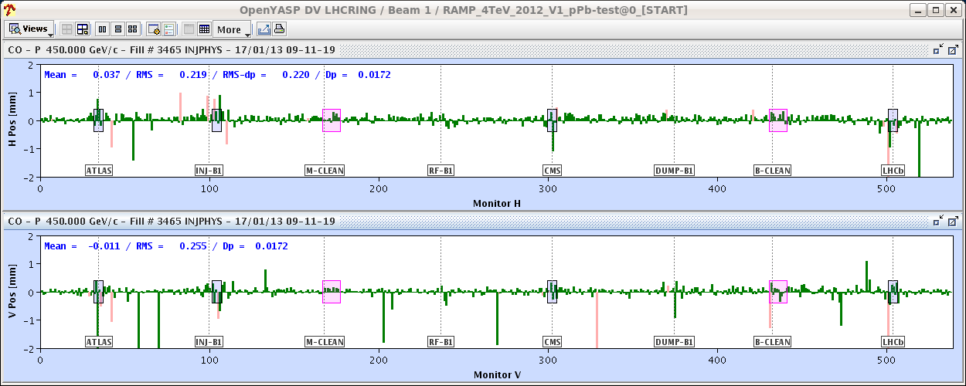
Thu 17/1
Cryo back at 06:00
7:20 Injection
Some difficulties to get stable bunch intensity from the injectors and to measure chromaticity.
After having injected pilots we start to inject bunches of 3x1010 p and we start to get bad readings from some BPMs. No improvement after re-phasing. This is not good!

Slide 12
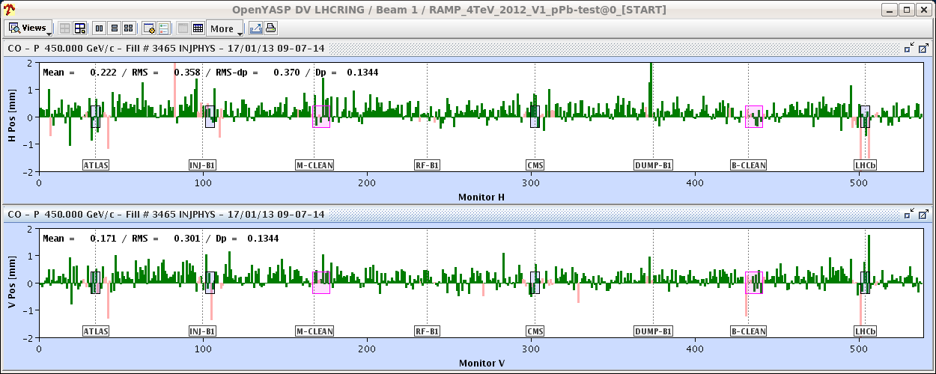
Thu 17/1
…even worse if we go with low sensitivity settings…
For this fill we gate the orbit acquisition on a single pilot bunch (synchronous acquisition). Not acceptable for multi-bunch schemes with proton bunches of more than 1.5x10¹⁰ p.
Not clear if we can follow path to increase the proton intensity later…

Slide 13
Thu 17/1/2013
15:00 first set of loss maps completed
16:00 Collimator alignment in point 7 completed
17:30 second set of loss maps completed
18:00-24:00 IR2 aperture measurements

Slide 14
Thu 17/1
Loss maps before and after alignment are consistent and the observed collimator aperture centres are consistent with previous ones (within tolerances) except for 1 collimators. Being checked.
G. Valentino
Collimator | March | January | Delta (mm)
TCSG.4R6.B1 | 0.125 | 0.405 | -0.28
TCP.D6L7.B1 | 0.240 | 0.200 | 0.04
TCP.C6L7.B1 | -0.178 | -0.225 | 0.047
TCP.B6L7.B1 | -0.320 | -0.340 | 0.02
TCSG.A6L7.B1 | -0.078 | -0.148 | 0.07
TCSG.B5L7.B1 | -0.375 | -0.455 | 0.08
TCSG.A5L7.B1 | -0.240 | -0.190 | -0.05
TCSG.D4L7.B1 | -0.070 | -0.073 | 0.003
TCSG.B4L7.B1 | 0.845 | 0.803 | 0.042
TCSG.A4L7.B1 | 0.835 | 0.783 | 0.0525
TCSG.A4R7.B1 | 0.693 | 0.768 | -0.075
TCSG.B5R7.B1 | 0.370 | 0.305 | 0.065
TCSG.D5R7.B1 | -0.228 | -0.280 | 0.052
TCSG.E5R7.B1 | 0.020 | -0.040 | 0.06
TCSG.6R7.B1 | -0.233 | -0.263 | 0.03
TCLA.A6R7.B1 | 0.328 | 0.228 | 0.1
TCLA.B6R7.B1 | -0.353 | -0.415 | 0.062
TCLA.C6R7.B1 | 1.443 | 1.283 | 0.16
TCLA.D6R7.B1 | -0.225 | -0.270 | 0.045
TCLA.A7R7.B1 | -0.418 | -0.465 | 0.047
Collimator | March | January | Delta (mm)
TCP.D6R7.B2 | 0.770 | 0.703 | 0.067
TCP.C6R7.B2 | 0.520 | 0.618 | -0.098
TCP.B6R7.B2 | -0.235 | -0.208 | -0.027
TCSG.A6R7.B2 | 0.075 | 0.040 | 0.035
TCSG.B5R7.B2 | 0.315 | 0.138 | 0.177
TCSG.A5R7.B2 | 0.540 | 0.438 | 0.102
TCSG.D4R7.B2 | -0.150 | -0.170 | 0.020
TCSG.B4R7.B2 | -1.058 | -1.228 | 0.170
TCSG.A4R7.B2 | -0.735 | -0.895 | 0.160
TCSG.A4L7.B2 | -0.760 | -0.825 | 0.065
TCSG.B5L7.B2 | 0.520 | 0.388 | 0.132
TCSG.D5L7.B2 | -0.240 | -0.265 | 0.025
TCSG.E5L7.B2 | 0.035 | -0.115 | 0.150
TCSG.6L7.B2 | -0.128 | -1.028 | 0.900
TCLA.A6L7.B2 | 0.338 | 0.341 | -0.003
TCLA.B6L7.B2 | 0.113 | -0.105 | 0.218
TCLA.C6L7.B2 | 0.805 | 0.810 | -0.005
TCLA.D6L7.B2 | 0.188 | 0.260 | -0.072
TCLA.A7L7.B2 | 0.688 | 0.765 | -0.077
TCSG.4L6.B2 | -0.188 | -0.11 | -0.078

Slide 15
Aperture measurement IP2 RB, MG, PH, LL, DM, SR, MS, RV)
We measured the aperture in IR2 for both beams and planes at the end of the squeeze with separated beams. We used the method of TCT scan + orbit bumps: after centring the TCTs (beam-based alignment around the reference orbit), we added orbit bumps to the orbit and increased the TCT gap until the triplet aperture was exposed. For the different planes/beams, we found the following on-momentum apertures: B1 - V (crossing) : 14.0-14.5 sigmas B2 - V (crossing) : 13.5-14.0 sigmas B1 - H (separation) : > 14.0 sigmas B2 - H (separation) : > 14.5 sigmas For the case B2-V we re-measured the aperture for both off-momentum signs (with off-momentum beta-beat correction knob active). We found that for the negative dp/p case we lose 0.5 sigmas whereas we lose nothing for the positive dp/p case. In conclusion, these apertures are fine for the operation at 80 cm. These preliminary results will have to be confirmed by loss maps after detailed TCT setup.

Slide 16
Friday 00:00-10:00 ramp, squeeze, first collisions
Ramp, frequency lock,
Cogging completed very quickly
squeeze, collision setup and first p-Pb collisions
Squeeze worked first time, with theoretical beta-beating corrections (R. Versteegen)
Collisions found in all experiments, luminosities
RF Frequency variations, ATLAS BPTX used to position collision points, now very fast
Ramp

Slide 17
Commissioning and run plan, done by Friday
Loss maps at flat top | p | 6 + 2pilot | 0.5 | INDIV 3. 10^10; correct orbit for beam intensity effect (cross-calibration above), IR7 collimator, TCSG in IR6, TCDQ, check re-setup, further loss maps. Off-momentum loss map. | OP/ABP | Done
Squeeze in single step, on momentum | p | 3 pilot | 0.1 | (Possibly scrape and take over beam from above.) Lower Q', measure Q, Q' through squeeze | OP | Done
Measure aperture in IR2 | p | 3 | 0.5 | (Possibly take over beam from above.) Try to finish in 4 h to avoid Pb injection in evening. | OP/ABP | Done
OP checks (injecton bucket for Pb, transverse feedback,…) | p,Pb | 3 | 0.125 |  | OP/RF | Done
Ramp, frequency lock, cogging, squeeze, collision setup and first p-Pb collisions | p,Pb | 6 non-colliding, >2 colliding in each IP | 0.75 | Need >4 bunches to have collisions in all experiments. Find collisions with help of luminosity experts in experiments. | OP/ABP/RF | Done

Slide 18
Commissioning plan, done by Saturday
Refill, ramp and squeeze in single step, on momentum | p | 3 Nominal | 0.75 | Only if necessary if collisions not found with p-Pb. Measure Q, Q'. Find collisions with help of luminosity experts in experiments. | OP | Dropped
One or two cycles through squeeze off-momentum p-p with all corrections and bumps, Beam1 and Beam 2, delta<0 first, apply beta-beat correction. (Possibly) repeat p-p Beam1 and Beam 2, delta>0. Check beta-beat. | p | 3 | 0.5 | Only if necessary. Do two proton beams in parallel with locked RF. Deltap is -+ 2.3 10^-4, radial loop OFF | OP/ABP | Dropped
Collimator and Roman pot alignment and loss Maps | p,Pb | 13 | 1.5 | TCT alignment (end of squeeze, collision). Loss maps - detailed list provided. - Alignment of the roman pots (VERTICAL ONLY) - partly done, to be completed. | OP/ABP | Done
Loss Maps (several fills) | p,Pb | 13 | 1.75 | Loss maps - detailed list provided. | OP/ABP | Done
Asynchronous dump tests (squeeze, collision) | p,Pb | 13 | 0.25 | Could be done at the end of one of the fills for collimaion set up | OP/ABT | Done

Slide 19
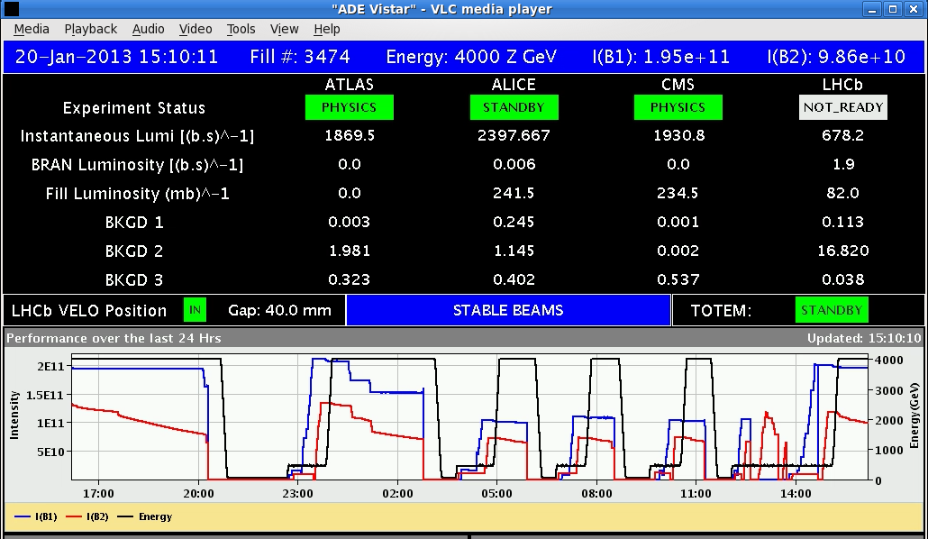
Fills for loss maps etc
Intense work and analysis by collimation team, also alignment of TOTEM and ALFA Roman pots

Slide 20
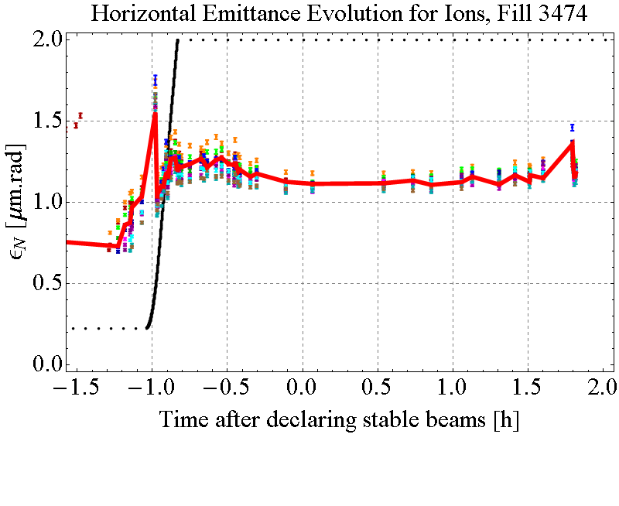
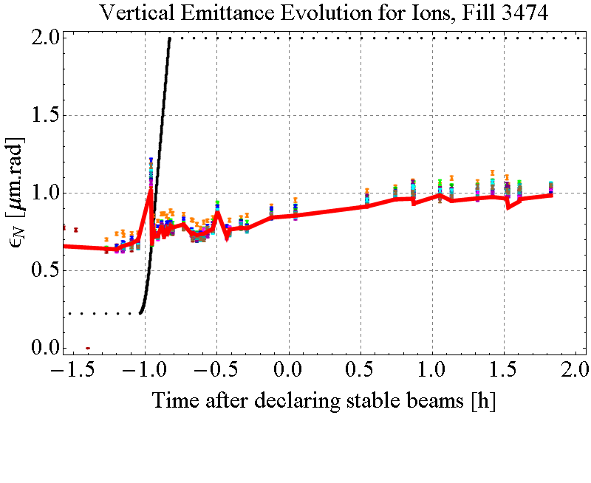
First STABLE BEAMS: 13Bunches – Pb emittance evolution
t = 0: start of SB
thick red line: non-colliding bunch

Slide 21
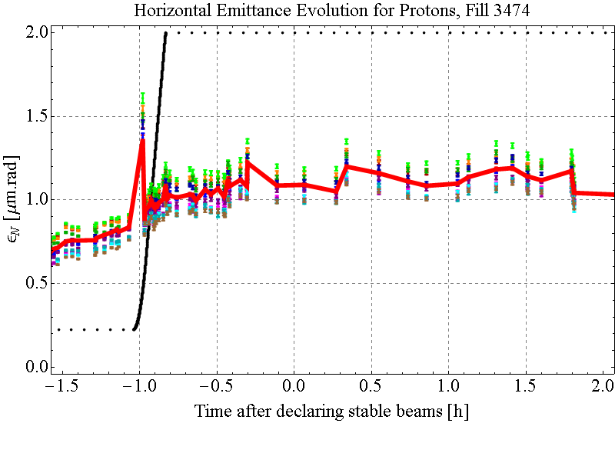
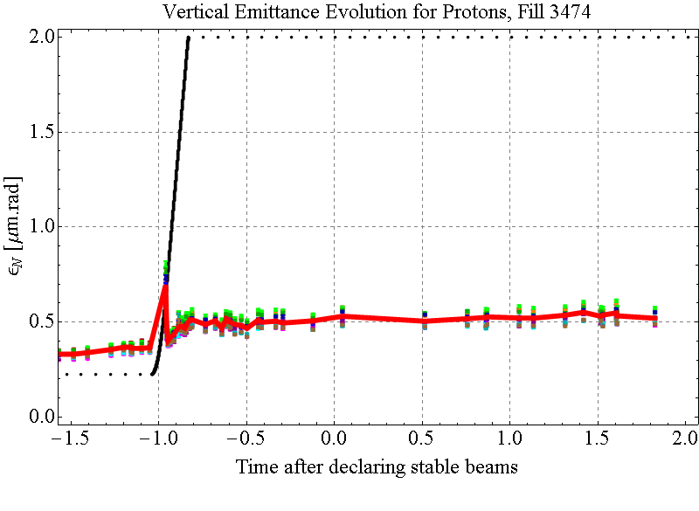
First STABLE BEAMS: 13Bunches – p emittance evolution
t = 0: start of SB
thick red line: non-colliding bunch
M. Schaumann

Slide 22
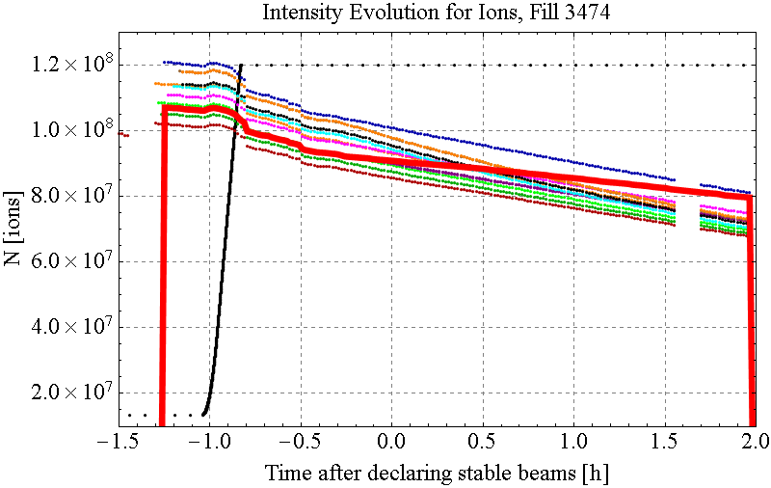
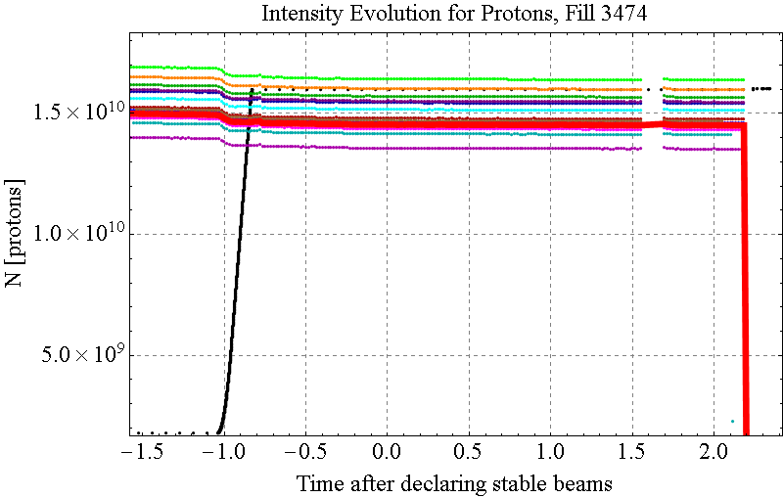
First STABLE BEAMS: 13Bunches Pb & p intensities
t = 0: start of SB
thick red line: non-colliding bunch

Slide 23
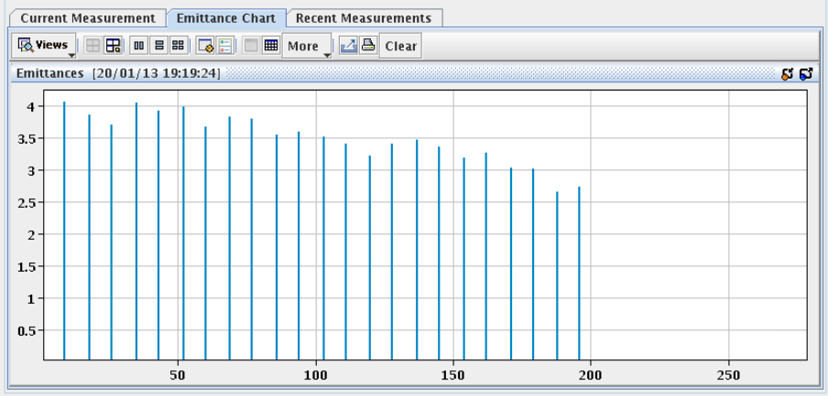
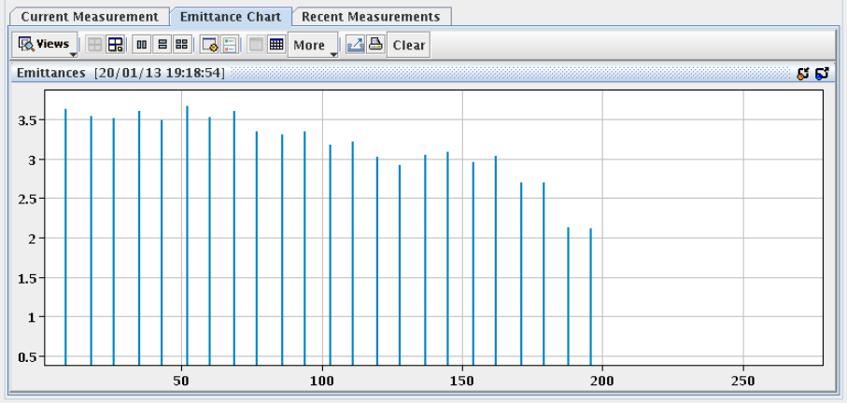
Emittances of first Pb train in LHC
B2 Horizontal
B2 Vertical
M. Schaumann

Slide 24
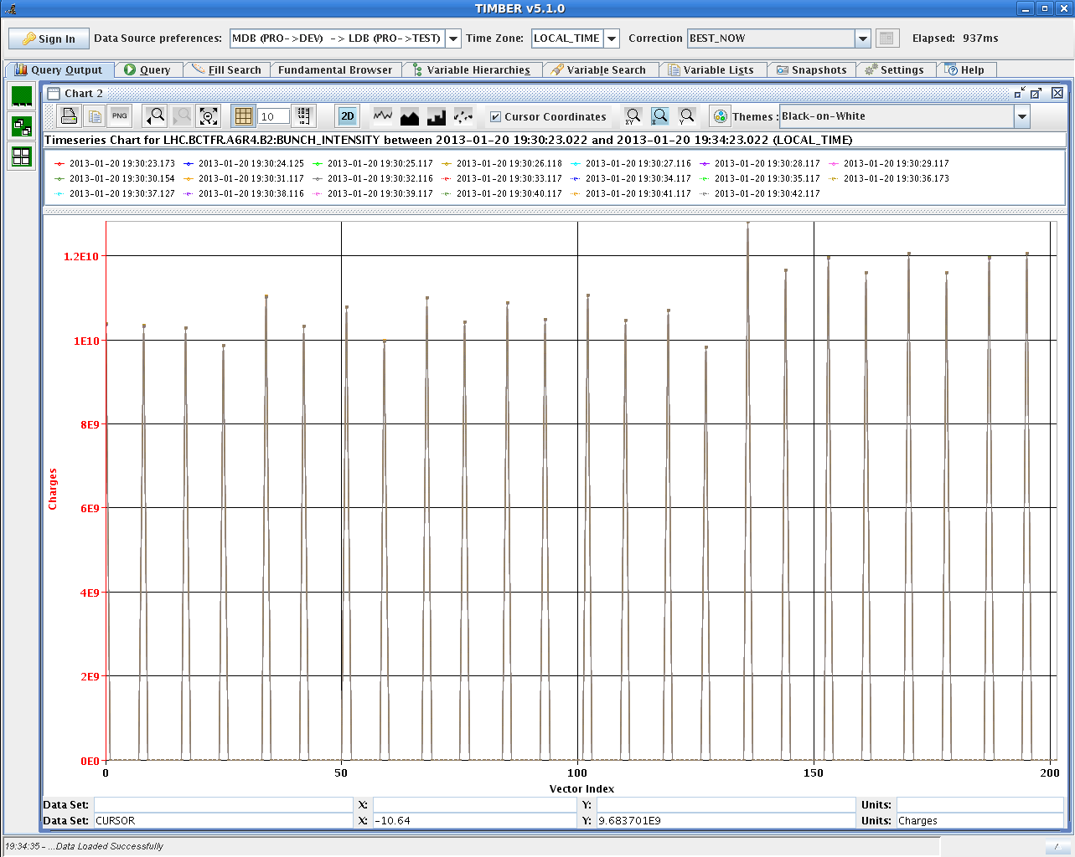
First Pb train in LHC

Slide 25
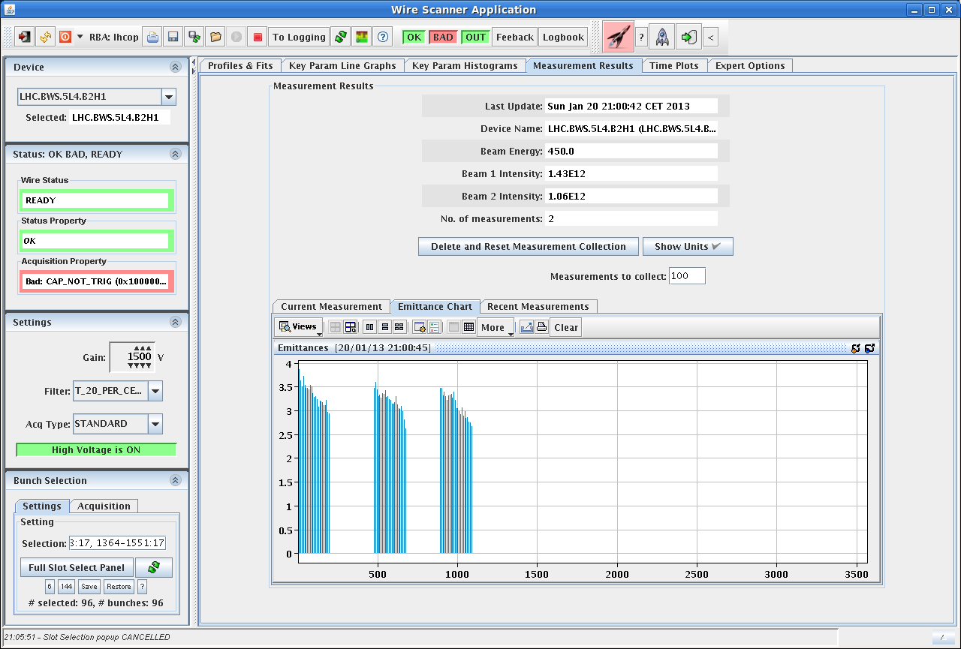
Pb emittances along trains
Reflects time spent by bunches on SPS injection plateau

Slide 26
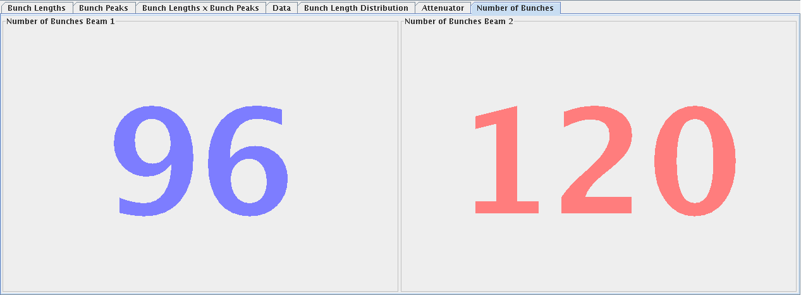
The Moment of Truth, finally, yesterday evening
Sunday evening, Fill 3474
First injection of Pb trains against proton trains
(the MD we’ve been trying to do since 10 September 2012).
Preliminary conclusions (pending further analysis, more data): moving long-range beam-beam encounters do not cause significant beam losses or emittance blow-up
c.f. RHIC, D-Au equal rigidity injection and ramp, exactly 10 years ago

Slide 27
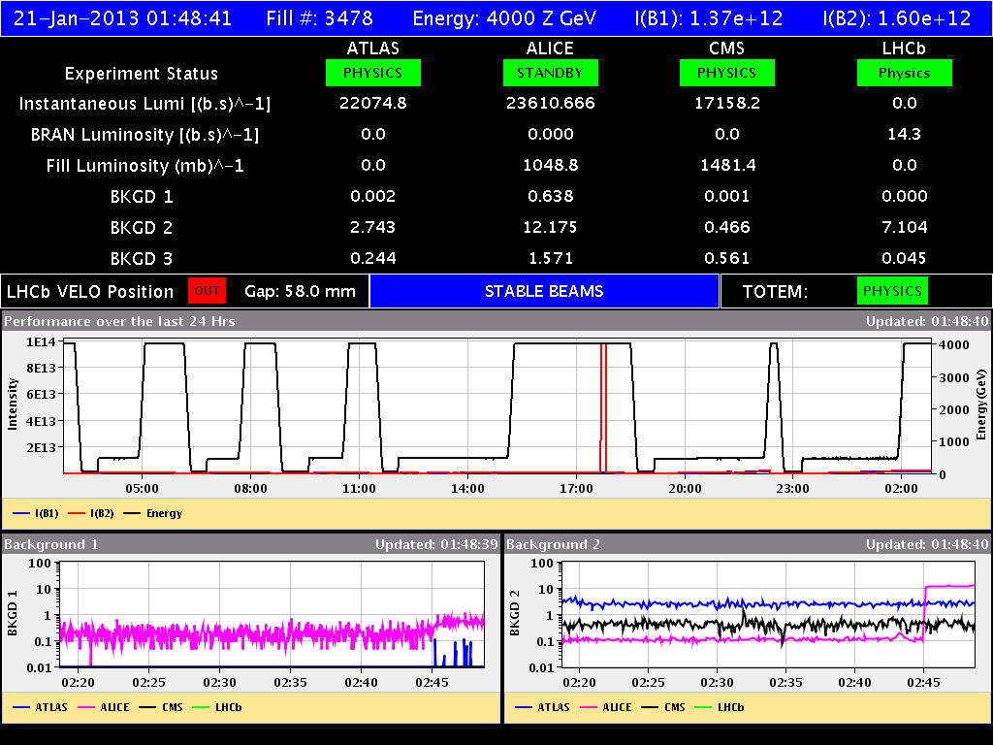
Intermediate filling scheme, STABLE BEAMS

Slide 28
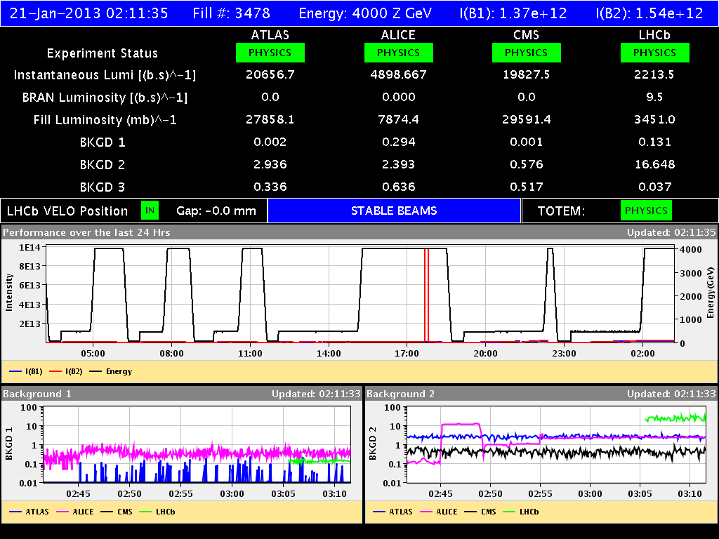
ALICE levelled for minimum bias data-taking

Slide 29
Full filling scheme, ramped just now
Record Pb intenisty in LHC !!
Thanks injectors!!

Slide 30
Commissioning and run plan, done by now
Collisions + first STABLE BEAMS for PHYSICS | p,Pb | 13 bunches, 8 colliding | 1 | Ramp with two beams, squeeze, checks, Stable beams. Only 1-2 h of stable beams. | OP/ABP/RF | Done
Trains of Pb and p at injection | p,Pb | 24n | 1.5 | Bumps for BCT position sensitivity Bumps for BSRT and wire scans for cross calibration and emittance evolution if not done yet: inject Pb trains 200ns B2 and afterwards p trains 200ns B1 | ABP/OP | Dropped
Intermediate filling scheme | p,Pb | 96, 120 |  | Ramp with two beams, squeeze, checks, Stable beams. Only 1-2 h of stable beams. | OP/ABP

Slide 31
Commissioning and run plan, remaining
Full filling scheme | p,Pb | 338 |  | Following minimum bias data collection by ALICE | OP/ABP
Increase p intensity 2,3,4, ... 10^10 | p,Pb | 338 |  | Level luminosity in ALICE to 1. 10^29 with transverse separation if necessary | OP/ABP
 |  |  |  | Physics production | OP
VdM scans |  |  |  | To be scheduled | OP/LPC/ABP
ALICE polarity switch |  |  |  | To be scheduled | OP/ABP
Beam reversal |  |  |  | To be scheduled, half-way through luminosity integration. Detailed setup procedure once p-Pb established | OP/ABP/RF
 |  |  |  | Physics production | OP
VdM scans |  |  |  | To be scheduled | OP/LPC/ABP
ALICE polarity switch |  |  |  | To be scheduled | OP/ABP

Slide 32
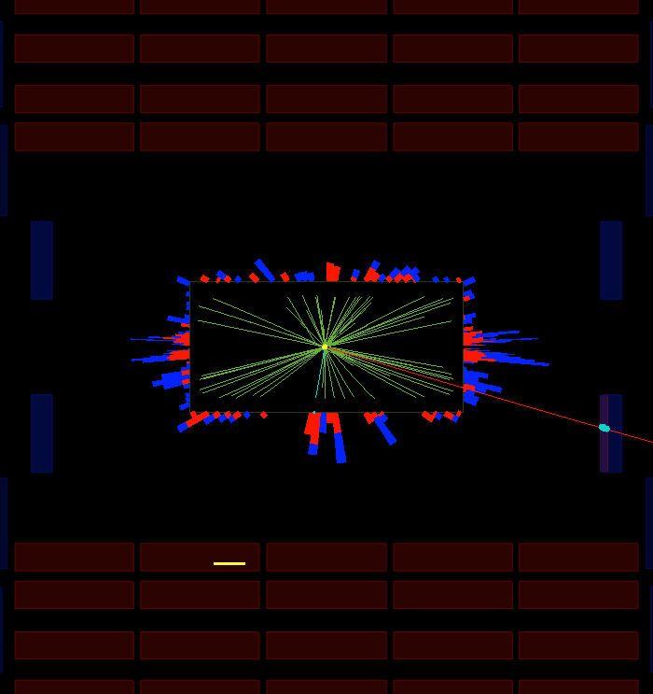
CMS event from first Stable Beams
I attach an event display from the firs pPb collisions of 2013 with a muon hitting the end cap muon chambers. It was very nice that the first collisions happened at 3pm instead of 3am! Cheers, Maria

Slide 33
Conclusions
Progress has been rapid during the time we have had beams available
Qualitatively new squeeze in good shape
Several critical steps to achieve first collisions and stable beams now done
Proton-lead injection, ramp, squeeze, collisions
Collimator alignment, qualification by loss maps
Finally tested effects of moving encounters
Luminosity
LHC now has a new physics programme, its first upgrade from Design Report baseline (at small cost)

Slide 34
Acknowledgements
This has been a difficult week, implementing several qualitatively new features of injectors and LHC operation, with many re-schedulings, key people not knowing when they should plan to sleep or be at CCC or deal with the rest of their lives.
Many interventions from piquets, repair teams, …
Thanks to everyone for their patience, flexibility and willingness to work ungodly hours far beyond the call of duty !

Slide 35
BACKUP SLIDes

Slide 36
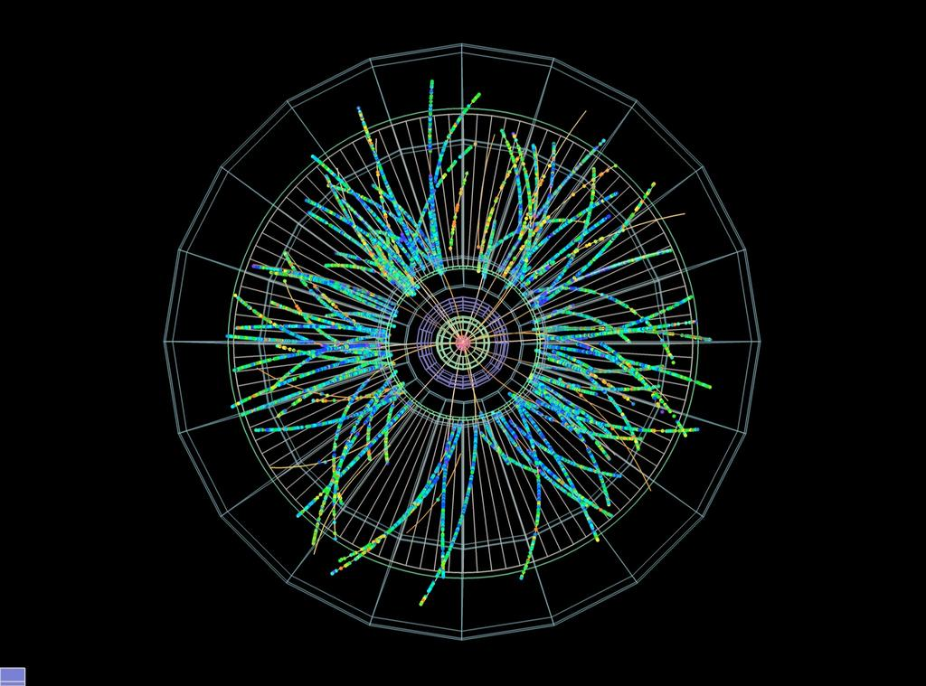
ALICE reconstructed event

Slide 37
Fast restart of Pb injectors
Thanks to Linac3 team working over Christmas break, the first Pb ions were available from:
Linac3 Monday 13:00
LEIR Monday 17:00
PS Tuesday 02:00
SPS Tuesday for North Area, Thursday single bunch LHC, Week-end 24 bunch train for LHC
New record performance of ~6x10¹⁰ charges at LEIR extraction today (5.5x10⁸ ions/bunch)
Source refilled yesterday, next refill on 28/1 or earlier, hope to hold until 11/2 without 3rd refill.
Prefer quench tests with ions at the beginning

Slide 38
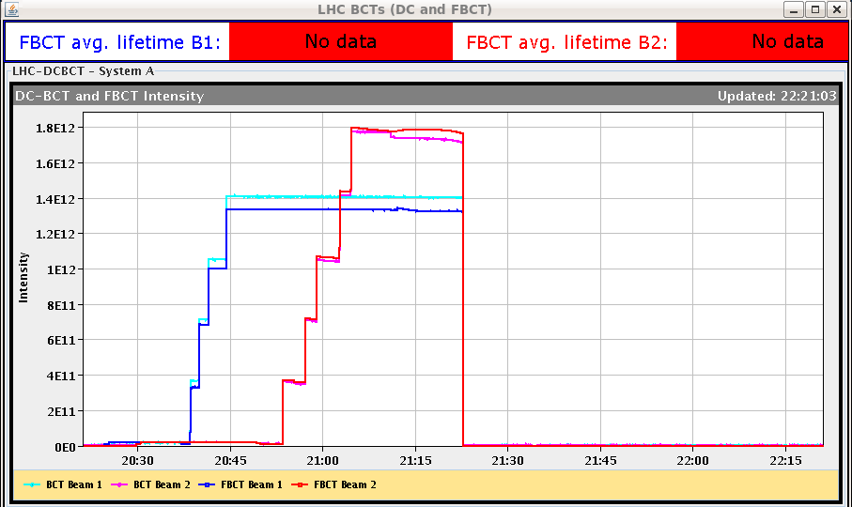
The Moment of Truth

Slide 39
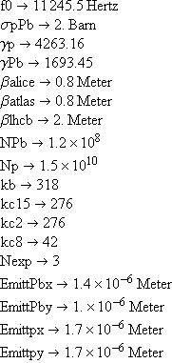
Baseline performance extrapolated from Pilot Fill
Already close to ALICE maximum luminosity with emittances of pilot fill, good Pb intensity, fairly conservative proton intensity – leaves room to try to increase it up to a factor ~3 (level ALICE if necessary).
Can easily be worse if we have blow-up or losses at injection or ramp (from moving encounters, IBS, …).
Unequal beam sizes were OK in pilot fill with higher β*.
Emittance increase will probably reduce luminosity for all experiments and pile-up for ALICE.
This is our preferred first goal for the run. But, on the basis of present knowledge, it is by no means a “safe set of parameters” (except for optics).

Slide 40
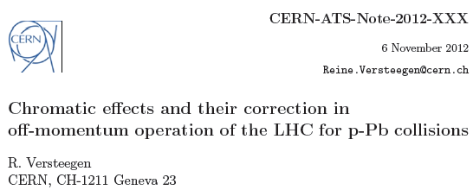
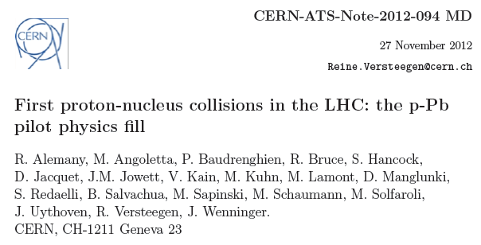
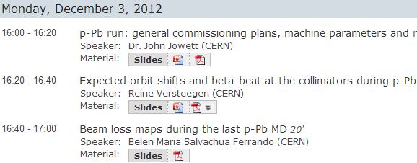
Off-momentum optics, beta-beating, etc
We are very well prepared to handle the new squeeze in ALICE, correct for off-momentum beta-beating and set up the collimation system.
Waiting for approval
Collimation working group

Slide 41
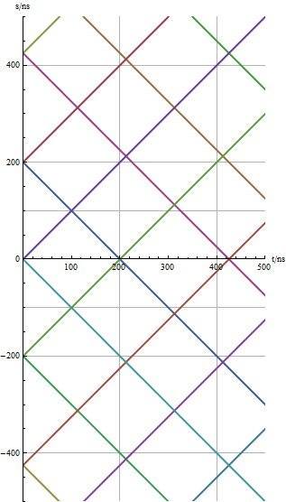
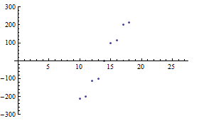
Encounters around an IP with 200/225 ns spacing
Encounter points at 0., 100., 112.5, 200., 212.5, 312.5, 325., 412.5, … ns from IP.
Collisions at IP only

