Slide 1
Monday 14.1.2013
9:20 beta beat corrections during squeeze for flat machine finished
Afterwards fixing issues at injection:
BPM rephrasing for B2 solved the problem with injection oscillation data not arriving
Reboot of OFB controller solved (at least for the time being) the problem with the slow orbit feed-back
13:10 start injection with trains of protons (200ns, 1E10 ppb)
Problem reading transfer line positions in YASP → workaround
16:30 finished the injection steering for both beams
16:40 – 18:20 access for ALICE, and BGI in parallel
Preparing for injection of Pb trains, could not be done because:
20:00 – 22:20 no beam from SPS

Slide 2
Summary beta-beat corrections (Rogelio and team)
Friday night: measurements of the virgin machine from flattop to 0.8m (B2) / 1m (B1)
Local corrections were calculated for IP[258]. IP1 data was unusable and the p-p correction from March2012 was assumed to still be valid (this is now supported by the beta-beating measurements and segment-by-segment results from this shift).
The knob for the local corrections is trimmed in from flattop "betabeat_IONS_pPb_local_4TeV“
Local corrections reduced the beta-beating from ~60% to ~20%.
Global beta-beating corrections were then calculated at 0.8m, which further reduced the B12(H&V) beta-beatings to ~5%.
The Global betabeating knobs are trimmed in from 1m as with the p-p knobs. "betabeat_IONS_pPb_Global_4TeV_b2_correct" "betabeat_IONS_pPb_Global_4TeV_b2_correct"

Slide 3
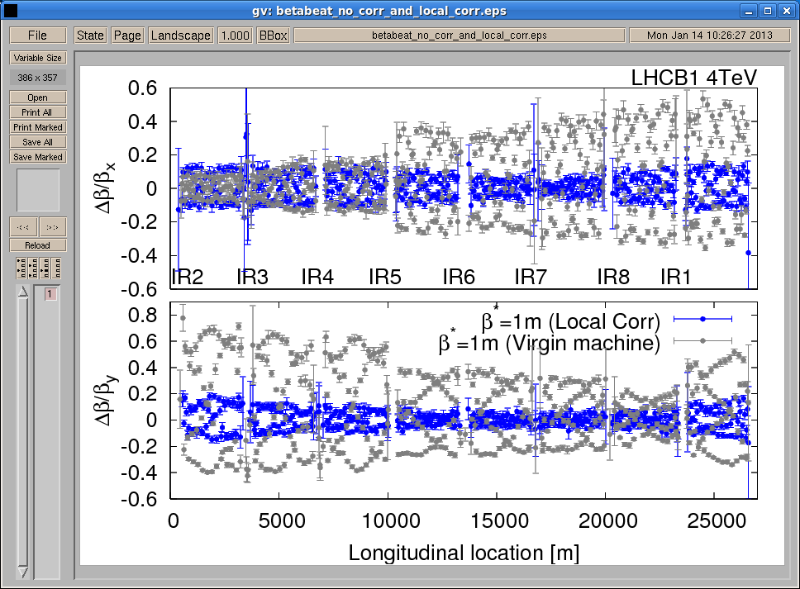
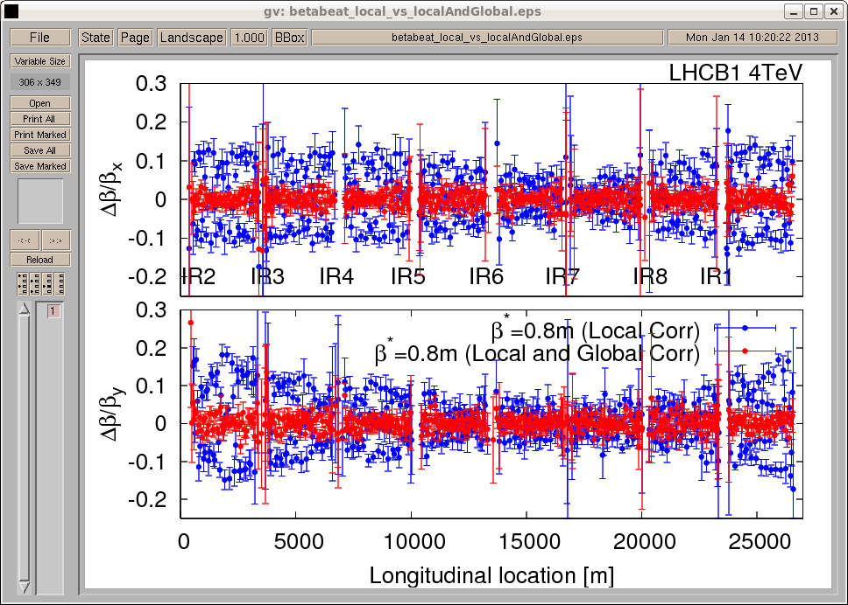
Comparison local corrections and virgin machine
Comparison local corrections and local+global corrections

Slide 4
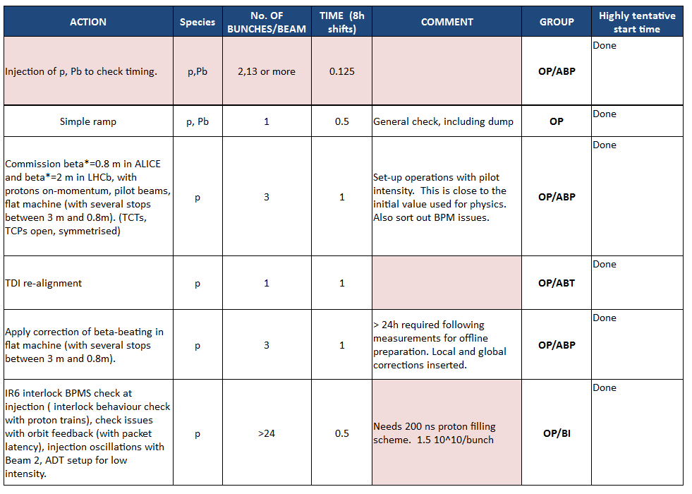

Slide 5
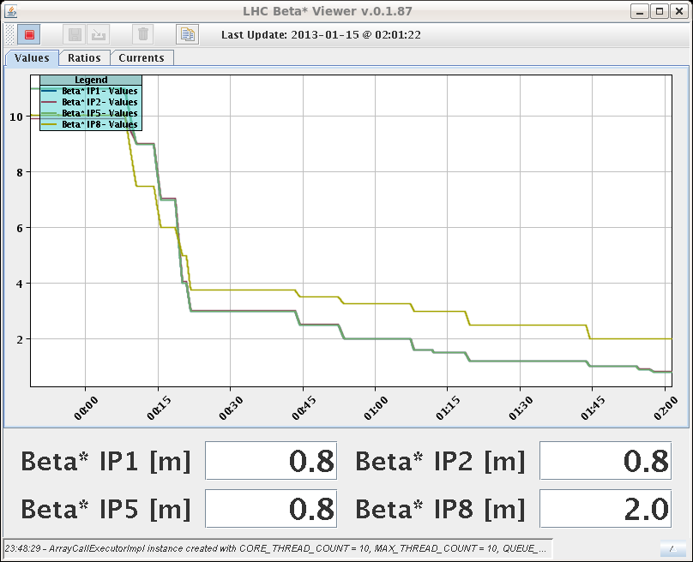
Monday Night
22:20 injecting 3 proton pilots for optics during the squeeze with experimental bumps; on momentum; trying to find collisions
0:00 – 2:00 orbit, tune and coupling corrections for the squeeze
Squeeze summary (Jorg, Ghislain, Rossano): - The orbit bumps went in fine. RT corrections for non-closures very modest. - Corrected the tunes and coupling quite a lot below 2.5 m. The situations looks good. The tune signals with 3 probes were very good! Some work needed on feed-forward of tune between matched points, some excursions in particular between the first points. - We had to open manually the TCTs in IR2 and IR8 as we were touching - we SHOULD NOT REPEAT THIS EXERCISE UNTIL WE HAVE BETTER TCT SETTINGS in IR2 and IR8.
Chromaticity at 0.8m: ~9-10

Slide 6
Tuesday Morning
2:00 – 4:00 collision beam process: orbit, tune and coupling corrections and trying to find collisions in the experiments
Summary (Jorg, Ghislain, Rossano):
Collision beam process is OK – but still have to check the V orbit functions again tomorrow (offline) for consistency.
Did not find collisions in any IP
For comparison of orbit measurement with high and low beam intensity: The BPM high and low sensitivity crossing calibration data has been recorded – will be analyzed today.
4:12 start off momentum optics at beta*=0.8m; Apply and check beta-beating correction knob; Check aperture.

Slide 7
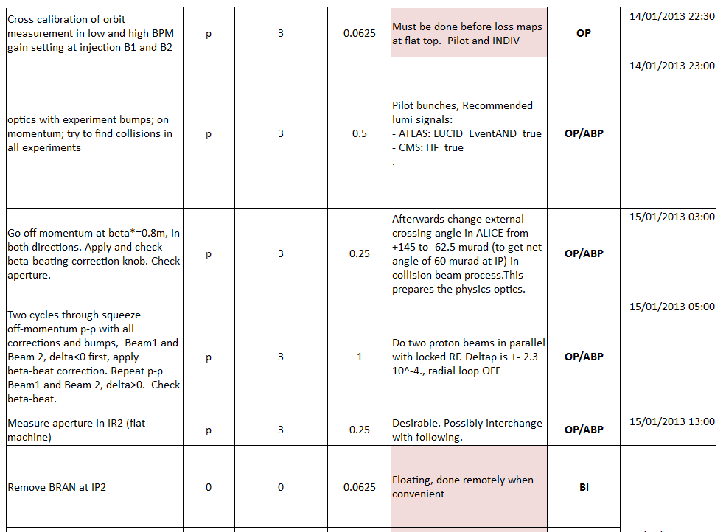

Slide 8
