Slide 1
LHC Week 2
Bernhard Holzer, Jan Uythoven
Restart LHC after technical stop,
prepare for p-Pb runs
commissionong & machine studies

Slide 2
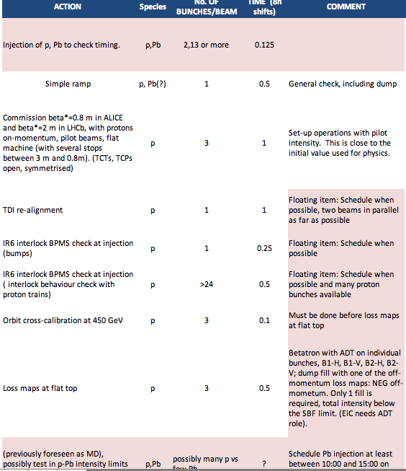
P-PB commissioning Plan
start with Pb injection
first
then back to original plan

Slide 3
Thursday 10-Jan
... end of technical stop
machine closed & ready for hardware checks
cryo OK
At the 8:30 Meeting: Router Restart needed ...
thanx a lot to IT for the check and pre-warning.
Affected routers and areas:
T2875-R-RHP82-1 LHC Point 8
T2275-R-RHP82-1 LHC Point 2
T376-R-RHP82-1 SPS West Area
T887-R-RHP82-1 SPS North Area
T2173-R-RHP82-1 SM18 + Cryo
T354-R-RHP82-1 PS Complex
For what concern IT-CS, the reboots can be scheduled any time from now on.
→ Thursday Morning 9:30

Slide 4
Major network incident on the 4th Jan
On the 4th of January, between 00:30AM and 4:00AM, 11 routers of the Technical Network stopped working, one after the other.
The problem was solved by restarting the boxes, operation done by a network expert alerted by the operators on shift.
The root cause has not yet been confirmed by the router manufacturer. But the suspect is that since the routers had been running for more than two years without any restart, the 32bits counter of the uptime wrapped and left the routers in a dangerous state.
In fact just before degrading, they all sent a syslog message dated 2009 complaining about the time synchronization.

Slide 5
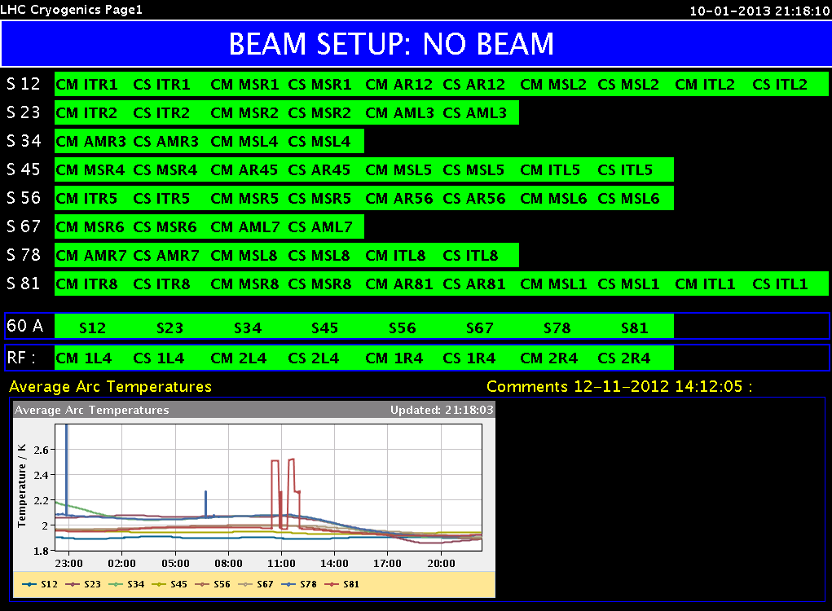
Network routers restart – IT
The restart of the routers did affect the LHC
Many cryo valves closed IP8. Stop of compressors just avoided because of the cryo crew was ready to react.
ODH in IP2 (as displayed in CCC)
Linac2 Vistar BCT (trafo) readings
Good that it was a coordinated reboot following yesterday’s request by IT

Slide 6
Thursday 10th January
9:30 Network routers restart, all went fine, but only just.
12:00 All power converters from the arcs on at standby
12:00 ELQA test finished
Still some selected accesses
17:40 Cryo Maintain OK for all sectors
18:37 Cryo OK complete machine
Test of circuits and QPS
22:55 All vacuum valves open
00:48 All HWC tests finished
02:41 BIS loops closed
06:50 RF conditioning M1.B1 finished

Slide 7
Friday Morning 12-Jan
... status Friday 08:30h
machine cycled, hardware checks ok,
short access for replacement of RCBV12.L7B2
RCBV28.R1B1
10:41h Access finished, preparing for injection
some delay: post mortem not available
decision: due to availability of experts:
start with Pb / p injection first
15:20h first ion injection: SPS BQM problem ...
masked ... but then wrong timing

Slide 8
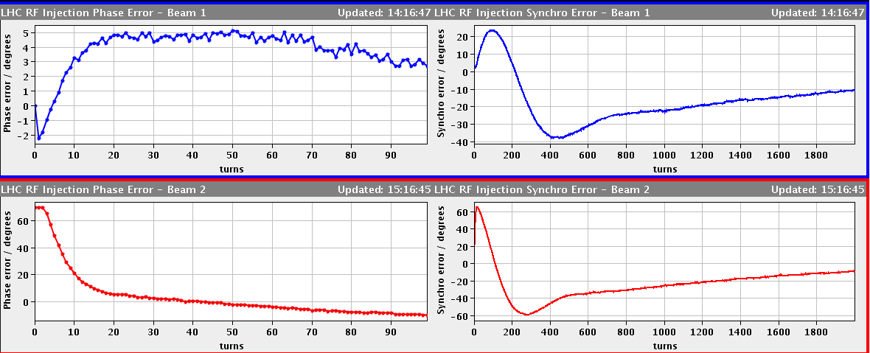
Friday Afternoon
15:30h first successful Pb injection ... leads die to BQM problem to
wrong timing / bucket in LHC
... not world record in long beam quality
5º
b1
60º
b2
Phase error at injection
16:20h prepare for a first test-ramp
Masked all BPM, BLM and RF interlocks (loss maps) and collimator movements
16:33h flat top reached with p-Pb bunches !!

Slide 9
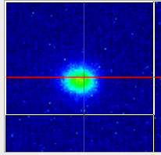
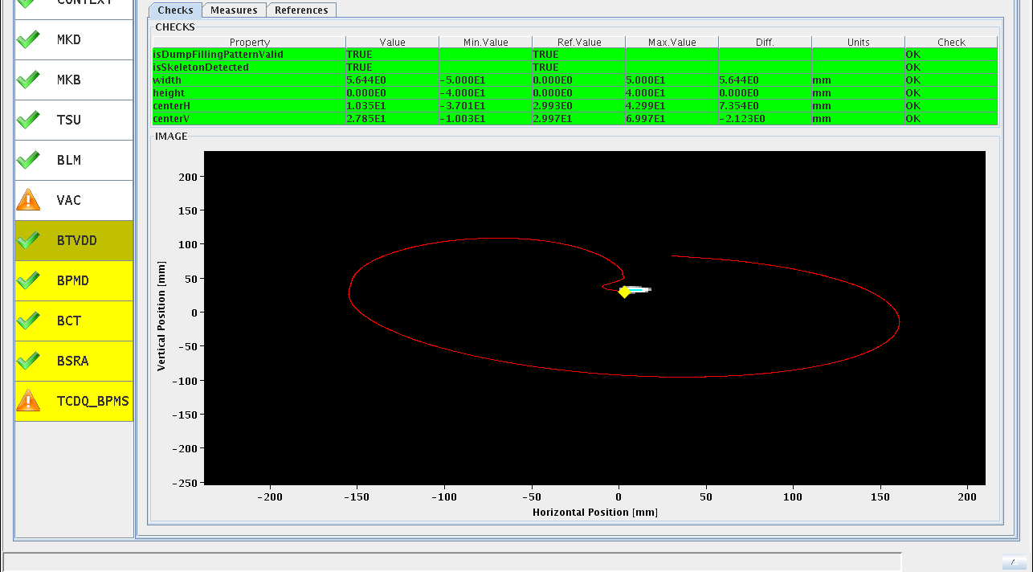
Friday Afternoon
15:30h first successful Pb injection ... leads due to BQM problem to
wrong timing / bucket in LHC
16:30h synchrotron light from a single pilot 4TeV
Pb bunch !!! (... in beam 2)
17:07h dump in “flat top” to check the system
(mainly position of bunch at dump)

Slide 10
Friday Afternoon
17:20h preparing for squeeze
little problem: matching quadrupole RQTL11.R2B1 beyond current limit.
(by ≈ 1A ... limit increased from 350-> 351A)
17:40h change particle type back to p-p operation
preparing the machine for proton injection / ramp / squeeze
& optic checks
19:50h When trying to move the TDI to +-8mm,TDI.4L2 right jaw got stuck at -8.2mm
21:00h injection three bunches
21:20h ramp, flat top

Slide 11
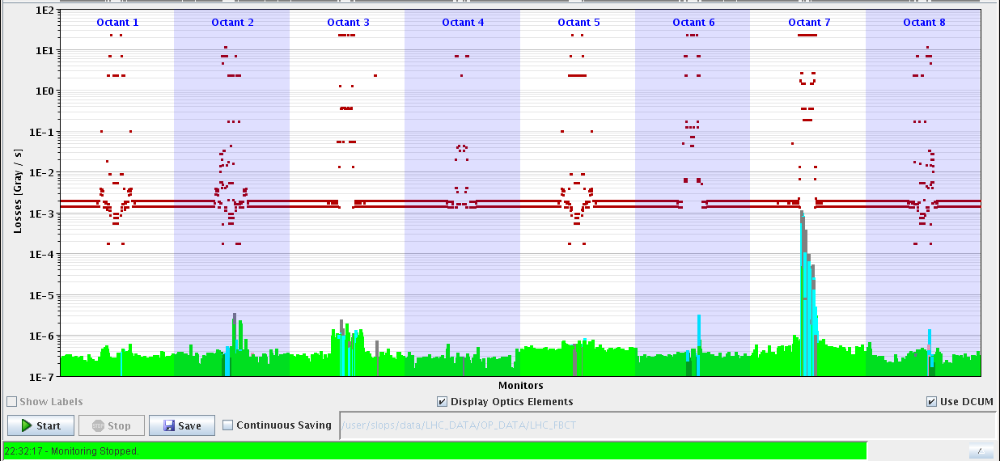
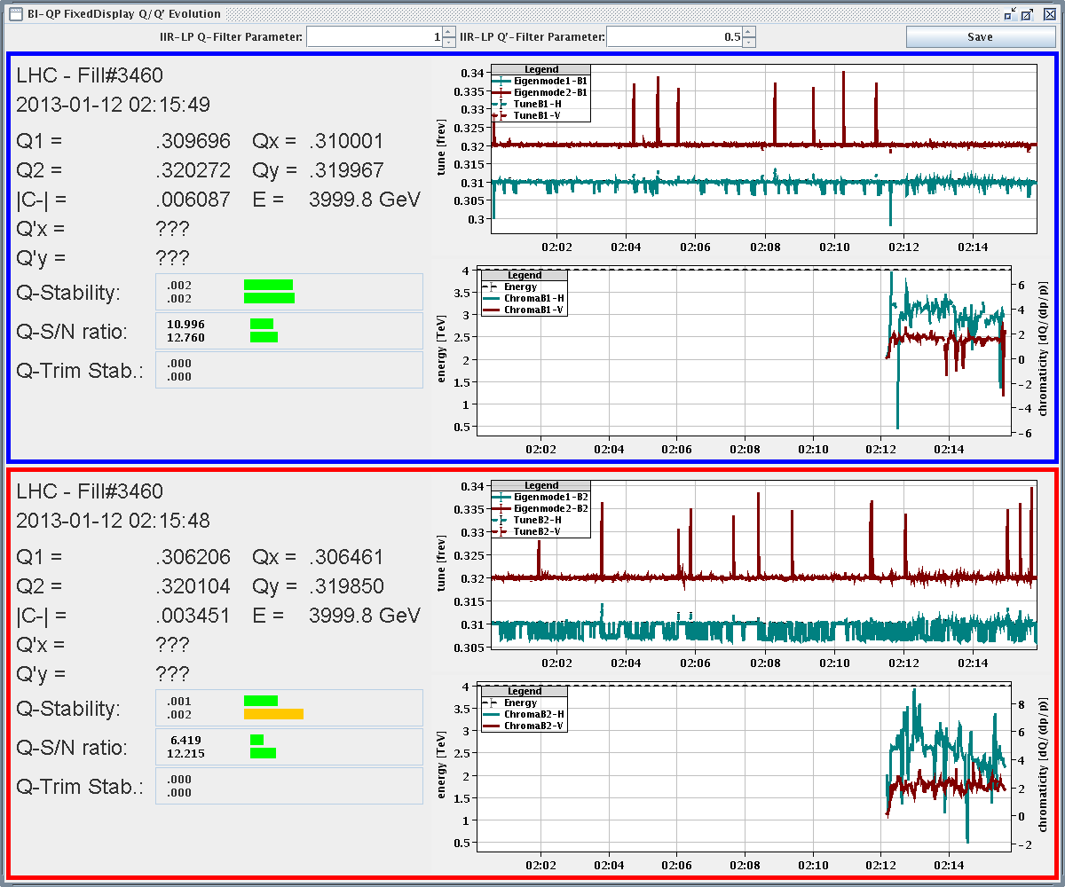
Friday Night
22:00h loss maps in flat top
to check for reproducibility
23:05h preparing for squeeze & optics checks
orbits flattened (x-ing angle & separation bumps off)
TCTs open
00:15h start Δβ/β measurement at flat top
00:50h squeezing in steps
tune / chroma / coupling / orbit correction
stops at β* = 7m, 3m, 1m
for optics measurement

Slide 12
Friday Night
04:40h reached β*=0.8m
04:50h beam loss in b1 during tune optimisation
optics measurement for beam 2
05:40h beam dump (OP)
ramp down, prepare for new injection
trip of RCD.A56B2 ... reset & recycle
Next step: TDI alignment studies

Slide 13
Saturday 12th January
13:30 TDI alignment finished successfully
13:30 Start of BPMS interlock check after installation of new attenuators during TS
16:30 Interlock checks finished successfully
16:30 Check of BPMS intensity limit with a single bunch: 1.5e9
17:30 Start check of BPMS with bunch trains at injection

Slide 14
TDI alignment Chiara & Wolfgang
Saturday 12th January
Part of the mechanics of the left(upper) jaw of TDIs in IP2 and IP8 were replaced during Xmas stop and LVDTs re-calibrated
References no more valid and new setup needed.
Results
TDI.IP2: Left (=upper) jaw: -3.03 mm & 0 urad Right (=lower) jaw: -4.39 mm & -840 urad
TDI.IP8: Left jaw: 3.19 mm & -157 urad Right jaw: 1.59 mm & -175 urad
settings ok and stored

Slide 15
BPMS checks Eva
Saturday 12th January
BPMSs interlock the beam position +/- 3 mm relative to reference to be sure that the beam passes through the beam dump channel.
Filters changed during TS so cross-over between high and low sensitivity mode is not at 2e10 p+, which is where we expect to be working for the coming pPb run but at 5e10 p+
Interlocking was checked
All channels interlock correctly, with an error of up to 0.5 mm
This error was smaller in the past, 0.1 mm, but is still acceptable
Checked with single bunch minimum intensity
At 1.45e9 interlock channels triggered
Still pending: check multiple bunches of 1 – 2 e10 p

Slide 16
19:15 Mains perturbation
Saturday 12th January
Explosion of a circuit breaker on the stable filter in BE9
This effects mainly the SPS. Repair most likely on Monday. Have to see if SPS can deliver some beam without this filter
Main damage on the LHC side is a UPS in point 8 and point 7
Fixable, but also needs external company
Repairs ongoing at this moment
Trips
‘All’ circuits lost including Experimental Magnets
Cryogenics OK lost – but compressors stayed on
RF lost
QPS in fault
Injection and beam dump kickers in fault
...

Slide 17
Saturday / Sunday
Problems to be fixed
LHC: UPS interventions ongoing UJ76 and RE88. To be finished early evening. Then pre-cycle and sanity check.
LHC: BLM CPU problem point 2 – intervention this morning
LHC: TDIs stuck – to be investigated
SPS: ‘Stable Filter’ not operational till Monday.
SPS: Beam dump errors on energy tracking
SPS: For the moment no protons from the SPS
Ramp up experimental magnets
ATLAS in the evening
If beam back, start with optics corrections through the squeeze.
Access requests (could be done this morning)
Ralph Steinhagen to change BBQ sensitivity

Slide 18
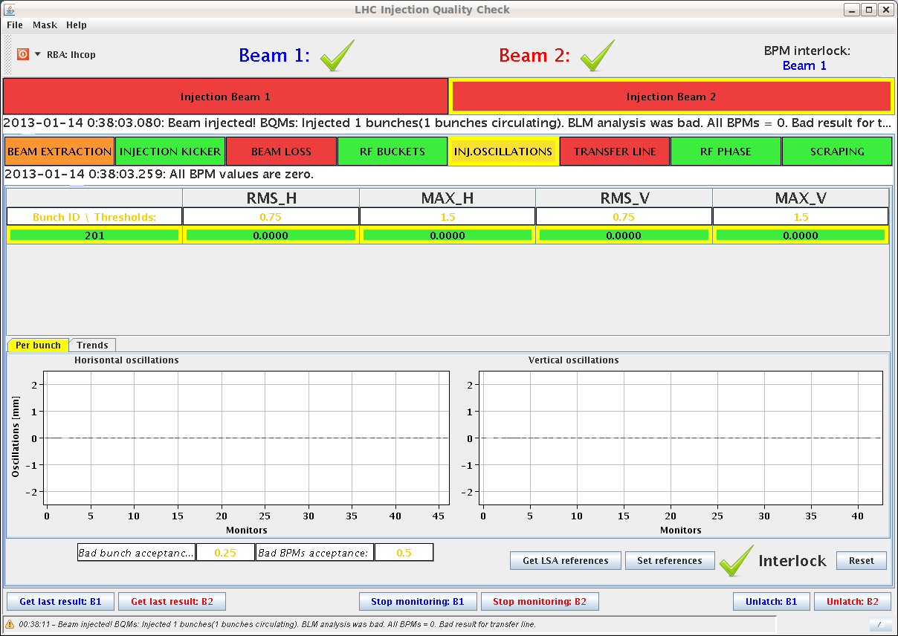
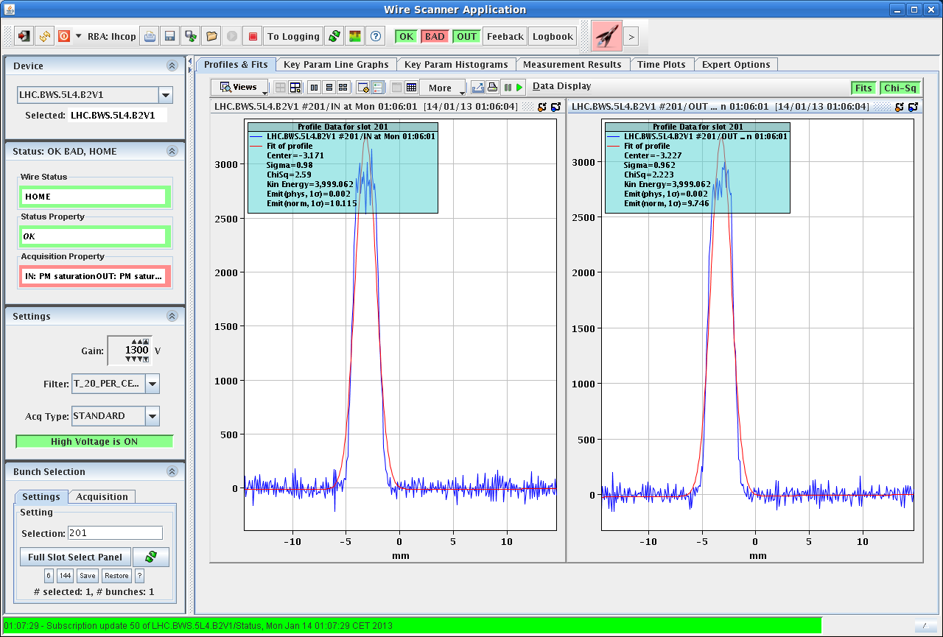
Sunday Night
21:45 Access finished, preparing restart
check of all other UPS was made around the LHC; no faults found.
The UPS channel on the PIC interlock tested: succesfully.
22:30 Pre-Cycling
23:45 Injection probes
small problem: after rephasing BPM, we have now
injection oscillation for beam 1 but still not for beam2
00:52 Ramp ... flat top ... but ...
emittances are very large
ε ≈ 10 !!!

Slide 19
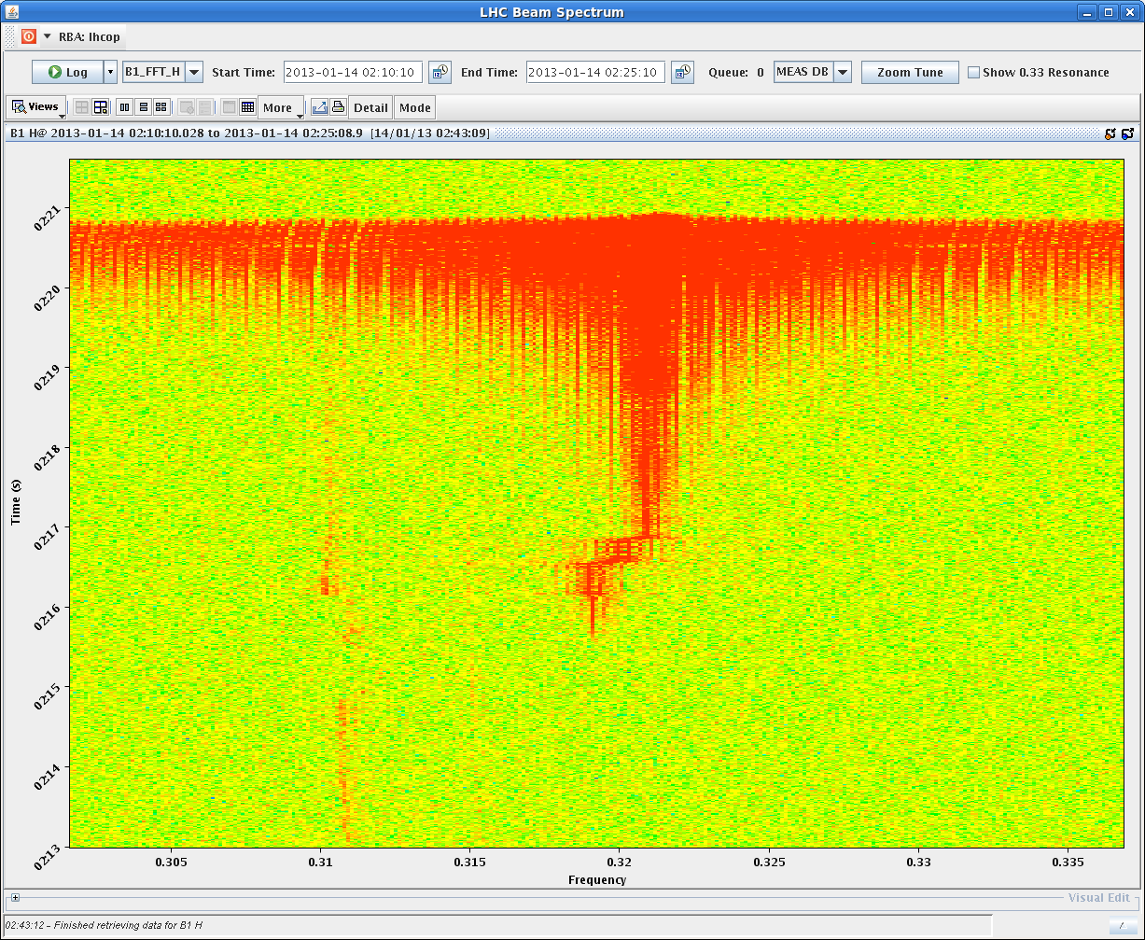
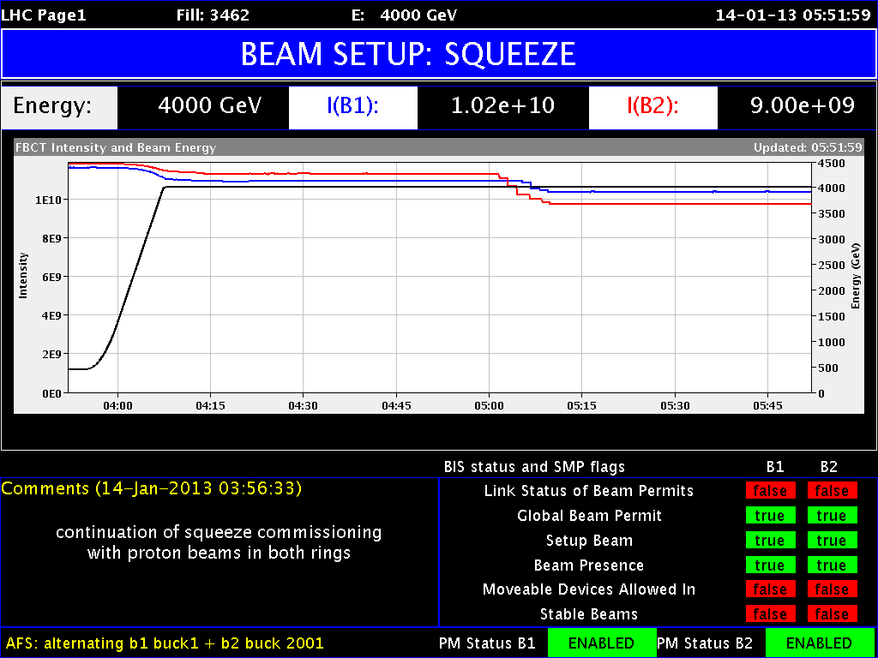
Sunday Night
01:35 Squeeze
02:23 B1 lost (instability ?) at 1.6m
02:25 Beam Dump (OP) and re-fill
03:15 Injection
03:55 Ramp ... Flat Top
ε ≈ ok (3.0)
04:25 Squeeze
β* = 0.8m reached
Next steps: Rogelio
cycle & run the squeeze with the bumps
(squeeze in steps) to check the bumps,
correct orbit errors not taken out by the OFB
(with probe), make further Q, Q’, coupling corrections if needed.

Slide 20
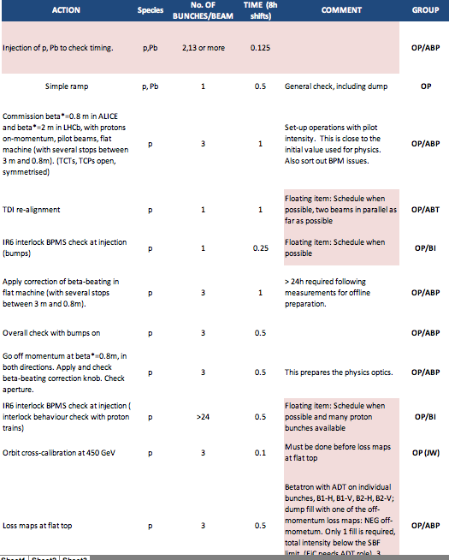
Plan
✔
✔
✔
✔
✔
✔

