Slide 1
Beta-beating measurements
15/01/2013

Slide 2
04:00 Start of beta-beating measurements
04:20 Measurements at 0.8 m with bumps ON, on-momentum
05:23 go to dp/p=-0.00023, Δf=33 Hz – apply correction knob, measurements
06:50 go to dp/p=+0.00023, Δf=-27 Hz – apply correction knob, measurements

Slide 3
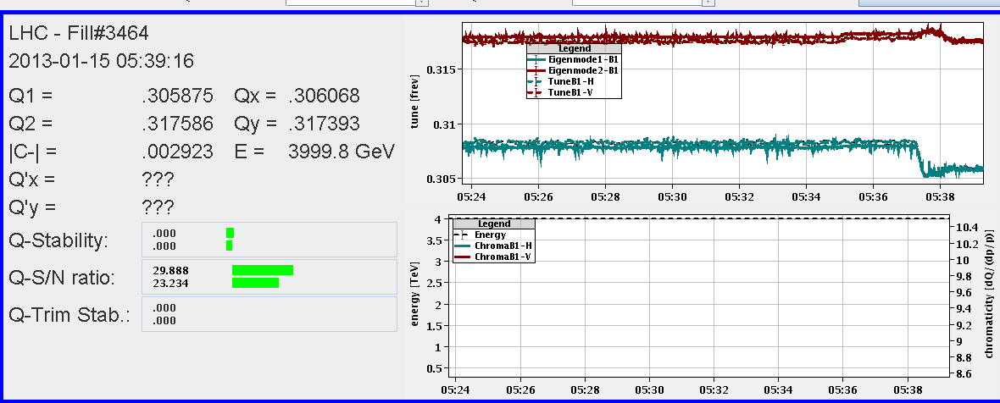
Sudden change of tune for the first try which did not repeat,
Hysteresis?

Slide 4
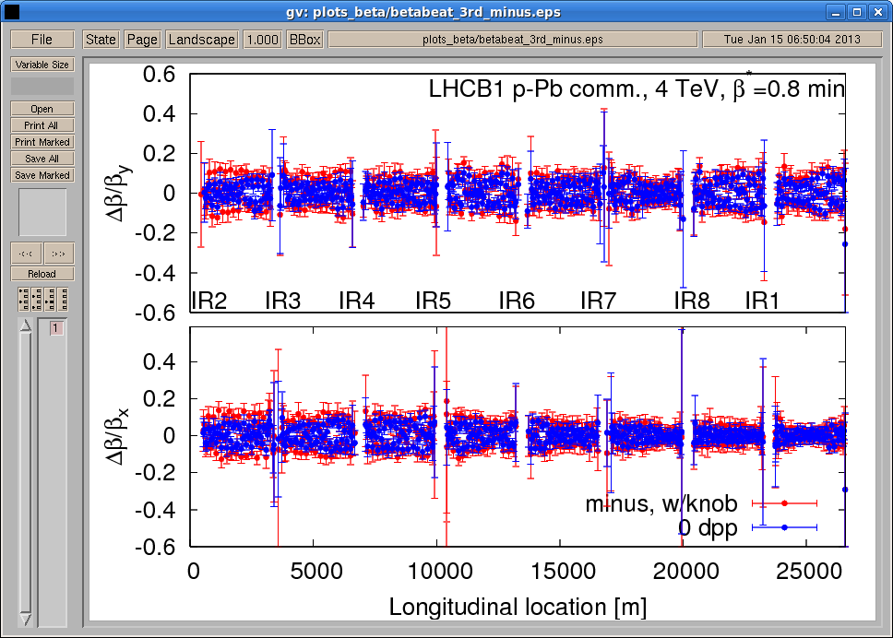

Slide 6
