Slide 1
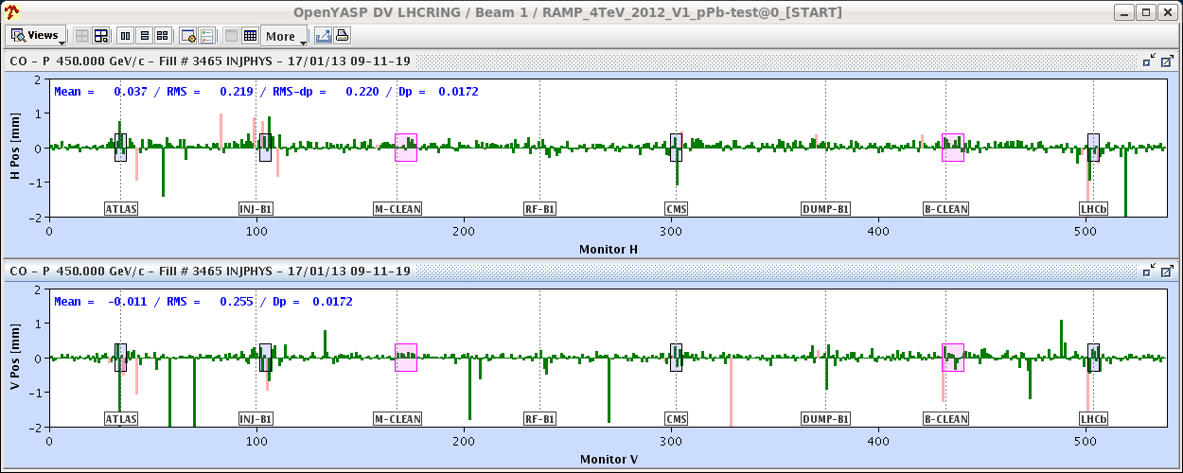
Thu 17/1
Cryo back at 06:00
7:20 Injection
Some difficulties to get stable bunch intensity from the injectors and to measure chromaticity.
After having injected pilots we start to inject bunches of 3x10¹⁰ p and we start to get bad readings from some BPMs. No improvement after re-phasing. This is not good!

Slide 2
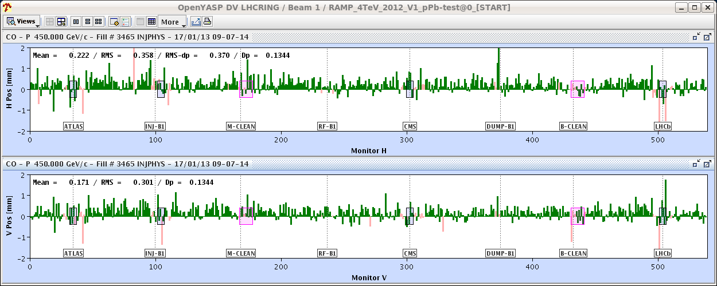
Thu 17/1
…even worse if we go with low sensitivity settings…
For this fill we gate the orbit acquisition on a single pilot bunch (synchronous acquisition). Not acceptable for multi-bunch schemes with proton bunches of more than 1.5x10¹⁰ p. Not evident to increase the proton intensity later…

Slide 3
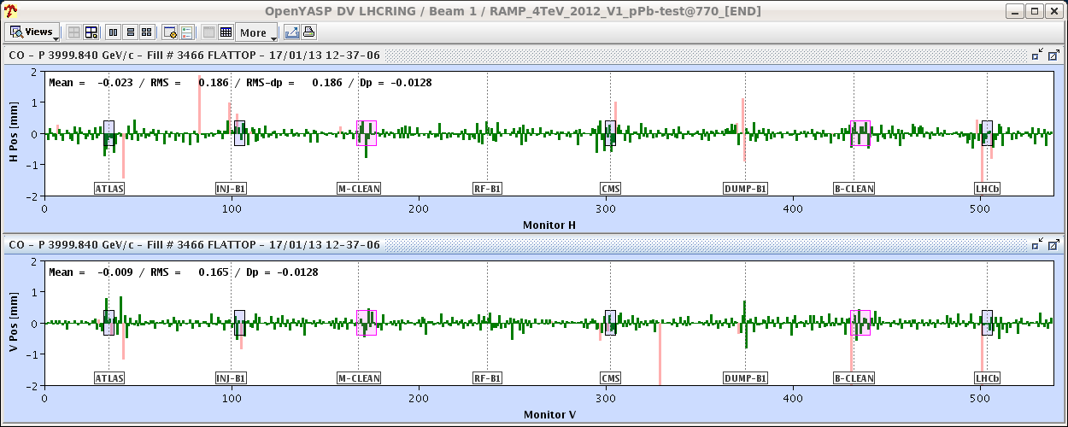
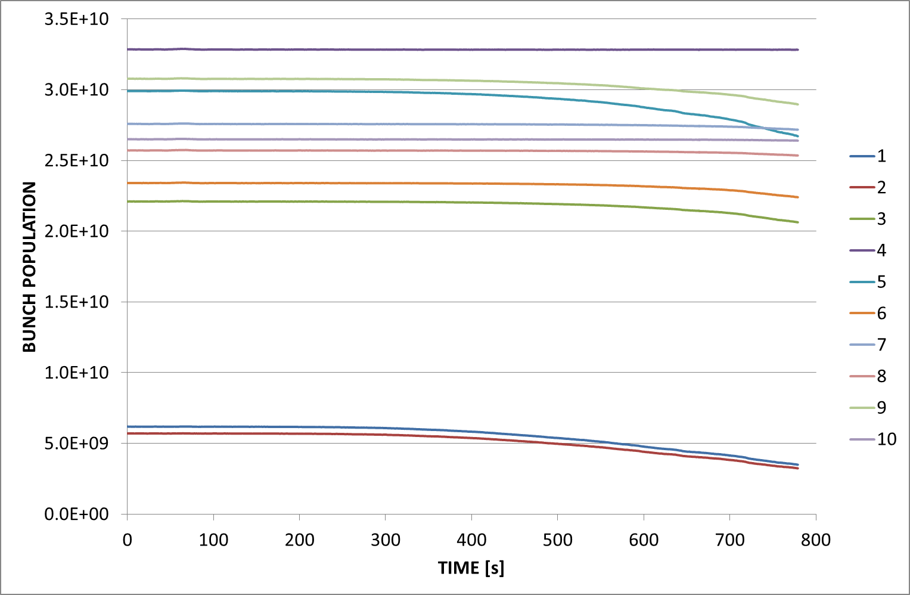
Thu 17/1
12:18: Beginning ramp
12:30: end of ramp. Orbit not very good. Likely because of the losses on the pilot bunch

Slide 4
Thu 17/1
14:00 Decided to scrape the beam down to ~1-1.5x10¹⁰ p/b and go ahead with programme
15:00 first set of loss maps completed
16:00 Collimator alignment in point 7 completed
17:30 second set of loss maps completed

Slide 5
Thu 17/1
Loss maps before and after alignment are consistent and the observed collimator aperture centres are consistent with previous ones (within tolerances) except for 1 collimators. Being checked.
G. Valentino
Collimator | March | January | Delta (mm)
TCSG.4R6.B1 | 0.125 | 0.405 | -0.28
TCP.D6L7.B1 | 0.240 | 0.200 | 0.04
TCP.C6L7.B1 | -0.178 | -0.225 | 0.047
TCP.B6L7.B1 | -0.320 | -0.340 | 0.02
TCSG.A6L7.B1 | -0.078 | -0.148 | 0.07
TCSG.B5L7.B1 | -0.375 | -0.455 | 0.08
TCSG.A5L7.B1 | -0.240 | -0.190 | -0.05
TCSG.D4L7.B1 | -0.070 | -0.073 | 0.003
TCSG.B4L7.B1 | 0.845 | 0.803 | 0.042
TCSG.A4L7.B1 | 0.835 | 0.783 | 0.0525
TCSG.A4R7.B1 | 0.693 | 0.768 | -0.075
TCSG.B5R7.B1 | 0.370 | 0.305 | 0.065
TCSG.D5R7.B1 | -0.228 | -0.280 | 0.052
TCSG.E5R7.B1 | 0.020 | -0.040 | 0.06
TCSG.6R7.B1 | -0.233 | -0.263 | 0.03
TCLA.A6R7.B1 | 0.328 | 0.228 | 0.1
TCLA.B6R7.B1 | -0.353 | -0.415 | 0.062
TCLA.C6R7.B1 | 1.443 | 1.283 | 0.16
TCLA.D6R7.B1 | -0.225 | -0.270 | 0.045
TCLA.A7R7.B1 | -0.418 | -0.465 | 0.047
Collimator | March | January | Delta (mm)
TCP.D6R7.B2 | 0.770 | 0.703 | 0.067
TCP.C6R7.B2 | 0.520 | 0.618 | -0.098
TCP.B6R7.B2 | -0.235 | -0.208 | -0.027
TCSG.A6R7.B2 | 0.075 | 0.040 | 0.035
TCSG.B5R7.B2 | 0.315 | 0.138 | 0.177
TCSG.A5R7.B2 | 0.540 | 0.438 | 0.102
TCSG.D4R7.B2 | -0.150 | -0.170 | 0.020
TCSG.B4R7.B2 | -1.058 | -1.228 | 0.170
TCSG.A4R7.B2 | -0.735 | -0.895 | 0.160
TCSG.A4L7.B2 | -0.760 | -0.825 | 0.065
TCSG.B5L7.B2 | 0.520 | 0.388 | 0.132
TCSG.D5L7.B2 | -0.240 | -0.265 | 0.025
TCSG.E5L7.B2 | 0.035 | -0.115 | 0.150
TCSG.6L7.B2 | -0.128 | -1.028 | 0.900
TCLA.A6L7.B2 | 0.338 | 0.341 | -0.003
TCLA.B6L7.B2 | 0.113 | -0.105 | 0.218
TCLA.C6L7.B2 | 0.805 | 0.810 | -0.005
TCLA.D6L7.B2 | 0.188 | 0.260 | -0.072
TCLA.A7L7.B2 | 0.688 | 0.765 | -0.077
TCSG.4L6.B2 | -0.188 | -0.11 | -0.078

Slide 6
17:47 Squeeze in one go completed chromaticity at the beginning and end of the squeeze now at ~3-5 units. Corrected to 3 units.
Tune feedback corrections during the squeeze fed forward in the tune trim functions
18:00-24:00 IR2 aperture measurements

Slide 7
Aperture measurement IP2 RB, MG, PH, LL, DM, SR, MS, RV)
We measured the aperture in IR2 for both beams and planes at the end of the squeeze with separated beams. We used the method of TCT scan + orbit bumps: after centring the TCTs (beam-based alignment around the reference orbit), we added orbit bumps to the orbit and increased the TCT gap until the triplet aperture was exposed. For the different planes/beams, we found the following on-momentum apertures: B1 - V (crossing) : 14.0-14.5 sigmas B2 - V (crossing) : 13.5-14.0 sigmas B1 - H (separation) : > 14.0 sigmas B2 - H (separation) : > 14.5 sigmas For the case B2-V we re-measured the aperture for both off-momentum signs (with off-momentum beta-beat correction knob active). We found that for the negative dp/p case we lose 0.5 sigmas whereas we lose nothing for the positive dp/p case. In conclusion, these apertures are fine for the operation at 80 cm. These preliminary results will have to be confirmed by loss maps after detailed TCT setup.

Slide 8
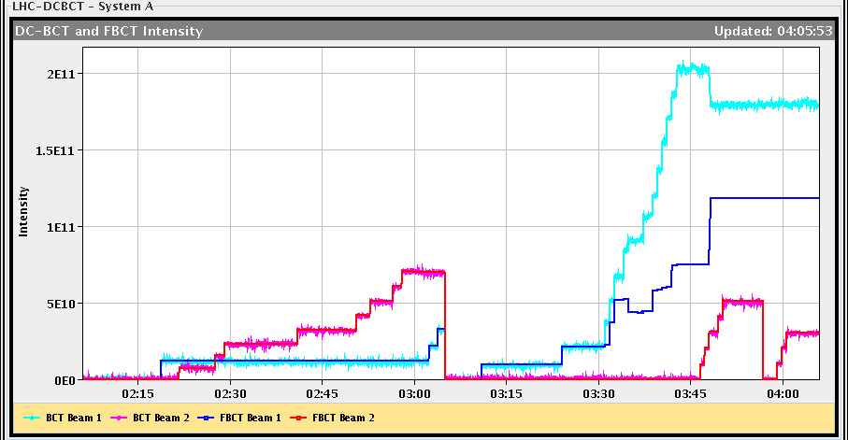
01:45-05:30
Steering
RF capture
Issues with the FBCT reading B1

Slide 9
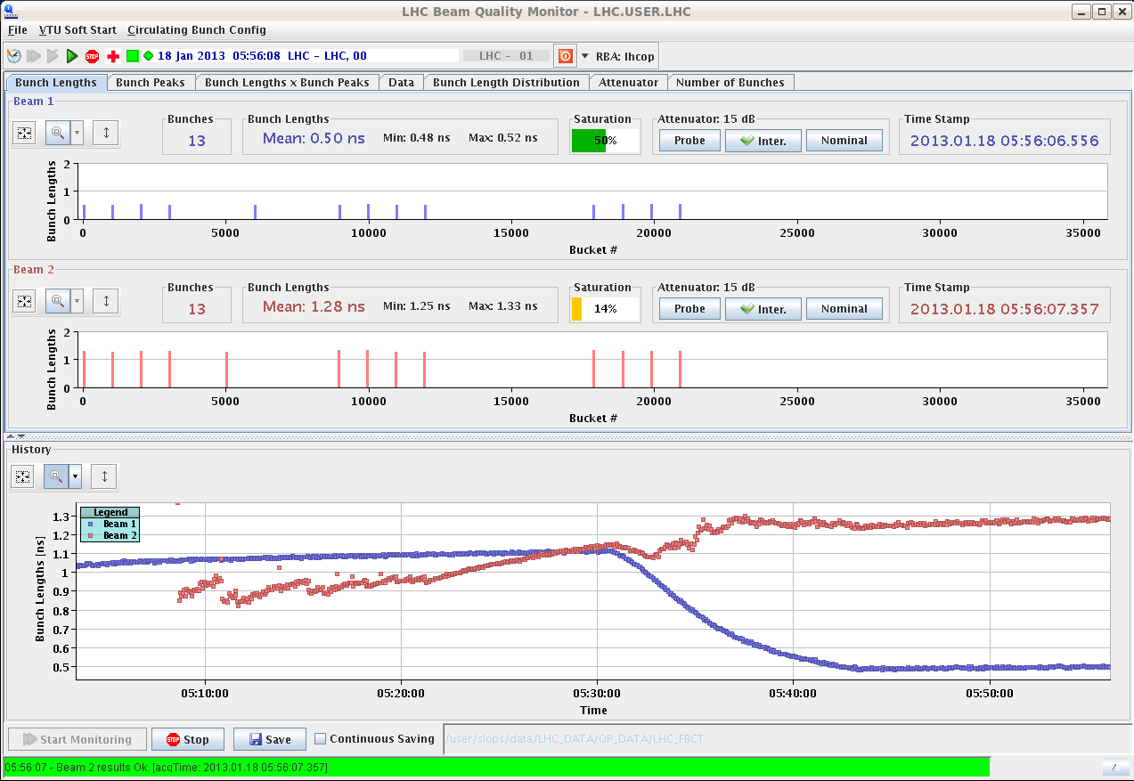
Bunch length (long blow-up left off for B1 on purpose)
Centred orbits at flat-top

Slide 10
Cogging done without problems
Still Beam 2 losses at TCTs in point 2 during the squeeze (to be set-up).
07:20 Looking for collisions
08:30 So far only LHCb missing

Slide 11
Plans
Collisions to be found
If OK:
One ramp for TCT and Roman pot (vertical) alignment (~10 h)
At least 4 more ramps for validation (~12 h)
Validations at injection (~2 h)
Still pending: check of the inejction of trains (2 h). Likely after the first alignment shift

Slide 12
Validation
 | Injection (Inj. Prot. IN) | Injection (Inj. Prot. OUT) | Flat-top | Squeezed, separated | Squeezed Collision
Betatronic-H | tbd | tbd | tbd | tbd | tbd
Betatronic-V | tbd | tbd | tbd | tbd | tbd
Neg. off-mom | tbd | tbd | -- | tbd (+500 Hz) | tbd (+500 Hz)
Pos. off-mom | tbd | tbd | -- | -- | tbd (-500 Hz)
Asynch dump | tbd | -- | -- | tbd | tbd
tbd=to be done

