Slide 1
Major Event on 12/01/2013
EL Report
8:30 meeting 14/01/2011
F Duval, on behalf of EN/EL

Slide 2
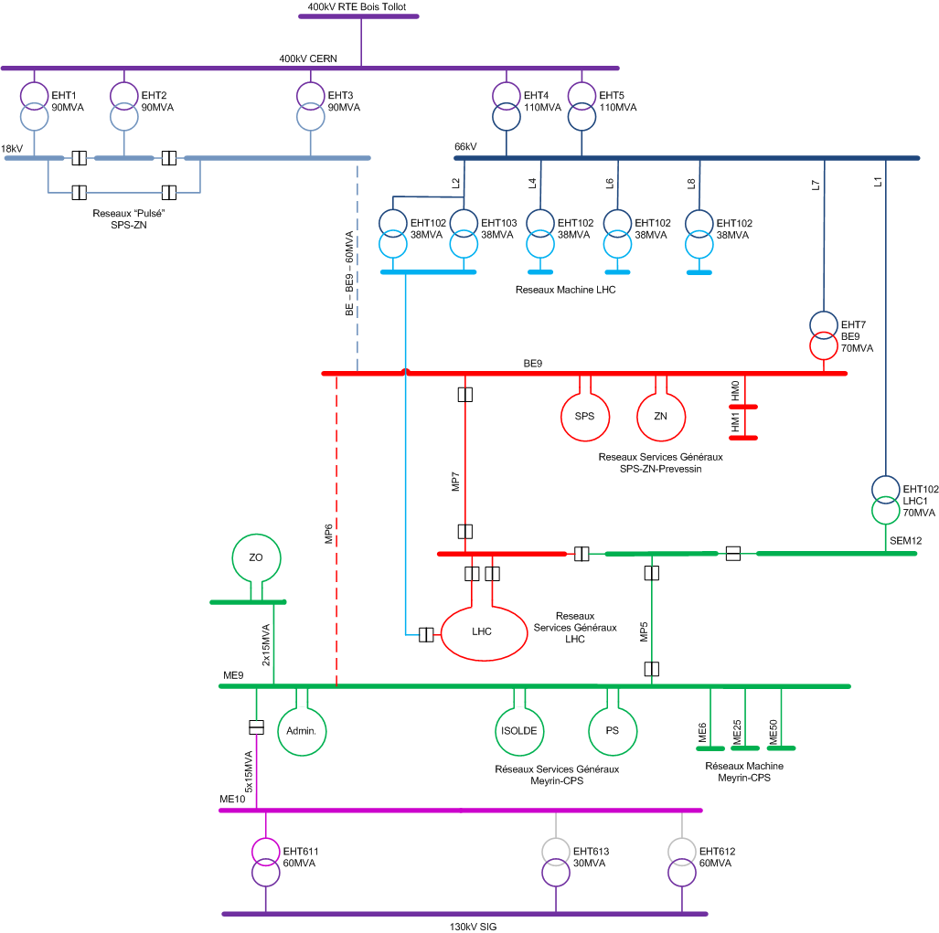
network configuration
events at 19:15:34

Slide 3
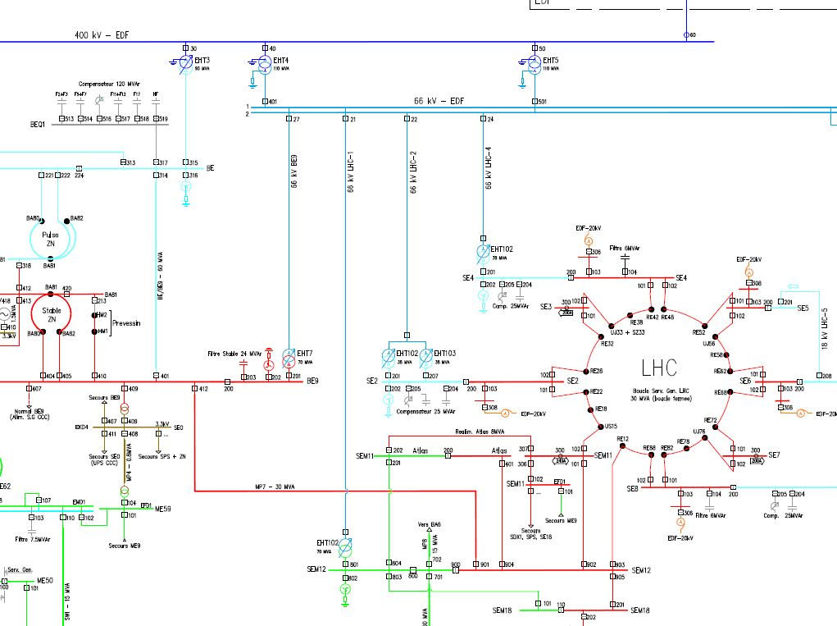
Detailed network configuration

Slide 4
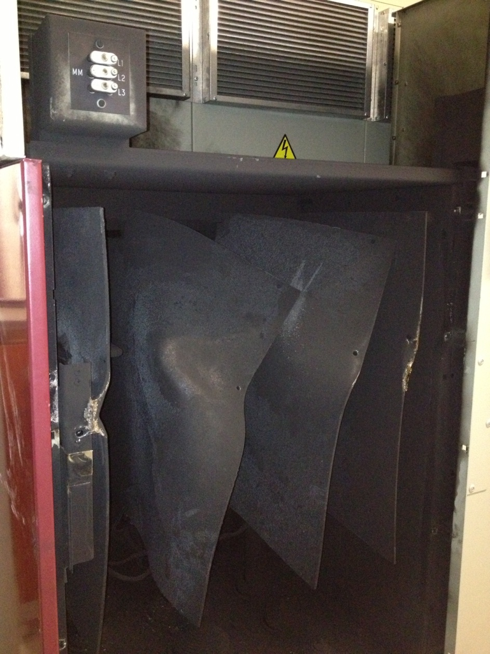
Substation BE9 cubicle EMD203 cables compartment

Slide 5
UPS EBS21/76 & EBS21/88: power converter burnt, battery elements and batteries CB burnt Filters tripped (LHC 1, 2, 4, 6, 8) Many feeders tripped (mainly for power converters ) Recovery Network reconfigured at 23:00 (filters) Booster restarted at 21:30 SPS restarted at 01:00 (13/01/2013) without stable filter Both UPSs replaced and back on service at XX:XX LHC restarted at xx:XX
Consequences

Slide 6
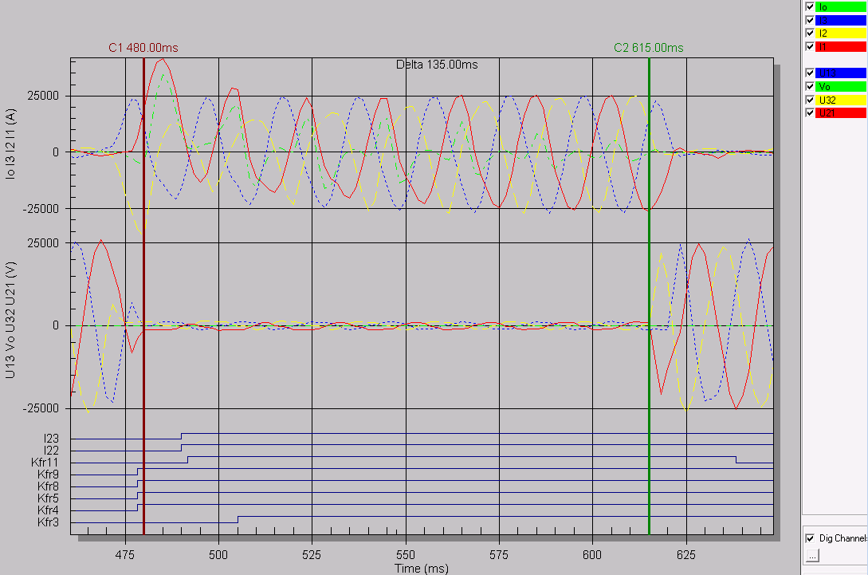
Recordings on 18 kV BE9 19:15:34

Slide 7
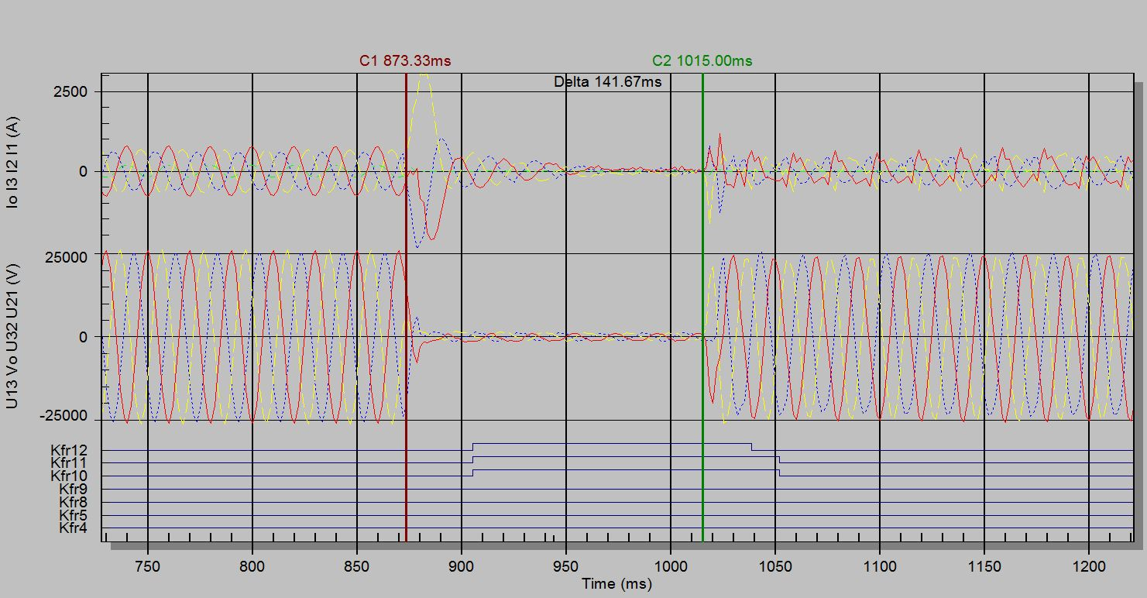
Recordings on 18 kV LHC1 19:15:34

Slide 8
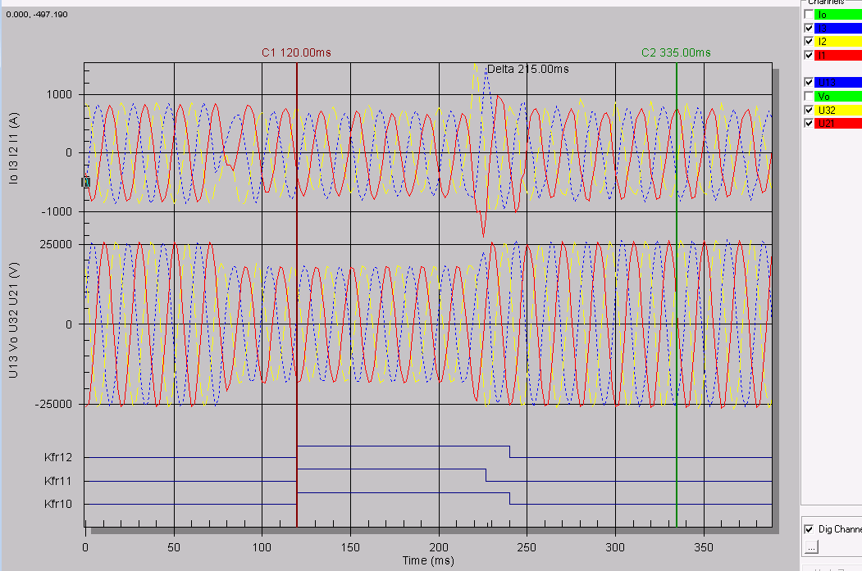
Recordings on 18 kV Meyrin 19:15:34

Slide 9
Follow up
If the SPS can be operated, we will have the whole Ion run without stable filters (no further time lost). Otherwise 2 days circa needed for the repair works.
a detailed analysis of the sequence of events is ongoing to detect eventual dysfunctions of other elements of the electrical distribution network.
Taking into account the damaged UPSs; other equipment located on the same circuit could have been damaged as well; EL patrols have checked the UPSs in the other locations.

