Slide 1
Thursday 10th January
9:30 Network routers restart, all went fine, but only just.
12:00 All power converters from the arcs on at standby
12:00 ELQA test finished
Still some selected accesses
17:40 Cryo Maintain OK for all sectors
18:37 Cryo OK complete machine
Test of circuits and QPS
22:55 All vacuum valves open
00:48 All HWC tests finished
02:41 BIS loops closed
06:50 RF conditioning M1.B1 finished

Slide 2
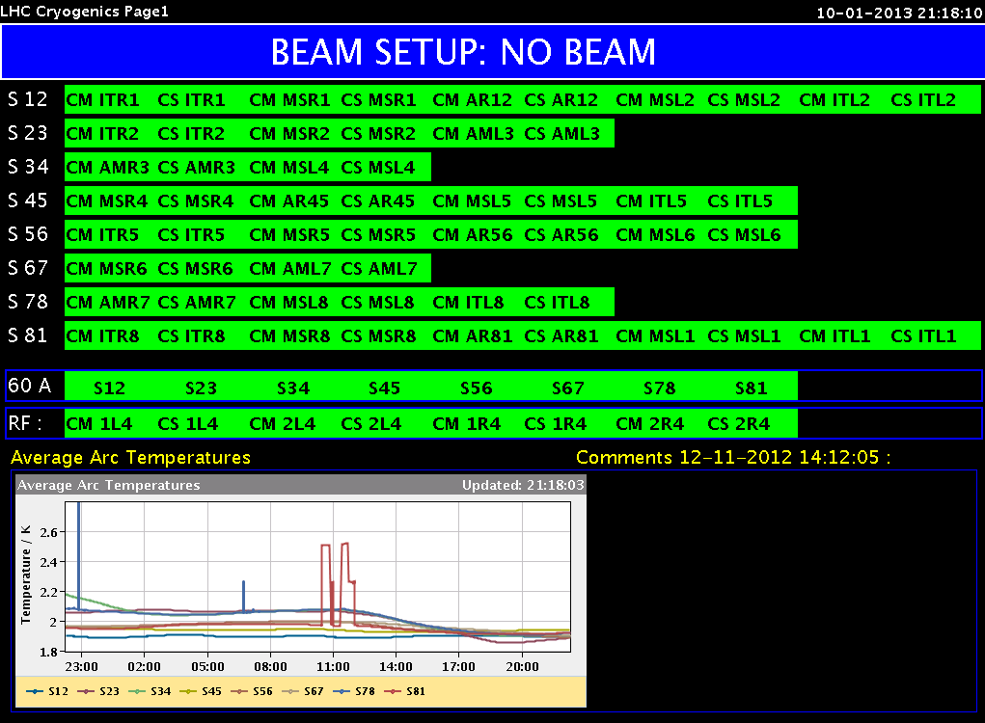
Network routers restart – IT department
The restart of the routers did affect the LHC
Many cryo valves closed IP8. Stop of compressors just avoided because of the cryo crew was ready to react.
ODH in IP2 (as displayed in CCC)
Linac2 Vistar BCT (trafo) readings
Good that it was a coordinated reboot following yesterday’s request by IT

Slide 3
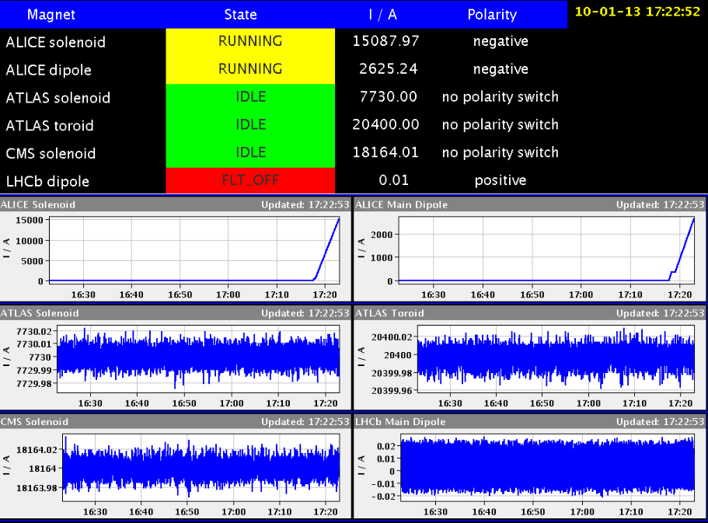
Decided on polarities

Slide 4
Outstanding
RF
“Module 1B1 has 2 cavities that need further conditioning overnight. We would make them operational early morning to-morrow.” Finished this morning at 6:50
RF interlock cav4.B2: piquet called
RF low-level set-up going on right know: 1 hour
Power converters to be changed
60 A corrector pc RCBV12.L7B2
60 A corrector RCBV28.R1B1
CMS shielding at top of pit?

Slide 5
The plan
John’s master plan, as presented yesterday, can be found via “latest news” page.
Today:
RF low-level set-up (1 h)
Change 2 pc (2 h)
Take first beams
Test ramp with dump at flat top
Set-up of squeeze, optics measurements
TDI, BPMS

