Slide 1
Status report on the 25ns beam in LHC - 17/12/2012
G. Arduini, H. Bartosik, G. Iadarola, G. Rumolo
Machine Coordinators: M. Lamont, B. Holzer
Thank to Cryogenics, Damper, EN/STI, Injection,
Operation, Vacuum teams
Several ABP, BI and RF colleagues contributing to measurements

Slide 2
Overview on 25ns beam operation
The scrubbing run took place from Thursday 06/12/12 until Monday 10/12/12 with excellent machine availability
Week 50 from Tuesday to Friday was planned to be partly devoted to ramping 25ns beams to 4TeV for
Long range beam-beam MDs
Further e-cloud/scrubbing studies
UFO studies
25ns pilot run
In practice, due to a few accumulated delays, the above program started on Wednesday 12/12/12

Slide 3
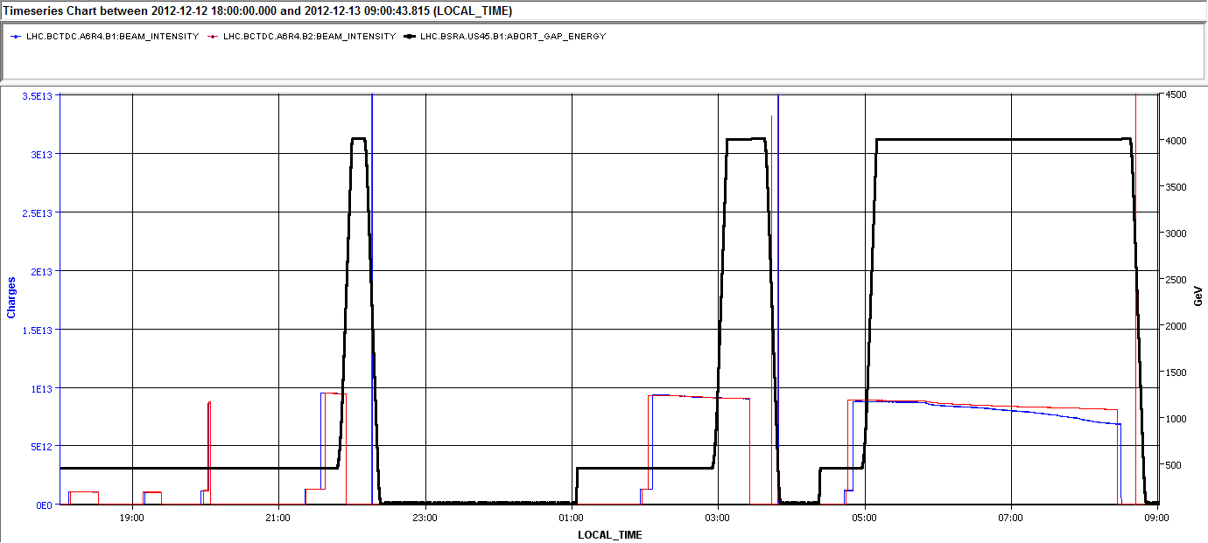
Wednesday 12/12
RF faults for 25ns operation
Long range beam-beam MD
I_{B1} I_{B2}
Injections tests for h9 25ns beams
Long range beam-beam MD started on Thursday early morning
Only one ramp with 72b per beam. Second ramp with 2x72b per beam did not take place due to the delay

Slide 4
Beam-Beam MD (summary from users)
Started at 6 AM due to issues with RF over night:
We had 1 train of 72 bunches spaced by 25 ns colliding head-on in IP1 and IP5 with a beta* = 1m and an initial half crossing angle of 145 urad. We reduce the crossing angles in IP1 and IP5 simultaneously in steps of 10% (145-130-117-106-96-87-72-65 urad), we observe the bunch-by-bunch losses and record luminous spots from ATLAS. Losses are observed for each step clearly on Beam 1 while Beam 2 seems transparent to the reduction of crossing angle. Onset of losses at around 106-96 urad. The onset of losses is consistent with experiments performed with 50ns beams, which indicates that DA losses occur at a normalized separation of 5 sigma. The total losses on beam 2 is about 1/3 of the total losses observed on beam1. The positive effect of the lower intensity seems also visible giving smooth loss rates for the different crossing angles wrt to the sharper ones observed for the 50 ns case.

Slide 5
Long range beam-beam MD
After difficulties with RF injected and ramped to 4 TeV 12+72 bunches
N~1.1x10¹¹ p/b
ε_{x,y}~2.5 μm @inj
Got in collision with with N~1.02 x10¹¹ p/b and ε_{x,y}~3.1 μm.
B2H
B1V
B2V

Slide 6
BSRT in collision (B1)
Initial
After 3h
σ_{x}² (mm²)
σ_{y}² (mm²)

Slide 7
65 μrad
72 μrad
87 μrad
96 μrad
106 μrad
130 μrad
117 μrad
145 μrad

Slide 8
UFOs (T. Baer)
for this fill: 8 UFOs in ~3hours at flat top. This is about twice more than for 1374b 50ns fills.

Slide 9
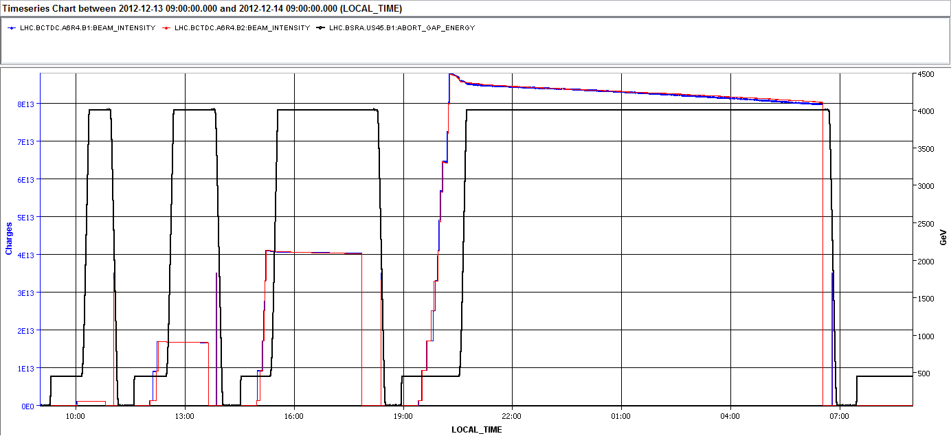
Thursday 12/12
I_{B1} I_{B2}
Loss maps to check anomalous pattern observed in collision
3 ramps with increasing number of bunches. 2x72b → 5x72b → 11x72b (804 bunches per beam!) with ~10h store

Slide 10
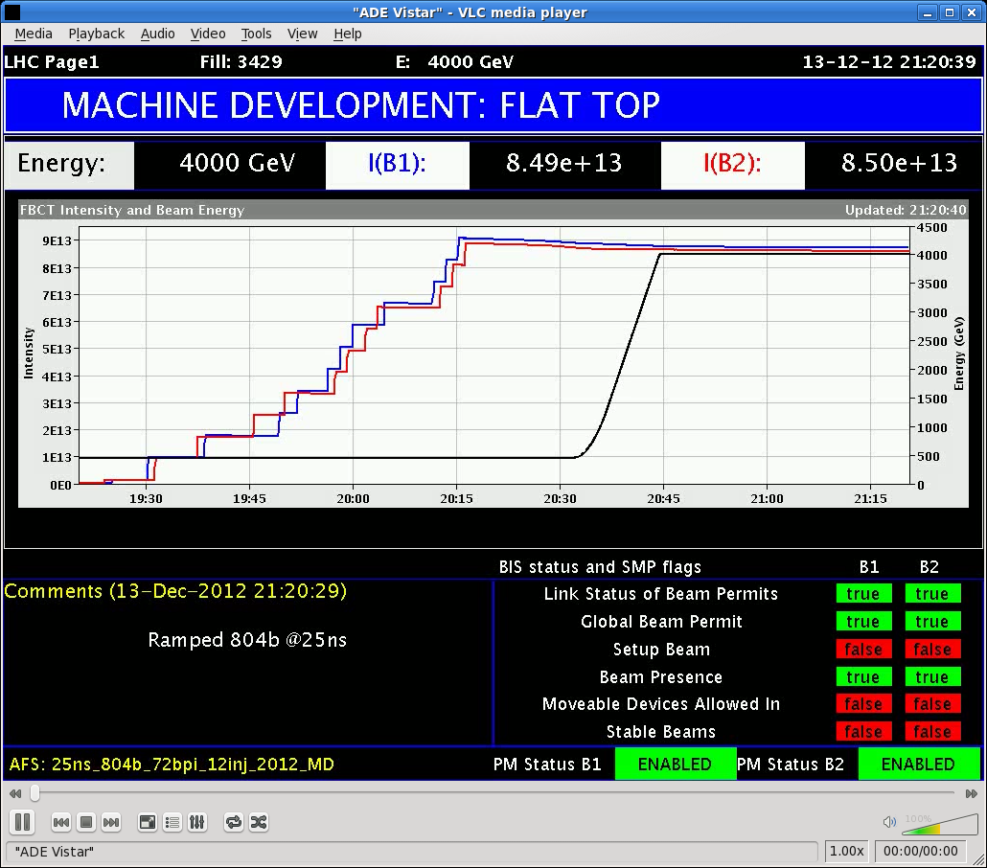
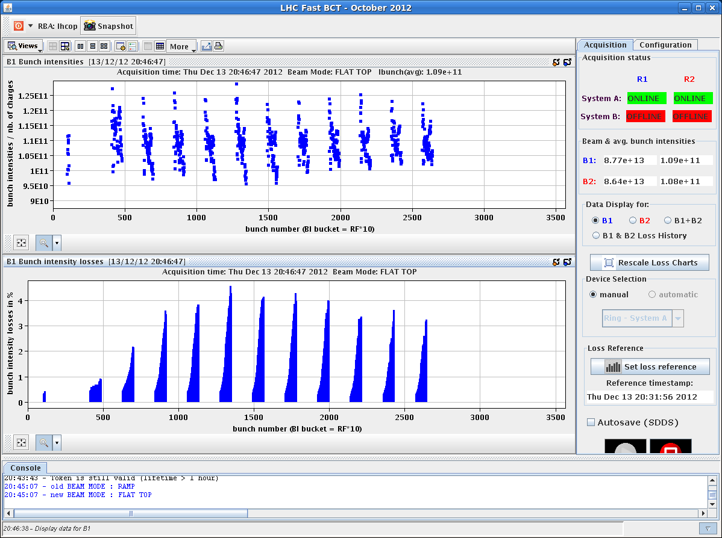
19:00-20:46. Filling with 804 bunches (in steps to allow cryo team to adapt regulation) + ramp. Cryo regulation during the ramp was very challenging

Slide 11
Heat load evolution (Wed + Thurs)
Fill with 12+72b and 12+2x72b showed low heat load (1 to 7 W/hc). Therefore the 2nd fill was only kept for ~1/2 hour and the intensity ramp up continued
12+2x72
12+72 (RF dump)
12+72 BB MD

Slide 12
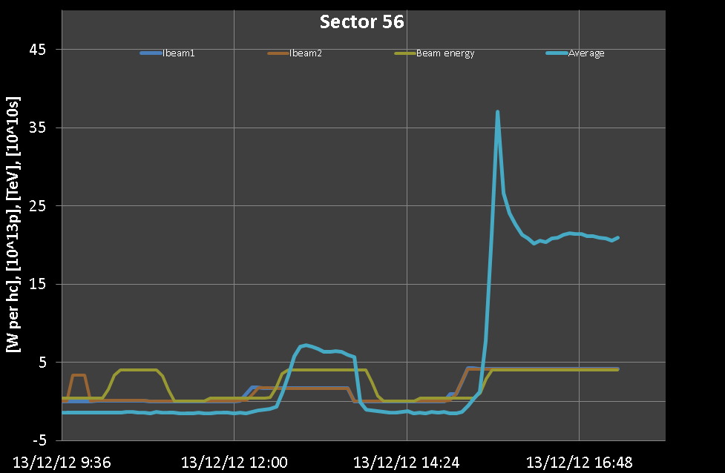
Heat load evolution (Wed + Thurs)
Ramp with 12+5x72b led to more substantive heat load (~20 W/hc)
Kept for ~2 hours to increase intensity. Heat load has sharp rise at ~2 TeV, when photoelectrons start to play a role.

Slide 13
Vacuum
V. Baglin
Pressure at arc extremities 78 during this fill. Photon stimulated gas desorption also appears at ~2 TeV i.e. when photoelectrons are produced. At this time, the cryogenic system observed a larger heat load due to photoelectrons induced multipacting.

Slide 14
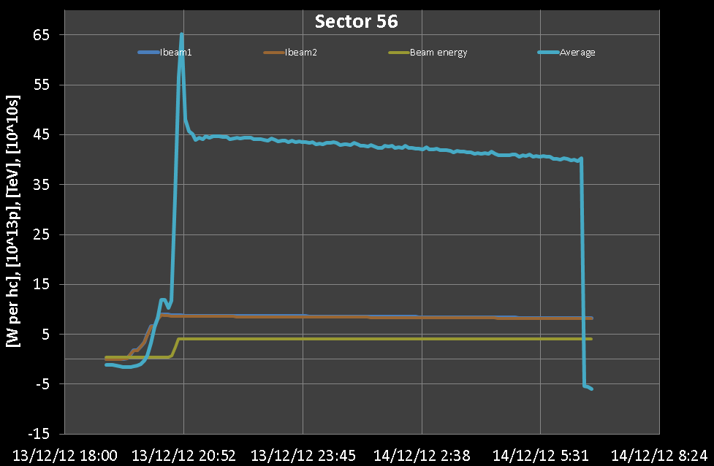
Heat load evolution (Wed + Thurs)
Ramp with 12+11x72b: Heat load larger than in previous fills, but not changing significantly over the fill duration.

Slide 15
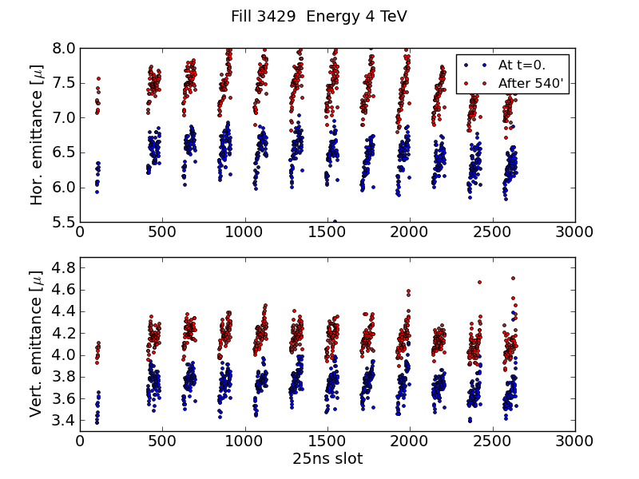
Emittance evolution at 4 TeV
Ramp with 12+11x72b: Transverse emittances exhibit a 10% growth over the fill length (~8h).
ε_{x}
ε_{y}

Slide 16
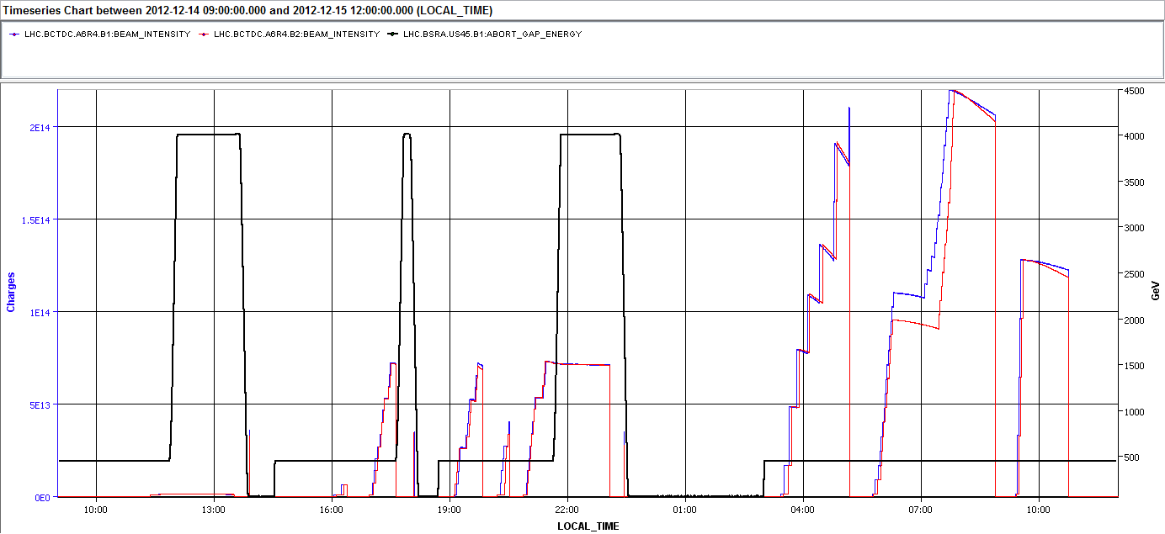
Friday – Saturday 14-15/12
Last 25ns tests @ 450 GeV
I_{B1} I_{B2}
A few failed attempts
Loss maps and h9 injection tests
Access system problem in Pt 6
Loss maps and h9 injection test (48b)
One ramp with 11x72b. Intensity per bunch decreased to 9e10 ppb to check dependence of heat load on bunch intensity

Slide 17
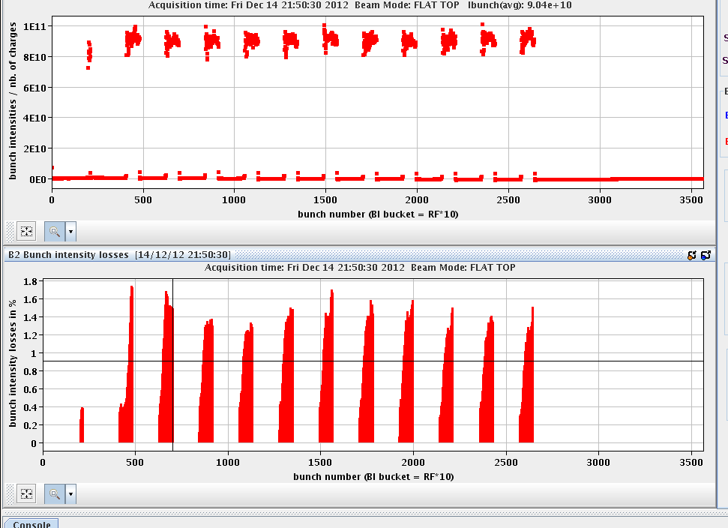
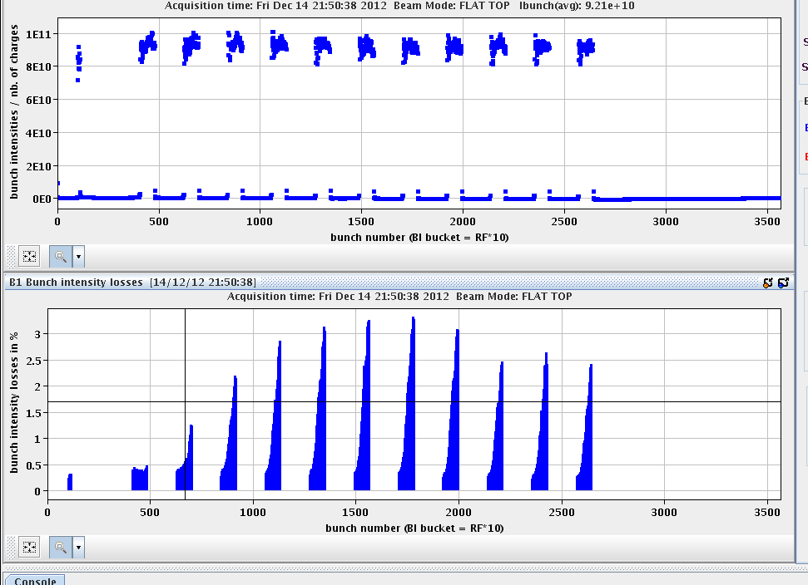
Ramp with lower bunch intensity
Ramp with 12+11x72b with 9e10 ppb:
Attempted four times, twice dumped because of BPM interlocks, once because of wrong octupole setting
Few % losses during the ramp

Slide 18
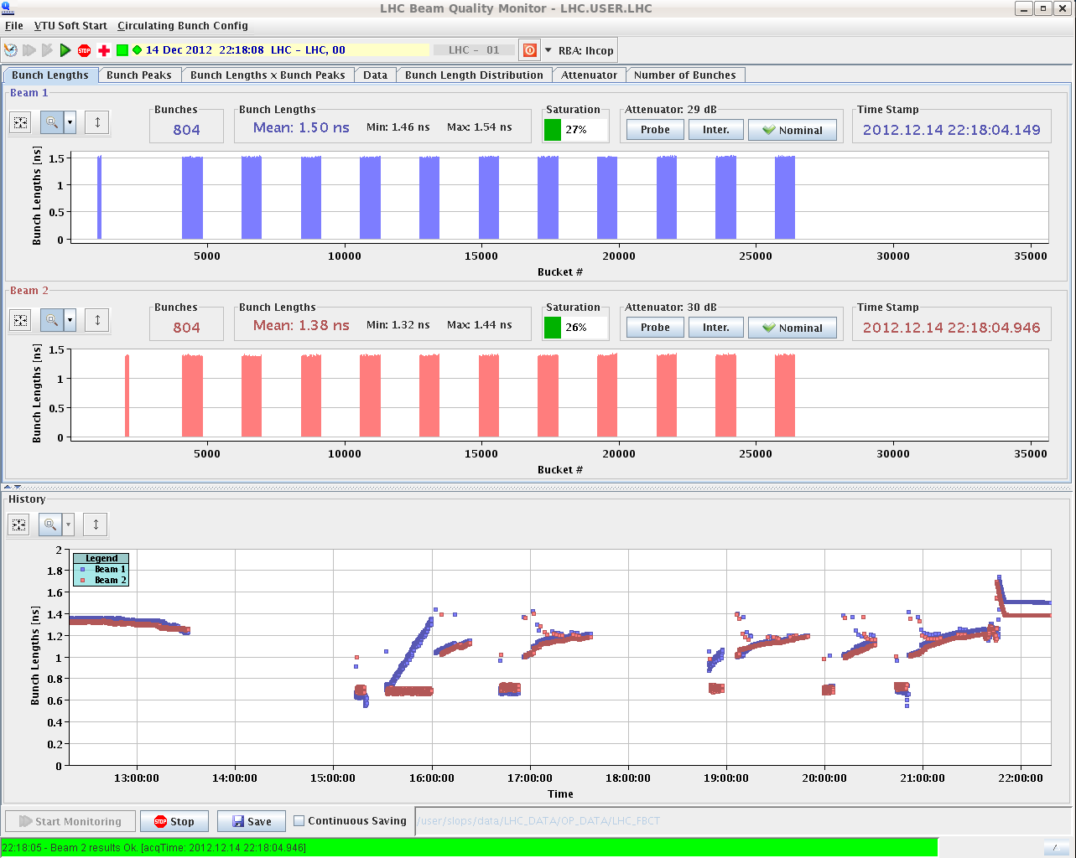
Ramp with lower bunch intensity
Ramp with 12+11x72b with 9e10 ppb:
Attempted four times, twice dumped because of BPM interlocks, once because of wrong octupole setting
Few % losses during the ramp
Strange bunch length increase during the ramp

Slide 19
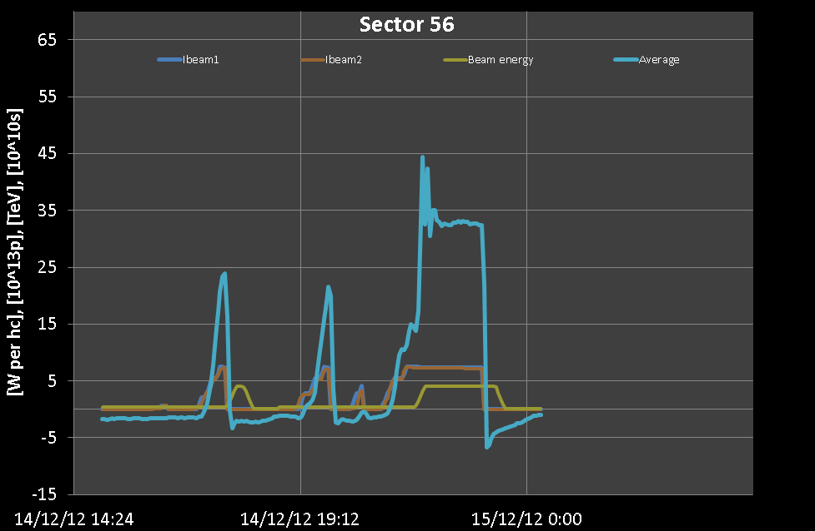
Heat load evolution (Friday)
Ramp with 12+11x72b and 9e10ppb: Heat load lower than in previous fill with same number of bunches, scaling like total beam current.

Slide 20
Tests at 450 GeV
Before going to 25ns physics:
Another fill with trains of 288b was attempted, but it was dumped when two injections were missing due to large orbit excursion
A fill with trains of 72b was made to benchmark with simulations
A fill with 4x288b was done to check the possible effect of scrubbing at 4 TeV

Slide 21
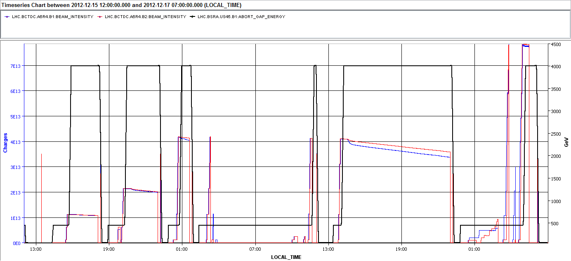
Saturday – Sunday 14-15/12
Timing problems, injection stability problems
I_{B1} I_{B2}
3441
3442
3453
RF, long. damper tests
Two physics fills with 12+2x48b (2h) and 12+4x48b (2.5h)
After some problems, one fill with 12+4x96b (9h) + final attempt to fill with 12+8x96b (dumped at collision)

Slide 22
Physics with 25ns beams
Physics fills:
H9 beam used ➔ low transverse emittances injected (1.2-1.3 μm)
1.8μm emittance from luminosity data (first fill)
B2H
B2V

Slide 23
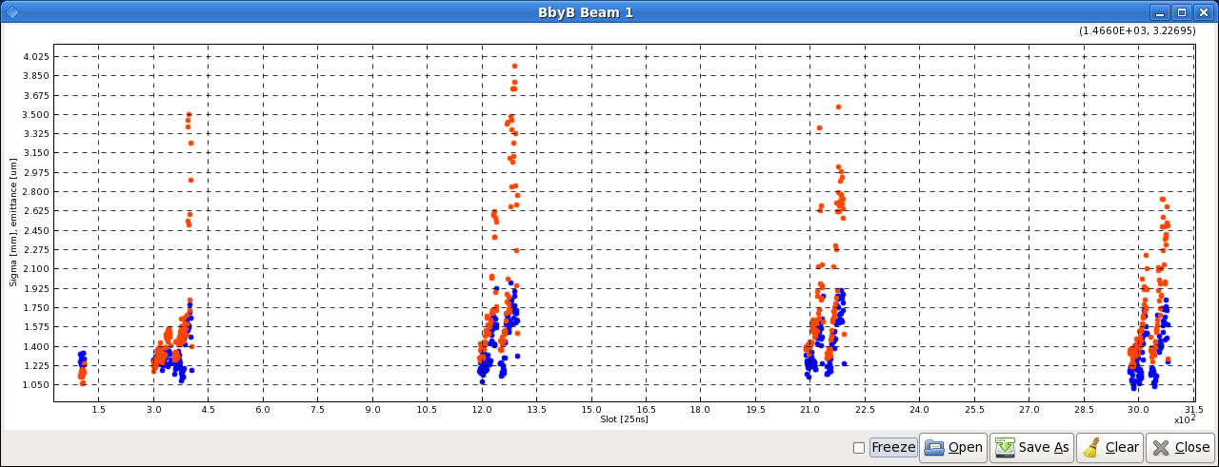
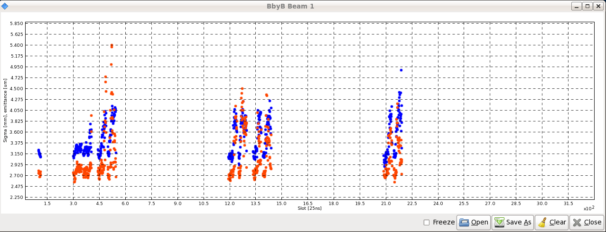
Physics with 25ns beams
Emittance blow up:
Injections of 96b trains led to emittance blow up along the beam
Clearly visible in the last two fills, increasing octupoles did not help
Fill 3453 B1V
Fill 3457 B1V

Slide 24
Heat load during physics fills
During 25ns physics:
Heat load as expected from previous 25ns fills.

Slide 25
Heat load during physics fills
During 25ns physics:
Enabled the abort gap cleaning on LOW then MEDIUM settings for some time to see whether the heat load on cryogenics would go down (removal of untrapped protons). Luminosity lifetime went down as expected but heat load stayed high.
AG ON

Slide 26
4TeV Arc UFOs with 25ns (T. Baer)
With 50ns, 1374b: ≈ 1.3 arc UFOs per hour
Since 13.12.2012: 9 UFOs > 10% of BLM dump threshold Largest UFO: 67% of BLM dump threshold
Fill | # bunches | Time @ 4TeV [h:m] | # arc UFOs | UFOs/hour
3425 | 84 | 3:21 | 8 | 2.38 (±0.84)
3427 | 156 | 1:02 | 7 | 6.73 (±2.55)
3428 | 372 | 2:37 | 36 | 13.68 (±2.28)
3429 | 804 | 9:49 | 87 | 8.85 (±0.95)
3436 | 804 | 1:19 | 8 | 6.02 (±2.13)
3441 | 108 | 2:11 | 5 | 2.29 (±1.02)
3442 | 204 | 2:31 | 5 | 1.98 (±0.88)
3443 | 396 | 0:38 | 3 | 4.73 (±2.73)
3453 | 396 | 8:43 | 11 | 1.26 (±0.38)
26

Slide 27
In summary
25ns beams with up to 804 bunches were accelerated to 4 TeV
Gradual ramp up of intensity
High heat load → does not seem to become better over the few days timescale
Beam stable and with good lifetime at flat top for short SPS trains
Emittance blow up (both at injection and at flat top) for longer SPS trains
Reference measurements at 450 GeV taken to check possible further scrubbing from 4 TeV fills
UFO rate still about 2.5 times higher with 25ns beams with respect to 50ns beams
10/12/2012

Slide 28
Thanks for your attention!

