Slide 1
Wednesday 12th December - morning
09:00 dump the quick filled for beam size measurements
Some delay in injecting:
TGM issue with mastership in SPS traced to BHZ377 that was off and could not be turned on for some time due to ongoing INCA release on PS side.
11:00 Start TDI alignment
15:00 ADT team start work on beam 2

Slide 2
TDI alignment
Following the TDI.P2 upper jaw exceeding the inner position dump limit on 11/12/2012 and a drift of the LVDT reading over the last few days we rechecked the alignment with beam.
MEASUREMENT:
- pilot beam B1
- angular scan
- the measurement becomes tricky due to the fact that for 0 angle setting the LVDT readings now show an offset of +250 urad (convoluted with a position off-set of 280 um); so the measured LVDT values and the setting must not be mixed.

Slide 3
TDI alignment
RESULTS:
these values are SETTING:
centre: -2.66 mm (old: -2.84 mm)
angle: -30 urad (old: -85 urad)
new jaw corners SETTINGS:
left upstream: 1.25 mm (old: 1.13 mm)
left downstream: 1.18 mm (old: 0.94 mm)
settings changed by 120 um for upstream corner and 240 um for the downstream corner.
the new values in LVDT READINGS:
left upstream: 0.72 mm (error rel. to setting 530 um !)
left downstream:1.19 mm (error rel. to setting 10 um)

Slide 4
TDI alignment
from the comparison it seems that only the upstream LVDT has a calibration error, which is consistent with:
Moving to the LVDT2 reading on 14/10/2012, after LVDT(1) failed. This introduced an error of about 200 um.
interventions on the upstream part of the upper jaw, after it fell into the beam on 3/12/2012, resulting in an additional error of about 100 um.
on top of this there has been an additional drift of the LVDT2 of about 120 um (which can be mechanical) over the last days, which is not understood.

Slide 5
TDI alignment
- we trimmed in the new settings and set the position interlock thresholds of +/- 200 um around the new values
- energy thresholds have been set up at gap+1sigma
VALIDATION:
the new settings were validated with the X-measurement and injection loss map
X-measurement:
opening the TCP gap while blowing up the beam with the MKQ and recording when losses move from the TCP to the TDI
we see a retraction of 6.4 sig (6.8 sig nominal)
the orbit was not nicely corrected for the validation test
Injection loss map vertical:
for RS01 and RS09 the TCP losses are significantly higher at the TCP than at the TDI (for RS09 factor 100, factor RS01 factor 5) -> hierarchy OK, should be compared to old loss maps

Slide 6
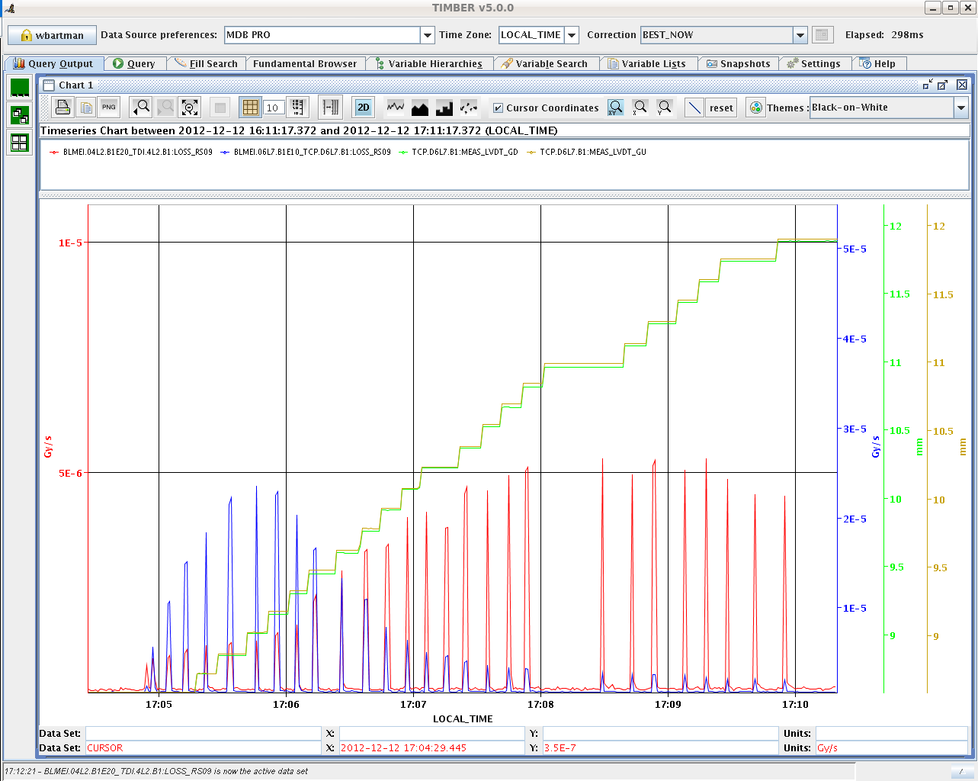
TDI alignment

Slide 7
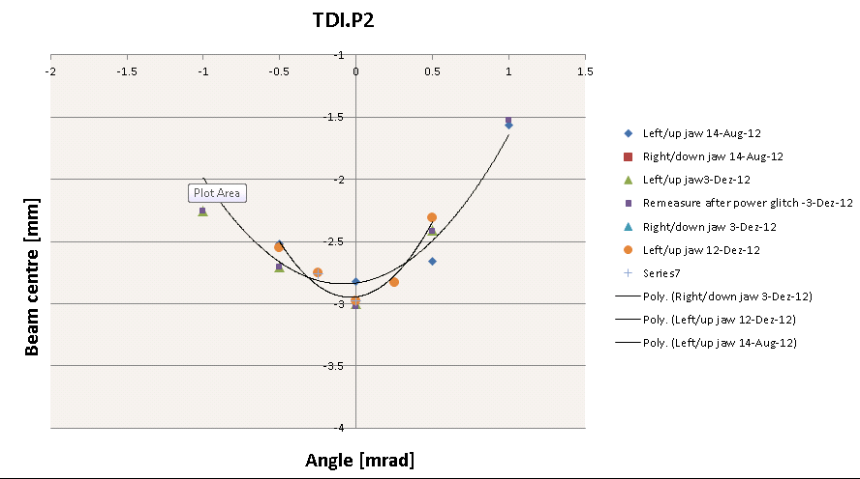
TDI alignment

Slide 8
ADT
Changed ADT gain modulation to adapt for the new filling scheme. Bunches with reduced gain could sit anywhere between bucket 1 to bucket 2401.
This needs to be undone before going back to the standard filling scheme.
Also completely removed gain modulation from flat top, squeeze and physics, i.e. damper gain is modulated only during the ramp.
Daniel Valuch

Slide 9
BBQ
Changed the default BBQ gating mask for the upcoming 25 ns ramp/operation
B1 - 14x25 ns slots starting from bunch 100 (RF slot: 1001)
B2 - 14x25 ns slots starting from bunch 200 (RF slot: 2001)
Needs to be changed if the bunch patter changes.
Ralph Steinhagen

Slide 10
Wednesday 12th December
Attempting to take BCMS…
18:30 MKI-B2 didn't pulse while attempting to inject 48b (12b circulating)
Few dummy extractions to test kicker – looks OK
19:30 B2 48b went again onto the TDI and the circulating 12b were dumped.
MKI8 pulsed…
To be following up today (CO/RF/ABT/BIS…)
19:30 Switch to standard 72*25 ns
20:03 RF modules M1B1 and M2B2 tripped while increasing power supply voltage from 50kV->58kV

Slide 11
Etienne Carlier on the first event

Slide 12
Weds – Thurs
Lost ramp to RF line 6B1 trip
Dry RF ramp
Back to 50 kV
Back up the ramp
Lost next attempt in adjust to:
LINE8B1 tripped with ARC detecded in the circulator load
The fault was an arc in circulator load 8B1.
At the time the klystron was giving 180 kW with 54 kV DC
We suppose that the higher power needed for 25 ns operation causes the problem. We restart and will keep the RF at 200 KW CW without beam
We believe that this could be a conditioning issue: these power levels are well within the RF specifications, but we have never operated with these settings.
Philippe and Themis

Slide 13
Summary of RF intervention:
The first ramp was dumped by an arc in the circulator load of K6B1
The second ramp was dumped (after short while at 4 TeV) by an arc in circulator load K8B1.
These faults are linked to the increased RF power needed (160-180 kW)for 25 ns operation with nominal intensity (peaked as soon as the RF has 2 microsec batch, 25 ns spacing). To reduce the problem on the third ramp, we reduced total voltage to 9 MV (was 10 MV), increased HV to 54 kV at start ramp (instead of 58 kV for first ramp), change QL to 50k (was 60 k). We also fine-adjusted the tuners to minimize power at 4 TeV.
Good result at 4 TeV. However the power during ramp is not smooth. That could improve after the adjustments done at 4 TeV. However the situation must be looked at by the RF power experts.
The longitudinal blow-up was not very good, but suffered probably from klystron saturation. we wait for next ramp to confirm.
Note1: The circulator loads and the klystrons are designed for operation at 300 kW CW max, but have been operated at much reduced level so far. Conditioning may be necessary.
Note2: Injecting spaced 72b batches should not change the picture. A bit more power might be necessary with 144b batch or longer. To be tested this year! An alternative solution would be to use the Cavity Phase Modulation algorithm, as done during last MD.
Themis and Philippe (at 5:40)

Slide 14
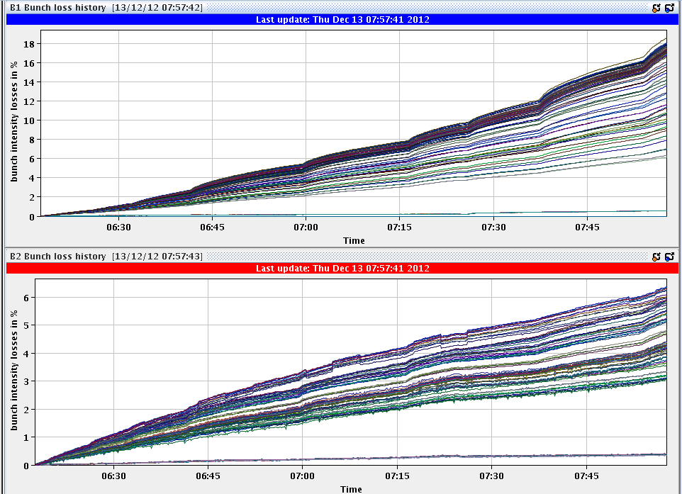
Thursday 13th December
06:15 Lumi peak at ~83e30 cm-2s-1
With 9e12 p per ring, 72 colliding bunches/ring and 12 non colliding per ring, that gives an emittance at the start of collisions of ~3.8 um.
Start long range MD

Slide 15
~planning
 | WEDNESDAY | THURSDAY | FRIDAY | SATURDAY | SUNDAY | MONDAY
0:00 |  | RF
1:00 |  | RF |  |  |  | pA tests
2:00 |  | RF
3:00 |  | RF
4:00 | LOSS MAPS |  |  | 25 ns
5:00 |  | LONG RANGE MD |  | PHYSICS
6:00
7:00
8:00
9:00 |  |  | CYCLE
10:00
11:00 | TDI checks
12:00 |  |  | e-cloud
13:00 |  |  | 450 GeV
14:00 | DAMPER SETUP | 25 ns at flat-top | calibration
15:00
16:00
17:00 | Injection
18:00 | Injection |  | e-cloud | 25 ns | RAMP DOWN
19:00 | Injection |  | 450 GeV | PHYSICS | ACCESS
20:00 | RF |  | calibration |  | CYCLING
21:00 | RF |  |  |  | pA tests
22:00 | RF
23:00 | RF

