Slide 1
MD#4 Summary
MD Coordinators:
Giulia Papotti, Frank Zimmermann
Machine Coordinators (last week):
Gianluigi Arduini, Eva Barbara Holzer
3 December 2012

Slide 2
MD#4 Mon (26.11.)
Day | Time | v | MP class | MP Comments
Mon | 06:00 | Ramp down if needed
 | 08:00 | 450 GeV: IR8 aperture | A | 450 GeV Pilote bunches(1e10p/bunch) to measure aperture.
 | 10:00 | 450 GeV: Beam instrumentation | B | BSRT vs WS, Schottky, WS PM saturation (partially done in MD3): 450 GeV B1: Pilot + 12b >=1.1e11p/bunch B2: Pilot + 50ns trains from 6 to 72 bunches Bumps at 450GeV and 4TeV Blow up with ADT 2) BGI, Gates BBQ, BSRT temperatures: 450GeV 50ns trains with minimum 600 bunches Bumps in B2 +- 3mm Blow up with ADT Gating with ADT off on some bunches 3) BPMs: Done in MD3 4) Matching: 450GeV Probe from 1 to 5e10p Inj, circulate (~100 turns) and dump (More details see slides )
 | 16:00 | 450 GeV→ 4 TeV: p-Pb test | C | From MD2 preparation: 450GeV and 4TeV Bunches of ~1.5e10p/bunch and >5e7Pb/bunch B2: few proton bunches and few Pb bunches B1: > 300 bunches with 10% ~1.5e10p/bunch, later with higher intensities. Test RF re-phasing procedure. Squeeze sequence and collisions. (More details see slides)
postponed (QPS access S6-7 RQF/RQD,
MKI2 fault in softstart, dump line vacuum);
rescheduled as Operational Dev. & successful
BPM studies and beam excitation, …
24 p batches from the SPS posed problems

Slide 3
MD#4 Tue (27.11.)
Day | Time | v | MP class | MP Comments
Tue | 00:00 | Ramp down
 | 02:00 | 450 GeV→ 4 TeV: MQY transfer function | A | 4 TeV. Pilote bunches (1-3e10p/bunch). Standard optics measurements with different MQY transfer funtions.
 | 06:00 | Ramp down
 | 08:00 | 450 GeV: RF study (longit. stability for batch or RF voltage modulation) | B | 450GeV A few nominal batches of 144b. RF Voltage modulation: fill half of the ring, to test the corrected algorithm of voltage set point adjustment Longitudinal stability: Full ring with max. bunch intensity. Excite a single mode in the beam with decreasing gain in the feedback loop. (More details see slides)
 | 16:00 | 450 GeV: beam-beam (noise or impedance) | C | 450 GeV In total 9 bunches per beam with different intensities (from 1e11 to 2e11), zero crossing angle in IP1, IP2 and IP5. Nominal crossing angle in IP8. Collision tune, Damper (ADT) off Introduce increasing noise with ADT Increase ADT gain in steps Scan separation in IP1 and 5 with 4 bunches (from 1e11 to 2e11) with damper of. (More details see slides)
 | 22:00 | 450 GeV→ 4 TeV: Collimation impedance & follow up from last MD | B | 4 TeV ~3b (1.3e11p/bunch) below SBF Alignment of collimators Impedance studies with tight collimator settings and moving IR7 collimators back and forth. (More details see slides)
successful!
successful
successful
successful

Slide 4
MD#4 Plan Wed – Thu (28.-29.11.)
Day | Time | MD | MP class | MP Comments
Wed | 04:00 | Ramp down
 | 06:00 | 450 GeV→ 4 TeV: two –beam impedance | C | 4TeV, squeeze to beta*=1.5m 150 bunches per beam (nominal filling scheme) Move beam 2 clockwise Reduce octupole currents in 5 different configurations (0 turn, ¼ turn, ½ turn, ¾ turn and 1 turn cogging) (More details see slides)
 | 14:00 | Ramp down
 | 16:00 | 450 GeV: transverse impedance localization at injection | C | 450GeV 8bunches with different intensities, equally spaced (5e9 … 1e10 … 5e10 … 1e11 … 1.5e11 … 2.2e11) Create kick with AC dipole or kicker Tune shift 2.1e-3 Move TDI Parallel measurement with ADT? (More detials see slides)
 | 18:00 | 450 GeV: TCDI automatic setup | A | 450 GeV Pilot bunches (1e10p/bunch)
 | 22:00 | 450 GeV→ 4 TeV: bunch flattening with RF phase modulation | B | 450 GeV and 4TeV Nominal LHC beam, i.e. 1374b per beam Add flattening signal (sine-wave close to the synchrotron frequ.) The MD will have ramp and all steps before physics. Measure effects of heating and transv. Instabilities.
Thu | 02:00 | Ramp down
 | 04:00 | End of MD#4
 |  | full cycle with 3 nominal bunches
 | 07:30 | 450 GeV: IR8 aperture | A
 | 10:30 | Access
successfully executed -
→new questions & theories
successful
successful
successful
successful!

Slide 5
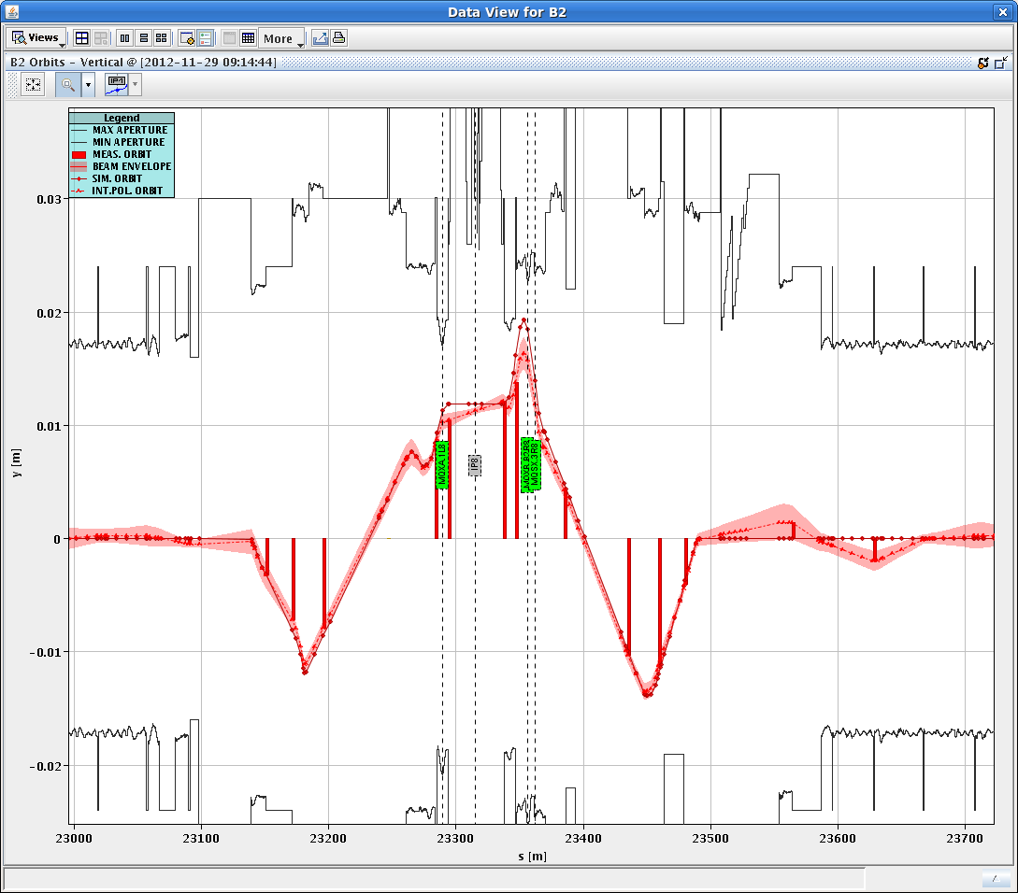
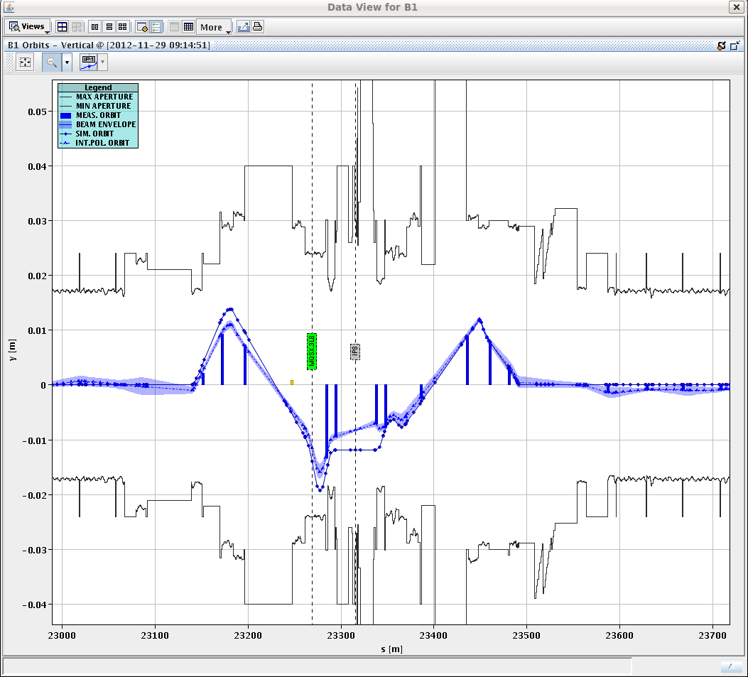
IR8 aperture measurements
M. Giovannozzi, S. Redaelli, J. Wenninger
Measured IP8 aperture to determine possibility of having vertical external crossing angle bump from injection to allow polarity switch also for 25 ns beams. Data being analyzed.

Slide 6
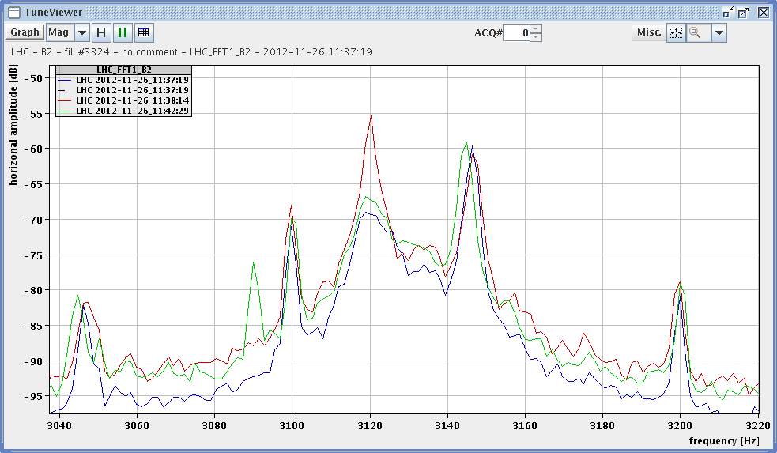
BI MD 50-Hz and 8-kHz investigation using BBQ
Aim: check if small fault currents passing along vacuum chamber can induce 50 or 8 kHz beam oscillations; two taps on B2 vacuum chamber right of P4. Distance between taps ~10 metres. Maximum current ~50 mA rms (tbc). Result: Exciting on off- and on-resonance of horizontal tunes → signal levels similar to those generated by 50 Hz lines.
Marek Gasior, Ralph Steinhagen
excitation on tune
resonance, 3120 Hz
off-resonance
excitation,
3090 Hz
w/o excitation

Slide 7
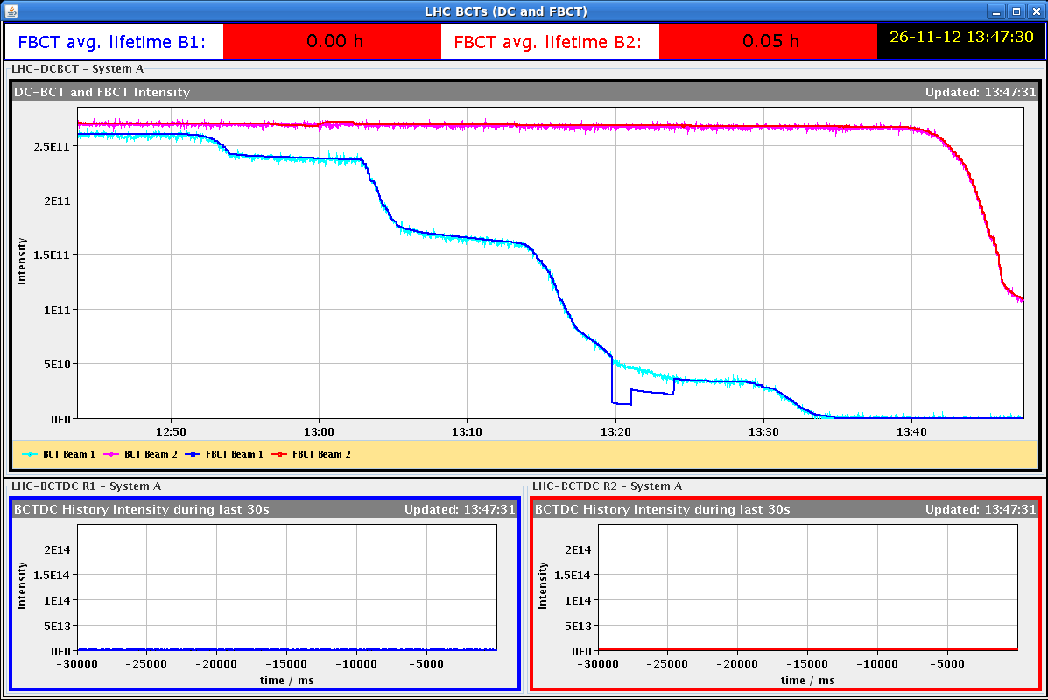
BI MD – BPM studies
Effect of crosstalk at striplines (overlapping and not overlapping bunches) with different ratios of beam intensities and with a cogging of B2 phase
Testing interlock behaviour in high sensitivity mode.
In B2 reflections not observable anymore for 1.3e10p/bunch at high sensitivity.
start scraping first beam 1 and then beam 2 ;
at the end switching to high sensitivity

Slide 8
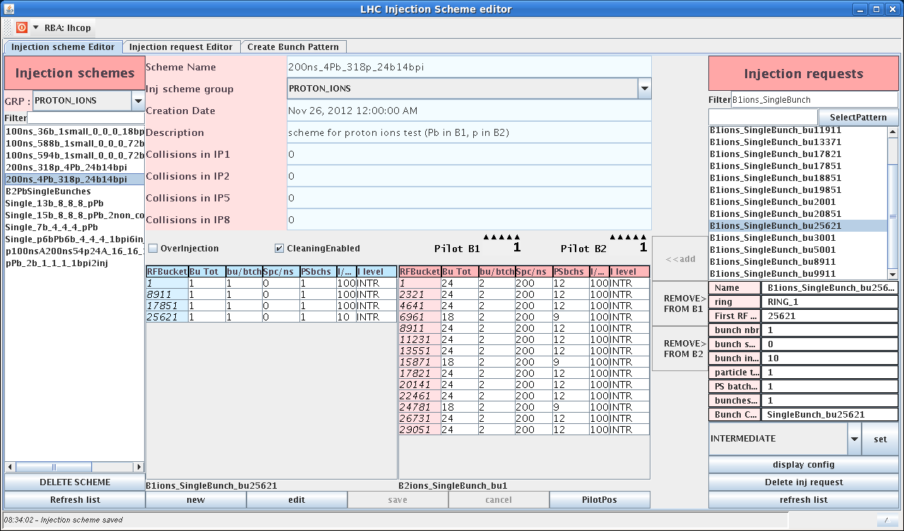
BI MD – new filling scheme for p-Pb MD
200ns_4Pb_318p_24b14bpi
lead in B1 and protons in B2
at the end of BI MD switched machine to ion-proton physics; hypercycle changed at flat bottom and RF settings changed

Slide 9
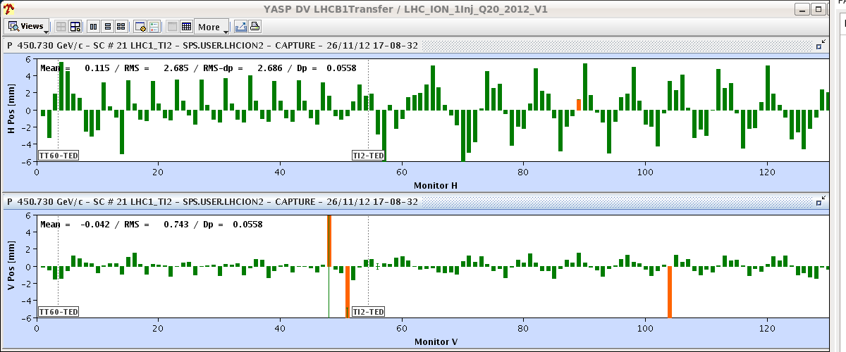
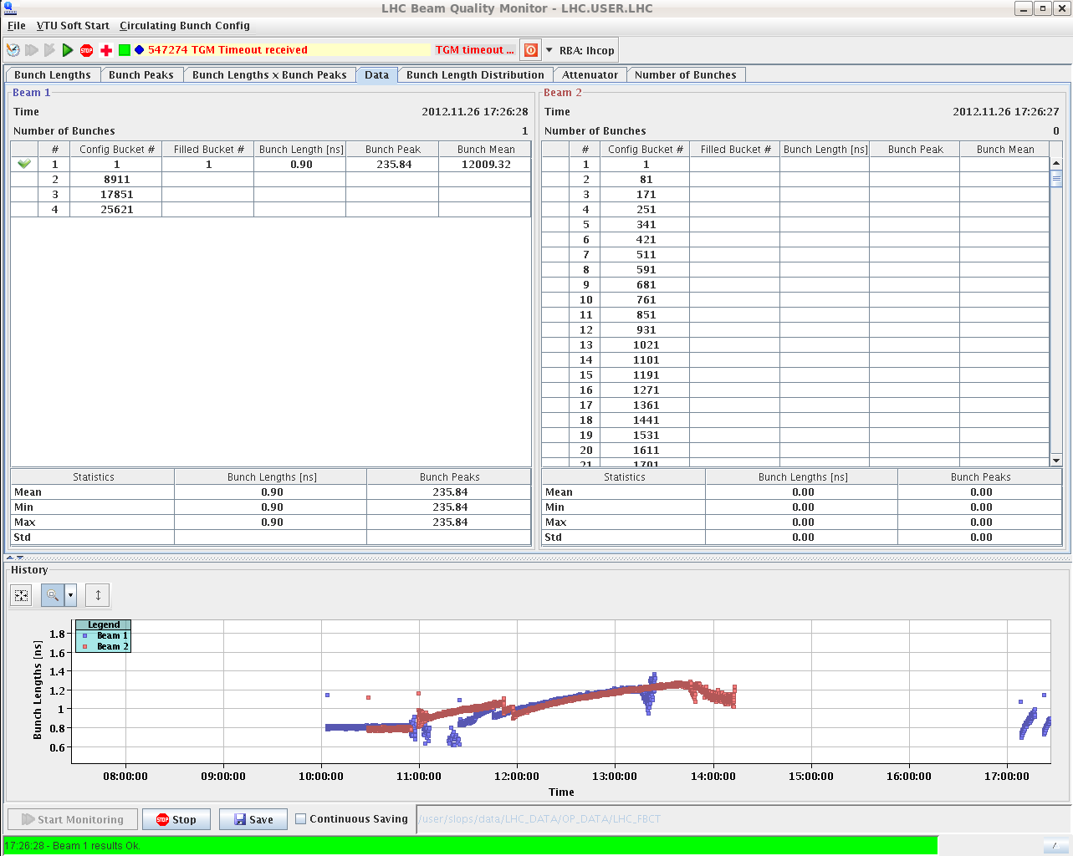
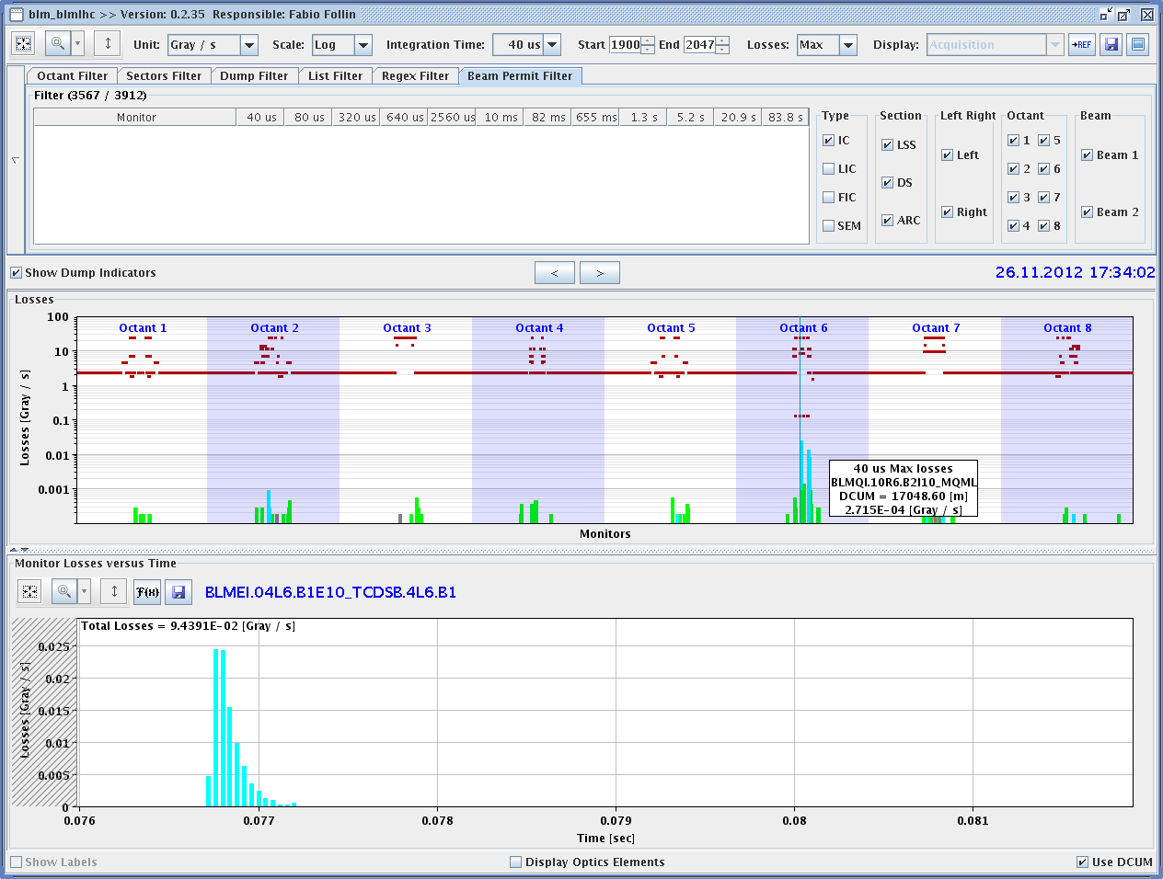
p-Pb MD – ion beam
first Pb beam in LHC
large difference in the SPS probably comes from the tune difference (0.13 for p, 0.3 for Pb); the difference was corrected in the line
second Pb bunch in after moving the buckets by one unit
BLM spurious trigger in IP5 dumped the beam
bunch length evolution

Slide 10
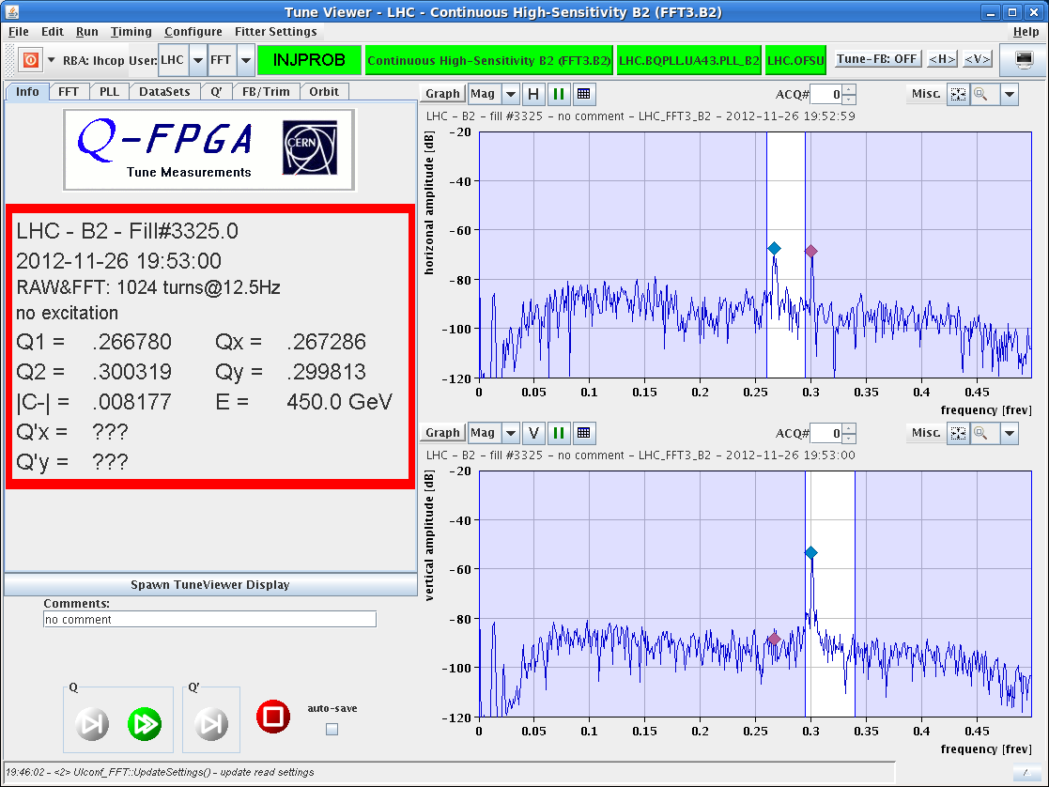
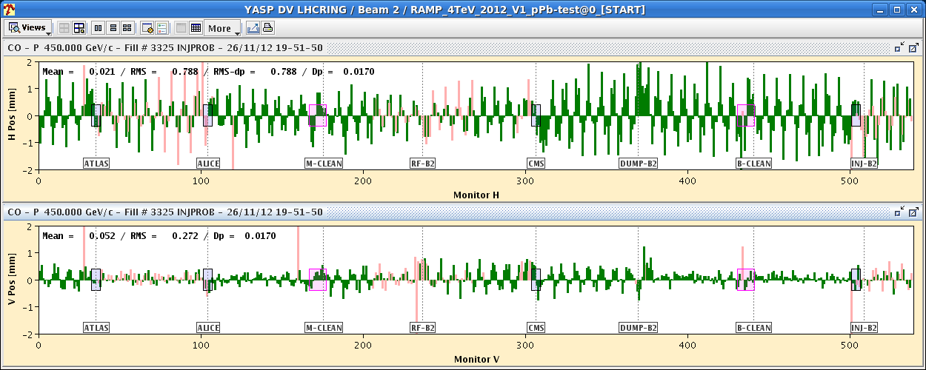
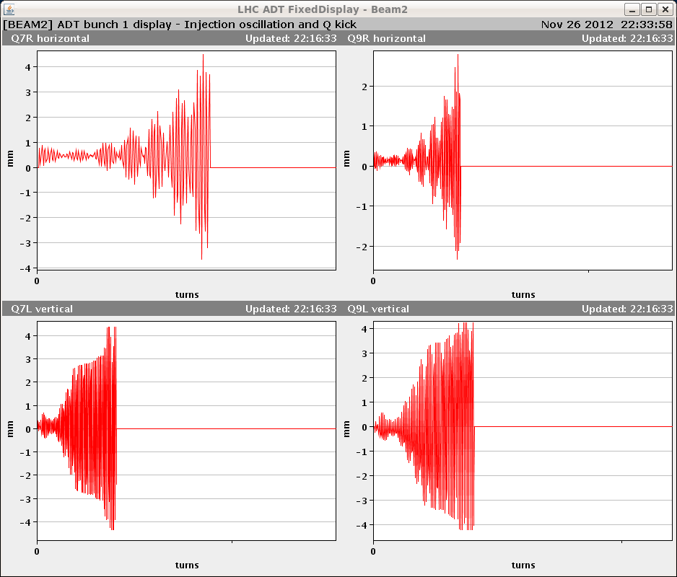
p-Pb MD – proton beam
first p beam in LHC ring 2
p orbit without OFB correction
& p tunes w/o correction
SPS ready with 200ns batch cycle. First 24 p bunches dumped because of beam losses in IP7 due to wrong ADT settings (B1/B2 swap).
On next attempt, 3 batches of 24 p bunches were injected, but when injecting 4th batch, interlocked BPMs triggered. Rest of the MD was spent on improving p beam in SPS.

Slide 11
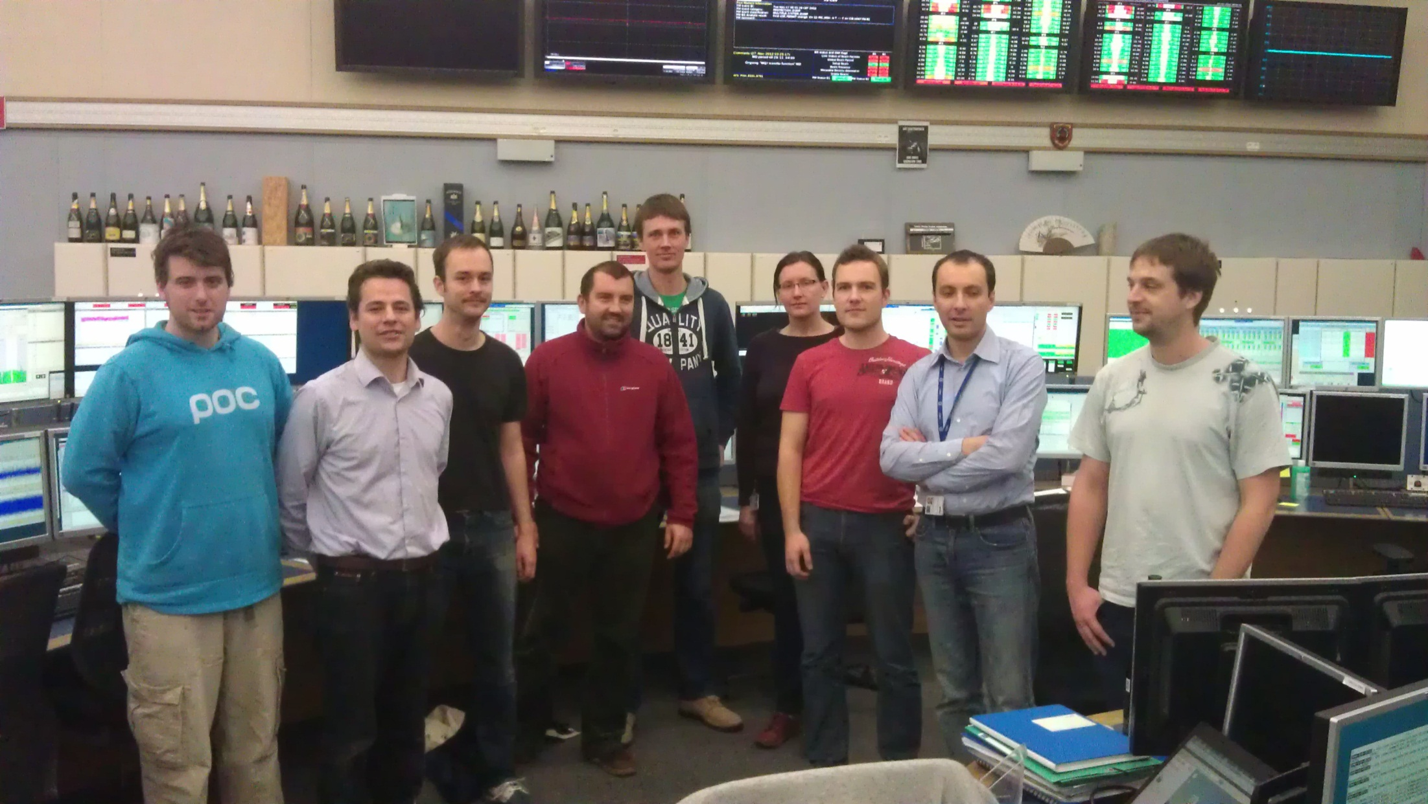
MQY TF MD
(R. Tomas et al)
LHC optics team after MQY calibration early this morning

Slide 12
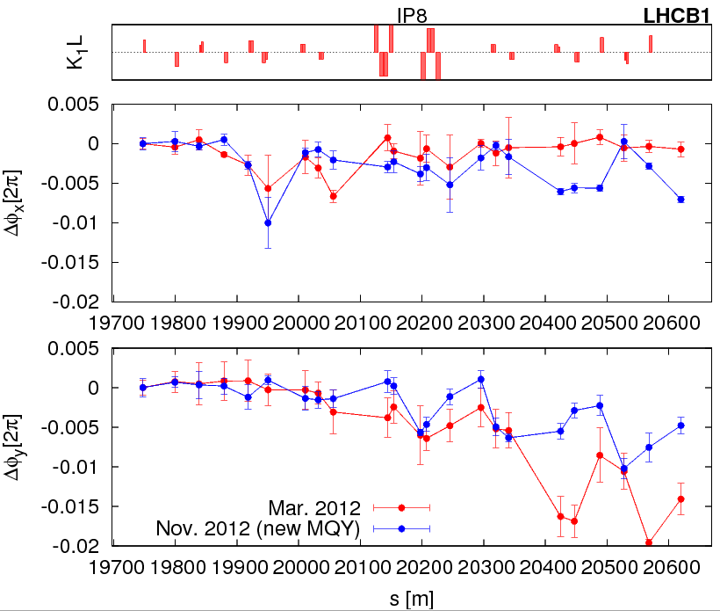
MQY TF MD – optics with new calibrations
Optics measurements at injection and flattop with new MQY calibrations. First analysis points to improved optics.
Afterwards measure detuning with amplitude at flattop.
Detailed analysis off-line.
phase beating error in IR8 (vertical) improved by factor 2

Slide 13
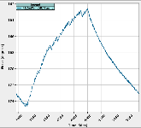
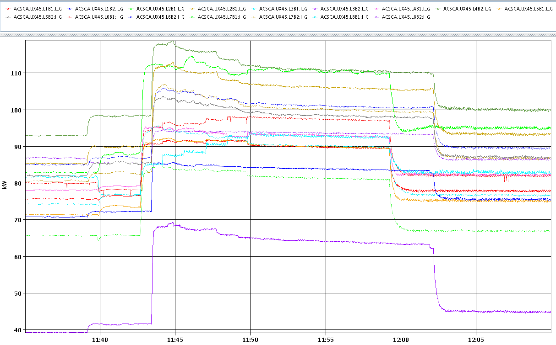
RF Study MD - voltage modulation
(T. Mastoridis, J. Molendijk, P. Baudrenghien et al)
Machine half full; adjusted phase of RF voltage set-point to minimize klystron power. With 1-T feedback ON algorithm was not converging for 2 out of 16 cavities, and converged set-point was not following beam loading exactly. Working with 1-T feedback OFF resulted in excellent performance. (Preliminary) conclusion: Smoothing" algorithm works fine with 1-T feedback OFF. Interplay with 1-T feedback to be understood.
phase modulation of
set point Cav5B2
klystron average power:
drop at 11:58 (B1) & 12:02 (B2), when adaptation was switched on

Slide 14
RF Study MD - longitudinal stability in batch mode
(T. Mastoridis, J. Molendijk, P. Baudrenghien et al)
Excited longitudinal coupled-bunch dipole modes of order 1, 3, 4 and 13, while reducing gain of RF feedback around cavity by 3, 9, 15 and 18 dB and while rotating the RF feedback phase by 5 and 10 degrees. The 1-T feedback was off.
Beam remained stable in all settings.
Conclusion: impedance of RF cavities at fundamental frequency is reduced to level compatible with at least
10x present beam current at 400 MHz.
Detailed analysis will yield damping rates and cross-check

Slide 15
Beam-Beam & Noise MD
(X. Buffat, W. Hofle, T. Pieloni, ++)
collision tunes, Q’~2 units
calibrated ADT noise amplitude w 1 bunch in B1 (V)
1 pilot & 3 bunches of different intensity (1E11, 1.5E11, 2E11)
lack of lumi signal from ATLAS → collided only in IP5
with ADT off, white noise was introduced in steps on B1V; WS measurement indicated different behavior for different bunches, t.b.c. offline
in particular, significant losses and emittance growth on bunch with highest beam-beam tune shift
at the end, recovering lumi signal from ATLAS, collided in IP1 as well, and repeated noise level scan
turning on ADT seemed to lower emittance growth

Slide 16
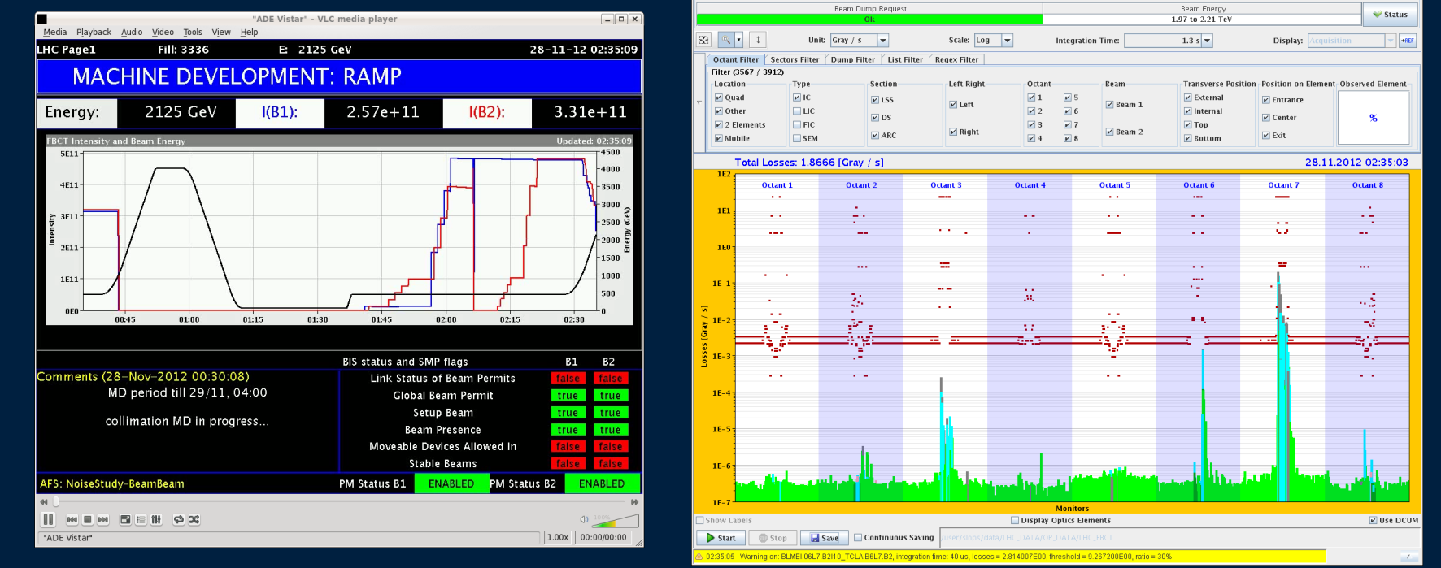
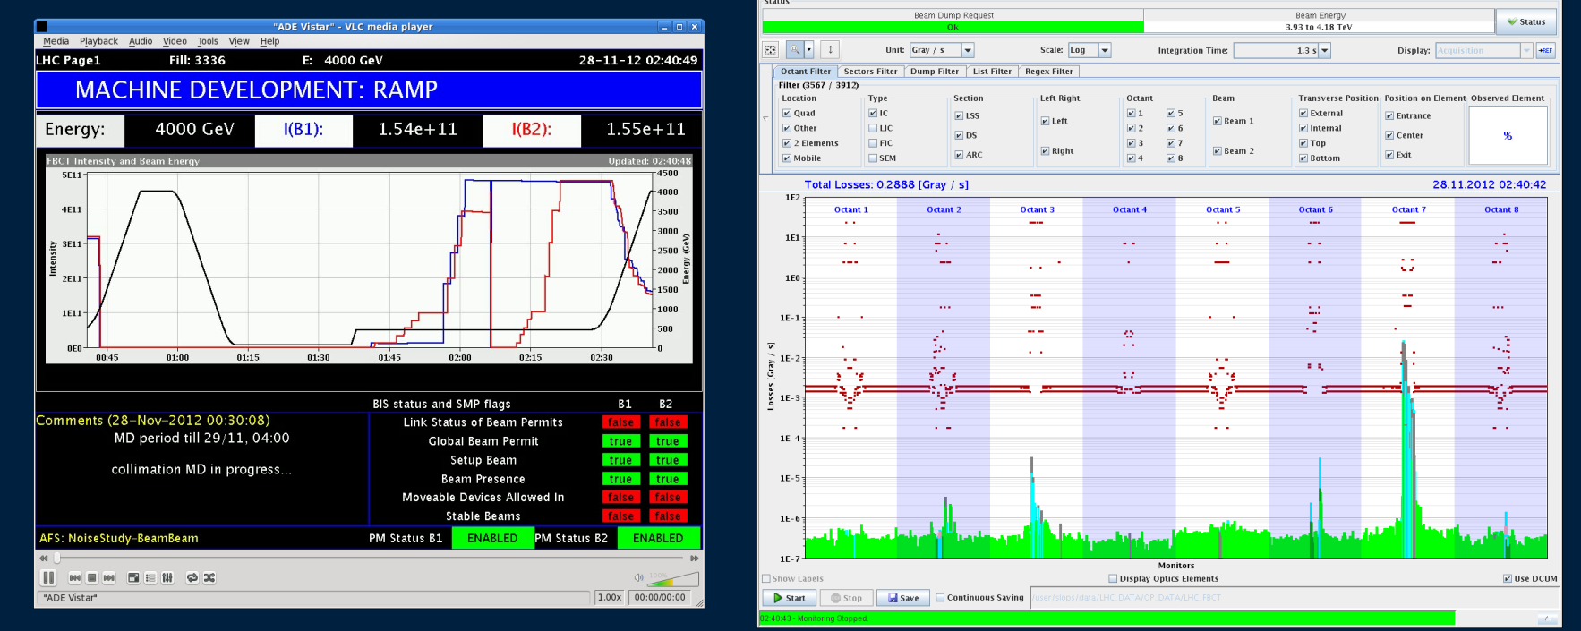
Collimator MD – loss maps on the ramp
Beam 1
2 TeV
Beam 1
4 TeV

Slide 17
Collimator MD - impedance
(S. Redaelli ++)
- collimators initially to nominal settings.
- tried measuring Q’ with ADT off → instability (B1 H).
- first tune shift measurement keeping the ADT on and leaving Q’ at physics settings → moved TCSG in IR7 back and forth (5.1 to 9 σ). Tune shift to be analyzed offline (no clear signal online).
- measured Q’ with ADT off → again several instabilities. Trimmed Q’ closer to zero, and kept ADT off.
- second tune shift measurement: same TCSG IR7 back-and- forth movement, with ADT off. Again tune shift to be analyzed offline (no clear signal online).
- finally, moved back-and-forth TCP from 4.2 to 6.2 σ, with ADT off → again no clear signal online
no clear tune shift when moving TCSG in IR7 or TCP

Slide 18
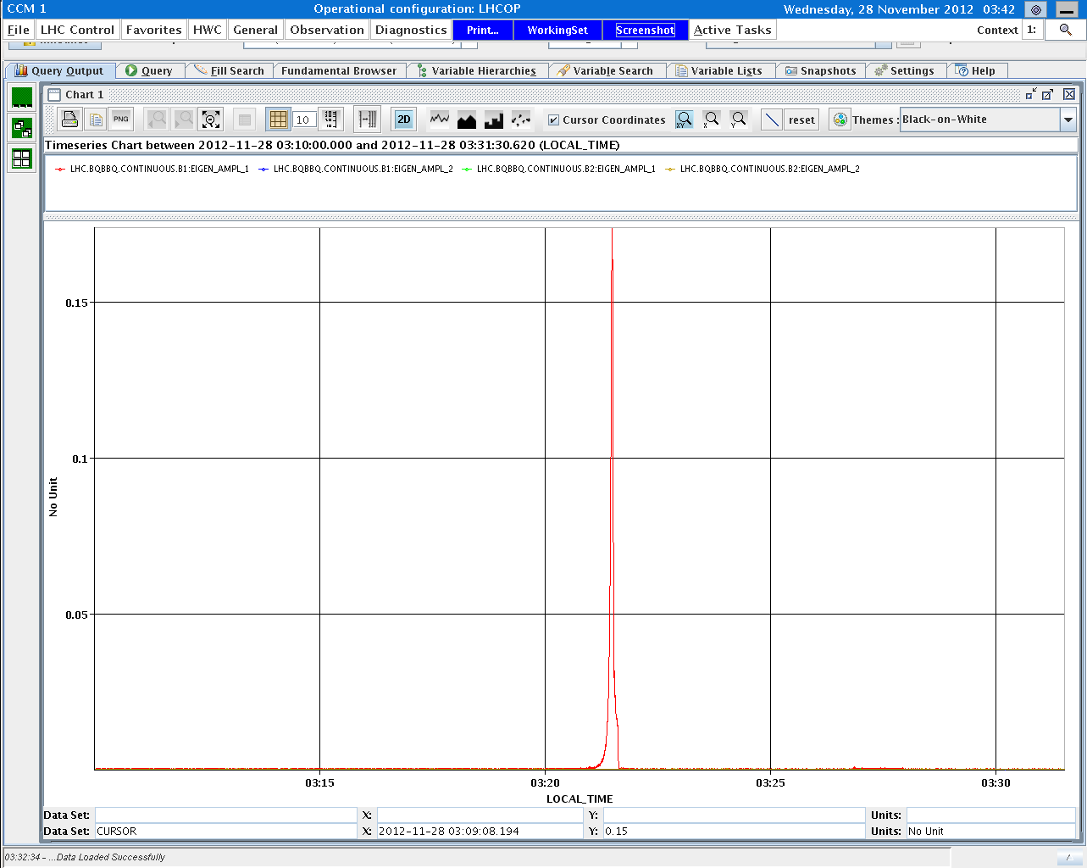
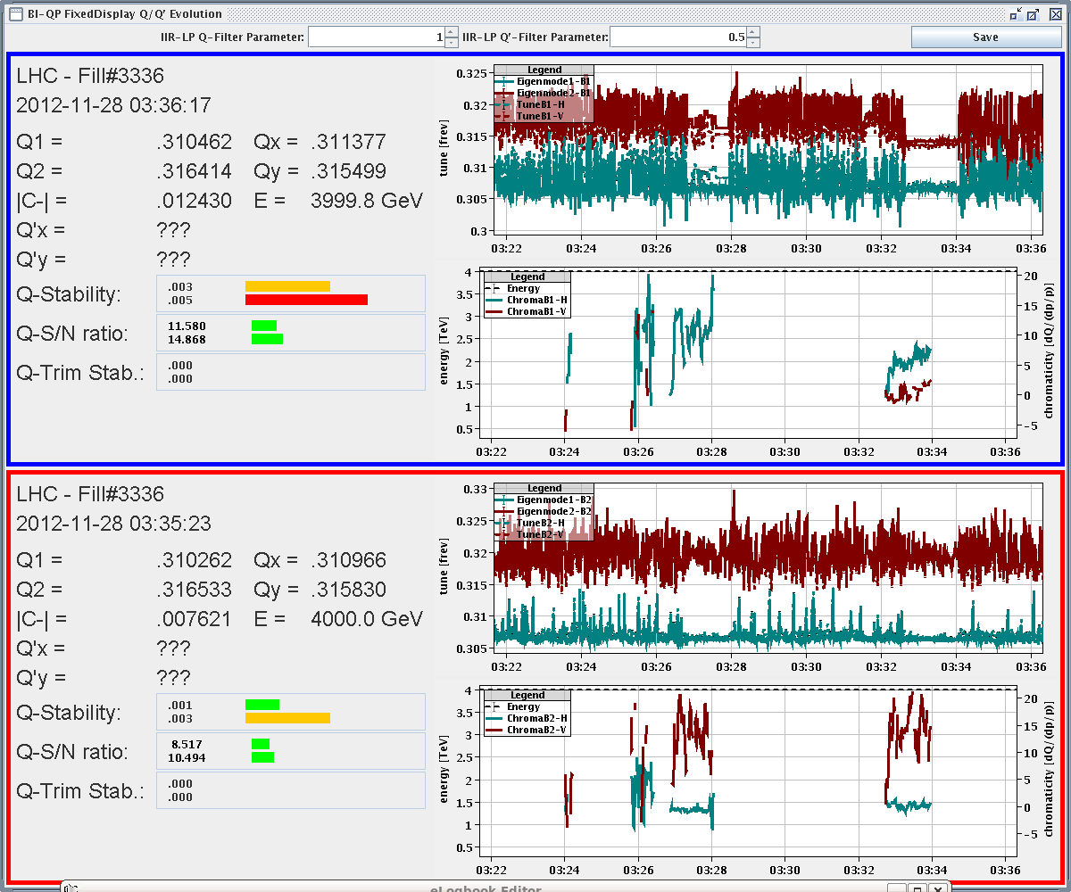
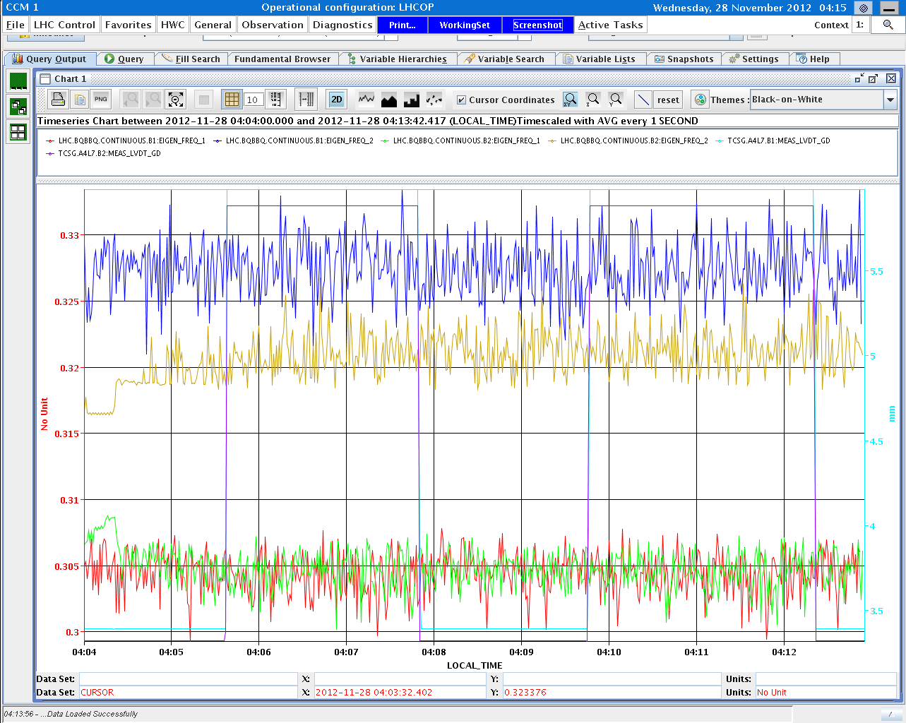
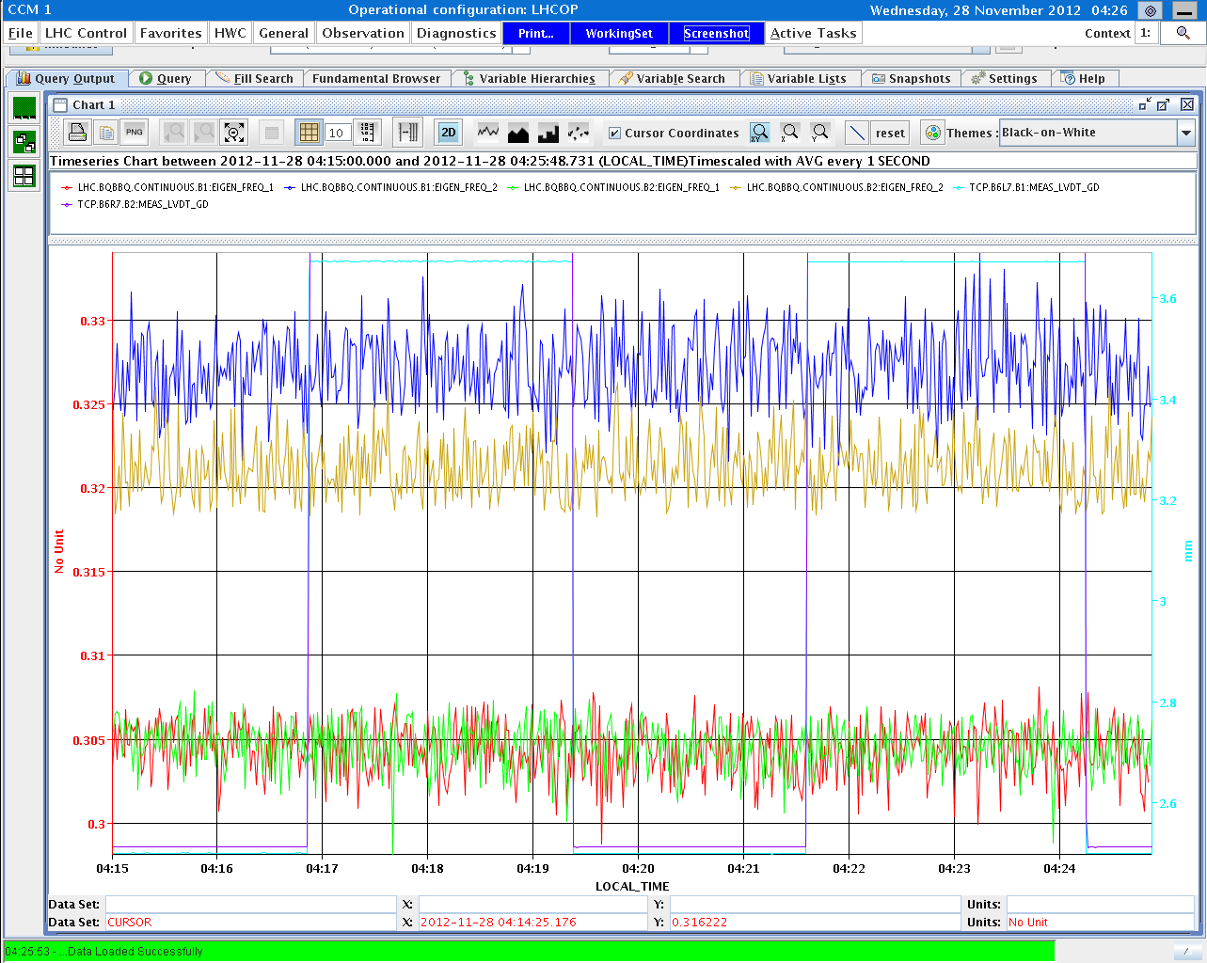
Collimator MD – impedance cont’d
Q’ measurement:
Q’=6, 0 B1 , then trimmed by -10, +2
Q’=0, 13 B2 , then trimmed by -10, +2
B1 instability
with ADT off
seen
on BBQ
Q’ at end of squeeze close
to zero in B1V & B2H?
Second tune shift measurement: TCSG IR7 in / out , ADT off
Third tune shift measurement, moving TCP IR7 in /out with ADT off.

Slide 19
Two-beam impedance MD - conditions
P. Baudrenghien, S. Fartoukh, E. Metral, A. Burov
78 nominal bunches (6+2*36), 1.5 E11, 1.5 micron emittance
nominal squeeze down to 0.6 m
RF cogging of beam2 at -12 Hz (10E-4 in dp), inducing clockwise rotation of beam2 (beam1 fixed).
4 cogging configurations: 0 turn (overlap in IR1 and IR5), 1/4 turn (IR2 only), 1/2 turn (no overlapp), 3/4 turn (IR8 only), 1 turn (back to 0 turn)
in each cogging configuration, MO scan was performed, some with tune split: always moving the most stable beam down along the diagonal
Result 1: cogging worked nicely, even in presence of moving LR encounters at full intensity (1.5 E11) & 9 sigma normalised crossing angle in IR1 & IR5

Slide 20
Two-beam impedance MD – 2nd result
P. Baudrenghien, S. Fartoukh, E. Metral, A. Burov
cogging (turns) | common IR | int. (av. b1/b2) [1e13] | MO thr. [A] | gain from tune split
0 | 1 & 5 | 1.15 | 400 | -100 A (B1: -0.005,-0.005)
¼ | 2 | 1.05 | 200 | small effect
½ | none | 1.00 | 150 | - (not tried)
¾ | 8 | 0.95 | 100
1 | 1 & 5 | 0.95 | always stable (scanned 520 to -520 A; also changed Q’ by +10 )
1+1/2 | none | 0.85 | still rock stable
MD ruled out scenarios were stability would be explained by negative Q’ or by LR tune spread
hypothesis: Landau damping from longitudinal plane

Slide 21
Two-beam impedance MD – more results
line 2*Q_{y} (actually 1-2*Q_{y}) systematically observed in the presence of instabilities regardless of the cogging configuration, i.e. with *and* w/o LR beam-beam
possible explanation (to be confirmed off-line): this line reflects beam response to machine nonlinearities, further amplified by tune proximity to 3rd order resonance after the first step of the squeeze (so coupled to Q_{x} and actually found to be moving when trimming Q_{x}), but also and mainly beyond the ADT tune window:.. so coherent mode (m=0) possibly undamped at this frequency ?? in general: Two-Beam-impedance effect seems to be excluded. In the presence of LR beam-beam the situation seems to get worst. There is a source of Landau damping which is strongly suspected in the longitudinal plane. Machine (and LR) nonlinearities certainly add frequencies to the beam spectrum (m*Q₁+n*Q₂); “for some of us, the behaviour of the ADT is not clear under these conditions”

Slide 22
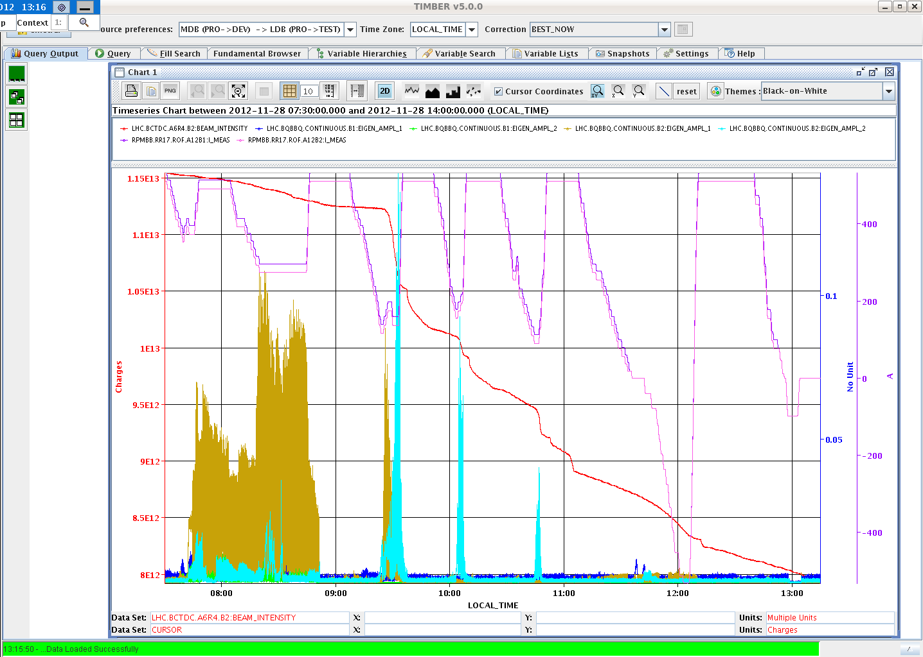
Two-beam impedance MD – illustrations
instability signals during the MD
B2H
B1V

Slide 23
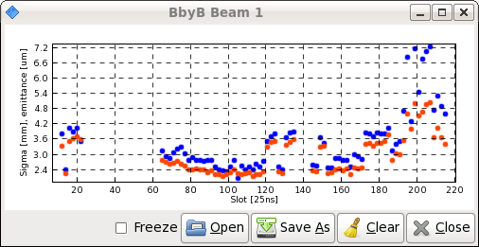
Two-beam impedance MD – illustrations
e-cloud effect?
B1 emittances after 1-turn cogging (~11:16);
blown up everywhere, especially in the tails

Slide 24
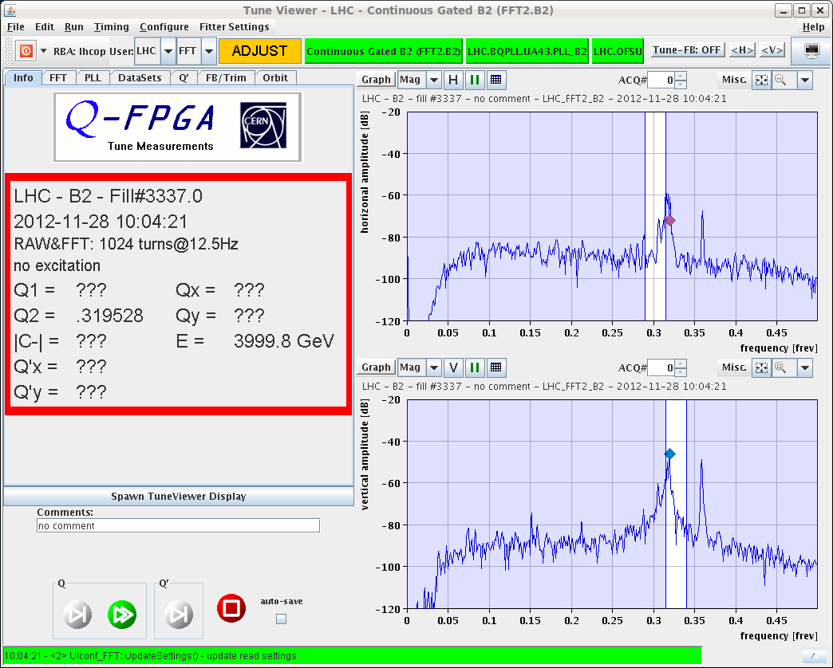
Two-beam impedance MD – illustrations
effect of
nonlinear pickup?
(Gianluigi Arduini)
1-2Q_{y}

Slide 25
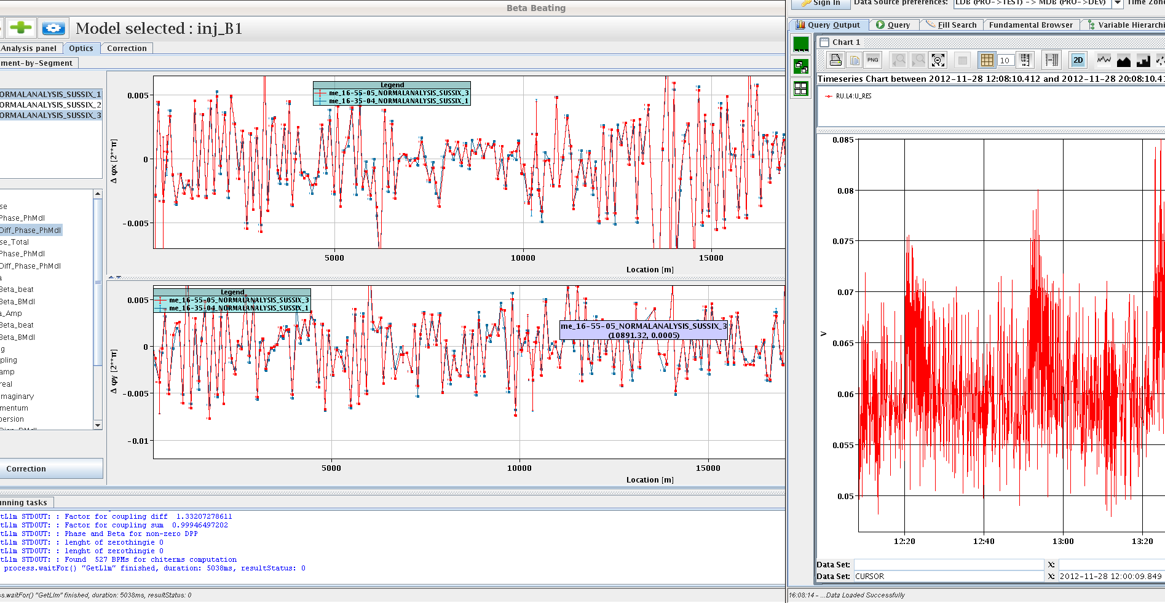
Impedance MD – Transverse Localization
B. Salvant, N. Biancacci
AC dipole kicks on high intensity bunches
ADT & octupoles off, increase Q’ for better beam stability
measurements with TDI close to the beam & TDI at 30 or 31 mm, mostly on beam 1 due to fault on LBDS2
phase beating with intensity

Slide 26
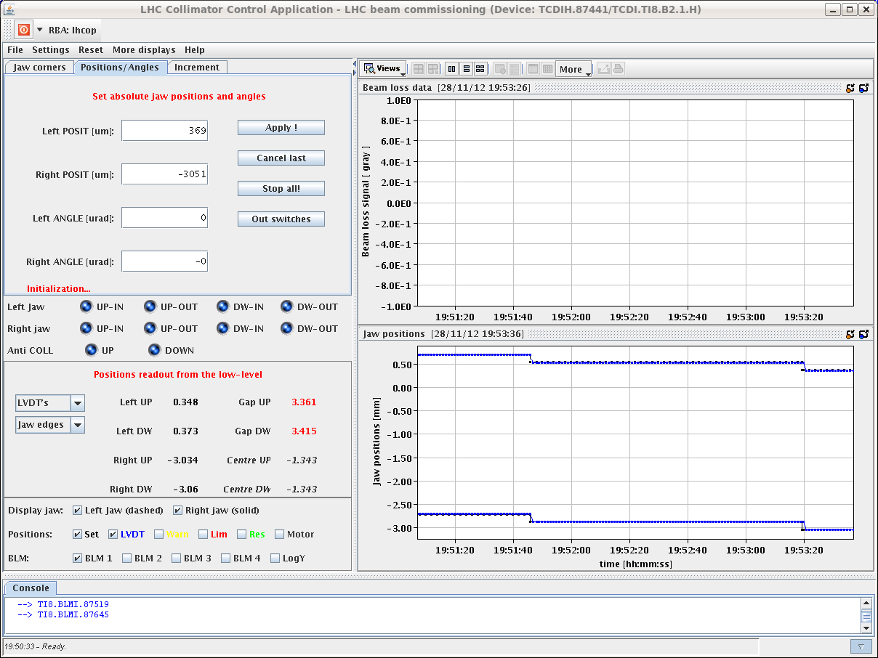
Injection MD – TCDI Automatic Setup
Inj & dump for TCDI setup software (setup beam flag limit raised to 6e10p)
pilot ; checked steering ; opened TCDI thresholds
3 scans with two different collimators in TI8
TCDI stayed once armed after the scan (not for the next scans)
correct detection when beam is not extracted (collimator not moved)
improvements: normalization to intensity ; zoom-in window ; automatic entry in logbook
manual checks of automatic analysis results (1st scan only movement)
2nd scan: +/- 2 sigma scan window too small for good fit
3rd scan: automatic centre: -0.242 sig, manual centre: -0.236 sig
not checked: automatic trim-in of new centres
The application works
correctly and can be used
for the next setup!
C. Bracco et al.

Slide 27
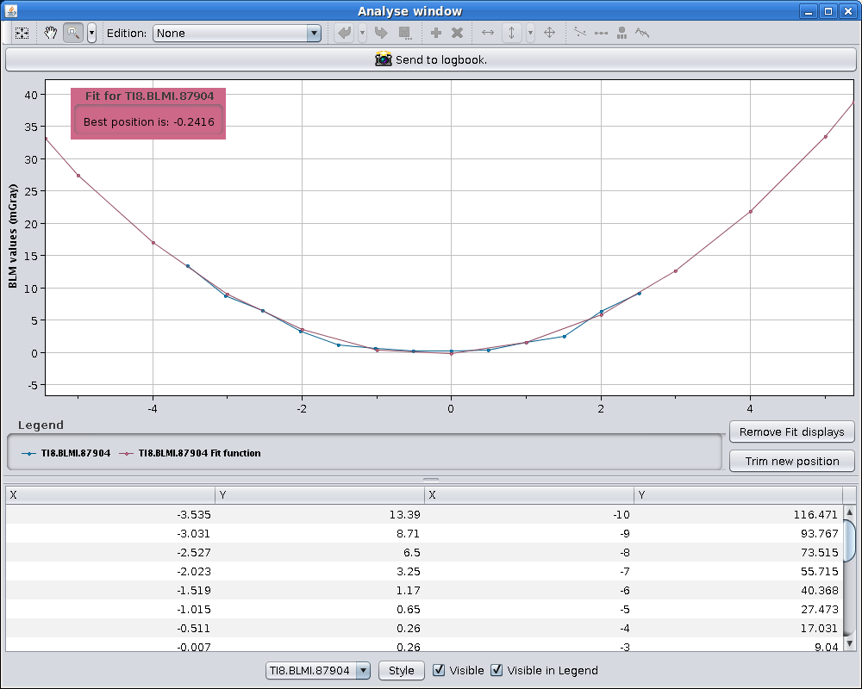
Injection MD – injection matching monitor
timing correct ; Al screen well centered
intensity too low for OTR measurements (limited time prevented scraping high intensity bunch in the SPS down to below the limit of 6e10)
C. Bracco,
F. Roncarolo,
et al

Slide 28
RF MD – bunch flattening w RF phase modulation
Test of phase modulation with individual bunches of different intensity at 450 GeV: difference in incoherent synchrotron frequency between low and high intensity bunches around 1 Hz. Effect of flattening observed through bunch phases and profiles.
Successful test with nominal beam in both rings on flat bottom,
effect observed on beam spectrum and profiles before and after application of phase modulation. Beneficial effect on ALFA heating also visible.
Test of RF voltage reduction from 10 MV to 6 MV on flat top, no losses, but some transverse (B1V) activity could still be observed at end of squeeze; detailed analysis required for comparison w higher voltage case.
Test of phase modulation with 10 MV in squeeze. When applied to B2 at revolution harmonics with phase loop on → bunch length variation around the ring was produced. Flattening of B1 was done with phase loop off and smaller amplitude. Heating in ALFA was significantly reduced for both beams. To be analysed for other equipment. At the end average BQM bunch length was 1.6 ns. During phase modulation of one beam, excitation could be seen on the other beam in the transverse (V) plane.
Finally beam was dumped due to slow losses in Point 5

Slide 29
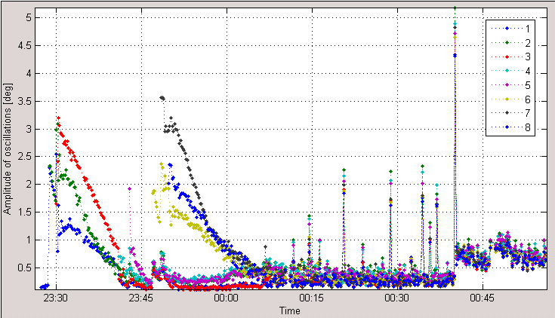
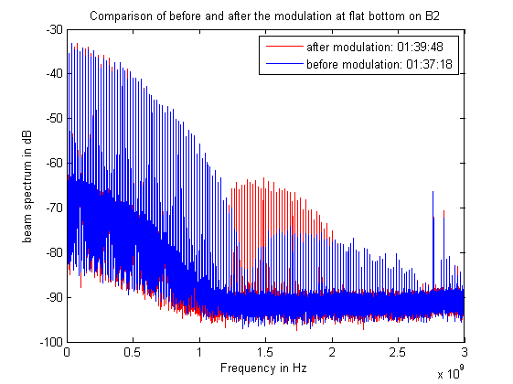
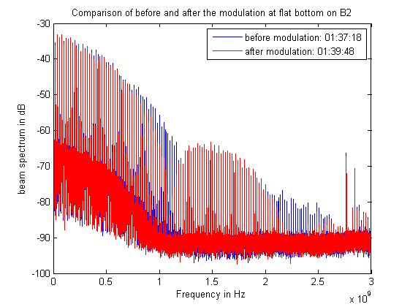
RF MD – bunch flattening w RF phase modulation
J. Esteban, T. Mastoridis
E. Shaposhnikova,
B. Salvant, et al
amplitude of phase oscillations
spectrum before
modulation
spectrum after
modulation

Slide 30
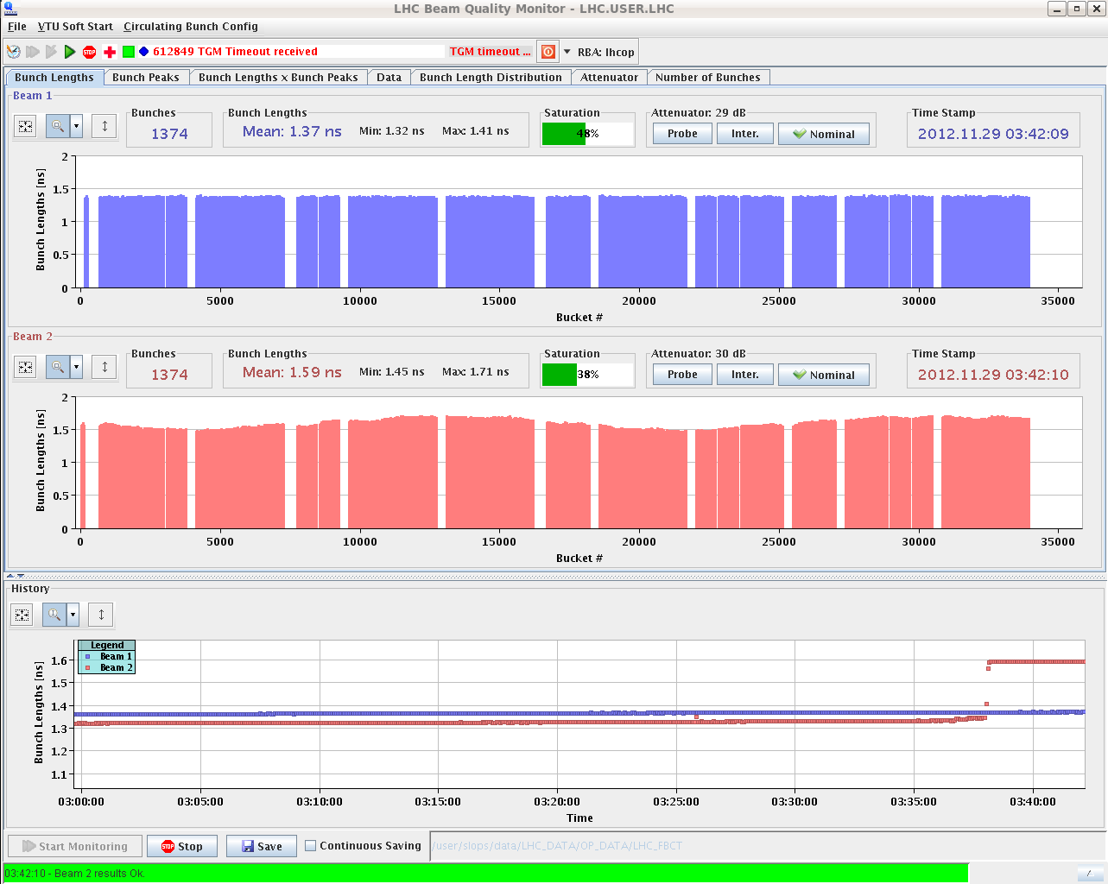
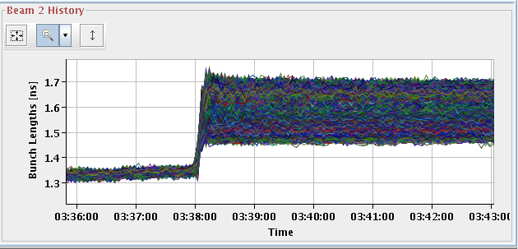
RF MD – bunch flattening w RF phase modulation
modulation in bunch length along all bunches of B2, following the RF modulation applied.
J. Esteban, T. Mastoridis
E. Shaposhnikova,
B. Salvant, et al

Slide 31
RF MD – effects of bunch flattening
beam spectra: clear effect of RF modulation
Roman Pot: temperature decreases after flattening bunches MD → very sensitive
TDI: no change noticeable
vacuum: VGI.210.5R6 quite high, tbc with vacuum experts
BSRT: changes of T slope also indicate beneficial effect of flattening bunches
MKI magnets: steady increase, difficult to see changes. MKI tube temperatures: steady increase. change of slope observed on MKI8C tube up temperature
TCTVB.4L8 and TCTVB.4R8: temperature probes show clear correlation with bunch length.
TCP.B6L7: no clear impact observed
beam screens or Q6R5: Nothing special observed (except for usual noise between 3am and 4am), according to TE/CRG operator, to be confirmed offline

Slide 32
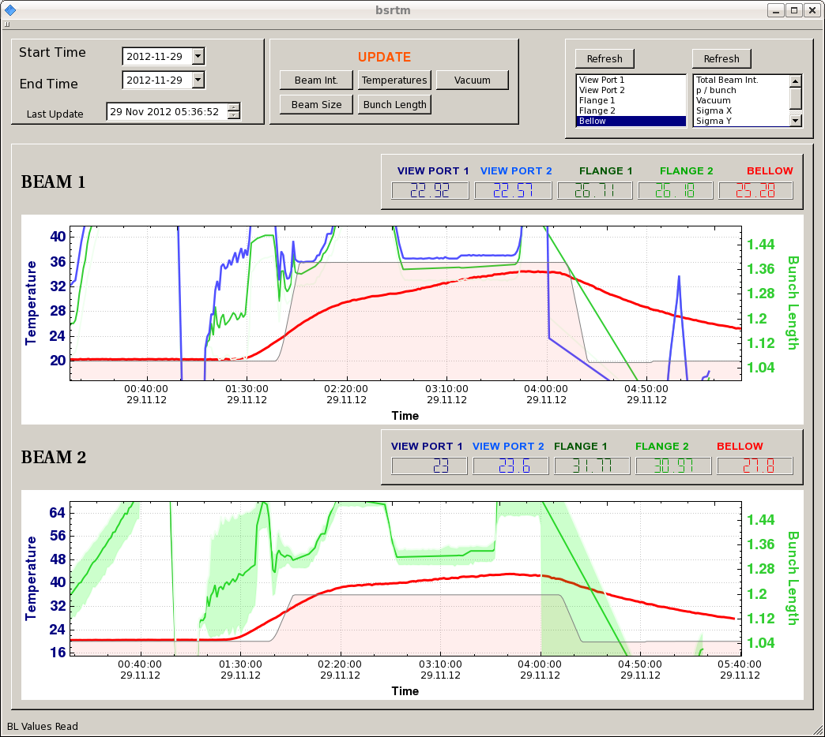
RF MD – effect of bunch flattening on BSRT

Slide 33
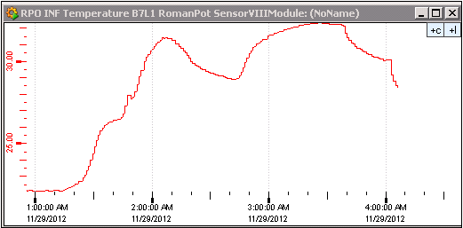
RF MD – effect of bunch flattening on ALFA RP
Sune Jakobsen
short
short
long
long

Slide 34
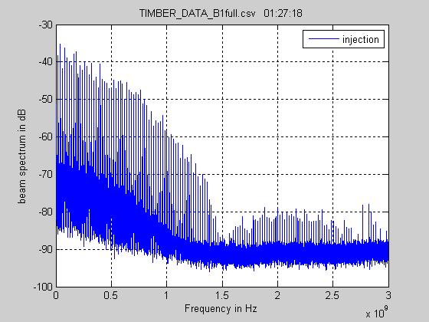
RF MD – spectrum evolution during the MD

