Slide 1
MD#4 Progress
MD Coordinators:
Giulia Papotti, Frank Zimmermann
Machine Coordinators:
Gianluigi Arduini, Eva Barbara Holzer
28 November 2012

Slide 2
MD#4 News & Plan Mon – Tue (26. – 27.11.)
Day | Time | v | MP class | MP Comments
Mon | 06:00 | Ramp down if needed
 | 08:00 | 450 GeV: IR8 aperture | A | 450 GeV Pilote bunches(1e10p/bunch) to measure aperture.
 | 10:00 | 450 GeV: Beam instrumentation | B | BSRT vs WS, Schottky, WS PM saturation (partially done in MD3): 450 GeV B1: Pilot + 12b >=1.1e11p/bunch B2: Pilot + 50ns trains from 6 to 72 bunches Bumps at 450GeV and 4TeV Blow up with ADT 2) BGI, Gates BBQ, BSRT temperatures: 450GeV 50ns trains with minimum 600 bunches Bumps in B2 +- 3mm Blow up with ADT Gating with ADT off on some bunches 3) BPMs: Done in MD3 4) Matching: 450GeV Probe from 1 to 5e10p Inj, circulate (~100 turns) and dump (More details see slides )
 | 16:00 | 450 GeV→ 4 TeV: p-Pb test | C | From MD2 preparation: 450GeV and 4TeV Bunches of ~1.5e10p/bunch and >5e7Pb/bunch B2: few proton bunches and few Pb bunches B1: > 300 bunches with 10% ~1.5e10p/bunch, later with higher intensities. Test RF re-phasing procedure. Squeeze sequence and collisions. (More details see slides)
cancelled (QPS access S6-7 RQF/RQD,
MKI2 fault in softstart, dump line vacuum);
to be rescheduled as Operational Dev.
BPM studies and beam excitation, …
24 p batches from the SPS posed problems

Slide 3
MD#4 New & Plan Mon – Tue (26. – 27.11.)
Day | Time | v | MP class | MP Comments
Tue | 00:00 | Ramp down
 | 02:00 | 450 GeV→ 4 TeV: MQY transfer function | A | 4 TeV. Pilote bunches (1-3e10p/bunch). Standard optics measurements with different MQY transfer funtions.
 | 06:00 | Ramp down
 | 08:00 | 450 GeV: RF study (longit. stability for batch or RF voltage modulation) | B | 450GeV A few nominal batches of 144b. RF Voltage modulation: fill half of the ring, to test the corrected algorithm of voltage set point adjustment Longitudinal stability: Full ring with max. bunch intensity. Excite a single mode in the beam with decreasing gain in the feedback loop. (More details see slides)
 | 16:00 | 450 GeV: beam-beam (noise or impedance) | C | 450 GeV In total 9 bunches per beam with different intensities (from 1e11 to 2e11), zero crossing angle in IP1, IP2 and IP5. Nominal crossing angle in IP8. Collision tune, Damper (ADT) off Introduce increasing noise with ADT Increase ADT gain in steps Scan separation in IP1 and 5 with 4 bunches (from 1e11 to 2e11) with damper of. (More details see slides)
 | 22:00 | 450 GeV→ 4 TeV: Collimation impedance & follow up from last MD | B | 4 TeV ~3b (1.3e11p/bunch) below SBF Alignment of collimators Impedance studies with tight collimator settings and moving IR7 collimators back and forth. (More details see slides)
successful!
successful
successful
successful

Slide 4
MD#4 Plan Wed – Thu (28.-29.11.)
Day | Time | MD | MP class | MP Comments
Wed | 04:00 | Ramp down
 | 06:00 | 450 GeV→ 4 TeV: two –beam impedance | C | 4TeV, squeeze to beta*=1.5m 150 bunches per beam (nominal filling scheme) Move beam 2 clockwise Reduce octupole currents in 5 different configurations (0 turn, ¼ turn, ½ turn, ¾ turn and 1 turn cogging) (More details see slides)
 | 14:00 | Ramp down
 | 16:00 | 450 GeV: transverse impedance localization at injection | C | 450GeV 8bunches with different intensities, equally spaced (5e9 … 1e10 … 5e10 … 1e11 … 1.5e11 … 2.2e11) Create kick with AC dipole or kicker Tune shift 2.1e-3 Move TDI Parallel measurement with ADT? (More detials see slides)
 | 18:00 | 450 GeV: TCDI automatic setup | A | 450 GeV Pilot bunches (1e10p/bunch)
 | 22:00 | 450 GeV→ 4 TeV: bunch flattening with RF phase modulation | B | 450 GeV and 4TeV Nominal LHC beam, i.e. 1374b per beam Add flattening signal (sine-wave close to the synchrotron frequ.) The MD will have ramp and all steps before physics. Measure effects of heating and transv. Instabilities.
Thu | 02:00 | Ramp down
 | 04:00 | End of MD#4
in progress

Slide 5
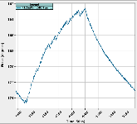
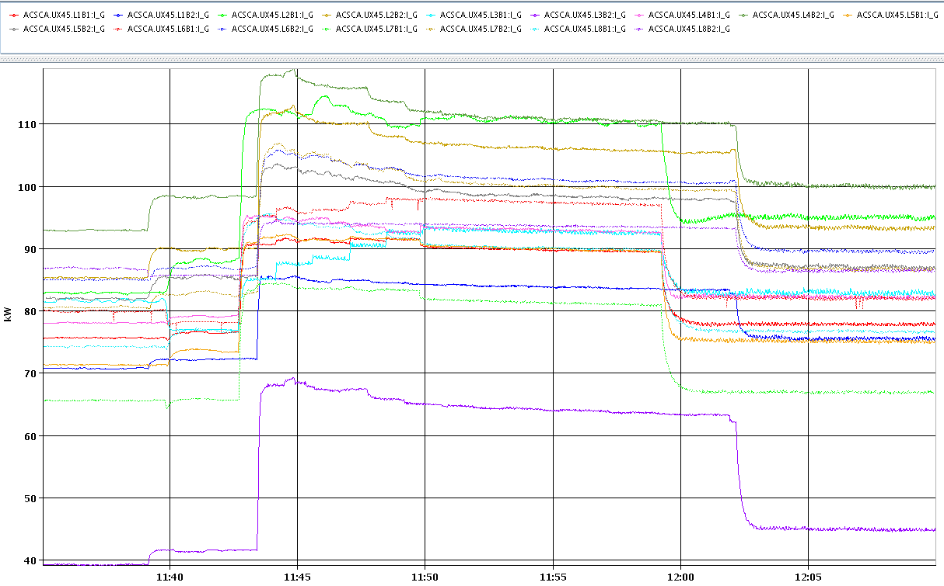
RF Study MD - voltage modulation
(T. Mastoridis, J. Molendijk, P. Baudrenghien et al)
With machine half-full adjusted the phase of the RF voltage set-point to minimize klystron power. With 1-T feedback ON the algorithm was not converging for 2 out of 16 cavities, and the converged set-point was not following the beam loading exactly. Working with 1-T feedback OFF resulted in excellent performance. (Preliminary) conclusion: The "smoothing" algorithm works fine with 1-T feedback OFF. The interplay with the 1-T feedback is to be understood.
phase modulation of
set point Cav5B2
klystron average power:
drop at 11:58 (B1) & 12:02 (B2), when adaptation was switched on

Slide 6
RF Study MD - longitudinal stability in batch mode
(T. Mastoridis, J. Molendijk, P. Baudrenghien et al)
Excited longitudinal coupled-bunch dipole modes of order 1, 3, 4 and 13, while reducing gain of RF feedback around cavity by 3, 9, 15 and 18 dB and while rotating the RF feedback phase by 5 and 10 degrees. The 1-T feedback was off.
The beam remained stable in all settings.
Conclusion: impedance of RF cavities at the fundamental frequency is reduced to a level compatible with at least 10 times the present beam current at 400 MHz.
Detailed analysis of the response to the excitation will yield damping rates and cross-check

Slide 7
Beam-Beam & Noise MD
(X. Buffat, W. Hofle, T. Pieloni, ++)
collision tunes, Q’~2 units
external ADT noise amplitude calibrated w 1 bunch in B1 (V)
1 pilot & 3 bunches of different intensity (1E11, 1.5E11, 2E11)
lack of good lumi signal from ATLAS → collided only in IP5
with ADT off, white noise was introduced in steps on B1V; WS measurement indicates different behavior for the different bunches, t.b.c. offline
in particular, significant losses and emittance growth on the bunch with highest beam-beam tune shift
at the end, recovering lumi signal from ATLAS & being unable to refill, collided in IP1 as well, and repeated the noise level scan
eventually, turning on the ADT seemed to lower the emittance growth

Slide 8
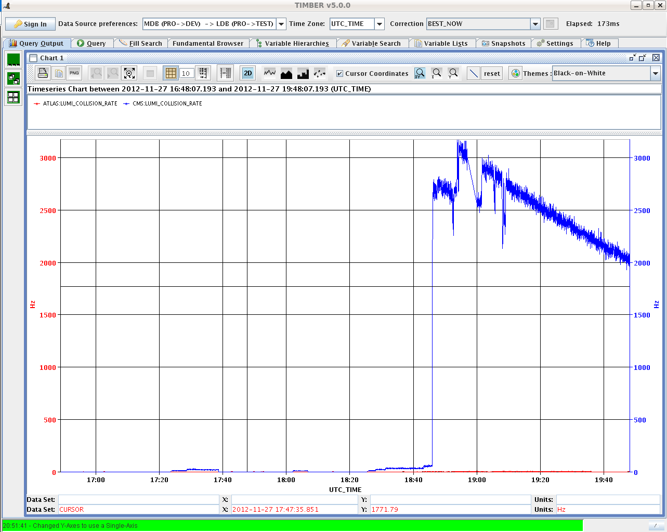
Beam-Beam & Noise MD cont’d
20:35 luminosity signals from
CMS and ATLAS

Slide 9
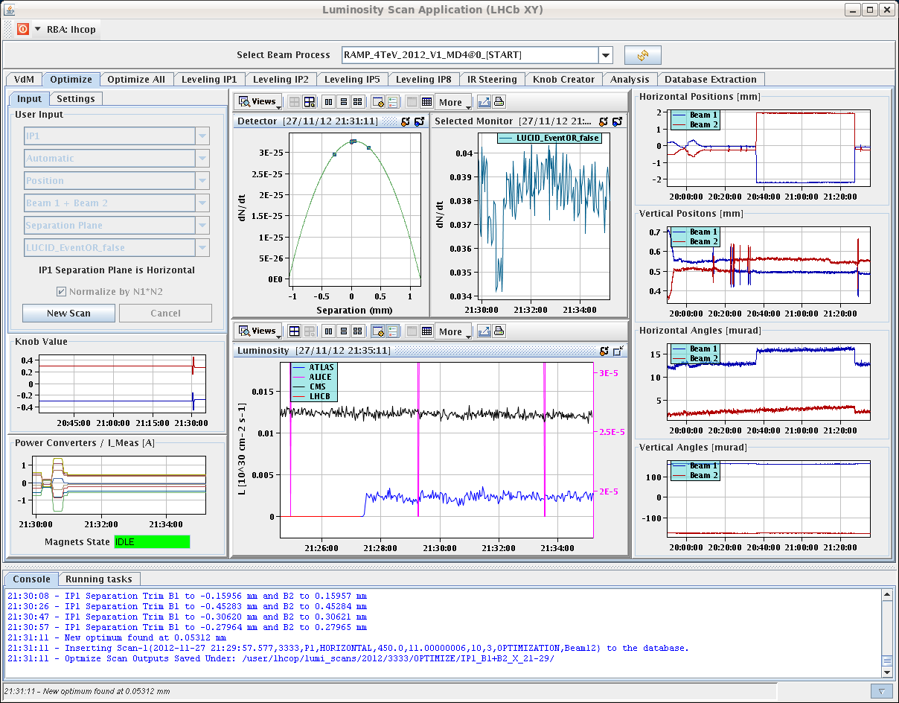
Beam-Beam & Noise MD cont’d
21:34 ATLAS published luminosity
signals recovered
(thanks Thilo Pauly!)

Slide 10
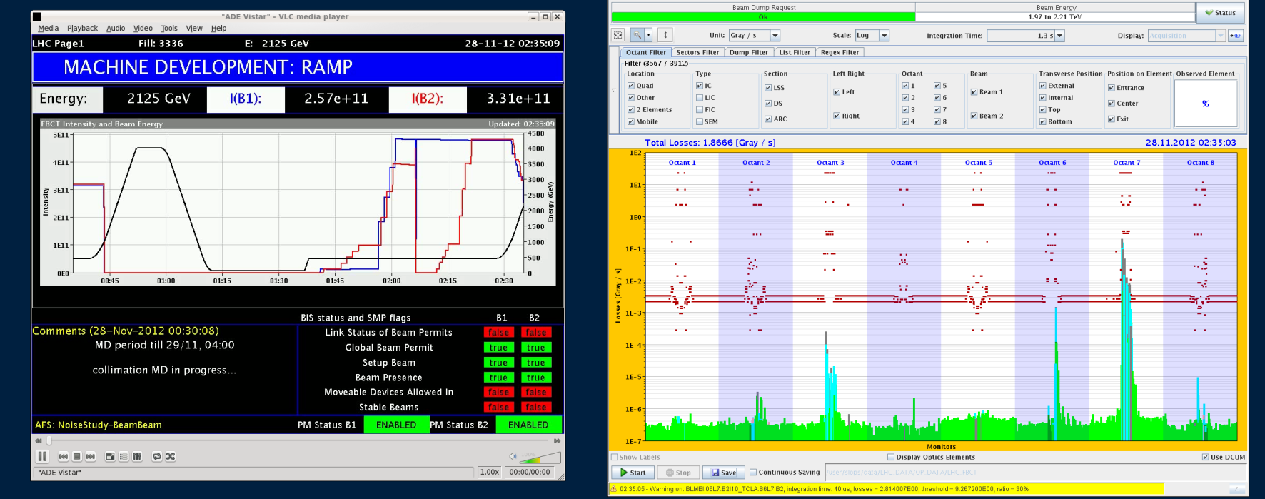
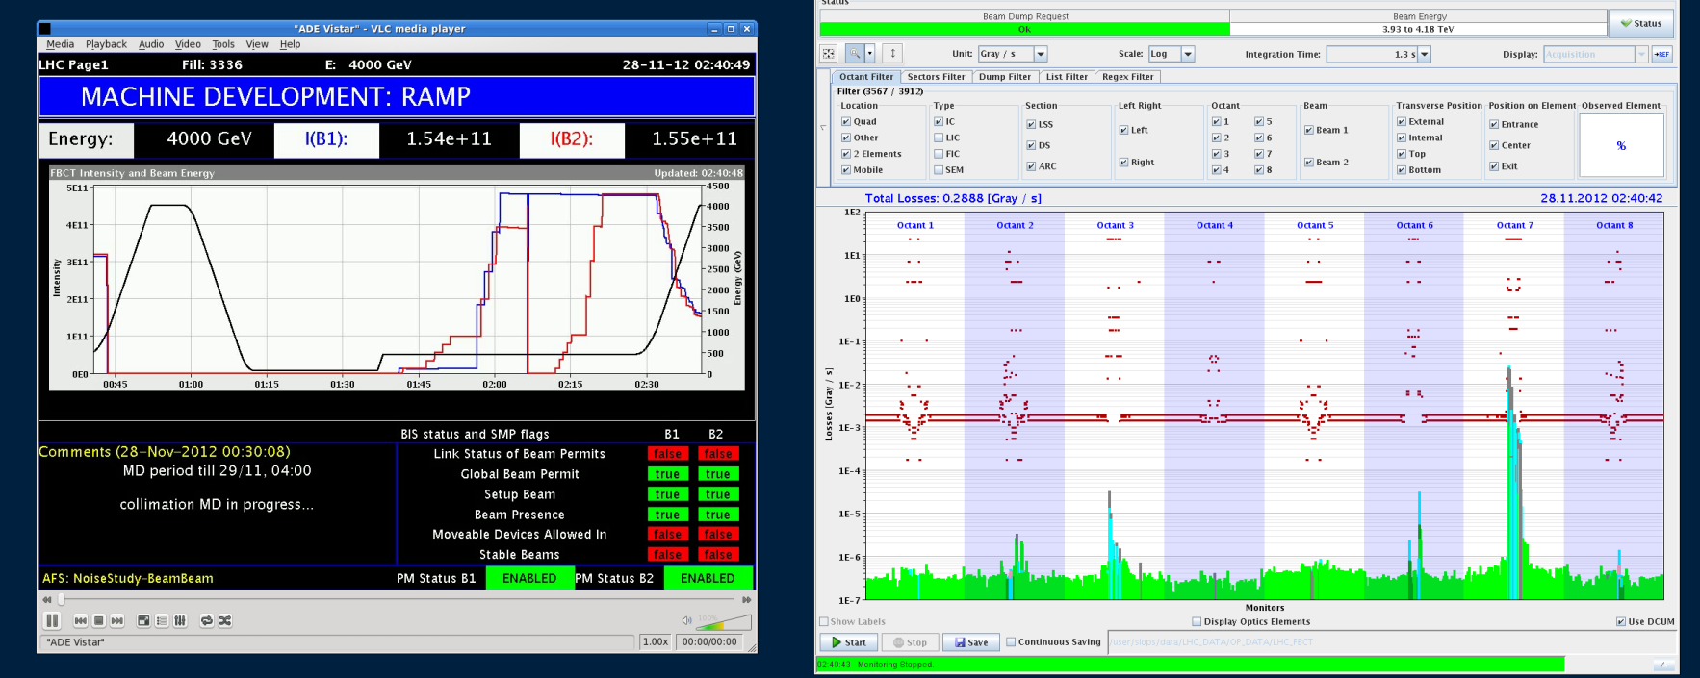
Collimator MD – loss maps on the ramp
Beam 1
2 TeV
Beam 1
4 TeV

Slide 11
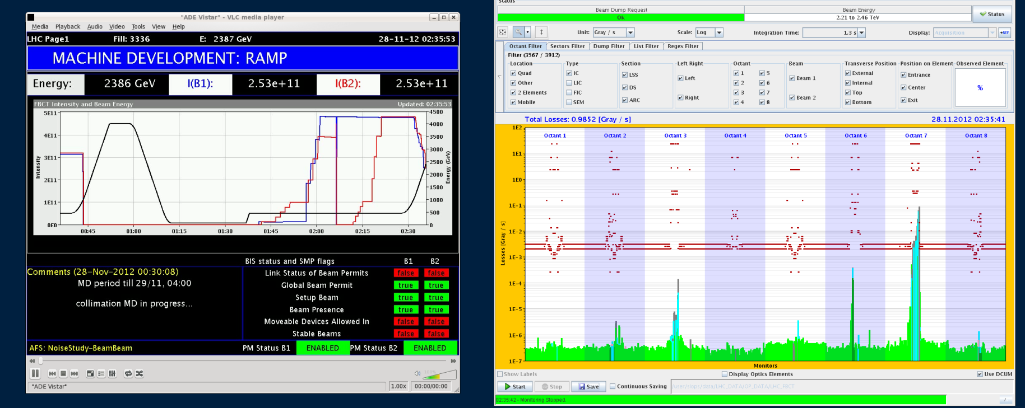
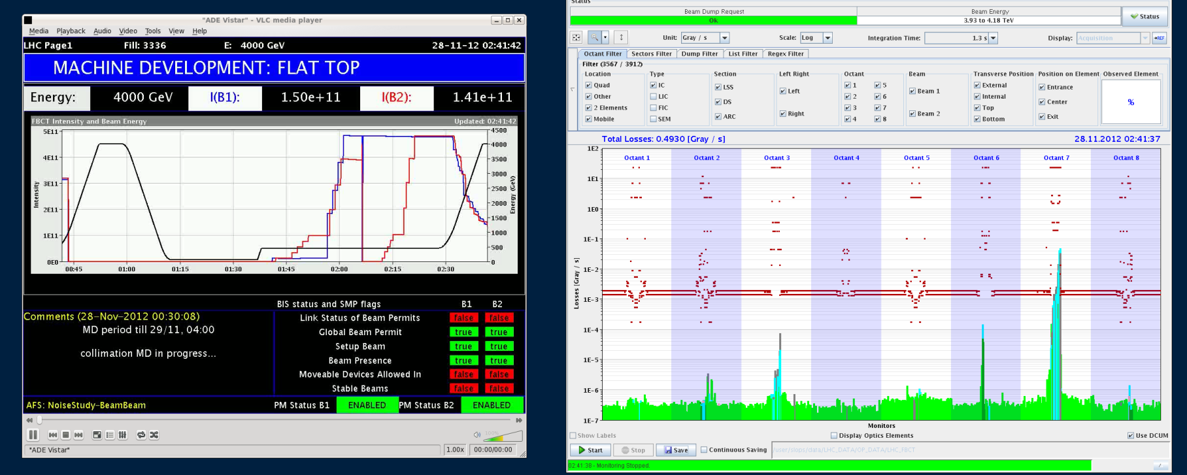
Collimator MD – loss maps on the ramp
Beam 2
2 TeV
Beam 2
4 TeV

Slide 12
Collimator MD - impedance
(S. Redaelli ++)
- collimators initially to nominal settings.
- tried measuring Q’ with ADT off → instability (B1 H).
- first tune shift measurement keeping the ADT on and leaving Q’ at physics settings → moved TCSG in IR7 back and forth (5.1 to 9 σ). Tune shift to be analyzed offline (no clear signal online).
- measured Q’ with ADT off → got again several instabilities. Trimmed Q’ closer to zero, and kept ADT off.
- second tune shift measurement: same TCSG IR7 back-and- forth movement, with ADT off. Again tune shift to be analyzed offline (no clear signal online).
- finally, moved back-and-forth TCP from 4.2 to 6.2 σ, with ADT off → again no clear signal online

Slide 13
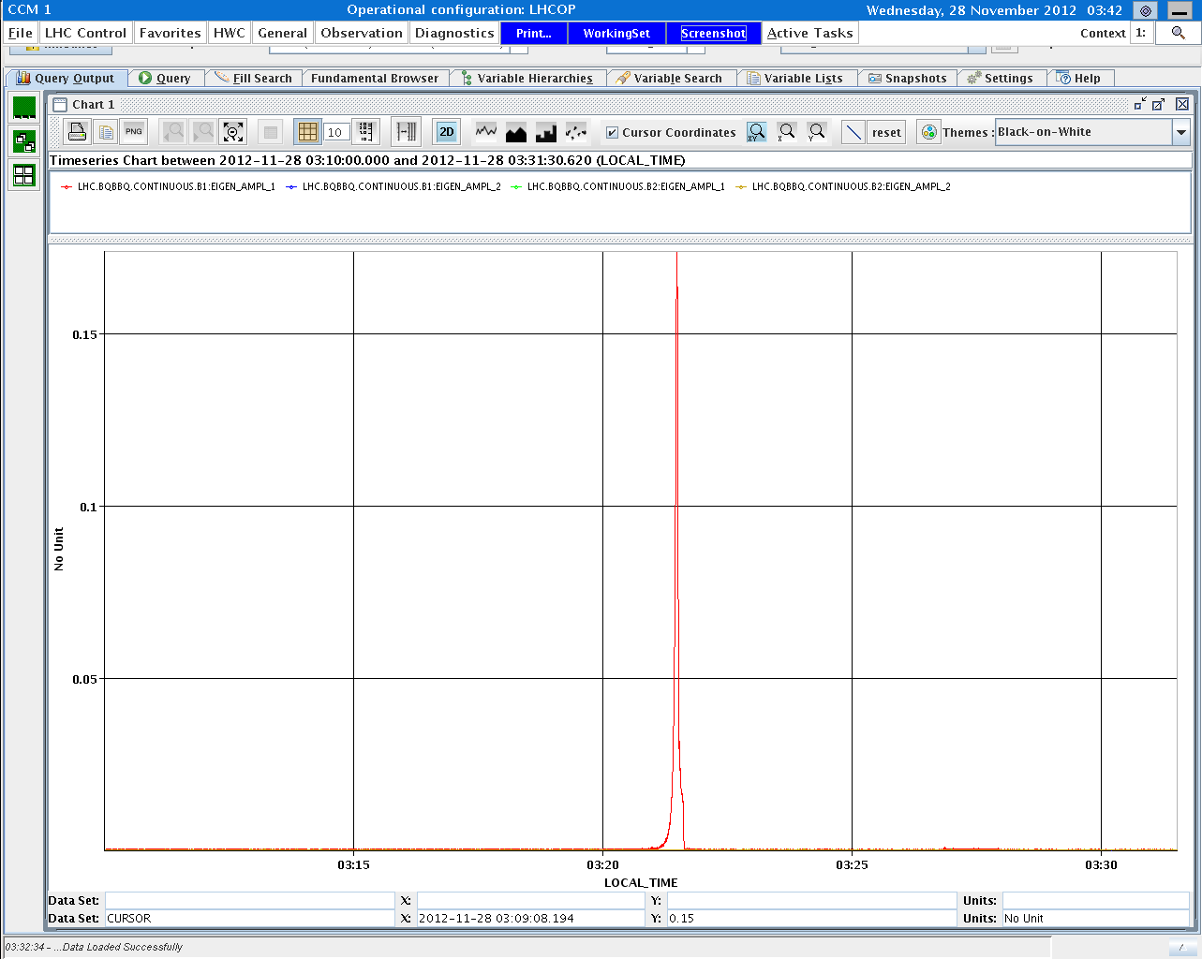
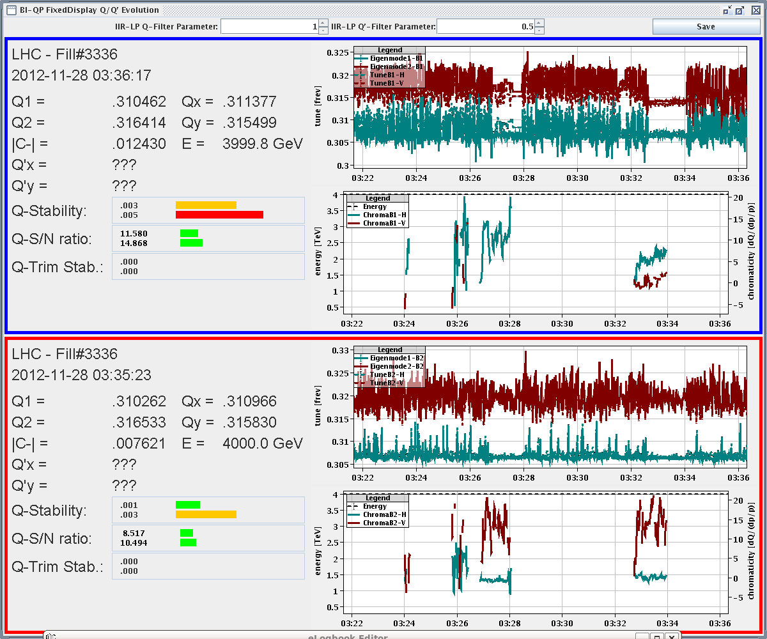
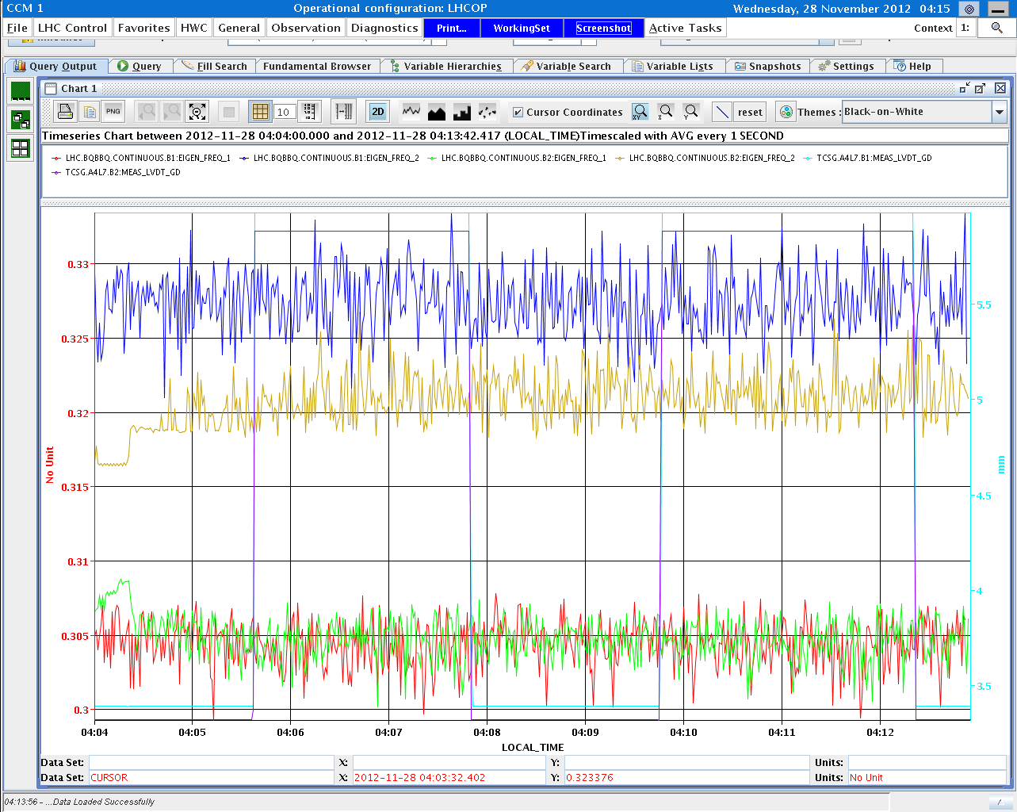
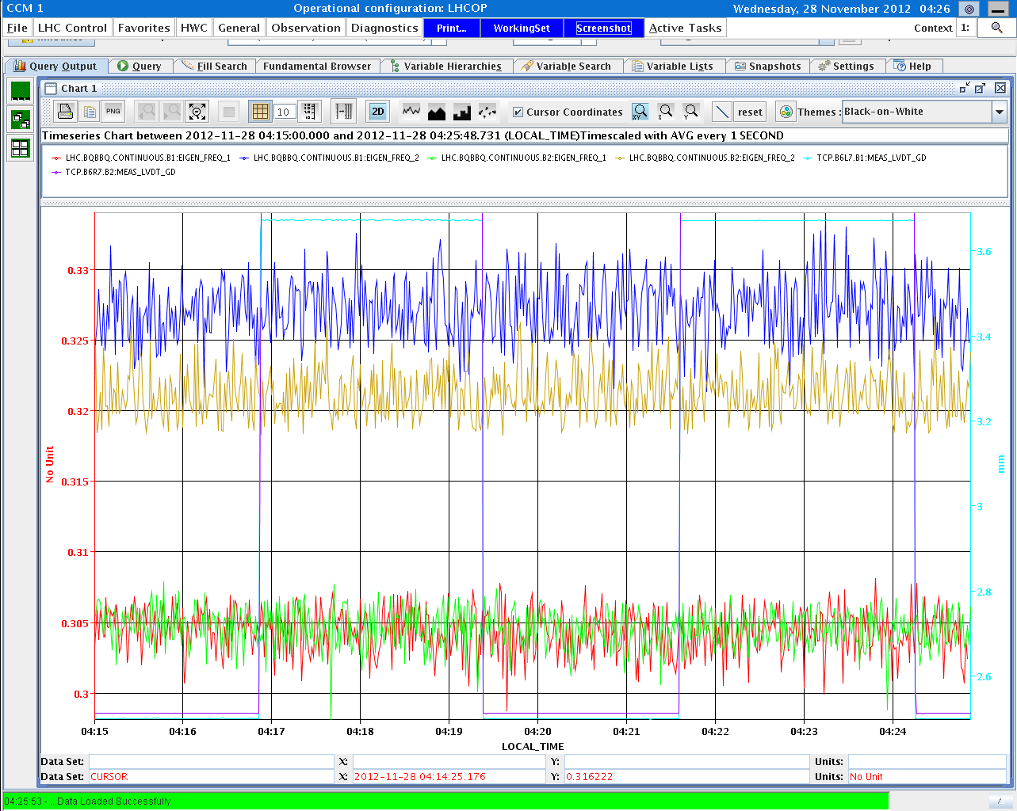
Collimator MD – impedance cont’d
Q’ measurement:
Q’=6, 0 B1 , then trimmed by -10, +2
Q’=0, 13 B2 , then trimmed by -10, +2
B1 instability
with ADT off
seen
on BBQ
Second tune shift measurement: TCSG IR7 in / out , ADT off
Third tune shift measurement, moving TCP IR7 in /out with ADT off.

Slide 14
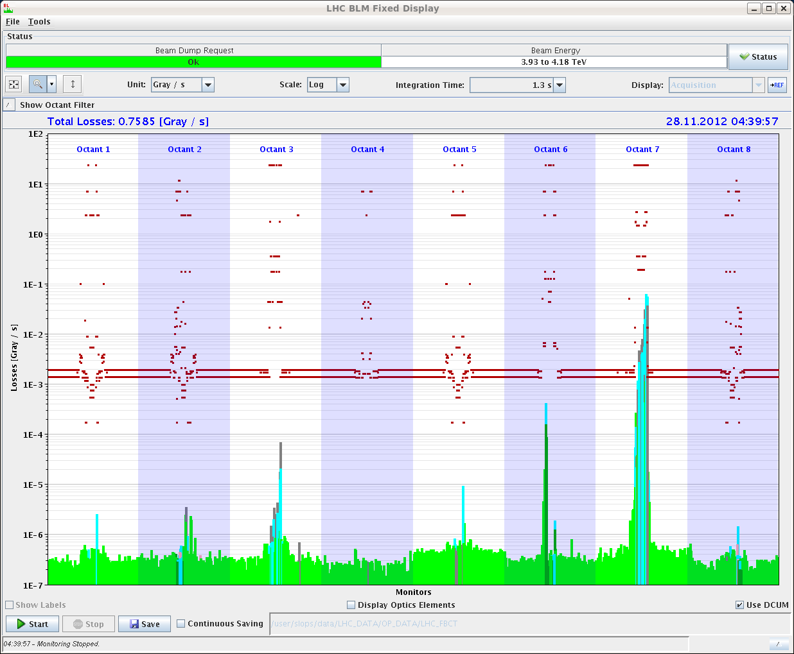
Collimator MD – impedance cont’d
B2V loss map with nominal settings

Slide 15
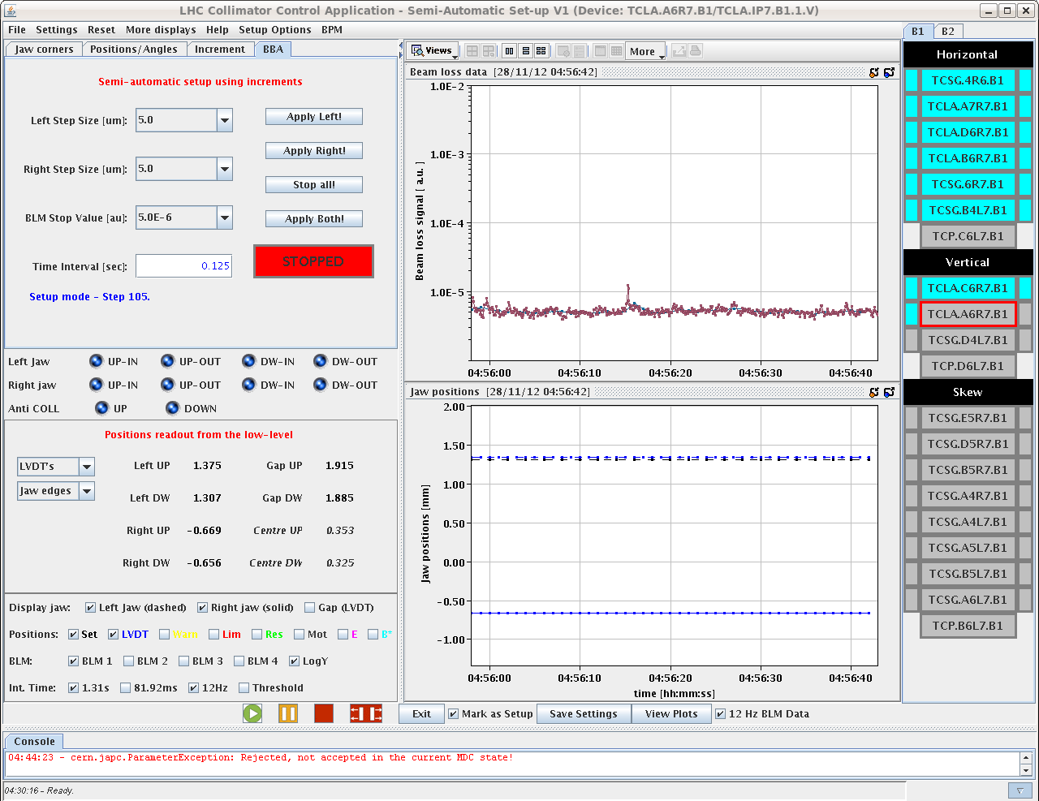
Collimator MD – impedance cont’d
Alignment completed for 10 collimators, however have to stop half-way through for next MD

Slide 16
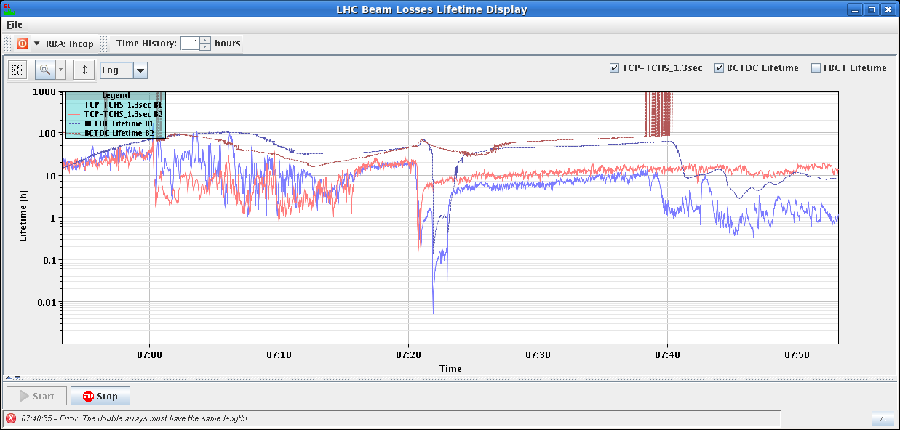
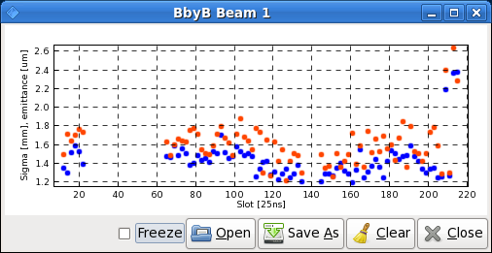
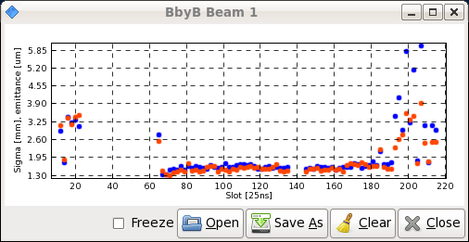
Two-beam impedance MD
78 bunches per beam
squeezed to 0.6 m
nominal Q’, no tune split, ADT off
octupole scan for nominal position; poor lifetime B1 &
reproducible onset of instability for B2 at 370 A
(P. Baudrenghien, S. Fartoukh, E. Metral, et al)
B1 emittance before B2
instability
prepared settings for rotation B2:
-12 Hz offset (+0.11 mm, +1E-4 dp/p)
-1 Hz/s max acceleration
it will take 13 minutes to rotate B2 by 1/4 turn
B1 emittance after B2
instability
lowered tunes on the more stable B1 by -0.005 trim → lifetime increased & B2 more stable …

Slide 17
MD#4 Plan Wed – Thu (28.-29.11.)
Day | Time | MD | MP class | MP Comments
Wed | 04:00 | Ramp down
 | 06:00 | 450 GeV→ 4 TeV: two –beam impedance | C | 4TeV, squeeze to beta*=1.5m 150 bunches per beam (nominal filling scheme) Move beam 2 clockwise Reduce octupole currents in 5 different configurations (0 turn, ¼ turn, ½ turn, ¾ turn and 1 turn cogging) (More details see slides)
 | 14:00 | Ramp down
 | 16:00 | 450 GeV: transverse impedance localization at injection | C | 450GeV 8bunches with different intensities, equally spaced (5e9 … 1e10 … 5e10 … 1e11 … 1.5e11 … 2.2e11) Create kick with AC dipole or kicker Tune shift 2.1e-3 Move TDI Parallel measurement with ADT? (More detials see slides)
 | 18:00 | 450 GeV: TCDI automatic setup | A | 450 GeV Pilot bunches (1e10p/bunch)
 | 22:00 | 450 GeV→ 4 TeV: bunch flattening with RF phase modulation | B | 450 GeV and 4TeV Nominal LHC beam, i.e. 1374b per beam Add flattening signal (sine-wave close to the synchrotron frequ.) The MD will have ramp and all steps before physics. Measure effects of heating and transv. Instabilities.
Thu | 02:00 | Ramp down
 | 04:00 | End of MD#4
shift this MD by 2 h?
time of last MD - pending proposal by Gianluigi Arduini

