Slide 1
MD#4 Progress
MD Coordinators:
Giulia Papotti, Frank Zimmermann
Machine Coordinators:
Gianluigi Arduini, Eva Barbara Holzer
27 November 2012

Slide 2
MD#4 News & Plan Mon – Tue (26. – 27.11.)
Day | Time | v | MP class | MP Comments
Mon | 06:00 | Ramp down if needed
 | 08:00 | 450 GeV: IR8 aperture | A | 450 GeV Pilote bunches(1e10p/bunch) to measure aperture.
 | 10:00 | 450 GeV: Beam instrumentation | B | BSRT vs WS, Schottky, WS PM saturation (partially done in MD3): 450 GeV B1: Pilot + 12b >=1.1e11p/bunch B2: Pilot + 50ns trains from 6 to 72 bunches Bumps at 450GeV and 4TeV Blow up with ADT 2) BGI, Gates BBQ, BSRT temperatures: 450GeV 50ns trains with minimum 600 bunches Bumps in B2 +- 3mm Blow up with ADT Gating with ADT off on some bunches 3) BPMs: Done in MD3 4) Matching: 450GeV Probe from 1 to 5e10p Inj, circulate (~100 turns) and dump (More details see slides )
 | 16:00 | 450 GeV→ 4 TeV: p-Pb test | C | From MD2 preparation: 450GeV and 4TeV Bunches of ~1.5e10p/bunch and >5e7Pb/bunch B2: few proton bunches and few Pb bunches B1: > 300 bunches with 10% ~1.5e10p/bunch, later with higher intensities. Test RF re-phasing procedure. Squeeze sequence and collisions. (More details see slides)
cancelled (QPS access S6-7 RQF/RQD,
MKI2 fault in softstart, dump line vacuum);
to be rescheduled as Operational Dev.
BPM studies and beam excitation, …
24 p batches from the SPS posed problems

Slide 3
MD#4 New & Plan Mon – Tue (26. – 27.11.)
Day | Time | v | MP class | MP Comments
Tue | 00:00 | Ramp down
 | 02:00 | 450 GeV→ 4 TeV: MQY transfer function | A | 4 TeV. Pilote bunches (1-3e10p/bunch). Standard optics measurements with different MQY transfer funtions.
 | 06:00 | Ramp down
 | 08:00 | 450 GeV: RF study (longit. stability for batch or RF voltage modulation) | B | 450GeV A few nominal batches of 144b. RF Voltage modulation: fill half of the ring, to test the corrected algorithm of voltage set point adjustment Longitudinal stability: Full ring with max. bunch intensity. Excite a single mode in the beam with decreasing gain in the feedback loop. (More details see slides)
 | 16:00 | 450 GeV: beam-beam (noise or impedance) | C | 450 GeV In total 9 bunches per beam with different intensities (from 1e11 to 2e11), zero crossing angle in IP1, IP2 and IP5. Nominal crossing angle in IP8. Collision tune, Damper (ADT) off Introduce increasing noise with ADT Increase ADT gain in steps Scan separation in IP1 and 5 with 4 bunches (from 1e11 to 2e11) with damper of. (More details see slides)
 | 22:00 | 450 GeV→ 4 TeV: Collimation impedance & follow up from last MD | B | 4 TeV ~3b (1.3e11p/bunch) below SBF Alignment of collimators Impedance studies with tight collimator settings and moving IR7 collimators back and forth. (More details see slides)
successful!
in progress

Slide 4
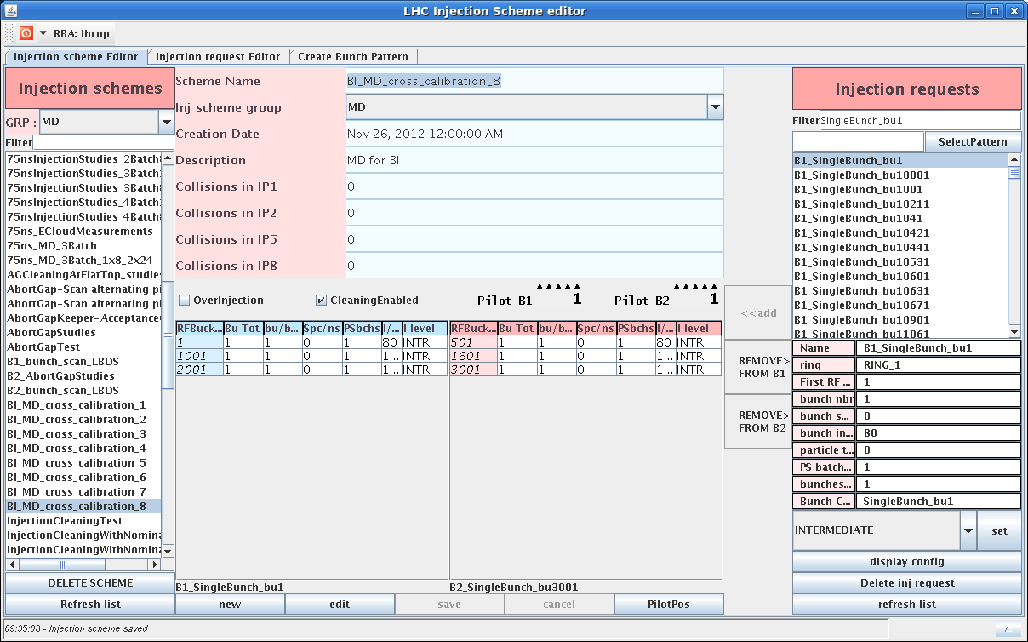
BI MD – new filling scheme for BLM MD
BI_MD_cross_calibration_8

Slide 5
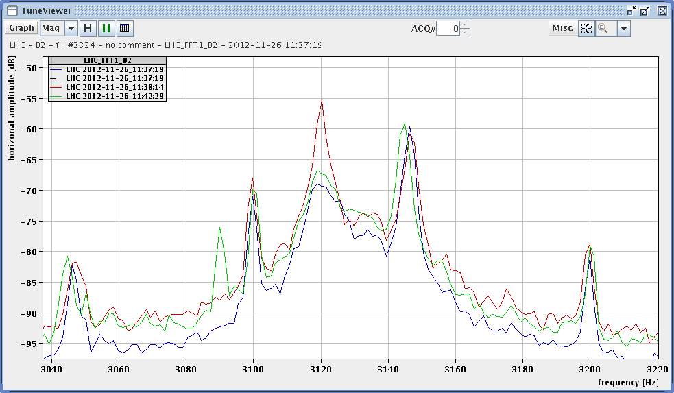
BI MD 50-Hz and 8-kHz investigation using BBQ
Aim: check if small fault currents passing along vacuum chamber can induce 50 or 8 kHz beam oscillations; during earlier TS two taps were installed on the B2 vacuum chamber right of P4. Distance between taps is ~10 metres. Maximum current ~50 mA rms (tbc).
Result: Exciting on off- and on-resonance of the horizontal tunes observed signal levels similar to those generated by the 50 Hz lines.
Marek Gasior, Ralph Steinhagen
excitation on tune
resonance, 3120 Hz
off-resonance
excitation,
3090 Hz
w/o excitation

Slide 6
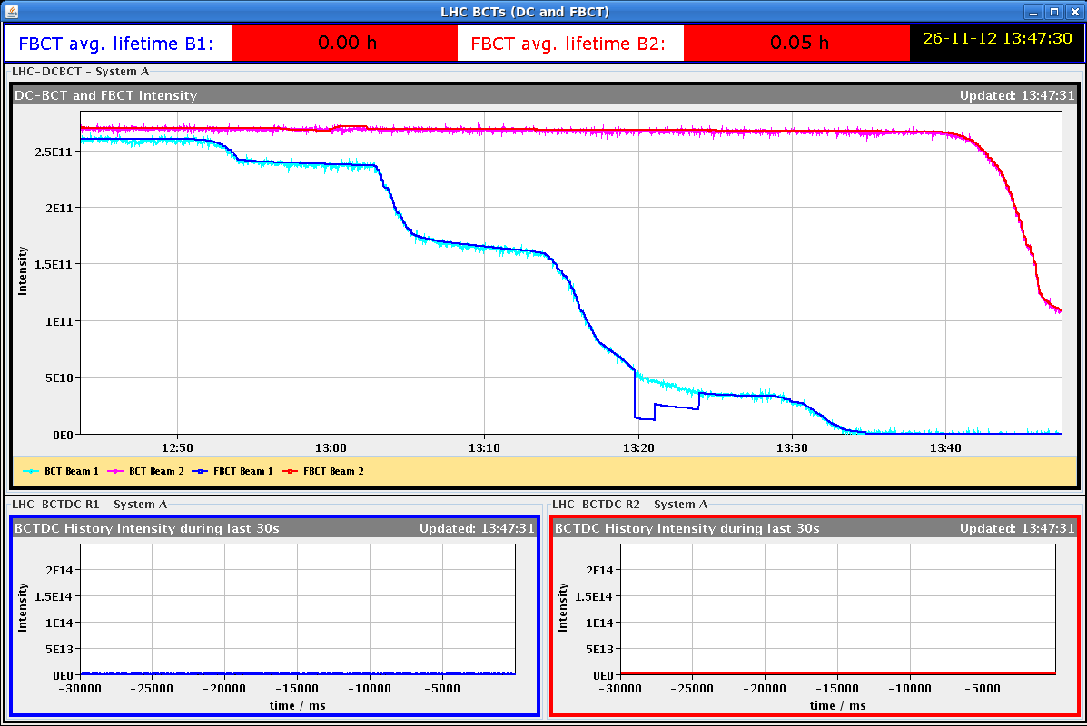
BI MD – BPM studies
Synchronous orbit using several OrbitBunch masks (overlapping and not overlaping bunches): Effect of crosstalk at striplines with different ratios of beam intensities and with a cogging of B2 phase to look for the worst case at the striplines.
Testing the interlock behaviour in high sensitivity mode. The reflections were not observable anymore in B2 at 1.3e10p/bunch at high sensitivity. Determining the B1 limit needs postprocessing of the off-line data.
start scraping first beam 1 and then beam 2 ;
at the end switching to high sensitivity

Slide 7
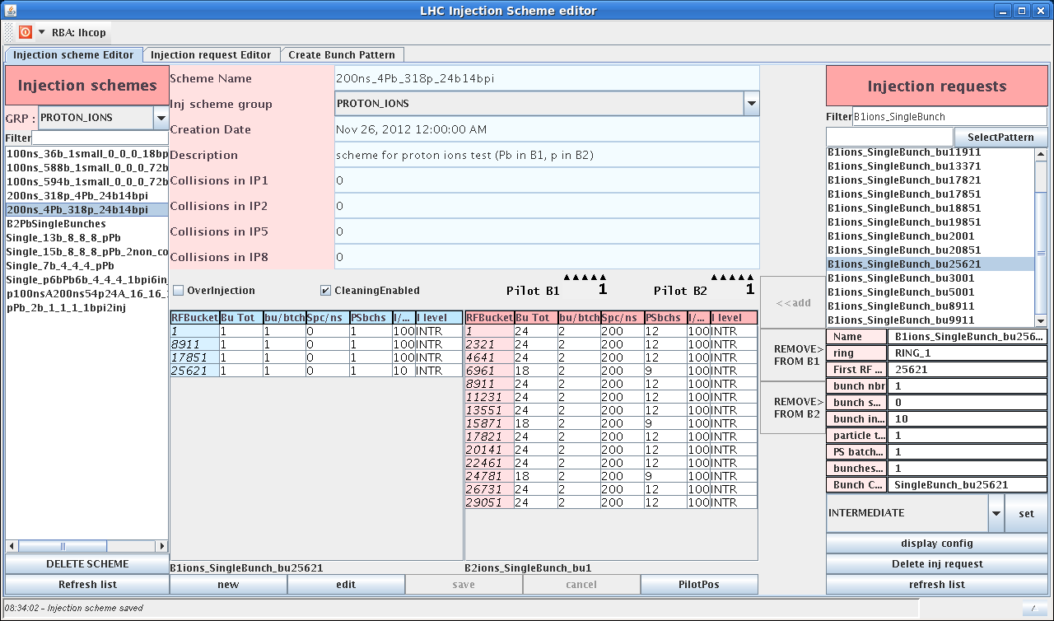
BI MD – new filling scheme for p-Pb MD
200ns_4Pb_318p_24b14bpi
lead in B1 and protons in B2
at the end of BI MD switched machine to ion-proton physics; hypercycle changed at flat bottom and RF settings changed

Slide 8
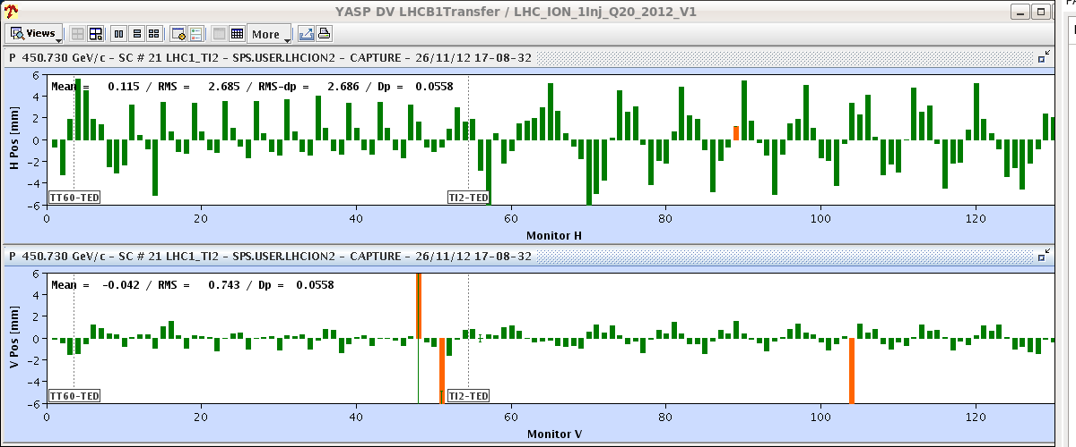
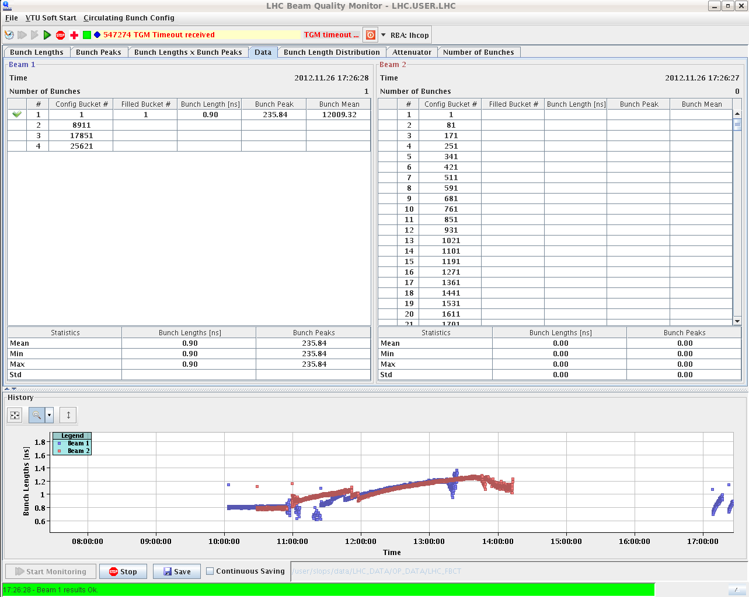
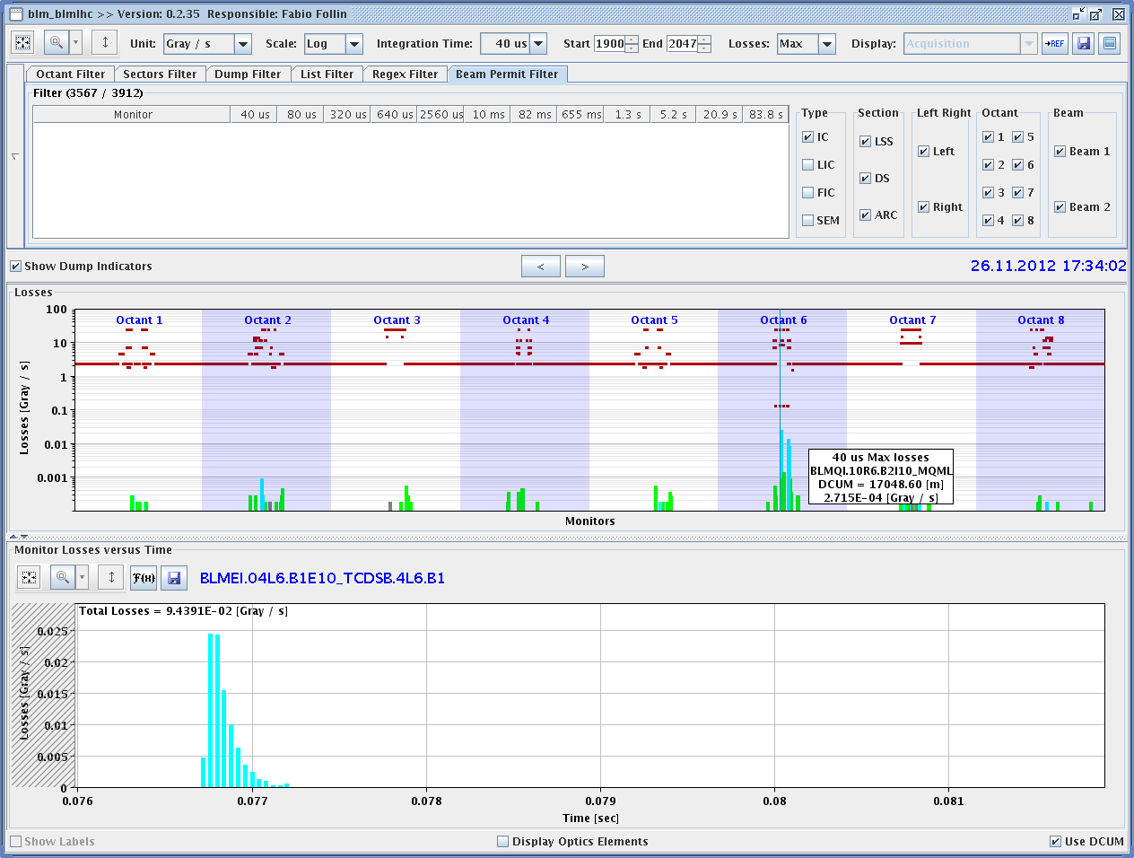
p-Pb MD – ion beam
17:10 first Pb beam in LHC
large difference in the SPS probably comes from the tune difference (0.13 for p, 0.3 for Pb); the difference is corrected in the line
second Pb bunch in after moving the buckets by one unit
17:40 BLM spurious trigger in IP5 dumped the beam
bunch length evolution

Slide 9
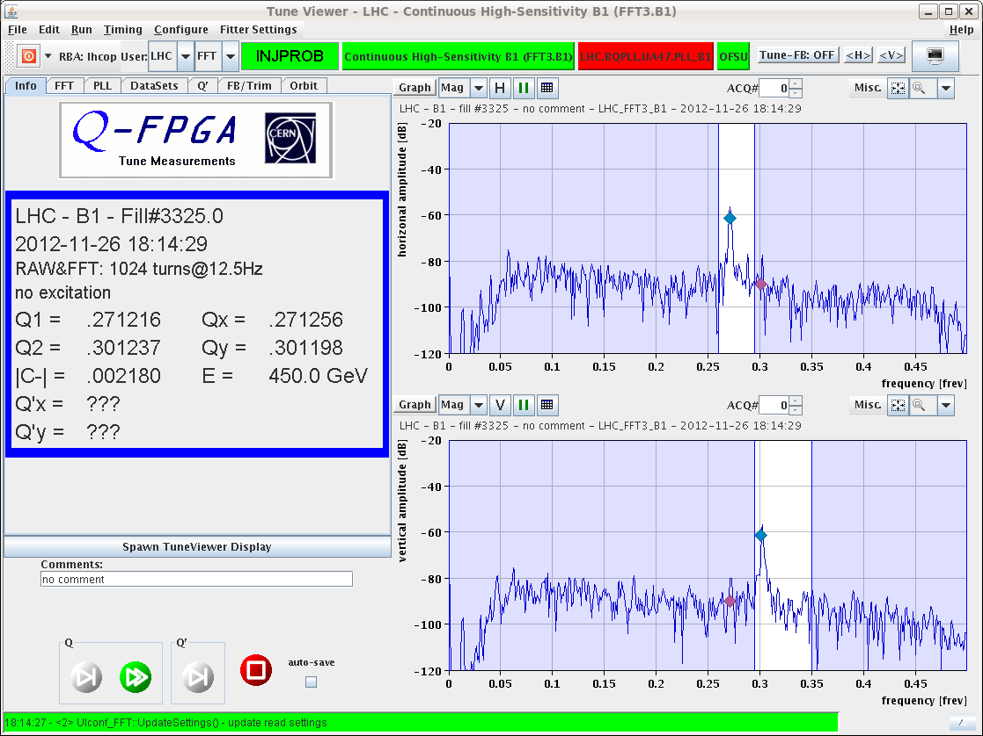
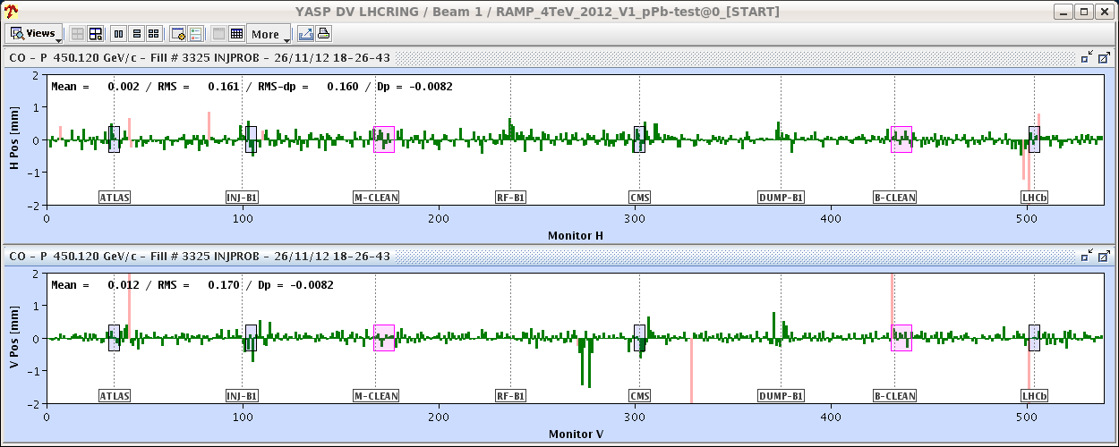
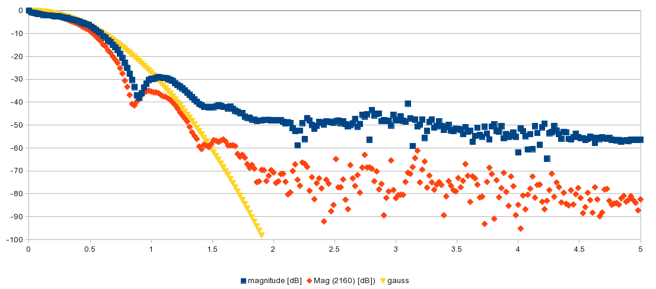
p-Pb MD – ion beam cont’d
ion tune spectrum &
ion orbit after centering by ~16 Hz
longitudinal bunch spectrum for B1 (ions) bunch 1 and 2160

Slide 10
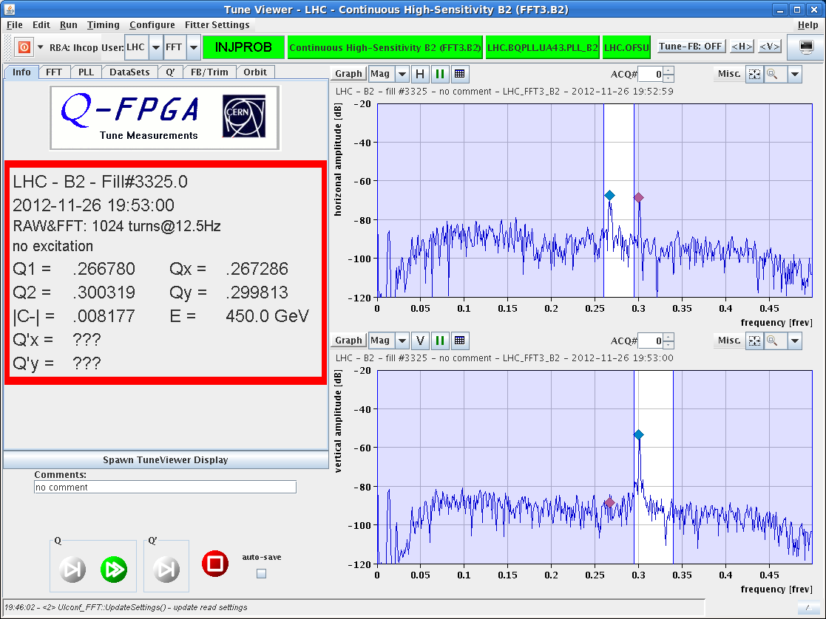
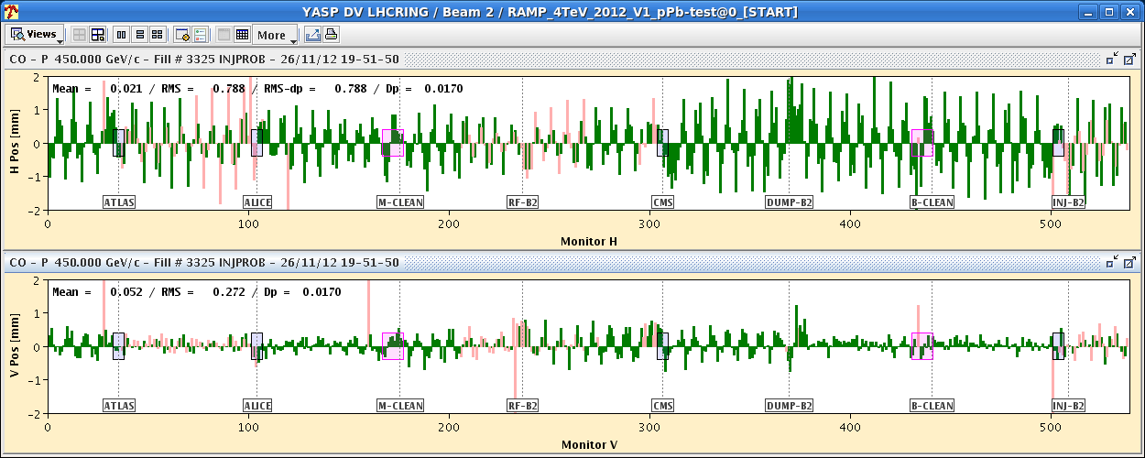
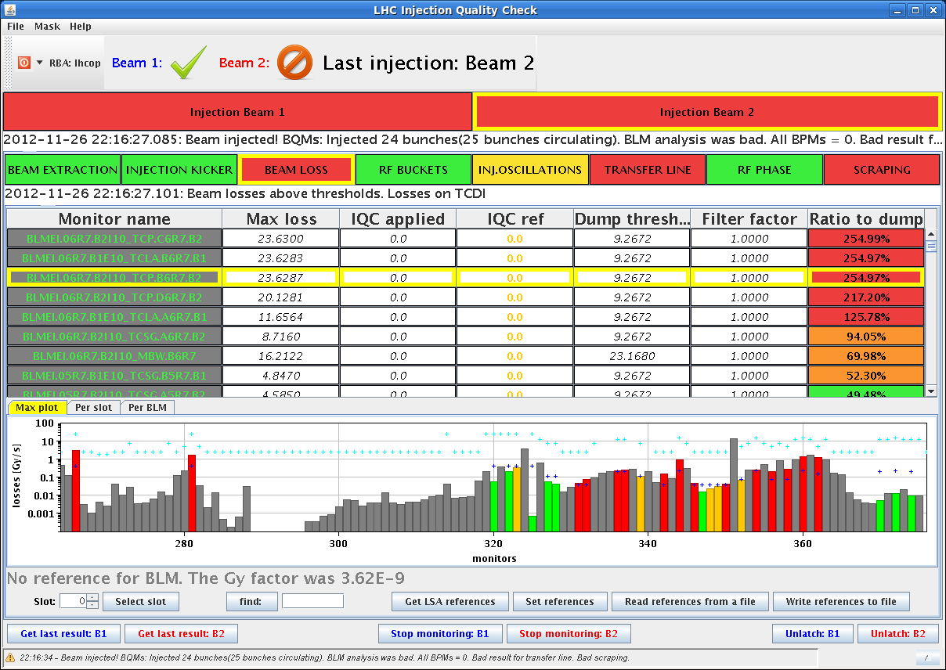
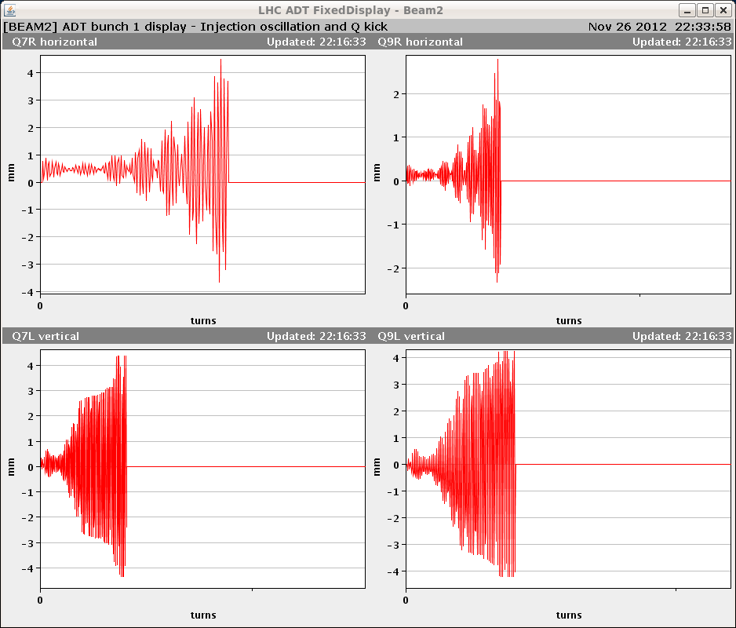
p-Pb MD – proton beam cont’d
19:48 first p beam in LHC ring 2
p orbit without OFB correction
& p tunes w/o correction
21:44 SPS ready with 200ns batch cycle.
First 24 p bunches dumped because
of beam losses in IP7
due to wrong ADT settings (B1/B2 swap).

Slide 11
p-Pb MD – proton beam
On the next attempt, 3 batches of 24 p bunches were injected, but when injecting the 4th batch, interlocked BPMs triggered.
The rest of the MD was spent on improving p beam in the SPS.

Slide 12
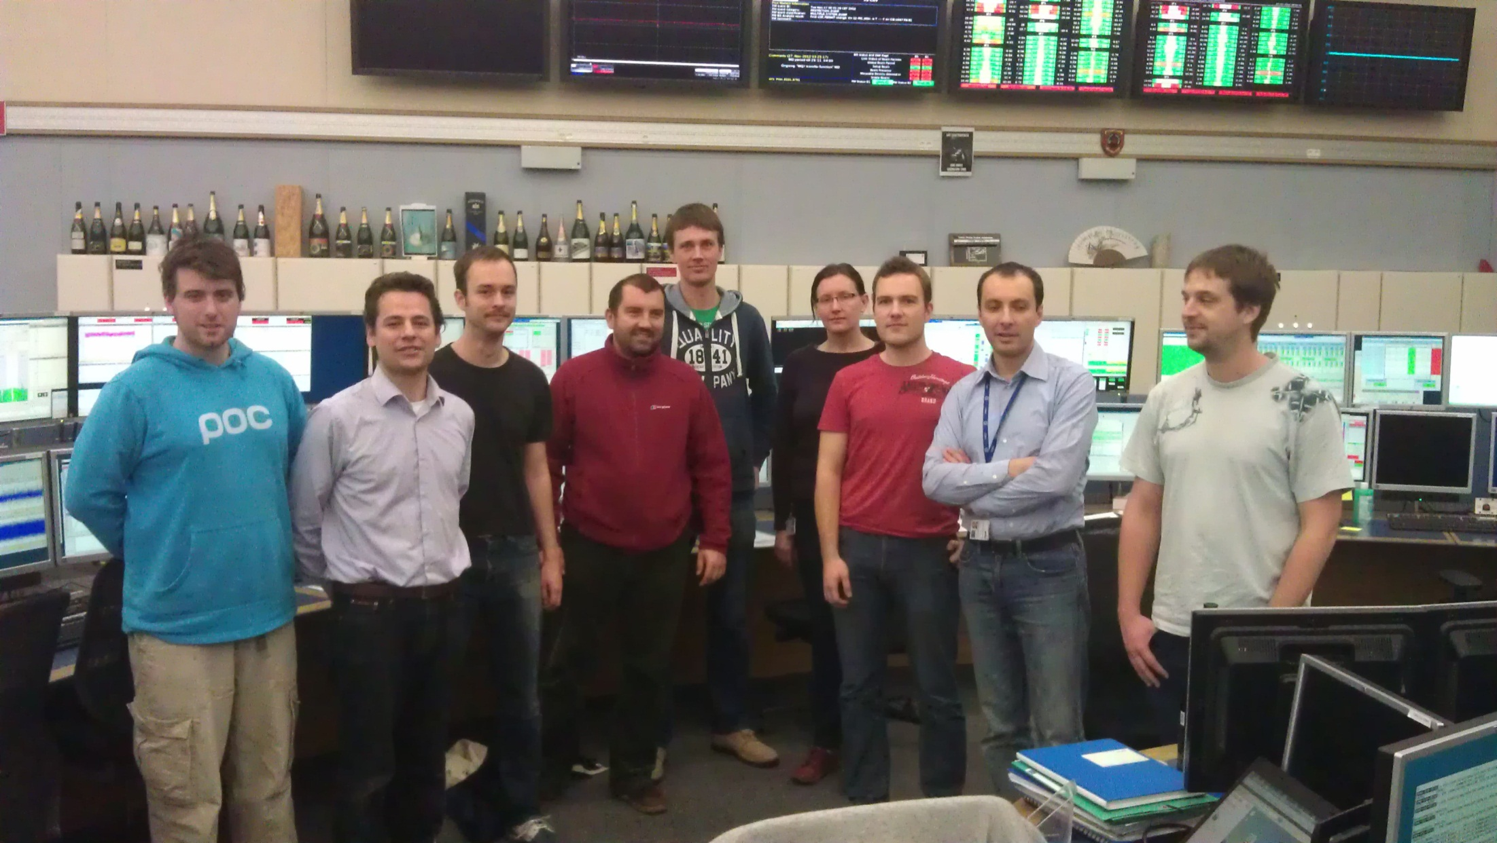
MQY TF MD
(R. Tomas et al)
LHC optics team after MQY calibration early this morning

Slide 13
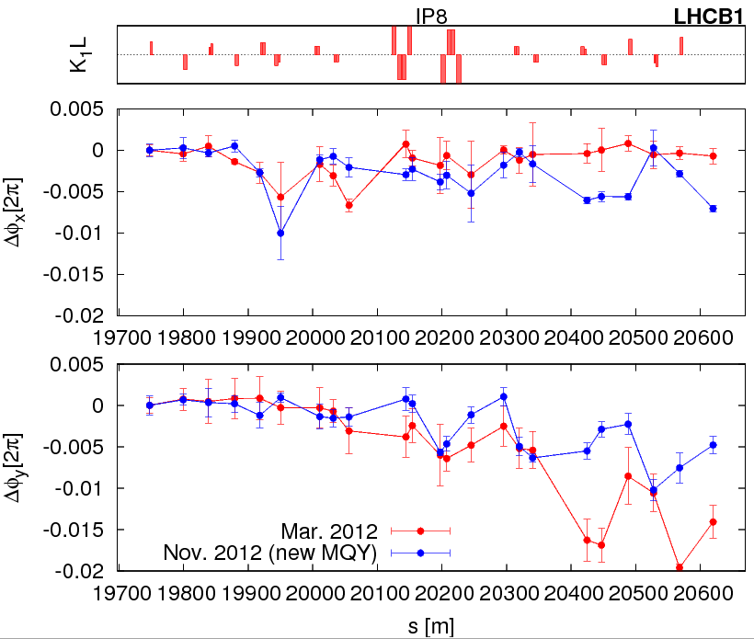
MQY TF MD
Optics measurements at injection and flattop with new MQY calibrations. First analysis points to an improved optics (as expected!). Afterwards, a few kicks mostly horizontally to measure amplitude detuning at flattop.
Detailed analysis off-line.
5:31 RQTD.A67B1 tripped
on a power converter fault.
DQAMS is in
FIP_COM_LOST.
phase beating error in IR8 (vertical) improved by factor 2

Slide 14
RF Study MD - ongoing
(P. Baudrenghien)
Plan:
We will start with the RF Voltage Modulation part. This was already done during last MD but with a very slow adaptation rate. We want to repeat with faster rate. The risk is slow debunching (machine half full, nominal intensity, 50 ns batches, 450 GeV). No debunching was observed in the previous trial.
If things go well we will move to the longitudinal stability part. We will excite a single longitudinal coupled-bunch mode n using narrowband phase noise excitation at n f_{rev} ±f_{s}, then switch the excitation off, record single bunch phase evolution and deduce damping time. We will repeat the experiment for various modes (n), while reducing the gain of our feedback loop (thereby increasing the effective cavity impedance). Full machine, 450 GeV. Again the risk is slow debunching while we excite the longitudinal mode. There is no risk to become unstable: we only measure lengthening of damping time and will not reach the instability threshold.

Slide 15
MD#4 Plan Mon – Tue (26. – 27.11.)
Day | Time | v | MP class | MP Comments
Tue | 00:00 | Ramp down
 | 02:00 | 450 GeV→ 4 TeV: MQY transfer function | A | 4 TeV. Pilote bunches (1-3e10p/bunch). Standard optics measurements with different MQY transfer funtions.
 | 06:00 | Ramp down
 | 08:00 | 450 GeV: RF study (longit. stability for batch or RF voltage modulation) | B | 450GeV A few nominal batches of 144b. RF Voltage modulation: fill half of the ring, to test the corrected algorithm of voltage set point adjustment Longitudinal stability: Full ring with max. bunch intensity. Excite a single mode in the beam with decreasing gain in the feedback loop. (More details see slides)
 | 16:00 | 450 GeV: beam-beam (noise or impedance) | C | 450 GeV In total 9 bunches per beam with different intensities (from 1e11 to 2e11), zero crossing angle in IP1, IP2 and IP5. Nominal crossing angle in IP8. Collision tune, Damper (ADT) off Introduce increasing noise with ADT Increase ADT gain in steps Scan separation in IP1 and 5 with 4 bunches (from 1e11 to 2e11) with damper of. (More details see slides)
 | 22:00 | 450 GeV→ 4 TeV: Collimation impedance & follow up from last MD | B | 4 TeV ~3b (1.3e11p/bunch) below SBF Alignment of collimators Impedance studies with tight collimator settings and moving IR7 collimators back and forth. (More details see slides)

Slide 16
MD#4 Plan Wed – Thu (28.-29.11.)
Day | Time | MD | MP class | MP Comments
Wed | 04:00 | Ramp down
 | 06:00 | 450 GeV→ 4 TeV: two –beam impedance | C | 4TeV, squeeze to beta*=1.5m 150 bunches per beam (nominal filling scheme) Move beam 2 clockwise Reduce octupole currents in 5 different configurations (0 turn, ¼ turn, ½ turn, ¾ turn and 1 turn cogging) (More details see slides)
 | 14:00 | Ramp down
 | 16:00 | 450 GeV: transverse impedance localization at injection | C | 450GeV 8bunches with different intensities, equally spaced (5e9 … 1e10 … 5e10 … 1e11 … 1.5e11 … 2.2e11) Create kick with AC dipole or kicker Tune shift 2.1e-3 Move TDI Parallel measurement with ADT? (More detials see slides)
 | 18:00 | 450 GeV: TCDI automatic setup | A | 450 GeV Pilot bunches (1e10p/bunch)
 | 22:00 | 450 GeV→ 4 TeV: bunch flattening with RF phase modulation | B | 450 GeV and 4TeV Nominal LHC beam, i.e. 1374b per beam Add flattening signal (sine-wave close to the synchrotron frequ.) The MD will have ramp and all steps before physics. Measure effects of heating and transv. Instabilities.
Thu | 02:00 | Ramp down
 | 04:00 | End of MD#4

