Slide 1
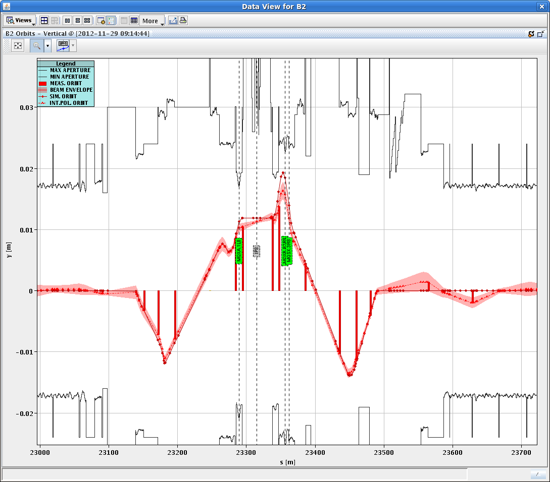
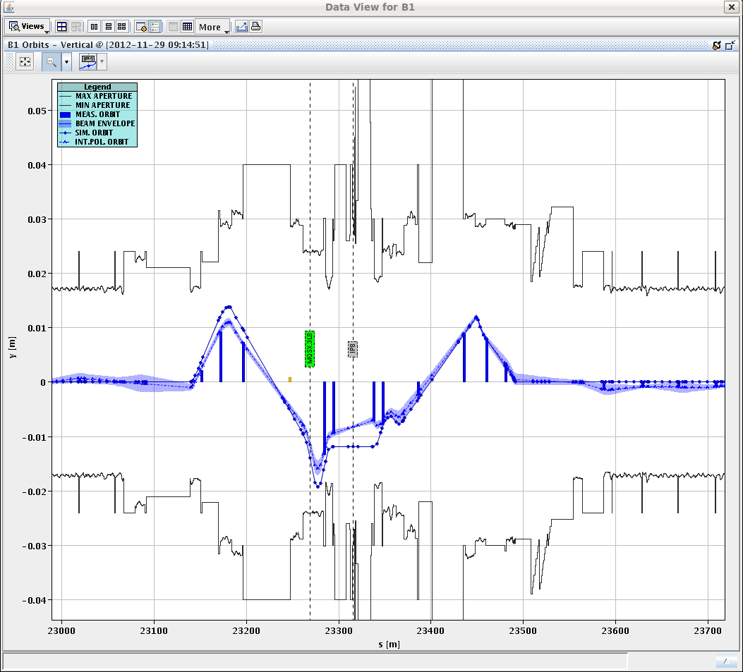
IP8 aperture measurements (07:30-10:30)
Aim:
Measure IP8 aperture to determine possibility of having vertical external crossing angle bump from injection to allow polarity switch also for 25 ns beams. Data being analyzed.
M. Giovannozzi, S. Redaelli, J. Wenninger

Slide 2
Access (10:30 – 14:30)
10:30 Start access. Difficult start due to problem with the movement of the TI2 downstream TED ➔ required strap of the corresponding interlock authorized by the DSO
11:30 – 15:20 Access in the machine and experiments:
ALICE network switch (US25)
60 A PC RCBV27.L5B1/RCBH26.R3B2L, sub-converters of RQD.A12, RQD.A23, RQF.A23.
Sublimation MKI2/8 in preparation of 25 ns run
BLM diamond detector (point 7)
ALICE, ATLAS (field off), CMS
BGI
TED TI2
BLM optical link in point 4
RB.A67 (QPS)

Slide 3
15:00 - 16:30. 50 ns beam checked by RF expert in PS and satellite enhancement ON
16:30 LHC ready to inject. No beam from SPS (coming out of MD)
17:40 Start injection and transfer line steering
18:40-21:40 Operational development. HOM heating studies with shorter bunches

Slide 4
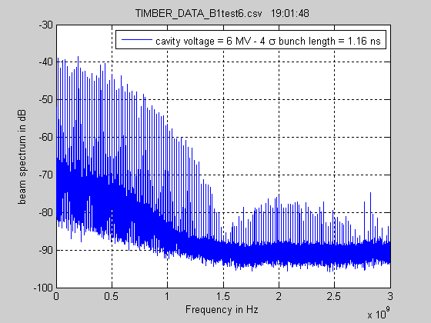
HOM heating vs. bunch length (B. Salvant et al.)
Injected 1374 bunches with ~1.5e11 p/b on B1 and B2.
Transverse emittance was blown up on purpose (screen in PS to SPS transfer line)
From nominal value of 6 MV, RF voltage was increased to 14 MV, reduced to 9.5 MV, increased back to 14 MV and finally reduced to 6 MV in 0.5 MV steps
Lifetime decreased with longer bunches.

Slide 5
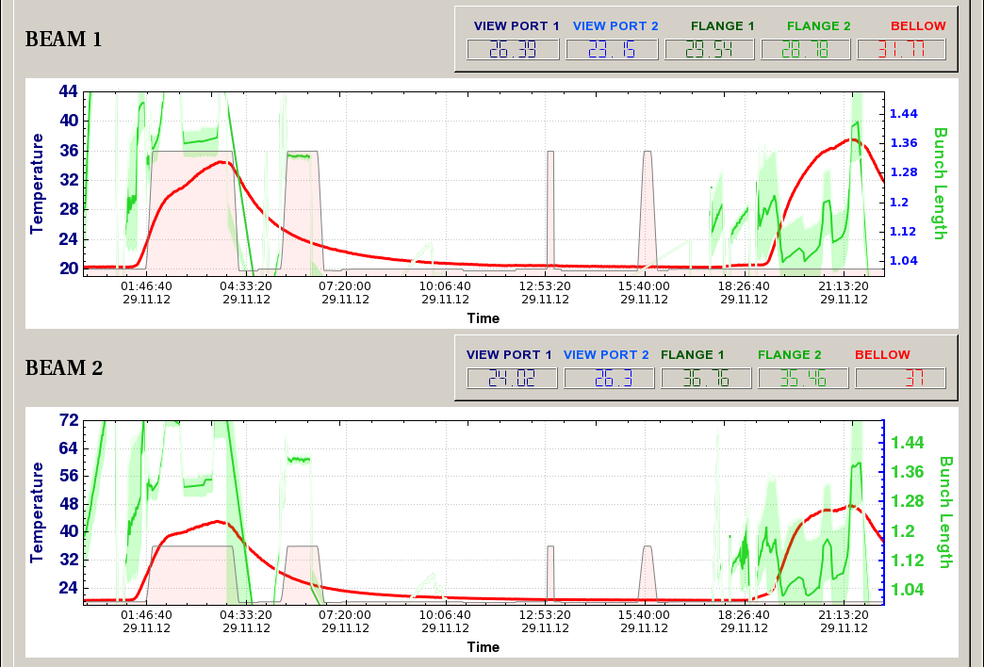
HOM heating vs. bunch length (B. Salvant et al.)
Interesting observations but nothing critical detected so far when running for prolonged time at a bunch length between 1 ns and 1.1 ns. Significant difference between the beam spectrum during and after the ramp with the spectrum observed today with higher voltage at injection: Much lower second lobe (as expected).
Preliminary observations on equipment (pending more detailed analysis by the experts):
CRYO (F.A. Gruffaz): nothing significant on Q6.R5. Arcs: clear correlation with bunch length
BSRT (E. Bravin/F. Roncarolo) Higher temperatures reached than during the flattening bunch MD yesterday. Vacuum pattern quite different. Visible change of slope observed when changing the bunch length

Slide 6
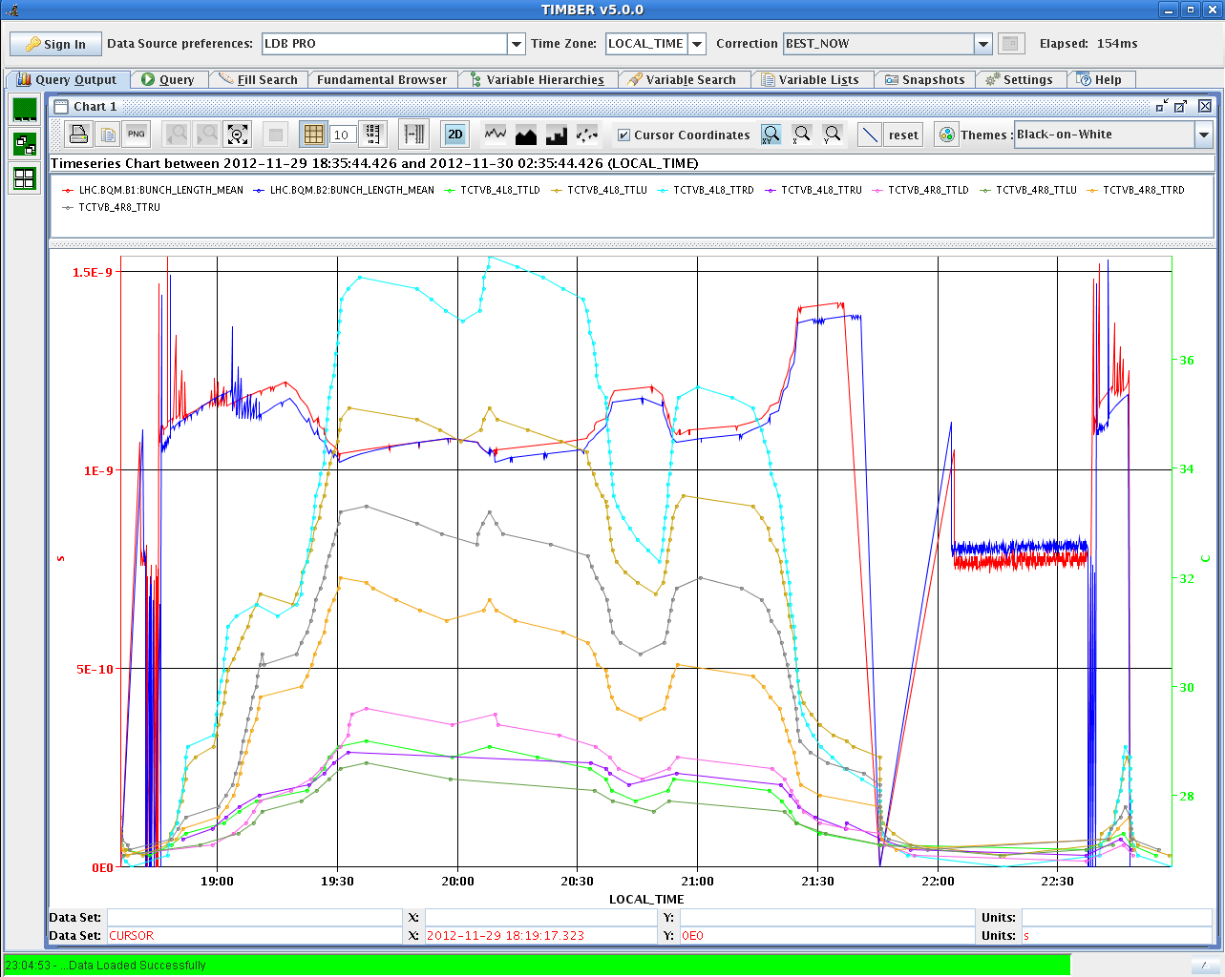
HOM heating vs. bunch length (B. Salvant et al.)
ALFA (S. Jakobsen) Clear correlation with bunch length.
TOTEM (M. Deile/G. Bregliozzi) pressure excursions on many gauges near the pots (and sometimes on the other beam) observed when the bunch length was increased to 1.4 ns and when the beam was dumped. To be understood.
Collimators (G. Bregliozzi/G.H. Hermelsoet/J. Uythoven) TDI (in parking position after injection): pressure increased slightly on TDI.4L2 at the end of the fill. Deformation rate looks quite large compared to previous fills. Nothing special on TDI.4R8 (deformation also similar to other fills). TCTVB: clear correlation with bunch length of all jaws (both 4L8 and 4R8) TCP.B6L7: steady increase without visible correlation to bunch length

Slide 7
HOM heating vs. bunch length (B. Salvant et al.)
Kickers (M. Barnes/G. Bregliozzi) - temporary pressure increase when bunch length decreases (VGI.161.5L2) - steady increase of tube temperature MKI8C - no clear correlation with bunch length (but heating time constants probably too large compared to bunch length steps). MKI8B magnet temperature the highest
BGI (M. Sapinski) : The glowing of the Frisch wires, expected to appear during bunch length decrease, has not been observed. Beam size decrease observed during bunch length decrease. Simulations are ongoing.

Slide 8
22:48 Trip of RCBXH2.L5 while filling for physics. Access required for power converter repair
00:10 Access finished
01:30 Start ramp: 48% BLM threshold at beginning of ramp (enhanced satellites?)
02:16 STABLE BEAMS #3347. Initial luminosity ~7.3x10³³ cm⁻²s⁻¹. Initial ALICE luminosity still too low (5.5x10³⁰cm⁻²s⁻¹)

Slide 9
Plan
Dump at 12:00
Fill with mixed pattern standard/high brightness beam (compression/merging). Filling pattern: 50ns_66b_60_0_0_36bpi3inj
In the mean time further enhancement of satellites in ALICE
Late afternoon: Fill for physics

