Slide 1
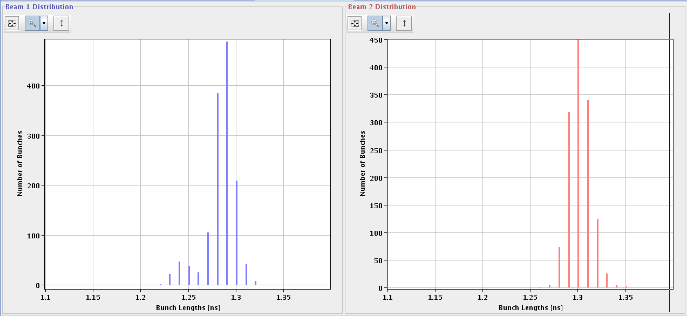
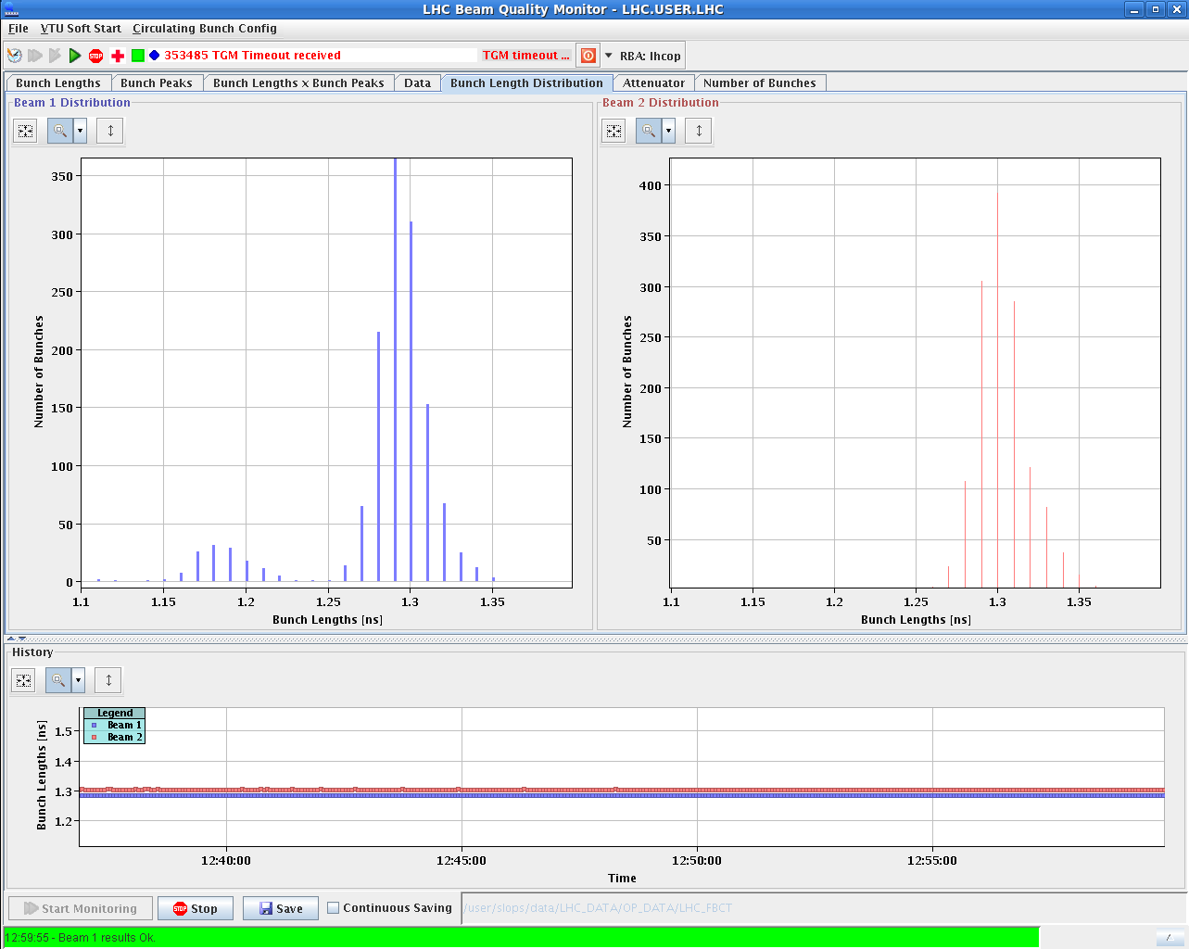
LHC Status Tuesday Morning 20-Nov
Bernhard Holzer, Mike Lamont
... stable beam since 05:40h
12:00h A78B2 and ROF.A78B2 tripped FAULT OFF
14:00h Beam dump by Operation
15:00h access for wire scanner repair
CMS et al
Wire Scanner Situation:
LHC.BWS.5R4.B1V1
LHC.BWS.5L4.B2H2 (this device has already seen many scans!)
No Scanner for B1H available
LHC.BWS.5L4.B2V1
09:00h
12:00h
bunch length distribution

Slide 2
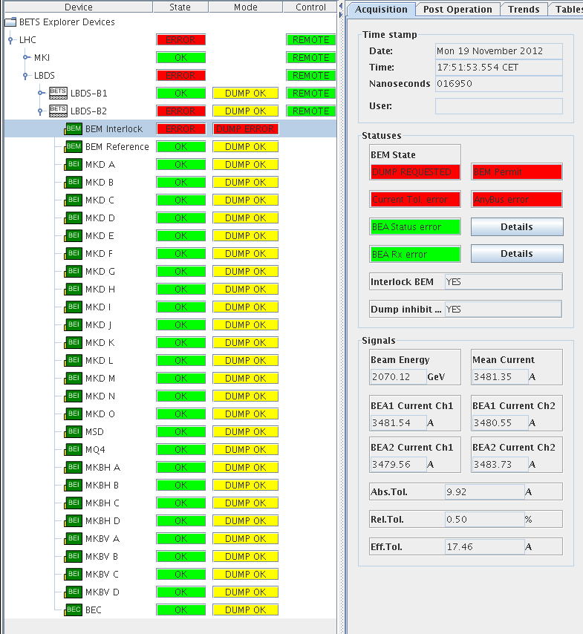
Monday Afternoon
17:50h BETS for LBDS-B2 is not OK
communication error between the interlock BEM
(sector 56 & 67) and the master PLC at the beginning
of the pre-cycling -> access needed
19:00h collimator settings in the transfer line
settings did not track Q26 -> Q20 transition
new settings calculated
new knobs calculated to scan TL aperture
validation of both TLs ( Chiara !!!)
23:30h RSS.A56.B2: QPS not OK
power cycle helps

Slide 3
Monday Night
Plan: VdM Scans
Hypercycle: The hypercycle is 4TeV_10Aps_0.6m_VdM.
BPs & settings: Ramp settings: RAMP_4TeV_2012_V1_MD3_EMIT
Collision BP is PHYSICS-VDM-SQUEEZE-2012_V1
no squeeze, collisions are with injection beta*
X-angles: ATLAS & CMS : 0,
ALICE : +145 (standard), LHCb : -220 (standard Hor).
First Fill: 3 bunches / beam (collisions in all IPs, 9E11 max (relaxed SBF).
Inject, ramp, collide, optimize, align TCTs, loss map, asynch dump test.
Second Fill: 3 bunches / beam (collisions in all IPs, 9E11 max,
Test with final collimator functions and all lumi scan corrections.
In collision some tests with offset scan to ensure that beam is stable enough.
At the end loss map or asynch dump test ...
Third Fill will be used for the VdMs.
proposed filling scheme for the VdM scan is: Multi_39b_30_1_6_4bpi13inj

