Slide 1
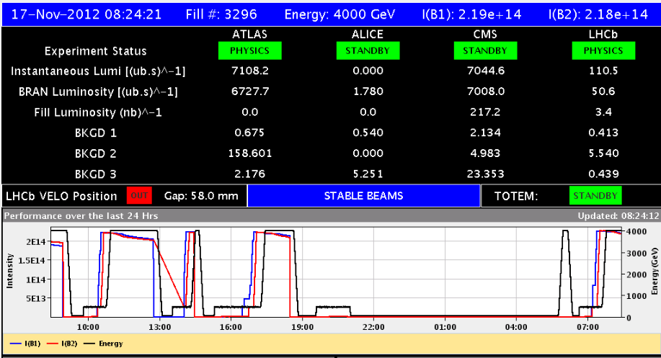
Rocky last 24 hours
Losses Q6.R5
Orbit
SIS TCDQ
OK!
Power converters
QPS

Slide 2
Friday 16th November
05:16 STABLE BEAMS fill 3292. 6.3x1033 cm-2s-1
08:56 Beam dump (SW interlock TCDQ reading - old data). 68 pb-1 in 3h40m.
11:27 Stable beams fill 3293. Initial lumi 6.85e33 cm-2s-1. Longitudinal blow-up 1.4 ns B2 only.
12:44 Beam dump, QPS trigger on RQT13.L5B2. Integrated lumi 28 pb-1 in 43m.
14:17 Start ramp fill 3294.
14:27 Dump during ramp at 2.86 GeV, slow losses at Q6.R5.
17:14 Start ramp fill 3295.
18:29 Operator dump before colliding in LHCb. Steering problems.
20:43 Injection fill 3296. Stop, problem corrector RCBH.23L6B1.
21:00 Access for RCBH.23L6B1 and warm up beam screen Q6.R5 near TOTEM.

Slide 3
This Saturday, so far
00:18 Sector 56 tripped while setting to stand-by after access. Problem with RQ10.R5, QPS problem suspected.
02:30 Problem RQ10.R5 identified to be due to power converter problem.
04:50 Access for power converter RQ10.R5.
05:29 Access finished.
06:42 Injecting fill 3296, clean without steering.
07:35 Start ramp.
08:23 Stable beams, initial lumi around 7.1e33 cm-2s-1

Slide 4
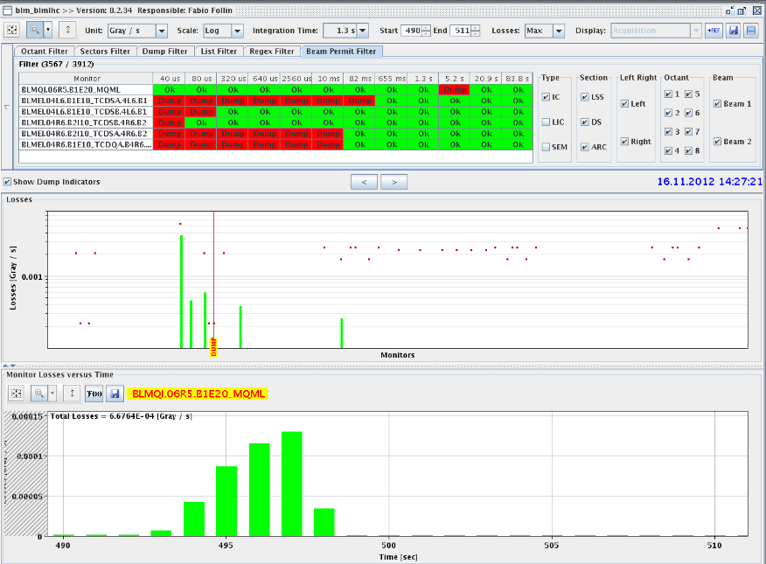
Fill 3294, Slow loss Q6.R5
Right of TOTEM
Takes about 5 seconds to develop, lots slower than UFO

Slide 5
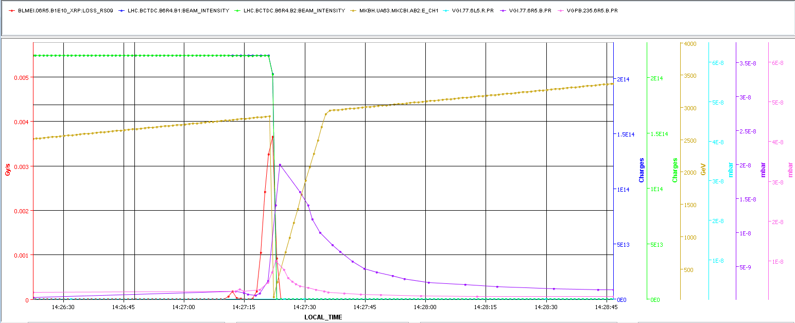
Beam Dump Losses Q6.R5
Losses go together with vacuum increase
Beam dump signal goes up before vacuum increase
Time correlation tricky
BLM
VAC

Slide 6
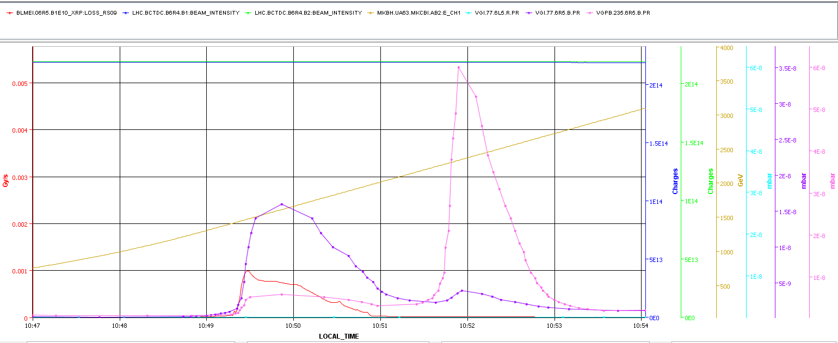
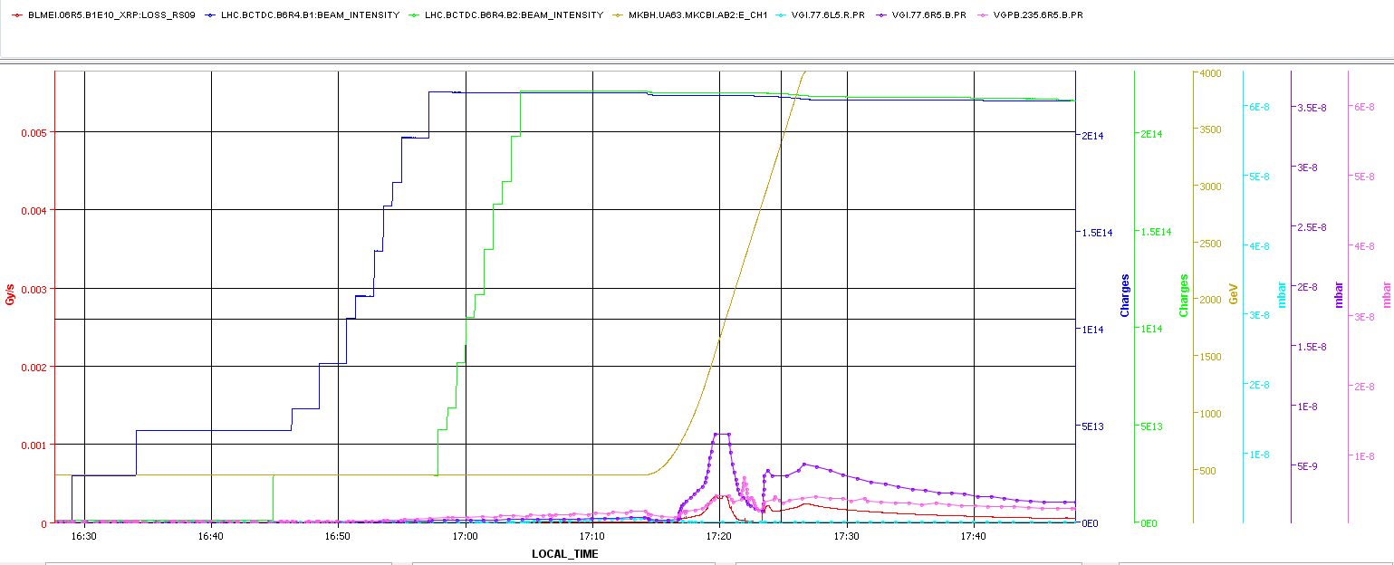
Good ramps: usual vac spike, small losses
VAC
BLM

Slide 7
Fill 3295
Lumis ATLAS end CMS at end of adjust too low
Need to re-optimise a lot get lumi’s back
Traced down to steering problems
Correctors masked for the orbit feedback system were used by the orbit feedback calculation, resulting in non standard orbit corrections
This is a bug which is not understood and appears on rare ocasions.
Did not want to start the LHCb collision exercise with an orbit which is not good and maximum beam in the machine.
Decide to dump.

Slide 8
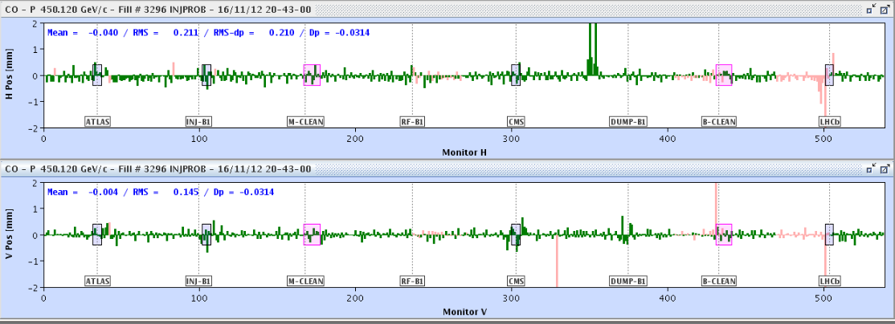
Fill 3296
Injection orbit with missing corrector RCBH.23L6B1. The corrector was 23urad at injection, orbit bump is at the limit (~2.25 mm).
Need to repair corrector
Same time warm up beam screen Q6.R5 and access ALICE
Power reset on the RQD.A12 for the QPS.

Slide 9
Fill 3296bis – beam unstable end of squeeze
Clean injection and going into physics.
BSRT B1 at 1 m
BSRT B1 at 0.6 m

Slide 10
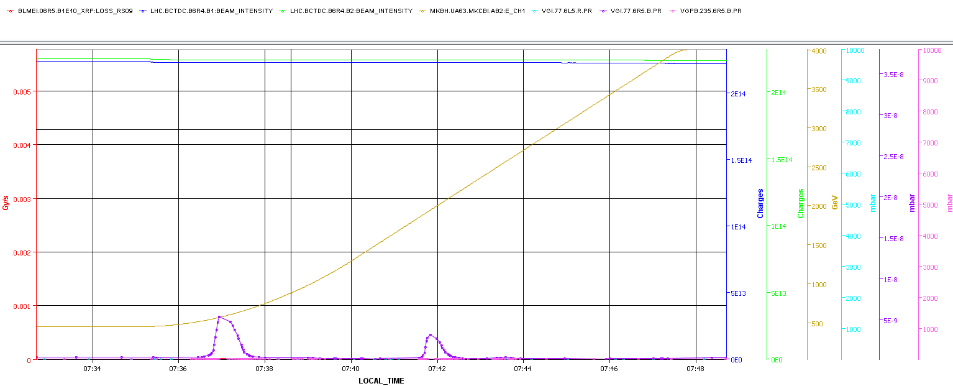
Ramp Saturday morning
Vacuum 5R6 well behaved during the ramp
Possibly positive effect of warm-up of the beam screen

Slide 11
The Plan
Physics:
Repositioning of the 6 bunches (B1/B2) postponed
Parameters being scanned (one at a time):
Batch-by-batch blow-up (now off)
Damper gain during the ramp to try and minimize blow-up now that gated BBQ is operational
Tune split during the squeeze to get rid of instability at the end of the squeeze
Pending access:
ALICE
Access wire scanner requested for Monday, including tunnel (RP).
PM32 : CV to check / remove sand.
Access system
CMS (Hadronic Forward Calorimeter) > 1 h
BI: wall current monitor (1 h – point 4 RF zone)

