Slide 1
Wednesday morning
Waiting for PS – problem on RF cavity.
10:00: Injecting probes and 6b. Steering of the line needed again.
Orbit was offset radially to reduce the synchro error. (RF frequency offset) – we could consider to do some energy matching with H CODs.
12:00 Filling for physics.
13:40 Stable beams fill 3269, 7.2e33 cm-2s-1.

Slide 3
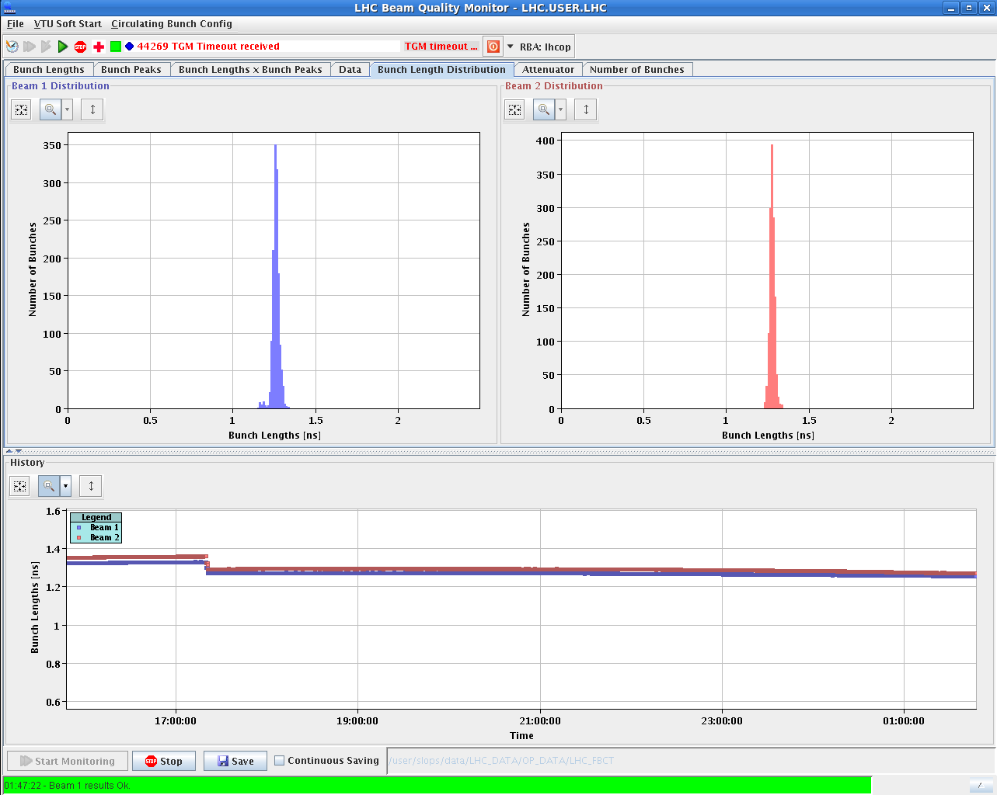
Night
This fill has no features on the bunch length.
02:10 OP dump – 188 pb-1.

Slide 4
Thursday
Unfortunately trip of RQTL10.R3B2 in the rampdown.
Access needed in UJ33.
06:00 Filling again.
Next fill:
LHCb polarity flip – no test cycle.
Energy matching check at injection.
Long. blowup / damper gain at start of ramp.

