Slide 1
Last 24 hours
OP
QX.L1
RCBXV1.R1

Slide 2
Thursday 1st November - afternoon
Keep fill 3249 until 12:40:
SPS dump switch repair
SPS RF transmitter tube replacement
197 pb⁻¹ in 15 hours
MKI B2 temperature thresholds tweaked
QPS controller for Q9/10.R5 could not be reset properly. Reiner confirms that we can continue with Q10/9.R5. An access is needed at the first opportunity to powercycle the controller
14:30 Injecting physics beam
15:55 Stable beams Fill 3250
Initial luminosity 7.23e33 cm⁻²s⁻¹

Slide 3
Thursday 1st November - evening
18:00+ Stefano opens the TCLs around IP1 and IP5
Cryogenics monitoring
TCLs in all IRs to 65 sigma
20:10 Beams lost to spurious QPS trigger on RQX.L1
Heaters fired, lost cryo start and maintain, vacuum valves around IP1 closed
Fill 3250: 83 pb⁻¹ in 4h17m
QPS & MP3 (MZ) give the green light to power the circuit again.
22:55 Cryo Maintain back
23:10 precycle triplets

Slide 4
Friday 2nd November - morning
01:00 Bad injection oscillations for both rings, mostly H. Are at the bottom of the tides, and the orbit is off by 6 Hz. Re-centre the orbit before TL steering.
02:50 Stable beams Fill 3252
Initial luminosity: 7.12e33 cm⁻²s⁻¹
ATLAS - rather high background from beam 1 (say 6 times more than in the afternoon).
06:00 Beams lost to QPS trigger on RCBXV1.R1
Re-armed by OP
Fill 3252: 65 pb⁻¹ in 3h13m
07:15 Injecting physics beams

Slide 5
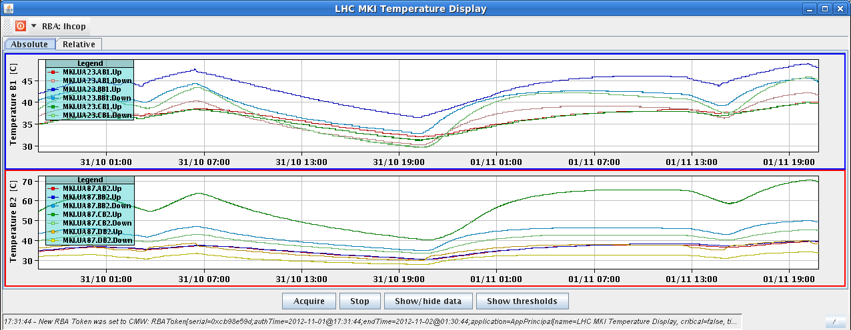
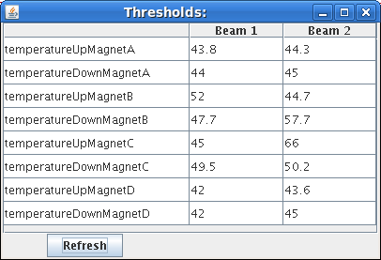
Jan changed the MKI8 magnet C_UP temperature threshold from 62C to 66C based on the MKISS analysis of M.Barnes

Slide 6
Outstanding
ADT changes to high bandwidth during fill and check luminosity lifetime
Access:
Marek Gasior – point 4
QPS reset Q9/10.R5

Slide 7
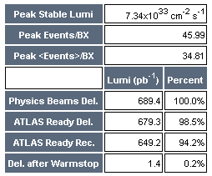
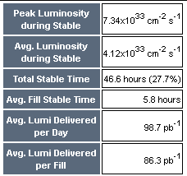
Week so far (Courtesy ATLAS)

