Slide 1
Friday 2nd November
08:45 Stable beams Fill 3253 Initial luminosity ~7.3e33 cm-2s-1
09:45 Increase RF voltage from 10 MV to 12 MV
12:00 ADT to wideband settings
12:38 Beams dumped, lost BLM crate L8. 79 pb-1 in 3h53m
BLM card change and BLM CPU change. Access BBQ and ATLAS.
17:48 Start pre-cycle
19:30 Transfer line steering
20:29 Beams dumped on last injection B2, LHCb BCM
22:09 Filling for physics
23:39 Fill #3259. Stable Beams. Initial lumi 6.5e33 cm-2s-1
09:04 Beams dumped: Sector 67 trip, RB.A67 ST_ABORT_PIC. Integrated lumi 143 pb-1.

Slide 2
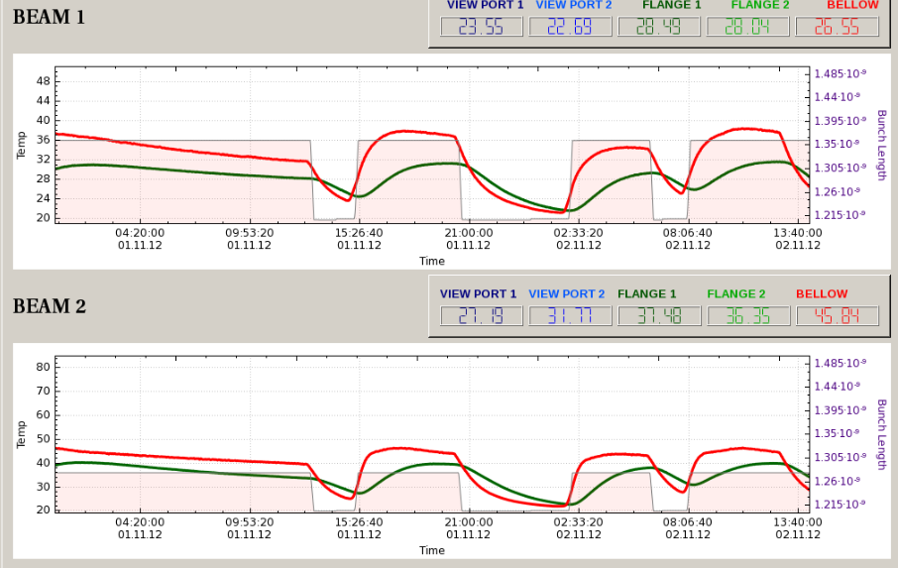
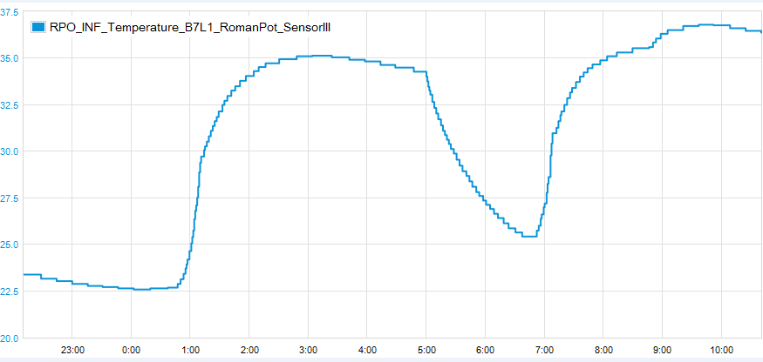
RF voltage up from 10 to 12 MV in fill
BSRT, no significant effect
ALFA, sees an effect

Slide 3
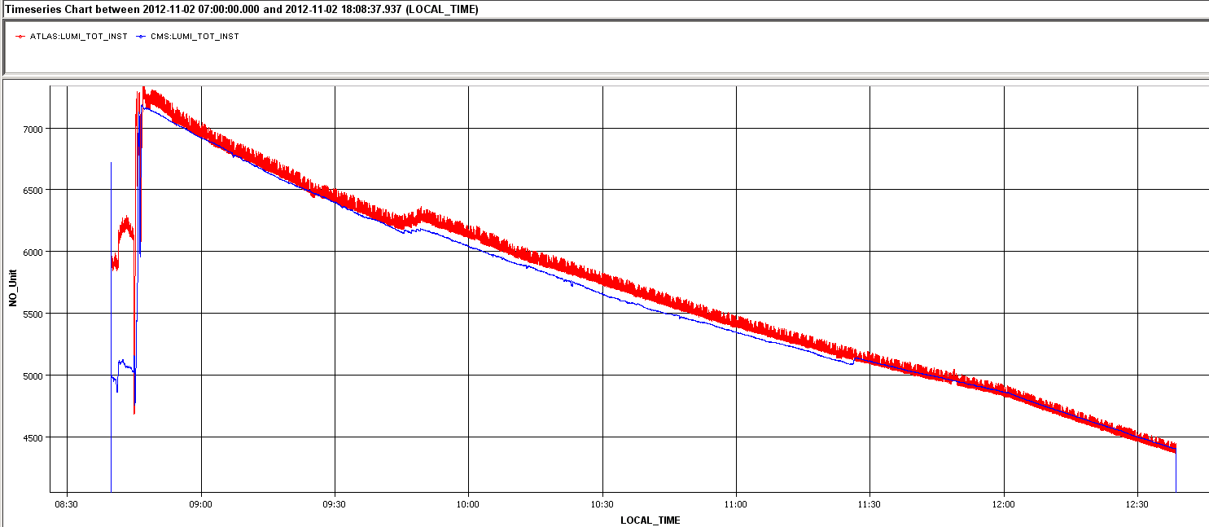
Lumi after Vrf and ADT bandwitdth
Good for the lumi to increase to RF voltage
ADT wideband settings still a (small) negative effect on lumi lifetime

Slide 4
BLM point 8 (Christos)
The FEC on crate SR8.L has become unreachable twice with one hour difference in between.
During the investigation it was noticed that one card has shown unreal temperature values in the last hours (see attached plot of the temperature of all the cards reported).
The card was decided to be exchanged as a precautionary measure. It is not sure if the crate crashes are related.
The CPU of SR8.L became unresponsive for a third time (after the exchange of the card in suspision) and therefore decided to also replace it.

Slide 5
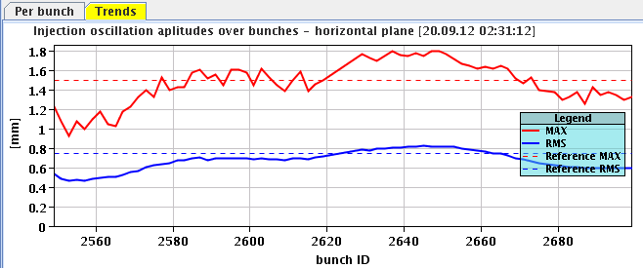
Transfer line steering
B2 horizontal oscillations
Injection looked quite good for these days
Last injection: Dump triggered by LHCb BCM upon injection of 144 bunches
In the past this was related to large satellite population...
Injected the following fill without further steering

Slide 6
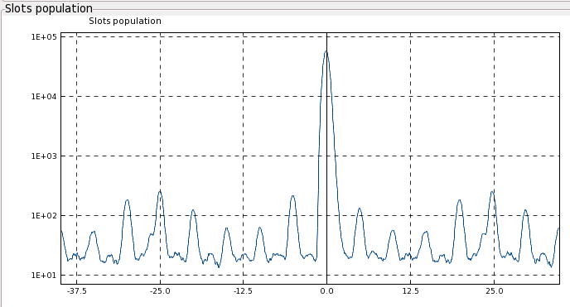
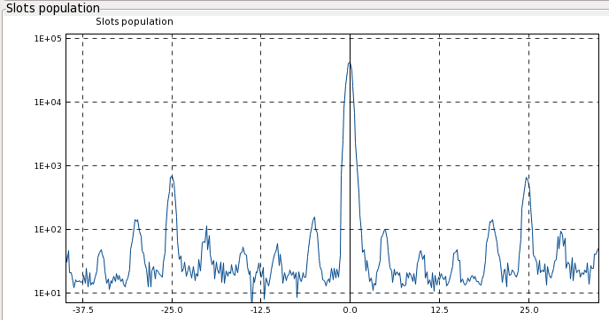
Fill #3259
23:39 Stable Beams. Initial lumi 6.5e33 cm-2s-1
Also indicates we don’t have perfect beam in the machine
Might be related to injection problems
LDM in physics – satellites at +/- 25 ns larger B2: OK. ALICE lumi max about 8 – not that large. B1 B2
Called Anna for missing BSRT image: got it back
Vertical tune B1 trimmed down by 3e-3 at the end of the squeeze thereby introducing a tune split.
Presently produced about 140 pb-1 in 9 hours
≈ 0.7 %

Slide 7
Outstanding
Urgent access ALICE, 4h
Improve on injection oscillations and losses, especially B2
Move in TOTEM and/or ALFA at end of fill
ALFA: Saturday or Sunday daytime, with TCLs in or out.
TOTEM: possible time slot Sunday afternoon, only with TCLs out

