Slide 1
Wednesday 31 October: Morning
6:26 End of fill #3244. Beams lost due to QPS - RQ4.L1, spurious self trigger of heaters. 50 pb-1 in 2h14m
Ramp down
09:00 Access in shadow of fibre optics cable move and SPS EDF intervention
LBDS Beam Energy tracking unit replaced: looks a lot better now. Back to original interlock configuration.
BI access in US45
Gas detection access in US15
ALICE solenoid, ATLAS, TOTEM
“Biometry problem UL55”
EPC: RQD.A56, RSF2.A67B1, RQS.A67B1 -> back in SOC
QPS at PM15
Vacuum in PM18
12:30 Optical fibre relocation finished. No knock-on effects seen afterwards, many thanks to Pierre Charrue & Team
SPS short in 18 kV cable found
12:52 Access finished

Slide 2
Afternoon
13:21 RCBWH5.L8B1 tripped before starting the dry ramp
13:18 Ramp with loops closed to check LBDS energy tracking after intervention, replaces normal pre-cycle
14:17 Ramp down
15:00 injecting probe – need to be adjusted in injectors
15:45 probes ok
16:05 Injecting 6 bunches – losses
Decide to finally steer the transfer lines
Does not seem obvious, also problems PS extraction kicker
18:45 Beams dumped on ring losses while injecting 144 bunches B1
It is not really understood why
19:00 Chiara and Wolfgang in to check TL steering
Situation not ideal, but can’t do much better

Slide 3
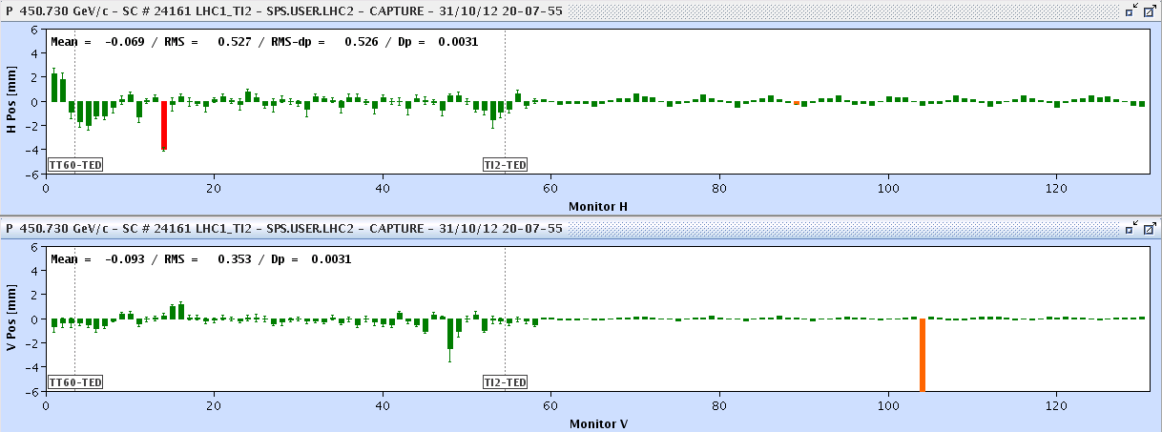
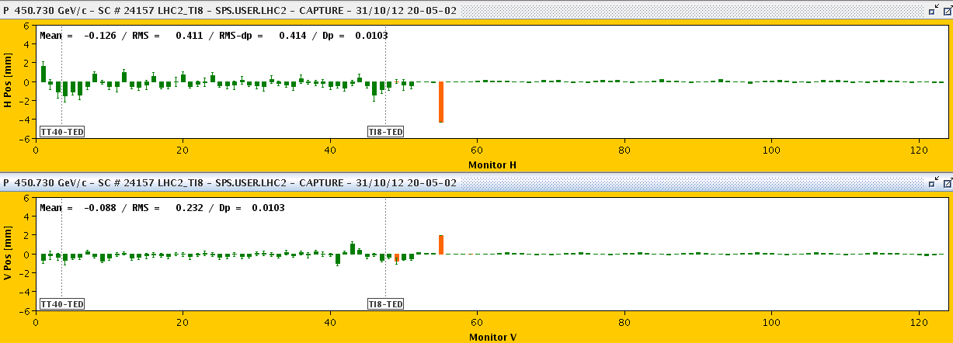
Injection losses
Transfer line steering ok but with the large bunch intensities there are losses all the way down the lines
B1
B2

Slide 4
Fill # 3249
Although injection just optimised by the experts the IQC is latching most of the time, especially B1...
Bunch intensities 1.72e11 on average, quite high
injection losses of up to 44% for B1 and 64% for B2;
Decide to go for physics anyway, it is about time
20:47 Start ramp
Losses point 3, 46 % of dump threshold during ramp. More than before.
And what looks like a UFO 7R3, with losses up to 86 %.

Slide 5
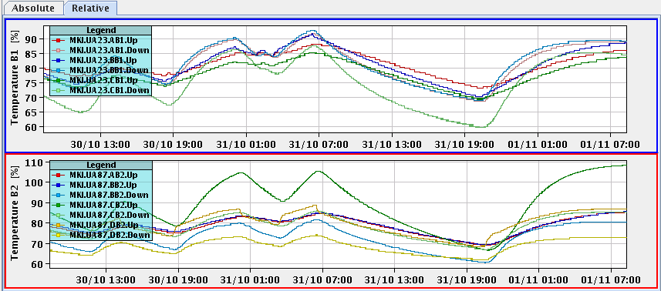
Fill # 3249
21:42 Stable beams, initial lumi 7.1e33 cm-2s-1
During fill problems with levelling (software) ALICE and LHCb
Tried trimming down V chroma of a couple of units, effect on intensity lifetime seemed negligible.
MKI.8C hot again
Non standard heating….
The plan:
Fix the dump kicker in the SPS
Dump the LHC followed by soft start. If data show that magnetic field of MKI.8C is fine, temporarily disable this interlock to allow injection.
Inch back on bunch intensity from the injectors
MKI.8C

Slide 6
Outstanding
TCL collimators out during the fill and check effect of losses on cryo load
ADT changes to high bandwidth during fill and check lumi lifetime

