Slide 1
Sat 27/10
7:58 beam dump by LBDS B2 (ASIBUS card failed), access needed; access for undulator repair in parallel.
10:32 LBDS ASIBUS card (safety bus) replaced
11:50 Undulator (L&R of point 4) power converters repaired. Synchrotron light monitors available at low energy. Insert BSRT mirror for B2 (F. Roncarolo)
14:33 STABLE BEAMS #3231. Initial luminosity ~7.4x10³³ cm⁻²s⁻¹
16:29 Trip of RCBWV5.L7B1. End of fill #3231. ~32 pb⁻¹ in 2 hours
18:50 STABLE BEAMS #3232. Initial luminosity ~7.4x10³³ cm⁻²s⁻¹

Slide 2
Sun 28/10
No major issue with the change from summer to winter time
04:30 (winter time): electrical perturbation on 18 kV in point 1 effect of EDF perturbations. Trip of RD1.LR1 & LR5 and RD34.LR3 trip (we were going to dump anyway…). End of fill #3232. ~160 pb-1 in 10.5 h.
05:30 Ready at injection. No injection permit from LHCb
06:00 – 06:34 storm of electrical perturbations. Several Trips:
RDs
LHCb dipole
RBs
Presently recovering: RB still to be restarted, piquet on site
PS trying to increase further satellites

Slide 3
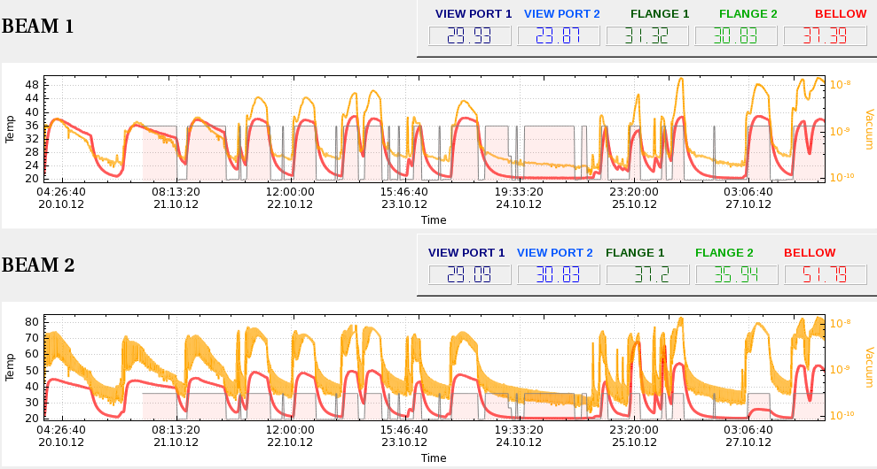
ALFA and BSRT temperature
BSRT temperature evolution
F. Roncarolo
Long. Blow-up@inj
Long. Blow-up@inj
3207
3220
3229
3223
3225
3226
BSRT B2 out

Slide 4
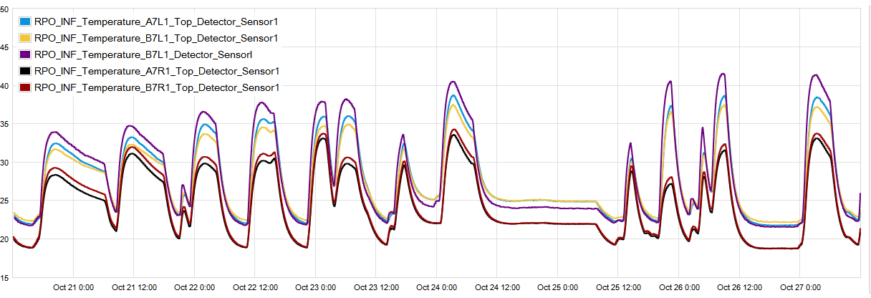
ALFA and BSRT temperature
ALFA temperature evolution
B. Salvant
Long. Blow-up@inj
Long. Blow-up@inj
3207
3220
3223
3225
3226
3229

Slide 5
Bunch length distribution
Flat top

Slide 6
Bunch population distribution
Flat top

Slide 7
N_{b}²/τ_{b} distribution
Flat top

Slide 8
Beam 2

Slide 9
B1 vs B2
Beam longitudinal spectra at flat-top
B. Salvant

Slide 10
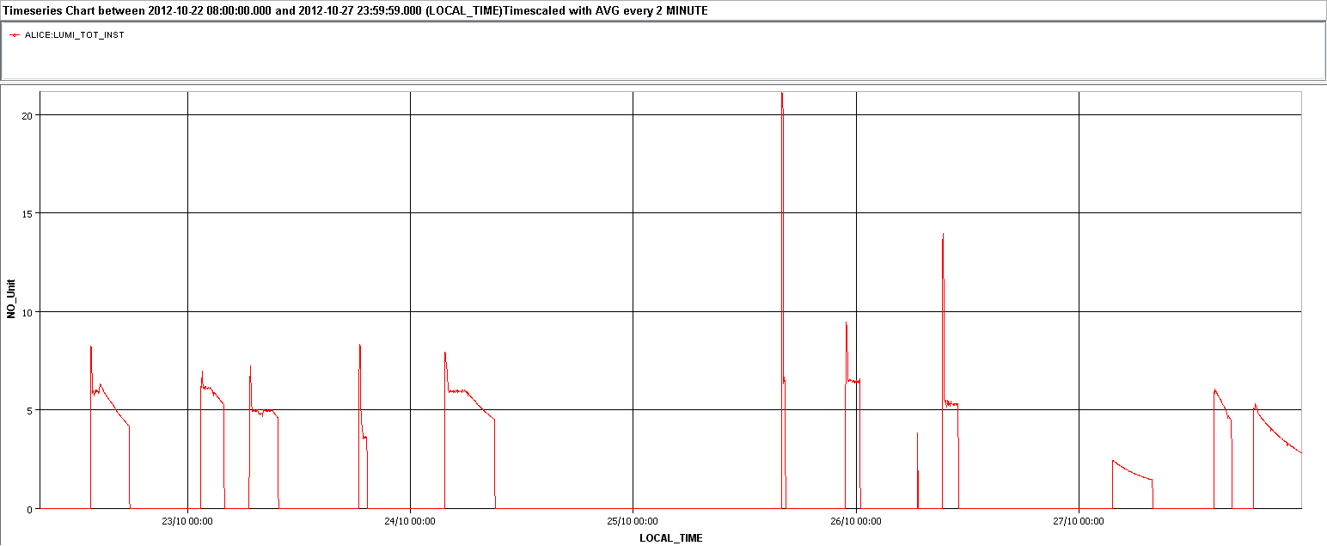
Satellites
25/10 12:27 Enhancement of satellite population
25/10 20:40 Reverted back due to LHCb triggers at injection
26/10 17:24 Longitudinal set-up (adjustment of re-bucketing on h=84). But no more satellite (LHC not informed)
27/10 10:36 Increased PS longitudinal blow-up to generate satellites. Not enough to be continued - ongoing (compatibly with losses)

Slide 11
Pending
Gated BBQ on B2
Tuning of the transverse damper high bandwidth (1 hour)

Slide 13
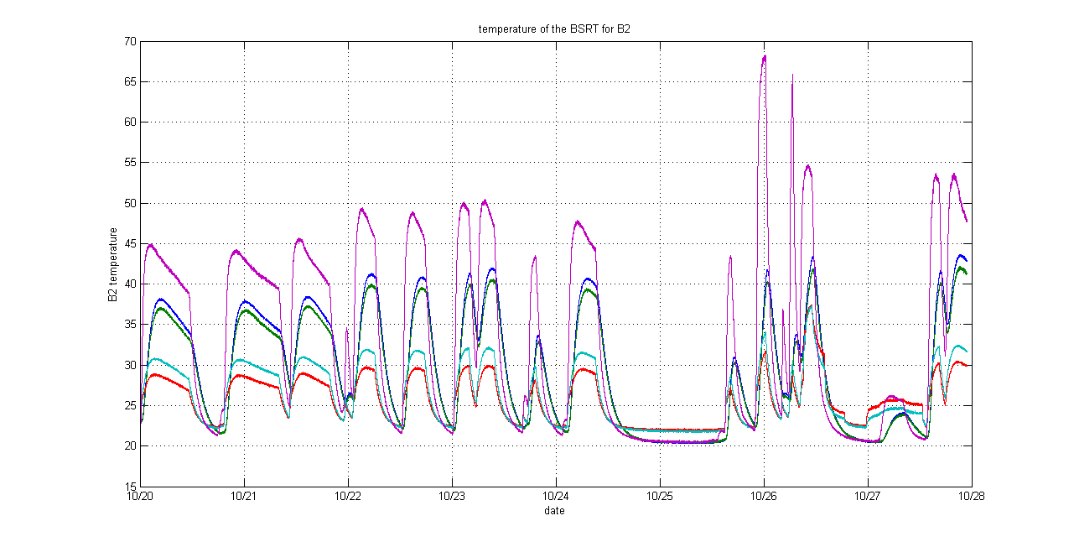
ALFA and BSRT temperature
BSRT temperature evolution
3223
3225
3226
3207
3220
3229

