Slide 1
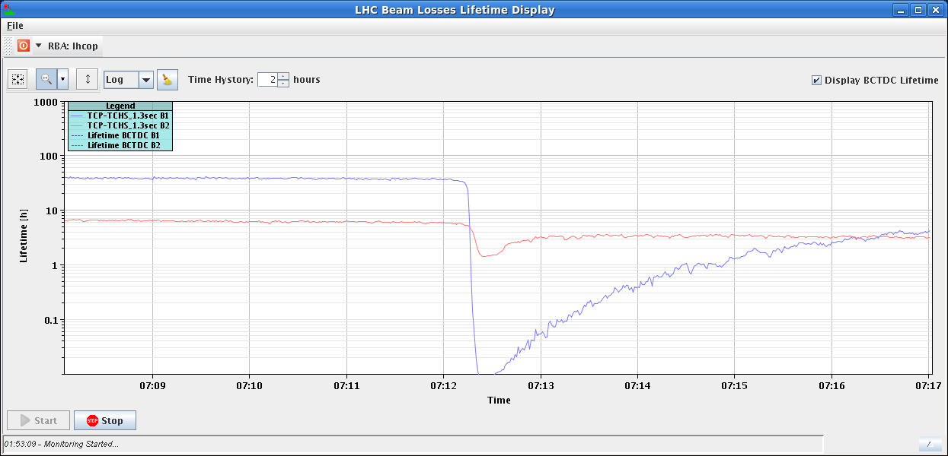
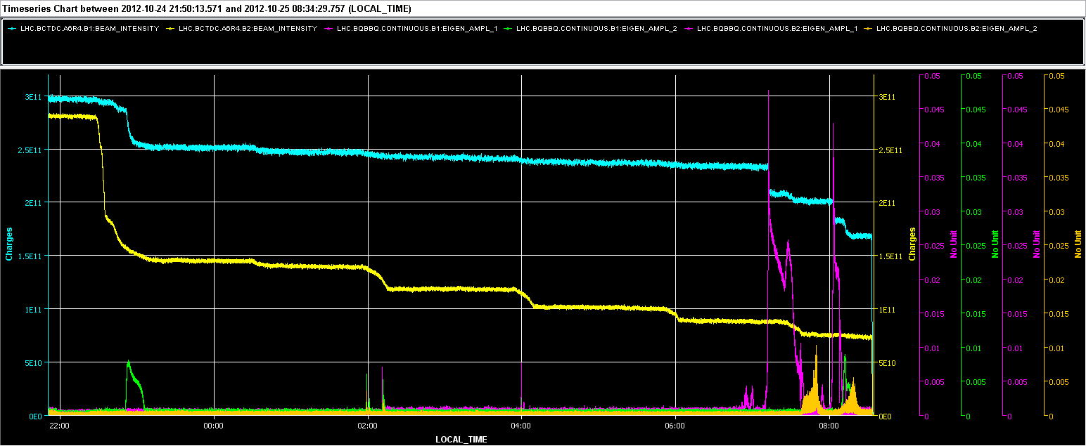
Thu 25/10
08:30 End of very successful β*=1 km physics run (H. Burkhardt et al.)
Blow-up and losses observed from time to time e.g. at ~07:12 due to instabilities

Slide 2
Thu 25/10
08:30-09:30 Ramp down and reset conditions for physics with LHCb negative polarity
New version of OFSU deployed after dry tests on Wednesday and Thursday
09:30-11:30 Pilot ramp with 2x6 bunches/beam for check after LHCb polarity reversal. In parallel wire scan measurements all along the cycle for emittance preservation studies
12:30 PS Setting-up to increase satellites for ALICE completed. Verifications in the SPS during filling

Slide 3
Thu 25/10
12:30 Installed the Batch-per-batch blow-up system this afternoon, and have monitored during the early afternoon fill. At present we increase bunch length to 1.4 ns in a few minutes after each injection. The mechanism is stopped at start ramp. Then the usual "common mode" blow-up takes over during the ramp.
13:22 LHCb trigger during injection of B2 (3rd 144 batch)
13:30 – 14:00 Steering lines
14:08 Spurious dump of LSS6 BPMs during pilot injection

Slide 4
Thu 25/10
15:59 STABLE BEAMS #3220 Initial luminosity 6.7x10³³ cm⁻²s⁻¹.
16:23 Trip of the 60 A correctors in sector 56 due to a loss of the 60 A power permit. Glitch in the communication between the PIC_PVSS and the PIC_PLC. This problem last occurred in 2010 ( in a different sector). End of fill #3220. 8.4 pb⁻¹ in 24 mins
In the mean time verification in the SPS of the beam quality (longitudinal)
19:30 Again LHCb trigger at injection of Beam 2

Slide 5
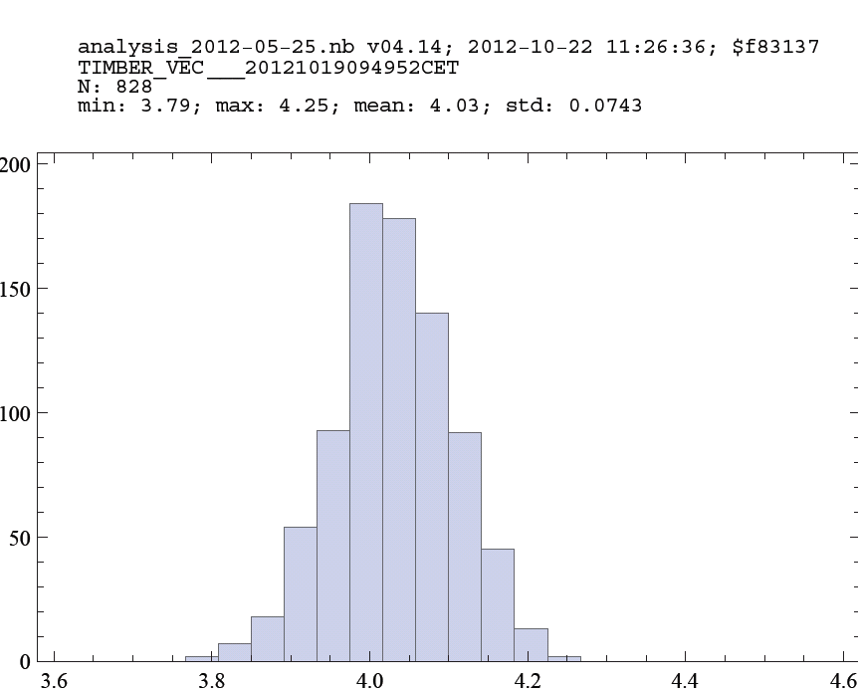
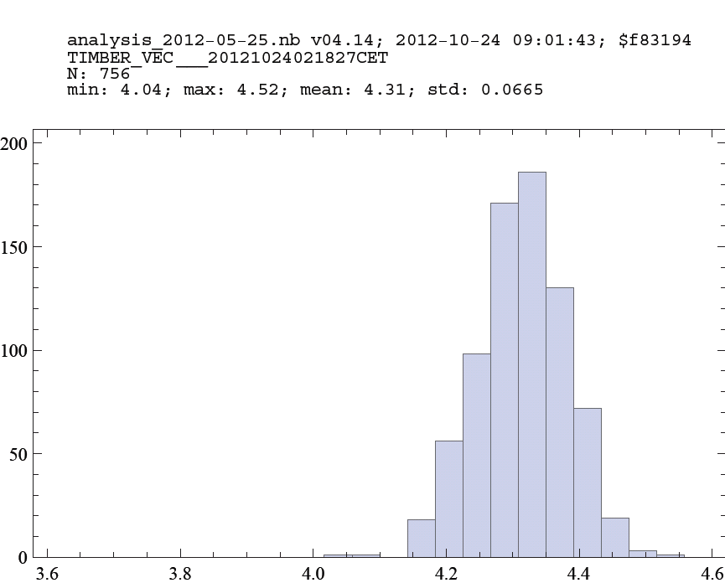
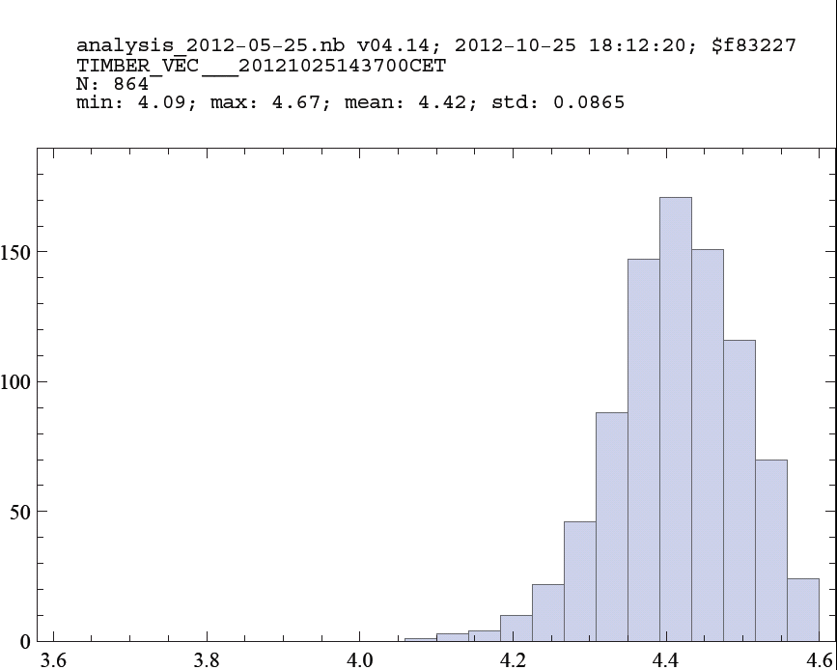
Thu 25/10
Fill#3200 – 19/10
Fill#3214 – 22/10
T. Bohl
#3200 enhanced satellites with short bunches
#3214: no satellites, standard length bunches
#3220: enhanced satellites, longer than standard bunches
Bunch length at SPS injection too large
Fill#3220 – 25/10

Slide 6
Thu 25/10 – Fri 26/10
20:00 Reduction of the bunch length at PS extraction
20:32 Again LHCb trigger. Decided to revert back to previous PS longitudinal set-up with reduced satellites
22:53 STABLE BEAMS #3223. Initial luminosity ~7x10³³ cm⁻²s⁻¹
00:26 Trip of RCBXV3.R5 (power converter): End of fill #3223. 34 pb⁻¹ in 1.5 h.
02:00-02:30 Access for repair of RCBXV3.R5 power converter
04:30 Issue with batch-by-batch longitudinal blow-up: bunch length continuously increasing ➔ experts called.
05:20 Filling again

Slide 7
Batch-by-batch blow-up issue
The FESA class AllInjectionSequencerB1 and ...B2, on charge of the Batch-per-batch blow-up at injection, manipulates the Bunch Mask in the AllBeamPhaseMeasB1 ....B2 FESA class (Beam phase loop): when one batch is being shaken, the corresponding bunch locations are masked so that the shaking does not propagate to all circulating bunches via the coupling of the Beam Phase Loop (averaging all non-masked buckets). When the Batch-per-batch blow-up is finished for a given batch, the AllInjectionSequencerB1-B2 classes modify the Bunch Mask so that the buckets are included in the phase loop average.
But...its RBAC token expired sometime between 22:00 (Thursday) and 3:00 (Friday) and renewal was refused...So the Bunch Mask was actually not including any bunch and the Beam Phase Loop was not doing anything, resulting in strong uncontrolled longitudinal emittance growth caused by the RF noise around the synchrotron frequency.
Action: We restart the AllInjectionSequencerB1-B2 classes and will solve the issue of RBAC token expiration with CO in the morning.

Slide 8
Fri 26/10
06:37 STABLE BEAMS #3225 Initial luminosity ~7.5x10³³ cm⁻²s⁻¹
06:39 UFO in point 4. Beam dump
Filling

Slide 9
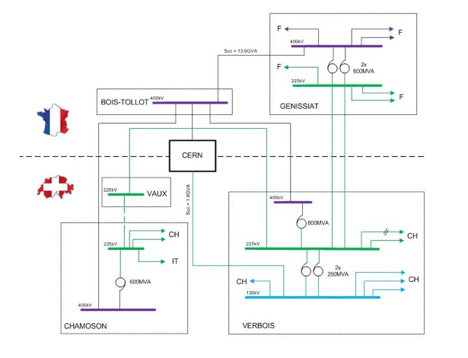
The Plug

Slide 10
Plan
07:30 Verbois transformer switched off
10:00 – 12:00 SPS stop for intervention on 18 kV cable
Expected restart of the SIG Verbois transformer in the afternoon (2 hours warning). Expect perturbations. Last time (25/09) trips of:
PSB
ATLAS toroid
filters in Pt2, 4 and 6
Cryo Pt2
ALICE solenoid and dipole tripped.
Afternoon: 14:30 – 17:30 access
17:30 Recovery (EL, CV, Cryo, EPC warned for support)
Physics

Slide 11
Accesses
Accesses:
LVDT TDI Pt2. UA23, 2 hours (A. Masi, G. Lendaro)
LBDS MKD-F-B1: check PC and generator. (UA63), 2 hours (E. Carlier)
Energy extraction switch RB.A67 (UA67), 2 hours (B. Panev)
Gated BBQ (higher sensitivity B1), (M. Gasior, R. Steinhagen) - Point 4 (RP required)
60 A Correctors replacement
Sector 34: RCBV24.R3B1 & RCBV33.L4B2 (V. Barbet) – (RP required)
Sector 23: RCBH17.R2B2 & RCBV24.R2B2 (O. Fournier) – (RP required)
Oxygen Deficincy monitor (UJ16) – TI - (RP required)
Radmon installation between Q5 and Q6 at IP1, (1 hour), (D. Macina) (RP required)

