Slide 1
Saturday 6th October
05:38 STABLE BEAMS #3134.
Initial luminosities: 6.77x10³³ cm⁻²s⁻¹
switched ON AG cleaning as went above threshold at the beginning of the shift.
incorporated the chroma trims of -3 units and reduction of landau octupole knob to -2.35 (limited by the BP length) in the second collisions BP.
18:06 OP dump
177 pb⁻¹ in 12h28m
20:28 back in Stable beams
Fill 3135 – initial luminosity: 7.11x10³³ cm⁻²s⁻¹

Slide 2
Sunday 7th October
06:30 fill 3135 lost to ALICE DIPOLE trip
158 pb⁻¹ in 10h3m
ATLAS
have again a gas leak in TRT detector – potential to lose quite a lot of Xe and which requires an urgent access of ~1h
09:00 preparing to go in
LHC is waiting for the MKI to cool down,

Slide 3
2012 records (courtesy ATLAS)

Slide 4
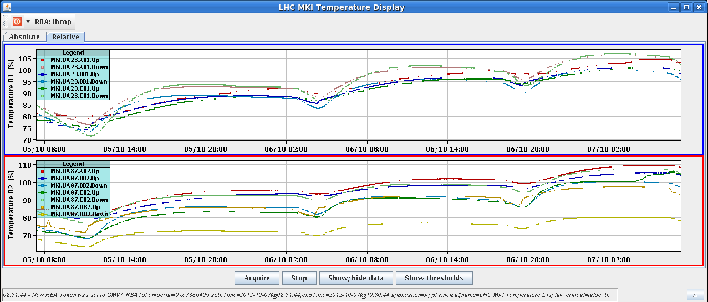
Injection kickers

Slide 5
Pending
Beams to be dumped at 06:00 Monday for start of MD program at 08:00
Operational Development
Gated tune measurement with reduced damper gain on first 6 bunches on-going
Damper test at injection of the increased bandwidth with 50 ns beam (after MD3)
Batch by batch blow-up (after MD3)
ALICE
The rate limit of ALICE is 500kHz. At the moment they have about 300kHz of background at the beginning of the fill. So can 'add' 200kHz of collisions i.e. a luminosity of 4e30. During the fill the background goes down to levels of less than 100kHz, so the luminosity can be increase to about 5e30.
to be sure that even up to the EOF there is a luminosity of at least 5e30 it means that at the beginning of the fill it should be at a potential peak (aka virtual) level of about 8e30

