Slide 1
Tuesday 3rd October
STABLE BEAMS until 12:25 when we switched to ADJUST for a EOF test for Tobias
dump B2 first and then B1.
Dump at EOF test because the BLMs in IR7 were above dump threshold (114%).
The losses were caused by the trajectory perturbation caused by the missing LR beam-beam kicks (as expected)
Fill 3121: ~150 pb-1 in 11h52m
Ramp-down
The ventilation door UL24 has been checked and was found to be properly closed.
Additional door one level above it was not checked… sorted by Ghislain later in the afternoon

Slide 2
Tuesday 3rd October - afternoon
16:17 beam dumped in ramp by LBDS internal error
Start short access at point 2 (for ventilation door) and point 6 for LBDS
Again having problems with key distribution at PM25. Need to switch to automatic mode in order the key drawer to open. Call access specialist.
Same problem seen at PM65 (need to give access in automatic mode)
Access problem (for key distribution in restricted mode) was checked by J-F Juget, but still remains to be solved. Access specialists to be called at next daytime access, to continue tests.

Slide 3
Tuesday 3rd October - afternoon
LBDS trip due to a corruption of the MKD-B1 internal safety ASIbus.
The result of this type of failure is a switch off of the mains electrical power distribution (trip of the top circuit breaker). Local rearm of the safety chain required in the tunnel.
Failure propagates to the TCDQ-B2 as both equipment share the same electrical distribution in UA63.
18:20 injecting again
19:26 Ramp started
Problem to keep chirp on at start ramp. Tune viewer appears to accept the chirp setting, but later slips back to a "none" status on the excitation.
Ramp without chirp, and numerous restarts of the QFB
Later tune acquisition freezes up
Re-boot BBQ front-end on flat-top – beams dumped

Slide 4
Tuesday evening
19:41 beam dumped on flat top after re-boot of BBQ front end
blocked B2 BBQ acquisition was just a symptom and pointing to a more severe problem and B1 would have probably been blocked soon after as well.
either related to a driver problem or blocked DAB card, since the acquisition could only be recovered after a hard VME reset and not via a simple restarting of the corresponding FESA class on cfv-ua47-bqp and/or GUIs.
The energy transmission after the restarted seemed to have been OK. The step in the RT trim functions is probably due to the first tune value being send to the OFC being wrong after the front-end restart. (should have stopped the Q-FB).
The reboot of the front-end was inevitable since any further deterioration could have disabled also the vital energy update for the OFC (which wasn't blocked btw.)

Slide 5
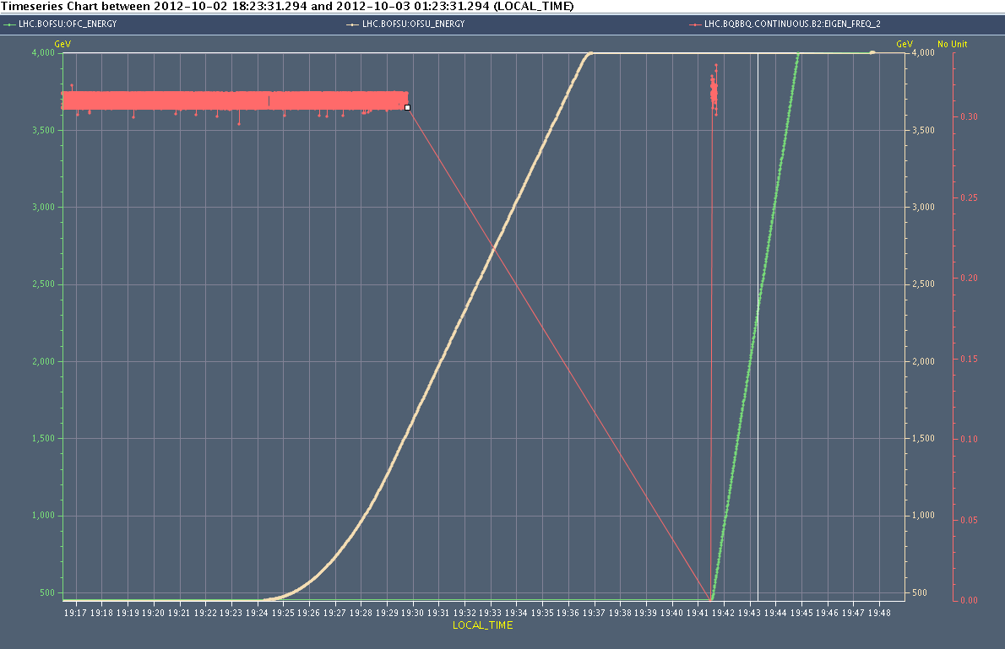
BBQ/ energy to OFC
OFB was working with the wrong energy, leading of course to weird kicks in the ramp... Not healthy, but the orbit remained stable.

Slide 6
Tuesday 2nd October - evening
20:40 Re-injecting
1.6E11/bunch. However we were just above the MKI B2 vacuum interlock threshold - injected all but one batch for beam2
22:30 Stable beams fill 3124
Initial lumi: 6.4e33 cm-2s-1
23:31 Beam dumped - cryogenic conditions lost in IT.R2
Cryo temperature on top of the current lead of RCBXV2.R2 stabilized (went to 400 K)and we had the OK from the cryo operator to start.
Precycling the IT.R2 while cryo operator checks the behaviour of the CL.
MKB B2 faulty – piquet called
PLC of the MKB, an access (in the UA) is needed.
Ron + kicker piquet in PM65
03:05 dry dump as requested by the kicker piquet, all looks fine

Slide 7
Wednesday 3rd October - morning
03:30 – injecting physics beam
03:50 beams dumped at 450 GeV
Trip of PC of RQTD.A34B1 – reset after checks
We reboot also the cfv-ua43-bqpll.
During this reboot we have to restart also the process BQBBQLHC_M on cfv-ua47-bq
Tune acquisition back (NB problem earlier in evening)
05:45 Stable beams fill 3126
Initial luminosity: 7.16e33 cm-2s-1

Slide 8
Miscellaneous
Scrubbing run postponed until before MD4 following discussion in LMC yesterday afternoon
Schedule update today
Access requests:
BSRT (3 hours)
Ralph – UA47
ATLAS (1 hour), TOTEM
Tobias – point 8 – quick one - diamonds
EOF:
Bunch length variation
OD
Batch by batch blow-up
LHCb polarity change (?)
Ventilation door S23

