Slide 1
Cryogenics sectors 78 & 81

Slide 2
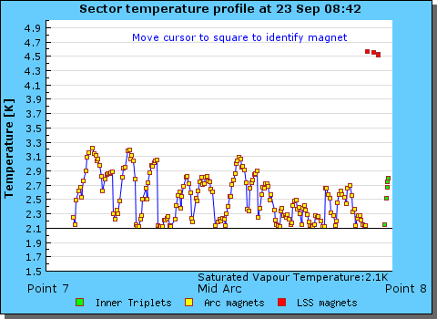
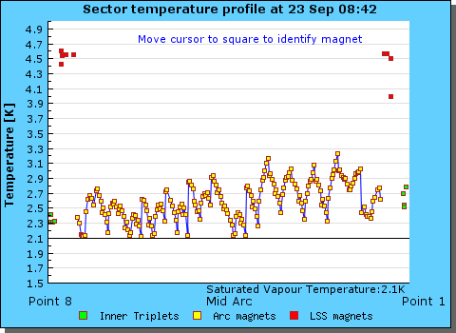
Cryogenics sectors 78 & 81

Slide 3
Sunday 23rd September - sliding plan
Cryogenic recovery – latest, optimistic, estimate: early this afternoon (not before 15:00)
Powering tests (RB.A78/RB/A81) (3 hours)
Pre-cycle (1 hour)
Go through the whole cycle (with new collision process) with pilot beam for validation and chromaticity measurement (~5 hours)
BBQ and BSRT verification in parallel.
Switch off Active filters of main circuits and warm dipoles one by one for mains line perturbation observations.

Slide 4
Plan
Setting-up of injection with Q20 optics (5 hours)
Loss maps in collision (betatron and +500 Hz) (5 hours).
Wire scans for BSRT calibration
Loss maps squeezed/separated: betatron and asynch.dump in collision. (5 hours)
Wire scans for BSRT calibration
First step of the intensity ramp-up: very short fill with 78 bunches with new collision process (5 hours)
1 hour Stable beams
Damper setting-up with larger bandwidth (5 hours)

Slide 5
Intensity ramp-up
456 bunches (50ns_456b_447_0_432_72bpi12inj)
CMS request for period at low pile-up (~1) – 2 h
ATLAS request for VdM scan – 2 h
Dump - Tobias special
840 bunches with additional train of 6 bunches (no collision and no long-range). Standard fill length.
1374 bunches

