Slide 1
Friday 14th September
03:15 Beta* at 1 km. Optics measurements, see yesterday.
07:00 Dump.
08:00 Refill with 3 nominal bunches for high beta.
11:15 Beams colliding at 1 km. Start of collimator and RP setup.
12:45 Dump.
Access for RF, line 2B1. Access LHCb.
17:30 pPb MD. Problems to inject 200 ns p+ beam. BPMS IP6 interlock
About 1 hour no beam from PS.
21:30 Again trip of line 2B1: isolate system
Struggle with interlock BPMS o-night.
04:20 all p+ bunches injected.
04:35 Dumped pn BPMS: pPb did not make it, but important lesson learned
Changed LHCb polarity and commission new collision beam process
06:38 Ramped with 2 x 2 x 6 bunches
08:12 Dump.

Slide 2
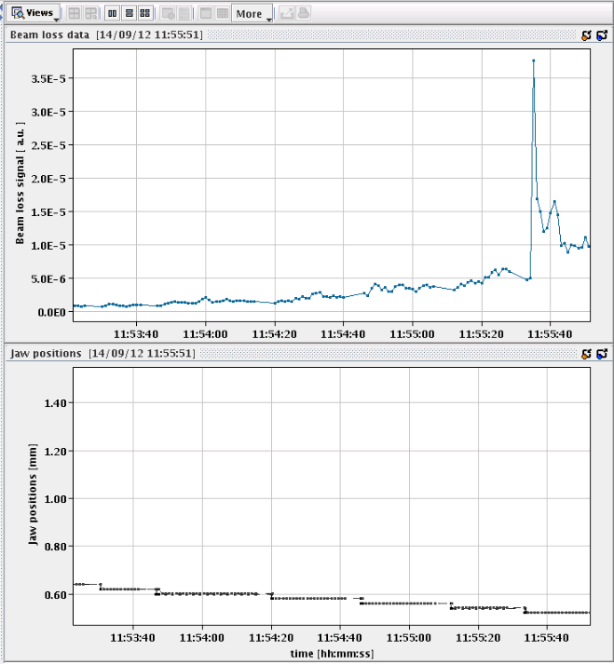
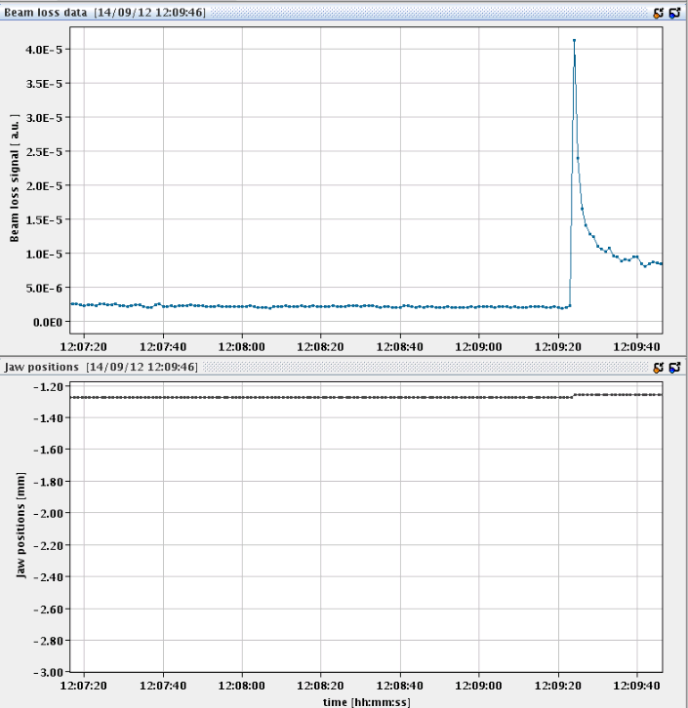
Second part of b* = 1000 m
Optics check with 2 x 3 pilots done o-night. Dumped at 7:00.
Filled with 2 x 3 small indivs of about 3e10 p+ for collisions
TOTEM and ALFA collimator and pot set-up. Scraping and some retraction to take some data.
Dump at 12:45
TOTEM @ 0.521 mm
ALFA touching the beam

Slide 3
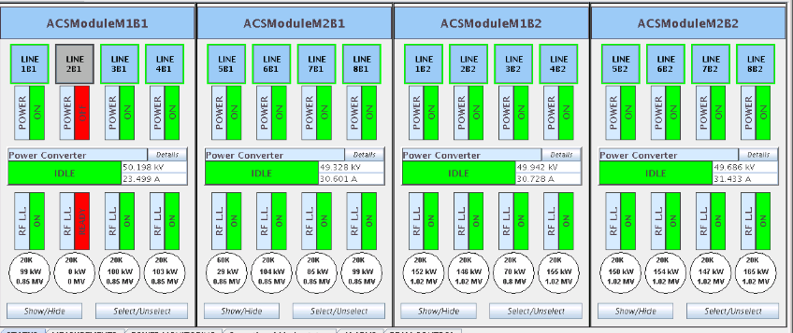
RF klystron 2B1
Good part of the afternoon access for RF power team to repair the klystron of line 2B1
Same problem since a few days
Switched back on end of the afternoon
Tripped again in the evening
Decided to isolate the klystron again and run without
Cannot take high intensity beams like due to cavity beam loading

Slide 4
pPb MD
Plan to inject 318 p+, max 2e10, against 4 Pb bunches
Pb injection fine, problems with RF/bucket/super cycle seem to be fixed
p+ injection difficult. Dumped by BPMS in IP6
Struggle throughout the night
Rhodri came in for BPMS. Reduce bunch intensity. BPMSA.A4L6.B1 vertical channel shows additional triggers even with one probe of 1e10. This channel more sensitive than others.
04:20 all p+ bunches injected.
04:35 Dumped on BPMS: pPb did not make it, but important lesson learned: needs work from BI and see which additional BPMS attenuators will be needed for the proton – ion run

Slide 5
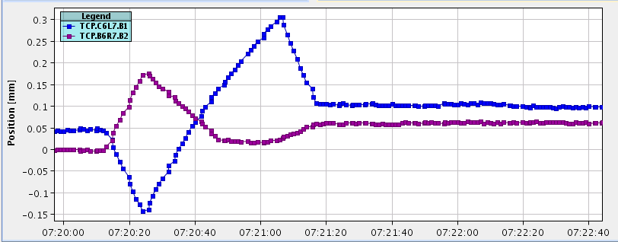
Test ramp with 2 batches of 8
Reversed LHCb polarity to negative
Split beam process: going into collision first in point 1 and 5, then in 8
Quite some corrections for going into collisions in 1 and 5
Beam position at collimator Needs to be corrected – reason for tests

Slide 6
The Plan
This morning: Switch SPS to Q20 optics and set-up injection into the LHC
End morning / beginning afternoon: RF module repair of line 2B1
Cable replacement by RF piquet
Two options
If RF module fixed go to physics with Q20 optics but lowish bunch intensity as collision in 1 and 5 might not be optimum
If RF module not fixed, no high intensity (physics) beams until the TS3 on Monday morning. Will go to MD program until Monday morning

