Slide 1
Thursday morning
09:30 Dump of pPb fill.
RF intervention on klystron line 2B1.
11:30 Preparing for injection. Problem with RF settings – fixed by G. Kruk.
Changes in settings made since BP was created were not propagated.
12:30 Again problem with 2B1. Switch off and remove from configuration of used cavities.
13:00 Injecting. BPM phasing (for bunch by bunch).
SPS no beam – HV cable issue.
15:00 Ramp with 3 probes / beam.

Slide 2
Thursday afternoon
15:40 Beam dumped in unsqueeze to 90m. Again the energy limits on TCTs…
Too tight for 90m, and the limits were not opened for high beta. It was ‘assumed’ that we would mask everything (unfortunately not communicated). But this is and should not be(come) common practice. The SBF can have glitches…
Opened energy limits for TCTs at 4 TeV (R. Bruce). And TCPs to reduce scraping in ramp.
But TCT interlocks back in next cycles… (but now masked). Too many other problems to investigate further.
17:30 Filling again
19:30 Ramp, then squeeze to 90 m.
At 90 m the orbit FB suddenly oscillates on B1V and kicks out ½ of the beam. Not understood at all…

Slide 3
Thursday afternoon
In parallel the unsqueeze to 500 m does not load. Current limits on RTQX in 1 and 5.
Limits were modified following a MP event with a trip of the triplet circuit. The limits were set based on currents used in OP (ECR) to +- 100 A (need -300 A for 1 km).
The currents used for 500/1 km were overlooked in the analysis.
A change of limits requires PCs to be OFF…
Beam2 lost when AC-dipole key was turned without masking BIS input (while sitting at 90 m).
20:30 Dump and try again. PC limits updated to +- 400 A.

Slide 4
Thursday getting late
22:00 Ramp again. De-squeeze to 90 m fine.
Then at start of unsqueeze to 500m orbit FB instability, orbit oscillates. Managed to control orbit by switching off FB when diverging, then back ON, some convergence and so forth.
Why did it never diverge before, even up to 1 km?
While trying to sort out OFB and run it with a different optics (with Ralph also in remote), OFB crash – this means all RT settings lost. Tried to save, but end of game no. 3.

Slide 5
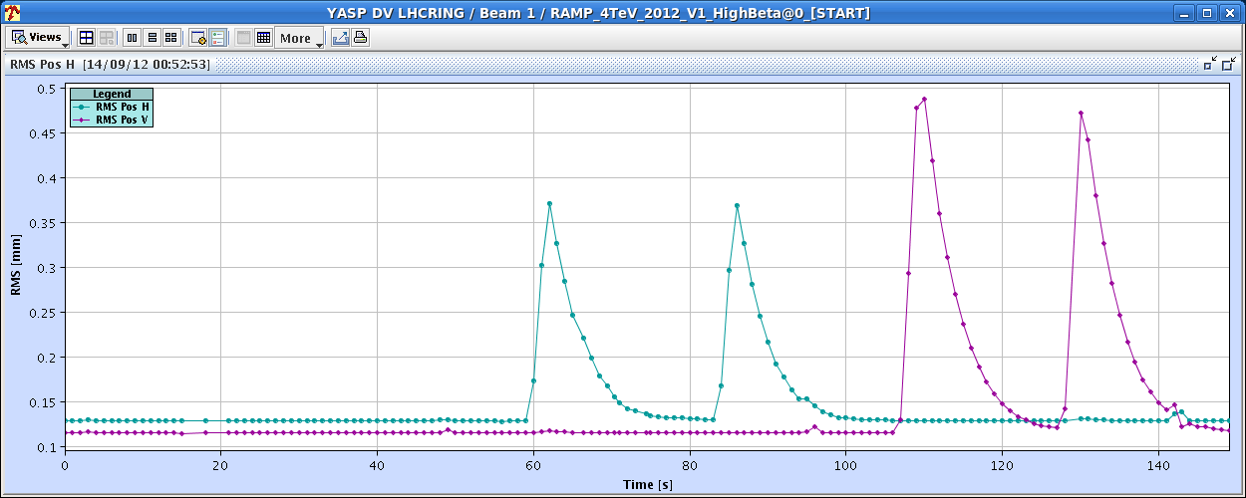
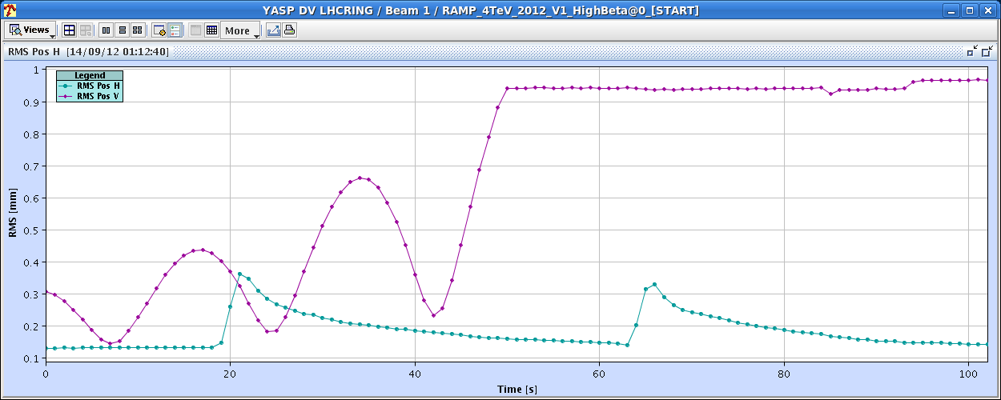
Thursday getting later and later
01:00 Back at injection. RS+JW checking out OFB. Nice convergence with injection optics, unstable with 1km optics (not surprising). No real anomaly.
Injection optics - OK
1km – unstable or slow convergence

Slide 6
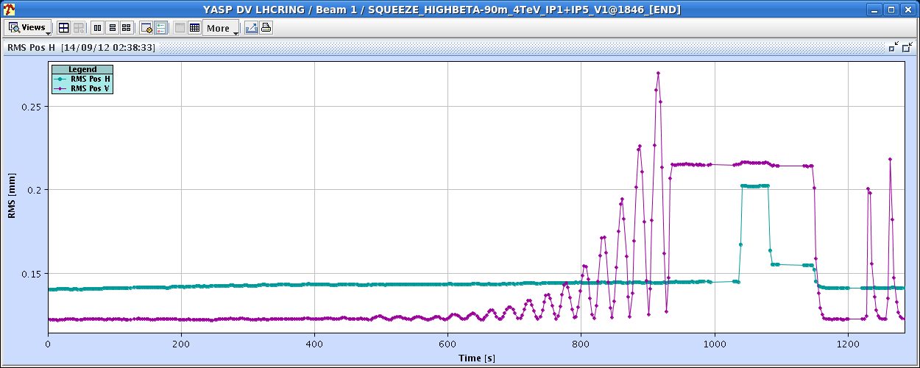
So late…
At 90m. This time the optics load worked. Not understood why the same commands to send the optics did not seem to have any effect the last times.
Switch optics
OK
Unstable with injection optics

Slide 7
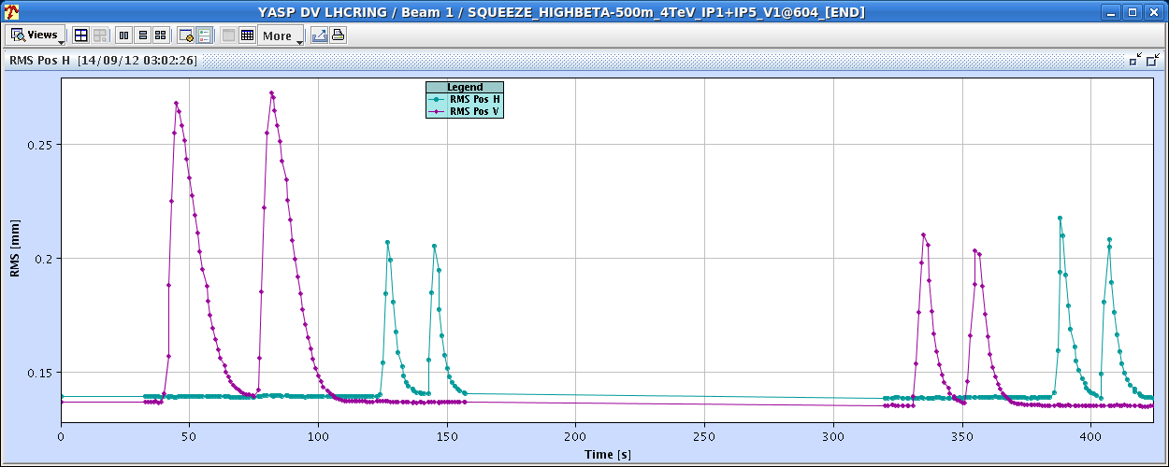
So late…
At 500m. Again optics load worked, contrary to last time.
With 90m optics
With 500m optics
Switch optics

Slide 8
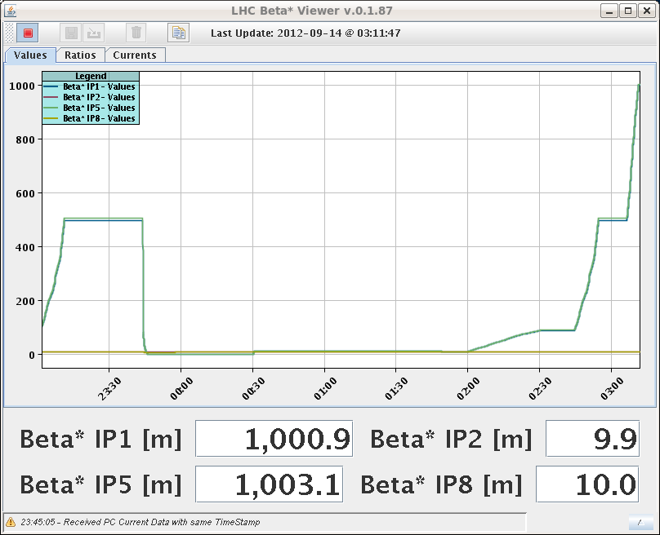
Finally
03:15 At 1 km – no losses in de-squeeze.

Slide 9
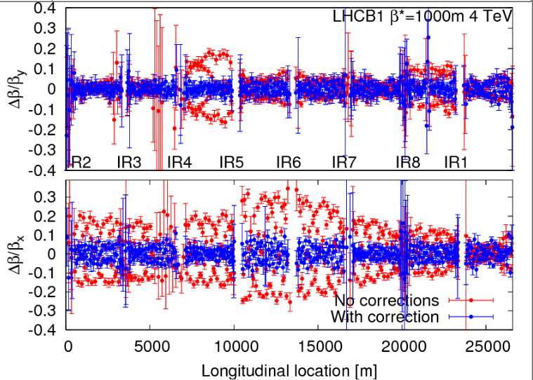
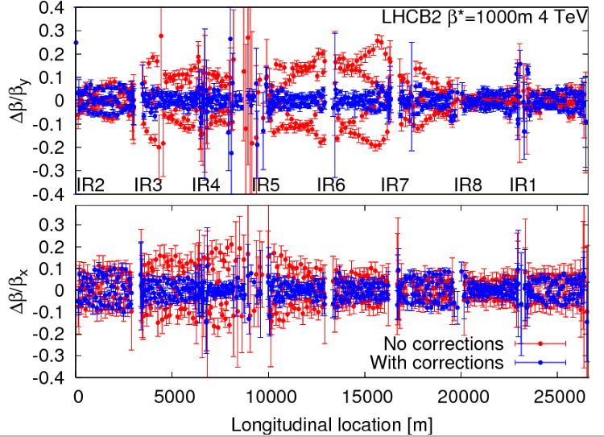
Finally measurements at 1 km
03:30 – 6:30 beta beat / optics measurements at 1 km
After applying the corrections calculated from the data taken in June 2012 we performed the measurements. The beta-beat went down from ~30% to less then 10% after applying the corrections.

Slide 10
Optics measurements at 1 km
Results
Off-momentum measurements were also done to check the dispersion. No big difference between the measurement and the model was found.
A k-modulation measurements was also performed to measure the beta* at IP1 and IP5. To be analyzed offline.

Slide 11
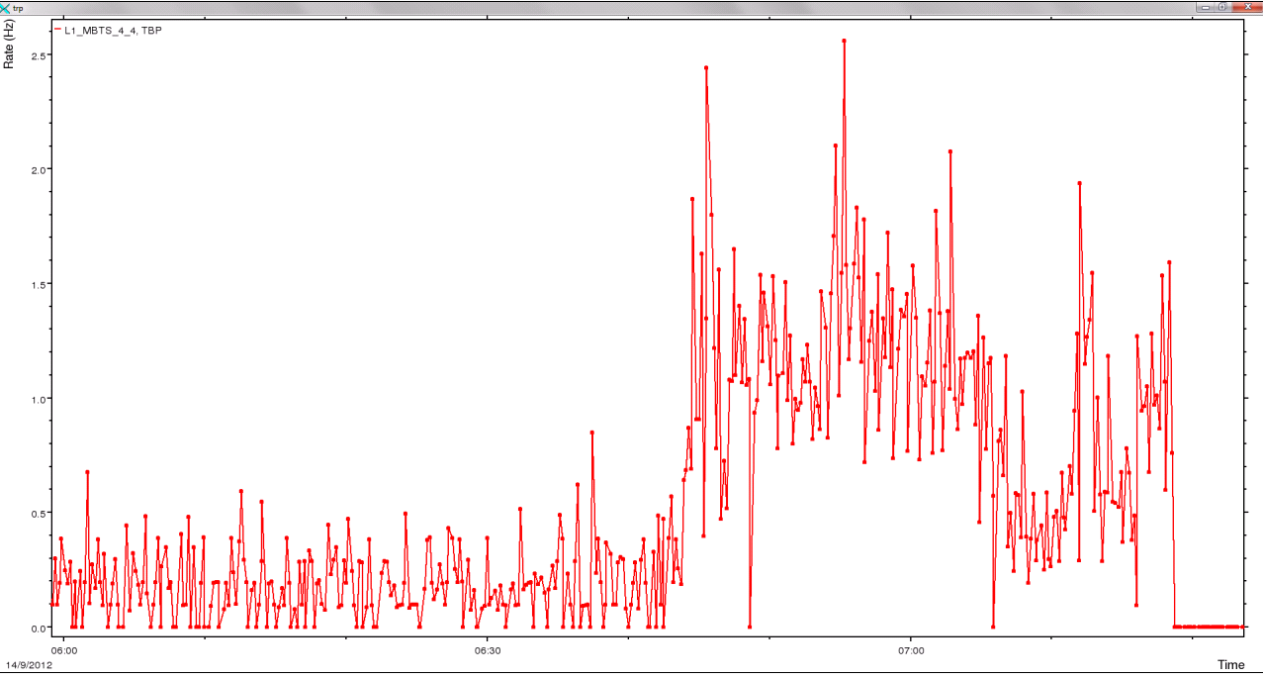
Collisions
07:00 Collisions at ALPHA, about 1 Hz
07:18 Dump and refill to go for small indiv to take some data with pots in on the next fill, during EDF intervention
Sune Jakobsen

Slide 12
Plan
Today at 09:00 EDF intervention on SPS HV cable.
Potentially no beam from SPS for the morning.
Go for another 1000 m fill during EDF intervention
RF line 2B1 repair (klystron modulator).
Then (options):
pPb MD many p bunches against Pb.
Q20 in SPS.
LHCb polarity.
Test fill with split collision BP and LHCb Pol-. One more test fill needed if split collision BP to be used after TS3 in ramp up.
Physics.

