Slide 1
Monday morning
08:30 Start of rephasing MD. Dry tests in the morning.
Firmware changes, software updates and debugging.
13:00 Starting beam tests at 450 GeV.
3 attemps with 6b/batch (1.6E11 p/bunch).
In each trial filled with rings locked, then added 30 Hz on ring1 and -30 Hz on ring2, let crossing point slip (1 microsec - 330 m - in 13 seconds), locked the two beams back to same frequency, then applied a series of frequency bumps to make beams collide in desired place.
P. Baudrenghien et al

Slide 2
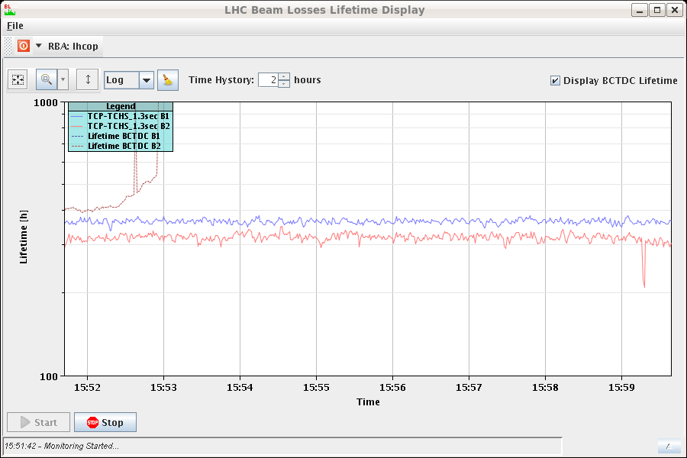
Monday afternoon
Attempts:
No. 1: dump when applying the +-40 Hz frequency bump (3E-4 dp/p): too large orbit deviation B1 → SIS.
No. 2: centred the orbit and reduced the amplitude of the frequency bumps to 20 Hz (1.5E-4 dp/p). Worked OK. Compared the RF measurements with the BPTX ATLAS and added offsets to converge to ATLAS BPTX reading zero.
No. 3: with the calibrations from the second trial. "Collision" point converged nicely (BPTX reading 0.050 ns). Lifetime drop B2?
No time left to try at 4 TeV.

Slide 3
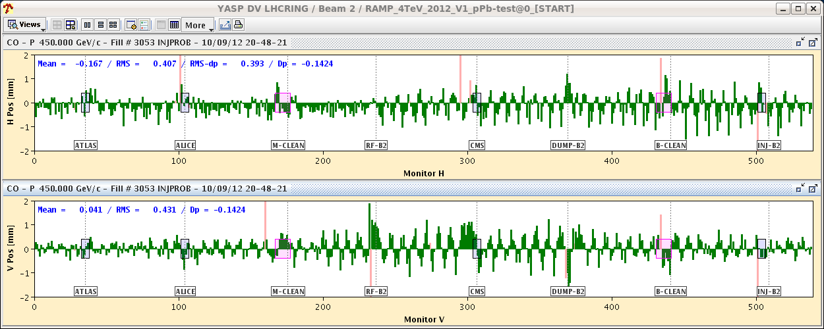
Monday evening
16:00 Switching to p-Pb setup.
Lot’s of last minutes things to fix on both SPS and LHC sides. Extraction settings SPS, collimator thresholds, ADT, RF, rephasing (and trying to remember how all this should fit together with mixed species…)
20:48 Trying to inject Pb – circulating at first attempt.
And ended up in the correct bucket.
First Pb orbit

Slide 4
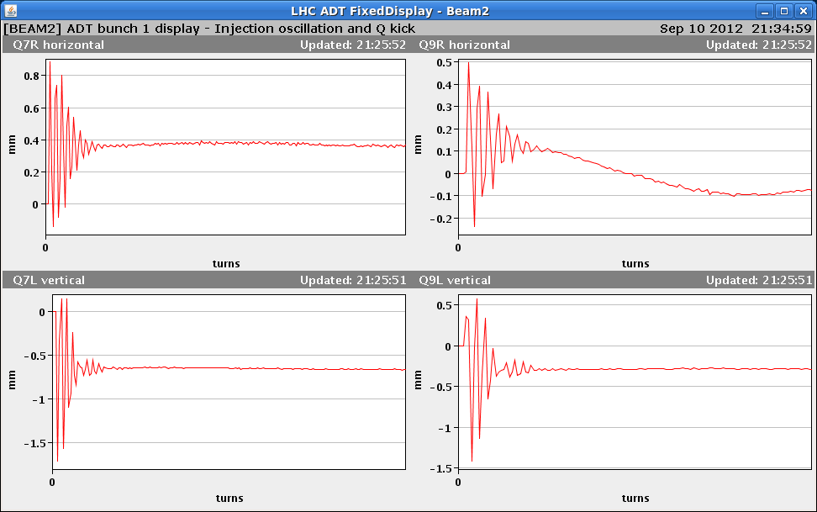
Monday evening
21:00+ Setting up RF loop gains, ADT gains…
After RF frequency trim on B2/Pb, SPS re-phasing does not converge anymore. To be fixed later…
ADT setup

Slide 5
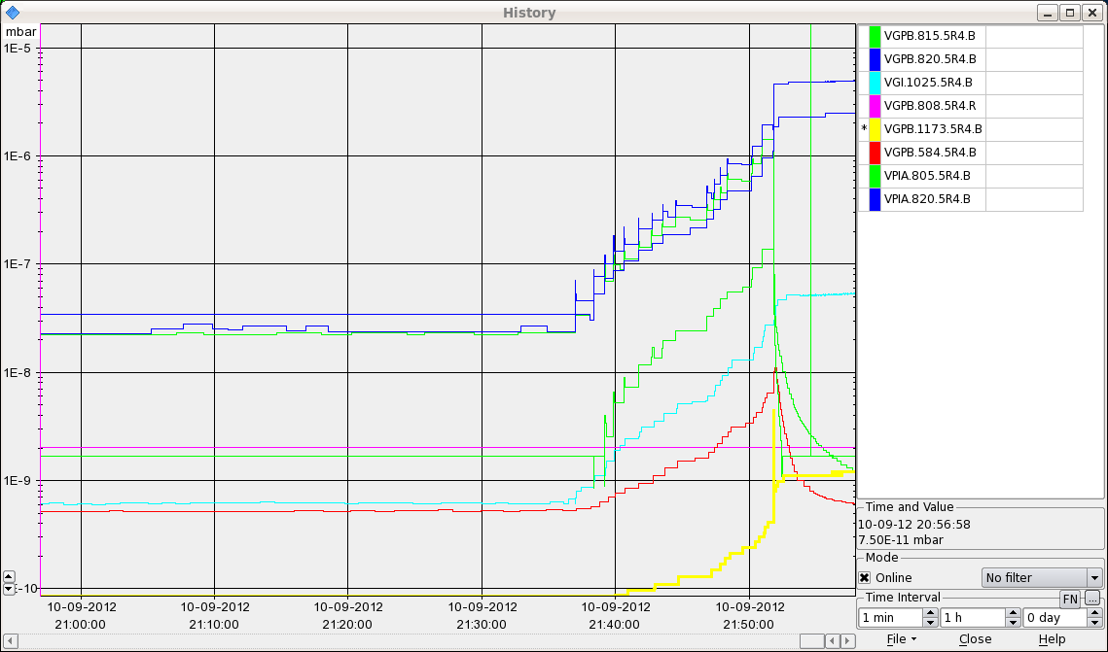
Monday night
22:00 B1 dumped – vacuum valve IR4.
Leak detection overnight – leak on bellow of the B1 wire-scanner. Attempts to varnish the leak failed, only a small reduction in pressure.

Slide 6
Today
Repair of leak in Pt4. Details and schedule will be worked and communicated by experts.
Expect to be back Wednesday morning.
VIP in Pt2.
10:30 Dry run of modes in p-A mode.
AC dipole dry run.
RF power tests – delayed.
Program (decided after the 08:30 meeting):
Wednesday : pA pilot physics,
Thursday: high Beta,
Friday: pA MD (1 shift).

