Slide 1
LHC summary – week 36
Coordination: Mike Lamont & Bernhard Holzer

Slide 2
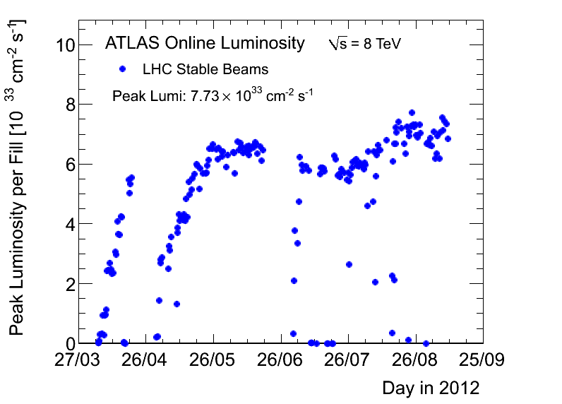
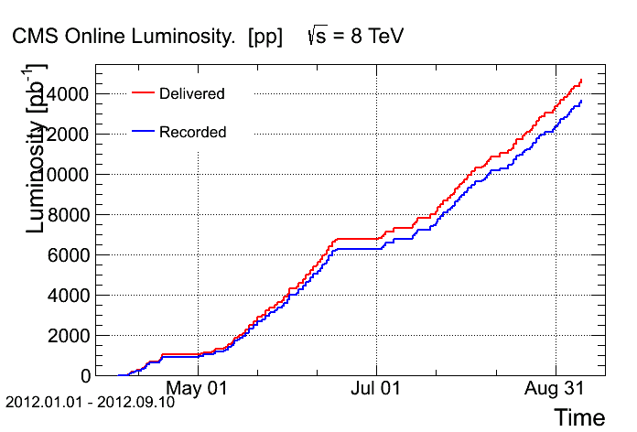
PERFORMANCE

Slide 3
Physics
Fill | Lumi | pb⁻¹ | Stable | Dump
3025 | 6.19 | 133 | 9h39m | Trip of RQF.A23: Non destructive SEU on DQQBS#3 of DQLPU.B14L3 - digital filter corrupted.
3027 | 6.35 | 25 | 1h19m | Failure of optical link in BLM system (electronic card was exchanged)
3029 | 6.95 | 120 | 6h46m | FMCM triggered the beam dump. Last cleaning 1h before the dump
3032 | 6.18 | 117 | 8h58m | OP
3033 | 7.06 | 145 | 9h40m | OP
3034 | 7.55 | 34 | 1h26m | RF trip
3036 | 7.14 | 102 | 5h34m | Inner triplet trip – dumped on BLMs
3039 | 7.44 | 19 | 48m | lost communication with RCS.A67B1 switch controller
3045 | 7.35 | 178 | 12h13m | OP
3047 | 6.85 | 146 | 10h46m | OP
1019 pb⁻¹ for the week

Slide 4
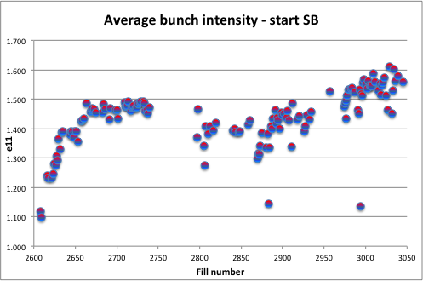
Bunch intensities
Up to an average bunch intensity of 1.69e11 ppb at 450 GeV

Slide 5
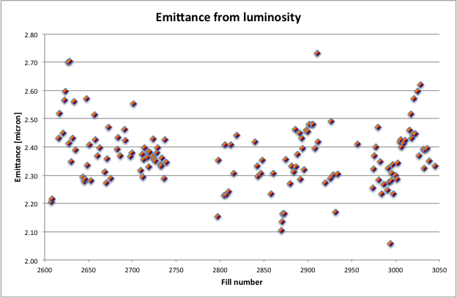
Emittances
Thanks to the injectors…

Slide 6
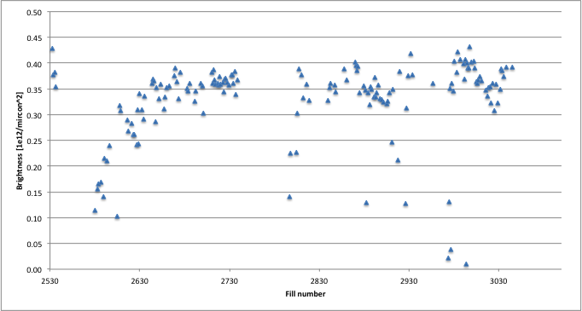
Brightness

Slide 7
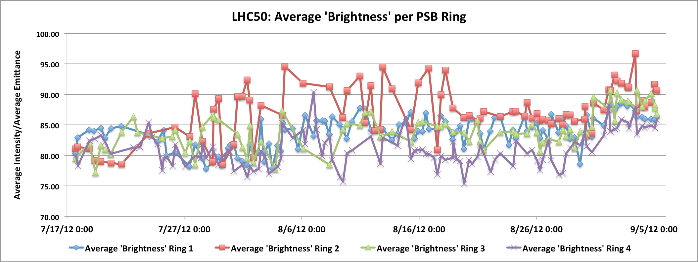
PSB – LHC beam brightness
Bettina Mikulec et al

Slide 8
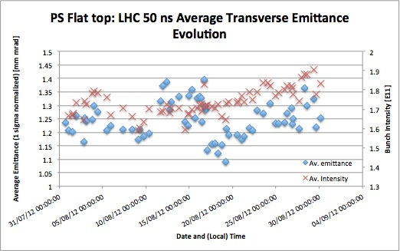
PS
Rende Steerenberg et a;

Slide 9
Lost fills above 450 GeV
Event Timestamp | Beam Mode | Fill Number | Mps Expert Comment
04-SEP-12 10.58. AM | ADJUST | 3026 | UFO on MKI.D5L2 above 200% of dump threshold, BLM at several magnets were above threshold, triggered also ALICE BCM.
07-SEP-12 03.43 AM | ADJUST | 3035 | Losses when going into collisions, while luminosity is just coming up. Beam oscillating on B1V. The orbit is still changing a bit (collision sequence not finished). The overall loss is not so high, dumped on TCSG IR7 0.6 s RS.
08-SEP-12 05.09 AM | SQUEEZE | 3041 | QF/QD Sector 2 - water pump motor
08-SEP-12 07.13 PM | ADJUST | 3044 | high beam losses going into collisions - high Q'
09-SEP-12 07.13 PM | SQUEEZE | 3046 | Very fast loss towards end of squeeze - not clear

Slide 10
Observations 1/2
PS working point adjustment
slightly lower bunch intensities but smaller emittances
Beam 1 vertical instabilities at end squeeze & collision BP
Brightness driven
Only a few bunches and not too detrimental
Tweaks: octupoles B1 to 520 A, Q’ B1 to around 16.5
Supressed with delta Q’V = +5 (total ~22) but beam lost on slow losses (long running sum) going into collisions
Beam 1 lifetime dip going into collisions - sometimes vicious – pushing loss limits
But beam 1 really likes the Q’ and octupoles trim down once in collisions
Chromaticity: -3 in H, – 8 in V
Octupoles down to ~200 A
Suggest to trim in in last 20 s or so of collision BP

Slide 11
Observations 2/2
Low-ish lifetime beam 2 in squeeze
delta QH = -0.002 not used but not ruled out
Occasional strong losses on bunch 20 & 22 (private IP8 bunches)

Slide 12
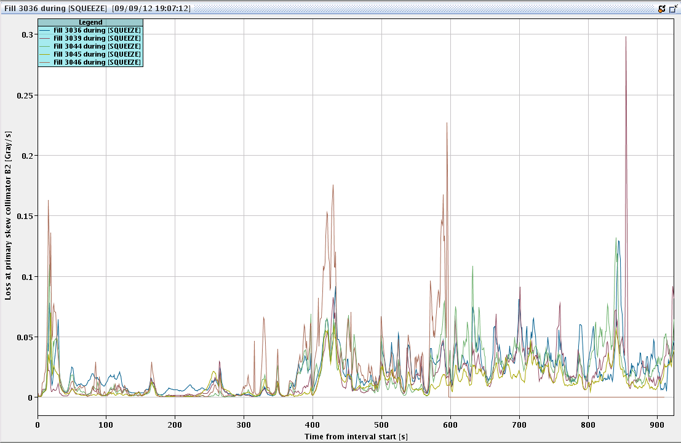
Beam loss in squeeze
3046 - lost
Orbit (JW) not bad at all, at least with the 1 Hz average orbit.

Slide 13
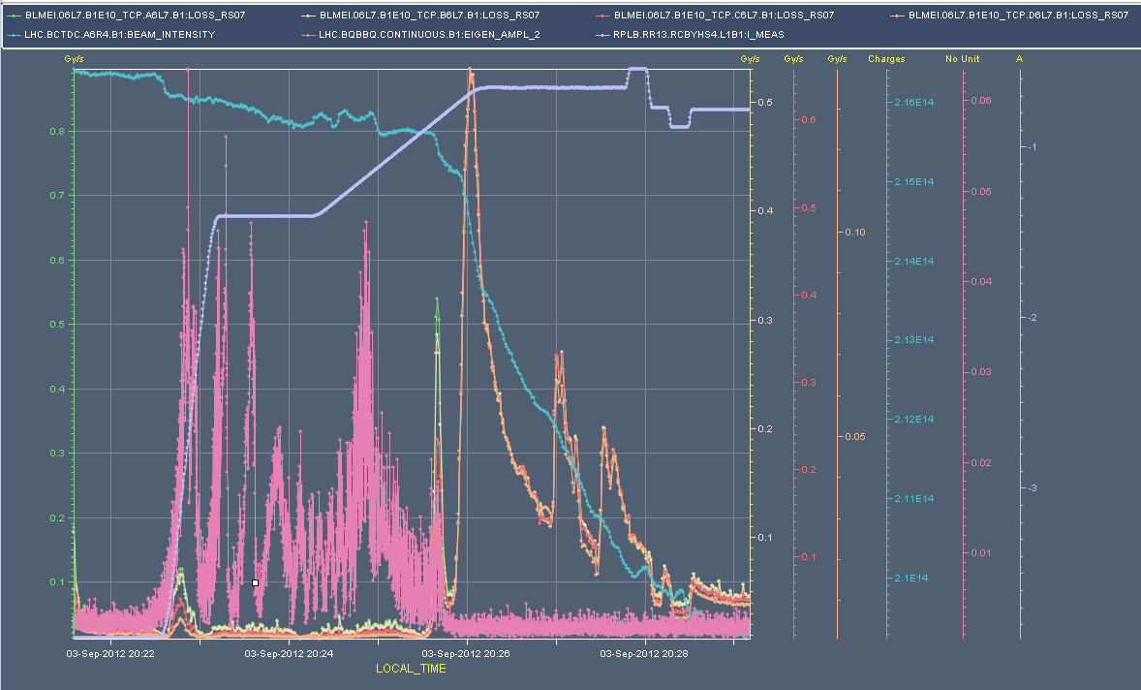
3205 – instability VB1

Slide 14
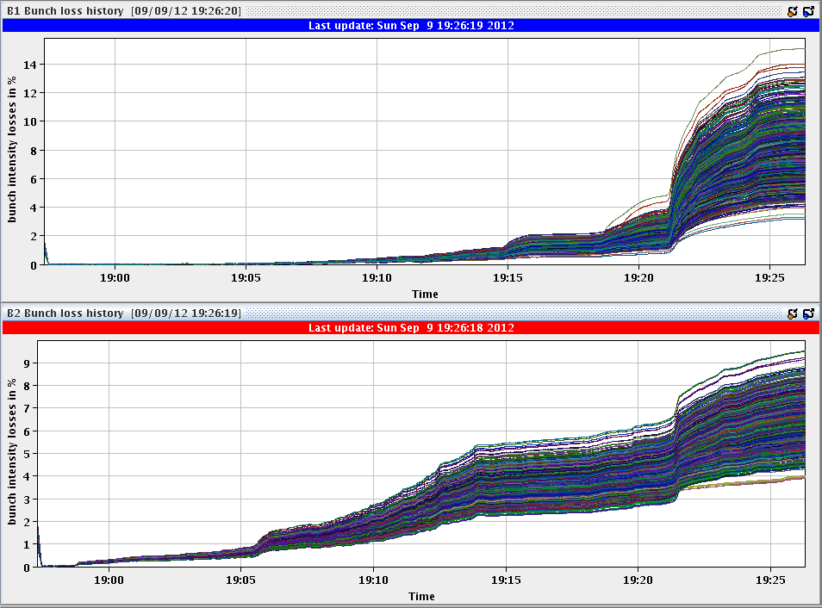
Losses going into collision
Particularly bad last night – really on the limit

Slide 15
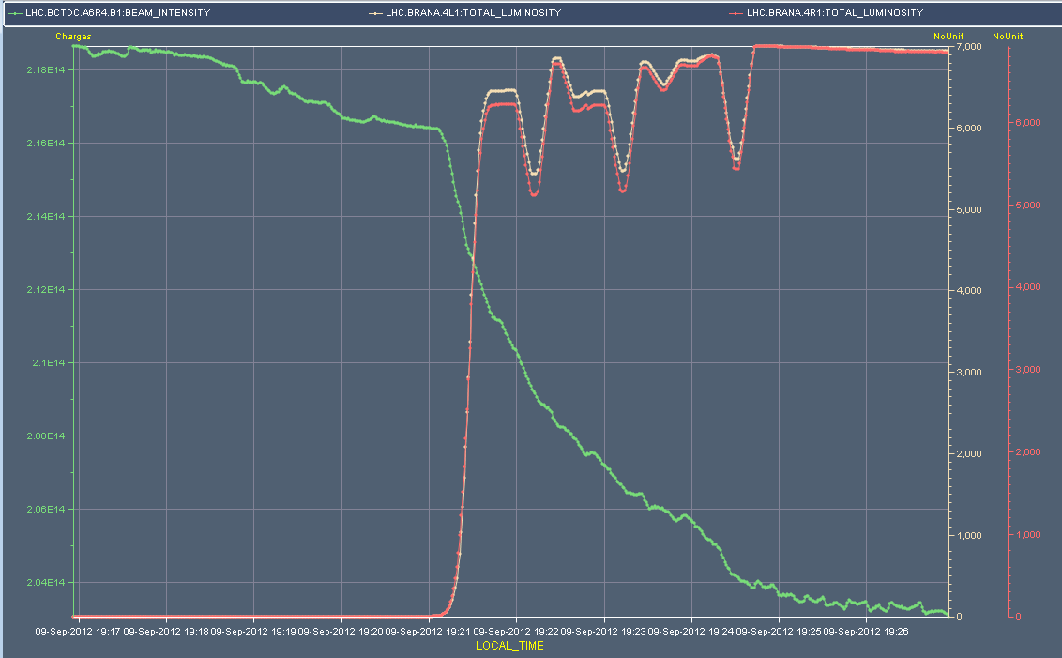
Beam 1 into collisions

Slide 16
Strange goings on…
~17:00 Wednesday 5th
Strong tune and orbit perturbations on beam – out of stable beams into adjust and back
(Also note occasional orbit perturbation which comes and goes – likely origin IR8)
At first though to be saturation of klystron 3B1
I realize that the main coupler klystron 3B1 has not moved since Aug 30th... On the ramp Aug 30th, 14:36 this klystron went in saturation and it has since been saturating in all ramps/physics till we made an intervention yesterday afternoon

Slide 17
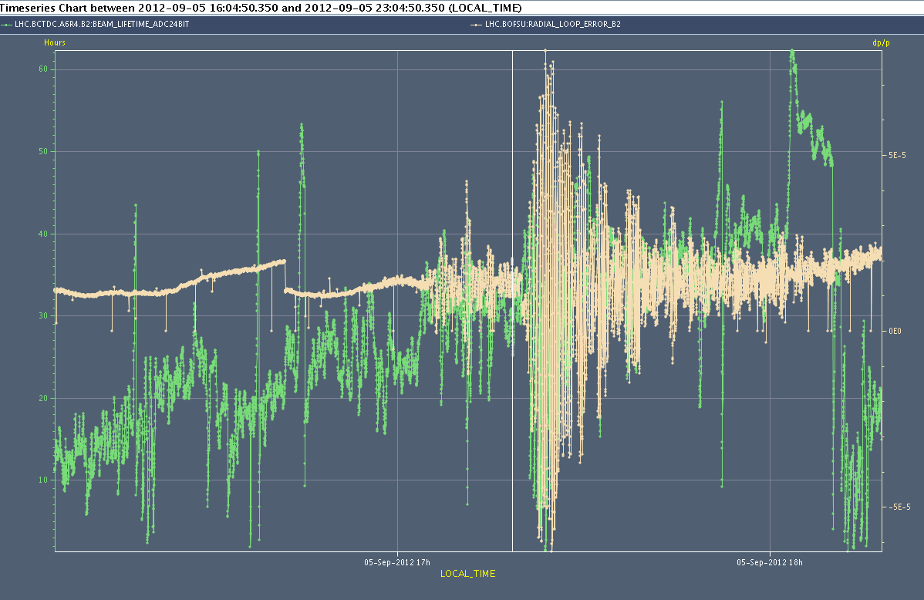
Strange

Slide 18
TIMEOUTS

Slide 19
Main timeouts
 |  | H:MM
Mon AM | Lost cryogenics in sector 78. QRL vacuum gauge spurious reading and triggering closure of cryo valves on DFB Access in point 7 for replacing vacuum PLC | 5:40
Mon PM | MCOX and skew octupoles checks in shadow of 18kV cable intervention in SPS
Wed | Electrical glitch captured by FMCM of RD1.LR5 Access required for QPS reset/send logging on RB.A12 didn't work to clear the fault | 1:27
Thursday AM | QPS (RQS/RSS controller) problem - access required twice – problems power cycling | 6:18
Friday | - Trip and reset of the RQX5.R5 power converter - Problem with the communication between the UPS and the PIC for point 5, - Problem on the RQX5.R5 QPS board B that required a reset – access required | 2:20

Slide 20
Main timeouts continued
 |  | H:MM
Sat early | Lost communication with RCS.A67B1 QPS switch controller; Access required | 2:35
Sat 05:00 | Motor for the demineralised water pump C211A ( pump for all of sector 23 and 34) changed. Experts working and transport being arranged ... the motor is a 1.5 ton object 13:20 Access for pump motor in Pt 2 is finished | 8:00
Sun AM | QPS – access required RQD/RQF.A56 controller can't be reset | 2:50
Mon AM | Access in cell 28R8 for the power cycle of a QPS controller on the main dipoles | ~2:00
QPS piquet (Stephen Pemberton) and RP piquet kept very busy all week

Slide 21
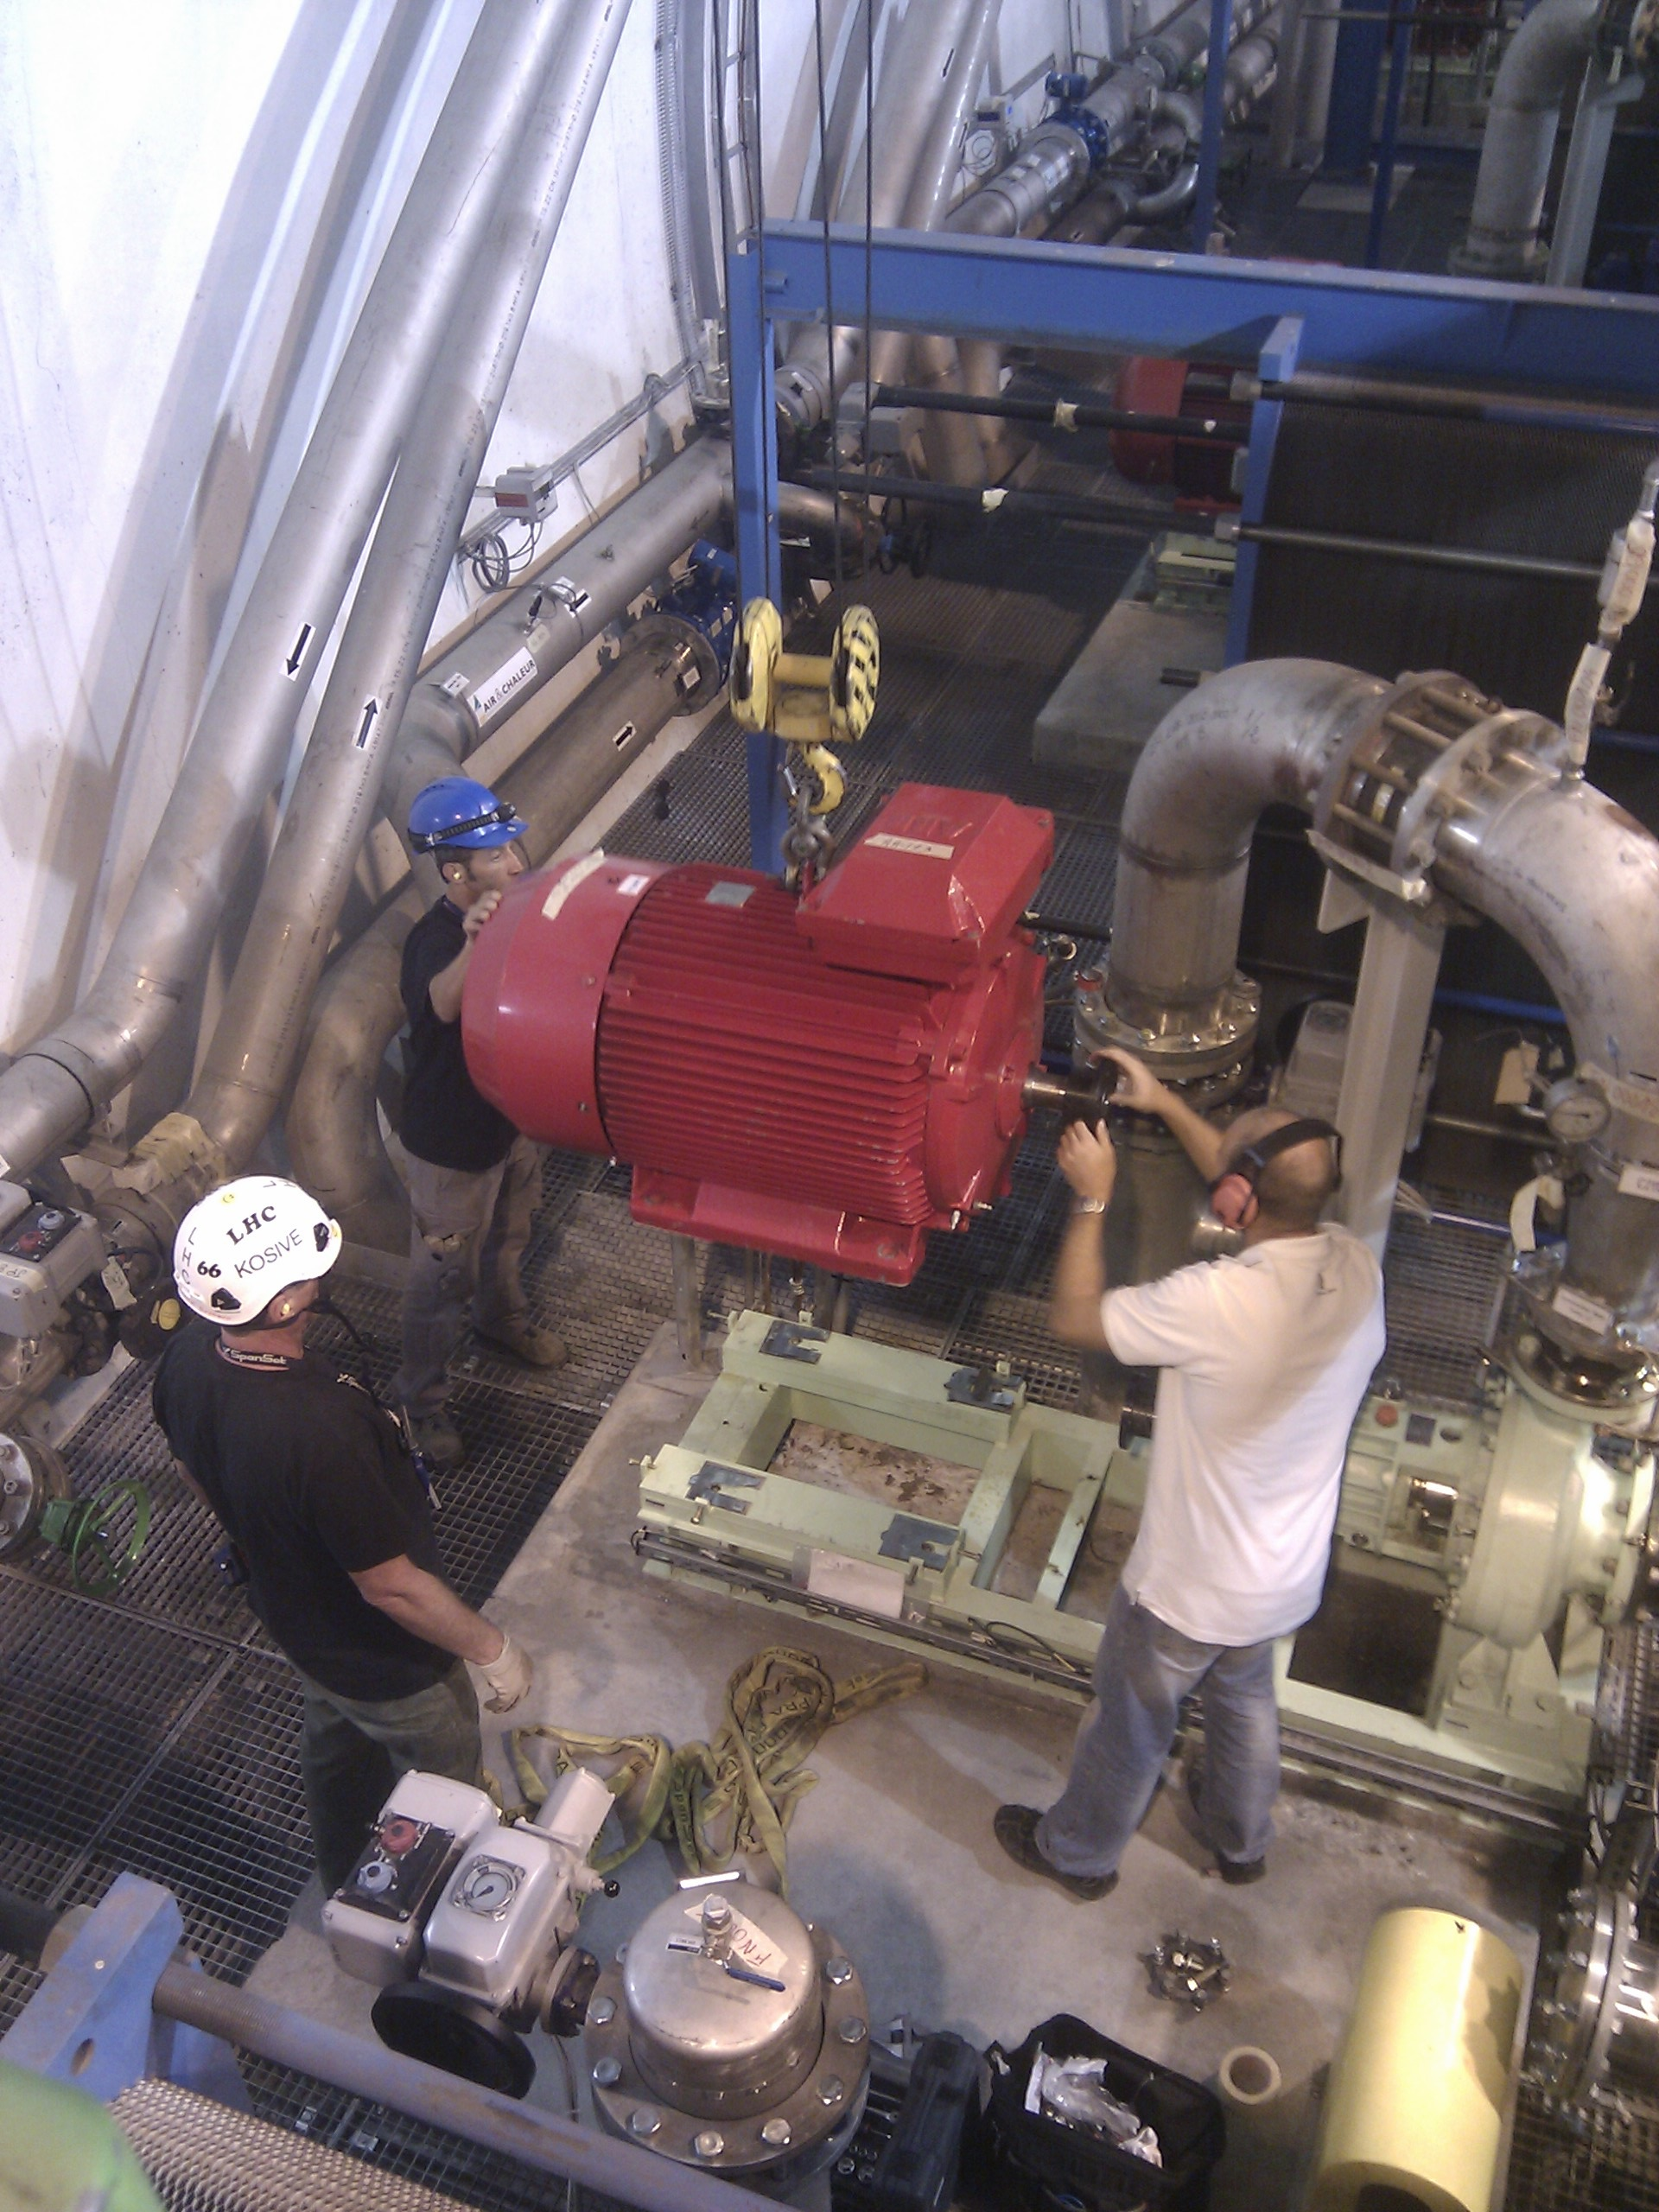
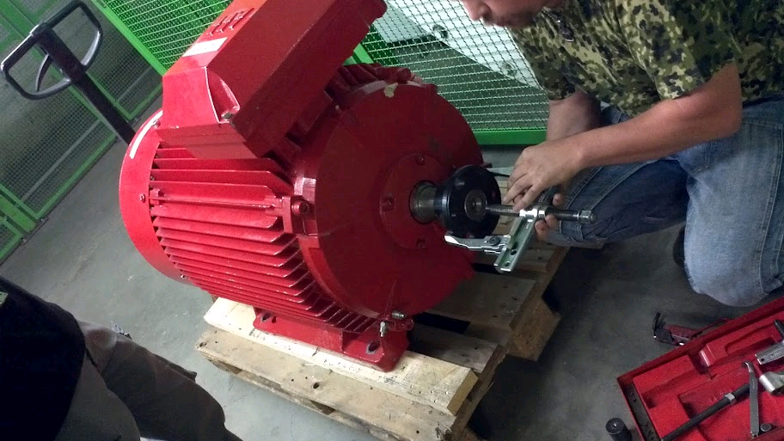
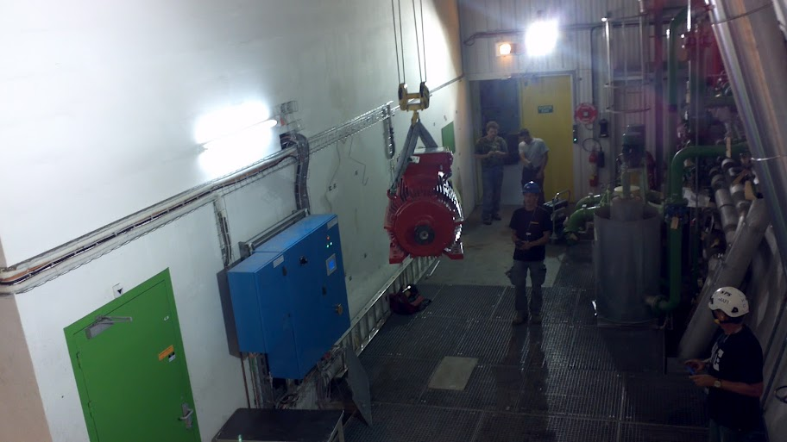
Motor replacement – Saturday morning
Thanks to CV, Transport, SPIE, Ronan Ledru (TI & photos)

Slide 22
Operational development

Slide 23
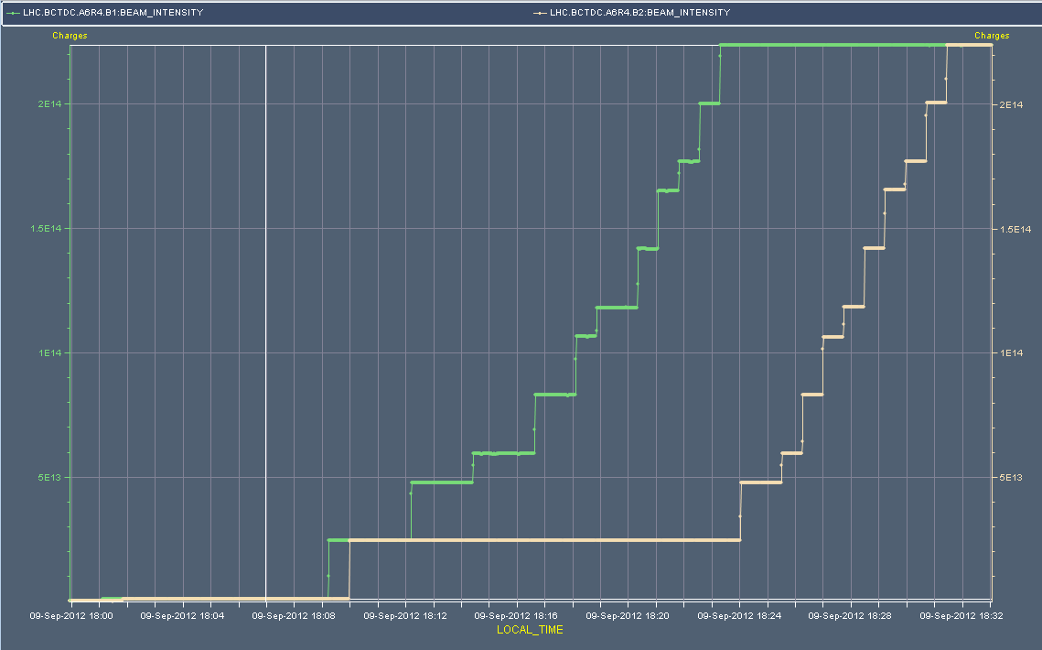
Injection for Alice
Beam 1, TDI out, and then B2

Slide 24
OD1
MCOX (inner triplet octupoles) successfully tested and polarities check (Rogelio et al)
Skew sextupoles – polarities partially checked
Abort gap cleaning
New mode (AG Population check) deployed – Daniel, Delphine et al – now operational
Updated the temperature limits for MKIs according to instructions from M. Barnes (JW)
OFC bug found – deploy fix next TS (Ralph Steinhagen)

Slide 25
OD2
Batch by batch blow-up
PHILIPPE BAUDRENGHIEN, JOHANNES MOLENDIJK, MICHAEL JAUSSI
Mechanics tested – mostly successful
Transverse profiles were taken during the 1-hour filling. The goal is to correlate transverse emittance evolution with longitudinal emittance. To be analysed.
Ramp, squeeze, collide (1,2,5), collide (8)…
Jorg, Laurette, Giulia, Markus
Mechanics successfully tested… to be deployed at a suitable moment

Slide 26
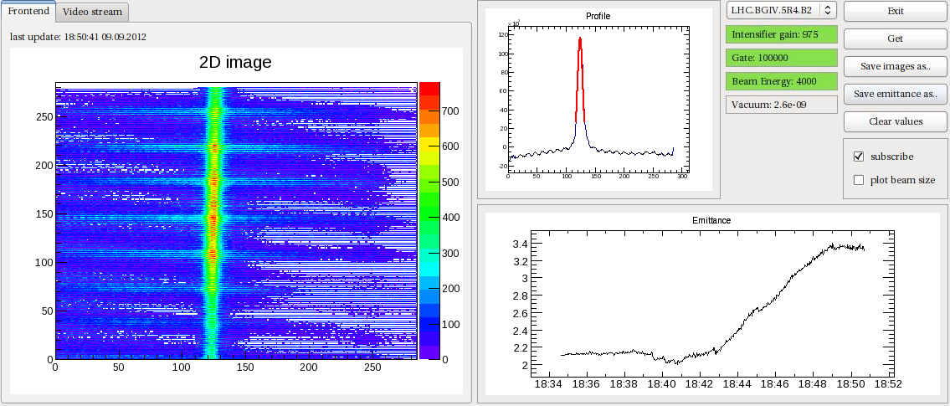
BGI
Mariusz Sapinkski
Ramp seen in BGI.
Front-end fit and correction are different, their results can be read from timber. Interestingly the initial dip is smaller but the total blow is larger.
Maybe the interesting conclusion at this stage is that the blowup takes place in the second part of the ramp.

Slide 27
Outstanding
Rogue PC-INTERLOCK through the RING_PERMIT
BLM sanity checks
Missing data for injection oscillations for b1 72-b trains
Vacuum spikes in ramp near MKI point 2
discussion with Mike Barnes we see that the recent pressure increases at the MKI2 during the ramp are worst between the MKI and the Q5L2 – e-cloud suspected
increase the e-cloud solenoid in the region (VRPMB.25.5L2) from 3 to 5 A…

Slide 28
Incoming
This week
Monday 08:00 to 16:00 RF test for pPb re-phasing
Monday 16:00 to Tuesday 9:00 pPb MD
Tuesday 9:00 to 16:00 VIP visit point 2 (ACCESS)
Tuesday 16:00 to 16:00 Wednesday: high beta*
Wednesday 16:00 to ~Thursday 16:00: pPb pilot run
Thursday
Operational use of Q20 in SPS
Possible deployment of collide-collide
On list
Transverse feedback tests – Wolfgang Hofle
Increase RF voltage in Stable beams – Benoit Salvant
Coordination: Jorg Wenninger, Jan Uythoven

