Slide 1
Wednesday 5th September - morning
06:34 Lost fill 3029
Electrical glitch all over CERN, captured by FMCM of RD1.LR5.
120 pb⁻¹ in 6h46m
Access required for QPS
QPS reset/send logging on RB.A12 didn't work to clear the fault
S12 and S81 off
08:35 access over
08:55 cycling
10:00 – 14:00
Controls issues with BQM - Apparently RBAC was deployed on OASIS FESA classes, including the ones used by the BQMLHC.
SPS in MD
Batch by Batch blow-up tests…

Slide 2
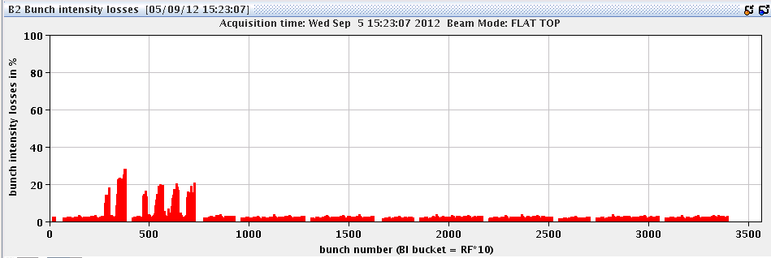
Wednesday 5th September - afternoon
14:15 Filling for physics
PS working point adjustment (lower bunch intensities but smaller emittances)
Beam quality not great…
Losses in ramp
16:00 Stable beams #3032
Instabilities going into collision, some losses on a few bunches
Initial luminosity: 6.2e33cm-2s-1,
initial bunch currents: 1.52/1.45 e11 ppb

Slide 3
Wednesday 5th September - afternoon
16:55 strange things going on
saturation of Kly3B1…
Transverse excitation, orbit movement, lifetime oscillations…
18:05 Change mode to ADJUST while RF sort out coupler position
18:17 Back to Stable beams
Still some perturbation on orbit – not understood
Continued probing effect of “abort gap monitoring” on luminosity lifetime etc.

Slide 4
Thursday 6th September – early morning
01:10 Fill 3032 dumped by OP
117 pb⁻¹ in 8h 58m
Problems
called QPS piquet (Stephen Pemberton) for the power cycle of the QPC controller of RSS.A56B1, RSS.A56B2, RQS.A56.B2, RQS.R5B1
02:35 The QPS problem is worse than expected and can not be solved remotely. Called RP piquet for an access in PM56. 04:30 access
The channels of the faulty controller on the power cycle crate was found OFF (relay stuck).
QPS piquet had to cut the power to the power-cycle crate, this reset all the QPS controllers attached to it. It took a while to clear up as some controller needed additional power cycles.
In the end the controller (4 circuits) that triggered the intervention were still bad and after a remote power cycle the relay got stuck again. QPS and RP are going back to pt 5.

Slide 5
Thursday 6th September – morning
07:55 QPS problem fixed
08:00 Cycling
OFSU crashed hard – sorted by Ralph S. from home

Slide 6
Test batch per batch longitudinal blow-up at injection
We used beam 1 only, series of 6 bunches batches.
Fill 3031 gives good results 12:55-14:00
We made 8 injections.
Some batches were not touched (3rd and 7th injection), the others were blown at injection, to 1.4 ns 4-sigma length with different strengths (took 5 min for injection 1 and less than a minute for injection 8).
Bunch length average shows that most bunches (apart for injections 3 and 7) spent the filling with increased longitudinal emittance (1.4 ns).
Bunch length by bunch, shows individual evolution: very clear is the fast blow-up of second injection and no blow-up on third. Notice that the previously injected bunches are not affected.
PHILIPPE BAUDRENGHIEN
JOHANNES MOLENDIJK
MICHAEL PIERRE JAUSSI

Slide 7
Test batch per batch longitudinal blow-up at injection
Transverse profiles were taken during the 1-hour filling. The goal is to correlate transverse emittance evolution with longitudinal emittance: we would expect batches 3 and 7 to grow faster (transverse) then the others.
To be analyzed. If the correlation is convincing, the method can be applied in operation after minor cleaning of the software (the very useful "failures" on injections 3 and 7 were not planned and we must solve some issues on B2).

Slide 8
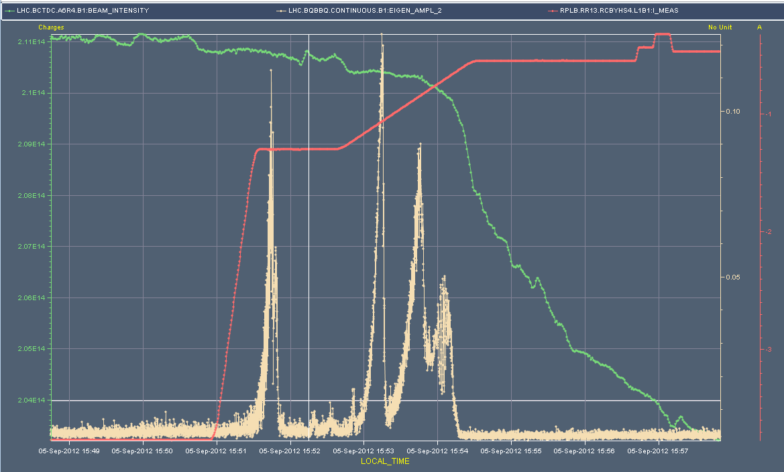
3032 – B1V instabilities...

Slide 9
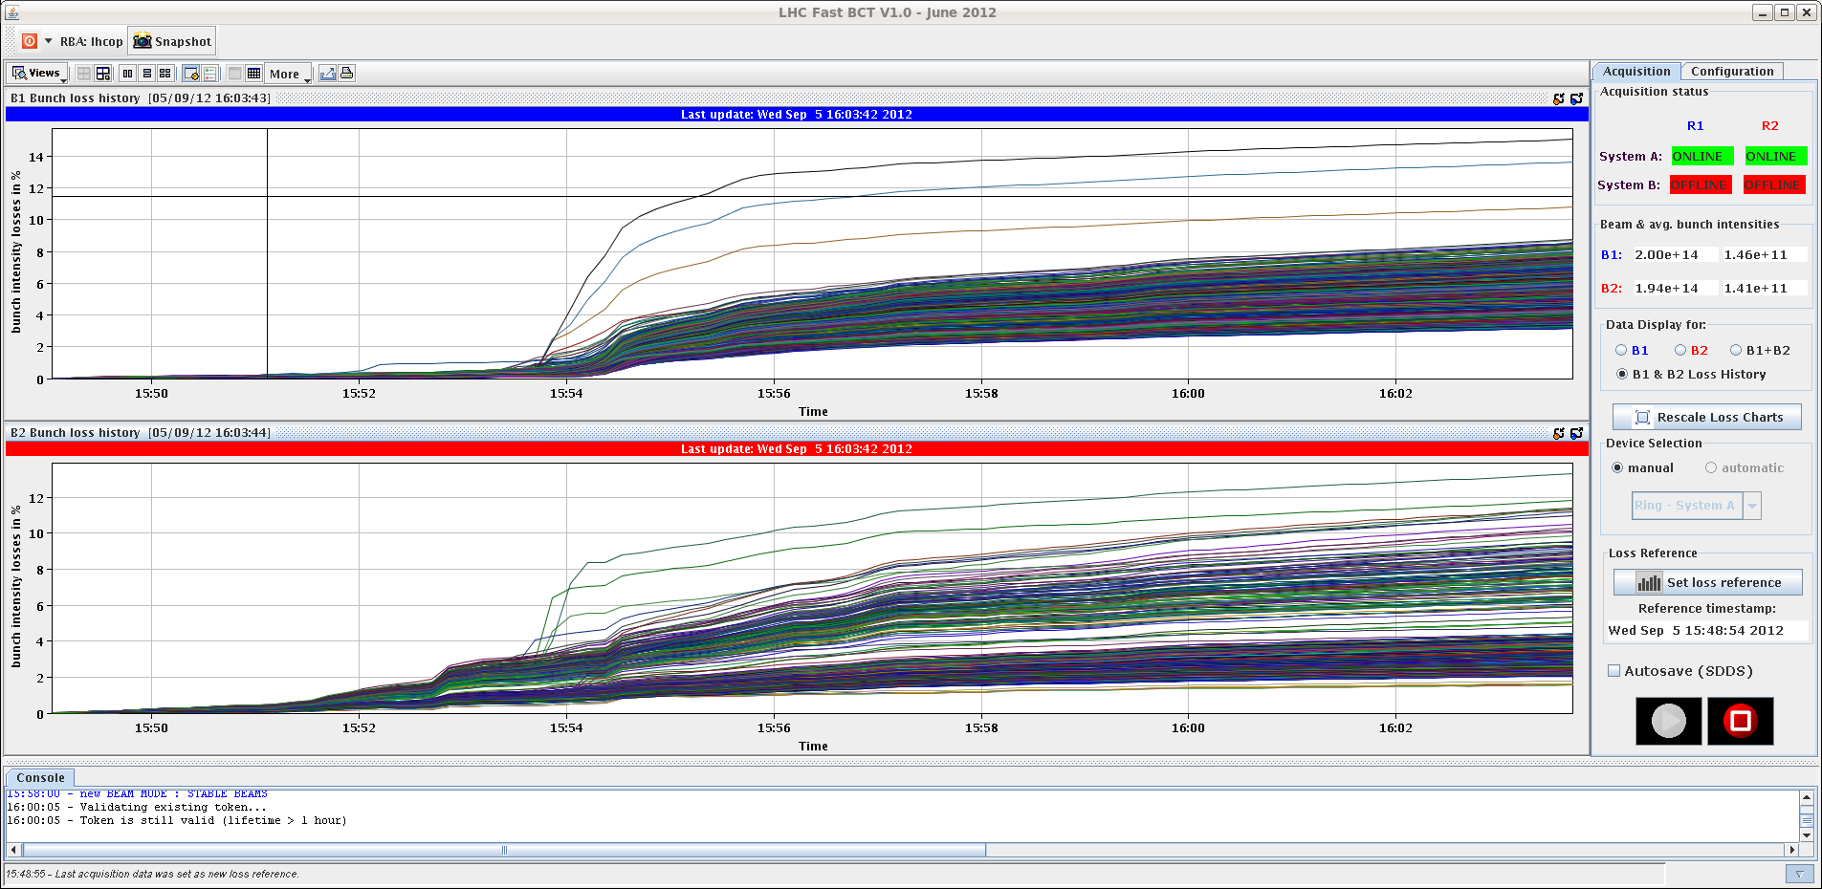
3032 in collisions

Slide 10
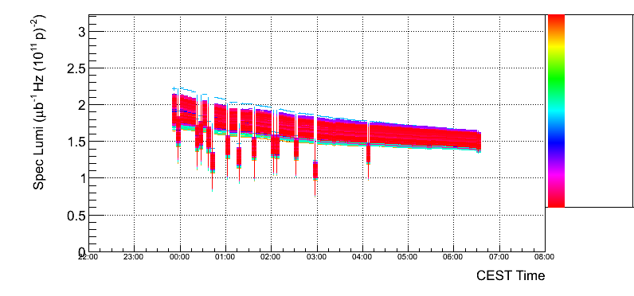
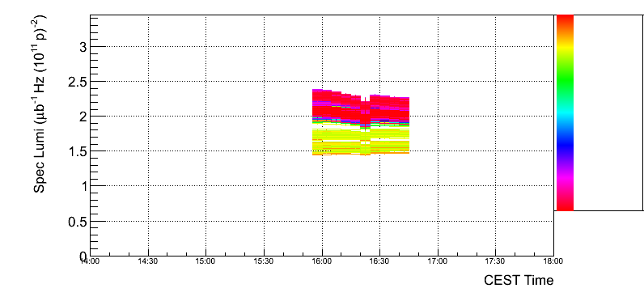
Specific luminosites
3029
3032

Slide 11
Klystron saturation
Our klystrons are operated with a main coupler position different during filling (when bandwidth is needed and not much voltage, thus lower loaded quality factor Q = 20000) and in physics (stable cavity voltage at higher field, thus higher Q = 60000). The couplers move from 20k position to 60k at start ramp (function).
The couplers motors are controlled by a PLC. The displacement is piloted from a VME module that communicates to the PLC via a so-called PHYTEK card. This is the source of the problem... These PHYTEK cards have not been very reliable. On several occasions they have stopped communicating with the VME module. In such a case the VME module detects the loss of communication and gives up sending coupler displacement commands resulting in the coupler remaining at the 20k position through the ramp and in physics. With the demanded 1.5 MV/cavity in physics the power needed at Q=20k is well above the 200 kW max resulting in klystron saturation.
We deal with such a saturation "elegantly", meaning that nothing dramatic happens: The klystron drive remains at the ceiling compatible with its saturation (fine-adjusted for each klystron). However, the many sources of RF phase and amplitude noise in the cavity are not corrected as well anymore as the RF drive is clamped.
Corrective actions:
We will insert a RESET of the PHYTEK communication card in the RF ON sequence ran before each filling (next TS).
We have a status on klystron saturation and propose to integrate it in Big Sister
PHILIPPE BAUDRENGHIEN

Slide 12
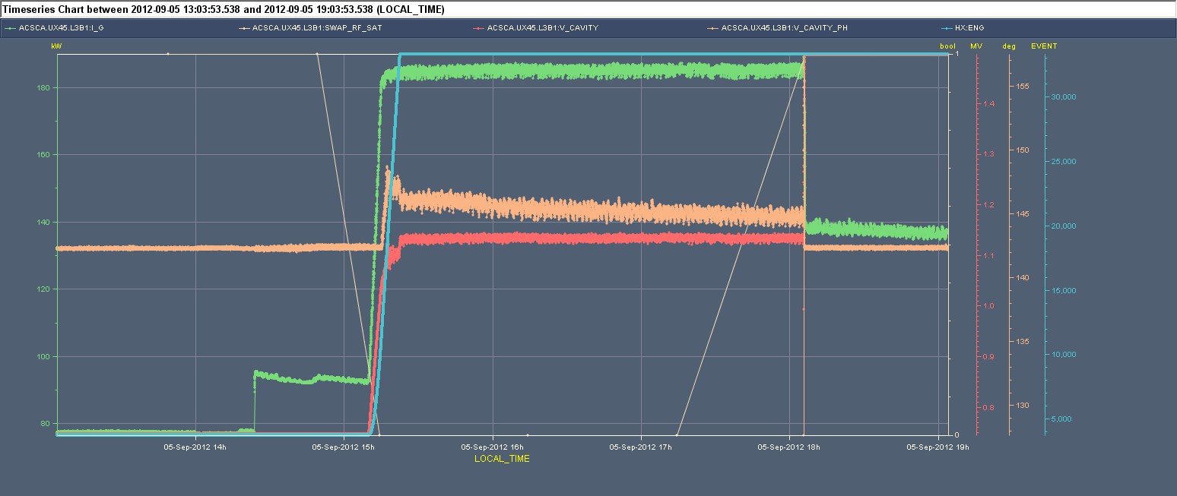
The first figure shows klystron drive (green) saturated around 185 kW till 18:10 when we reset the PHYTEK communication resulting in coupler movement to Q=60k and demanded klystron power falling to 140 kW. The cavity voltage (red) was saturating around 1.15 MV till the coupler movement allowing it to reach the requested 1.5 MV.

Slide 13
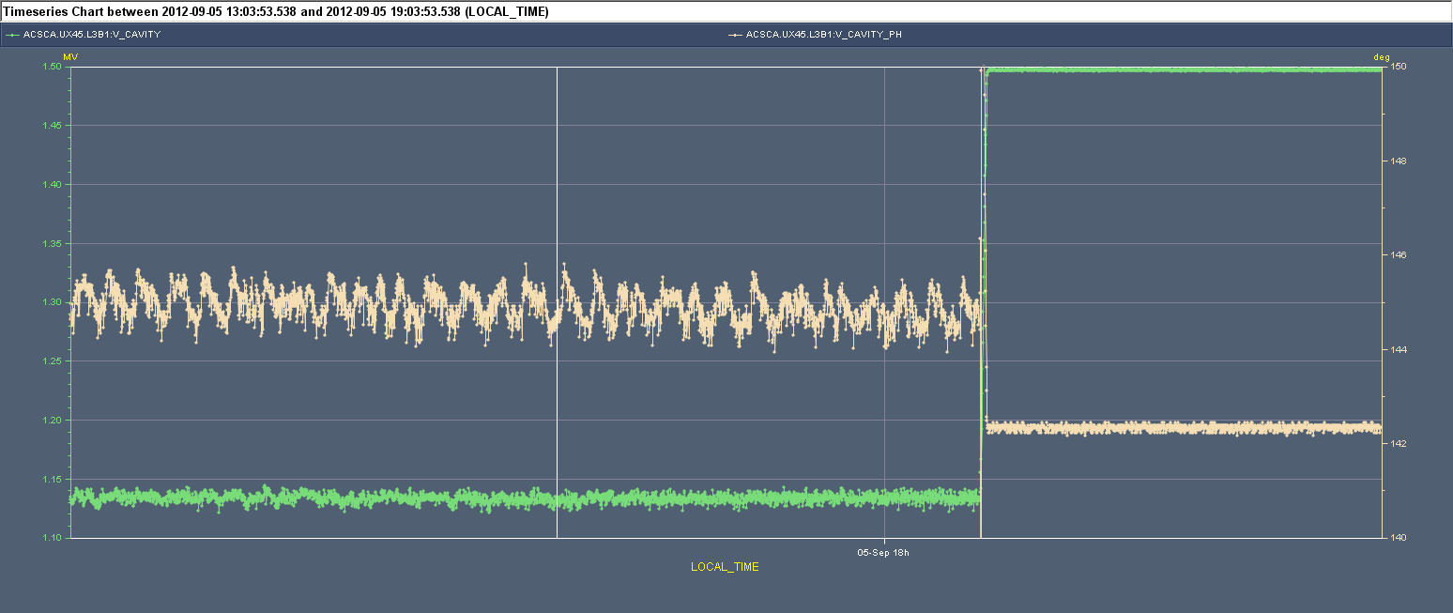
enlargment showing cavity field amplitude (green) and phase (beige) around the time when we corrected the situation. The noise was much larger with saturated klystron (close to 2 degree pk-pk phase noise and 10 kV pk-pk amplitude noise). There is some periodicity in the phase noise but it may be aliased by the very slow acquisition rate of Timber.

Slide 14
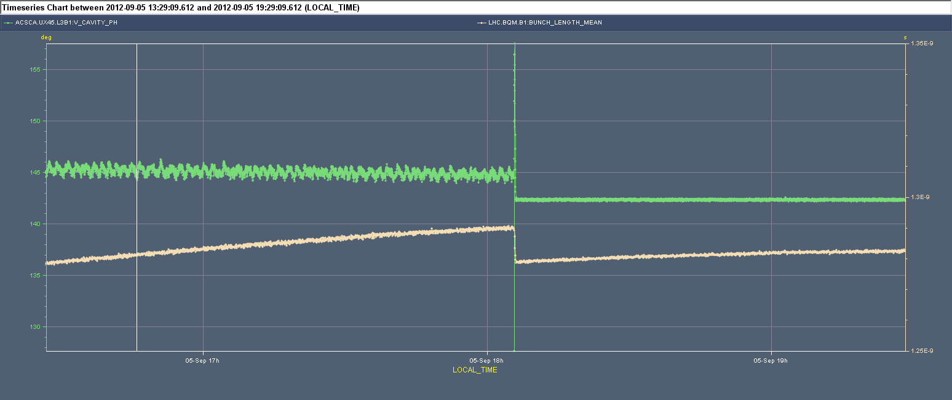
What we would expect is fast longitudinal emittance growth. Indeed the third figure shows a faster bunch lengthening when the klystron was saturating. I saw many figs in the log-book on side-effects in the transverse plane but cannot make clear correlations...

Slide 15
